Slide 1
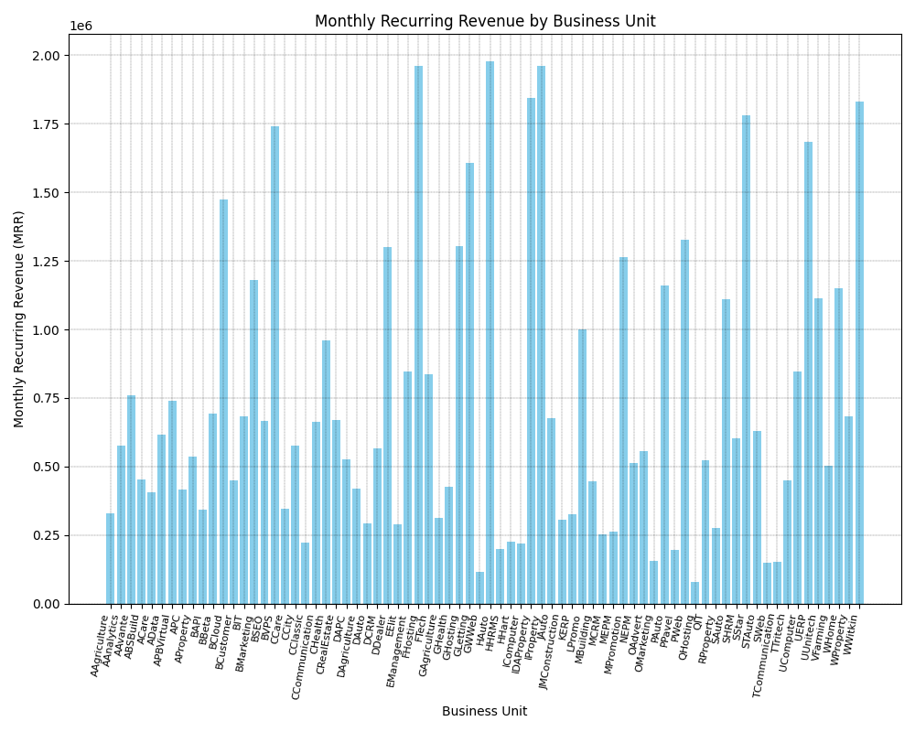

Slide 2
The image is a bar chart that shows monthly recurring revenue (MRR) for different business units. Here's a summary: * **Purpose:** The chart visualizes the MRR contribution of various business units, allowing for easy comparison. * **X-axis:** Lists the different business units, likely abbreviated for space (e.g., "Agriculture," "Banking," "Construction"). * **Y-axis:** Represents the MRR values, ranging from 0 to just above 2 million. * **Chart Type:** Uses a vertical bar chart (column chart), suitable for comparing discrete categories. * **Data Interpretation:** Some business units generate significantly more MRR than others. For example, the units around "Education" and "Manufacturing" stand out as high performers. Without knowing the exact business context or the meaning of the abbreviations, it's difficult to provide a more in-depth analysis. However, the chart clearly highlights the revenue disparities between different parts of the business.

Slide 3
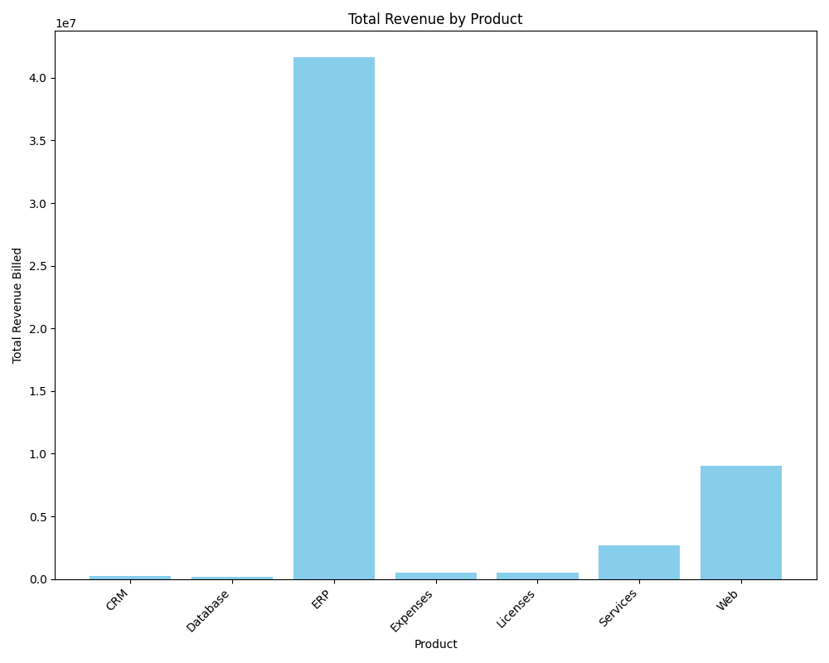

Slide 4
The bar chart illustrates the total revenue generated by different products. The x-axis represents the various products offered, specifically CRM, Database, ERP, Expenses, Licenses, Services, and Web. The y-axis represents the total revenue billed, measured in a unit that appears to be tens of millions. The standout observation is the significantly high revenue generated by the product "ERP," towering over all other products. "Web" also showcases a relatively strong performance, securing the second position in terms of revenue generation. In contrast, products like "CRM," "Database," "Expenses," and "Licenses" demonstrate relatively low revenue figures, barely registering on the chart. "Services" falls somewhere in the middle, exceeding the lower-performing products but dwarfed by the revenue from "ERP" and "Web."

Slide 5
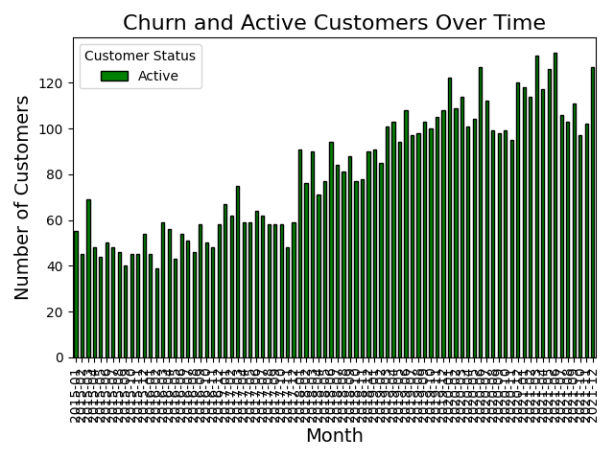

Slide 6
This chart shows the churn and active customer counts over time. The red portion represents churned customers, while the green portion represents active customers.

Slide 7
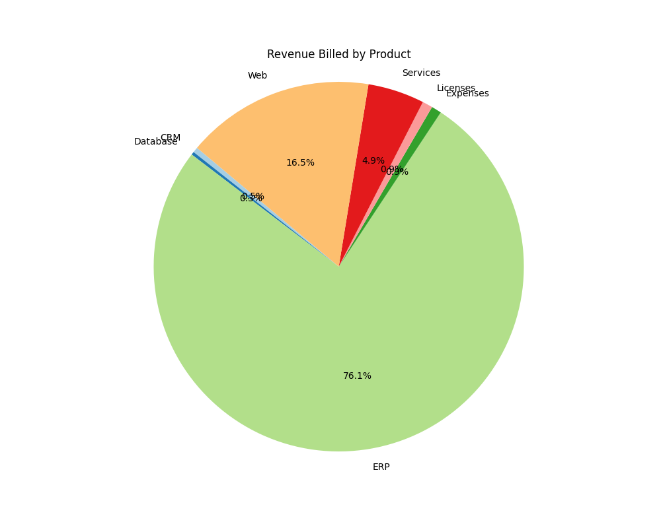

Slide 8
This pie chart shows the distribution of revenue billed by different products. Each slice represents the proportion of total revenue billed by each product.

