Slide 1
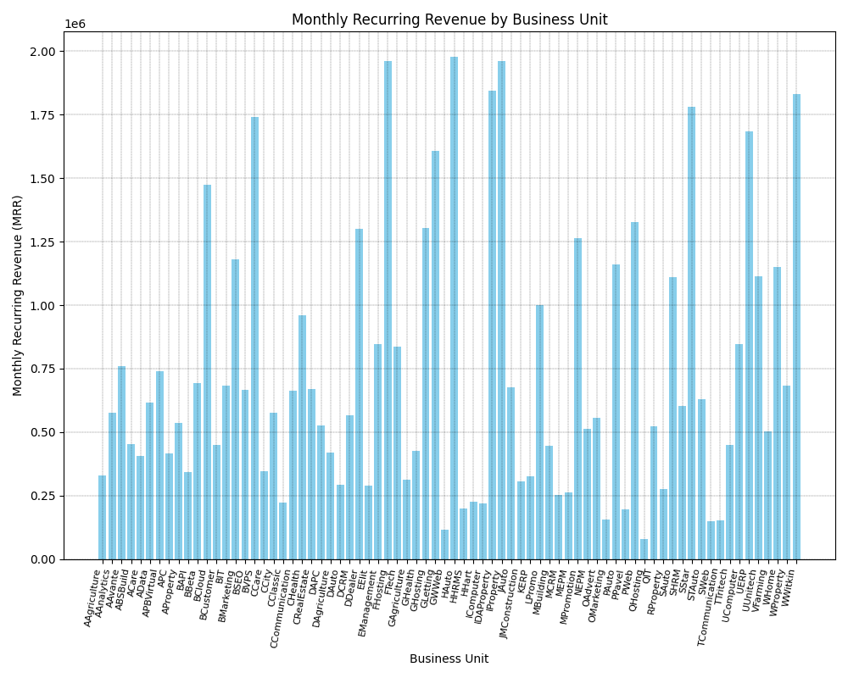

Slide 2
Monthly Recurring Revenue by Business Unit
The bar chart depicts the Monthly Recurring Revenue (MRR) generated by different Business Units. Here are some key observations:
Business Units: They are listed on the horizontal axis, seemingly representing different industries or departments. The labels are abbreviated, making it difficult to decipher without additional context.
MRR: Represented on the vertical axis, ranging from $0 to slightly over $2 million.
Highest Performers: A few business units stand out with significantly higher MRR, particularly those around the middle of the chart such as HAuto and IProperty.
Low Performers: A few business units with low MRR, such as OIT and OHosting.
Overall, the chart effectively presents a comparative view of MRR across different business units.

Slide 3
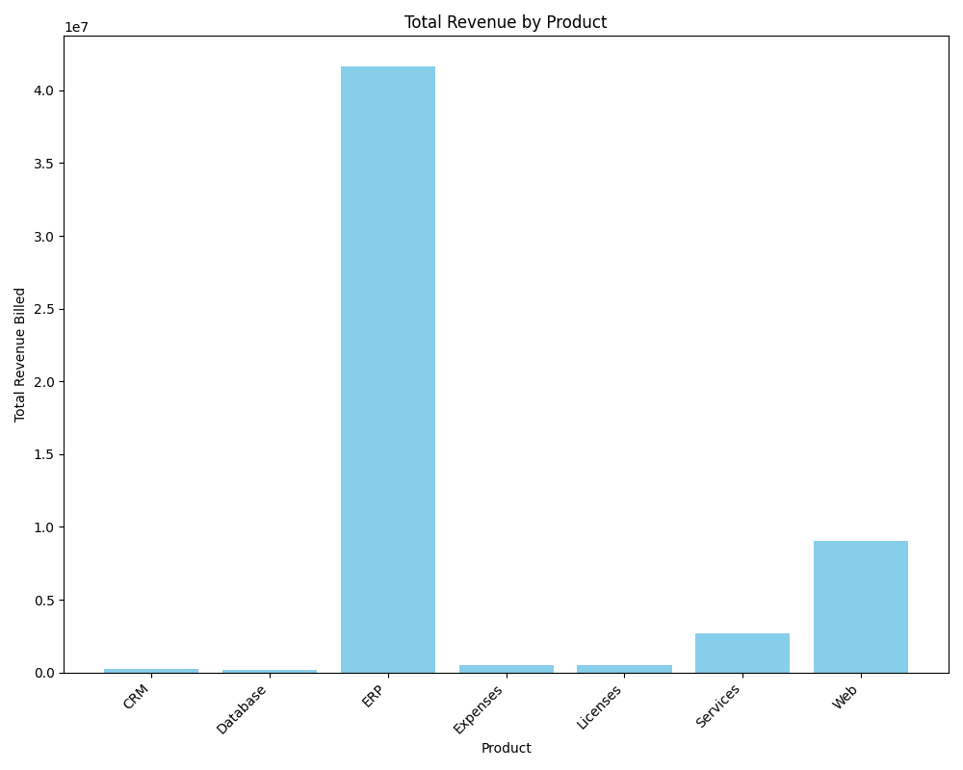

Slide 4
Total Revenue by Product
Revenue by Product: The chart illustrates the total revenue generated by various products.
Product Categories: The horizontal axis represents product categories: CRM, Database, ERP, Expenses, Licenses, Services, and Web.
Revenue Scale: The vertical axis depicts revenue in units of ten million.
Top Revenue Generators:
ERP: Revenue exceeds 40 million.
Web: Revenue approaches 1 billion.
Lower Revenue Categories:
CRM, Database, Expenses, and Licenses: Revenue is below 1 million.
Moderate Revenue: Services generate revenue surpassing 250 million.
Revenue Disparity: The chart highlights the significant disparity in revenue contribution among product categories.
Primary Revenue Drivers: ERP and Web are identified as the primary revenue drivers.

Slide 5
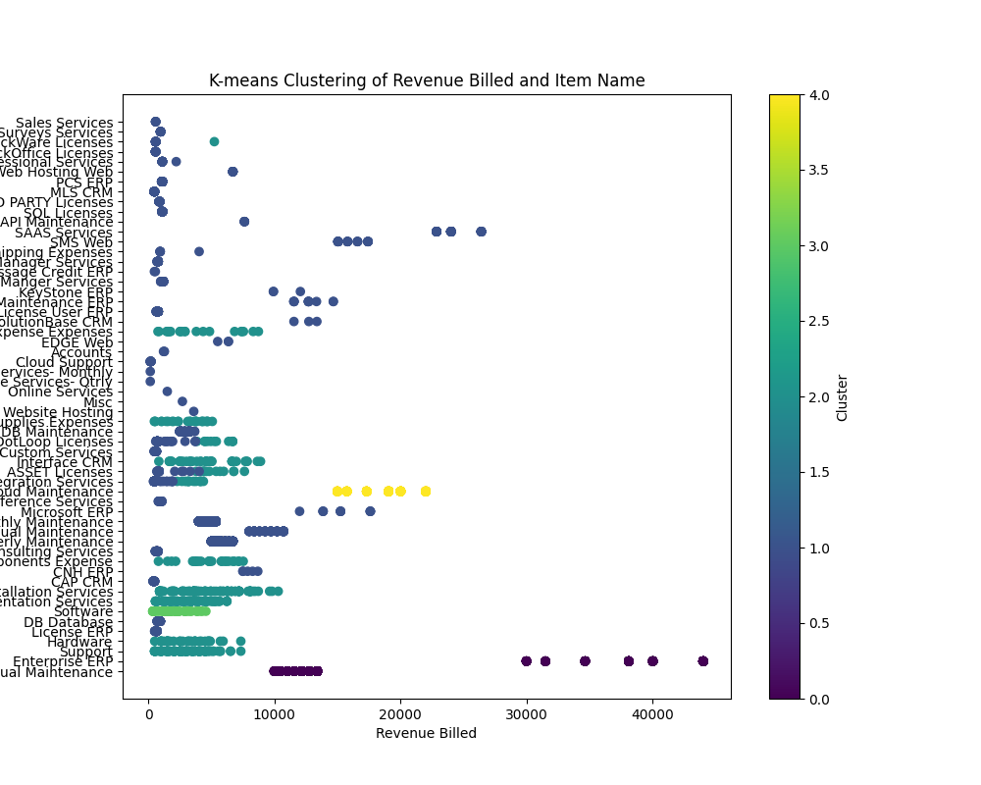

Slide 6
K-Means Clusters of Revenue Billed and Item Name
This image is a scatter plot that visualizes the results of K-means clustering based on "Revenue Billed" and "Item Name." Each point represents a different item, and the position on the x-axis indicates the revenue associated with that item. The y-axis lists the item names. The colors of the dots indicate different clusters, with the color bar on the right showing the cluster labels (from 0 to 4).
In summary:
The plot shows how different items are grouped into clusters based on the amount of revenue billed.
Items with similar revenue patterns are grouped into the same cluster, represented by the same color.
The plot aims to show how different items are grouped based on their revenue similarity. Items clustered together are expected to have relatively similar revenue figures. The Visualization helps identify patterns and relationships between the revenue generated by different items.

Slide 7
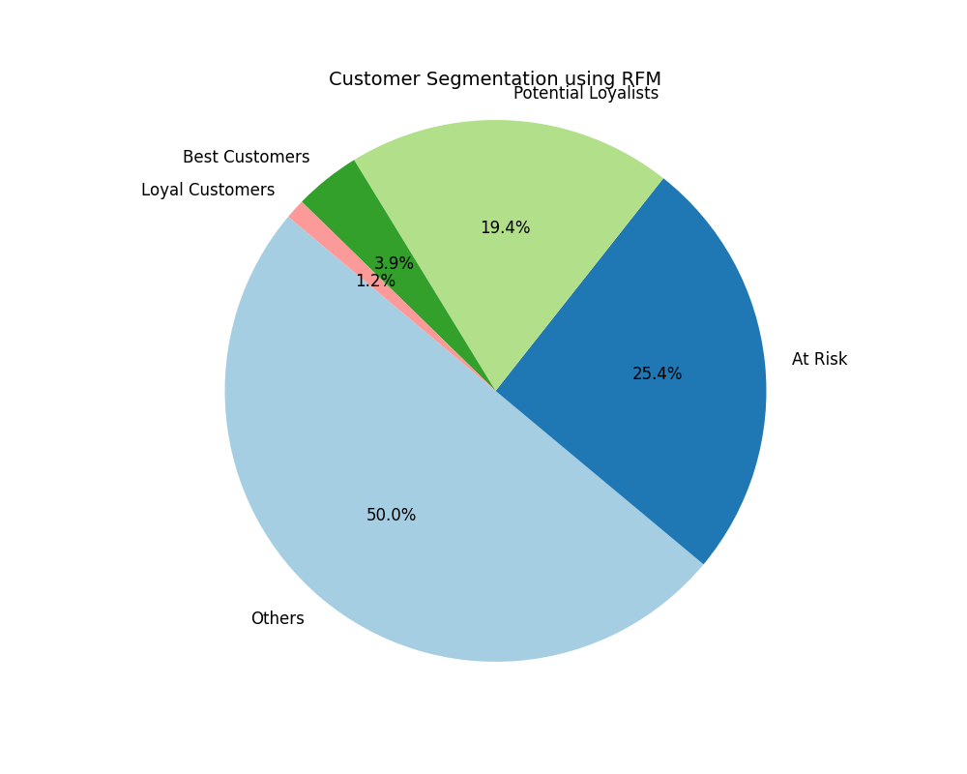

Slide 8
Customer Segmentation using the RFM Model
Segments:
Others (Light Blue): This segment occupies the largest portion (50%) suggesting a significant number of customers don't fall into the clearly defined RFM categories. This could represent newer customers or those with inconsistent buying habits.
At Risk (Dark Blue): The second largest group (25.4%) is labeled "At Risk". These are likely customers who haven't made a purchase recently. Businesses focus on re-engaging this group to prevent churn.
Potential Loyalists (Light Green): Making up 19.4%, this segment shows promise. They might be relatively new customers who have made a few purchases and have the potential to become loyal.
Best Customers (Green): This valuable group (3.9%) represents those with high recency, frequency, and monetary value. They are the most engaged and profitable.
Loyal Customers (Pink): While smaller in proportion (1.2%), "Loyal Customers" are those with consistent purchasing behavior over a long period.

Slide 9
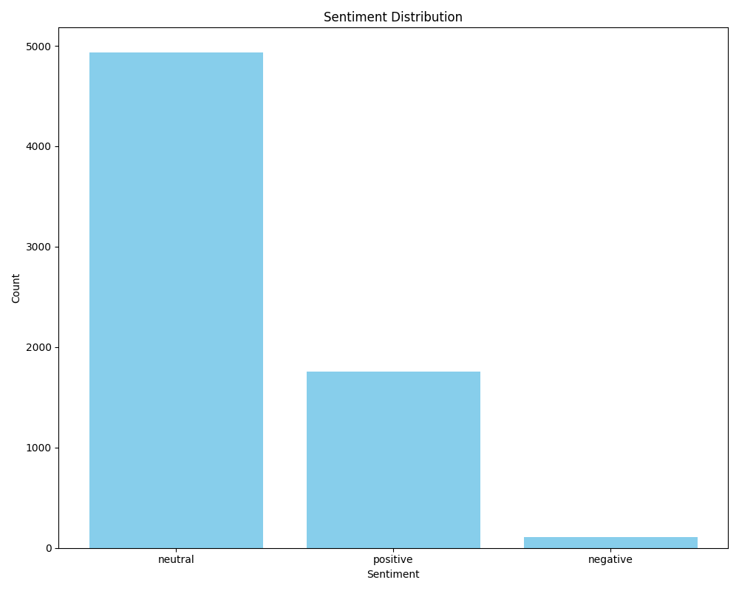

Slide 10
Sentiment Distribution
Neutral Sentiment: The majority. This means most of the data falls under neutral sentiment.
Positive Sentiment: A small bar, indicating that only a few data points are categorized as positive.
Negative Sentiment: The smallest bar, showing that only a negligible number of data points have a negative sentiment.
Most Revenue-Generating Product: ERP
Sentiment polarity: 0.13055555555555556
Sentiment subjectivity: 0.4861111111111112

Slide 11
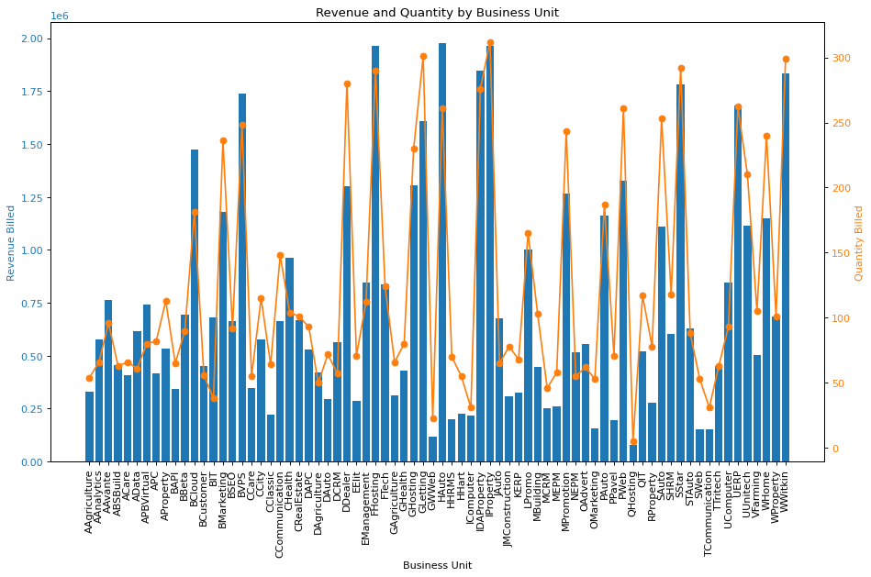

Slide 12
Revenue and Quantity by Business Unit
The unit 'HAuto' generated the highest revenue.
The unit 'IProperty' had the highest quantity billed.
The unit 'OHosting' generated lowest revenue and quantity billed.
Some business units generate high revenue with relatively low quantities, suggesting that they may be selling high-value products or services. On the other hand, other business units might have high quantities but low revenue, indicating that they may need to increase their prices or improve their product offerings.

Slide 13
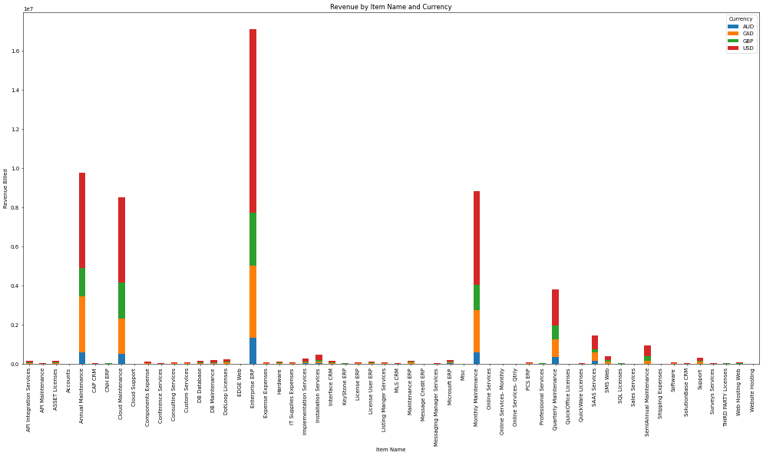

Slide 14
Revenue by Item Name and Currency
Significant revenue contributions are observed for items 'Enterprise ERP' and 'Annual Maintenance', primarily in currencies 'USD' and 'USD'.
X-axis (Horizontal):
Represents the Item Name (e.g., different products or services sold).
Each item listed on the x-axis is a product or service provided by the business.
Y-axis (Vertical):
Represents the Revenue Billed for each item.
The scale on the y-axis is in scientific notation, indicating that some items generated significant revenue (e.g., values like 1e7 mean 10 million).
Colors (Legend):
The different colors in the stacked bars represent different currencies:
Blue: AUD (Australian Dollar)
Orange: CAD (Canadian Dollar)
Green: GBP (British Pound)
Red: USD (US Dollar)
The stack shows how much of the revenue for each item was billed in each currency.

Slide 15
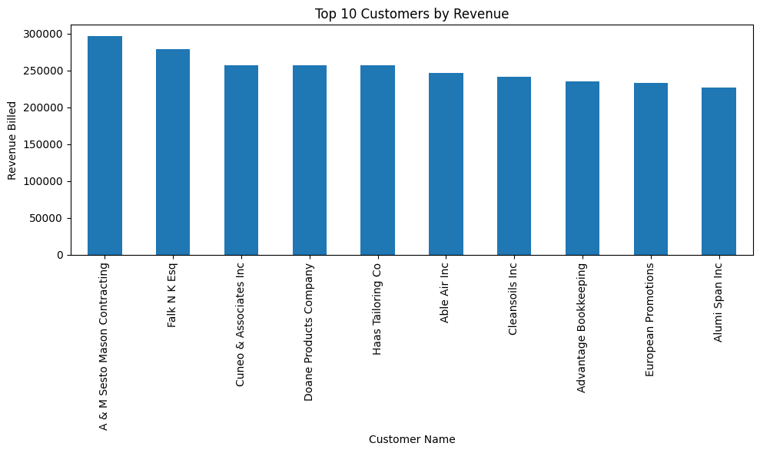

Slide 16
Top 10 Customers by Revenue
A & M Sesto Mason Contracting: The top customer with a total revenue of 296945.50.
Falk N K Esq: Approximately 280,000
Cuneo & Associates Inc: Approximately 260,000
Doane Products Company: Approximately 260,000
Haas Tailoring Co: Approximately 260,000
Able Air Inc: Approximately 250,000
Cleansoils Inc: Approximately 250,000
Advantage Bookkeeping: Approximately 240,000
European Promotions: Approximately 230,000
Alumi Span Inc: Approximately 220,000

