Slide 1

CMS Intro: Part 3
What is Drupal and when/why use it!

Slide 2
Who Am I
Bill Seremetis
Drupal Implementor* at zehnplus.ch
Founding member of the Greek Drupal Community
Maintainer of Drupal modules, translations etc.
*implementor: Alternative spelling of implementer.
The definition of implementer is the person who implements something or who puts it into practice.

Slide 3
Who uses Drupal?
Global
NGOs
Amnesty International, Pronatura
Universities
Oxford, Standford, Princeton, Minesotta
Goverments
UK, US, France, German, Australian
News
Economist, Examiner, BBC, NBC, MTV
Other
XING, NASA, Weather.com
etc etc etc...
Greece
Πανεπιστήμιο Πατρών
Πανεπιστήμιο Θεσσαλονικής
Αρχαιολογικό Μουσείο Θεσσαλονίκης
Ελληνική Κυβέρνηση
TVXS
Left.gr
Iefimerida
Athens Voice
SDNA
Gazzeta

Slide 4
What is Drupal
What Drupal isn’t
Drupal is a CMS (Content Management System),
often called a Content Management Framework.
Ideal for vast range of web based products.
An automatic solution to all your problems.

Slide 5
Reasons to use Drupal:
Not (very) Technical:
Free and open source software, forever!
Huge and active community.
Oh, we are also friendly!
Excellent codebase, actively developed.
Follows closely with developer trends and up to date technologies.
Technical:
Secure
Scalable
Multilingual
Flexible Content Architecture
Content as a service (REST)
Huge and active community!
1.000.000+ developers
40.000+ modules
2.500+ themes

Slide 6




On the shoulder of giants

Slide 7
Unlimited Flexibility
Use what you want, the way you want!
CKeditor is the default, but
you can change it, even with Gutenberg!
Want powerful search?
Add SOLR!
Want React/VUEjs/insertNextTrendHere?
No problem!
Many sites with the same codebase?
Go multisite!
E-commerce?
Absolutely!
Advanced publication workflows?
I’ll discuss this with your editor :)

Slide 8
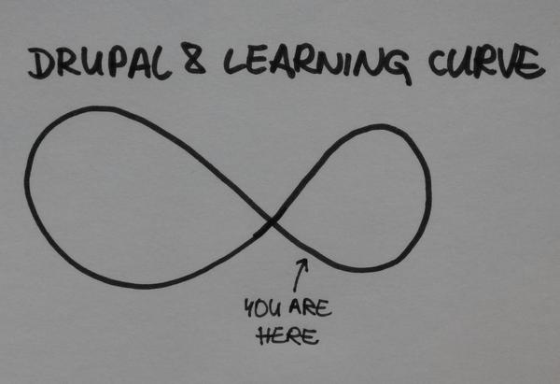
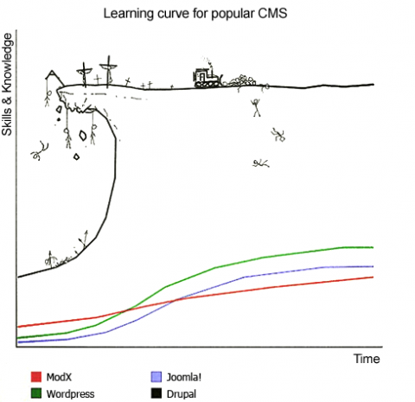
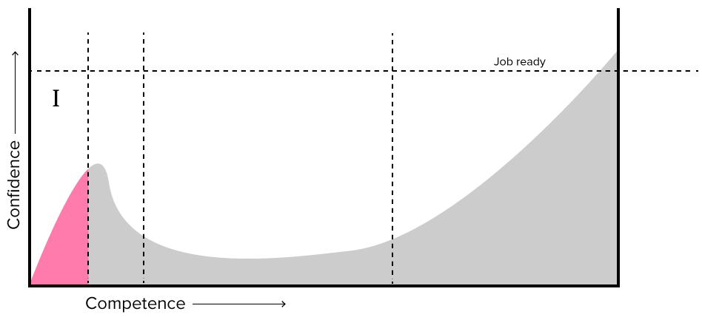
Compared to Wordpress, Wix etc...
Harder to master, but given its complexity it is easier to create complex/personalized features.
Features that would be almost impossible with other systems are, generally easier.

Slide 9
Questions?
Thank you!
Bill Seremetis
(bill@seremetis.net)
zehnplus.ch

