Slide 1
Teb arf project presentation
Zehra bengü emül

Slide 2
Steps taken in the project
1- SEPARATION OF DATA
2-DEFINING COLUMNS TO BE CONVERTED IN DIFFERENT WAYS
3- SEPARATION OF TEST AND TRAIN DATA
4-CREATION OF PIPELINES FOR NUMERICAL AND CATEGORICAL FEATURES
5- APPLICATION OF COLUMNTRANSFORM PROCESS FOR EACH COLUMNSET
6- ADDING A MODEL TO THE FINAL PIPELINE (XGBOOST)
SELECTING THE BEST 1O FEATUREIN FROM 7-SHAP , PERMUTATION IMPORTANCE AND RANDOM FOREST
8-CREATION OF CONFUSION MATRIX
9-EVALUATION OF METRICS
10-VISUALIZATION OF DATA

Slide 3
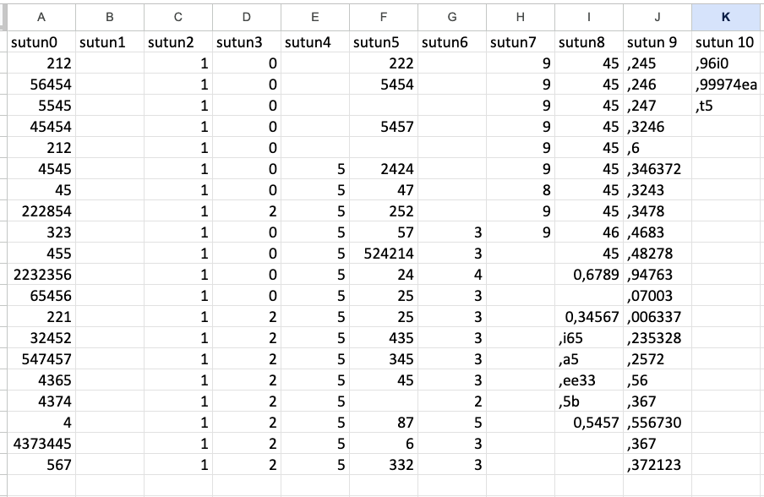

Slide 4
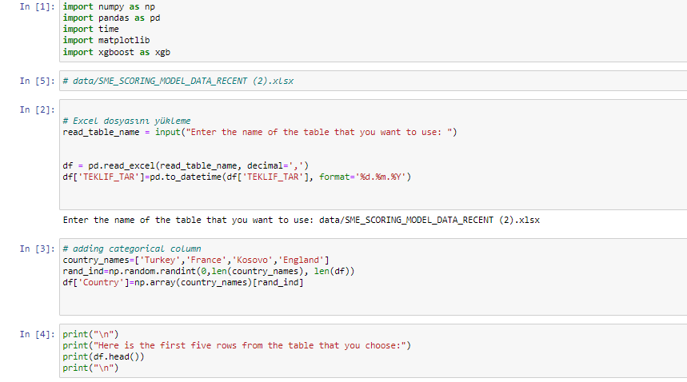

Slide 5
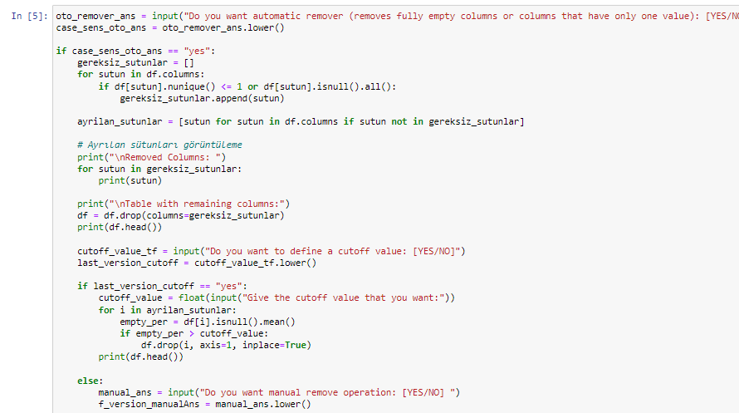

Slide 6
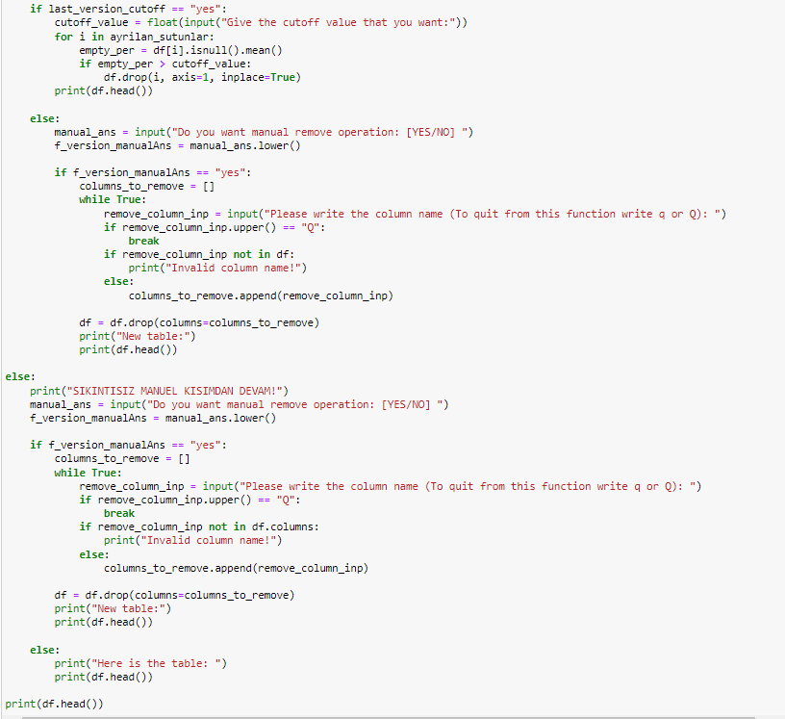

Slide 7
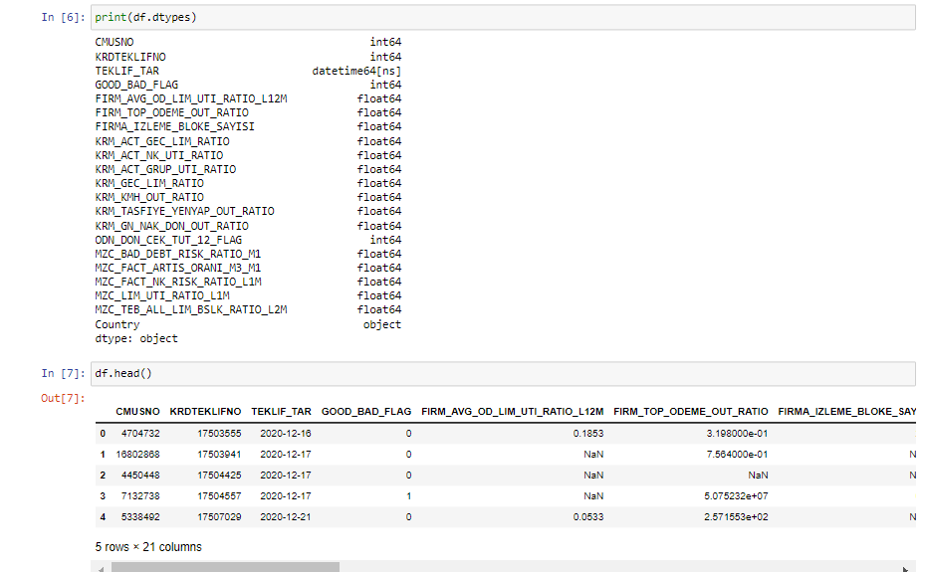

Slide 8
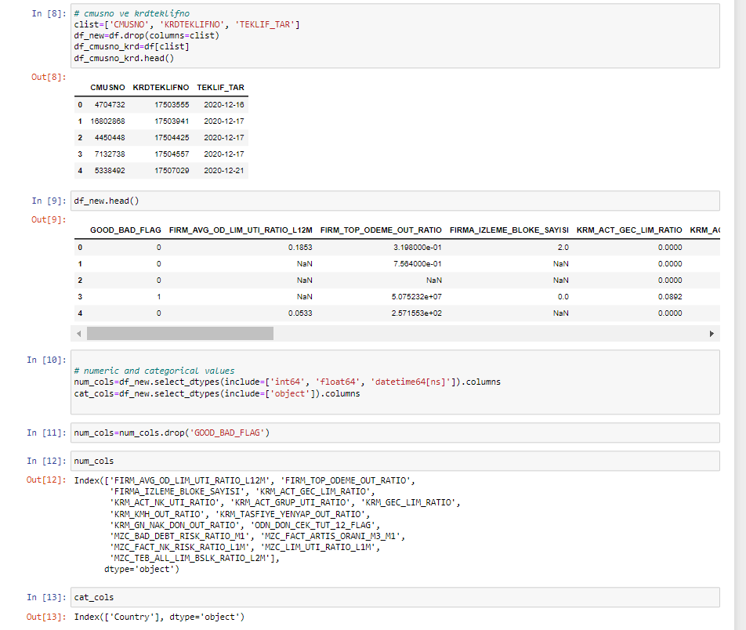

Slide 9
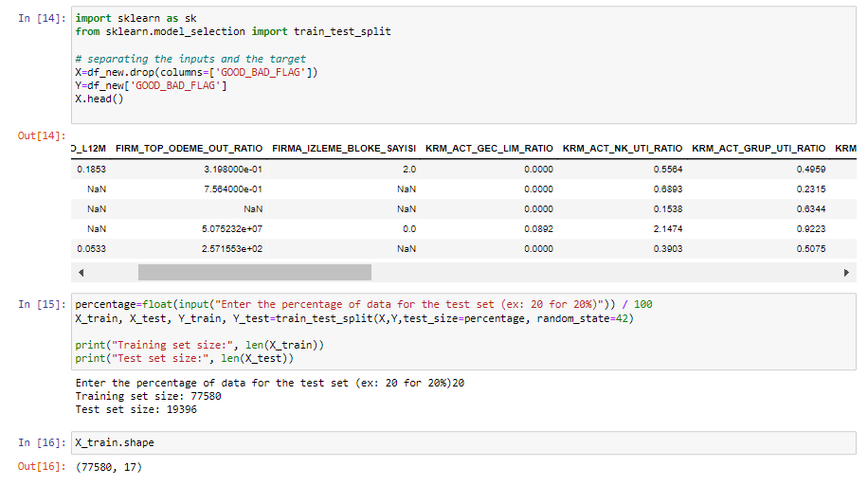

Slide 10
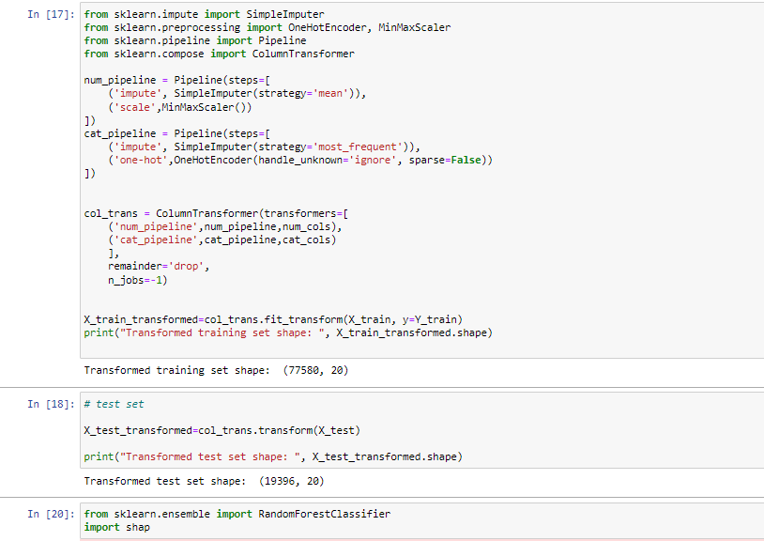
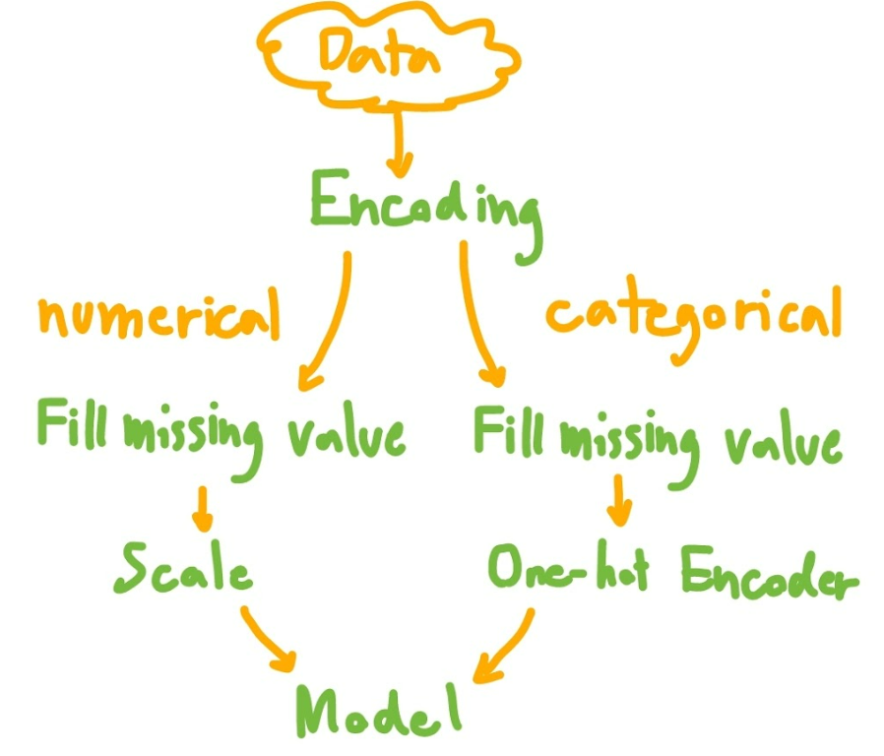

Slide 11
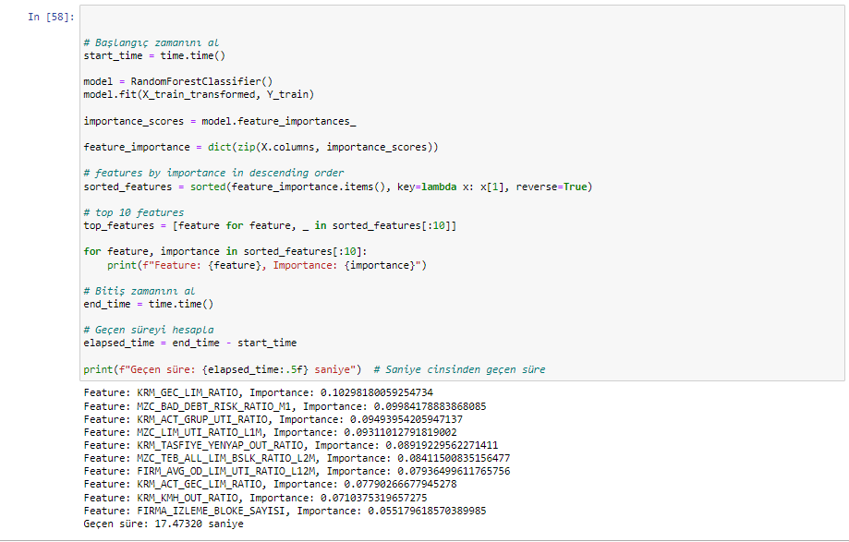

Slide 12
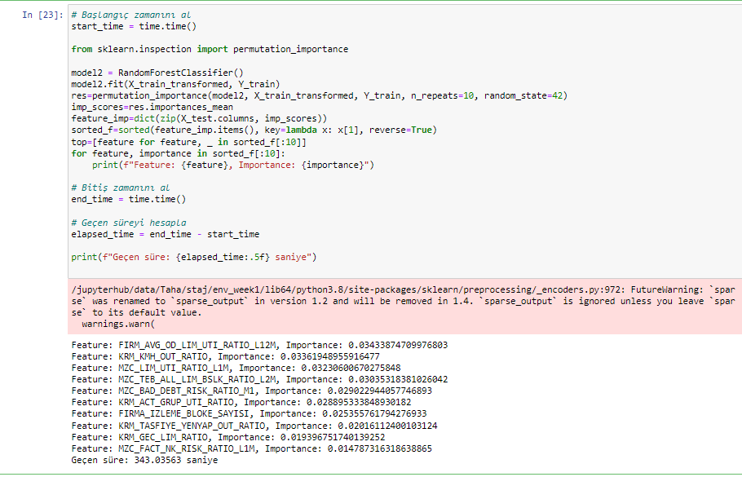

Slide 13
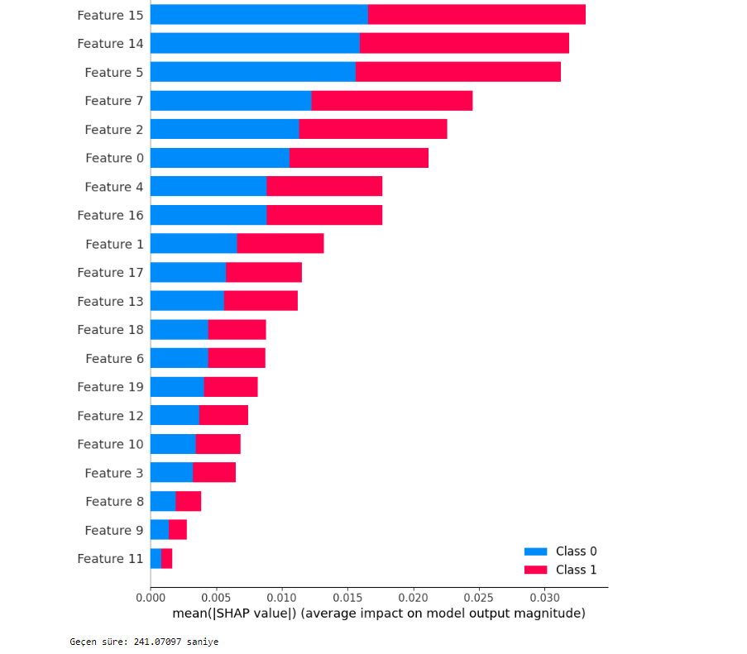

Slide 14
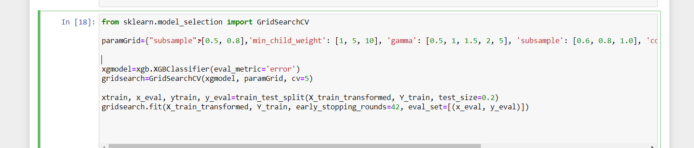
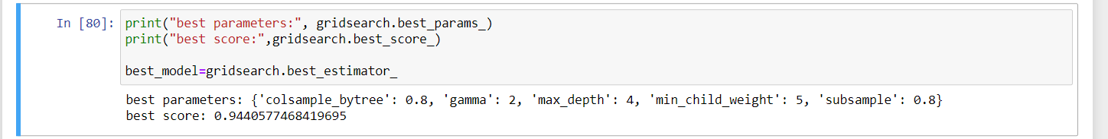
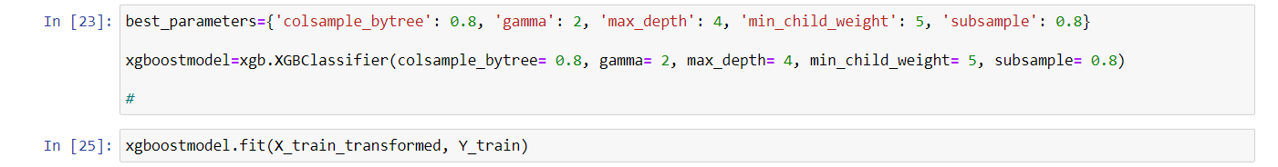

Slide 15
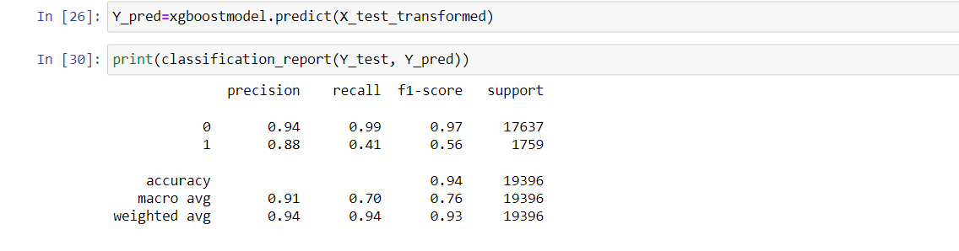

Slide 16
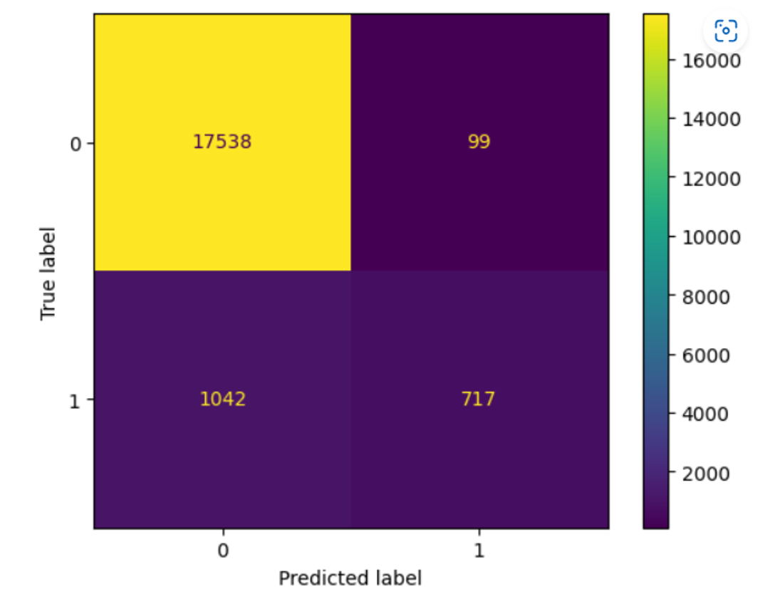

Slide 17
