Slide 1

AI-Based Healthcare Chatbot
A GenAI Project for Medicine Recommendation

Slide 2
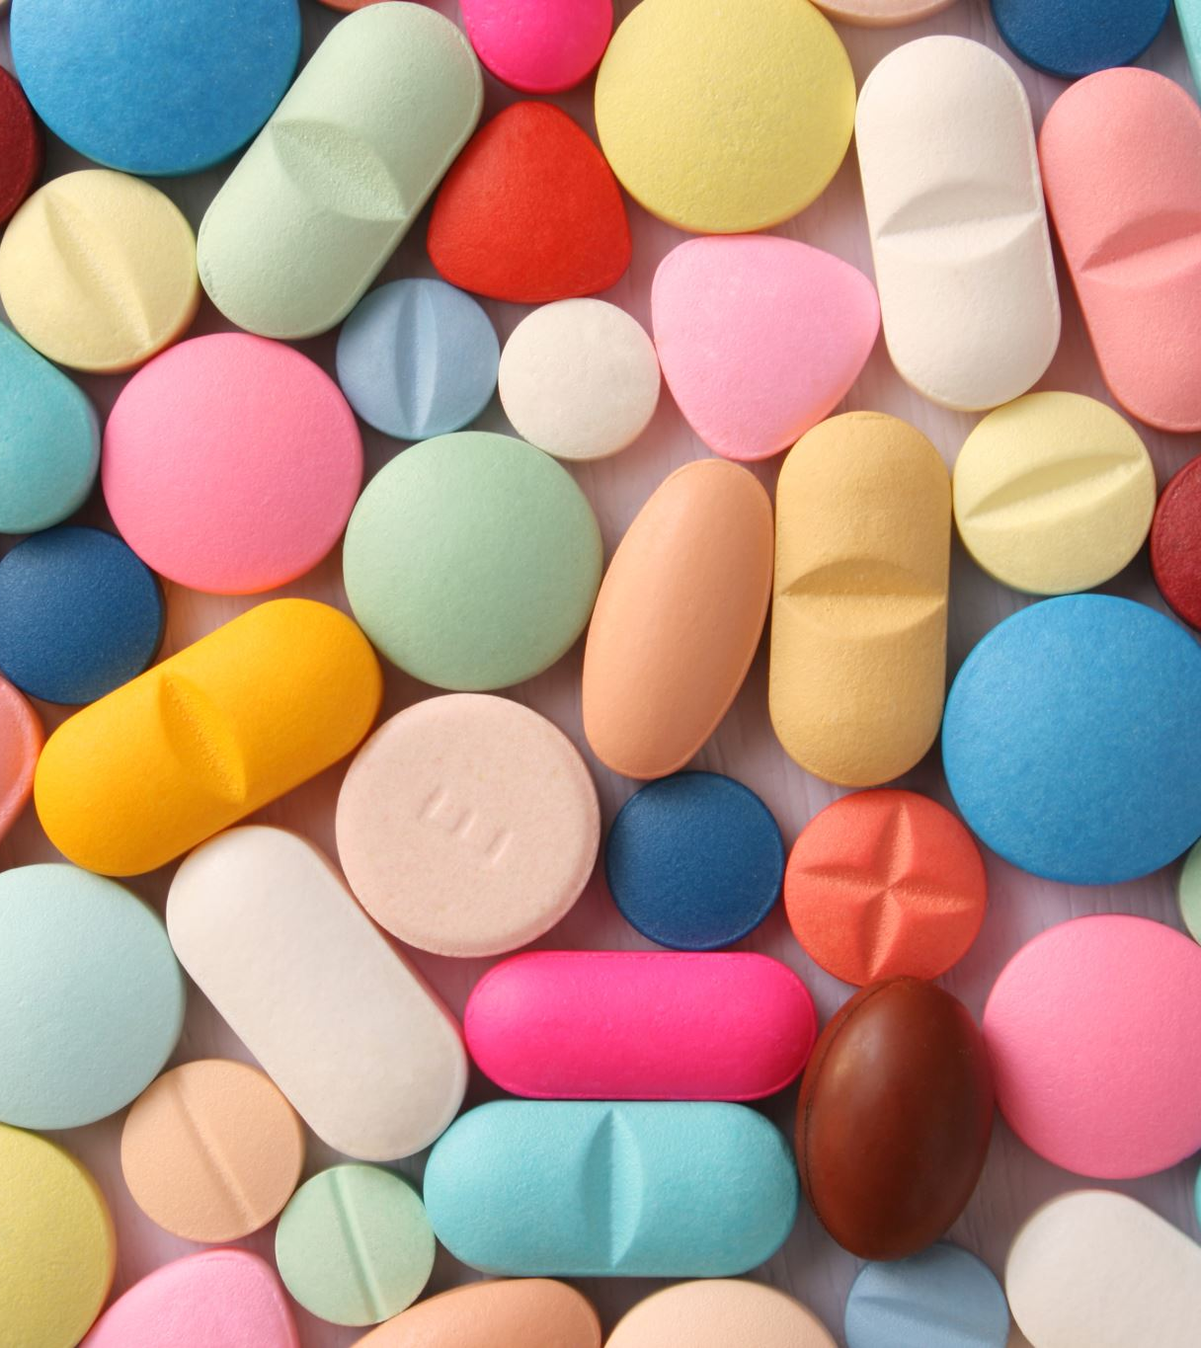
Introduction
Fast and accurate access to medical information is crucial.
Project goal: Develop a chatbot that recommends appropriate medications.
Two main use cases:
1. User requests drug information.
2. User asks for medication recommendation for a condition.

Slide 3
Dataset Overview
Structured CSV file with six main columns:
- Drug Name
- Medical Condition
- Recommended Age Range
- Drug Interactions
- Food Interactions
- Side Effects

Slide 4
Technologies Used
Python (main language)
Pandas (data processing)
Regular Expressions (age extraction)
Command-Line Interface (user interaction)
CSV format (dataset storage)

Slide 5
Method and Approach
1. Collect user input: age, drug name, or medical condition.
2. Match drugs or conditions from dataset.
3. Check age compatibility and interactions.
4. Display side effects and final response.

Slide 6
Chatbot Conversation Flow
1. Greeting & Age Input
2. Intent Selection (Drug info or Recommendation)
3. Display Results (usage, side effects, etc.)
4. Optional: Drug Interaction Check
5. End conversation with suggestion

Slide 7
Conclusion
Chatbot offers meaningful, data-driven medical guidance.
Supports user decision-making without replacing doctors.
Promotes safer and more conscious medication use.

Slide 8

Thanks For Listening! ☺

