Slide 1
Introduction to OBJECTED ORIENTED PROGRAMMING
Lecture # 1

Slide 2
Lecture outline
What is Object Oriented Programming
Building Blocks of OOP
Four principles of OOP
_________________
Introduction to Java
Basic Terminologies
Components of Java
Setting Environment
First Program in Java
Eclipse IDE

Slide 3
What Is OOP (Object Oriented Programming)?
Meaning, Fundamental Concepts, Significant Advantages

Slide 4
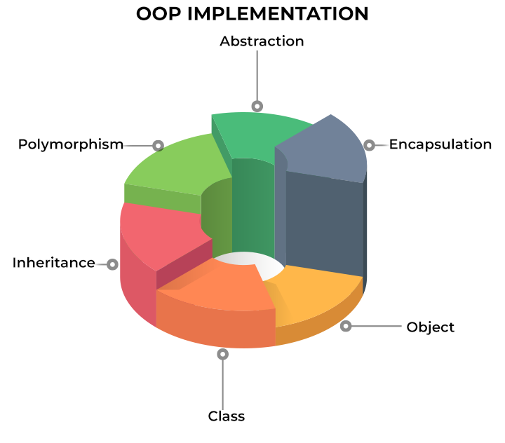
What is it?
Definition: Object-oriented programming (OOP) is a programming paradigm (not a specific language) built on the concept of objects, i.e., a set of data contained in fields, and code, indicating procedures – instead of the usual logic-based system
What is meant by programming paradigms?
Notes:
Paradigm can also be termed as a method to solve some problems or do some tasks.

Slide 5
Programming paradigms
Paradigm can also be termed as method to solve some problem or do some task.
Paradigm is a school of thought or model that has distinct features, frameworks, patterns, and style which help you solve a particular problem.
Paradigms are used in all fields such as psychology, sociology, computer science and so on.
Object-oriented programming (OOP) is a fundamental and most popular programming paradigm used by nearly every software developer at some point in their career and is taught as the standard way to code for most of a programmer’s educational career.
4 different programming paradigms – Procedural, Object-Oriented, Functional and Logical.

Slide 6
Procedural programming
Procedural Programming can also be referred to as imperative programming
Simply contains a series of computational steps, these steps instruct the computer on how to solve a task in logical steps. They are a list of instructions to tell the computer what to do step by step. Procedural programming is best for simple programs but is better is use other programming paradigms for solving complex programs.
Procedural programming languages are known as top-down languages. Most of the early programming languages are all procedural; examples are Fortran C and Cobol
Advantages:-
Best for general-purpose programming.
Reusability of the code.
It is easy to trace the flow of the program.
Disadvantages:-
The data is exposed (security issues).
Difficult to solve real-world problems.

Slide 7
Functional programming
Functional programming is a programming paradigm in which we use functions as the main building blocks of our program. This paradigm uses the approach of “what to solve” instead of “how to solve”.
Functional programming has been there for around six decades, but it is quickly gaining atraction now, due to current trends like parallel computing, data science, and machine learning applications
C, C++ and Python are best for functional programming

Slide 8
Object oriented programming paradigm
Object Oriented Programming (OOP) as a whole, without relying on a particular programming language. You'll learn what it is, why it's so popular as a programming paradigm, its structure, how it works, its principles, and more.
OOP is defined as a programming paradigm that relies on the concept of classes and objects
you can use it to structure a software program into simple, reusable code blocks (in this case usually called classes), which you then use to create individual instances of the objects.
Object-oriented programming (OOP) is a computer programming model that organizes software design around data, or objects, rather than functions and logic. An object can be defined as a data field that has unique attributes and behavior.

Slide 9
Object-oriented programming (OOP) is a computer programming model that organizes software design around data, or objects, rather than functions and logic. An object can be defined as a data field that has unique attributes and behavior.
This approach to programming is well-suited for programs that are large, complex and actively updated or maintained. This includes programs for manufacturing and design, as well as mobile applications.
The organization of an object-oriented program also makes the method beneficial to collaborative development, where projects are divided into groups. Additional benefits of OOP include code reusability, scalability and efficiency.

Slide 10
The first step in OOP is to collect all of the objects a programmer wants to manipulate and identify how they relate to each other -- an exercise known as Data Modeling
Examples of an object can range from physical entities, such as a human being who is described by properties like name and address, to small computer programs, such as widgets.

Slide 11
Object oriented programming paradigm
One of the biggest benefits that drives OOP is that it makes it much easier to collaborate on the development process, especially when a project is divided into groups. This is made possible by code reusability, scalability, and efficiency.
OOP enables developers to model real-world objects like people, pets, or businesses in code, making software development and maintenance easier for developers
Object-oriented programming is a software development technique that emphasizes the division of programs into discrete, self-contained objects. An object, in this case, is an independent construct like a data structure and an executable unit of code. An object could depict real-life things like people, cars, and buildings. On the flip side, it can represent more abstract things, such as operations or algorithms.

Slide 12
Oop paradigm advantages and disadvantages
Advantages:-
It can relate to real-world entities.
Code Reusability
Data hiding
Disadvantages:-
Complex Design
Large size

Slide 13
Python Supports;
Procedural programming
Object-Oriented Programming
Functional programming
question is … which paradigm is best?
There isn’t any clear answer to that question, if the program just uses a concrete set of steps then it is recommended to use procedural, if the program has real-world analogy then the answer is OOP.
Python is suitable for quick prototyping, highly recommended for data manipulation and machine learning applications.

Slide 14
Building blocks of oop

Slide 15
Building blocks
CLASSES
OBJECTS
ATTRIBUTES
FUNCTIONS

Slide 16
Object oriented programming paradigm
OOP was a total paradigm shift in programming because it relies on classes and objects, which is a confusing pair of constructs.
To define these, one might say an object is an instance of a class. But just what is a class? Basically, it is a blueprint from which objects are created.

Slide 17
Object
Any entity that has state and behavior is known as an object. For example, a chair, pen, table, keyboard, bike, etc. It can be physical or logical.
An object can be defined as an instance of a class, and there can be multiple instances of a class in a program.
An object contains an address and takes up some space in memory.
Objects can communicate without knowing the details of each other's data or code. The only necessary thing is the type of message accepted and the type of response returned by the objects.
Example: A dog is an object because it has states like color, name, breed, etc. as well as behaviors like wagging the tail, barking, eating, etc.

Slide 18
Object -- an encapsulation of data along with functions that act upon that data.
An object consists of:
Name -- the variable name we give it
Member data -- the data that describes the object
Member functions -- behavior aspects of the object (functions related to the object itself)

Slide 19
Object
Object means a real-world entity such as a pen, chair, table, computer, watch, etc.
Object-Oriented Programming is a methodology or paradigm to design a program using classes and objects. It simplifies software development and maintenance by providing some concepts:
At the point of creation of a class, the description is the first object to be defined. An instance of a class exists in an object. Notably, the system does not allocate any memory space when a class is specified, but it’s allocated when it is instantiated, i.e., when an object is formed. Real-world things have state and behavior in common, a pair of features. An object conceals its behavior through methods and keeps its information in attributes.

Slide 20
OBJECT
Any entity that has state and behavior is known as an object. For example, a chair, pen, table, keyboard, bike, etc. It can be physical or logical.
An Object can be defined as an instance of a class. An object contains an address and takes up some space in memory. Objects can communicate without knowing the details of each other's data or code. The only necessary thing is the type of message accepted and the type of response returned by the objects.
Example: A dog is an object because it has states like color, name, breed, etc. as well as behaviors like wagging the tail, barking, eating, etc.

Slide 21
Class
A class is a user-defined type that describes what a certain type of object will look like.
Collection of objects is called class. It is a logical entity.
A class can also be defined as a blueprint from which you can create an individual object.
Class doesn't consume any space.
It is a user-defined data type that can be accessed and used by creating an instance of that class.
It has its own data members and member functions.
Both member functions and data members are found in classes.
The data members inside the class are manipulated using these member functions.

Slide 22
Classes are user-defined data types that act as the blueprint for individual objects, attributes and methods.
Objects are instances of a class created with specifically defined data. Objects can correspond to real-world objects or an abstract entity. When class is defined initially, the description is the only object that is defined.
Methods are functions that are defined inside a class that describe the behaviors of an object. Each method contained in class definitions starts with a reference to an instance object. Additionally, the subroutines contained in an object are called instance methods. Programmers use methods for reusability or keeping functionality encapsulated inside one object at a time.
Attributes are defined in the class template and represent the state of an object. Objects will have data stored in the attributes field. Class attributes belong to the class itself.

Slide 23
Principles of oop

Slide 24
Oop principles
More importantly, however, OOP adheres to 4 principles:
Encapsulation: when an object can keep its state private (within a class).
Abstraction: a natural extension of Encapsulation, which makes it possible for objects to only reveal operations relevant to other objects. For example, you get in your car and press the Start button. You don’t have to know how everything works under the hood, to drive.
Inheritance: makes it possible to create a child class that is derived from a parent class that reuses all fields and methods from the parent.
Polymorphism: makes it possible for objects to take on more than one form based on the context in which it is used.

Slide 25
building blocks of object-oriented programming
What are the building blocks of object-oriented programming?
Class: In object-oriented programming, classes define the structure of a program or the relationships between objects. Classes can also specify the types of attributes and behaviors that an object should have. Classes enable programmers to reuse elements when multiple instances of a specific data type exist.
Object: An object is a discrete entity representing a real-world concept or an abstraction. Also, an object is a collection of related data fields and functions to be treated as a whole. An object references other objects for interaction within the system.
Method: A method is a function or set of rules that act on an object. Methods are useful for grouping related tasks, making the code quicker to read and maintain. Also, methods enable an object to interact with other objects and receive input.
Attributes: The members of each class are attributes. An attribute is a data-modifying descriptor that identifies the properties of an object. Developers can modify these attributes over time to change how an object behaves. For example, if you wish to change how an object moves, alter its acceleration attribute.

Slide 26
Q #4) Is functional programming the future?
Answer: Functional programming has existed for over 6 decades but still it has not overcome the use of other OOP languages like Java, C#, etc. Functional programming is definitely gaining popularity owing to mostly huge growth in data science and machine learning and with greater support for concurrency, these languages find a good place for such applications.
So, it’s good for the community for both OOPs and FP languages to co-exist and developers can choose the language framework that best suits their needs.
There are languages like Kotlin and Python which support both Object-Oriented as well as functional programming constructs.

Slide 27
Object-oriented programming (OOP) is defined as a programming paradigm (and not a specific language) built on the concept of objects, i.e., a set of data contained in fields, and code, indicating procedures – instead of the usual logic-based system
What is meant by programming paradigms?
Notes:
Paradigm can also be termed as a method to solve some problems or do some tasks.

Slide 28
Nearly all developers employ the core programming paradigm known as object-oriented programming at some point in their careers.
The well-known programming paradigm, OOP, is taught as the norm for most of a programmer’s educational career. OOP is based on the idea of classes and objects. It organizes a computer program into basic, reusable blueprints of code or “classes.” These classes are then used and reused to create new and unique objects with similar functions. This paradigm represents a system that interacts with actual items in real life – such as the user.

Slide 29
Different parts of it perform actions on real-world items, creating actual interactions between people and machines. The strategy is advantageous for collaborative development when projects are divided into groups due to the organization of object-oriented software. Code reuse, scalability, and efficiency are other advantages of OOP.

Slide 30
The first stage in OOP is to gather all the objects that a programmer wishes to work with and determine their relationships, a process known as data modeling. Data and functions are combined to create an object from the data structure. Programmers can also establish connections between several objects. Objects can, for instance, acquire traits from other objects.
A human is a straightforward illustration of an object.
You would logically anticipate that a person would have a name. This would be regarded as being in the person’s possession. Another thing you could expect from someone is their ability to do, like walk or drive. One might view this as one of the person’s methods. Objects serve as the framework for object-oriented programming code.

Slide 31
Explain OOP Like I'm 5
The dictionary meaning of an object is "an entity that exists in the real world", and oriented means "interested in a particular kind of thing or entity".
In basic terms, OOP is a programming pattern that is built around objects or entities, so it's called object-oriented programming.

Slide 32
How OOP Became Popular
The concepts of OOP started to surface back in the 60s with a programming language called Simula. Even though back in the day, developers didn't completely embrace the first advances in OOP languages, the methodologies continued to evolve.
The recognition continued to grow during the 90s, and with the arrival of Java, OOP attracted a huge following.
In 2002 in conjunction with the release of the .NET Framework, Microsoft introduced a brand new OOP language called C# – which is often described as the most powerful programming language
It's interesting that, generations later, the concept of organizing your code into meaningful objects that model the parts of your problem continues to puzzle programmers.
Many folks who haven't any idea how a computer works find the thought of object-oriented programming quite natural. In contrast, many folks who have experience with computers initially think there's something strange about object oriented systems.

Slide 33
Imagine that you are running a pet shop, with lots of different breeds and you have to keep track of the names, age, days attended to, and other common upkeep details. How would you design reusable software to handle this?
Keep in mind we have many breeds, so writing code for each would be tiresome. But we can group related information together so that we can produce shorter and more reusable code.
That's where the building blocks come in to help us do this by using Classes, Objects, Methods and Attributes.

Slide 34
Building blocks
Classes - these are user-defined data types that act as the blueprint for objects, attributes, and methods.
Objects - These are instances of a class with specifically defined data. When a class is defined initially, the description is the only object that is defined.
Methods - These are functions that are defined inside a class that describe the behavior of an object. They are useful for re-usability or keeping functionality encapsulated inside one object at a time. Code re-usability is a great benefit when debugging.
Attributes - These are defined in the class template and represent the state of an object. Objects contain data stored in the attribute field.

Slide 35
The focal point of OOP is a class that is used to create objects. A class is the blueprint of an object. It literally describes what an object will be but separate from the object itself. The same class can be used for creating multiple objects.

Slide 36
Principles of OOP
In order for us to know how to write good OOP code, we need to understand the 4 pillars of OOP (four principles of object-oriented programming) we should adhere to:
Encapsulation
Abstraction
Inheritance
Polymorphism

Slide 37
Encapsulation
Say we have a program. It has a few logically different objects which communicate with each other — according to the rules defined in the program.
Encapsulation is achieved when each object keeps its state private, inside a class. Other objects don’t have direct access to this state. Instead, they can only call a list of public functions — called methods.
So, the object manages its own state via methods — and no other class can touch it unless explicitly allowed. If you want to communicate with the object, you should use the methods provided. But (by default), you can’t change the state.
This is the concept that binds data together. Functions manipulate the info and keep it safe. No direct access is granted to the info in case it's hidden. If you wish to gain access to the info, you need to interact with the article in charge of the info.

Slide 38
Encapsulation
Example:
Think about a human resources department. The human resources staff members encapsulate (hide) the data about employees. They determine how this data will be used and manipulated. Any request for the worker data or request to update the info must be routed through them.
By encapsulating data, you make the information of your system safer and more reliable.
You're also able monitor how the information is being accessed and what operations are performed on it.
This makes program maintenance easier and simplifies the debugging process.

Slide 39
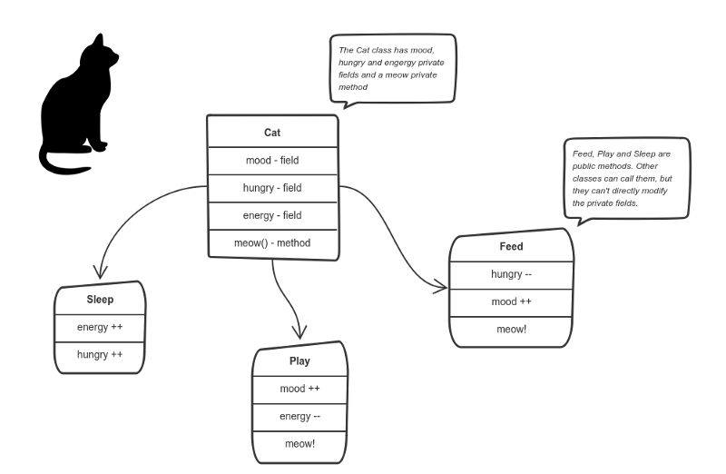
Encapsulation
Let’s say we’re building a tiny Sims game. There are people and there is a cat. They communicate with each other. We want to apply encapsulation, so we encapsulate all “cat” logic into a cat class.
Here the “state” of the cat is the private variables mood, hungry and energy. It also has a private method meow()
Other objects can modifiy the internal state somehow by invoking public methods.
Thus, the binding between the private state and public methods is made.
This is encapsulation.

Slide 40
This principle states that all important information is contained inside an object and only select information is exposed. The implementation and state of each object are privately held inside a defined class. Other objects do not have access to this class or the authority to make changes. They are only able to call a list of public functions or methods. This characteristic of data hiding provides greater program security and avoids unintended data corruption.

Slide 41
Abstraction
In object-oriented design, programs are often extremely large. And separate objects communicate with each other a lot. So maintaining a large codebase like this for years — with changes along the way — is difficult. Abstraction is a concept aiming to ease this problem.
Basically, we use abstraction to handle complexity by allowing the user to only see relevant and useful information.
Applying abstraction means that each object should only expose a high-level mechanism for using it. This mechanism should hide internal implementation details. It should only reveal operations relevant for the other objects.

Slide 42
Abstraction
Example:
When you have an automatic car and want to get from point A to point B, all you need to do is give it the destination and start the car. Then it'll drive you to your destination.
What you don't need to know is how the car is made, how it correctly takes and follows instructions, how the car filters out different options to find the best route, and so on.
Example:
Think — a coffee machine. It does a lot of stuff and makes quirky noises under the hood. But all you have to do is put in coffee and press a button.
Preferably, this mechanism should be easy to use and should rarely change over time. Think of it as a small set of public methods which any other class can call without “knowing” how they work.

Slide 43
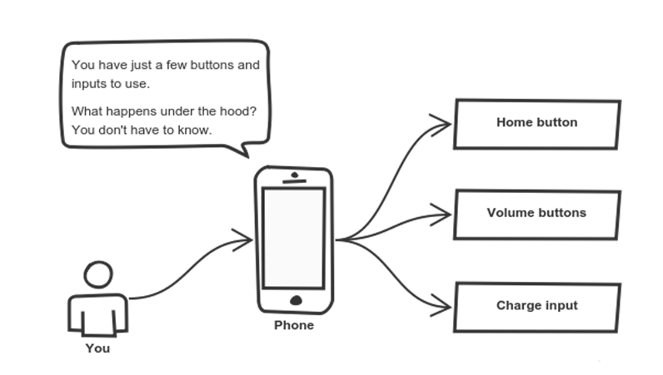
Abstraction
Another real-life example of abstraction; think about how you use your phone:
You interact with your phone by using only a few buttons. What’s going on under the hood? You don’t have to know — implementation details are hidden. You only need to know a short set of actions. Cell phones are complex. But using them is simple.
Implementation changes — for example, a software update — rarely affect the abstraction you use.
The same concept is applied when constructing OOP applications. You do this by hiding details that aren't necessary for the user to see.

Slide 44
Inheritance
OK, we saw how encapsulation and abstraction can help us develop and maintain a big codebase.
But do you know what is another common problem in OOP design?
Objects are often very similar. They share common logic. But they’re not entirely the same. Ugh…
So how do we reuse the common logic and extract the unique logic into a separate class? One way to achieve this is inheritance.
It means that you create a (child) class by deriving from another (parent) class. This way, we form a hierarchy.
The child class reuses all fields and methods of the parent class (common part) and can implement its own (unique part).

Slide 45
Inheritance
Inheritance allows classes to inherit features of other classes.
You use inheritance in OOP to classify the objects in your programs per common characteristics and performance.
This makes working with the objects and programming easier, because it enables you to mix general characteristics into a parent object and inherit these characteristics within the child objects.

Slide 46
Inheritance
Example:
Define an employee object that defines all the overall characteristics of employees in your company.
You'll be able to then define a manager object that inherits the characteristics of the employee object but also adds characteristics unique to managers in your company.
The manager object will automatically reflect any changes within the implementation of the employee object.
This way, each class adds only what is necessary for it while reusing common logic with the parent classes. Thus we can implement this class hierarchy.

Slide 47
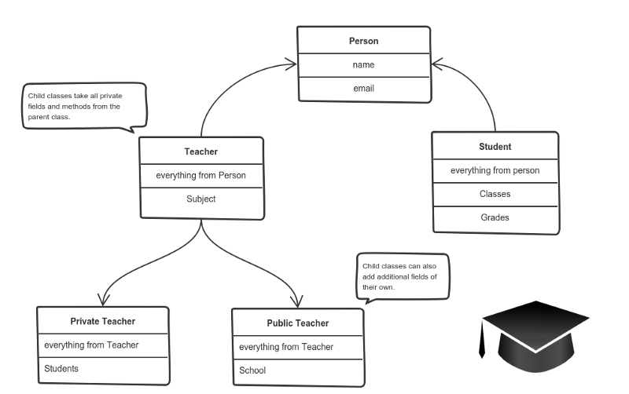
Inheritance
Example:

Slide 48
Polymorphism
Polymorphism means “many shapes” in Greek.
So we already know the power of inheritance and happily use it. But there comes this problem.
Say we have a parent class and a few child classes which inherit from it. Sometimes we want to use a collection — for example a list — which contains a mix of all these classes. Or we have a method implemented for the parent class — but we’d like to use it for the children, too.
This can be solved by using polymorphism.
This is the power of two different objects to reply to one form. The program will determine which usage is critical for every execution of the thing from the parent class which reduces code duplication. It also allows different kinds of objects to interact with the same interface.

Slide 49
Polymorphism
polymorphism gives a way to use a class exactly like its parent so there’s no confusion with mixing types. But each child class keeps its own methods as they are.
This typically happens by defining a (parent) interface to be reused. It outlines a bunch of common methods. Then, each child class implements its own version of these methods.
Any time a collection (such as a list) or a method expects an instance of the parent (where common methods are outlined), the language takes care of evaluating the right implementation of the common method — regardless of which child is passed.

Slide 50
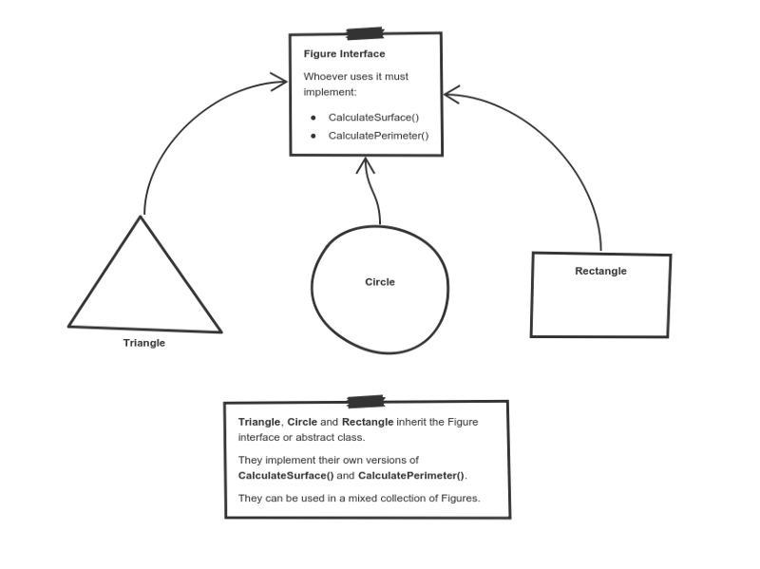
Polymorphism
Take a look at a sketch of geometric figures implementation. They reuse a common interface for calculating surface area and perimeter:

Slide 51
Polymorphism
Having these three figures inheriting the parent figure interface lets you create a list of mixed triangles, circles and rectangles. And treat them like the same type of object.
Then, if this list attempts to calculate the surface for an element, the correct method is found and executed. If the element is a triangle, triangle’s CalculateSurface() is called. If it’s a circle — then circle’s CalculateSurface() is called. And so on.

Slide 52
Examples of OOP Languages
Technology and programming languages are evolving all the time. We have seen the rise of may langs under the OOP category, but Simula is credited as the first OOP language.
Programming languages that are considered pure OOP treat everything like objects, while the others are designed primarily with some procedural process.
Examples of OOP langs:
Scala Emerald Ruby
JADE Java Python
C++ JavaScript C#
PHP Kotlin R

Slide 53
Benefits of OOP
During the 70s and 80s, procedural-oriented programming languages such as C and Pascal were widely used to develop business-oriented software systems. But as the programs performed more complex business functionality and interacted with other systems, the shortcomings of structural programming methodology began to surface.
Because of this, many software developers turned to object-oriented methodologies and programming languages to solve the encountered problems.

Slide 54
Benefits of OOP
The benefits of using this languages included the following:
Code Re-usability - through inheritance, you can reuse code. This means a team does not have to write the same code multiple times.
Improved integration with modern operating systems.
Improved Productivity - developers can construct new programs easily and quickly through the use of multiple libraries.
Polymorphism enables a single function to adapt to the class it is placed in.
Easy to upgrade, and programmers can also implement system functionalities independently.
Through Encapsulation objects can be self-contained. It also makes troubleshooting and collaboration on development easier.
By the use of encapsulation and abstraction, complex code is hidden, software maintenance is easier, and internet protocols are protected.

Slide 55
Apart from these concepts, there are some other terms which are used in Object-Oriented design:
Coupling
Cohesion
Association
Aggregation
Composition

