Slide 1



Compiler Techniques For High Performance Sequentially Consistent Java Programs
Zehra Sura:
Xing Fang, Sam Midkiff:
Jaejin Lee:
David Wong, David Padua:
IBM Research
Purdue University
Seoul National University
University of Illinois

Slide 2
Objective
Performance of Java using sequential consistency as the memory model
  Fast and effective analysis of thread interactions through shared memory

Slide 3
Outline
Part I: Introduction
  Memory Consistency Models
  Compiling for Memory Consistency
Part II: Compiler Analysis
  Delay set analysis
  Synchronization analysis
Part III: Results and Conclusion

Slide 4
Shared Memory Programming
Need to reason about access orders
Processor 1
Processor 2
(A) X = 1
(B) Y = 1
(C) t1 = Y
t2 = X
Print t1, t2
Initially X=0 and Y=0
Unordered
memory accesses
Order
E:(t1,t2)
Shared Memory
A B C D
(1,1)
Location X
C D A B
(0,0)
Location Y
A C D B
(0,1)
B C D A
(1,0)

Slide 5
Sequential Consistency (SC)
Processor 2
Processor 3
Processor 1
Processor 4
3
3
2
4
2
5
3
4
2
3
Stream of
Instructions
Ordering Requirement
1
2
1
1
1

Slide 6
Relaxed Consistency (RC)
Allow re-ordered or overlapped execution for some instructions
Examples:
  Weak consistency
  Release consistency
  Java memory model

Slide 7
RC versus SC
SC better for programmability
  Fewer re-orderings to reason about
RC better for performance
  Allow accesses to overlap or be re-ordered
Can we recover performance for SC?
  Compiler analysis to determine orders that really need to be enforced
Mark Hill, Multiprocessors should support simple memory-consistency models,
IEEE Computer, August 1998

Slide 8
Hardware and Language Models
Programmers
Language memory model
Orders enforced by compiler
and hardware fences or syncs
Compiler
Hardware memory model
Orders enforced by hardware
H/W

Slide 9
Compiler for SC
Source Java
Bytecode
Hardware
Memory Model
Thread Escape Analysis
Program
Analysis
Alias Analysis
Synchronization Analysis
Synchronization Analysis
Delay Set Analysis
Delay Set Analysis
Ordering
Constraints
Code Re-ordering and Code
Elimination Transformations
Jikes
RVM
Barrier Insertion and Optimization
Target Machine Code (SC)

Slide 10
Outline
Part I: Introduction
  Memory Consistency Models
  Compiling for Memory Consistency
Part II: Compiler Analysis
  Delay set analysis
  Synchronization analysis
Part III: Results and Conclusion

Slide 11
Delay Set Analysis
Delay set: pairs of shared memory accesses (X,Y) whose order must be enforced
Shasha and Snir (TOPLAS 88) show how to find the minimal delay set
  Build graph to capture all possible access orders in program execution

Slide 12
Ordering Requirement
Thread 1
a) X = 1
c) Z = Y
Captures (b)
has occurred
before (c)
b) Y = 1
d) W = X
Captures (a) has
not occurred
Must enforce order: (a) (b)
Program edge
Conflict edge
Notes:
Captured the value … actual execution orders conflict edges

Slide 13
Simplified Delay Set Analysis
Look for end-points of a possible cycle
Delay from A to B if:
  A and B are thread escaping, and
  Conflict edge between A and some access X, and
  Conflict edge between B and some access Y
A
Y
conflict edge
Program edge to
test for delay
Some path that
completes cycle
B
conflict edge
X

Slide 14
Synchronization Analysis
Consider two types of synchronization:
  Thread structure, due to thread start() and thread join() calls
  Locking, due to synchronized blocks
More accurate graph to find delays
  Eliminate conflict edges
  Order shared memory accesses

Slide 15
Summary of Program Analysis
A
Y
conflict edge
Program edge to
test for delay
Some path that
completes cycle
B
conflict edge
X
Escape analysis determines A, B refer to locations accessible from multiple threads
Conflict edges (B,Y) and (A,X) exist
  Both may access same location and one is a write
  Not eliminated by lock synchronization, or single thread
Orders B → Y, Y → X, and X → A are possible
  Cannot infer Y → B, X → B, X → Y, A → X, or A → Y

Slide 16
Effect of Thread Start Calls
Program
entry point
T(S) may start after P = T
T(S) may finish before P = F
T(S) may be concurrent P = F
P
T(S) may start after S = T
T(S) may finish before S = F
T(S) may be concurrent S = F
Thread
started
Thread
start
S
X
Q
T(S) may start after Q = F
T(S) may finish before Q = F
T(S) may be concurrent Q = T
T(S) may start after X = F
T(S) may finish before X = F
T(S) may be concurrent X = F
Y
Notes:
All threads started at S threads_started<S>, TS<S>

Slide 17
Effect of Thread Join Calls
Program
entry point
T(S) may start after P = T
T(S) may finish before P = F
T(S) may be concurrent P = F
P
T(S) may start after S = T
T(S) may finish before S = F
T(S) may be concurrent S = F
Thread
started
Thread
start
S
X
Q
T(S) may start after Q = F
T(S) may finish before Q = F
T(S) may be concurrent Q = T
T(S) may start after X = F
T(S) may finish before X = F
T(S) may be concurrent X = F
T(S) may start after J = T
T(S) may finish before J = F
T(S) may be concurrent J = T
Thread
Join for S
Y
J
T(S) may start after R = T
T(S) may finish before R = T
T(S) may be concurrent R = F
R

Slide 18
Inferring Orders
(T(S) may start after Y, T(S) may finish before Y, T(S) may be concurrent Y)
(F F F)
(F F T)
(F T F)
(F T T)
(T F F)
(T F T)
(T T F)
(T T T)
Y є S
S → Y
Y → S

Slide 19
Inferring Orders
(T(S) may start after Y, T(S) may finish before Y, T(S) may be concurrent Y)
Access Y
(F F F)
(F F T)
(F T F)
(F T T)
(T F F)
(T F T)
(T T F)
(T T T)
Access X
Y є S
S → Y
Y → S
(F F F)
X є S
X → Y
Y → X
(F F T)
(F T F)
Y → X
Y → X
S → X
(T(S) may start after X,T(S) may finish before X,T(S) may be concurrent X)
(F T T)
(T F F)
X → Y
X → Y
X → S
(T F T)
(T T F)
(T T T)

Slide 20
Inferring Orders
Cannot infer an order between X and Y if:
  T(S) concurrent X, and
  Y is an access executed as part of a thread directly or indirectly started via S
S
Thread started
Z
T(S) may start after X = F
T(S) may finish before X = F
T(S) may be concurrent X = T
X
Y
T(S) may start after Y = F
T(S) may finish before Y = F
T(S) may be concurrent Y = F
J
T(S) may start after Y = F
T(S) may finish before Y = T
T(S) may be concurrent Y = F
Y
Notes:
Order??

Slide 21
Inferring Orders
(T(S) may start after Y, T(S) may finish before Y, T(S) may be concurrent Y)
Access Y
(F F F)
(F F T)
(F T F)
(F T T)
(T F F)
(T F T)
(T T F)
(T T T)
Access X
(F F F)
X → Y
Y → X
(F F T)
X → Y
Y → X
(F T F)
Y → X
Y → X
Y → X
Y → X
(T(S) may start after X,T(S) may finish before X,T(S) may be concurrent X)
(F T T)
Y → X
(T F F)
X → Y
X → Y
X → Y
X → Y
(T F T)
X → Y
(T T F)
(T T T)

Slide 22
Single Thread Constraint
No conflict edge between accesses that only execute as part of a single thread
S
Thread of type T started
Z
T(S) may be concurrent Z = F
X
Y
J
T(S) may be concurrent Y = F
Y

Slide 23
Outline
Part I: Introduction
  Memory Consistency Models
  Compiling for Memory Consistency
Part II: Compiler Analysis
  Delay set analysis
  Synchronization analysis
Part III: Results and Conclusion

Slide 24
Benchmarks
Benchmark
Source
Bytecodes
Thread Types
Hashmap
Doug Lea
24,989
1
GeneticAlgo
Stephen Hartley’s code
plus Doug Lea’s library
30,147
6
BoundedBuf
Uses Doug Lea’s library
12,050
1
Sieve
Stephen Hartley
10,811
2
DiskSched
Doug Lea
21,186
2
Montecarlo
Java Grande Forum
63,452
1
Raytracer
33,198
1
Java Grande Forum
MolDyn
Java Grande Forum
26,913
1
SPECmtrt
SPECjvm98
290,260
2
SPECjbb00
SPECjbb00
521,021
1

Slide 25
Experiments
Execution time for three configurations:
  Base: default JikesRVM with a relaxed consistency model
  Escape: sequential consistency, using:
    iterative, context-sensitive escape analysis
    order enforced between each pair of escaping accesses
  Delay: SC using the escape analysis above, and our synchronization analysis and delay set analysis

Slide 26
System Configuration
Intel Pentium 4 Platform
  Dell PowerEdge 6600 SMP, using two 1.5GHz Xeon processors with 6GB system memory
Power3 Platform
  IBM SP 9076-550, using four 375MHz processors with 8GB system memory

Slide 27
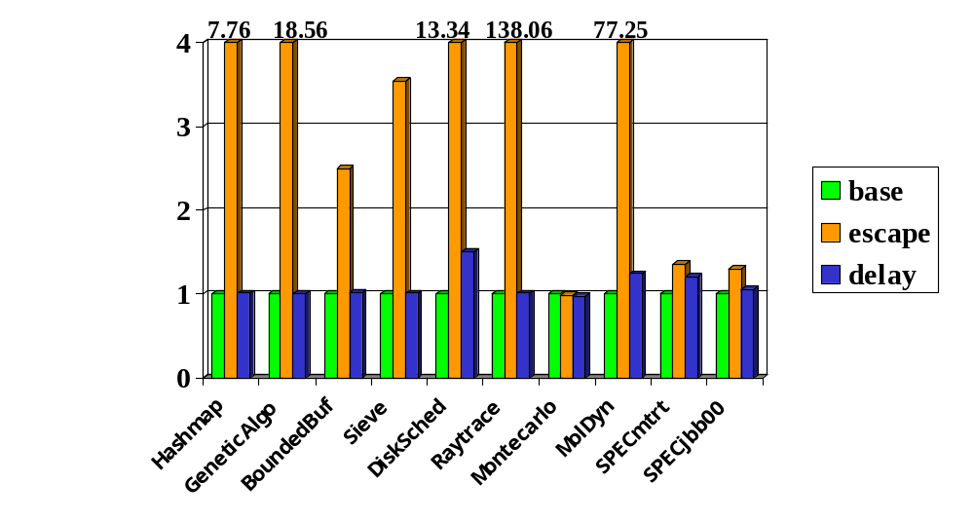
Performance (Intel Xeon)
Slowdown w.r.t. Base
Average Slowdown of 10%

Slide 28
Performance (Intel Xeon)
DiskSched (50%)
  Programmer-defined busy-wait synchronization using volatile variables
MolDyn (24%)
  Individual elements of shared arrays accessed by a single thread
SPECmtrt (21%)
  I/O library
  Adaptive re-compilation for optimization

Slide 29
Number Of Delays (Intel Xeon)
Benchmark
Checked For
Need Enforcing
% Removed
Hashmap
16,089
60
99.6
GeneticAlgo
9,587
367
96.3
BoundedBuf
8,139
884
89.1
Sieve
151,699
1,866
98.8
DiskSched
4,041
58
98.6
Raytracer
17,418
46
99.7
Montecarlo
7,156
153
97.9
MolDyn
13,370
6,924
48.2
SPECmtrt
174,263
28,434
83.7
SPECjbb00
1,415,865
115,580
91.8

Slide 30
Analysis Time (in seconds)
Benchmark
Total Base
Total Delay
Synch
Delay Set
Hashmap
1.3
4.7
0.6
0.1
GeneticAlgo
1.8
4.8
0.8
0.1
BoundedBuf
1.7
2.9
0.3
0.02
Sieve
5.7
8.9
0.2
0.6
DiskSched
1.2
4.9
0.5
0.1
Raytracer
2.6
6.6
0.7
0.1
Montecarlo
2.1
7.2
1.1
0.1
MolDyn
1.8
22.6
0.6
0.7
SPECmtrt
6.6
89.1
9.1
5.5
SPECjbb00
42.8
716.5
33.0
60.1

Slide 31
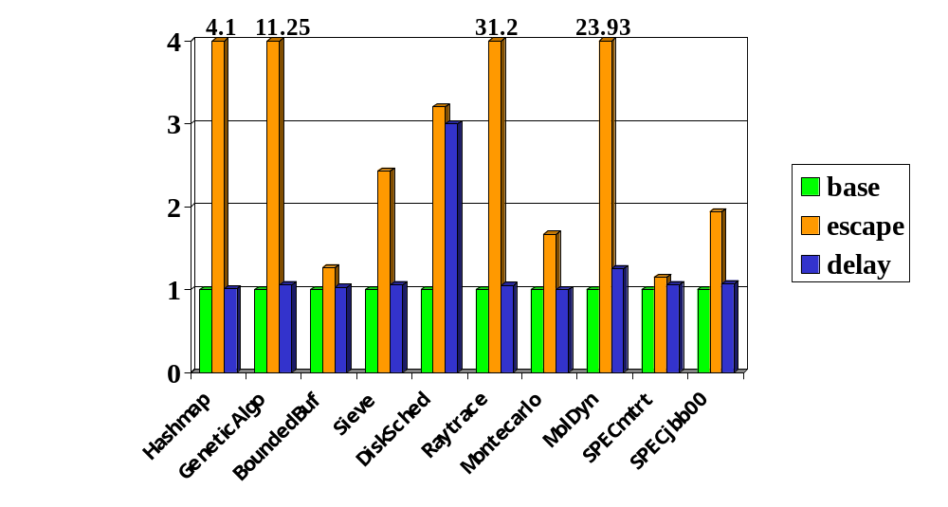
Performance (Power3)
Slowdown w.r.t. Base
Average Slowdown of 26%

Slide 32
Number Of Delays (PowerPC)
Benchmark
Checked For
Need Enforcing
% Removed
Hashmap
17,265
347
98.0
GeneticAlgo
17,664
750
95.8
BoundedBuf
3,890
824
78.8
Sieve
5,256
1,121
78.7
DiskSched
3,296
202
93.9
Raytracer
78,786
47
99.9
Montecarlo
16,568
314
98.1
MolDyn
13,938
6,583
52.8
SPECmtrt
150,501
19,861
86.8
SPECjbb00
1,162,591
88,309
92.4

Slide 33
Conclusion
Our techniques enable fast and effective inter-thread analysis for object-oriented programs using shared memory
Sensitive to accuracy of escape analysis
SC shows average slowdown of 10% on an Intel Xeon platform, and 26% on a Power3 platform
Use SC + defined synchronization primitives?

Slide 34
Related Work
Delay set analysis:
  Shasha and Snir, 88
  Midkiff, Padua, and Cytron, 90
  Krishnamurthy and Yelick, 96
  von Praun, 04
Synchronization analysis
  Netzer and Miller, 90
  Emrath, Ghosh, and Padua, 89
  Duesterwald, and Soffa, 91
  Masticola and Ryder, 93
  Naumovich, Avruninand, and Clarke, 99

Slide 35
Related Work … contd.
Languages and compilers for memory models:
  Pugh, 99
  Lee, Padua, and Midkiff, 99
  Lee and Padua, 00
  Liblit, Aiken, and Yelick, 03
Other
  Gniady, Falsafi, and Vijaykumar, 99
  Praun and Gross, 03

Slide 36
Future Work
Apply analysis to:
  Debug race conditions
  Perform optimizations
    Redundant synchronization removal
    Thread scheduling
    Code specialization
Constructs for a parallel programming language to make the analysis more effective

Slide 37
Thank You!

Slide 38
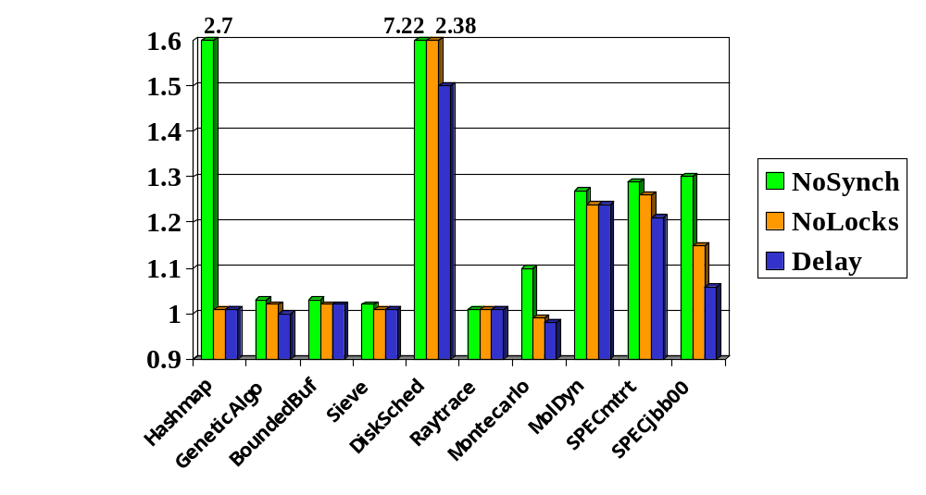
Effect of Synchronization
Slowdown w.r.t. Base
Notes:
Average effect (excluding DiskSched): 24.3% improvement

Slide 39
Analysis Time (no re-compilation)
Benchmark
Total Base
Total Delay
Synch
Delay Set
Hashmap
1.3
4.7
0.6
0.1
GeneticAlgo
1.8
4.8
0.8
0.1
BoundedBuf
1.0
1.7
2.4
2.9
0.2
0.3
0.02
0.02
Sieve
1.0
5.7
2.3
8.9
0.2
0.2
0.02
0.6
DiskSched
1.1
1.2
3.9
4.9
0.5
0.5
0.1
0.1
Raytracer
2.6
6.6
0.7
0.1
Montecarlo
2.1
7.2
1.1
0.1
MolDyn
1.6
1.8
6.6
22.6
0.6
0.6
0.2
0.7
SPECmtrt
5.2
6.6
65.0
89.1
9.1
9.1
3.6
5.5
SPECjbb00
28.4
42.8
212.3
716.5
24.6
33.0
9.9
60.1
Notes:
Mtrt: improvement from 21% to 8.8%
Jbb: improvement from 6% to 2%
MolDyn: degradation of 10%
Montecarlo: degradation of 15%
Raytracer: degradation of 20%

Slide 40
Number Of Fences
Benchmark
Static
Dynamic
Delay
% Escape
Delay
% Escape
Hashmap
6
0.4
62 K
0.0
GeneticAlgo
56
3.9
4,066 K
0.5
BoundedBuf
20
1.6
263,951 K
6.7
Sieve
394
4.0
4,538 K
0.2
DiskSched
9
0.7
50,129 K
9.5
Raytracer
11
0.9
6 K
0.0
Montecarlo
18
1.2
40 K
0.7
MolDyn
78
7.1
26,057 K
1.5
SPECmtrt
970
23.2
3,700 K
39.6
SPECjbb00
2,344
12.0
238,103 K
19.1

Slide 41
Number Of Syncs
Benchmark
Static
Dynamic
Delay
% Escape
Delay
% Escape
Hashmap
23
1.9
129
0.0
GeneticAlgo
76
5.4
2,514 K
0.6
BoundedBuf
25
2.2
13,373 K
9.4
Sieve
94
8.6
4,964 K
2.3
DiskSched
12
1.1
15 K
0.1
Raytracer
4
0.2
1 K
0.0
Montecarlo
56
3.8
106 K
0.1
MolDyn
79
8.2
12,998 K
4.5
SPECmtrt
914
24.5
8,339 K
28.8
SPECjbb00
2,657
15.6
173,385 K
13.0

Slide 42
Analysis Time (in seconds)
Benchmark
Total Base
Total Delay
Synch
Delay Set
Hashmap
4.2
18.2
2.0
0.2
GeneticAlgo
4.8
16.6
2.5
0.3
BoundedBuf
4.1
9.1
0.9
0.03
Sieve
3.4
7.9
0.8
0.1
DiskSched
3.2
13.9
1.7
0.1
Raytracer
8.0
24.3
2.3
0.3
Montecarlo
8.4
25.7
4.7
0.3
MolDyn
4.8
17.5
1.8
0.4
SPECmtrt
14.6
179.7
19.4
12.0
SPECjbb00
47.7
716.7
31.1
45.0

Slide 43
Lock Synchronization
Java synchronized blocks:
  Use monitors to provide mutual exclusion
  Acquire semantics at the beginning
    No memory access is moved ahead of the acquire
  Release semantics at the end
    No memory access is moved past the release
Conflict edge between two accesses protected by the same monitor can be ignored

Slide 44
Using Locks to Eliminate Delays
Applicable in our approximate delay analysis
C
Acquire Lock
Acquire Lock
A
B
A
B
Release Lock
Release Lock
D

Slide 45
Thread Escape Analysis
Iterative, partially context-sensitive
Uses types to accelerate convergence
Distinguishes fields of thread objects
/* X, Y escape */
Call M (X, Y);
/* X, Y escape */
M (u, v) {
/* M causes v to escape only
if u escapes on entry */
}
/* X, Y do not escape */
Call M (X, Y);
/* Y escapes */

Slide 46
Alias Analysis
Two references A and B are assumed to be aliased if:
  Type of A is same as type of B, or
  Type of A is a subtype of B, or
  Type of B is a subtype of A, or
  Type of A implements interface type B, or
  Type of B implements interface type A
No subscript analysis for array accesses

Slide 47
Time Complexity
Time for approximate delay set analysis
  O ( p² * m³ * s )
    p: maximum no. of shared memory accesses in a method
    m: number of methods in the program
    s: number of thread start points + number of locks
Time for synchronization analysis
  O ( n² * s )
    n: total number of shared memory accesses

Slide 48
Space Complexity
Space Required
  O ( (m * t * s) + (i * s) )
    m: number of methods in the program
    t: number of field types in the program
    i: maximum number of instructions in a method
    s: number of thread start points + number of locks

Slide 49
Inferring Orders
Order for any instance of X with respect to any instance of Y
X → Y if this same order is enforced by each thread start() that spawns a thread that may execute X or Y
Notes:
Order??

Slide 50
Method Summary Information
Summarize analysis results for each method:
  Over all read accesses of a given type
  Over all write accesses of a given type
  Over all accesses, direct or indirect

Slide 51
Assumptions
Hardware supports atomicity requirement
  Intermediate states of a write not visible
Semantics of sync/fence instructions
  Enforce sequential consistency when correctly inserted
Thread 1
Thread 2
Thread 3
S1
A=1
t1=A
S2
B=1
S3
t2=B
S4
t3=A
S5

Slide 52
Shared Memory Programming
Need to reason about access orders
Initially X=0 and Y=0
An Execution
Thread 1
Thread 2
X = 5;
(1) X = 5;
Y = 1;
While (Y == 0)
;
(4) Print X;
Y = 1;
While (Y==0);
Print X;
Execution order (1), (2), (3), (4) → value printed
= 5
Notes:
Second execution order is allowed under the Java memory model.
Say, assume sequential consistency…don’t sat “can’t reorder” otherwise

Slide 53
Shared Memory Programming
Need to reason about access orders
Initially X=0 and Y=0
An Execution
Thread 1
Thread 2
Y = 1;
(1) X = 5;
Y = 1;
While (Y == 0)
;
(4) Print X;
While (Y==0);
Print X;
X = 5;
Execution order (1), (2), (3), (4) → value printed = 5
Execution order (2), (3), (4), (1) → value printed
= 0
Notes:
Second execution order is allowed under the Java memory model.
Say, assume sequential consistency…don’t sat “can’t reorder” otherwise

Slide 54
Memory Consistency Models
Ordering Constraints
STRONG
Sequential Consistency (SC)
RELAXED (RC)
Jikes RVM Consistency
Weak Consistency
Release Consistency
Processor Consistency

Slide 55
Inferring Orders - 2
(T(S) may start after Y, T(S) may finish before Y, T(S) may be concurrent Y)
Access Y
(F F F)
(F F T)
(F T F)
(F T T)
(T F F)
(T F T)
(T T F)
(T T T)
Access X
(F F F)
X → Y
Y → X
(F F T)
X → Y
Y → X
(F T F)
Y → X
Y → X
[Y → X]
Y → X
Y → X
(T(S) may start after X,T(S) may finish before X,T(S) may be concurrent X)
(F T T)
[X → Y]
Y → X
(T F F)
X → Y
X → Y
X → Y
X → Y
[X → Y]
(T F T)
X → Y
[Y → X]
(T T F)
(T T T)

Slide 56
Inferring Orders - 2
Conflict edges between accesses in different threads:
  Determine order for some conflict edges
T(S) may start after Y = T
T(S) may finish before Y = F
T(S) may be concurrent Y = F
Y
Single Thread
T(S) may start after X = T
T(S) may finish before X = F
T(S) may be concurrent X = F
X
S
Thread started
S
Y
T(S) may start after Y = F
T(S) may finish before Y = F
T(S) may be concurrent Y = F
T(S) may start after Y = F
T(S) may finish before Y = F
T(S) may be concurrent Y = T
Y
Notes:
Order??

Slide 57
Example
T(D) start after A = true
T(D) finish before A = false
T(D) concurrent A = false
A
Main thread
Method Z
B: call Z
F
C
Thread Y
D: start Y
E: call Z

Slide 58
Example - step 1
T(D) start after A = true
T(D) finish before A = false
T(D) concurrent A = false
A
Main thread
Method Z
T(D) start after B = true
T(D) finish before B = false
T(D) concurrent B = false
B: call Z
F
T(D) start after F = true
T(D) finish before F = false
T(D) concurrent F = false
C
Thread Y
D: start Y
E: call Z

Slide 59
Example - step 2
T(D) start after A = true
T(D) finish before A = false
T(D) concurrent A = false
A
Main thread
Method Z
T(D) start after B = true
T(D) finish before B = false
T(D) concurrent B = false
B: call Z
F
T(D) start after F = true
T(D) finish before F = false
T(D) concurrent F = false
T(D) start after C = true
T(D) finish before C = false
T(D) concurrent C = false
C
T(D) start after D = true
T(D) finish before D = false
T(D) concurrent D = false
Thread Y
D: start Y
E: call Z

Slide 60
Example - step 3
T(D) start after A = true
T(D) finish before A = false
T(D) concurrent A = false
A
Main thread
Method Z
T(D) start after B = true
T(D) finish before B = false
T(D) concurrent B = false
B: call Z
F
T(D) start after F = true
T(D) finish before F = false
T(D) concurrent F = false
T(D) start after C = true
T(D) finish before C = false
T(D) concurrent C = true
C
T(D) start after D = true
T(D) finish before D = false
T(D) concurrent D = false
Thread Y
T(D) start after E = false
T(D) finish before E = false
T(D) concurrent E = false
D: start Y
E: call Z

Slide 61
Example - step 4
T(D) start after A = true
T(D) finish before A = false
T(D) concurrent A = false
A
Main thread
Method Z
T(D) start after B = true
T(D) finish before B = false
T(D) concurrent B = false
B: call Z
F
T(D) start after F = true
T(D) finish before F = false
T(D) concurrent F = true
T(D) start after C = true
T(D) finish before C = false
T(D) concurrent C = true
C
T(D) start after D = true
T(D) finish before D = false
T(D) concurrent D = true
Thread Y
T(D) start after E = false
T(D) finish before E = false
T(D) concurrent E = true
D: start Y
E: call Z

Slide 62
Example Orders - 1
T(D) start after A = true
T(D) finish before A = false
T(D) concurrent A = false
A
Main thread
Method Z
T(D) start after B = true
T(D) finish before B = false
T(D) concurrent B = false
B: call Z
F
T(D) start after F = true
T(D) finish before F = false
T(D) concurrent F = true
T(D) start after C = true
T(D) finish before C = false
T(D) concurrent C = true
C
T(D) start after D = true
T(D) finish before D = false
T(D) concurrent D = true
Thread Y
T(D) start after E = false
T(D) finish before E = false
T(D) concurrent E = true
D: start Y
E: call Z

Slide 63
Example Orders - 2
T(D) start after A = true
T(D) finish before A = false
T(D) concurrent A = false
A
Main thread
Method Z
T(D) start after B = true
T(D) finish before B = false
T(D) concurrent B = false
B: call Z
F
T(D) start after F = true
T(D) finish before F = false
T(D) concurrent F = true
T(D) start after C = true
T(D) finish before C = false
T(D) concurrent C = true
C
T(D) start after D = true
T(D) finish before D = false
T(D) concurrent D = true
Thread Y
T(D) start after E = false
T(D) finish before E = false
T(D) concurrent E = true
D: start Y
E: call Z

Slide 64
Example Orders - 3
T(D) start after A = true
T(D) finish before A = false
T(D) concurrent A = false
A
Main thread
Method Z
T(D) start after B = true
T(D) finish before B = false
T(D) concurrent B = false
B: call Z
F
T(D) start after F = true
T(D) finish before F = false
T(D) concurrent F = true
T(D) start after C = true
T(D) finish before C = false
T(D) concurrent C = true
C
T(D) start after D = true
T(D) finish before D = false
T(D) concurrent D = true
Thread Y
T(D) start after E = false
T(D) finish before E = false
T(D) concurrent E = true
D: start Y
E: call Z

Slide 65
Example Orders - 4
T(D) start after A = true
T(D) finish before A = false
T(D) concurrent A = false
A
Main thread
Method Z
T(D) start after B = true
T(D) finish before B = false
T(D) concurrent B = false
B: call Z
F
T(D) start after F = true
T(D) finish before F = false
T(D) concurrent F = true
T(D) start after C = true
T(D) finish before C = false
T(D) concurrent C = true
C
T(D) start after D = true
T(D) finish before D = false
T(D) concurrent D = true
Thread Y
T(D) start after E = false
T(D) finish before E = false
T(D) concurrent E = true
D: start Y
E: call Z

Slide 66
Design of our Delay Set Analysis
Simple and efficient
Determine absence of delay edges
Use synchronization orders

Slide 67
Compiler for SC
Average Slowdown of 32.2 times
Source Java
Program
Hardware
Memory Model
Jikes RVM Escape Analysis
Program
Analysis
Ordering
Constraints
Code Re-ordering and Code
Elimination Transformations
Jikes
RVM
Barrier Insertion and Optimization
Target Machine Code

Slide 68
Compiler for SC - II
Average Slowdown of 26.5 times
Source Java
Program
Hardware
Memory Model
Our Escape Analysis
Program
Analysis
Ordering
Constraints
Code Re-ordering and Code
Elimination Transformations
Jikes
RVM
Barrier Insertion and Optimization
Target Machine Code

Slide 69
From Theory to Practice
Find ‘critical’ cycles in access order graph [1]
NP-hard [2]
Precision depends on accuracy of the graph
  Memory ambiguation
  Numerous or unknown no. of threads
  Program control flow: loops and branches
  Program synchronization effects
[1] Shasha and Snir, Transactions on Programming Languages and Systems, 88
[2] Krishnamurthy and Yelick, Journal of Parallel and Distributed Computing, 96
Notes:
Need heuristics bec of NP-complete

Slide 70
Thread Structure Analysis
For each thread start() statement S,
For each program point P,
  May a thread started at S be started after P?
    T(S) may start after P
  May all threads started at S finish before P?
    T(S) may finish before P
  May a thread started at S be concurrent with P?
    T(S) may be concurrent P

Slide 71
Thread Join Calls
Have an effect only when matched with a thread start call
Change the ordering information for their corresponding start calls

Slide 72
Applying Analysis Results
Derive relative order of any two program statements, X and Y, from
  orders of thread starts and joins w.r.t. X
  orders of thread starts and joins w.r.t. Y
“Must” from “may”:
  T(S) start after X = true, and
  T(S) finish before X = false, and
  T(S) concurrent X = false
T(S) must
happen after X

Slide 73
Simplified Delay Set Analysis
Delay from A to B if:
  A and B are thread escaping, and
  Conflict edge between A and some access X, and
  Conflict edge between B and some access Y, and
  B may occur before X and Y in an execution, and
  Y may occur before X in an execution, and
  X and Y may occur before A in an execution
A
conflict edge
Y
Program edge to
test for delay
Some path that
completes cycle
B
conflict edge
X

