Slide 1
System and Method for Runtime Estimation of Machine Learning Jobs
Invention Reference: P201705005

Slide 2
Background
Machine learning service is offered by major cloud services providers (CSPs)
IBM Watson Machine Learning; Amazon Sagemaker, Google Cloud Machine Learning Engine, Microsoft Azure
Support building, training, deployment, and inferencing
Resource scaling, full life cycle management, fault tolerance, monitoring, object storage
Performance of machine learning jobs depend on :
Model
Model size, number of layers, number of neurons per layer, interconnection topology
Type: Deep Belief Networks (DBNs), Convolutional Neural Networks (CNNs), Recurrent Neural Netwroks (RNNs)
Alexnet, Resnet, Googlenet, Phalanx
Model Framework
Caffe, Caffe2, Torch, Pytorch, Tensorflow, Theano
Dataset
Training and testing dataset: modality, size, encoding
Imagenet, Placesdb, Food101, Trec
Training framework and hyperparameters: Single node/distributed, batch size, learning rate
Resource configuration
Cpu, gpu (number and interconnection topology), memory, storage, network
Support of multiple service classes by CSPs: pre-emption of low priority jobs by high priority jobs (e.g., free vs paid)

Slide 3
Problem Definition
End users would like to know how long their ML job will last
Cost-performance tradeoffs
Resource scaling decisions
Selecting service classes
Runtime of a job is a complex function of many factors
Shared infrastructure and priority based scheduling further complicate runtime estimation

Slide 4
Our Invention
Core Idea: System and method for offline and online runtime estimation of machine learning jobs
Novelty:
Accounts for different factors affecting runtime of ML jobs: workload (model, model framework, training dataset, testing dataset, training framework, hyperparameters, hardware resources)
Accounts for possible queueing in cloud environments: unavailability of resources, scheduling delays
Accounts for pre-emption in cloud environments supporting priority classes and halt/resume of ML jobs

Slide 5
Main Components: Offline Estimation
Job signature extractor: Extracts a set of features which uniquely defines a machine learning job. Different frameworks (Caffe, Tensorflow, Torch,…) store model meta-data in different formats. <model,trainingdata,framework>
Training job artifacts store: Stores training logs and associated model files (model definition file, job manifest file)
Historical training metadata database: Different models specify their model and training logs in different formats. We need framework specific parsers for extracting training job metadata. These parsers work on training logs and model files stored in artifacts store and extract training metadata.
Job clustering engine: Employs algorithms to cluster historical jobs based on similar runtime performance
Job classification engine: Matches a job to a historical job or a cluster of jobs
Performance modeling engine: Runtime estimation models for different workloads. The models capture the functional dependence of runtime on different machine learning jobs parameters, hyperparameters, pre-emption probability, queueing.

Slide 6
Main Components: Online Estimation
Job signature extractor: same as in offline
Monitoring engine: monitors training jobs and extracts per iteration time
Performance modeling engine: takes online measurement of per iteration time and estimate remaining run-time for current and other possible scaling options by accounting for possible pre-emption, queueing, shared resource (network,cpu,memory) utilization.

Slide 7
Sample Embodiment: Offline Estimation
Performance Model Based Runtime Estimation
<{f1,f2,…,fn}, iteration time>
<[{f1,f2,…,fn,..,fm}, iteration time]>
<[{g1,g2,…,gn,..,gm}, iteration time]>
<runtime estimate(s)>
<{f1,f2,…,fn}>
Job Clustering and Classification
<get runtime, model-id>
Job Signature Extractor
<iteration time>
<[{f1,f2,…,fn,..,fm}, iteration time]>
<[{g1,g2,…,gn,..,gm}, iteration time]>
<model-id>
<manifest file, model files>
Historical Training Metadata
Database
Training Job Artifacts Store
(training logs and model files)

Slide 8
Sample Embodiment: Online Estimation
Model Based Runtime Estimation
<model-id>
Monitoring Engine
(Job and Resource)
<iteration time>
<{f1,f2,…,fn}>
<runtime estimate(s)>
<get runtime, model-id>
Job Signature Extractor
<model-id>
<manifest file, model files>
Training Job Artifacts Store
(training logs and model files)

Slide 9
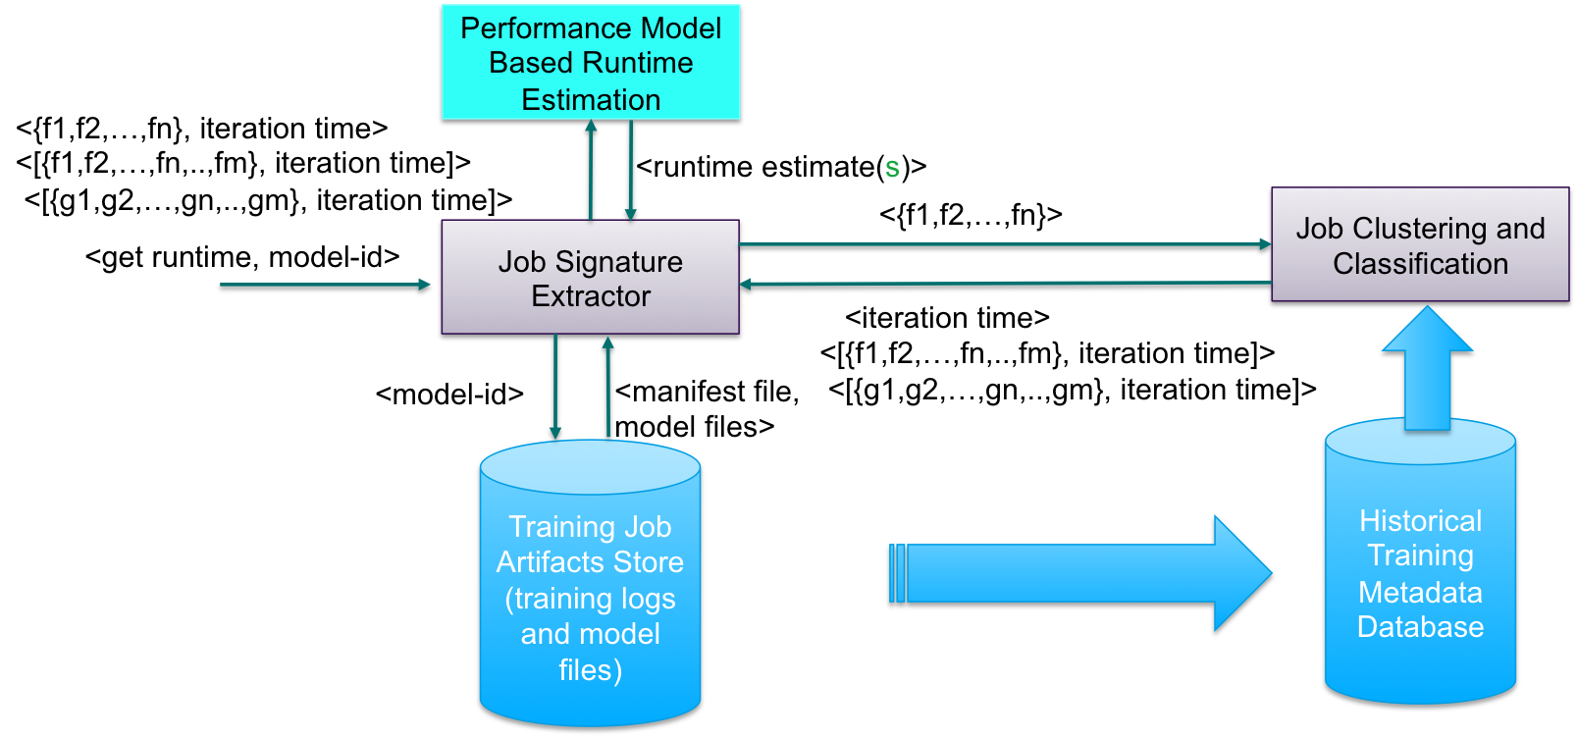
Sample Profiler Component
Used for bootstrapping runtime estimates, especially for non-standard/custom-coded neural network codes
Can be invoked on-demand by the runtime estimator
Invoked initially to get an accurate time estimate on some reference compute device
Invoked periodically during a run (to adapt to dynamic conditions)
Sample profiler takes as input the model-id, and returns as output a reference time estimate:
Derives a sample job from the original user job, but with a fixed small number of iterations
Determines input data size for the sample job, and generates and loads dummy data
Runs the sample job on the reference compute device and records timing
Reference time estimate is used by the Runtime Estimation module to project time estimates for different run configurations
<model-id>
Sample
Profiler
<runtime
estimate(s)>

Slide 10
Accuracy Target (incorporated in Online Monitoring Engine Component)
Problem: Training can take a long time, and model development is an iterative process: users train one model version, then based on the result they tweak parameters to get a new model version, and repeat. The process involves continuously monitoring the accuracy attained as model training progresses to decide whether to stop training early:
because accuracy reached some target value
because accuracy plateaued or reduced over some length of training interval
Solution: Instead of users monitoring the accuracy attained, let them specify stop-conditions based on accuracy A, e.g.:
A >= absolute-value
A >= absolute-value for last m of n test-iterations
X-delta <= A <= X+delta for last n test-iterations, for specified delta and any value of X (plateau condition)
Online monitoring engine automatically keeps track of accuracy conditions specified by the user
If a condition is met, the job is paused, and the user is alerted
The user can then take appropriate action:
Terminate the job
Modify hyper-parameters and resume the job

Slide 11
Invention Uses Cases
End-users
To compare different resource configurations options before submitting their job to obtain trade-offs regarding the price and performance of their jobs
To monitor remaining runtime of their job
To auto-scale their running job (change number of learners/gpus, etc.) based on remaining runtime estimates
Service providers
To differentiate among job containers to be preempted by accounting for the demand of a job, where the demand of a job is the number of requested resources and the duration of the time for which they will be occupied
To differentiate among jobs that could be preempted when there is not enough capacity by assigning bid values to them, e.g., to avoid preemption of jobs which are close to finish or short jobs.
Provide updated runtime estimates for current configuration and other possible scaling options

Slide 12
Prior Work: Patents
Cloud Job Runtime Estimation: https://patents.google.com/patent/WO2012005611A1/en?q=runtime&q=estimation&q=cloud&q=jobs
Systems and methods for profiling an application running on a parallel-processing computer system: https://patents.google.com/patent/US20070294681A1/en?q=estimating&q=job+execution&q=times&q=parallel&q=computing
No prior patents on runtime estimation for ML jobs

Slide 13
Prior Work: Papers
Some prior work is on runtime estimation of cloud computing jobs
JamaisVu: Robust Scheduling with Auto-Estimated Job Runtimes: http://www.pdl.cmu.edu/PDL-FTP/CloudComputing/CMU-PDL-16-104.pdf
Forming SPN-MapReduce Model for Estimation Job Execution Time in Cloud Computing https://dl.acm.org/citation.cfm?id=3100838.3100903
Using Straggler Replication to Reduce Delay in Large-Scale Parallel Computing: https://dl.acm.org/citation.cfm?id=2847223
ML training time is inherently different from standard cloud computing jobs. Algorithm parameters such as mini-batch size, model size, number of layers, neurons per layer etc. need to be considered.

