Slide 1

Literature Review and Treatment Recommendations for HIV-Positive Black Women
Zehuan Yu
July 27, 2024
Notes:
I will be presenting my research on Literature Review and Treatment Recommendations for HIV-Positive Black Women

Slide 2
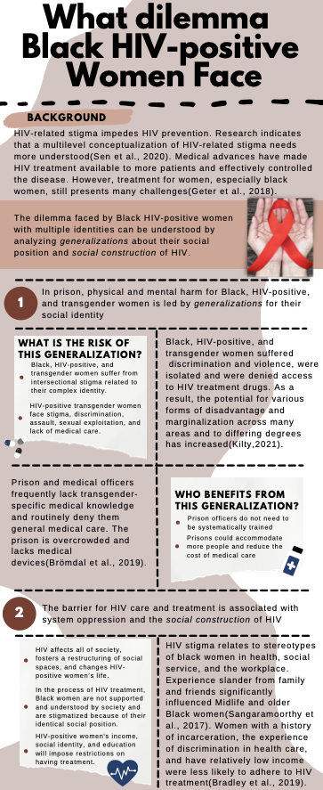
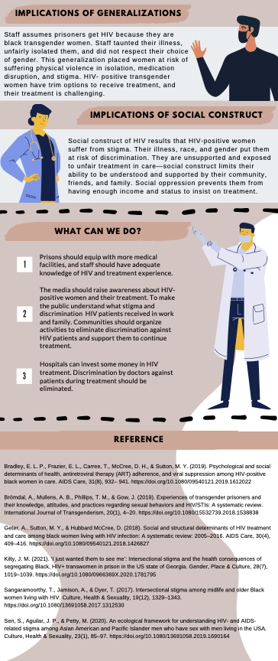
Into
Notes:
I chose this topic because in my first year in umich, I took a course about women health. My final project is what dilemma black HIV-positive women face. This is the poster I made for my project. Black HIV-positive women are losing their jobs. They are not supported and understood by the whole society. They are suffering discrimination and lacking correct treatment. Their illness, race and gender put them in risk. They need more attention. They need help. So from that time, I started to care about this population and their unique challenges.

Slide 3
Outline
Challenges faced by HIV-positive Black women.
Wodarz and Nowak model
Model Modification
Simulation
Treatment Recommendation
Notes:
In this presentation, I will cover the following topics: the challenges faced by HIV-positive Black women, an overview of the Wodarz and Nowak model, modifications to the model to include socio-economic factors, the results of my simulations, and finally, the treatment recommendations based on my findings."

Slide 4
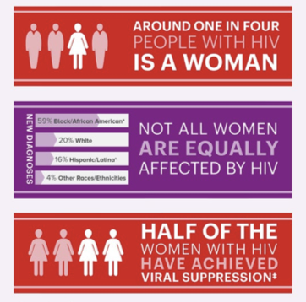
Challenges for Black women
Barriers:
Socio-economic disadvantages.
Healthcare access issues.
Cultural stigmas.
Impact:
Increased risk of drug resistance.
Lower adherence to ART treatment.
Notes:
HIV remains a significant public health issue, particularly among Black women who face higher infection rates and unique socio-economic challenges. These challenges include socio-economic disadvantages, limited access to healthcare, and cultural stigmas. As a result, Black women with HIV are at a higher risk of drug resistance and have lower adherence to ART treatment. Addressing these challenges is crucial for improving their health outcomes

Slide 5
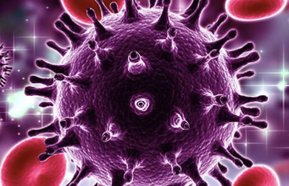
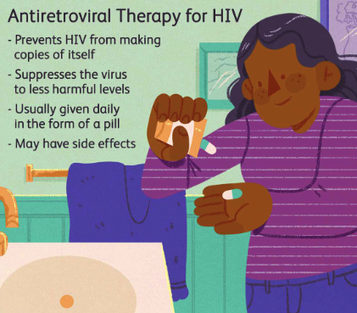
Biological Background
HIV attacks CD4+ T cells which has a primary role in the generation of immune response
CTLs: Cytotoxic T Lymphocytes kill infected cells
CTLp: Potential CTLs
CTLe: Effector cells derived from CTLp cells
ART treatment reduce viral load and preserve CD4+ T cells
Notes:
Here are all the bio concepts I’m going to use in modeling. We have introduced them in lecture before, but let me clarify their meanings here again.
HIV attacks the immune system, specifically CD4+ T cells, leading to a gradual decline in immune function and increased susceptibility to opportunistic infections.
CD4+ T cells are crucial components of the immune system, acting as ”helper” cells that trigger the body’s response to infections.
CTLp cells are immature T cells that have the potential to CTLs upon activation. These cells play a crucial role in the immune response to viral infections.
When CTLp cells recognize antigens presented by infected cells, they proliferate and differentiate into CTLs, which are capable of directly killing infected cells.
CTLe cells are the effector cells derived from CTLp cells. CTLe cells are responsible for identifying and destroying infected cells by recognizing viral peptides presented on the surface of these cells.
A robust CTL response can significantly reduce the viral load by killing infected cells and preventing the production of new virions.
ART treatment will reduce viral load and preserve CD4+ T cells. This create an environment where CTLs can operate more effectively and is crucial for controlling the infection and preventing the progression of the disease.

Slide 6

Wodarz and Nowak model
The first model of Wodarz and Nowak considers three state variables inside a whole body model.
x: Dynamics of the concentration of healthy CD4+ cells
y: Dynamics of the concentration of infected CD4+ cells
v: The concentration of free virions
Notes:
The first model of Wodarz and Nowak
The first equation represents the dynamics of the concentration of healthy CD4+ cells (x);
λ represents the rate at which new CD4+ T- cells are generated.
The death rate of healthy cells is d.
In case of active HIV infection the concentration of healthy cells decreases proportionally to the product βxv, where β represents a coefficient depending to various factors, as the velocity of penetration of virus into the cells, frequency of encounters between uninfected cells free virus, etc.
The second equation describes the dynamics of the concentration of infected CD4+ cells (y); β is the rate of infection, a is the death rate of infected cells.
The last equation describes the concentration of free virions (v), they are produced by the infected cells at a rate k, u is the death rate of the virions.

Slide 7
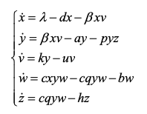
Wodarz and Nowak model
The final model of Wodarz and Nowak
w: Dynamics of precursors of cytotoxic T- lymphocytes CTLp
z: Responsible of development of an immune memory, and effectors of cytotoxic T-lymphocytes CTLe
Notes:
Wodarz and Nowak add a more comprehensive representation of the immune response to HIV infection. Two differential equations are added to the first model.
The fourth function W describe the dynamics of precursors of CTLp.
c indicates the proliferation rate of CTLp due to interactions with infected cells, showing how the presence of infection stimulates immune responses.
q represents the conversion rate of CTLp to CTLe, illustrating the maturation process of immune cells to their active form.
b is the death rate of CTLp
Z describe the responsible of the development of an immune memory, and effectors of cytotoxic T-lymphocytes CTLe . h is the death rate of CTLe

Slide 8
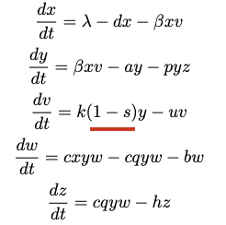
modification
"s” represent socio-economic factors, affecting the rate of ART adherence and efficacy.
“s” ranges from 0 to 1
Notes:
To improve the model’s relevance for Black women, we propose incorporating factors that affect this population uniquely. We introduce a new parameter s, representing socio-economic factors, affecting the rate of ART adherence and efficacy.
In the original model, the term ky in the equation for dv\dt represents the production rate of free virions from infected CD4+ T cells. Here, k is the rate constant for virion production. This term indicates that the number of free virions produced is directly proportional to the number of infected CD4+ T cells.
By modifying the term to k(1−s)y, we introduce a factor that adjusts the production rate of free virions based on socio-economic status.
The term 1−s adjusts the virion production rate. When s is higher, indicating better socio-economic conditions, the effective production rate k(1−s) decreases.
s ranges from 0 to 1. s=0 represents the worst socio-economic conditions, where the production rate of free virions remains at its maximum, k.
s=1 represents the best socio-economic conditions, where the production rate of free virions is minimized, potentially reaching zero.

Slide 9
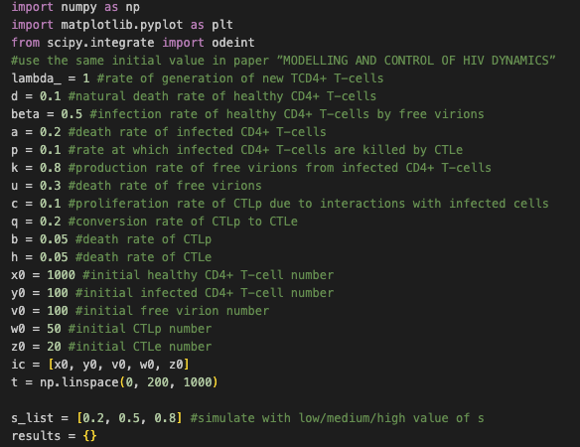
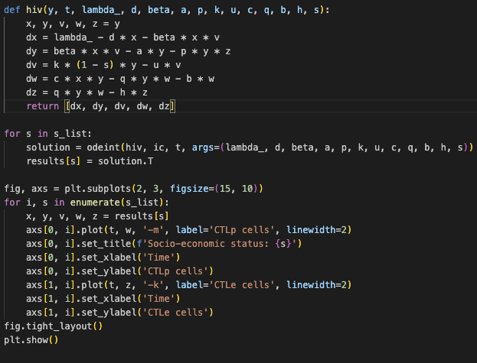
Notes:
To simulate this model, I solved the model with different values of the socio-economic parameter s.
The left picture is the initial value I used. They are from the paper ”MODELLING AND CONTROL OF HIV DYNAMICS”
The right picture is the ode equations and I used python to solve it with s = 0.2/0.5/0.8

Slide 10
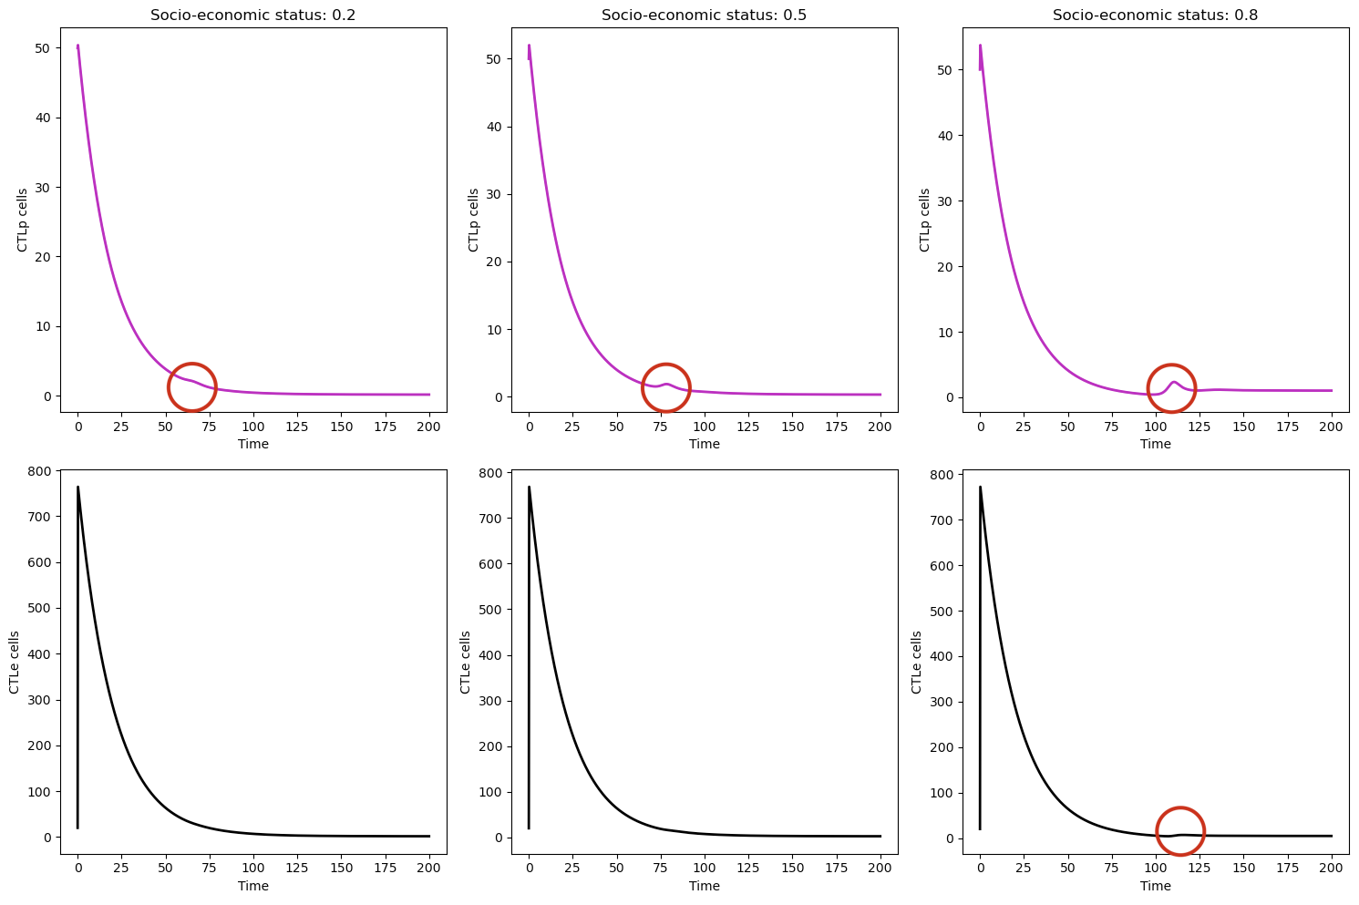
Notes:
Upper row:
For low socio-economic status (s=0.2), the number of CTLp cells rapidly declines from an initial value of 50 to near zero within the first 50 days.
This rapid decline suggests that in conditions of low socio-economic status, the precursor CTLp cells are not sustained effectively, possibly due to poor adherence to ART and limited healthcare access.
For medium socio-economic status (s=0.5), the CTLp cell count also declines quickly, but there is a slight stabilization around the 75 days unit mark before it approaches zero.
This status shows some improvement in the sustenance of CTLp cells compared to low status.
For high socio-economic status (s=0.8), The CTLp cells initially decline rapidly but show a slight resurgence around 100 days units before finally stabilizing close to zero.
this provides the best outcomes among the three conditions. There is an initial decline in CTLp cells, but the slight resurgence suggests better ART effectiveness and healthcare support.
Bottom row:
The number of CTLe cells drops sharply from an initial count of 700 to near zero within the first 50 days. High socio-economic status results in the best outcomes for CTLe cell dynamics. The initial decline is followed by a stabilization, indicating a more effective and sustained immune response due to better ART adherence and healthcare support.
The key findings of this study are that higher socio-economic status leads to better ART adherence, a more robust immune response, and improved control of the virus. This underscores the importance of addressing socio-economic disparities in HIV treatment.

Slide 11

result
Higher socio-economic status leads to better ART adherence, stronger immune response and improved viral control.

Slide 12

Treatment recommendation
Enhance access to healthcare through affordable plans.
Establish mobile health clinics in underserved areas.
Employ community health workers for ART adherence support.
Provide medication adherence tools.
Improve cultural competency in healthcare.
…
Notes:
Based on these findings, we can see the socio-economic status significantly influences the effectiveness of ART and the immune response in HIV-positive individuals.
To improve outcomes for HIV-positive Black women, I recommend enhancing access to healthcare through affordable coverage plans, establishing mobile health clinics, employing community health workers, providing medication adherence tools such as reminder apps, and improving cultural competency in healthcare. These steps will significantly improve ART adherence for HIV-positive Black women.

Slide 13

Conclusion
Importance of considering socio-economic factors in HIV treatment.
Better prediction of treatment outcomes with refined models.
Need for multi-faceted treatment strategies to address socio-economic disparities.
Notes:
In conclusion, socio-economic factors play a critical role in the treatment and management of HIV among Black women.
By incorporating these factors into existing mathematical models, we can better predict treatment outcomes and develop more effective interventions.
Future research should focus on refining these models and implementing multi-faceted treatment strategies to address socio-economic disparities.
I wish more people would pay attention to black HIV-positive women . More attention leads to more research and more help.

Slide 14

Q&A

Slide 15
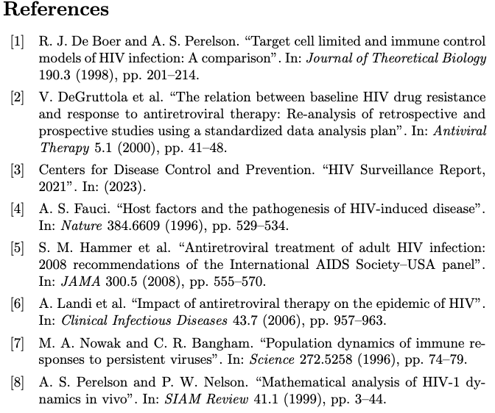
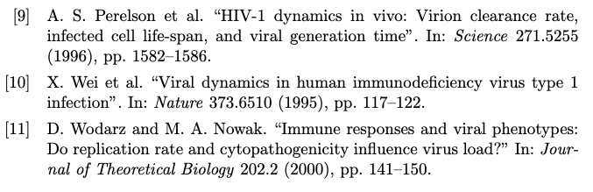

Slide 16

Thank You

