Slide 1
Quantum Probability and entanglement
Zehuan Yu

Slide 2
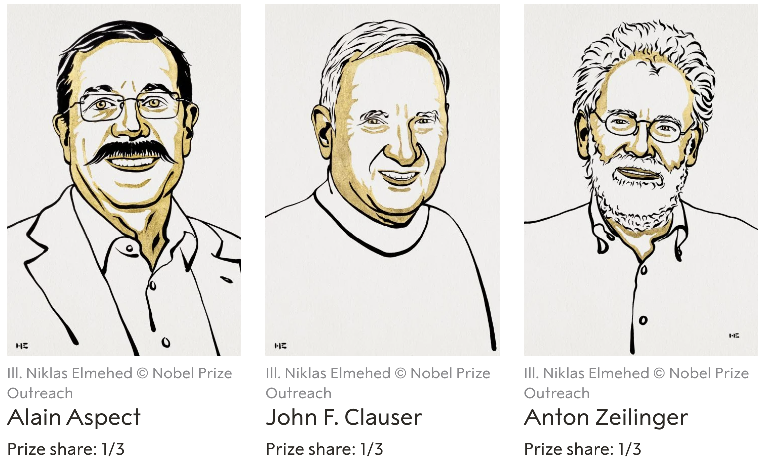
The Nobel Prize in Physics 2022
The Nobel Prize in Physics 2022 was awarded jointly to Alain Aspect, John F. Clauser and Anton Zeilinger “for experiments with entangled photons, establishing the violation of Bell inequalities and pioneering quantum information science”.

Slide 3
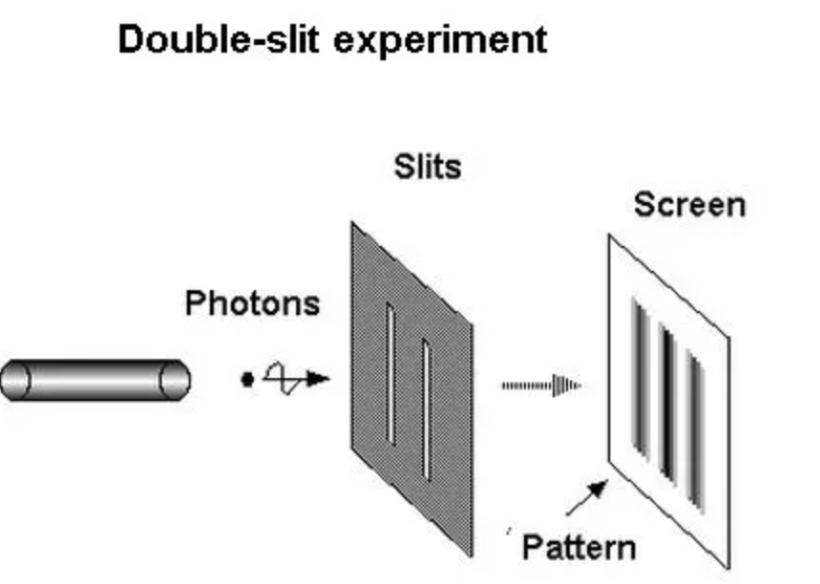
The photon is in a superposition state.
Two possible outcomes have–ideally– equal amplitudes until its position is determined.

Slide 4
Einstein
“God does not play dice.”
He disliked the idea that the laws of nature were inherently probabilistic
Hidden variables theory
Some variables let photon detect another slits; It shows interference pattern because it knows there is another slit.

Slide 5
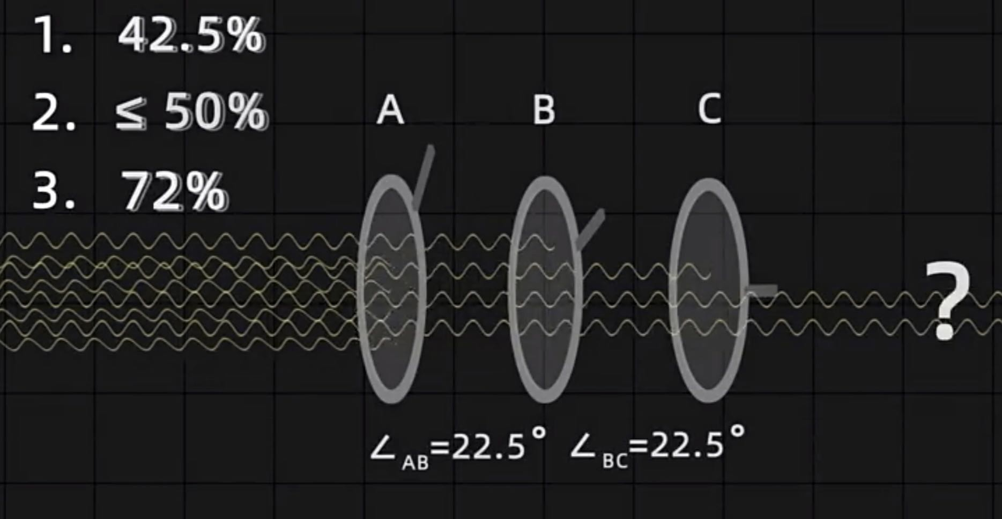
=85%*50%
=85%*85%

Slide 6
Entangled particles
Alain’s example: Twins with same eye color. If we saw one of them have blue eyes, we know the other.
The eye color is in superposition state before we observed.
Transfer is faster than light.
Einstein: Not in superposition. It’s bule but we didn’t know.

Slide 7
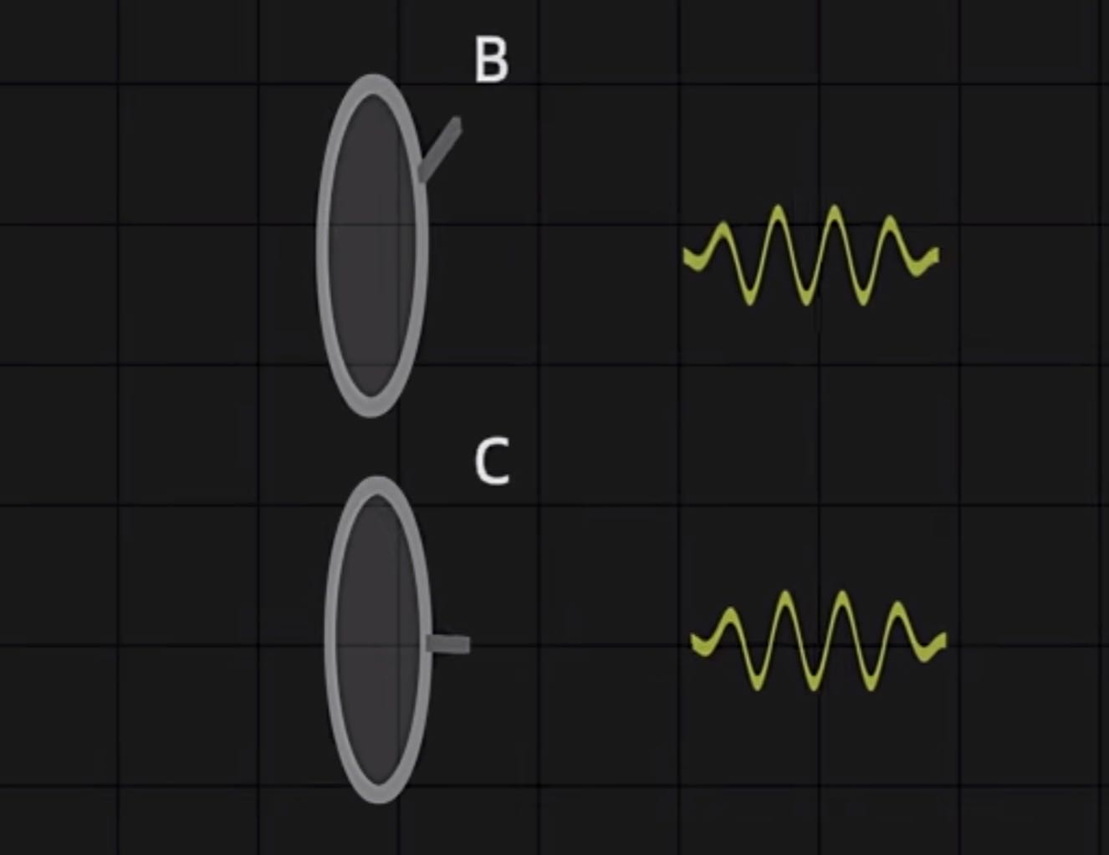
What’s the Probability of passing both B and C
85%
Two entangled photons
The same properties passing through filters.
85%*50%？-Classical
85%*85%？-Quantum
50%

Slide 8
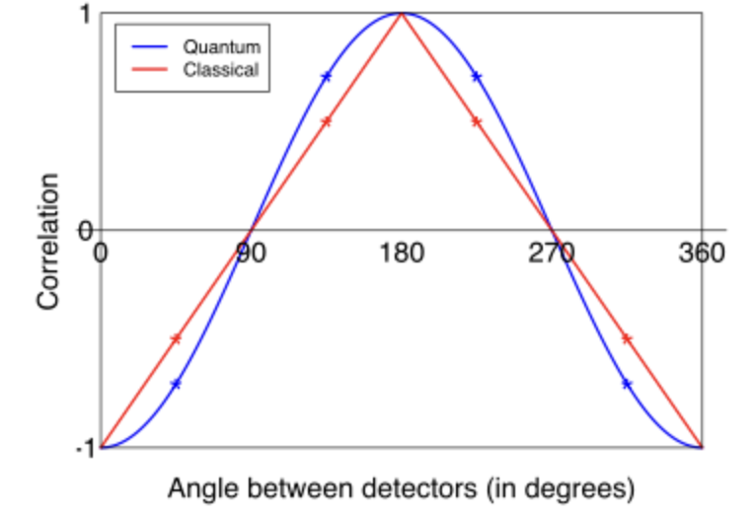
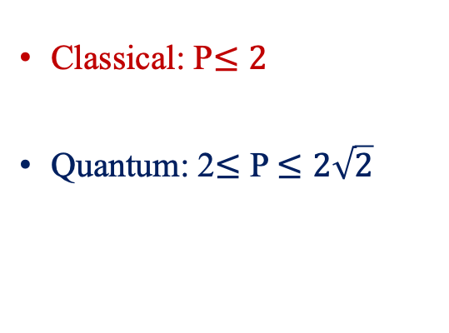
Bell's inequality
Classical: P$≤2$
Quantum: 2$≤$ P $≤2\sqrt{2}$

Slide 9
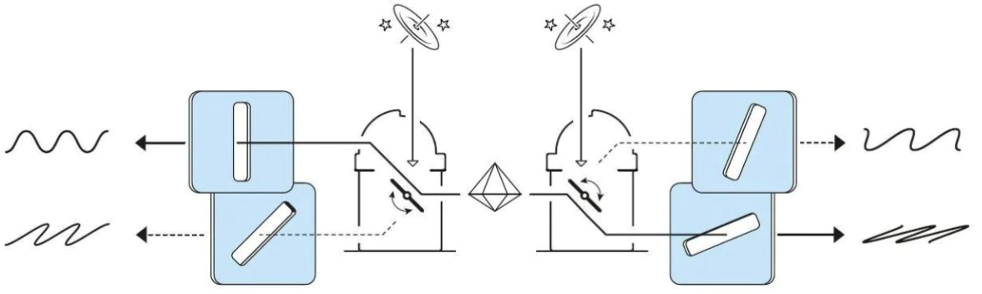
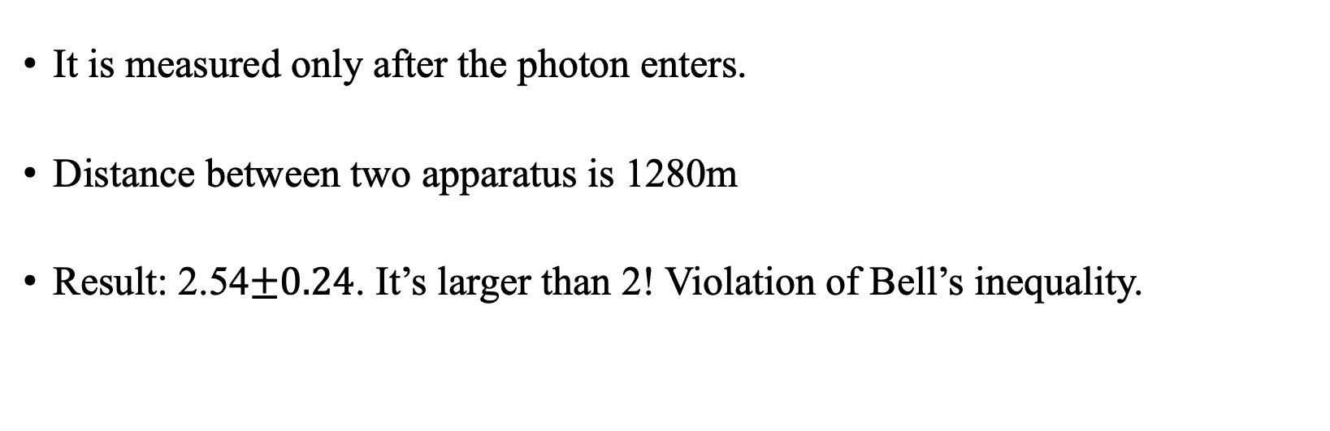
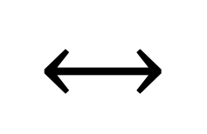
$$⟷$$
1280m
It is measured only after the photon enters.
Distance between two apparatus is 1280m
Result: 2.54$±0.24$. It’s larger than 2! Violation of Bell’s inequality.

Slide 10
Conclusion
Quantum probability
Quantum entanglement and Bell’s inequalities
Experiments with entangled photons

Slide 11
Citations
https://plato.stanford.edu/entries/qt-quantlog/
https://www.quantamagazine.org/where-quantum-probability-comes-from-20190909/
https://www.nobelprize.org/prizes/physics/2022/summary/
https://www.unive.it/pag/16575/?no_cache=1&tx_news_pi1%5Bnews%5D=13244&tx_news_pi1%5Bcontroller%5D=News&tx_news_pi1%5Baction%5D=detail

