Slide 1
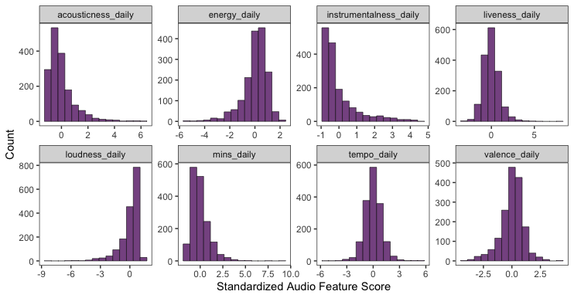

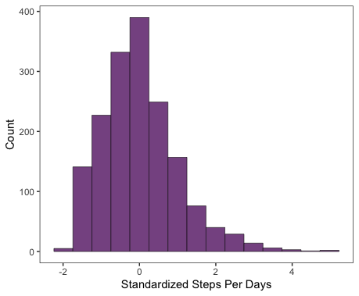

Trends in music?
Trends in steps?

Slide 2
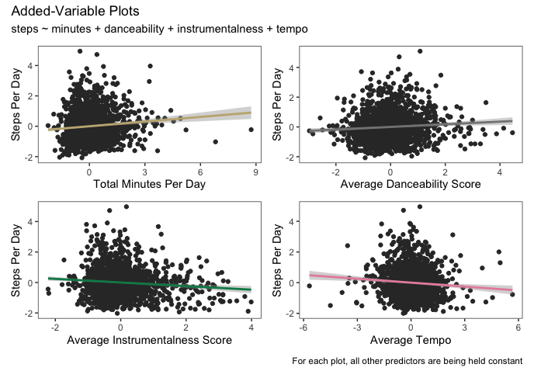
1. Can a specific combination of audio features explain how active I am?

Slide 3
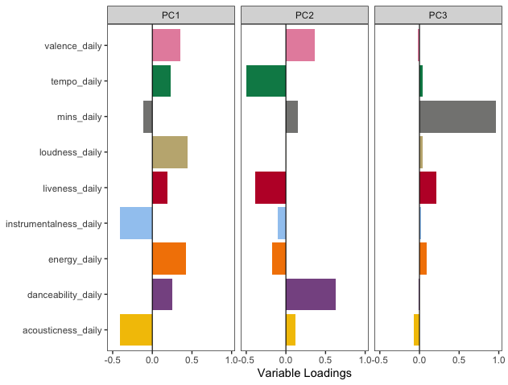
2. Are there groupings of audio features that describe the variance in my data?

