Slide 1

SLEEP STAGE
CLASSIFICATION
Using ECG-Based IHR Signals
By: Zeinab Abdo
Supervised by: Dr. Ibrahim Sadek | Eng. Veronica William

Slide 2
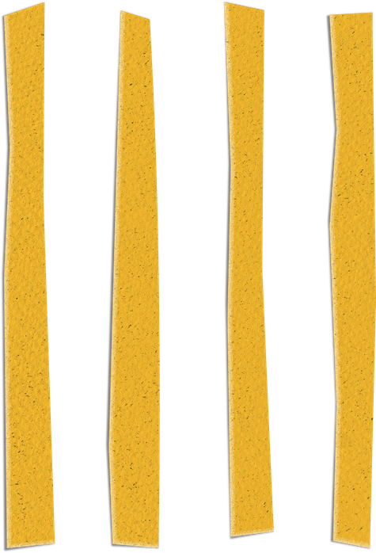
PIPELINE
Channel Selection
(EKG)
Feature Extraction
Preprocessing
Data Balancing
Hybrid Model
Classification

Slide 3
DATA PROCESSING PIPELINE
Signal Conditioning
R-Peak & HRV Analysis
Feature Extraction
Labeling

Slide 4
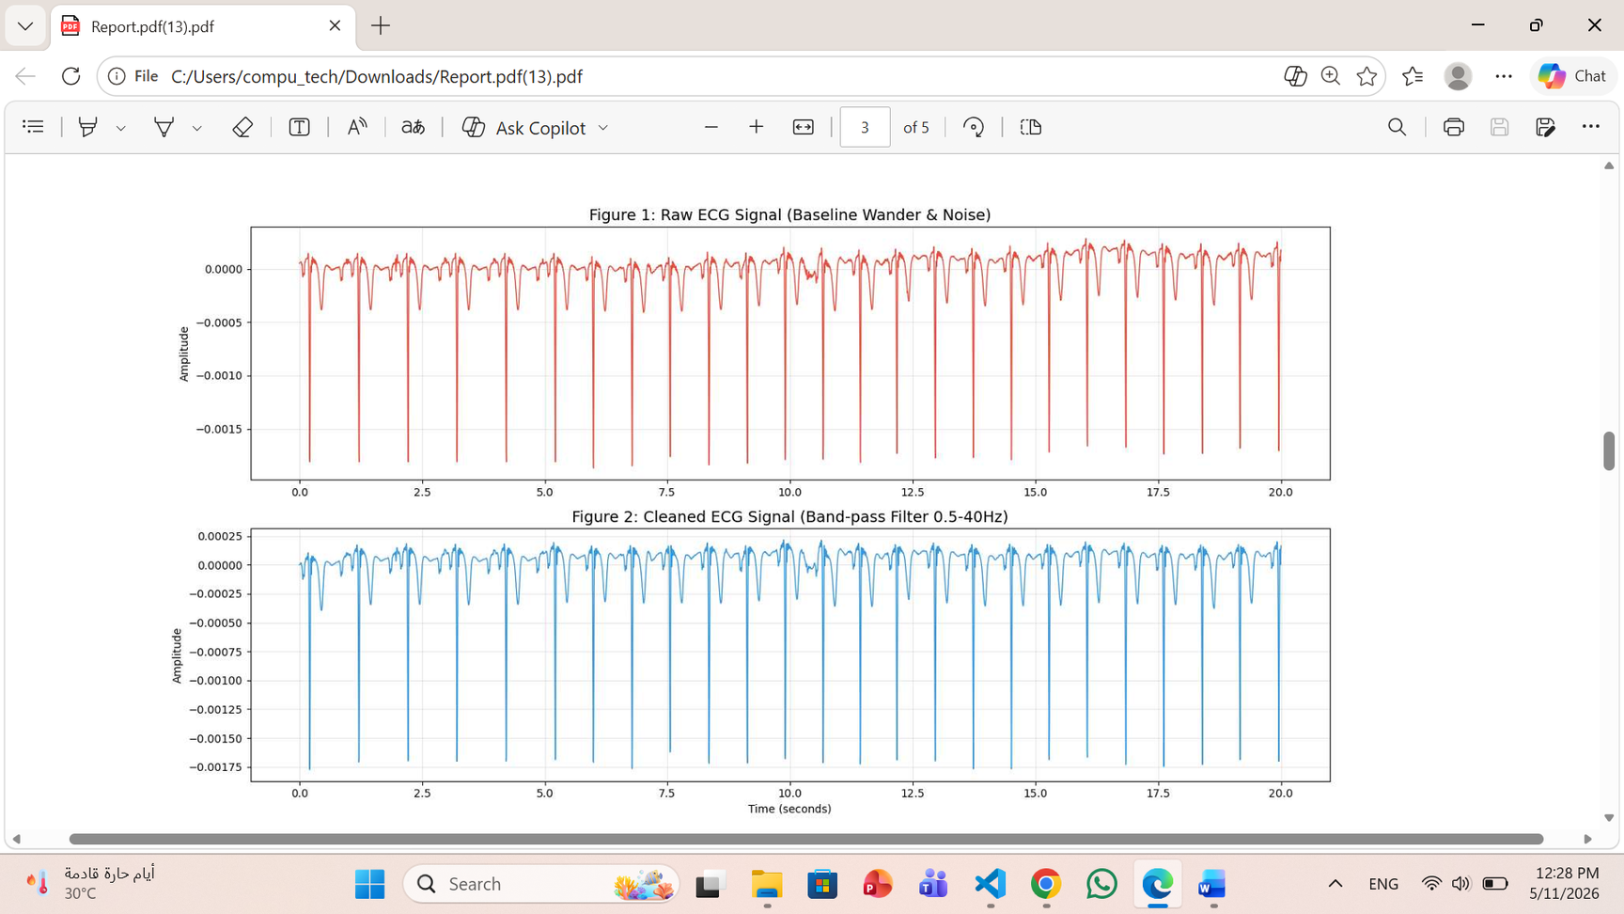
1.SIGNAL LOADING AND CONDITIONING
mne.io.read_raw_edf: For reading medical-grade EDF data.
raw.pick(['EKG']): To focus exclusively on the electrocardiogram signal.
raw.filter(0.5, 40.0): Applied a Bandpass Filter to eliminate baseline wander and high-frequency powerline noise.

Slide 5
2.HEARTBEAT DETECTION AND RESAMPLING
Located R-peaks, calculated Inter-Beat Intervals (IBI), and handled physiological outliers to create a uniform heart rate signal.
mne.preprocessing.find_ecg_events: For automated R-peak detection.
scipy.signal.medfilt: Applied a Median Filter to remove outliers from the IBI sequence.

Slide 6
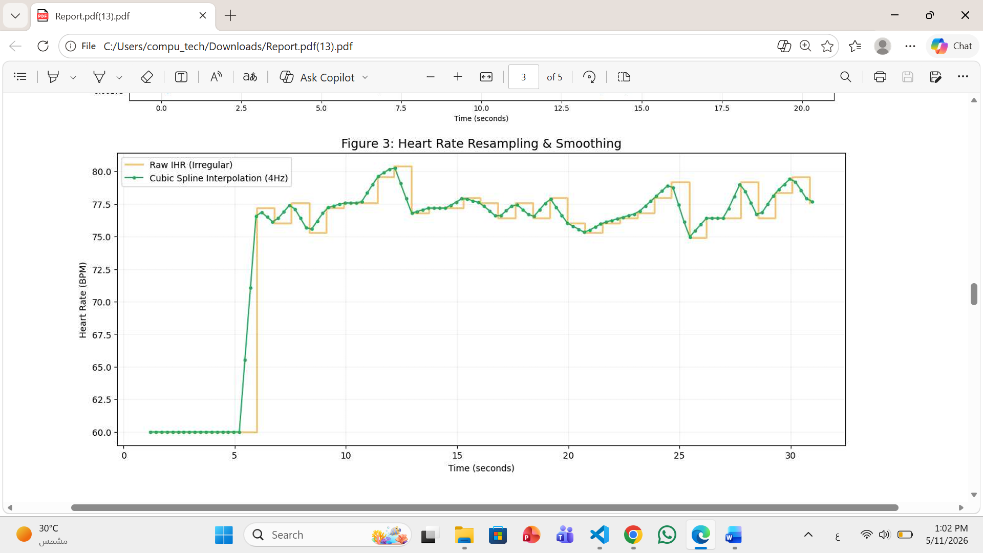
2.HEARTBEAT DETECTION AND RESAMPLING
scipy.interpolate.interp1d: Performed Linear Interpolation to convert irregular heartbeats into a continuous signal sampled at 4Hz.

Slide 7
30 SEC WINDOWING AND NORMALIZATION
Divided the continuous 4Hz signal into 30-second windows (120 samples each) and standardized the data for each window.
Manual Slicing (for loops): Segmented the signal into 30s epochs to match standard sleep staging protocols.
numpy.mean & numpy.std: Applied Z-score Normalization per window to ensure the model focuses on morphological patterns rather than amplitude variations.

Slide 8
FREQUENCY-DOMAIN FEATURE EXTRACTION
scipy.signal.welch: Calculated the Power Spectral Density (PSD) to transform the signal from the time domain to the frequency domain.
scipy.integrate.trapezoid: Performed integration to compute Low Frequency (LF) ,High Frequency (HF) power,Normalized Units (nu) to represent the relative balance of the autonomic nervous system, independent of total power variations.

Slide 9
ANNOTATION PARSING & LABELING
Extracted sleep stage from XML files and synchronized it with the segmented windows.
xml.etree.ElementTree (ET): Parsed XML files to extract event concepts, start times, and durations.
Dictionary Mapping: Converted text labels ('Wake', 'Stage 1',..) into numerical values for the classifier.

Slide 10
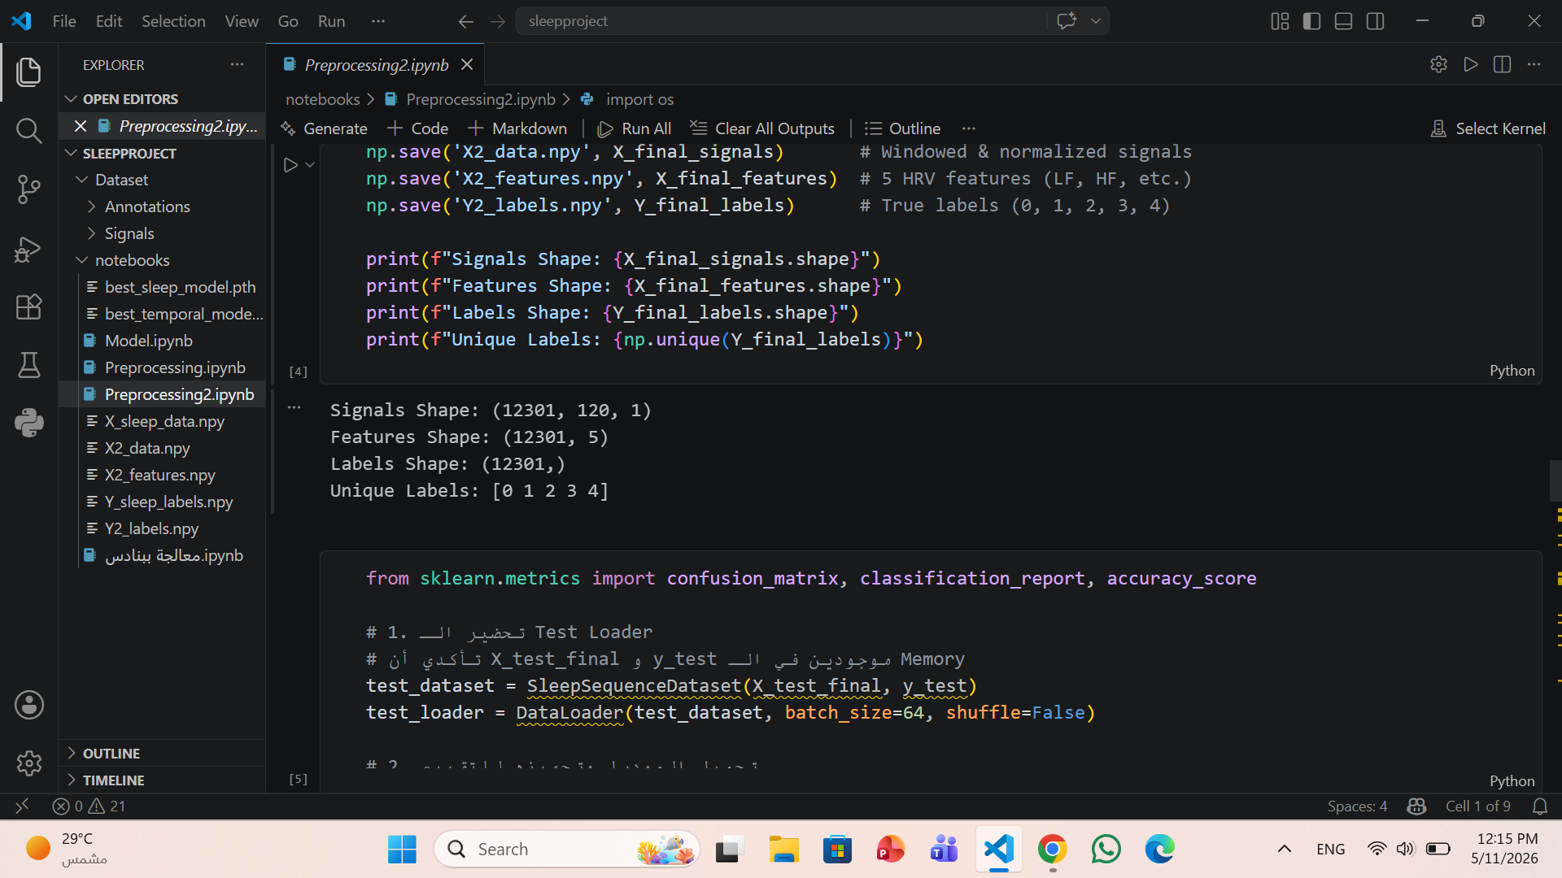
FINAL FORMATTING
numpy.expand_dims: Adjusted array shapes to be compatible with Temporal Models (adding a channel dimension for CNNs/LSTMs).
numpy.save: Exported the final signals, features, and labels as .npy files for efficient loading during training.

Slide 11
DATA BALANCING & AUGMENTATION
FEATURE FUSION
Flattened the 3D signal arrays and horizontally stacked them with the handcrafted HRV features to create a combined feature vector.
numpy.reshape: To flatten the signal dimensions.
numpy.hstack: To combine temporal signals and statistical features into one input matrix.

Slide 12
DATA BALANCING & AUGMENTATION
STRATIFIED SPLITTING
Divided the data into 70% Training, 15% Validation, and 15% Testing. Used stratification to ensure that the percentage of each sleep stage remains consistent across all sets.
Tools:
sklearn.model_selection.train_test_split: To create the three independent datasets while maintaining class balance using the stratify parameter.

Slide 13
DATA BALANCING & AUGMENTATION
CLASS BALANCING (SMOTE)
Applied the Synthetic Minority Over-sampling Technique (SMOTE) only to the training set to resolve the imbalance between sleep stages (e.g., more Wake samples than Stage 1.
imblearn.over_sampling.SMOTE: To generate new, synthetic training samples based on the nearest neighbors of the minority classes.

Slide 14
DATA BALANCING & AUGMENTATION
SYNTHETIC SIGNAL SMOOTHING
To ensure the newly generated (synthetic) signals are physically plausible, a moving average filter was applied specifically to the samples created by SMOTE.
numpy.convolve: Applied a mathematical convolution with a uniform kernel (ones(5)/5) to smooth out any sharp edges or noise in the synthetic ECG signals.

Slide 15
DATA BALANCING
TEMPORAL MULTI-INPUT RECONSTRUCTION
Separated the combined data back into signals and features, then concatenated them into a final 3D format suitable for temporal models.
Custom Python Function (process_back): To accurately slice and reshape the signals (120 samples) and features.
numpy.concatenate: To merge the 2D features into the signal's time-steps, creating the final input for the Deep Learning model.

Slide 16
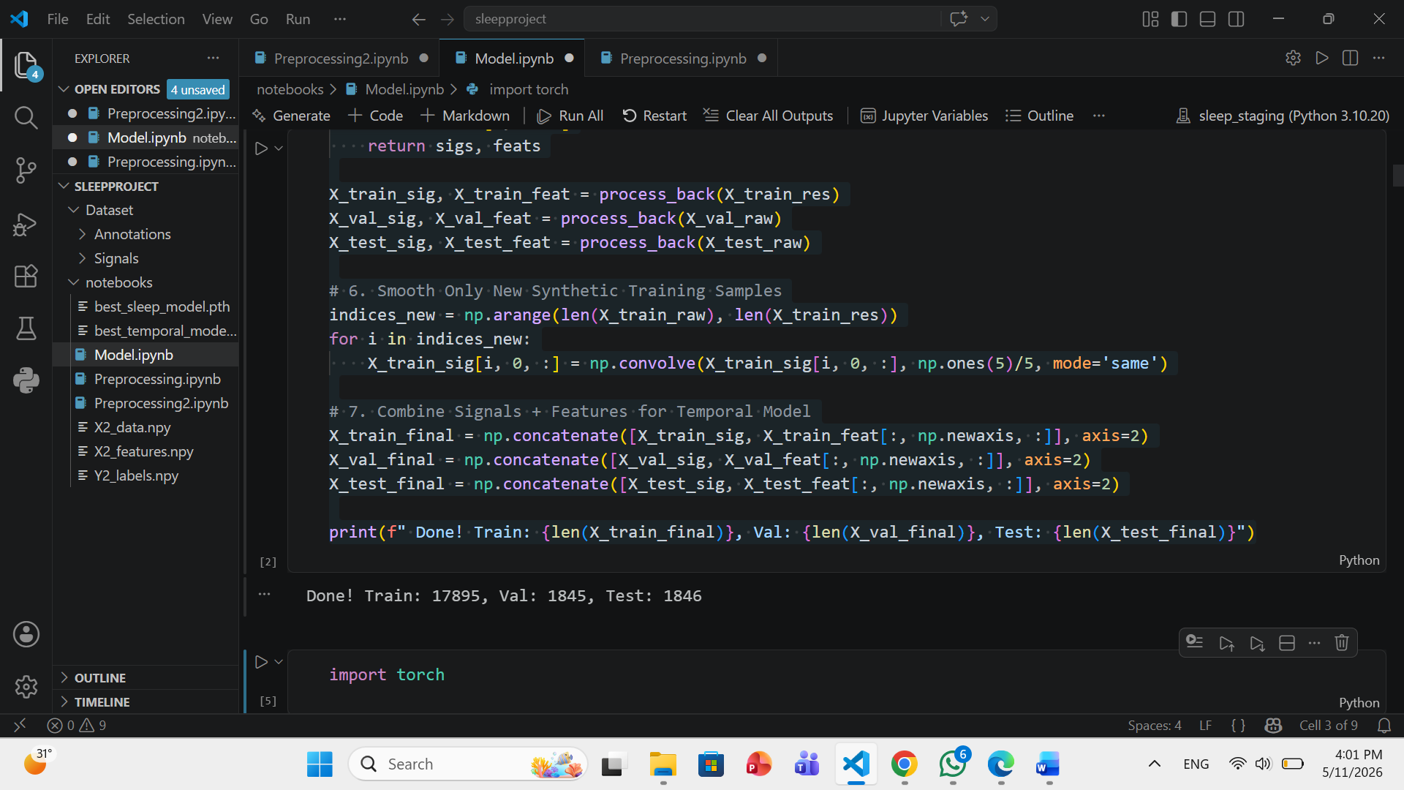
DATA BALANCING
TEMPORAL MULTI-INPUT RECONSTRUCTION
Separated the combined data back into signals and features, then concatenated them into a final 3D format suitable for temporal models.
Custom Python Function (process_back): To accurately slice and reshape the signals (120 samples) and features.
numpy.concatenate: To merge the 2D features into the signal's time-steps, creating the final input for the Deep Learning model.

Slide 17
Temporal WINDOWING
Capturing Sleep Dynamics:
Sequential Loading: Processes 5 consecutive windows (150 seconds) instead of a single epoch to capture sleep stage transitions.
Targeting: The model predicts the stage of the last window based on the context of the previous four.
Input Shape: (Batch, 5, 1, 120) – representing a sequence of 5 IHR signal segments.

Slide 18
Hybrid Model ARCHITECTURE (CNN-LSTM)
Feature Extraction (ResNet-1D): Uses Residual Blocks to extract deep morphological patterns from the IHR signal while preventing gradient vanishing.
Temporal Learning (Bi-LSTM): A 2-layer Bidirectional LSTM analyzes the sequence of extracted features to understand the "history" of the heart rate.
Decision Head: A Fully Connected layer with Softmax outputting probabilities for 5 sleep stages (Wake, N1, N2, N3, REM).

Slide 19
TRAINING & OPTIMIZATION
Optimizer: Adam (LR=0.0005) with Weight Decay to ensure stable learning and prevent overfitting.
Dynamic Scaling: ReduceLROnPlateau scheduler to decrease learning rate when performance plateaus.
Checkpointing: Automated saving of the "Best Model" based on peak Validation Accuracy.
Goal: Achieving high generalization across different sleep cycles and subjects.

Slide 20
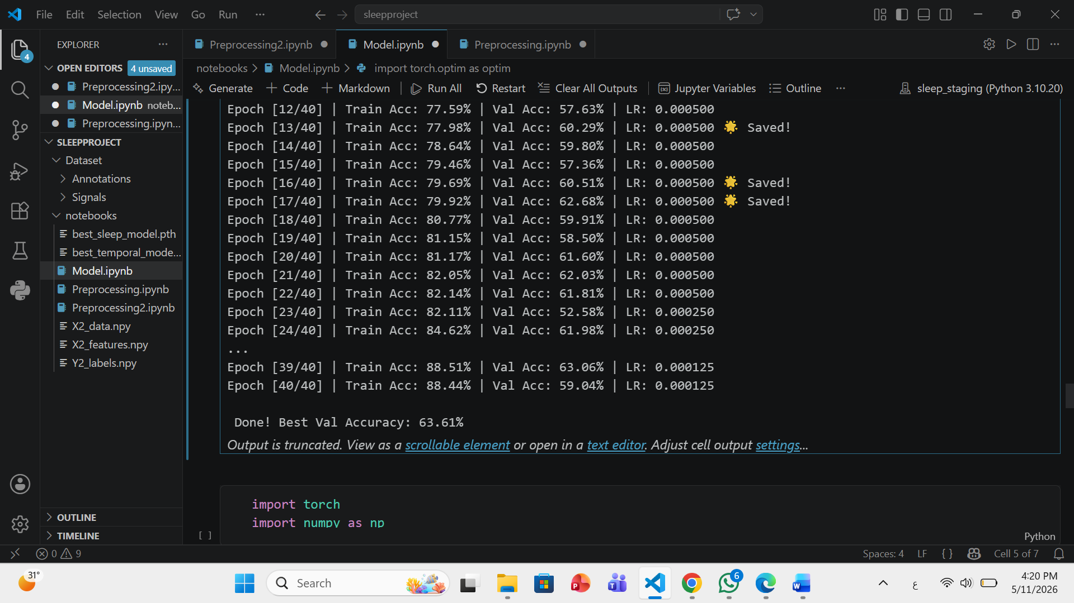
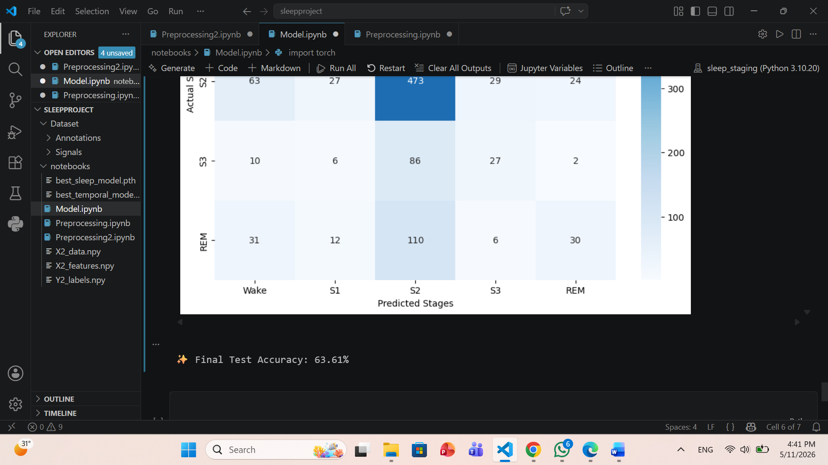
TRAINING & OPTIMIZATION
Best Validation Accuracy: 63.6%
Test Accuracy: 63.6%

Slide 21
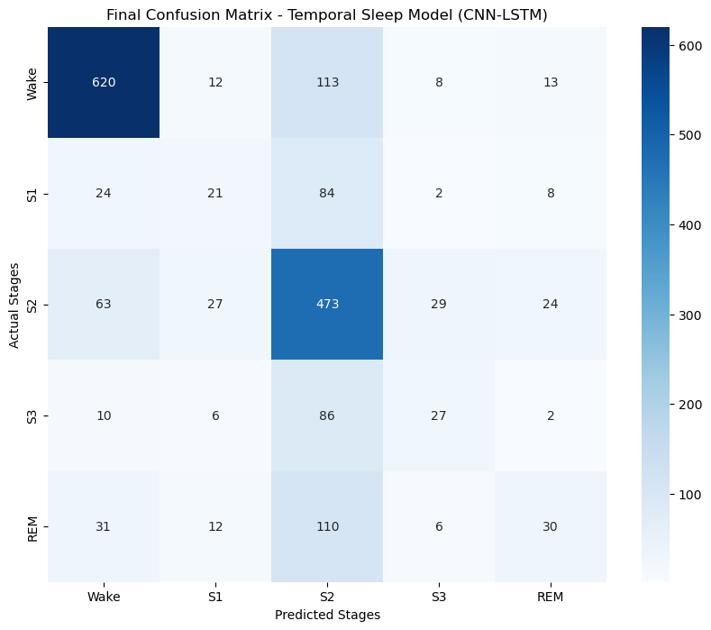
FINAL CONFUSION MATRIX

Slide 22
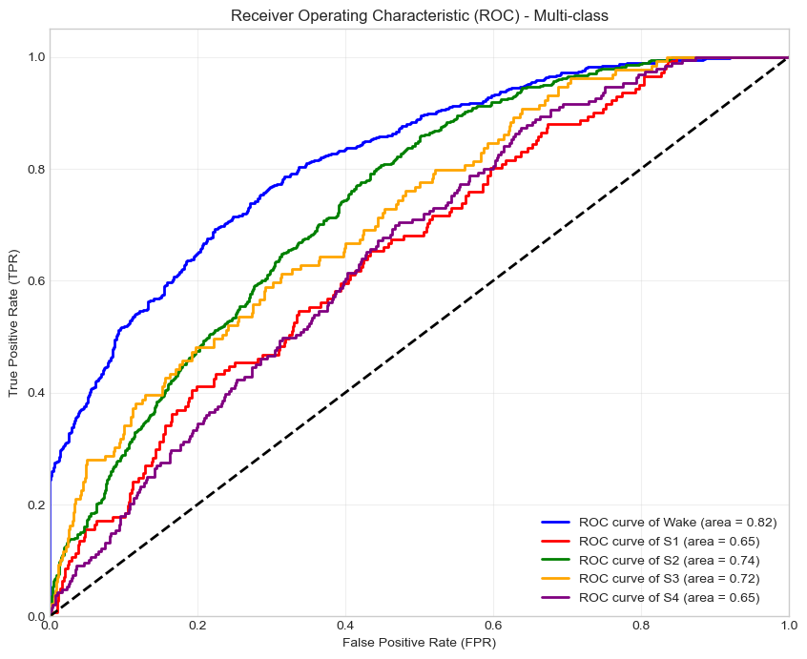
ROC CURVE

Slide 23

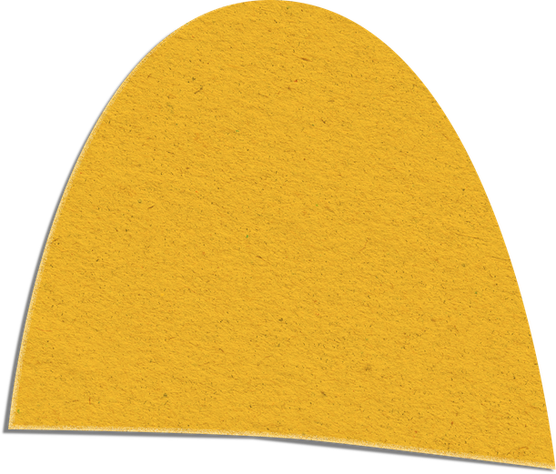
THANK YOU!

