Slide 1

News Ranking Framework for Globe and Mail
Zeinab Noorian
Department of Mechanical and Industrial Engineering,
Ryerson University
Notes:
1

Slide 2
Contents
Problem Statement
Related Work
The Proposed Ranking Model
Evaluation
Conclusion
Future Work

Slide 3
Problem Statement
Given sets of articles for each section, we want to propose a ranking model to rank them in the Homepage.
Each Section shows e.g. 5-top news in their dedicated space in Homepage.
Assumption
Articles have been already clustered in different sections
The editors determine to which sections articles belong.

Slide 5
Related Work: Popularity Ranking
Common practice:
News recommendation approaches:
Personalized
Semi-personalized
There is no personalization in Globe and Mail.
Alternatively, news ranking can be based on:
Freshness,
Importance of news source,
Keywords’ importance.

Slide 6
The Overview of the Proposed Ranking Model
Step1
Data Preprocessing
Step2
Dataset cleaning and transformation
Keyword Evaluation
Exploratory Data Analysis
Step3
Feature engineering
TFIDF approach
Learning and Prediction
Keyword popularity
Word2vec approach
Feature selection
Classification algorithm

Slide 7
Step1: Data Preprocessing
Step1
Data Preprocessing
Step2
Dataset cleaning and transformation
Keyword Evaluation
Feature Engineering
Step3
Exploratory Data Analysis
TFIDF approach
Learning and Prediction
Keyword popularity
Word2vec approach
Feature selection
Classification algorithm

Slide 8
Step1: Data Preprocessing
Step 1-1
Set of Articles
Web Scraping
Initial Features
Extract Article’s content, Authors name, Headlines
URL, Pos, Published date, Visit, Color, Median time spent, SectionID
Articles’ Keyword Vector
Aggregated Data

Slide 9
Step1: Data Preprocessing
Step 1-2
Step 1-3
Feature Engineering
Feature Creation
Normalizing
Published Date
Remove correlated features
Median spent time
Convert categorical variables to numerical
Number of articles written by author
New Features: Authors Reputation, Articles’ Freshness
Cleaned Dataset

Slide 10
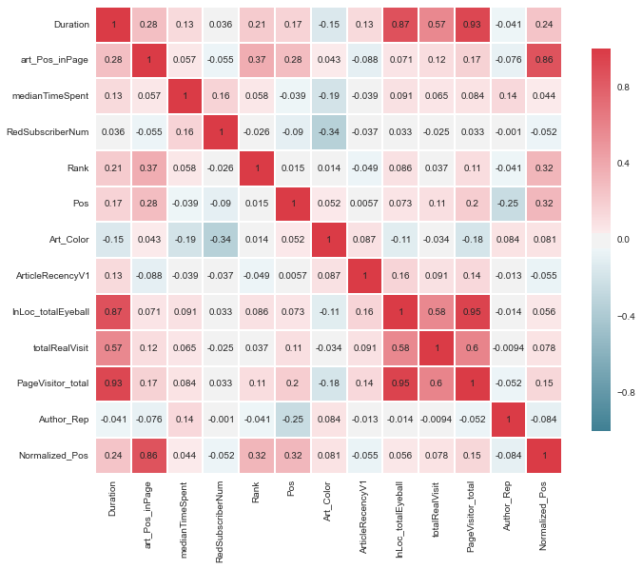
Exploratory Data Analysis: Features’ Correlations

Slide 11
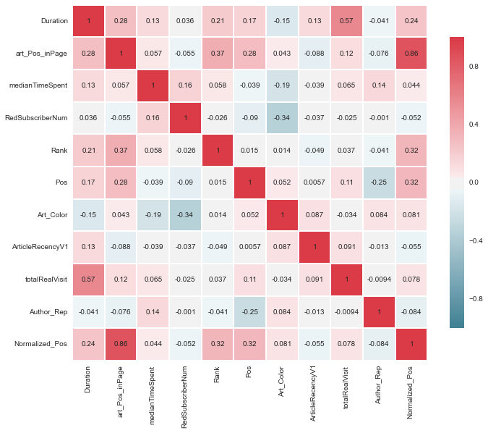
Feature Correlation (2): Removing Highly-Correlated Features

Slide 12
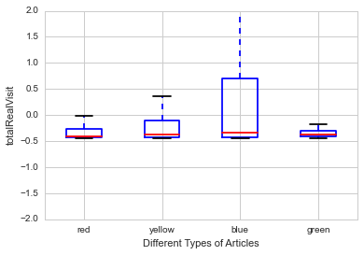
Exploratory Data Analysis: Article Type vs. Visit

Slide 13
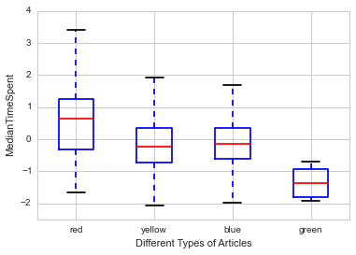
Exploratory Data Analysis: Article’s Type vs. MedianSpentTime

Slide 14
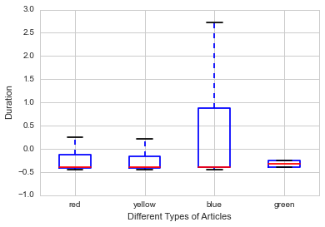
Exploratory Data Analysis: Article’s Type vs. Duration

Slide 15
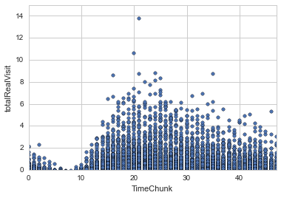
Exploratory Data Analysis: Visit vs. TimeChunk

Slide 16
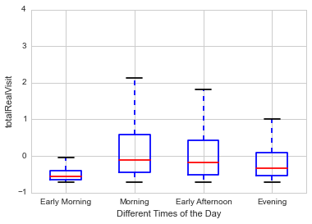
Exploratory Data Analysis: Visit vs. Time of the Day

Slide 17
Step2: Keyword Evaluation
Step1
Data Preprocessing
Step2
Dataset cleaning and transformation
Keyword Evaluation
Exploratory Data Analysis
Step3
Feature engineering
TFIDF approach
Learning and Prediction
Keyword popularity
Word2vec approach
Feature selection
Classification algorithm

Slide 18
Step2: Keyword Evaluation TFIDF Approach
Describe each article using TF-IDF measure.
We tokenize each article and extract their keywords.
Calculate keywords’ weight using TF-IDF.
TF: measures how often a term appears.
Assuming that important terms appear more often.
IDF: aims to reduce the weight of terms that appear in all articles.
Different approaches:
n-grams
Skip-grams

Slide 19
Step2: Keyword Evaluation: Keyword Popularity Approach
Keywords’ weights are measured by:
How many people visited a particular keyword e.g. Canada.
Duration of keyword promotion
[ArticleID=20, (Canada,2)] , [ArticleID=30, (Canada, 5)] a Keyword_duration for Canada is 7.
Combine these two factors and generate Keyword_weights.
Two variation to use:
Directly apply them on the keywords.
Normalized them by TFIDF value of keywords.

Slide 20
Step2: Keyword Evaluation: Word2vec Approach
Published by Google in 2013, is a two-layered neural net that processes text.
Takes a text corpus as input and produces the word vectors as an output.
Constructs vocabulary from the training text.
Creates numerical representation of words, called, feature vectors.
Measures cosine similarity of words and group them together.
e.g. word clustering, sentiment analysis, etc.

Slide 21
Example
Given the corpus, the example output with the closest token to ‘San-francisco’ is:

Slide 22
Learning with Word2vec Features
Build feature vectors of n-dimensions for each keyword.
Given set of keywords of each article;
We calculate the centroids of the keywords; assign it to its article.
Apply different learning algorithms.

Slide 23
Step 3: Learning and Prediction
Step1
Data Preprocessing
Step2
Dataset cleaning and transformation
Keyword Evaluation
Exploratory Data Analysis
Step3
Feature engineering
TFIDF approach
Learning and Prediction
Keyword popularity
Word2vec approach
Feature selection
Classification algorithm

Slide 24
Step3: Learning and Prediction
Author reputation, Article freshness, Article type
Training Articles
Feature Vectors
Feature Vectors
keywords Vectors
Feature Selection
model
Machine Learning Algorithm
Learning Phase
Labels (Positions)
New Articles
keywords Vectors
Feature Transformation model
Classifier
Prediction Phase
Author reputation, Article freshness, Article type
Predicted Position

Slide 25
Evaluation Results
We have conducted 2 series of experiments:
Prediction Accuracy of different Classification Algorithms using observation from different time intervals ( 2 month, 4 Month, etc.)
Classification performance of different algorithms for different number of classes: (3-Class, 4-Class, 7-Class)

Slide 26
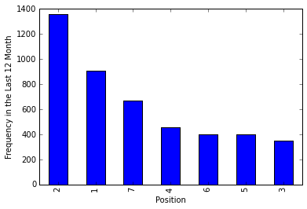
Dataset Specs
Number of observation for Different Time Intervals—(3 Positions)
2 Month | 4 Month | 8 Month | 12 Month
211 | 688 | 1545 | 2615
Number of observation for Different Time Intervals—(7 Positions)
2 Month | 4 Month | 8 Month | 12 Month
356 | 1114 | 2676 | 4532

Slide 27
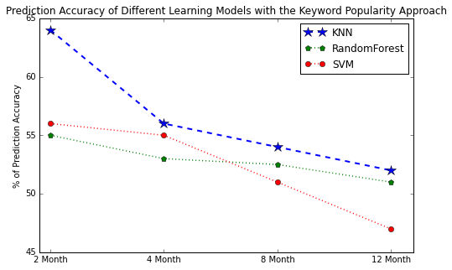
Accuracy of Different Classification Algorithms with keyword Popularity Approach

Slide 28
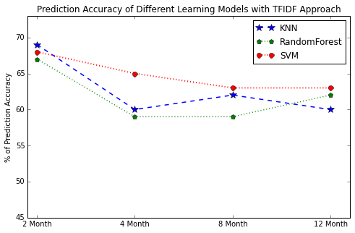
Accuracy of Different Classification Algorithms using TFIDF Approach

Slide 29
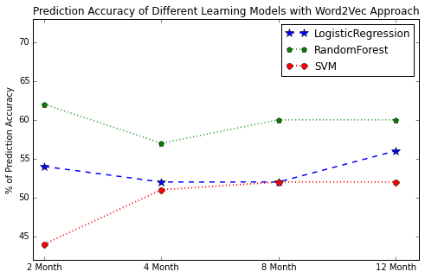
Accuracy of Different Classification Algorithms using Word2Vec Approach

Slide 30
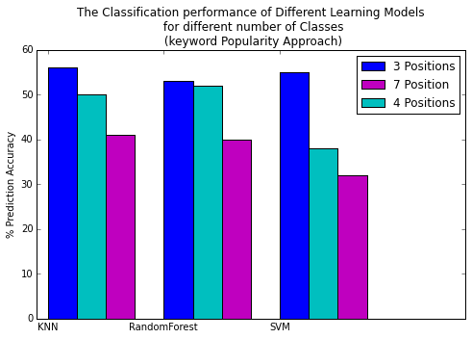
Multi-class Classification Performance(1)

Slide 31
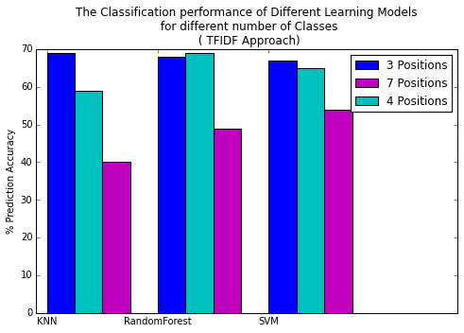
Multi-class Classification Performance(2)

Slide 32
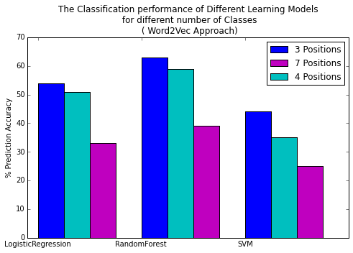
Multi-class Classification Performance(3)

Slide 33
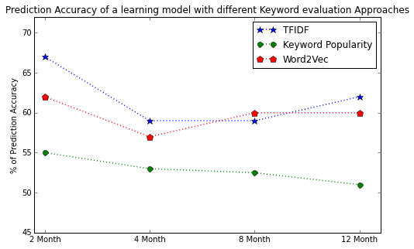
Comparing prediction Accuracy of different keyword evaluation approaches

Slide 34
Summary of the Results
Learning model made based on more recent articles can predict the position of articles more accurately, specifically in keyword popularity and TF-IDF approaches.
Old articles degrade the prediction accuracy.
Multi-class classification algorithms works better for a small number of classes.

Slide 35
Conclusion
We proposed ranking model to place articles in the Homepage of Globe and Mail in order to increase number of visits.
Given articles’ keywords and applying different keyword evaluation metrics, we classified articles into different positions.
Experimental analysis indicated that the classification performance is maximum where the dataset include more recent articles.

Slide 36
Future Work
Perform Keyword Analysis using a Text Engineering tool (GATE)
Differentiate General Keywords from Specific ones
Apply Decay factor to specific keywords
Derive additional features.
Experiment with large and more recent datasets.
Use other keyword evaluations
E.g., LDA; combine different methods together…

Slide 37
Thank You…

