Slide 1
Etraveli customer analysis
Optimizing Support Load and Operational Efficiency
Zeinab Moradi Nour

Slide 2
Why Optimizing Support Load Matters
🌍 Travel support handles millions of customer interactions, often tied to time-sensitive or high-stakes situations like cancellations, re-bookings, and payment issues.
⏱️ Every unnecessary contact adds cost, delays resolution, and strains resources, especially in peak seasons or during disruptions.
💬 High contact volumes are often driven by repeatable, low-value interactions creating an opportunity for automation and smarter triage.
💸 Support effort is not always aligned with customer value, with many low-revenue cases consuming significant agent time.
🧠 Understanding contact patterns, resolution behavior, and action outcomes is essential to designing efficient workflows and scalable customer service.
🚀 Improving support efficiency leads to faster resolutions, happier customers, and lower operational cost a key enabler for sustainable growth in travel services.
Instruction: Please find my recommendation either written in green font or in green text box!
Note: Text editing and phrasing support provided by ChatGPT (OpenAI, private subscription). No sensitive or confidential information was shared.

Slide 3
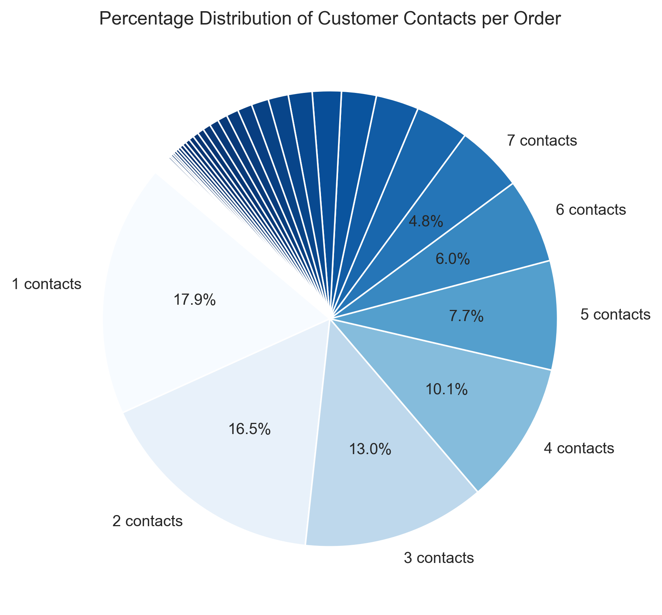
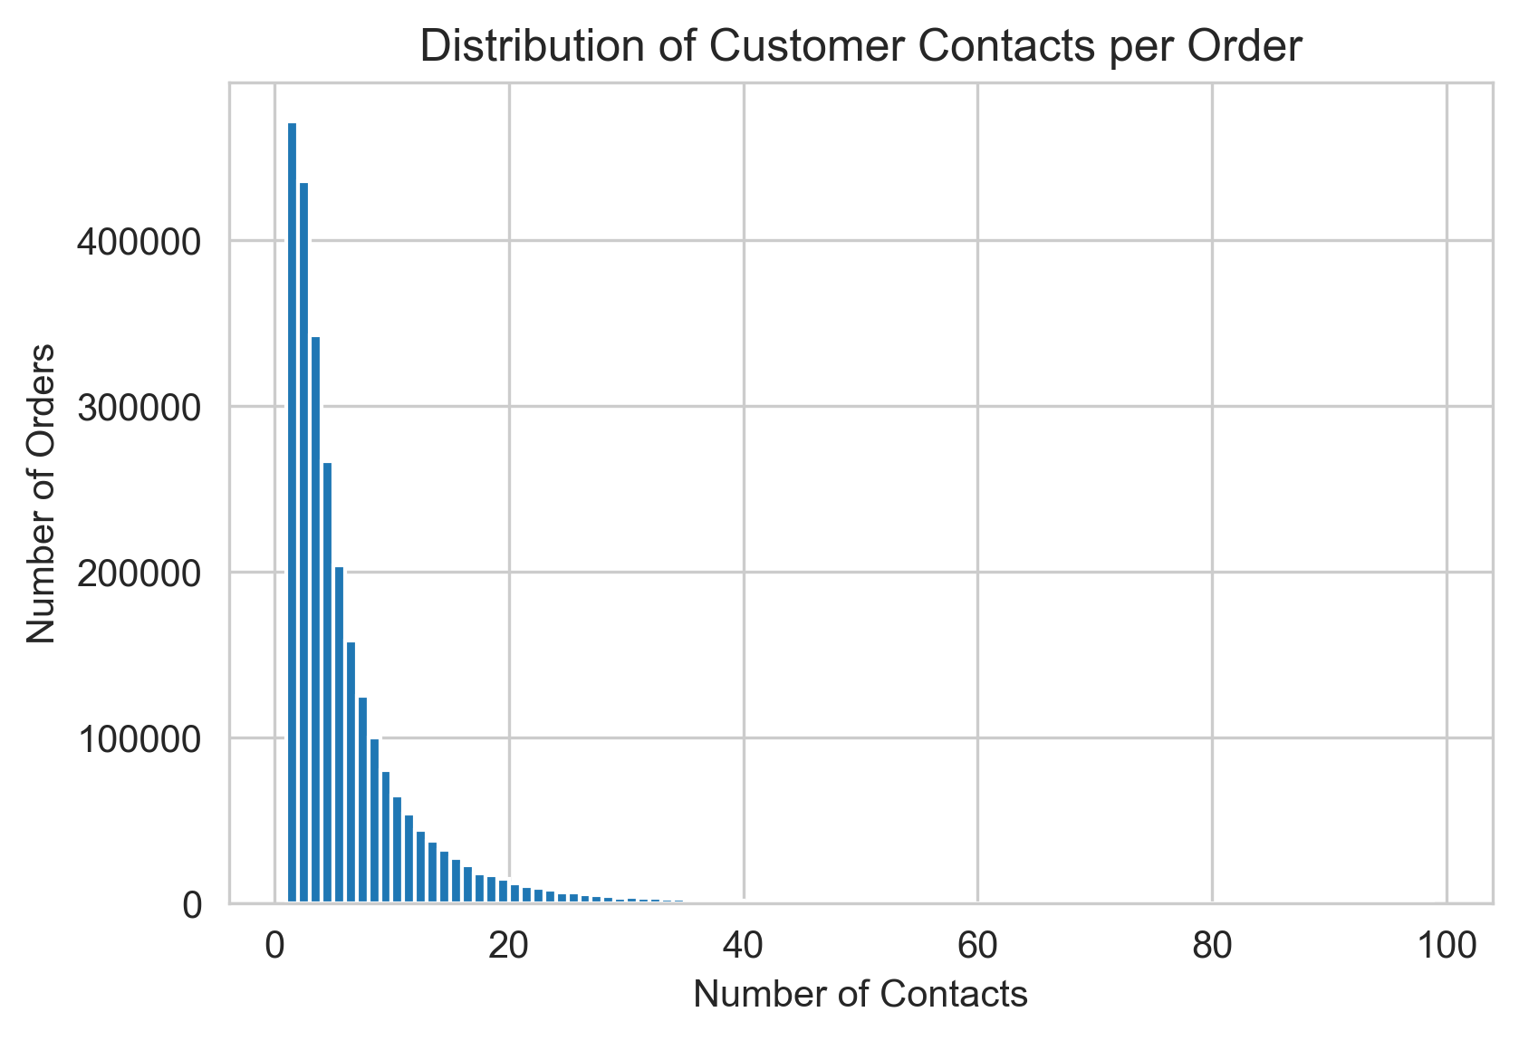
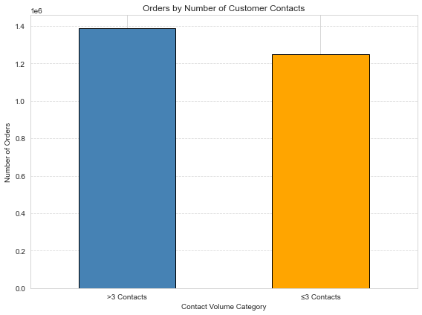
Overview
Index | Count | Mean | std | min | 25% | 50% | 75% | max
Num_contacts | 2.63779e+06 | 6.01215 | 7.17645 | 1 | 2 | 4 | 7 | 98
Room for improvement!
To be proud of!
Number of orders with more than threshold (3) customer contacts: 1388174
Number of orders with less than threshold (3) customer contacts: 1249616

Slide 4
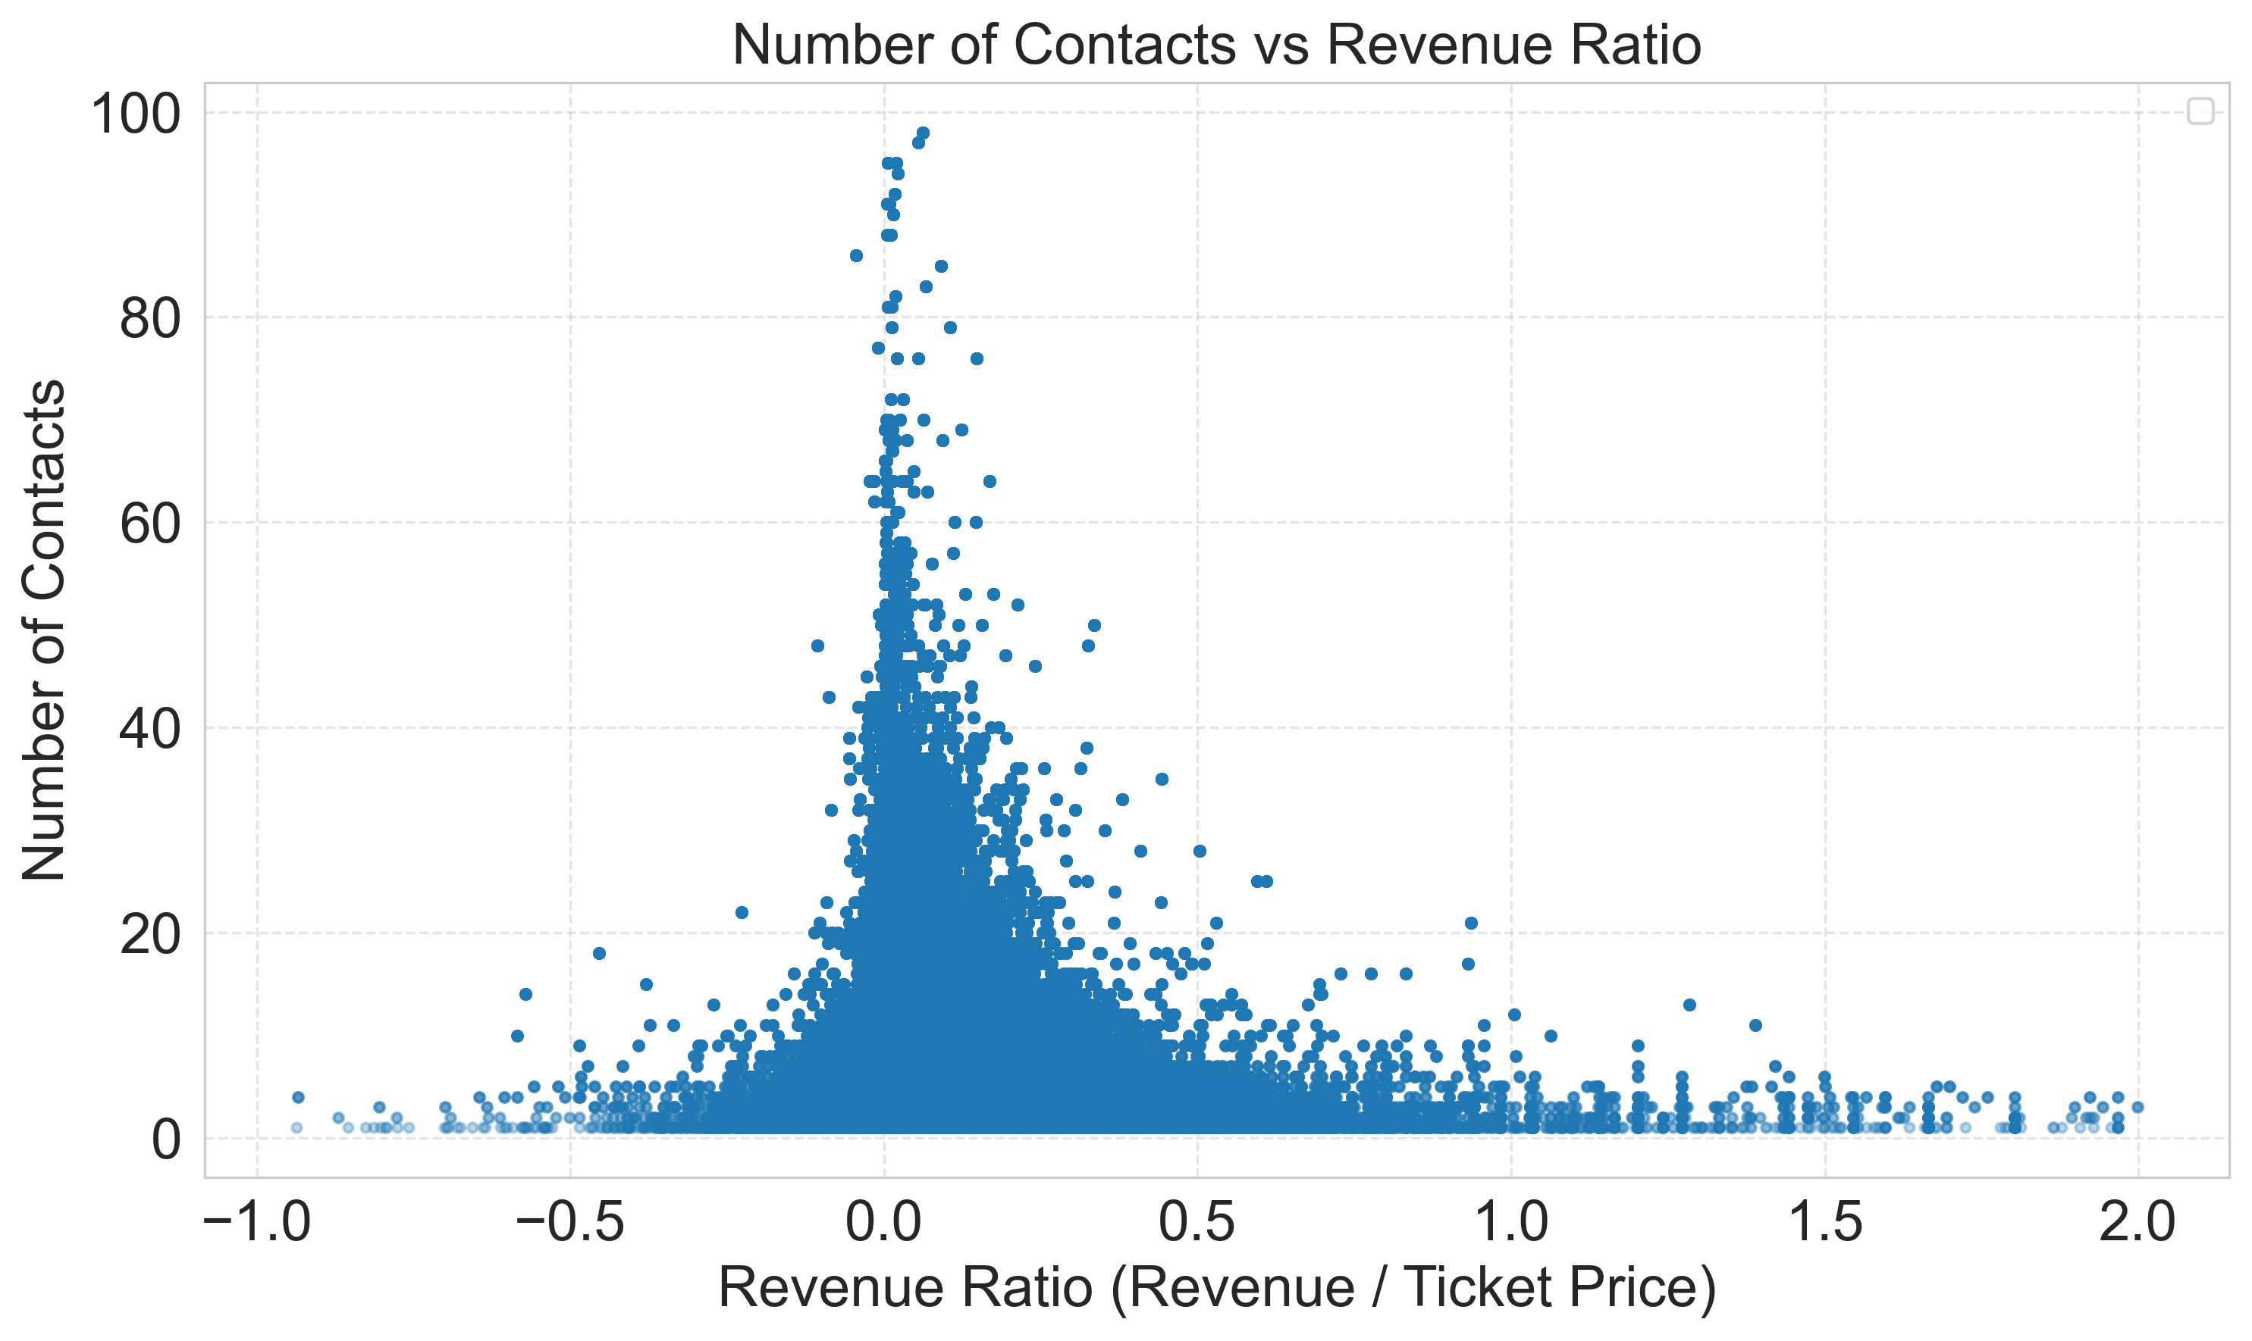
Revenue vs Number of contacts
📉 Correlation: -0.072
✅ What It Means: Very weak negative correlation (close to 0 = no strong linear relationship). As revenue ratio increases, number of contacts slightly decreases, but the effect is very small and not practically significant
💬 Business Interpretation:
Support effort is not aligned with customer value
There might be over-servicing low-revenue bookings
There is a scalability risk if contact volume grows
The real-world effect is weak, however directionally valid:
low-value orders consume disproportionate support time.
🎯 How to use this insight strategically
Consider automating or deflecting low-revenue, high-contact errands.
Protect live agent time for complex or high-value customers.
Refine internal processes where many contacts are required but revenue remains low.

Slide 5
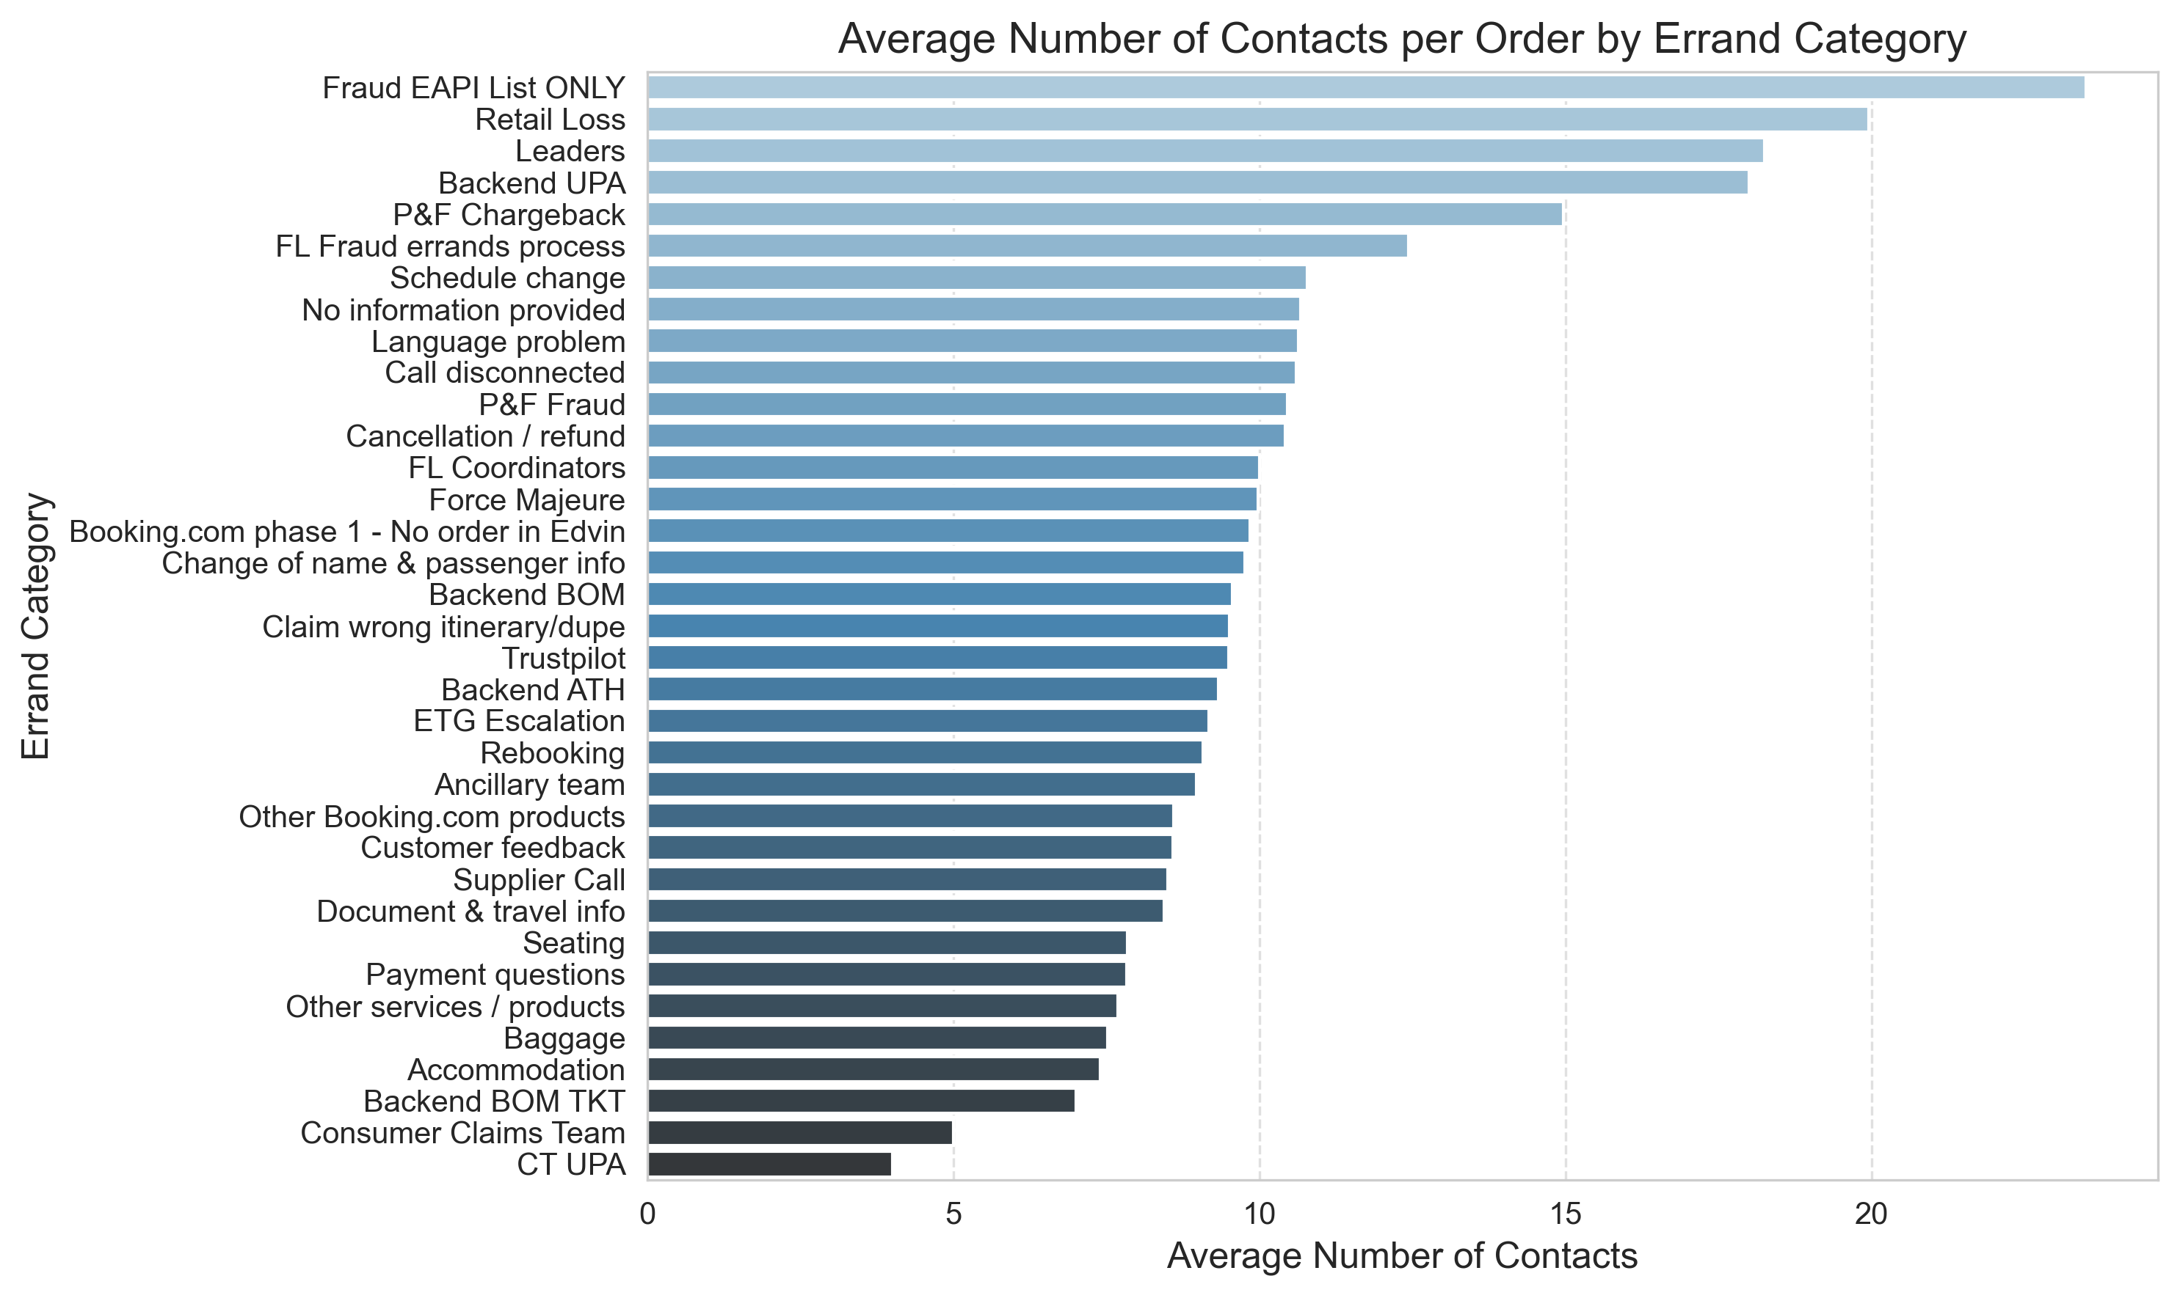
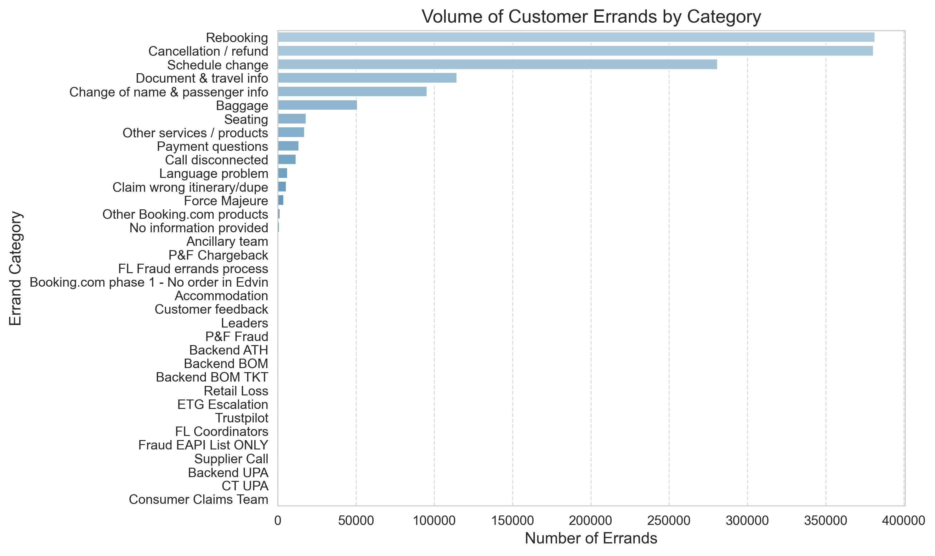
Categorization Based on Errand Category (Multi contact cases)
Metric | What to learn
Avg Contacts per Order | How complex or effortful it is to resolve a case in that category
Volume of Errands by Category | How frequently customers need help with that issue
📊 What the plots show: where complexity meets frequency:
👉 Strategic takeaway: Cancellation/refund, Rebooking ->
Highest volume with Moderately high contact effort (~10 per case), possible problems:
More complex issues
Poor resolution in the first contact
Lack of self-service options or inefficient document
Notes:
Which errand categories tend to create more customer effort:
Categories with higher average contact counts may reflect:
More complex issues
Poor resolution in the first contact
Lack of self-service options
Potential pain points in your customer service or product
If a certain category (e.g. “Rebooking” or “Document issues”) has unusually high contacts:
Consider automation
Better FAQs
Improve process clarity
Low-effort categories show:
Where things are efficient or well-automated

Slide 6
🚨 High Effort ≠ High Volume
Top items on ”Avgerage Contacts" chart, e.g., Fraud, Backend UPA, P&F Chargeback, shows low-volume but extremely high-effort cases (15–22 contacts on average).
✅ Conclusion: These are operationally expensive edge cases, likely tied to:
Escalations, unresolved loops, or system constraints
Risk & fraud processes
Internal communication gaps (e.g., no ownership or handovers)
👉 Strategic Action: Reduce friction or redesign the handling workflow, using smarter solutions for fraud detection cases
Some Categories Are Already Efficient: Categories like “Payment Questions,” “Seating,” “Baggage”:
Lower average contacts
Decent volume
✅ Conclusion: These are well-managed and can serve as benchmarks for other categories.
👉 Strategic Action: Study what’s working here, possibly: Better self-service, More effective agent scripts, Clearer customer instructions

Slide 7
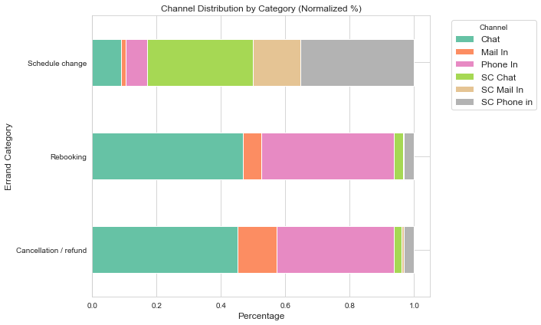
Focus Area: Channel dist.
📊 What the plot shows: (high-volume, moderately complex errands)
Rebooking & Cancellation / Refund:
Dominated by Chat and Phone In
Phone In takes up almost half of all contacts
Chat already handles ~40–50%, which is great but could go further
Schedule Change
Less use of Chat
Heavy reliance on Service Center channels (SC Chat, SC Mail In, SC Phone In), together over 75% of the load
Suggests back-end process dependency
This category is likely less automated, more internal, and involves manual rebooking workflows or coordination.
🎯 How to use this insight strategically
Rebooking & Cancellation: Strong Candidates for Chat Expansion, Chat already handles a good share, but Phone is still heavily used.
✅Recommendation:
Redirect Phone traffic to Chat-first
Use GenAI in Chat to explain cancellation policies, timelines, and rebooking rules dynamically Schedule Change Needs Process Simplification: Over 75% handled via SC channels → indicates agent dependence or backend tooling gaps
✅ Recommendation:
Audit the end-to-end flow of schedule change cases
Identify which ones could be:
Automated (e.g., rebook via self-service)
Handled without SC (improve frontline agent tools)
In general clear and step-by-step instruction using structured decision trees or guided chat flows would improve the chatbot efficiency

Slide 8
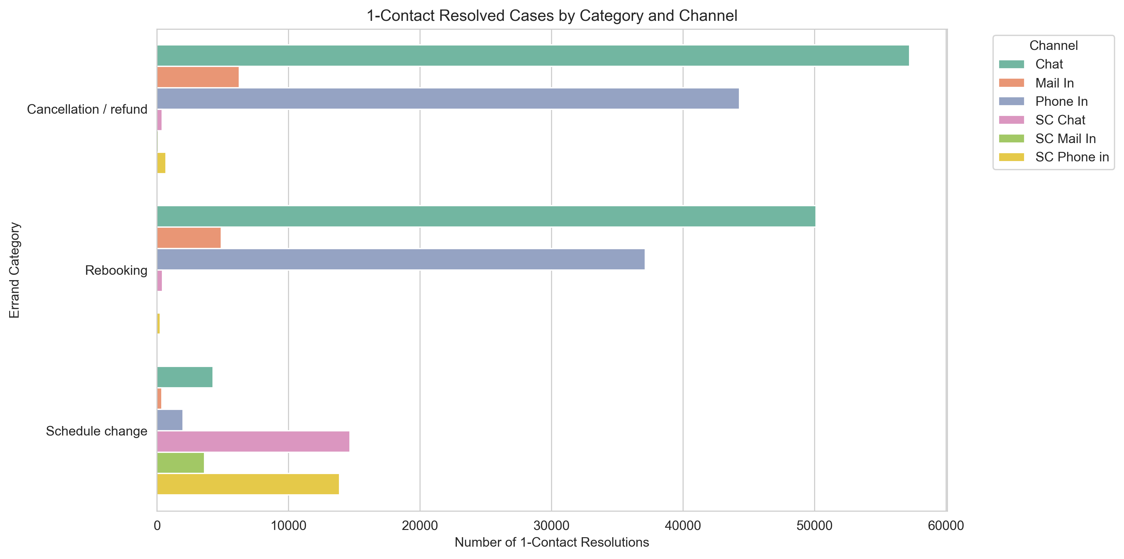
Focus Area: 1-Contact Resolutions by Channel & Category, learning from the best!
📊 What the plot shows:
Chat Is Extremely Effective for Cancellation & Rebooking: Highest number of 1-contact resolutions in both categories
✅ Conclusion: Chat is not only efficient (as I showed earlier),
it’s also highly effective in resolving many cases quickly.
Phone Still Plays a Major Role: Phone is second only to Chat
✅ Conclusion: Phone is necessary for certain cases, but could be triaged better to avoid overload.
Schedule Change Is Spread Across SC Channels: contact resolutions mostly come from SC Mail In, SC Phone In, and SC Chat. Indicates these are back-office driven issues, not easily solvable on the front line
✅ Conclusion: Schedule change cases may be too dependent on manual or disconnected workflows, even when resolved in one step, possibly after a delay.
🎯 Strategic Follow-Up Actions:
Chat resolves most 1-contact cases -> Push more traffic to Chat with AI triage / assist
Phone still used heavily in Rebooking -> Deflect non-complex cases via structured chat flows
Schedule change handled via SC -> Redesign workflows, integrate back-office actions into UI

Slide 9
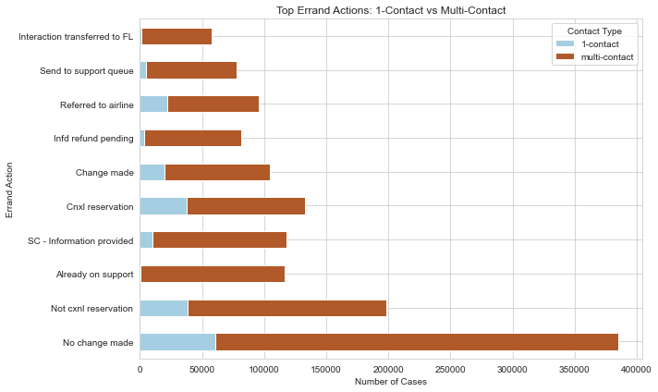
Focus Area: 1-Contact vs Multi-Contact Action Distribution
📊 What the plot shows: Dominance of Multi-Contact Cases: Some actions have almost zero 1-contact cases
”No change made” possible scenarios: Customer misunderstanding, Agent unable to take action, Blocked workflows
Conclusion: High support effort spent on non-actionable requests → candidate for automation + clearer customer guidance
“Not cancellation reservation”, “Already on support”, “SC - Info Provided” possible scenarios: Common actions in multi-contact, but not productive (they’re status messages or dead ends)
Conclusion: These likely reflect information loops, often due to unclear first replies -> Improve agent tools to help classify non-cancellable” before contact is made)
“Informed refund pending” and “Referred to airline” possible scenarios: These reflect external dependencies or waiting periods, Often agents can’t do more than notify the customer
Conclusion: These are “limbo actions” — not problems themselves, but signals of long resolution paths or backend bottlenecks -> Automate status updates + Add visibility in the customer portal (“Refund expected by X date”)

Slide 10
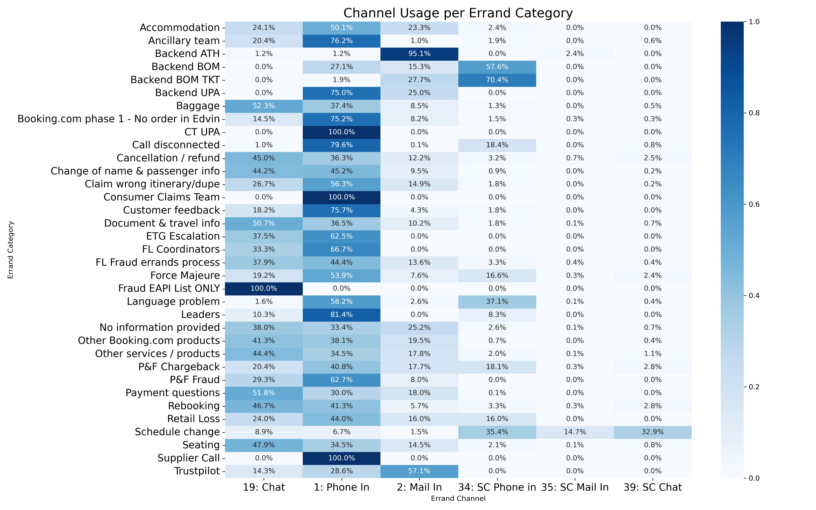
Correlation between Errand channel vs Category
📊 The heat-map showing:
How different channels are used for different errand categories
Whether certain categories prefer or rely on specific channels
If there are imbalances suggesting channel optimization or training gaps
✅ General observation:
💡 Most errands are resolved via Phone, primary contact channel but also the most resource-intensive. Second most used channel is Chat. We discussed about both channels earlier.
💡 Mail In is a rarely used channel across all errand categories.
📌Recommendations:
If Mail In serves niche but valid use cases, consider converting it to an automated intake form or ticketing portal. Integrate with workflows or self-service. Add GenAI suggestions before submission. Route directly to backend teams.
If usage is low and effort is high, encourage customers to use Chat or Phone instead or disable the channel in UIs, templates, or auto-replies

Slide 11
Top 5 Strategic Suggestions for Optimizing Travel Support Load
📲 Expand Chat-First Resolution for High-Volume Cases Rebooking and Cancellation/Refund show strong success rates via Chat. Increase automation, triage, and smart bot routing to shift more volume away from Phone.
🔁 Redesign Back-End Dependent Workflows (e.g., Schedule Change) Heavy reliance on Service Center channels and multi-contact patterns reveal a need to simplify and automate internal coordination.
🧠 Improve First-Contact Resolution with Smarter Agent Support Actions like “No change made” and “Not cancellation reservation” dominate multi-contact cases. Equip agents with clearer resolution pathways and better triage tools.
📉 Eliminate or Deflect Non-Actionable Requests High-frequency actions like “Already on support” or “Informed refund pending” often do not lead to resolution. These should be handled through proactive messaging or self-service status updates.
🧹 Standardize Data & Terminology for Better Insight Inconsistent errand categories and unclear abbreviations reduce analytical clarity. Cleaning up key definitions and categories will improve reporting and root cause tracking. Improving data consistency by reducing duplicate or redundant keys used for the same errand category. Enhance definition clarity by standardizing terminology and providing a clear reference for abbreviations and action labels.

