Slide 1
Detecting Healthcare Provider Fraud Using Machine Learning
Building a Provider-Level Fraud Risk Scoring System
Presented by: Zeina Shaarawy, Judy Hisham, Jana Saeed, Farah Sherif

Slide 2

The Problem: The Cost of Healthcare Fraud
Healthcare fraud is a pervasive issue costing billions annually, directly impacting insurance payers, patients, and the integrity of the healthcare system.
Inflated Billing: Fraudulent providers submit claims for services not rendered or charge exorbitant amounts.
Upcoding Procedures: Billing for more complex and expensive procedures than actually performed.
Deceased Patient Billing: Exploiting administrative loopholes by billing for services to deceased individuals.
Manual auditing of every provider is infeasible, necessitating an automated risk scoring system to efficiently identify high-risk cases.

Slide 3




Project Objectives: A Machine Learning Approach
Our initiative focused on developing a robust, end-to-end machine learning pipeline to proactively identify and prioritize fraudulent providers from complex claims data.
Predict Fraudulent Providers
Handle Class Imbalance
Utilizing historical claims data to accurately flag potential fraud at the provider level.
Addressing the challenge of rare fraud instances (~9%) to prevent model bias.
Provide Explainable Insights
Precision & Recall Focus
Ensuring transparency in fraud detection, allowing investigators to understand the "why" behind each flag.
Optimizing models for metrics crucial in fraud detection, minimizing both false positives and false negatives.

Slide 4
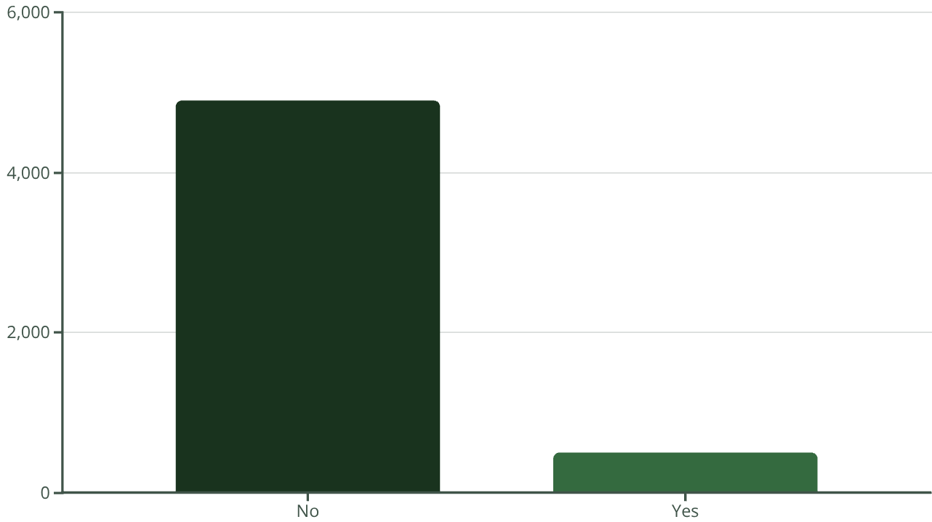
Comprehensive Data Overview
Our analysis integrated four distinct datasets to construct a holistic view of provider behavior and identify fraudulent patterns.
Beneficiary Data: Demographic and enrollment information for patients.
Inpatient Claims: Detailed records of services provided during hospital stays.
Outpatient Claims: Records of services provided in non-inpatient settings.
Provider Fraud Labels: Ground truth data indicating known fraudulent providers.
Fraud rate 9.35
With a fraud rate of 506 out of 5410 providers, approximately 9.35% of providers were labeled as fraudulent, highlighting the class imbalance challenge.

Slide 5
Strategic Data Preparation for Robust Modeling
Rigorous data cleaning and transformation were essential to ensure the quality and consistency of our feature set, preparing it for machine learning analysis.
01
02
Missing Value Imputation
Sparse Code Removal
Addressed gaps in data, such as deductibles, using appropriate imputation techniques.
Eliminated diagnosis and procedure codes with very low occurrence to reduce noise and dimensionality.
03
04
Data Standardization & Merging
Provider-Level Aggregation
Ensured consistent naming conventions and successfully integrated all disparate datasets.
Transformed raw claims data into a rich set of features aggregated at the individual provider level, forming the core unit of our modeling.

Slide 6





Feature Engineering: Unveiling Behavioral Patterns
We engineered a suite of provider-level behavioral features designed to capture anomalies indicative of fraudulent activity.
Total Claim Cost
Claim-per-Patient Ratio
Number of Unique Patients
Aggregated costs for both inpatient and outpatient services.
Measures the average number of claims filed per unique patient.
Counts distinct patients treated by a provider.
Deceased Patient Ratio
Revenue Mix
Proportion of claims linked to patients identified as deceased.
The distribution of revenue originating from inpatient vs. outpatient services.
These features served as critical input for our predictive models, allowing us to differentiate between legitimate and fraudulent billing practices.

Slide 7
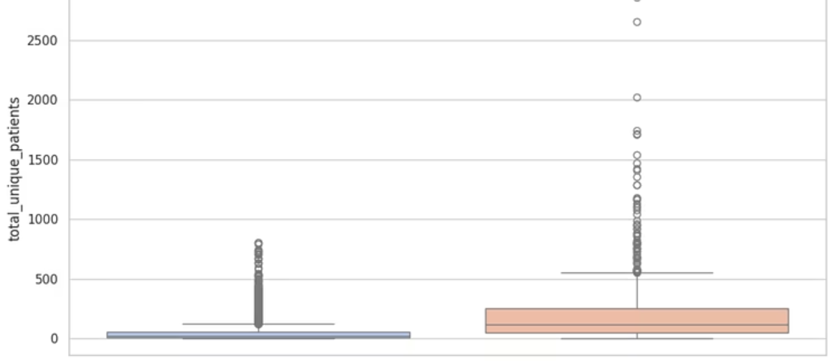
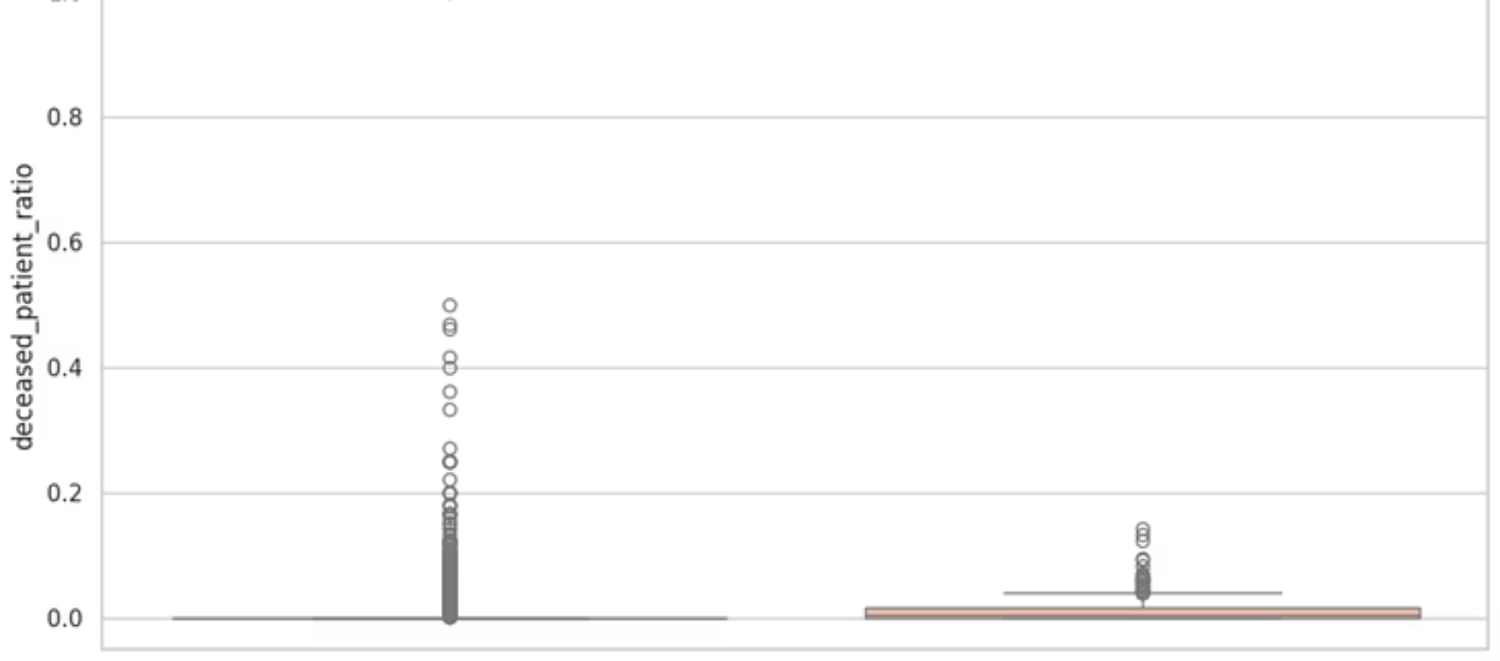
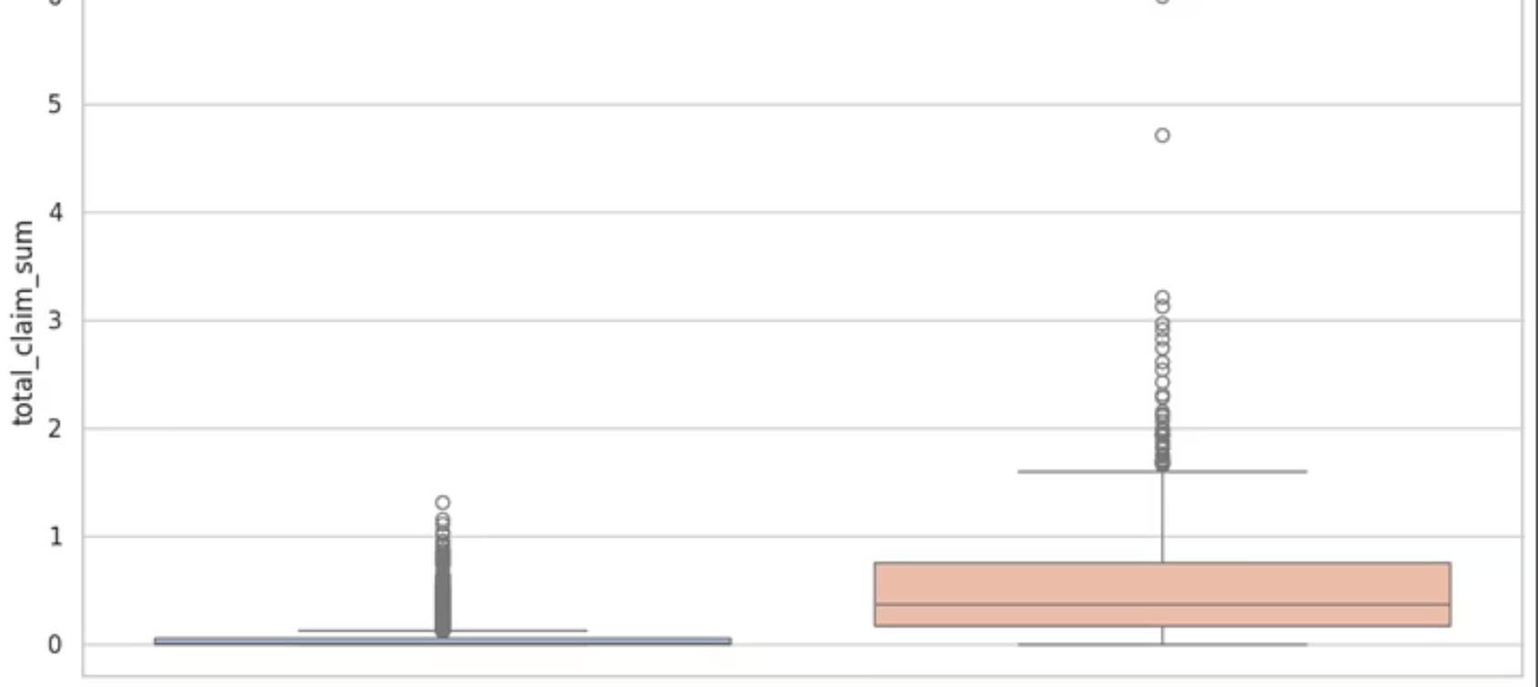
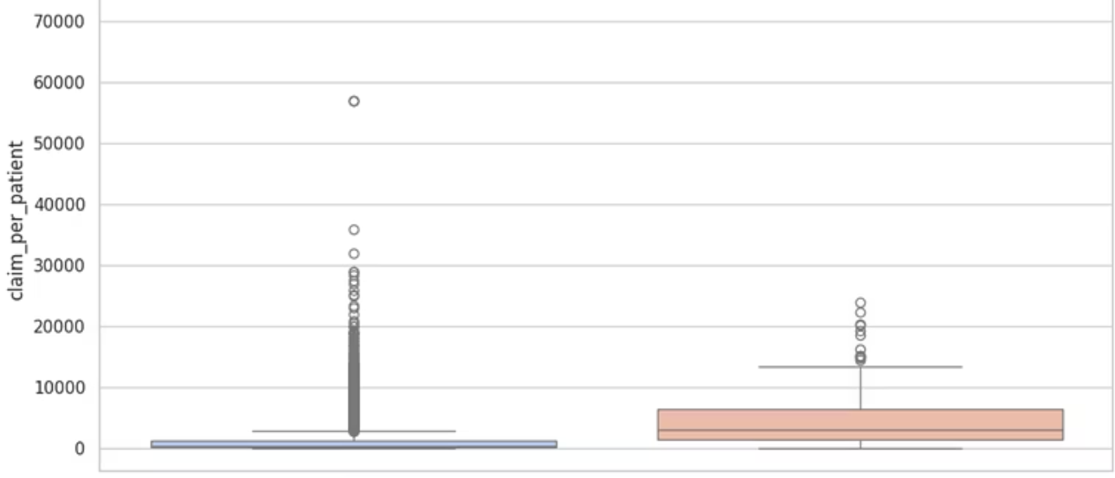

Slide 8
Modeling Strategy: Addressing Complexity and Imbalance
To tackle the inherent challenges of fraud detection, particularly class imbalance, we evaluated a range of robust machine learning models and techniques.
Models Explored:
Validation Method:
Logistic Regression: A baseline for binary classification.
Stratified K-Fold Cross-Validation: Ensures that each fold maintains the same class distribution as the original dataset, providing reliable performance estimates.
Decision Tree: Provides interpretability for rule-based insights.
Random Forest: An ensemble method known for high accuracy and robustness.
XGBoost: A powerful gradient boosting framework, optimized with class weighting and SMOTE.
Imbalance Handling:
Class Weighting: Assigning higher penalties to misclassified minority class samples.
SMOTE (Synthetic Minority Over-sampling Technique): Generating synthetic samples for the minority class to balance the dataset.

Slide 9
Model Performance: Identifying the Optimal Solution
Evaluating models on precision, recall, F1-score, ROC-AUC, and PR-AUC, the Random Forest model emerged as the most balanced choice for our objectives.
Model
Precision
Recall
F1
ROC-AUC
PR-AUC
Random Forest
0.59
0.77
0.67
0.95
0.72
XGBoost (weighted)
0.51
0.80
0.62
0.95
0.74
Logistic Regression
0.39
0.86
0.54
0.95
0.74
Decision Tree
0.45
0.78
0.54
0.86
0.57
Chosen Model: Random Forest
Selected for its optimal blend of performance, stability, and interpretability, with a lower risk of overfitting compared to other high-performing models.

Slide 10
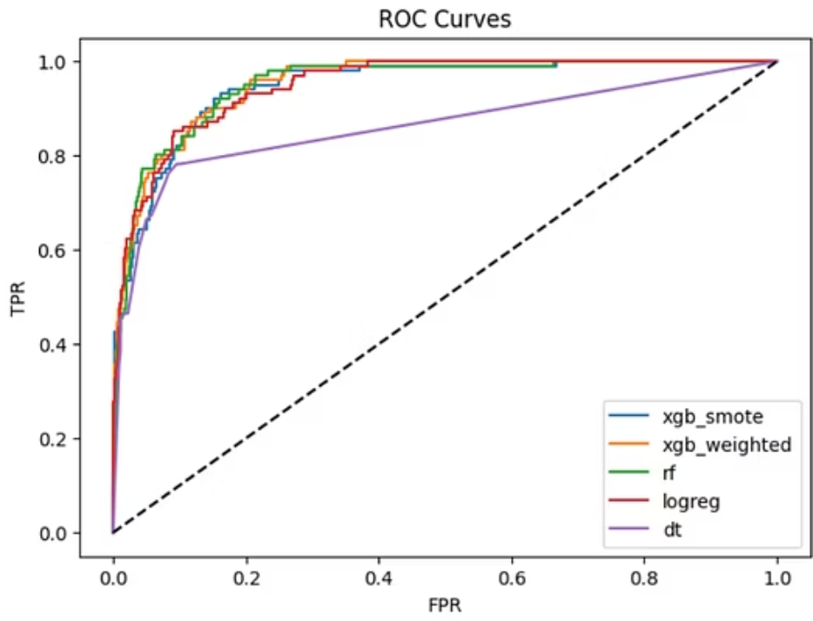
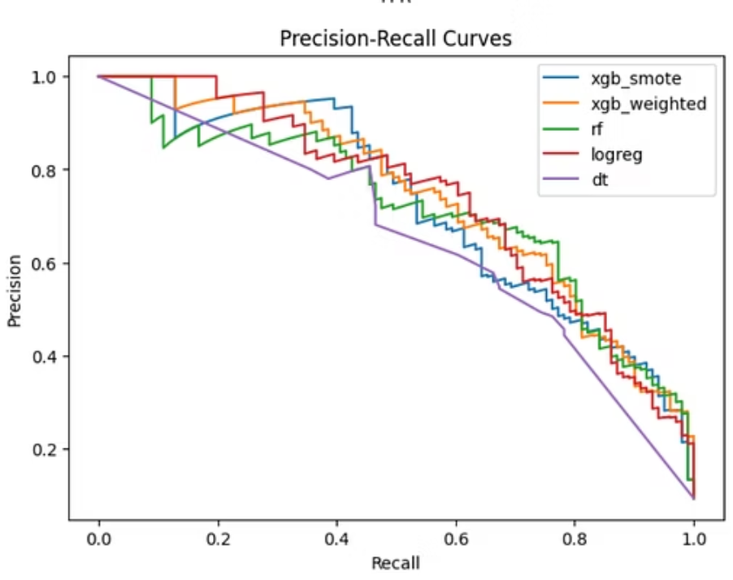

Slide 11
Feature Importance: Understanding Why Fraud is Detected
The Random Forest model highlights key behavioral indicators that strongly correlate with fraudulent activity, providing actionable insights for investigators.
1
Total Claim Cost (Inpatient/Outpatient)
Providers with unusually high overall billing amounts are significant flags.
2
Claim-per-Patient Ratio
A high volume of claims per unique patient indicates potential over-servicing or unnecessary procedures.
3
Deceased Patient Ratio
A disproportionate number of claims for deceased patients is a strong indicator of fraud.
4
Inpatient Claim Count
Frequent or high counts of inpatient claims can signal suspicious billing patterns.
5
Chronic Conditions Mix
An unusual distribution or prevalence of chronic conditions billed by a provider can be a red flag.
Interpretation: Providers exhibiting unusually high billing per patient or a significant number of claims for deceased patients are prioritized for investigation.

Slide 12
Error Analysis: Refining Our Fraud Detection System
A detailed analysis of false positives and false negatives reveals areas for further model refinement and highlights the nuances of healthcare fraud detection.
False Positives (Legitimate providers flagged as fraud)
False Negatives (Actual fraud missed by the model)
Pattern: Oncology and surgical clinics frequently exhibit naturally high billing volumes due to the nature of their services.
Pattern: Providers engaging in subtle fraudulent activities, such as mild upcoding, where patterns blend with normal billing behaviors.
Why? These legitimate practices can mimic fraudulent patterns of "high billing per patient," requiring careful review to distinguish actual fraud from high-cost, necessary care. This includes clinics treating older or high-mortality patients.
Why? These instances are harder to detect as they often involve providers with average billing that subtly manipulate codes. Missing detailed diagnosis codes in the initial data can further obscure these subtle fraudulent signals.

Slide 13

Business Impact: Driving Efficiency and Accountability
Our machine learning model delivers significant tangible benefits, transforming how healthcare fraud is detected and mitigated.
Targeted Auditing
Cost Savings & Recovery
Auditors can efficiently prioritize the top 10% riskiest providers, focusing resources where they are most needed.
This targeted approach significantly reduces investigation costs while increasing the rate of fraud recovery.
Enhanced Transparency
Proactive Policy Design
The model's explainability supports robust regulatory decisions and justifies audit actions.
Insights from the model aid in designing effective policies to reduce systemic fraud across the healthcare system.
This streamlined process allows for a more effective and data-driven approach to combating healthcare fraud.
All Providers
100,000 providers
High-Risk Providers
Investigations
10,000 flagged
1,000 selected

Slide 14




Future Work: Enhancing Fraud Detection Capabilities
To further bolster our fraud detection system, we've identified several key areas for future development and refinement, focusing on deeper data integration and proactive monitoring.
Leverage Richer Code Data
Incorporate Time-Series Analysis
Integrate detailed diagnosis and procedure codes to uncover more granular fraudulent patterns, especially for subtle upcoding and misrepresentation.
Develop models to detect anomalous temporal patterns, such as sudden and unexplained spikes in billing activity or claim frequency, indicating emerging fraud schemes.
Optimize Cost-Sensitive Thresholds
Implement Real-time Monitoring
Refine model decision thresholds to minimize the financial impact of false positives and false negatives, balancing detection accuracy with investigation costs.
Develop a dynamic dashboard for continuous, real-time assessment of provider risk scores, enabling immediate action on emerging threats and suspicious activities.

Slide 15
Conclusion
Full Pipeline Established
Strong Performance Achieved
Successfully built a comprehensive pipeline from raw claims data to actionable risk scoring for healthcare fraud.
The chosen Random Forest model demonstrated robust performance, achieving an ROC-AUC of approximately 0.95.
Actionable Insights Provided
Path for Future Enhancement
The system generates clear, interpretable insights, empowering investigators to prioritize and target potential fraud effectively.
Identified clear next steps and areas for further development to continually refine and improve fraud detection accuracy.

Slide 16
Questions & Answers
Thank you for your attention. We are now open to any questions you may have regarding our machine learning model for healthcare fraud detection.
Thank You!

