Slide 1


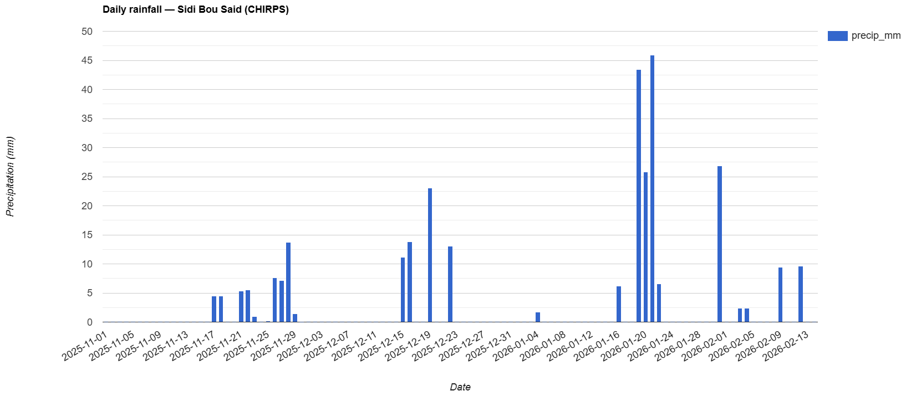
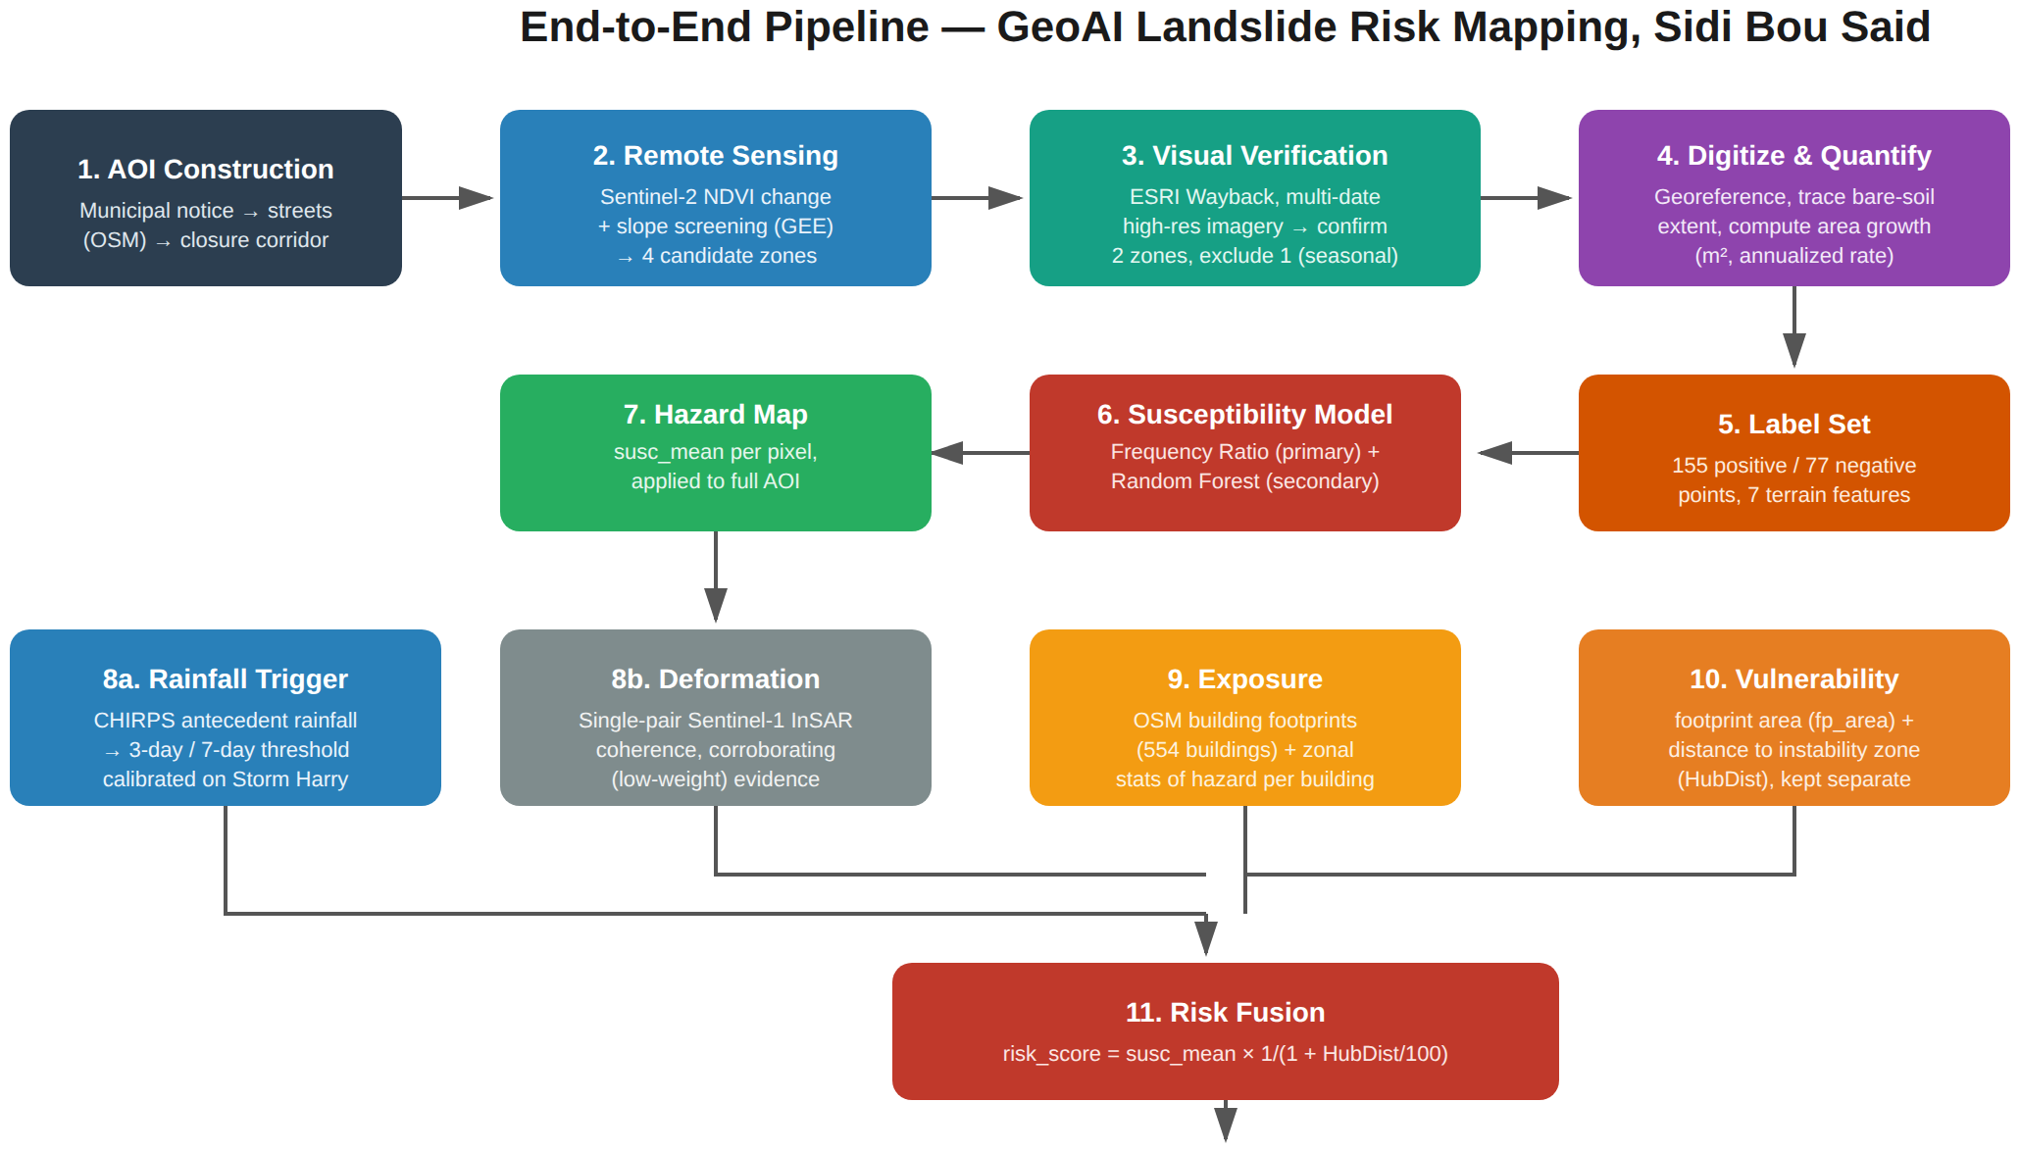
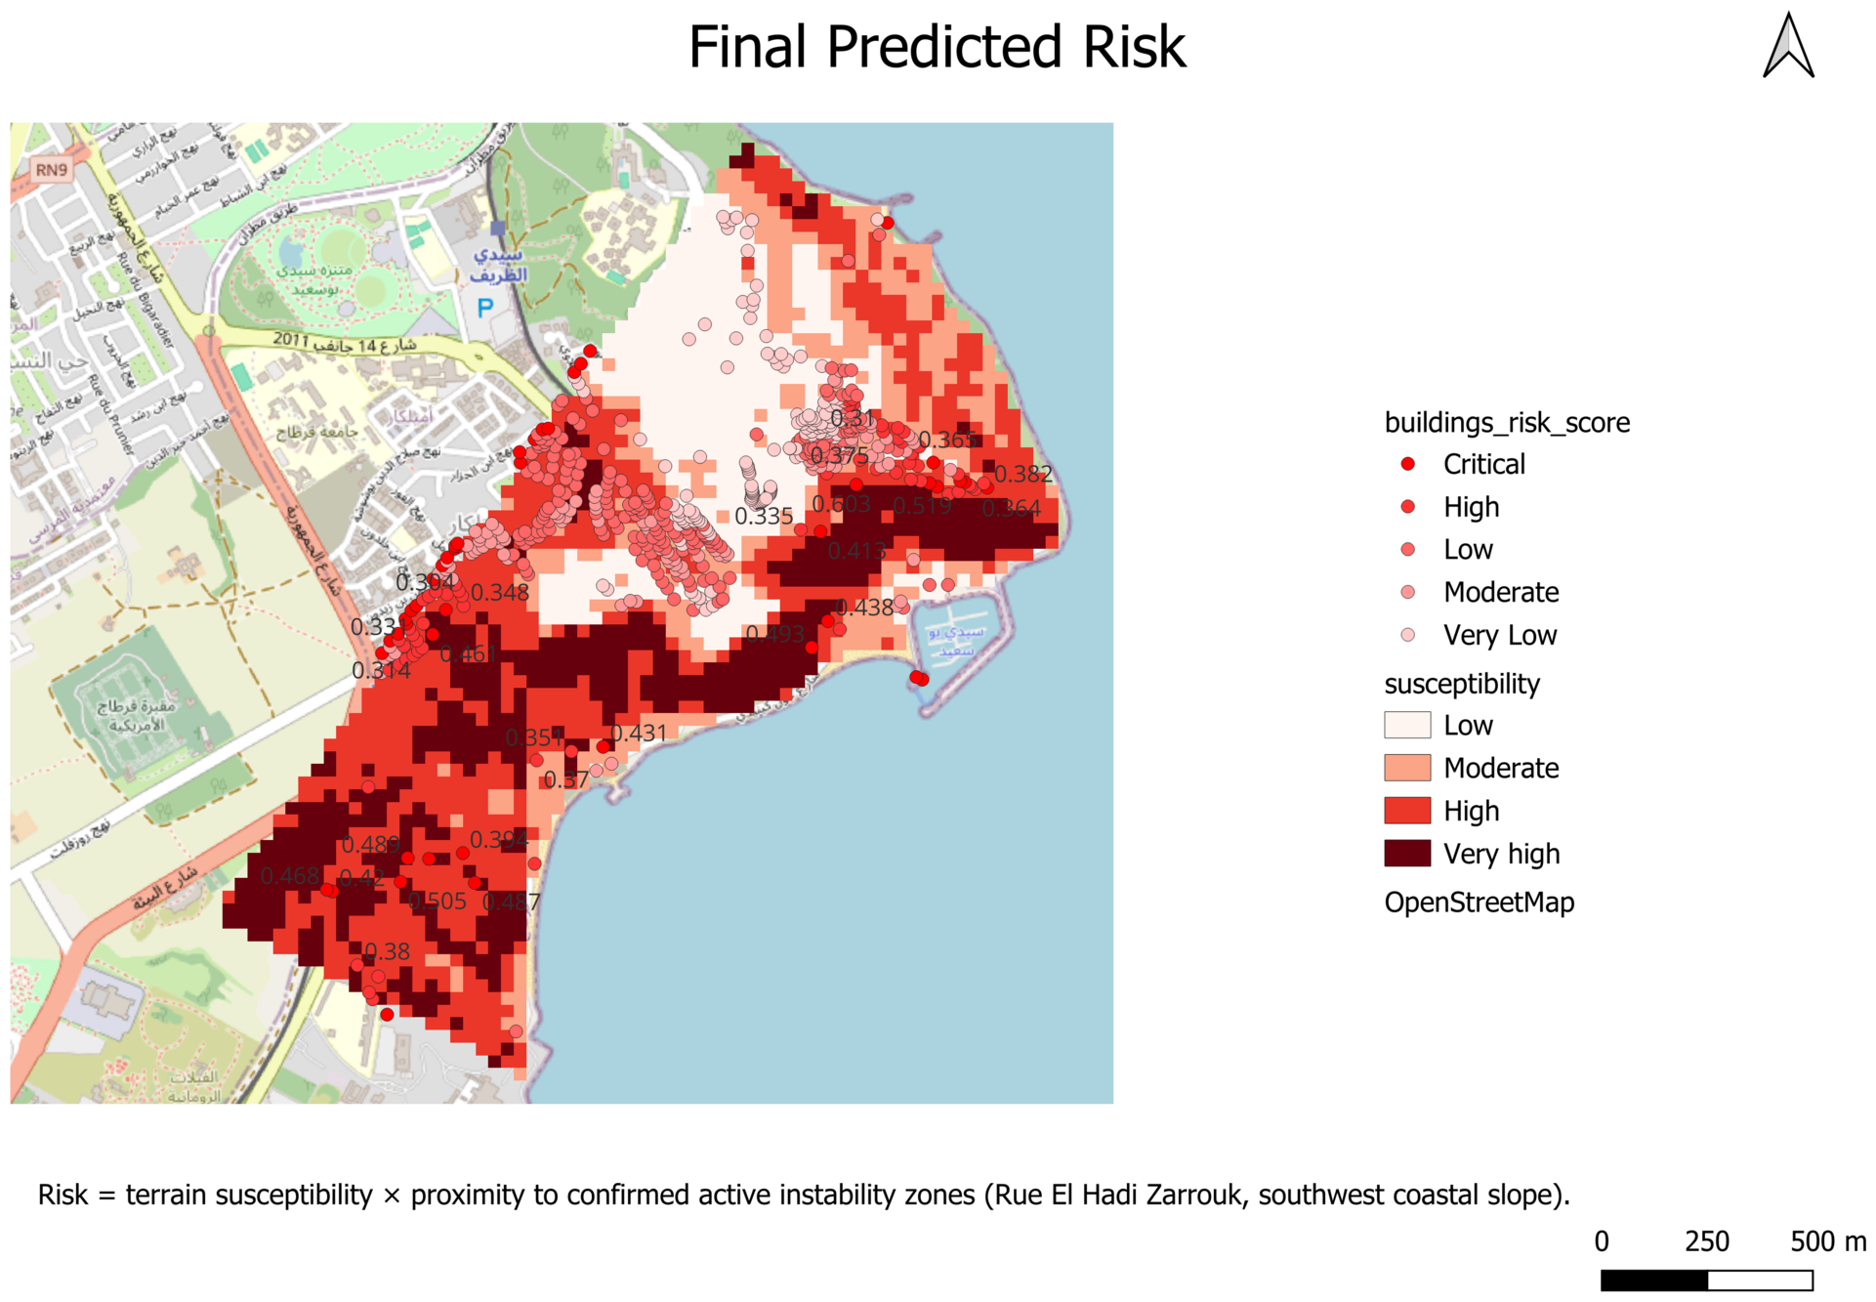
GeoAI-Based Landslide and Slope-Failure Risk Mapping
A Per-Building Risk Assessment for the Sidi Bou Said Hillside, Tunisia
Directed by : Zeineb Sinini | AGI Internship, Tunis | 08/01/2026 – 09/01/2026
Context & Motivation
Study Area & Key Event: Storm Harry
Landslides threaten hilly coastal areas, where rain-induced instability can endanger buildings with little warning. Mapping risk per building, not per slope, shows which structures need monitoring or intervention.
Case study: the Sidi Bou Said hillside, Tunisia, struck by Storm Harry (January 2026), with no formal regional landslide inventory available.
Goal: a single per-building risk product that combines static susceptibility, rainfall and ground-deformation evidence, and exposure and vulnerability.
Sidi Bou Said: a coastal hillside near Tunis on clay-rich soils that lose cohesion when saturated, and already unstable before the storm.
Storm Harry (Jan 2026): about 300 mm in 48 h, the heaviest rain in 70+ years. Eight properties evacuated; Rue El Hadi Zarrouk and Avenue John Kennedy partly closed.
Risk = Hazard × Exposure × Vulnerability
CHIRPS daily rainfall: Storm Harry peak, 3-day total 115 mm (21 Jan 2026)
Methodology: Evidence-Based Pipeline
Susceptibility Modeling
Labels built from NDVI change, slope screening and multi-date imagery: 155 positive and 77 negative points.
7 DEM terrain covariates feed Frequency Ratio + Random Forest; risk = susceptibility × proximity.
0.958→0.884
Random Forest AUC: full model → no elevation
FR 1.41
Frequency Ratio, roughest TRI bin (steepest slope: 1.38)
3 drivers
Slope, TRI and aspect, confirmed by both independent methods
Results: Per-Building Risk Map
Validation & Limitations
Validation: the highest-risk buildings fall in the area actually closed and partly evacuated during Storm Harry, although the model never saw building locations.
Limitations: single-event calibration; partly circular validation; coarse CHIRPS rainfall (~5.5 km); weak single-pair InSAR (coherence 0.44–0.47 vs 0.51 baseline); proxy-only vulnerability.
554 buildings scored and ranked in five Jenks risk classes
Very Low
0.000–0.069
Low
0.069–0.148
Moderate
0.148–0.246
High
0.246–0.382
Critical
0.382–0.603
Highest susceptibility lies along the coastal band, including Rue El Hadi Zarrouk and the southwestern slope.
Top-risk buildings cluster in the corridor closed and partly evacuated during Storm Harry.
Peak score 0.603; most others score below 0.2.
Future works
Calibrate with multiple independent triggering events.
Process a full multi-temporal SBAS / PSInSAR deformation time series.
Replace proxies with real vulnerability data: construction type, occupancy, age.
Extend the AOI to the whole village and surrounding hillside.
Acknowledgment
Association of Geospatial Intelligence (AGI)
Manouba School of Engineering

