Slide 1

UNCOVERING INSIGHTS FROM BRITISH AIRWAYS REVIEWS: A DATA ANALYSIS APPROACH
Presented by : Zeineb Romthana

Slide 2
ANALYSIS OF BRITISH AIRWAYS SERVICE REVIEWS
Objective: To analyze customer reviews of British Airways using topic modeling, sentiment analysis, and word cloud visualization
Topic Modeling:
Key Topics Identified
Topic 0: ['cabin', 'service', 'food', 'economy', 'flight', 'ba', 'business', 'class', 'seat', 'wa']
=>Focuses on cabin service, food quality, economy and business class, and the overall flight experience.
Topic 1: ['day', 'told', 'time', 'british', 'customer', 'hour', 'service', 'ba', 'flight', 'wa']
=>Highlights time-related issues, including flight delays, customer service problems, and communication issues.
Topic 2: ['ticket', 'day', 'airport', 'delayed', 'hour', 'luggage', 'london', 'ba', 'wa', 'flight']
=> Centers around airport experiences, ticketing problems, flight delays, and luggage issues.
Topic 3: ['day', 'staff', 'wa', 'time', 'voucher', 'hour', 'airline', 'london', 'ba', 'flight']
=>Discusses staff behavior, customer service, vouchers, and flight delays.
Topic 4: ['club', 'cabin', 'food', 'service', 'time', 'crew', 'good', 'ba', 'flight', 'wa']
=>Emphasizes club cabin services, food quality, and crew performance.

Slide 3
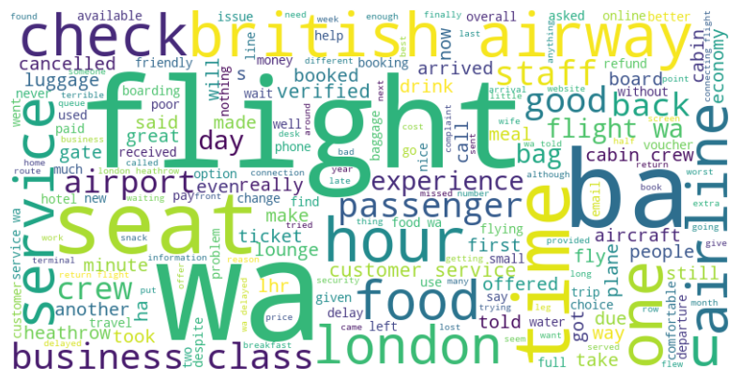
2. Sentiment Analysis - VADER :
Key Insights:
-Positive Sentiment: 493 of reviews praised business class and crew service.
-Negative Sentiment: 502 of reviews mentioned issues with luggage, flight delays, and cancellations.
-Neutral Sentiment : 5 are neutral
3. Word Cloud
Frequent Words: "Flight", "Service", "Crew", "Seat", "Luggage", "Business Class"
Conclusion: Customers are particularly vocal about service, seating, and luggage handling.

