Slide 1
Driver Monitoring and Alert System
Real-Time Detection of Driver Drowsiness, Distraction, and Phone Usage
Presented By :
Zein Saad
Presented To :
Dr . Abbass Zaineddine

Slide 2
Project Objective
Detect eye closure to identify driver drowsiness
Detect mobile phone usage using object detection
Detect head pose deviation to identify driver distraction
Combine all detections into a priority-based alert system

Slide 3
Eye Closure Detection: Model Overview
A CNN is trained to classify eye images as:
  Open
  Closed
Input: 64 × 64 grayscale eye image
CNN Architecture : 3 Convolution layers 16 → 32 → 64 filters (3×3)

Slide 4


Eye State Dataset
Drowsiness Detection Dataset (https://www.kaggle.com/datasets/prasadvpatil/mrl-dataset/data)
  Labeled images: open eyes / closed eyes
  Used for binary classification
Data Preprocessing :
  For Training:
    Grayscale conversion
    Resize to 64×64
    Random affine transformations
    Brightness & contrast jitter
    Normalization (mean=0.5, std=0.5)
  For Validation:
    Same preprocessing
    No augmentation

Slide 5
Drowsiness Decision Logic
Each eye classified independently
Probabilities averaged for robustness
Eye closure detected when:
  Closed-eye probability < threshold
  Condition persists for several frames
Short blinks are ignored

Slide 6
Training & Validation Results — Eye State CNN
Dataset Split
  Training set: 3,200 images
  Validation set: 800 images (80 / 20 split)
Final Performance (Epoch 10)
  Training Accuracy: 98.91%
  Validation Accuracy: 98.88%
  Training Loss: 0.0040
  Validation Loss: 0.0052

Slide 7
Phone Detection Module — Objective
The phone detection module aims to:
  Identify the presence of a mobile phone in the driver’s vicinity
  Detect phone usage under real driving conditions

Slide 8
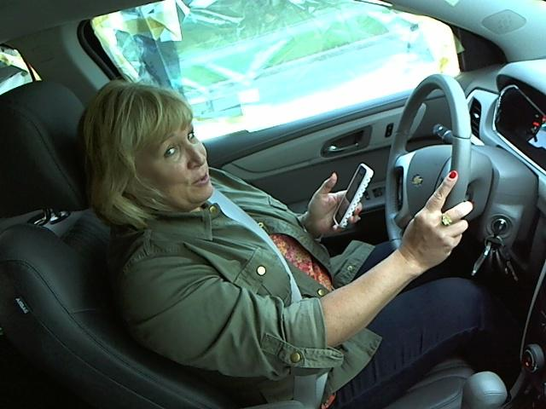
Phone Detection Dataset
Dataset Used:
  State Farm Distracted Driver Detection
  (https://www.kaggle.com/competitions/state-farm-distracted-driver-detection/data)
  Real-world driving images
  Multiple driver distraction categories
Focus of This Project:
  Extract phone usage cases only
  Ignore other distraction classes
  Use dataset as a source of realistic driving scenarios
Limitation:
  Dataset is designed for classification, not object detection
  No bounding box annotations for phones

Slide 9
Dataset Adaptation & Annotation
Problem:
  Dataset is not YOLO-ready
  Missing object-level phone annotations
Solution:
  Manual annotation of 50 images using CVAT.ai
  Assisted annotation to label remaining images
Post-processing with Python:
  Remove images with no phone detected
  Filter out low-confidence detections
  Reduce false positives
Final Dataset Size After Processing :
  TRAIN images : 6608
  VAL images : 1653

Slide 10
Phone Detection: Phase 1 (Base Training)
Model : YOLOv8
Dataset : State Farm Distracted Driver Detection
Training Setup: 30 epochs

Slide 11
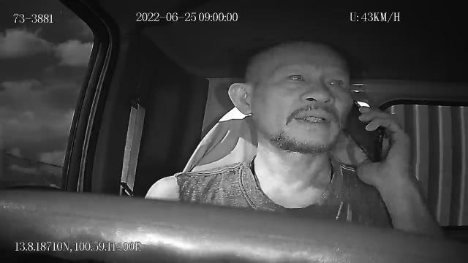
Limitation & Fine-Tuning Strategy
Observed Limitation:
  Poor detection performance during real webcam testing
Root Cause:
  State Farm dataset camera setup differs from real in-car webcams
Solution — Fine-Tuning Phase:
  Dataset: Advanced Driver Monitoring
  Dataset Size : 2000 images (80% training / 20% validation)
  Training: 6 fine-tuning epochs
  Goal:
    Adapt the model to realistic camera viewpoints
    Improve detection robustness in live conditions

Slide 12
Final Results
Precision (85.6%):
  When the system detects a phone, it is correct in 85.6% of cases, reducing false alerts.
Recall (82.6%):
  The system successfully detects 82.6% of all actual phone usage instances.
mAP@0.5 (89.8%):
  The model achieves strong overall detection performance with accurate phone localization at IoU ≥ 0.5.

Slide 13
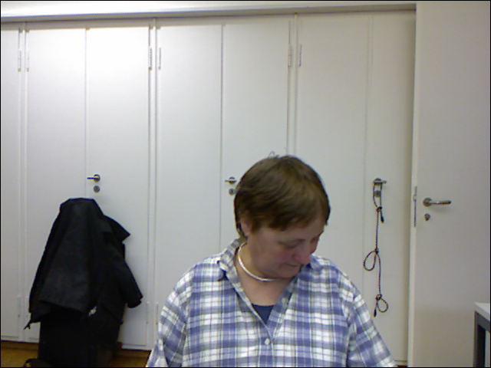
Head Pose Dataset
BIWI Kinect Head Pose Dataset
Dataset Overview:
  Public benchmark dataset for head pose estimation
  Captured using RGB + Depth Kinect sensor
  Designed for yaw, pitch, and roll estimation
Annotations
  Each frame has ground-truth head pose
  Pose stored as 6 values:
    Translation: (tx, ty, tz)
    Rotation (Euler angles in degrees): (pitch, yaw, roll)

Slide 14
Head Pose Model Training Pipeline
Data Preparation
  Used face-cropped RGB images
  Matched each image with its corresponding pose file
  Extracted yaw and pitch angles (degrees)
Preprocessing
  Resize images to 224 × 224
  Normalize using ImageNet statistics
  No angle normalization (trained directly in degrees)
Model Architecture
  Backbone: ResNet-18
  Pretrained on ImageNet
  Custom regression head:
    Fully connected layers
    Outputs: Yaw & Pitch

Slide 15
Head Pose Real-Time Testing
Calibration Phase :
  The system asks the driver to look straight ahead
  Yaw and pitch angles are collected over several frames
  The average yaw and pitch define the neutral head position
  The standard deviation (σ) measures the driver’s natural head movement
Adaptive Threshold Computation
  Thresholds are computed using statistical variation: Threshold = K × σ
  K = 3, covering approximately 99% of normal behavior
  This ensures thresholds adapt to each individual driver

Slide 16
Results & Performance
Best Validation Performance after 25 epochs :
  Yaw MAE: 4.81°
  Pitch MAE: 5.57°
  Average MAE: 5.19°

Slide 17
Conclusion
This project presented a real-time Driver Monitoring and Alert System capable of detecting drowsiness, distraction, and phone usage using computer vision and deep learning techniques.
By combining:
  Eye state classification for reliable drowsiness detection
  YOLO-based phone detection adapted to real in-car conditions
  Head pose estimation with adaptive, driver-specific calibration
Together, these components form a unified safety system capable of providing timely and meaningful alerts to enhance driver awareness and road safety.

