Slide 1


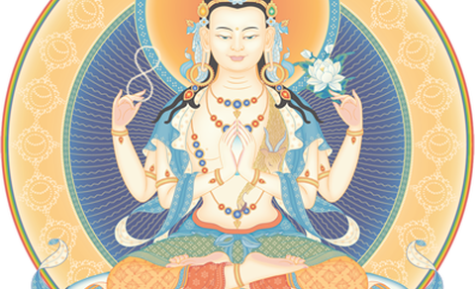

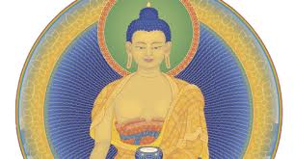
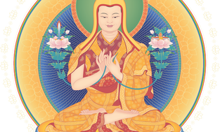



Home
About Us
Council
Events
Contacts
News
Oct. 6-12 Int'l Fall Festival - Germany
Dec. 1-3 Southwest Dharma Celebration in New Mexico
HOW TO MEDITATE
With the hectic pace and demands of modern life, many people feel stressed and over-worked. It often feels like there is just not enough time in the day to get everything done. Our stress and tiredness make us unhappy, impatient and frustrated. It can even affect our health. We are often so busy we feel there is no time to stop and meditate! But meditation actually gives you more time by making your mind calmer and more focused. A simple ten or fifteen minute breathing meditation as explained below can help you to overcome your stress and find some inner peace and balance. …..click to see more
Nov. 3-5The Midwest Dharma
Dec. 1-3 The South West Dharma Celebration
Meet us on:
All rights reserved © Vipassanā - Insight Awareness LLS, Horsens Denmark, Chr M Østergaards Vej 4 str., 8700

Slide 2

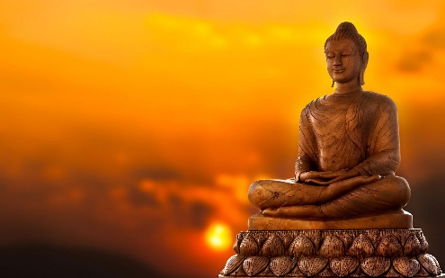
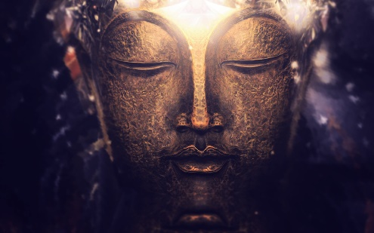
Home
About Us
Council
Events
Contacts
News
HOW TO MEDITATE
With the hectic pace and demands of modern life, many people feel stressed and over-worked. It often feels like there is just not enough time in the day to get everything done. Our stress and tiredness make us unhappy, impatient and frustrated. It can even affect our health. We are o…..click to see more
Getting Closer to the Buddha
Buddhist practitioners light and burn incense sticks. They raise the burning sticks above the head and bow to the statues of Buddha. Then they place their sticks vertically on burners from which smoke wafts.
Worshipers do so in a hope to talk to the Buddha w…..click to see more
Astrology and Astronomy
From the very beginning of time man has been fascinated by the stars and he has always tried to find some links between them and his own destiny. His observation of the stars and their movements gave rise to two very important areas of study, namely, As…..click to see more
Meet us on:
All rights reserved © Vipassanā - Insight Awareness LLS, Horsens Denmark, Chr M Østergaards Vej 4 str., 8700

Slide 3
Home
About Us
Council
Events
Contacts
News
HOW TO MEDITATE
With the hectic pace and demands of modern life, many people feel stressed and over-worked. It often feels like there is just not enough time in the day to get everything done. Our stress and tiredness make us unhappy, impatient and frustrated. It can even affect our health. We are often so busy we feel there is no time to stop and meditate! But meditation actually gives you more time by making your mind calmer and more focused. A simple ten or fifteen minute breathing meditation as explained below can help you to overcome your stress and find some inner peace and balance.
Meditation can also help us to understand our own mind. We can learn how to transform our mind from negative to positive, from disturbed to peaceful, from unhappy to happy. Overcoming negative minds and cultivating constructive thoughts is the purpose of the transforming meditations found in the Buddhist tradition. This is a profound spiritual practice you can enjoy throughout the day, not just while seated in meditation.
On this website you can learn the basics of Buddhist meditation. A few books are mentioned that will help you to deepen your understanding if you wish to explore further. Anyone can benefit from the meditations given here, Buddhist or not. We hope that you find this website useful and that you learn to enjoy the inner peace that comes from meditation.
Meet us on:
All rights reserved © Vipassanā - Insight Awareness LLS, Horsens Denmark, Chr M Østergaards Vej 4 str., 8700

Slide 4
Home
About Us
Council
Events
Contacts
News
Getting Closer to the Buddha
Buddhist practitioners light and burn incense sticks. They raise the burning sticks above the head and bow to the statues of Buddha. Then they place their sticks vertically on burners from which smoke wafts.
Worshipers do so in a hope to talk to the Buddha who will appear in the smoke. This is the scene you will see in most of the functioning Buddhist temples in China.
Incense burning is a common Chinese religious ritual in Chinese Buddhism as well as Chinese ancestor worship and Taoism. The most common practice is that followers burn three sticks of incense at once, one for the Buddha; another for the Buddha’s teachings, known as the Dharma; and a third for the community of Buddhists, the Sangha.
So incense smoke is a soul link between worshipers and the Buddha. With joss sticks burning, people are getting closer the Buddha and it also reminds us to burn ourselves, to give and to sacrifice though in reality, many people come here praying for health, love, money and the list can be much longer.
What would you talk with Buddha if you have the chance to burn incense sticks? For sacrifice or taking? If you are planning your Beijing tour, do allocate one or two hours visiting Lama Temple, also known as Yonghe Temple or Yonghe Lamasery. You will be infected by the solemn and mythical atmosphere of incense burning and praying.
Meet us on:
All rights reserved © Vipassanā - Insight Awareness LLS, Horsens Denmark, Chr M Østergaards Vej 4 str., 8700

Slide 5
Home
About Us
Council
Events
Contacts
News
Astrology and Astronomy
From the very beginning of time man has been fascinated by the stars and he has always tried to find some links between them and his own destiny. His observation of the stars and their movements gave rise to two very important areas of study, namely, Astronomy and Astrology. Astronomy can be considered a pure science which is concerned with the measurements of distances, the evolution and destruction of stars, their movements, and so on. Of course all these calculations are always made in relation to planet earth and how these interplanetary movements affect mankind on a physical level. Modern astronomy seeks to find answers to the still unanswered questions regarding the origin of man and the final, possible end of his existence as a member of the human race. It is a fascinating area of study and our new knowledge of the universe and the galaxies has put much pressure on many religions to evaluate their age-old postulations regarding the creator and the creation of life.
Buddhism does not face any dilemma, simply because the Buddha did not encourage His followers to speculate on things beyond their comprehension. However, He has made many allusions which in the light of our new knowledge gained through science, shows us that the Buddha was very much aware of the true nature of the Universe, that it was never created in one glorious moment, that the earth is merely a tiny, even unimportant speck in all of space, that there is constant creation and destruction, and that everything is in constant motion.
Meet us on:
All rights reserved © Vipassanā - Insight Awareness LLS, Horsens Denmark, Chr M Østergaards Vej 4 str., 8700

Slide 6




Home
About Us
Council
Events
Contacts
News
 | Phone number : +45 6666 6666 Email: oskars@VIA.dk Occupation: Board member. Incharge of something else
 | Phone number : +45 5555 5555 Email: liviu@VIA.dk Occupation: Board member. Incharge of new information
Oskars Arajs
Liviu Pascari
 | Phone number : +45 4444 4444 Email: taha@VIA.dk Occupation: Board member. Incharge of Web Design
 | Phone number : +45 4444 4444 Email: dragos@VIA.dk Occupation: Board member. Incharge of Web Design
Taha Muhamed Alzein
Dragos Chirtoaca
Meet us on:
All rights reserved © Vipassanā - Insight Awareness LLS, Horsens Denmark, Chr M Østergaards Vej 4 str., 8700

Slide 7
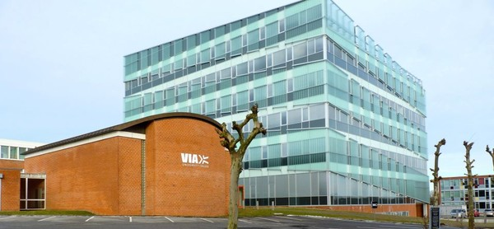
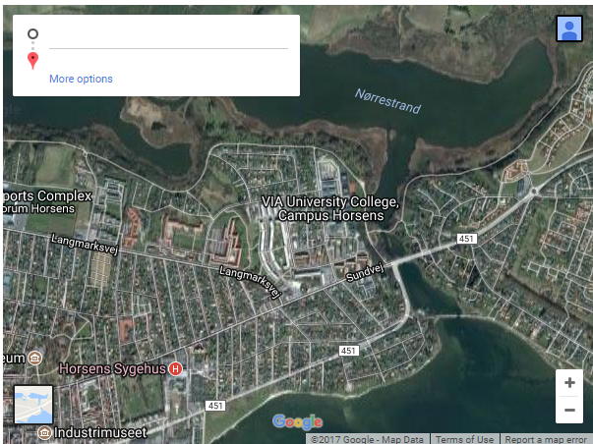
Home
About Us
Council
Events
Contacts
News
Addresse: Vipassanā - Insight Awareness LLS
Chr M Østergaards Vej 4,
8700 Horsens
Fax: +1 (212) 222 8888
Tele: +45 2222 3333
Mail: information@via.dk
Meet us on:
All rights reserved © Vipassanā - Insight Awareness LLS, Horsens Denmark, Chr M Østergaards Vej 4 str., 8700

Slide 8
Home
About Us
Council
Events
Contacts
News
Oct. 6-12 Int'l Fall Festival - Germany
Dec. 1-3 Southwest Dharma Celebration in New Mexico
Nov. 3-5 The Midwest Dharma
At this festival, Gen-la Dekyong will explain the essential practices of training the mind (Lojong) based on Venerable Geshe Kelsang Gyatso Rinpoche’s book Universal Compassion. The practices of training the mind are exceptionally powerful methods for overcoming our delusions, especially our self-cherishing, and for gaining deep realizations of conventional and ultimate bodhichitta. In this way, we can attain the real meaning of our human life – enlightenment.
Inspired by our Founder, Venerable Geshe Kelsang Gyatso, every year practitioners from the southwest US and beyond gather together for this special evenwonderft. The celebration will be a ul opportunity to receive teachings from our Western US National Spiritual Director, Gen Kelsang Rigpa, and to meet with spiritual friends. Enjoy the company of like-minded people, and empower your spiritual life at this special weekend event.
Celebration is a very special annual event that connects practitioners around the Midwest. This relaxing weekend of practical teachings, guided meditations, and empowerment nourishes our spiritual life and increases our capacity for boundless inner peace and happiness. If you are new to Buddhism, the Celebration weekend provides a perfect opportunity to gain a deeper understanding and experience of Buddha’s teachings.
<<Pre
Next>>
Meet us on:
All rights reserved © Vipassanā - Insight Awareness LLS, Horsens Denmark, Chr M Østergaards Vej 4 str., 8700

Slide 9

Home
About Us
Council
Events
Contacts
News
Vipassanā ‐ Insight Awareness
VIA is a center for spiritual events originally with a base in the Buddhist principles of meditation as an insight with awareness of what is happening as it happens. Today events at VIA also includes spiritual practices not directly linked to any religion like dream interpretations, healing, astrology, reincarnation, Karma, alternative health care and similar.
Future vision
Our vision for the future is the same as our view of the present. It’s to educate people on a more spiritual level, help to gain inner piece and to understand that everything in life is connected. To show people how meditation can help you get through hard times, how Buddhism can help you find inner piece and how astrology can show you connection you never believed before
Meet us on:
All rights reserved © Vipassanā - Insight Awareness LLS, Horsens Denmark, Chr M Østergaards Vej 4 str., 8700

