Slide 1
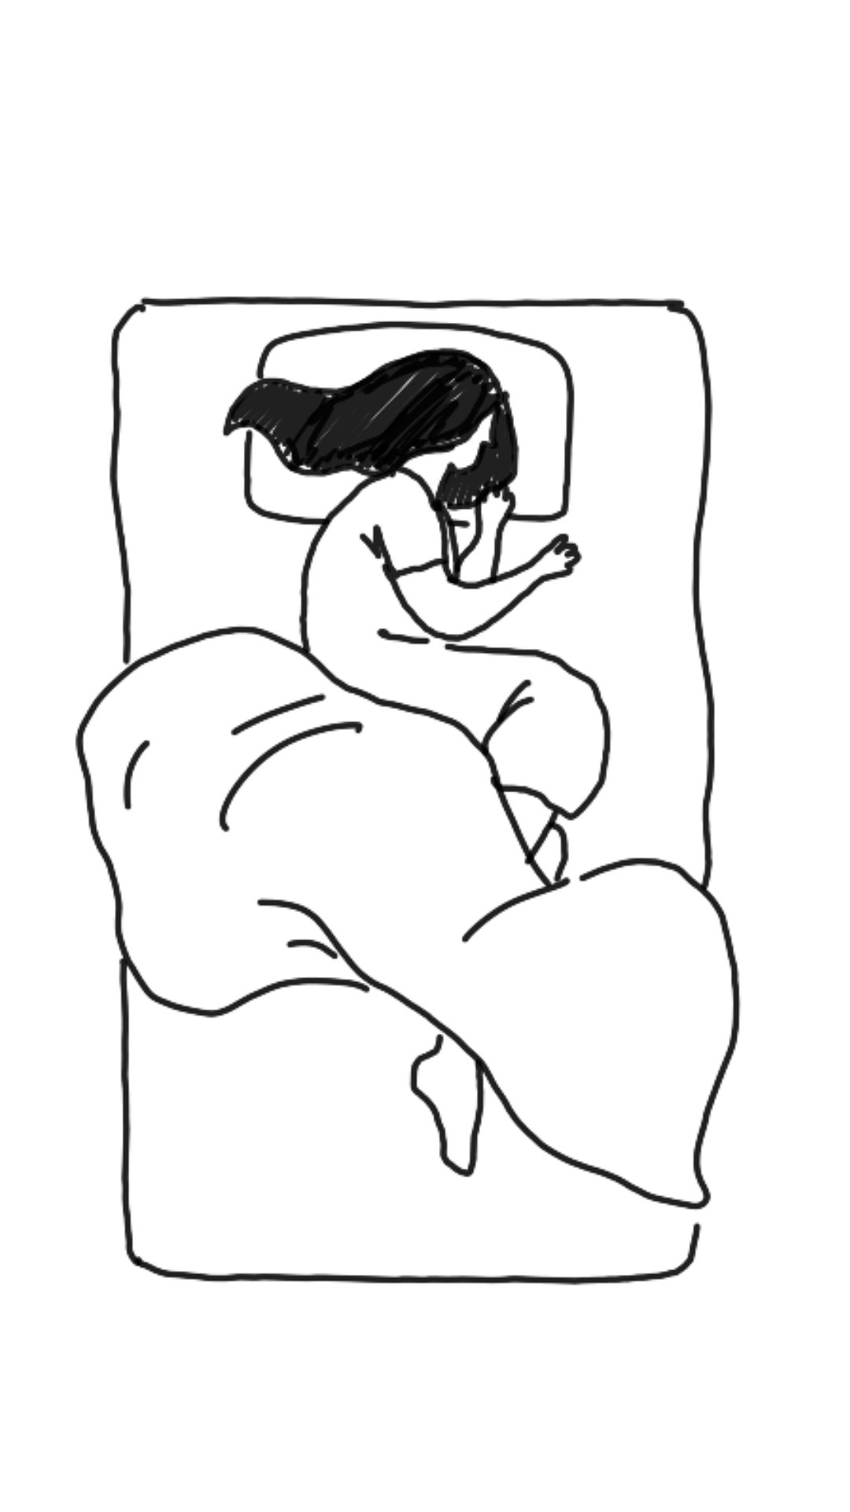
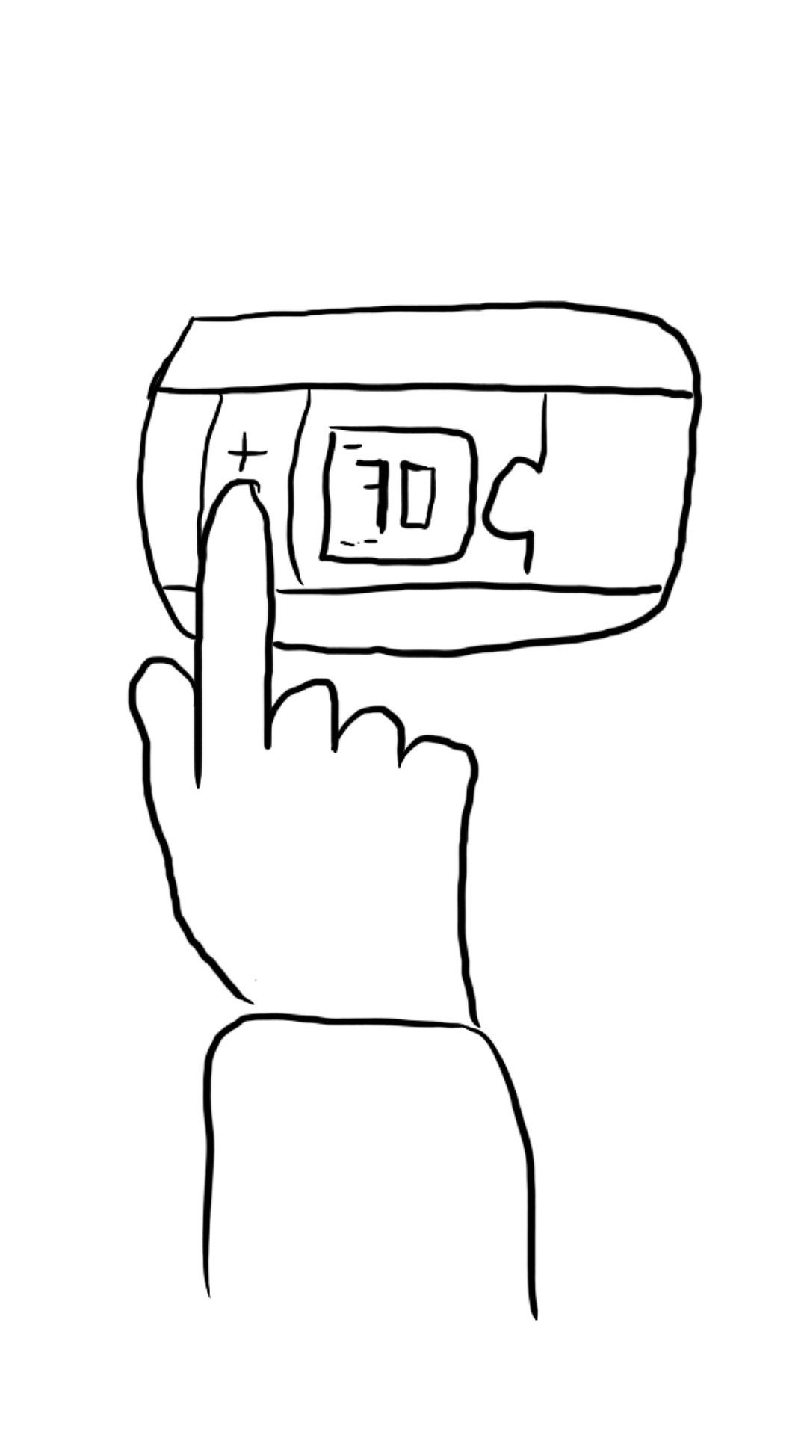
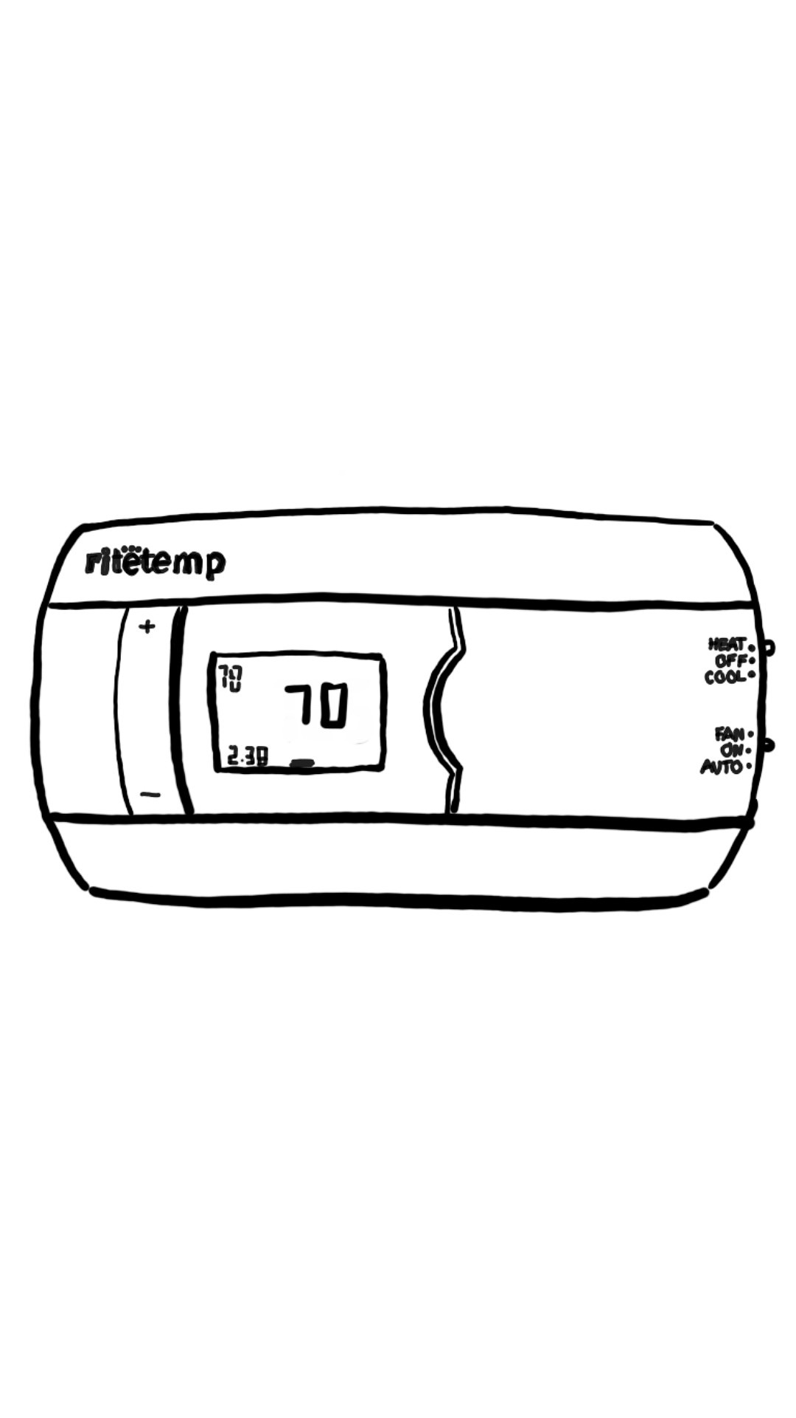
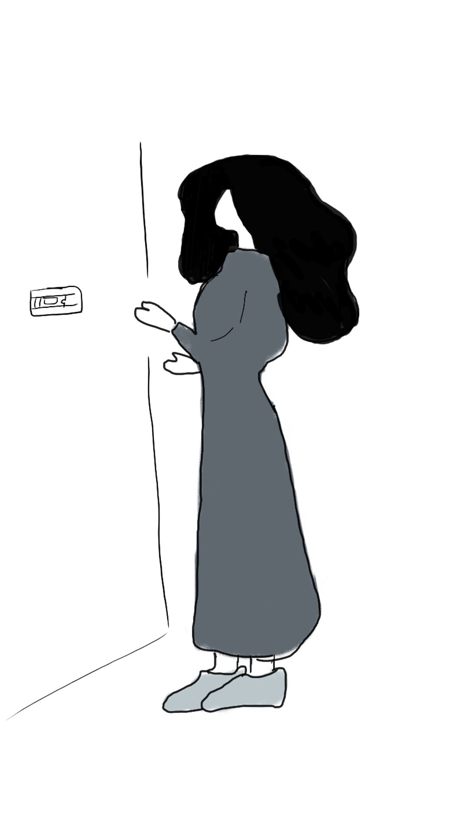
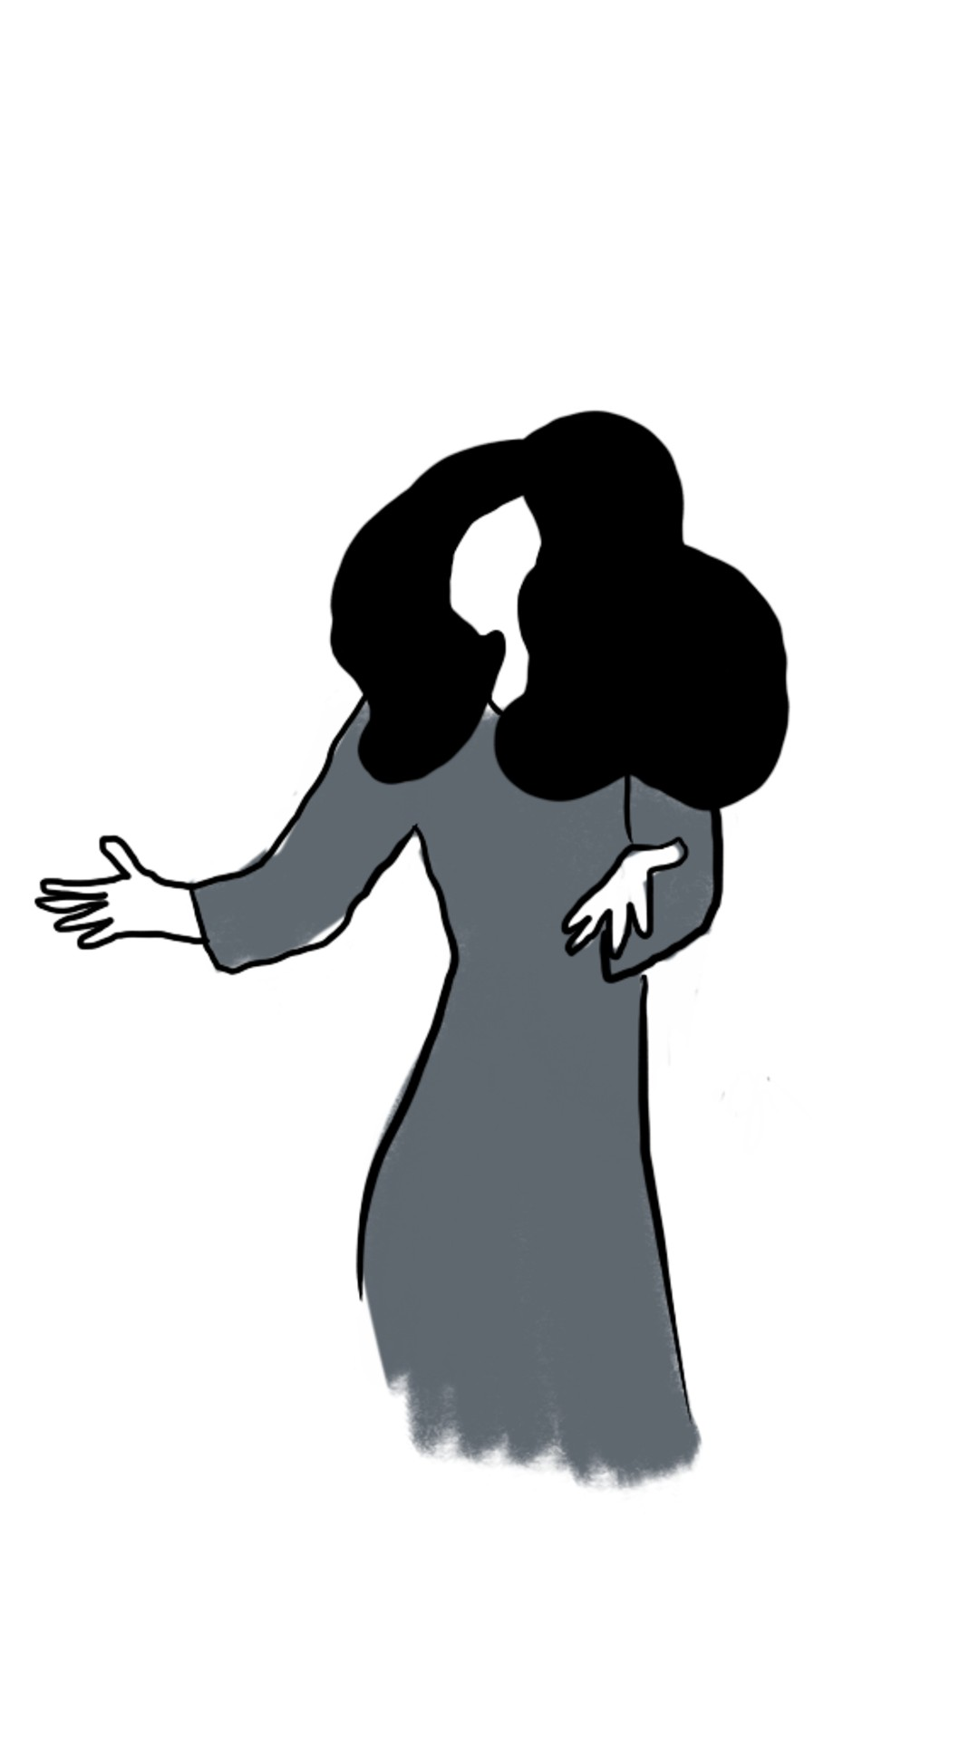
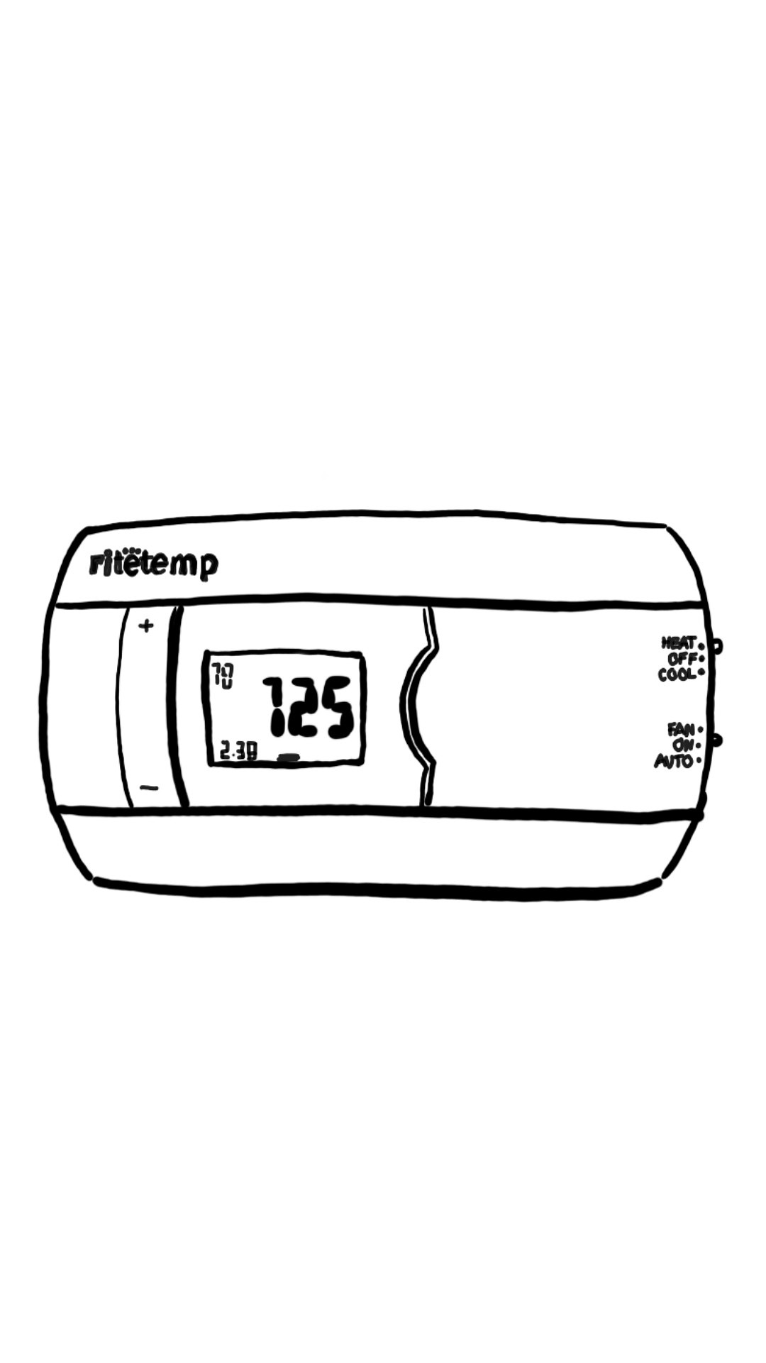
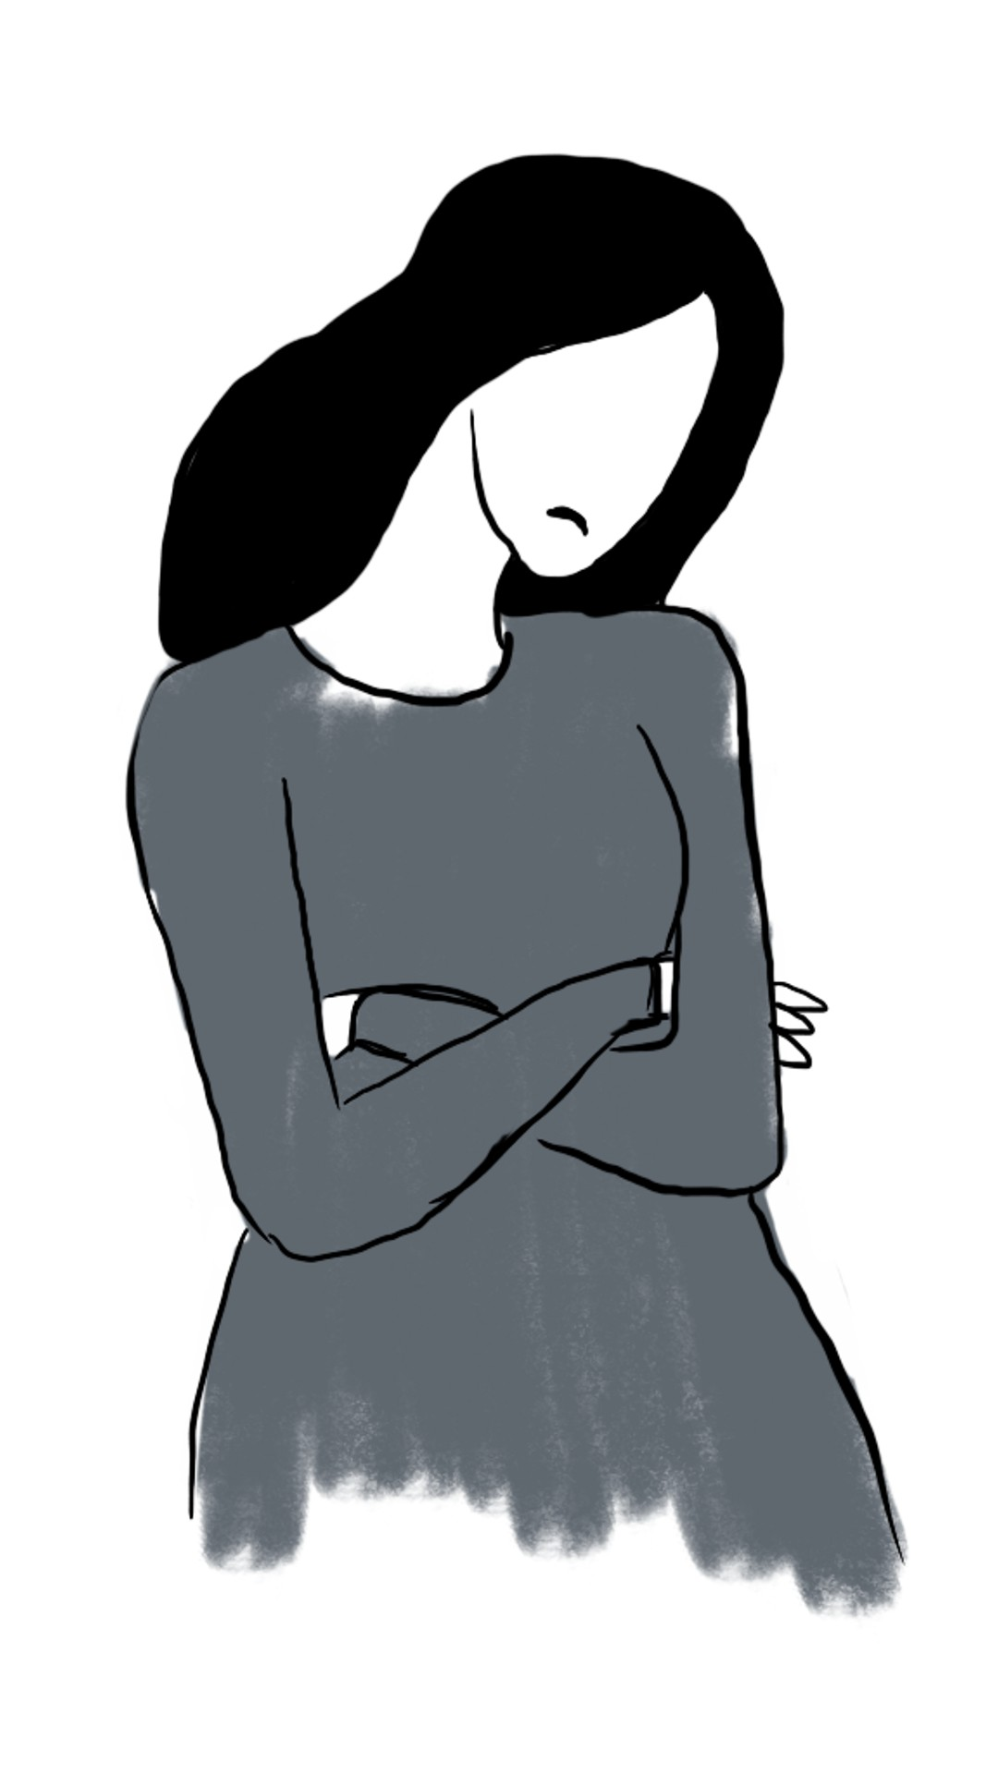
It's a particularly cold night and Beatrice has just come home from a busy day at work. She wants to go to bed but it's far too cold and her feet are freezing.
She goes to the living room to increase the heat temperature.
She presses the + button.
The screen does not change.
She presses the same button again, with more force this time.
Again, the screen doesn't change.
Groggy and frustrated, Beatrice exclaims in exasperation and believes the thermostat is broken. She even considers calling the landlord to get someone to fix it at that moment.
She decides to press again, this time with excessive force, because she's so upset.
Finally, the screen changes and the temperature increases.
Upset that it took that long, Beatrice is now even more tired and annoyed.

Slide 2
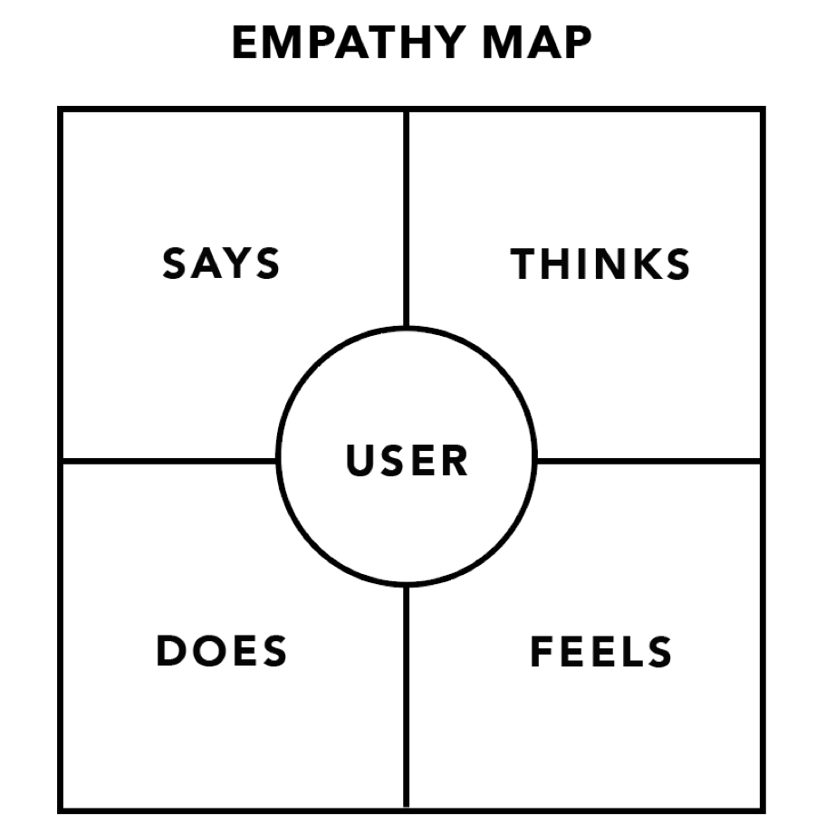
SAYS
THINKS
Why is it so cold in here?
Crap! It’s freezing outside.
Busy Beatrice is a 24 year old woman with a full-time job at a consulting firm who is extremely busy with work. Tonight was a particularly busy day in the office and she’s coming home very late.
The interface problems she faces include not being able to adjust temperature properly because of difficulty pressing buttons and understanding the purpose of various buttons.
This persona represents the users of the chosen interface because she lives in a home where adjusting the heat is necessary on her part (she has to do it herself).
Is the heat working? Wait, what?
I just want to get home!
Just my luck, I should have brought a heavier jacket
Are these buttons not working?
Busy Beatrice
Runs to house from car.
Pressured by upcoming case deadline
Takes off shoes and steps barefoot into house.
Very tired and drained from work.
Goes to check house temperature. Sets thermostat.
Uses physical force to try to get buttons to work.
Surprised by how cold it is inside her house.
Speaks to herself when doing so.
DOES
FEELS

Slide 3
SAYS
THINKS
Wait did that work?
Isn’t it the middle of December?
Lonely Lucas is a male high school student in his senior year. His parents are always on business trips, leaving him alone at home often for multiple nights in a row. Today was an unusually warm day for winter and he wants to turn the heat off and AC on.
The interface problems this persona faces is he is not able to know if he set the heat properly or not.
So, he’s always second-guessing himself and is never sure if the heat/AC is actually on when it says it is.
This persona represents the users of the chosen interface because he is also the one who has to use the thermostat given there is no one else to do it for him.
Wow, global warming is real.
How do I…?
It’s so sunny today!
Maybe this one…?
Lonely Lucas
Looks outside window.
Very alone in the house.
Gets up from bed and goes to living room to check the thermostat.
Surprised at how warm it is given the time of year.
Sets thermostat.
Turns off heat by using switch on the sides.
Annoyed that he has to set the thermostat because he doesn’t like it.
Speaks to himself when doing so.
DOES
FEELS

Slide 4
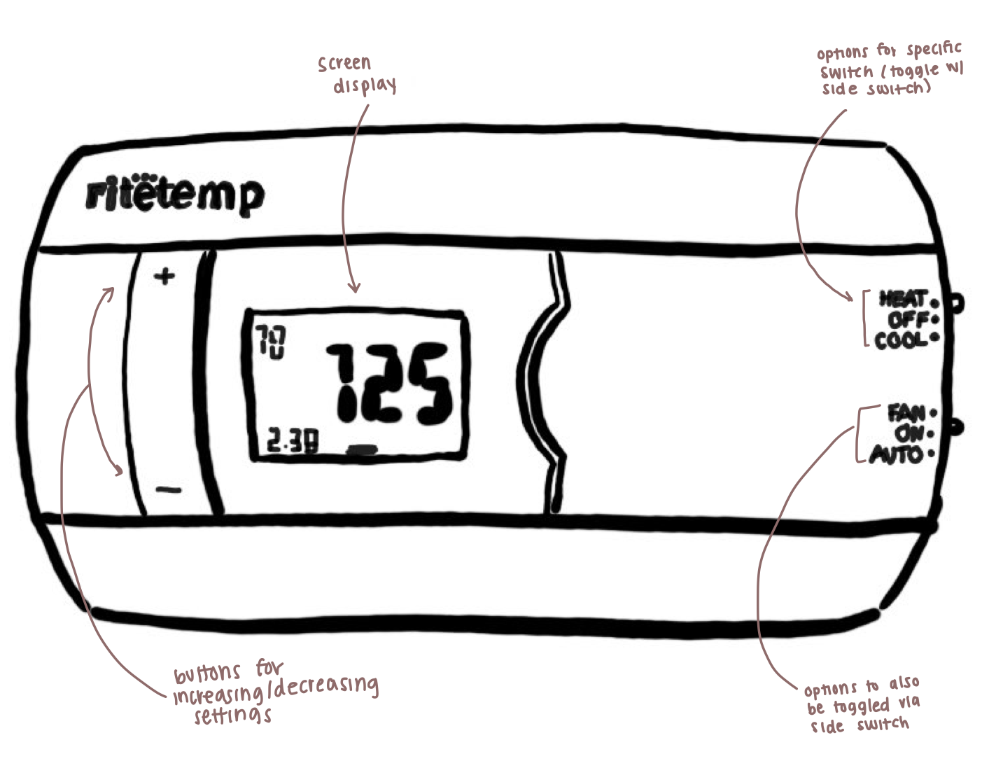

Slide 5
