Slide 1
Restaurants and cafes in Stuttgart
Influence of location and type of cuisine on future ratings

Slide 2
INTRODUCTION
For sure, the ratings of a restaurant are highly dependent on the quality of the food, the service and the whole atmosphere.
BUT beside these criteria of a running business, are there fundamental conditions I can set before opening a business which are influencing the future rating?
E.g. before I'm opening a restaurant business I have to decide
where to locate it and
which kind of cusine I want to offer.
When taking the decision I should consider that this cuisine is demanded by customers in this area of the city.
Of course, I can't look in the future or asking all the residents, but I can check how the existing businesses perform.

Slide 3
DATA
I want to investigate this problem for the city of Stuttgart in Germany.
As level of detail on the locations I'm choosing the ZIP-codes in the city area. This ZIP-code areas should sufficient enough to represent the different neighborhoods --> Web-source
For each ZIP-code area I can pull the geo coordinates to get reference points per neighborhood. --> GEOPY
With the geo coordinates I can get a list of food-related businesses from Foursquare which are close to each neighborhood
For each food-related business I'm pulling the rating from Foursquare.
For exotic cuisine I won't have enough data that's why I'm focusing on the top10-cuisines only.
My dataset consists of "rating" (as target) and "close neighborhoods" and "cuisine" (as features)
With a Linear Regression-method I can evaluate the impact of the features on the ratings to see if they are worth considering in the fundamental decisions.

Slide 4
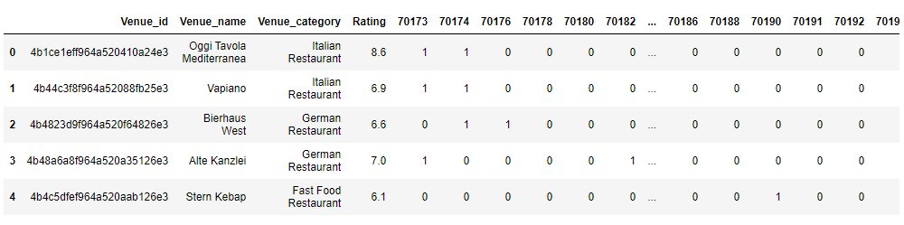
FINAL DATA SET
5 records out of 176

Slide 5
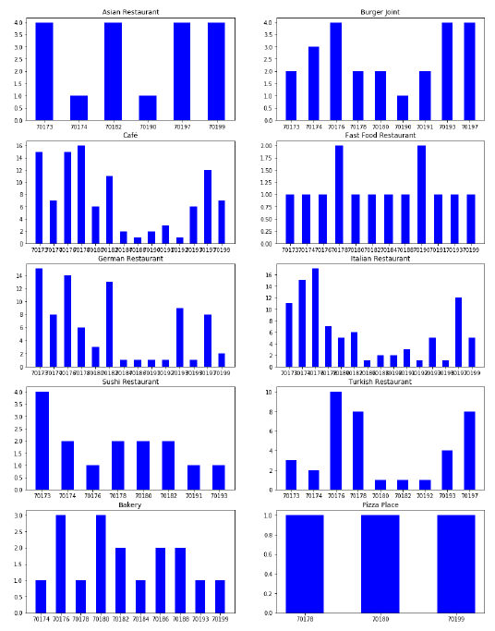
ANALYSIS OF DATA No. of restaurant per cuisine for each ZIP-code area

Slide 6
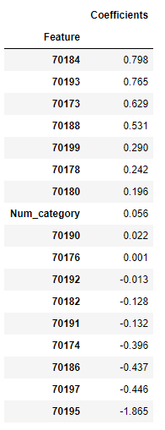
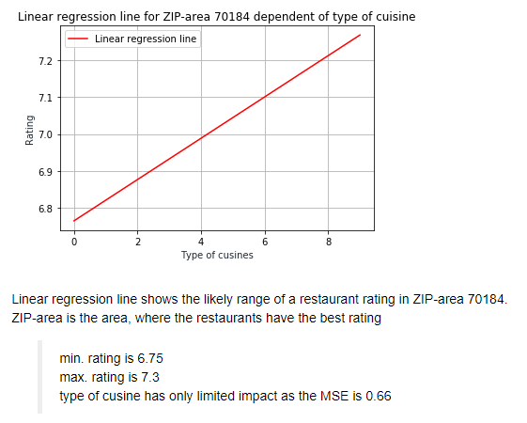
RESULTS OF LINEAR REGRESSION

Slide 7
CONCLUSION
The impact of location and cuisine on the rating is not significant enough to be considered as crucial criteria

