Slide 1
FLASK Workshop
Conducted By: KONG ZE JIE

Slide 2
TOPICS
01
03
02
04
Overview of Web
Hands-on
Exercise
Setting up Flask
Extra Resources

Slide 3

INTRODUCTION
Flask is a web application framework written in Python. A Web Application Framework represents a collection of libraries and modules that enable web application developers to write applications.

Slide 4
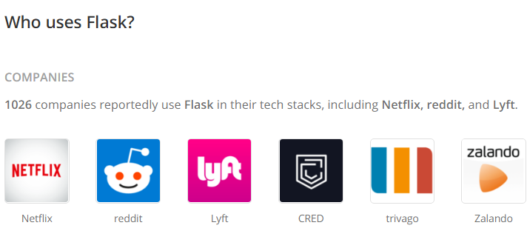
Motivation
Easy to learn
Popular
Applications
Up-to-date / modern. Scalable.
Limitless applications.
Small learning curve. Written in Python. Good starting point to get into front-end or back-end.

Slide 5
01
Overview of Web
Notes:
Dynamic web pages, static web pages

Slide 6
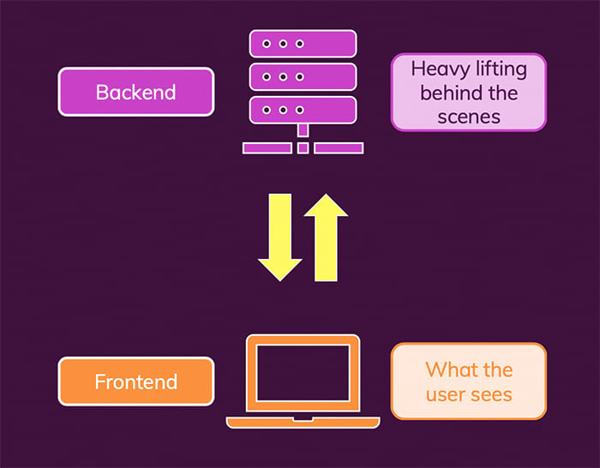

Slide 7
Python 3.6 ++
IDE
Requirements
Module
Browser
Latest version of Python recommended.
Vscode, Pycharm …
pip (package manager), venv
Access localhost
Notes:
Localhost explain

Slide 8
02
Setting up Flask

Slide 9
Directory Structure
Desktop/flask-tutorial
├── flaskr/
│ ├── __init__.py
│ ├── db.py
│ ├── schema.sql
│ ├── auth.py
│ ├── blog.py
│ ├── templates/
│ │ ├── base.html
│ │ ├── auth/
│ │ │ ├── login.html
│ │ │ └── register.html
│ │ └── blog/
│ │ ├── create.html
│ │ ├── index.html
│ │ └── update.html
│ └── static/
│ └── style.css
├── tests/
│ ├── conftest.py
│ ├── data.sql
│ ├── test_factory.py
│ ├── test_db.py
│ ├── test_auth.py
│ └── test_blog.py
├── venv/
├── setup.py
└── MANIFEST.in

Slide 10
Virtual Environment
1.) Create project folder and virtual environment
$ mkdir myproject
$ cd myproject
$ python3 –m venv venv
Why use virtual environment ???
2.) Activate virtual environment
$ source venv/bin/activate

Slide 11
Flask Code Template
from flask import Flask
app = Flask(__name__)
@app.route("/")
def hello_world():
return "<p>Hello, World!</p>"
Notes:
from flask import Flask
app = Flask(__name__)
@app.route("/")
def hello_world():
return "<p>Hello, World!</p>"

Slide 12
Routing
- Start with @app.route(“relative URL path”)
- Followed by a function.
- Usage : Bind defined function to the specified URL
@app.route("/")
def hello_world():
return "<p>Hello, World!</p>"
E.g. When relative URL “/” is accessed, a webpage with “Hello World!” will be shown.
Notes:
Decorators – modify the function of a function. Return a function based on give function parameter https://www.datacamp.com/community/tutorials/decorators-python

Slide 13
Variable Rules
@app.route("/<name>")
def hello_world(name):
return "<p>Hello" + name + "</p>"
- Append input parameter at the end of URL
- Input stored in variable and passed into function
Note: f strings can be used to simplify return statement
E.g.
return f"<p>Hello{name}</p>"

Slide 14
URL Building, Redirect URL, Render Template
@app.route("/intu/<user>")
def intu(user):
if user == “student”:
return redirect(url_for(student))
elif user == “staff”:
return redirect(url_for(staff))
@app.route("/student")
def student():
return render_template(“student.html”)
@app.route("/staff")
def staff:
return render_template(“staff.html”)
Notes:
What happens if return student()?

Slide 15
Intro to HTML
<!DOCTYPE HTML>
<html>
<head>
<meta charset="utf-8" />
<title>App</title>
<meta name="viewport" content="width=device-width, initial-scale=1" />
<script charset="utf-8" src="js/app.js"></script>
<link rel="stylesheet" href="css/app.css" />
</head>
<body>
<h1>Hello!</h1>
</body>
</html>

Slide 16
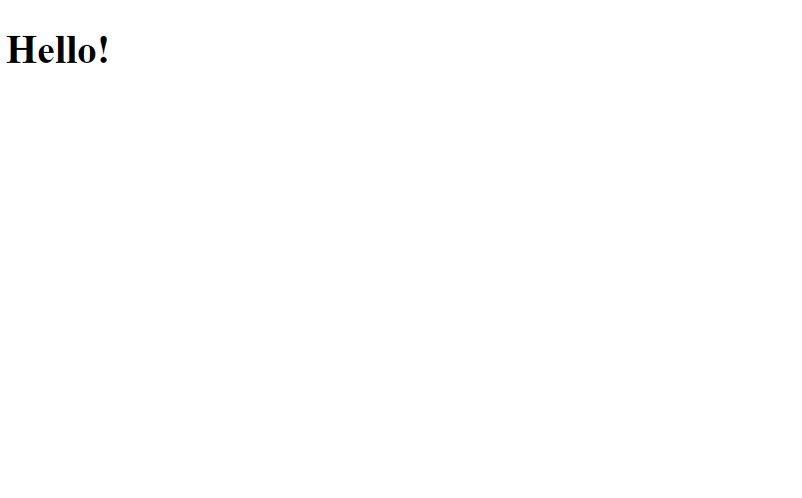
Real-time html editor : https://htmledit.squarefree.com/
Common HTML Tags : https://www.w3schools.com/TAGS/tag_a.asp

Slide 17

HTTP Methods
GET
POST
Client requests (GET) data from server. Default method for app.route().
Client sends (POST) data to server. Typically, by submitting a form in HTML.
@app.route("/",methods = [‘GET’,‘POST’])
def func():
if request.method == ‘POST’:
return ...
else:
return ...
Note : import request
Notes:
Communicate between server and client

Slide 18
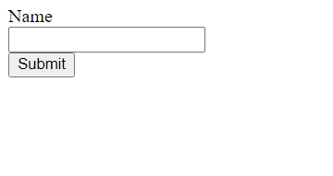
HTML Form
<form action=“{{url_for(func)}}” method=‘post’>
<label for=‘name’> Name </label>
<input type=‘text’ id =‘name’ name=‘name’>
<input type=‘submit’ name=‘submit’>
</form>

Slide 19
Accessing POST Data
- Use request.form[key]
- Returns a string object of the value
@app.route("/",methods = [‘GET’,‘POST’])
def func():
if request.method == ‘POST’:
name = request.form[‘name’]
return ...
else:
return ...
Notes:
Check key??? What is key name in html??

Slide 20
03
Exercise

Slide 21
04
Extra Resources

Slide 22



Contacts
https://github.com/zejiekong
https://www.linkedin.com/in/ze-jie-kong/
Feel free to connect with me ! 😀
Notes:
Github : https://github.com/zejiekong
Linkedin : https://www.linkedin.com/in/ze-jie-kong/

Slide 23
THANKS!
Please, keep this slide for attribution.

