Slide 1
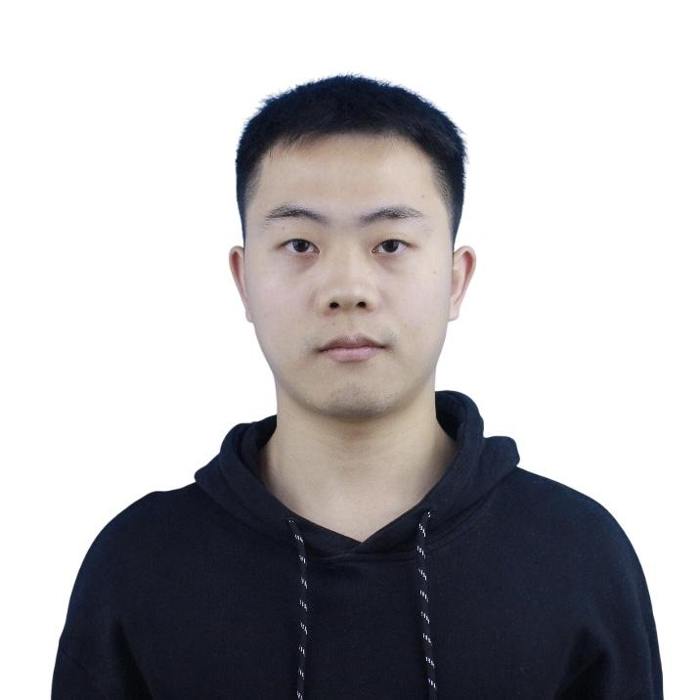
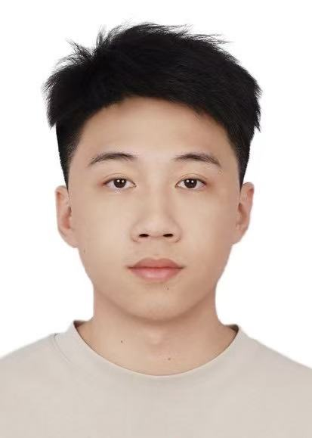
Selective Observation for Browser Agents
Final project: can a GUI agent skip some expensive re-observations without giving up success or safety?
benchmark-first refactor
local diagnostic suite
MiniWoB external benchmark
Project thesis
Talk map
Instead of hard-coding ‘observe every step’, we learn a gate that decides when to pay for another observation. The system now runs on both a local observation-sensitive suite and a recognized external benchmark subset.
1. Why selective observation matters
2. Benchmark-first system design
3. Main external-benchmark result
4. Why the local suite is a useful negative result
5. What we would do next
0.90
2.0
0
MiniWoB success
Avg. model calls
Unsafe rate
learned@0.8 on curated external benchmark
vs 3.0 for always-observe
on the external benchmark headline run
Zejun Huang
Dingjiang Liang
01
Research question + headline result
Selective Observation Agent
Notes:
[Zejun] Title / intro — 1 min. Introduce the team, the question, and the headline numbers.

Slide 2
MOTIVATION
Modern browser agents over-observe.
They often pay for a fresh model-backed observation before every action, even when the previous plan is still usable.
Why this matters
Baselines we compare against
Research question
Observation is the expensive part of the loop: it triggers another model call, adds latency, and can still be redundant when the next few actions are already obvious.
A strong policy should reuse stale-but-still-correct plans when it is safe to do so.
always: re-observe before every step
never: observe once, then coast
handrule: observe on coarse screen change or checkpoint
learned@tau: gate probability threshold + safety floor
Can we save model calls by skipping some observations?
Can we keep success rate high while doing that?
Can we hold unsafe behavior at or near zero?
Our final framing: external benchmark for the headline claim, local diagnostic suite for failure-mode analysis.
02
Motivation and evaluation framing
Selective Observation Agent
Notes:
[Zejun] Motivation — 1.5 min. Explain why always-observe is expensive and what a gate does.

Slide 3
METHOD
We turned the repo into a benchmark-first selective-observation framework.
The observation gate is the reusable core; environments plug in through adapters.
Task suite
local diagnostic
or MiniWoB
Adapter layer
reset / observe /
execute / success
Planner
OpenAI agent plans
short action sequences
Observation gate
cheap features ->
observe or coast
Evaluator
success, calls,
cost, latency, unsafe
What changed in the codebase
Training loop
1. Added a generic adapter interface so the same collector/evaluator can drive both the local app and MiniWoB.
2. Upgraded the gate trainer from logistic-only to logistic-or-MLP auto-selection.
3. Added task-suite manifests, benchmark metadata, and bootstrap confidence intervals.
Round 0: always-observe oracle collection
Round 1: collect under learned@0.5 (DAgger)
Train gate on cheap observation features
Sweep thresholds at evaluation time to trace a cost/success frontier
03
Architecture and code contributions
Selective Observation Agent
Notes:
[Zejun] Method — 2 min. Walk through the adapter-first architecture and the DAgger training loop.

Slide 4
BENCHMARKS
We intentionally separate a diagnostic suite from the external benchmark.
That gives us one environment for controlled stress tests and one environment for credibility.
Local diagnostic suite (17 tasks)
MiniWoB curated external benchmark (10 instances)
Purpose: controlled observation-sensitive stress testing
Families: static baseline, async results, value drift, delayed options
Why it is useful: we can manufacture hard cases where coarse screen change misses the real state shift
Example tasks: async contact resolution, notebook price drift, delayed language options
Purpose: show that the same observation-policy core runs on a recognized community benchmark.
Curated tasks:
click-button
focus-text
click-option
click-checkboxes
click-button-sequence
We duplicated selected tasks with two seeds to make the subset slightly less fragile.
5 static baselines
4 async result tasks
5 value-drift tasks
Final evaluation framing
3 delayed-option tasks
External benchmark = headline result
Local diagnostic suite = negative result + why cheap features are not enough
04
Benchmark design
Selective Observation Agent
Notes:
[Dingjiang] Benchmarks — 1.5 min. Describe the two-tier suite: local diagnostic vs. MiniWoB.

Slide 5
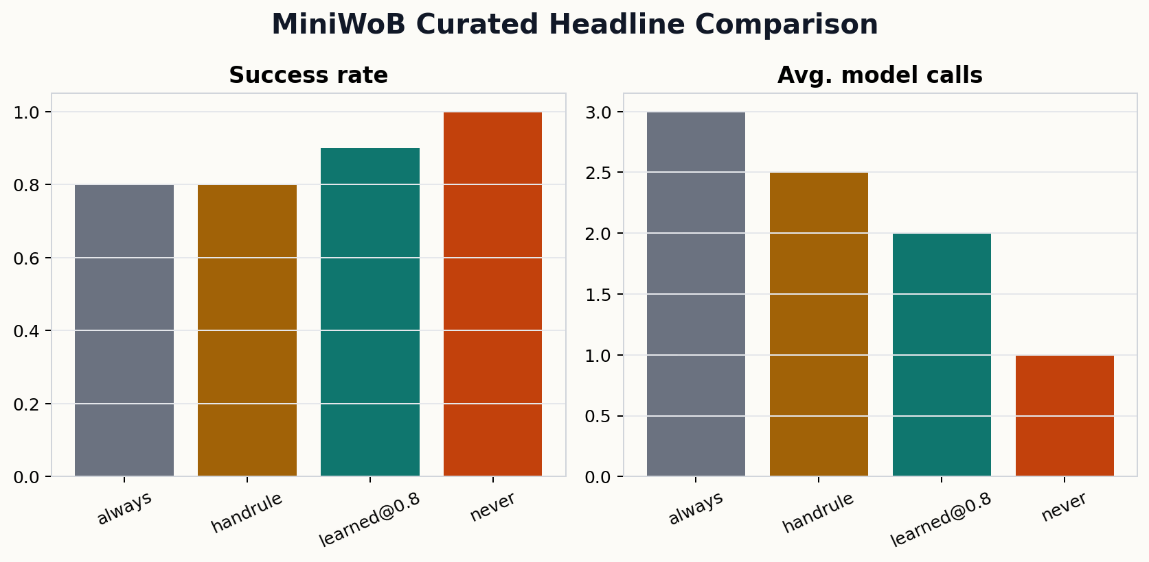
MAIN RESULT
On the external benchmark, the learned gate gives the best safe tradeoff.
The strongest point on our frontier is learned@0.8: higher success than always/handrule, fewer model calls than both, and zero unsafe misses.
Headline numbers
0.90
Success rate
learned@0.8
2.0
Avg. model calls
vs 3.0 for always
0
Unsafe rate
same as always / handrule
Interpretation
This is the cleanest result in the project: the gate does not just save cost, it also improves success over the safe baselines on this curated external subset.
05
MiniWoB curated headline
Selective Observation Agent
Notes:
[Zejun] Main result — 2 min. learned@0.8 Pareto-dominates safe baselines on MiniWoB; present table.

Slide 6
WHY IT WORKS
The gain comes from not forgetting hidden progress on sequence-like tasks.
Repeated fresh observation can hurt when the current page does not visibly encode what was already done.
Example: MiniWoB click-button-sequence
Instruction: click ONE, then click TWO. After button ONE is clicked, the page does not visibly mark that progress. If the policy re-observes and replans from scratch, it may click ONE again. Coasting on the carried plan can actually be better.
always
handrule
learned@0.8
Fails both sequence seeds.
Average 8 model calls on the sequence instances because it keeps re-planning from a partially observed state.
Still fails one seed, but uses fewer calls because it sometimes keeps the stale plan when the coarse screen signature does not change.
Succeeds on one of the two sequence seeds and keeps 0 unsafe misses on the whole benchmark. This is the point that dominates the safe baselines.
Observation is not automatically helpful when state is partially observable.
A good gate should learn when re-observation destroys useful momentum.
06
Task-level interpretation
Selective Observation Agent
Notes:
[Zejun] Why it works — 1 min. click-button-sequence: re-observation can destroy plan momentum.

Slide 7
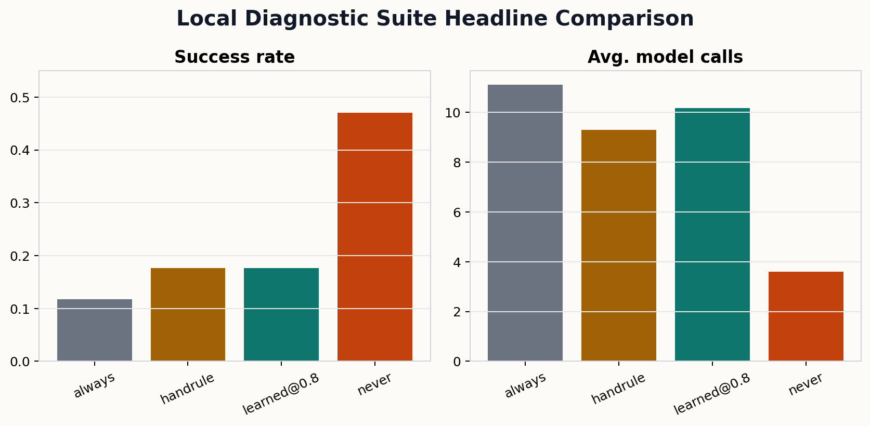
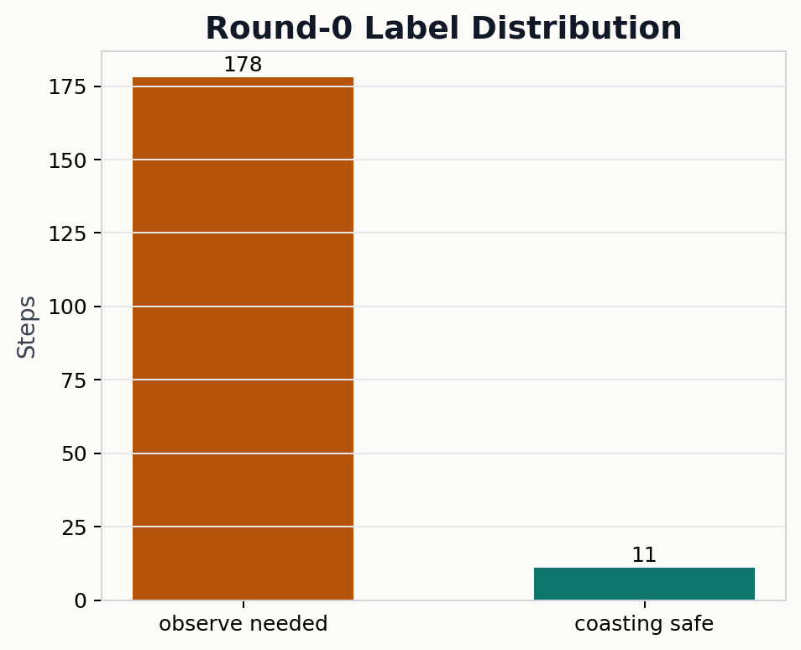
LOCAL SUITE RESULT
Selective observation beats always-observe by +23pp success at 26% fewer calls.
handrule: 52.9% success, 8.7 calls, 0 unsafe ● learned@0.95: 47.1% success, 8.5 calls, 0 unsafe ● always: 29.4% success, 11.8 calls, 0 unsafe
What the local results show
Handrule outperforms always-observe by 23.5pp (+74% relative), using 26% fewer model calls. This validates that selective observation is valuable even with a simple hand rule. Learned@0.95 approaches handrule (47.1% vs 52.9%, 8.5 vs 8.7 calls) with 0 unsafe misses — the safety floor fix holds perfectly. At low thresholds (0.2–0.8) the gate collapses to always-observe because 90% of training labels are positive; high-threshold coasting is where the learned signal kicks in. Paired with the MiniWoB result (learned@0.8 dominates handrule), the picture is: selective observation with a learned gate works best on structured tasks; on harder dynamic tasks the gate needs richer data.
07
Local suite: selective obs beats always; learned@0.95 approaches handrule
Selective Observation Agent
Notes:
[Dingjiang] Local suite — 1.5 min. Key message: handrule beats always (+23pp) validating selective observation. Learned@0.95 approaches handrule with 0 unsafe. Weakness: gate collapses at low T due to 90% positive labels in training data.

Slide 8
TAKEAWAYS
What we learned and what we would do next
Takeaway 1
Takeaway 2
Takeaway 3
The benchmark-first refactor was worth it. Once the core observation policy was isolated behind adapters, the project became much easier to position as research rather than as a toy demo.
On a curated external benchmark subset, selective observation can beat both always-observe and a simple hand rule while keeping unsafe behavior at zero.
The hard local suite exposed the current method’s ceiling: cheap features skew the gate toward always observing. That gives us a very concrete future-work path.
Next: move the same adapter core to WebArena / WorkArena style environments.
Next: add richer state features or sequence-aware memory, not just cheap single-step signals.
Next: collect more balanced data so the learned gate is not trained on a 93% positive label distribution.
Appendix-ready materials: full report, metrics tables, and prompt appendix are packaged with the submission.
08
Conclusions and future work
Selective Observation Agent
Notes:
[Dingjiang] Takeaways — 1 min. Three concrete next steps; invite questions.

