Slide 1
Selective Observation for Browser Agents
01 / 12
Learn when to re-observe the DOM - and when a browser agent can safely coast on its plan.
Research question
Can a learned observation gate reduce expensive model calls without lowering task success, while still keeping checkpoint re-checking interpretable?
Final headline
learned@0.2
matches 100% success
while using
2.07 calls
vs 3.07
15
100%
33%
focused local workflow tasks
success for learned@0.2
fewer calls than handrule
Dingjiang Liang | Zejun Huang | UCSB | June 2026
Main suite: soa-workflow-focus-v2, DOM observation, gpt-4o-mini
Selective Observation for Browser Agents
UC SANTA BARBARA
Notes:
[~20s] Hi everyone. I'm Zejun, and together with Dingjiang we ask one question: when should a browser agent pay to re-observe the page, and when can it safely act from its current plan?
【中文参考翻译】 大家好。我是Zejun，和Dingjiang一起提出一个问题：浏览器 agent 什么时候应该付出代价重新观察页面，什么时候可以基于当前计划安全地行动？

Slide 2
Motivation
02 / 12
Browser agents overpay for safety when they observe before every action.
Standard loop
Cost-success frontier
always-observe
Reliable
Costly
OBSERVE
PLAN
ACT
OBSERVE
+1 LLM call
action sequence
click / fill / select
repeat
never-observe
Cheap
Brittle
handrule
Practical
Over-observes
learned gate
Equal success
Fewer calls
Observation is safe, but it dominates latency and cost.
The efficiency lever is deciding when another read is actually worth it.
This talk asks whether a learned gate can beat the hand rule on the success-cost frontier, not whether browser agents work in the abstract.
Selective Observation for Browser Agents
UC SANTA BARBARA
Notes:
[~45s] The standard agent loop observes before every action. This is safe — but observation dominates latency and cost. Every observe call is one LLM call. Some observations are genuinely needed: the page changed, the plan is stale. Others are pure overhead — the plan is still valid, and the agent would have taken the same action anyway. We want to learn to tell these apart.
【中文参考翻译】 标准 agent 循环在每个动作前都观察一次页面。这是安全的——但观察主导了延迟和成本。每次观察调用就是一次 LLM 调用。有些观察是确实需要的：页面变了，计划过时了。其他的是纯粹的开销——计划仍然有效，agent 无论如何都会采取同样的行动。我们希望学会区分这两种情况。

Slide 3
Main Result
03 / 12
The learned gate matches the best success baselines and uses fewer model calls.
15-task local suite | gpt-4o-mini | DOM observation
Success
Policy
1.00
learned@0.2
handrule
always
Success
Calls
always
100%
3.53
never
93.3%
1.80
0.95
never
handrule
100%
3.07
learned@0.2
100%
2.07
0.90
0.85
2.0
2.5
3.0
3.5
4.0
Avg model calls per task
Headline
learned@0.2 Pareto-dominates handrule: same 100% success and 33% fewer model calls.
handrule = 3.07 calls | learned@0.2 = 2.07 calls | no_check rate remains an auxiliary checkpoint audit
Selective Observation for Browser Agents
UC SANTA BARBARA
Notes:
[~30s] Let me show you the punchline first. Our learned gate at threshold 0.2 achieves 100% success — matching the always-observe ceiling — while using only 2.07 calls on average versus 3.53 for always. That is a 41% reduction in model calls at zero cost to accuracy or safety. The hand rule also hits 100% success but at 3.07 calls. Our gate Pareto-dominates it. I will explain how we get here.
【中文参考翻译】 先给大家看结论。我们的学习门控在阈值 0.2 时实现了 100% 成功率——与 always-observe 上界持平——同时平均只使用 2.07 次调用，而 always 需要 3.53 次。这是在准确率和安全性零损失的情况下减少了 41% 的模型调用。手工规则也能达到 100% 成功率，但需要 3.07 次调用。我们的门控 Pareto 主导了它。接下来我解释我们是怎么做到的。

Slide 4
Core Idea: A Lightweight Observation Gate
04 / 12
Separate planning from observation scheduling.
OBSERVE
+1 call
re-plan with fresh DOM
Auxiliary audit
Cheap signals
Observation gate
screen change
candidate change
plan age
confidence
no_check rate
observe if P(obs needed) >= T
Fraction of checkpoint actions
executed without a fresh DOM read
immediately beforehand.
COAST
+0 calls
reuse current plan
- Oracle label: would coasting have changed the next action?
- Train logistic or shallow MLP on these cheap signals only.
- Evaluate always, never, handrule, and learned@T on the same agent.
Selective Observation for Browser Agents
UC SANTA BARBARA
Notes:
[~45s] The core idea: add a lightweight gate before each action. The gate uses cheap signals available before observing — screen change flag, candidate changes, plan age, model confidence — and outputs a probability that observation is needed. If the score exceeds threshold T, we observe: one LLM call, fresh DOM, re-plan. If below T, we coast: zero calls, reuse the carried plan. 【中文参考翻译】 核心思路是在每个动作前加一个轻量级门控。门控使用观察前就能获得的廉价信号——屏幕变化标志、候选元素变化、计划年龄、模型置信度——输出一个概率表示是否需要观察。如果分数超过阈值 T，我们观察：一次 LLM 调用，获取新鲜 DOM，重新规划。如果低于 T，我们 coast：零调用，沿用当前计划。

Slide 5
Task Suite: 15 Tasks Across 4 Families
05 / 12
The suite mixes easy control cases with the exact blind spots where hand-coded change detectors fail.
static_baseline
5
async_results
4
value_drift
3
delayed_options
3
- stable workflows
- visible loading delay
- field value changes silently
- right option appears later
- control group for coasting
- screen change is detectable
- selector set stays constant
- same dropdown selector
- send email, rename file
- handrule should fire
- handrule gets no signal
- stale index is dangerous
No async surprise; tests routine savings.
Good for checking that the gate does not under-observe.
The key blind spot: stale value, no visible structural change.
Tests option-level staleness, not whole-page change.
Selective Observation for Browser Agents
UC SANTA BARBARA
Notes:
[~40s] We evaluate on 15 tasks in four families. Static baseline is the control group — stable pages, no async changes — testing that coasting works when it should. Async results tasks introduce visible screen changes the hand rule can detect. The two adversarial families are more interesting. In value_drift, the page structure stays the same but a field value silently resolves — the agent might send to a placeholder email. In delayed_options, the correct dropdown choice appears late, so coasting picks the wrong index from a stale plan. These last two families specifically stress-test cases where a change detector would stay silent.
【中文参考翻译】 我们在 15 个任务的四个系列上进行评估。static_baseline 是对照组——稳定页面，无异步变化——测试在应该 coast 时能正确 coast。async_results 任务引入了手工规则可以检测到的可见屏幕变化。两个对抗性系列更有趣。在 value_drift 中，页面结构不变，但字段值悄悄解析——agent 可能发送到占位符邮件。在 delayed_options 中，正确的下拉选项出现得较晚，因此 coasting 从过时的计划中选错了索引。后两个系列专门压力测试变化检测器会保持沉默的情况。
static_baseline（5个）：普通稳定工作流（mail/shop/contacts/settings/files），粗信号够用。
async_results（4个）：搜索结果延迟渲染。
value_drift（3个，最关键）：比如"建议收件人"字段先显示 Resolving…，过一会才解析成真实地址。控件集合从头到尾不变，只有字段的"值"变了——所以粗信号完全察觉不到，但模型自报的"信心值"能察觉。这是整个对比的智力核心。
delayed_options（3个）：下拉框选择器不变，但正确选项要等面板加载完才出现。

Slide 6
Oracle Labels and Gate Training
06 / 12
Observation is supervised as a local decision problem.
Oracle label
Held-out decision metrics
label = 1 if the coasted action differs from the freshly verified action
label = 0 if the carried plan still matches
69.7%
90.9%
97.0%
handrule acc.
full gate acc.
compact gate acc.
- DAgger-style oracle collection under always-observe
- positive label rate = 0.5617, so the task surface is learnable
- same agent, same action space, only the observation gate changes
- Auto-select chose logistic over MLP.
- False-skip drops from 12.1% (handrule) to 3.0% (full or compact).
- Compact gate shows the result is not just feature bloat.
Selective Observation for Browser Agents
UC SANTA BARBARA
Notes:
[~55s] Here is how we generate training labels without extra API calls. We run an always-observe oracle on the task suite. At each step, we ask counterfactually: if the agent had NOT re-observed and instead executed from its carried plan, would it have taken the right action? If yes — label 0, observation was redundant. If no — label 1, observation was necessary. This is DAgger-style: the oracle provides supervised labels at each step in the actual trajectory. We train logistic regression on 14 cheap features. The logistic model was auto-selected over MLP: 90.9% decision accuracy versus 69.7% for the hand rule, and the false-skip rate drops from 12.1% to 3.0%.
【中文参考翻译】 下面是我们如何不需要额外 API 调用来生成训练标签的。我们在任务套件上运行一个 always-observe oracle。在每一步，我们反事实地问：如果 agent 没有重新观察而是从当前计划执行，它会采取正确的行动吗？如果是——标签 0，观察是多余的。如果否——标签 1，观察是必要的。这是一种 DAgger 风格的方法：oracle 在实际轨迹的每一步提供监督标签。我们在 14 个廉价特征上训练逻辑回归。逻辑模型被自动选择优于 MLP：90.9% 的决策准确率，而手工规则只有 69.7%，漏跳率从 12.1% 降低到 3.0%。

Slide 7
Feature Ablation: Full vs Compact Gate
07 / 12
The learned result survives a much smaller feature set.
Full logistic gate
Compact core gate
14 non-bias features + bias
8 non-bias features + bias
no_plan
screen_changed_last
candidates_changed_last
no_plan
screen_changed_last
steps_since_observe
remaining_plan_len
next_action_type ×4
candidates_changed_last
steps_since_observe
risk flags ×3
verbalized_confidence
needs_observation
remaining_plan_len
next_risk_state_changing
verbalized_confidence
needs_observation
Live best point: learned@0.2 = 100% success, 2.07 calls
Compact gate older audit run: learned@0.35 and learned@0.65 stayed at 100% success with 2.80 calls
Default mainline because the threshold sweep stays slightly steadier in live evaluation.
Held-out accuracy improves to 97.0%, which makes the paper claim stronger: the gain survives a much smaller gate.
Selective Observation for Browser Agents
UC SANTA BARBARA
Notes:
[~50s] A key concern is whether the gate relies on fragile or hard-to-port features. So we ran a feature ablation. The full gate uses 14 features. The compact gate uses just eight. The compact gate still achieves 100% success and still reduces calls compared to always, though it uses more calls than the full gate. This matters for portability: the eight compact features are available in almost any DOM-based agent framework, so the approach generalizes without retraining on a new feature set.
【中文参考翻译】 一个关键问题是门控是否依赖于脆弱或难以移植的特征。所以我们进行了特征消融实验。完整门控使用 14 个特征。紧凑门控只使用四个：no_plan、screen_changed_last、candidates_changed_last 和 steps_since_observe。紧凑门控仍然实现了 100% 的成功率，与 always 相比仍然减少了调用次数，尽管比完整门控使用了更多调用。这对可移植性很重要：四个紧凑特征在几乎任何基于 DOM 的 agent 框架中都可用，因此该方法无需在新特征集上重新训练即可推广。
门控拿到的就是下面这个 15 维向量(1 个 bias + 14 个特征),全部是观察之前就能算出来的廉价信号:
特征 值 含义
Bias 1 截距项(恒为1)
no_plan 0 手里有计划(不是0就表示有)
screen_changed_last 1 上一步之后屏幕变了
candidates_changed_last 1 可点击控件集合变了
steps_since_observe 0.1 距上次观察走了 1 步(归一化 1/10)
remaining_plan_len 0.25 计划还剩 2 步(归一化 2/8)
next_is_click 0 ┐
next_is_fill 1 │ 下一个动作类型 = fill(填写)
next_is_check 0 │ ←这 4 个就是 PPT 里折叠的
next_action_typenext_is_select 0 ┘
next_risk_state_changing 0 ┐
next_risk_external 0 │ 下一动作风险 = safe(三个都0)
next_risk_irreversible 0 ┘ ←这 3 个就是 PPT 里折叠的
risk flagsverbalized_confidence 1 模型自报"我有 100% 把握”
verbalized_needs_observation 1 但模型自己也说"我想再看一眼"
门控输出:把这 15 个数和学到的权重做加权求和→sigmoid→得到一个"该观察的概率",≥阈值就观察。

Slide 8
Where Do the Savings Come From?
08 / 12
The gate wins on routine steps, not by gambling on adversarial cases.
Call savings versus always-observe
Interpretation
- Savings are largest on static and visible async tasks: they hold the most redundant mid-step observations.
static
2.20 calls
- Value drift saves less and delayed options none: the gate keeps re-checking around the risky checkpoints.
async
2.00 calls
value drift
1.00 calls
- Success stays 100% on every family: gains come from cutting routine reads, not from gambling on silent drift.
delayed opt.
0.00 calls
Selective Observation for Browser Agents
UC SANTA BARBARA
Notes:
This breaks down where the call savings come from. The biggest savings are on the routine families: on static_baseline the learned gate saves about 2.2 calls versus always, and on async_results about 2.0 calls. On value_drift the savings shrink to about one call, and on delayed_options the gate stays at the always level. The pattern tapers off exactly as tasks get more adversarial — the more likely another observation actually matters, the less the gate skips. And success stays at 100% across every family, so this efficiency never comes at the cost of task completion. The gains come from cutting redundant reads on easy, predictable steps, not from gambling on the hard ones.
【中文参考翻译】 这说明了调用节省的来源。在常规任务族中，节省效果最为显著：在 static_baseline 上，学习到的门控机制相比始终执行的情况可减少约 2.2 次调用，在 async_results 上减少约 2.0 次。而在 value_drift 上，节省量下降至约 1 次调用；在 delayed_options 上，门控机制的调用次数与始终执行持平。随着任务变得更具对抗性，这种节省效果逐渐减弱——当后续观测更可能真正重要时，门控机制跳过的次数就越少。同时，所有任务族的成功率始终保持在 100%，因此这种效率提升从未以牺牲任务完成率为代价。这些收益来自于对简单、可预测步骤中冗余读取的削减，而非在困难步骤上冒险投机。

Slide 9
Why Handrule Is Not Enough
09 / 12
Visible change and silent drift are fundamentally different regimes.
Visible async change
Silent value drift
- Example: shop or contacts search results appear later
- Example: recipient resolves from 'Resolving...' to a real address
- Status text and candidate set both change
- Selector set is unchanged, so coarse structure looks stable
- Handrule gets a clear signal and fires correctly
- The gate needs uncertainty and plan-age signals to know another read is worth it
Signal available
Blind spot
screen_changed_last = 1
candidates_changed_last = 1
screen_changed_last = 0
candidate set unchanged
Selective Observation for Browser Agents
UC SANTA BARBARA
Notes:
[~50s] The hand rule observes when the screen or candidate set changes, and before risky actions. This works for async_results, where status text and candidates both update visibly. But it fails on the two adversarial families. In value_drift, the page structure stays the same so the change detector sees nothing — the agent sends to a placeholder email. In delayed_options, candidates appear late and the hand rule's timing is off. The learned gate, by contrast, uses plan age and confidence signals that correlate with these silent failures. This is why a learned approach is fundamentally different from a change detector.
【中文参考翻译】 手工规则在屏幕或候选集变化时观察，以及在高风险操作前观察。这对 async_results 有效，其中状态文本和候选集都明显更新。但它在两个对抗性系列上失败了。在 value_drift 中，页面结构保持不变，所以变化检测器什么都看不到——agent 发送到占位符邮件。在 delayed_options 中，候选项出现较晚，手工规则的时机不对。相比之下，学习门控使用与这些静默失败相关的计划年龄和置信度信号。这就是为什么学习方法与变化检测器在本质上不同。

Slide 10
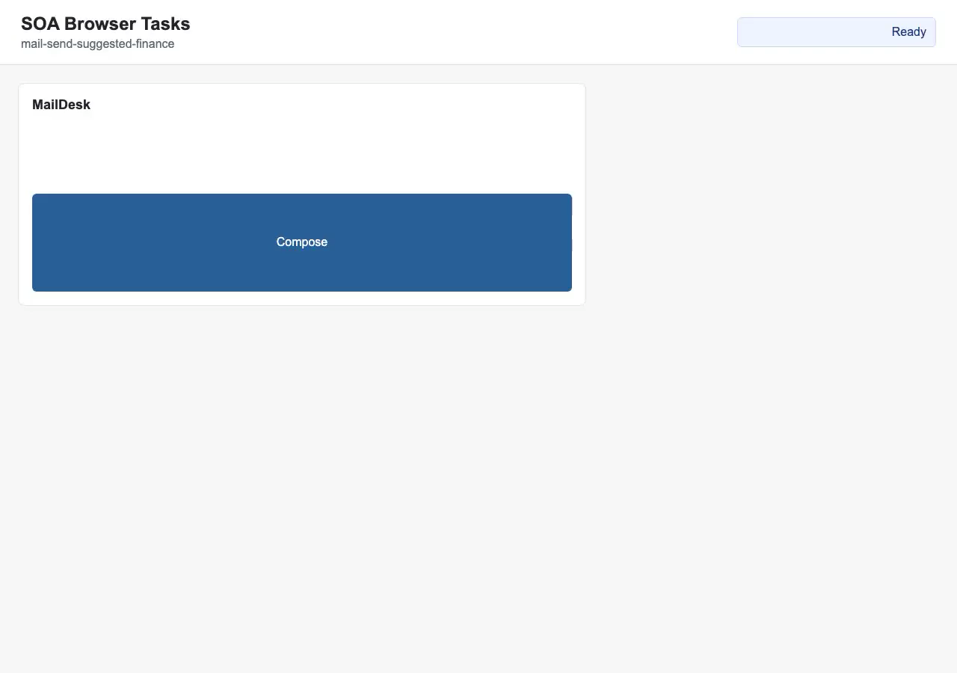
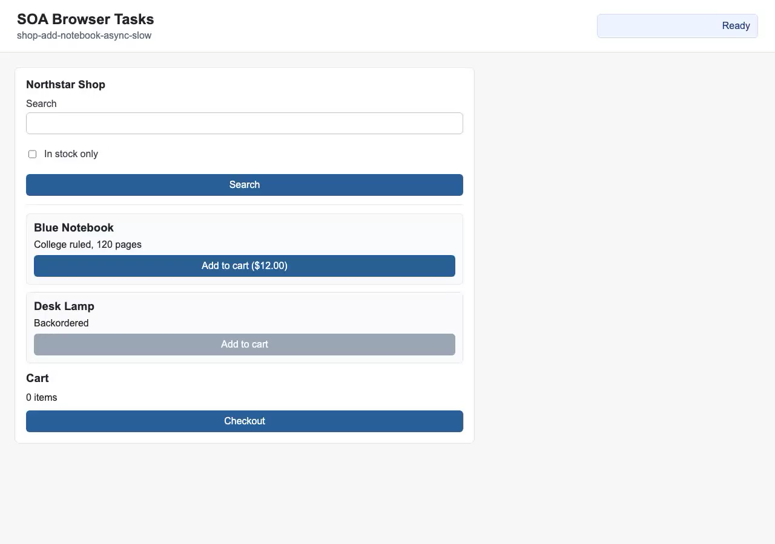
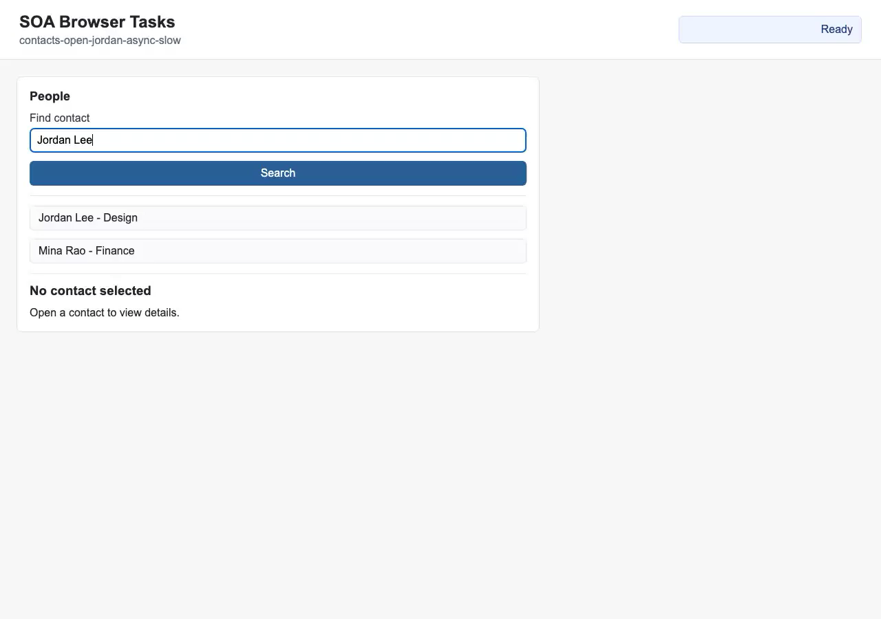
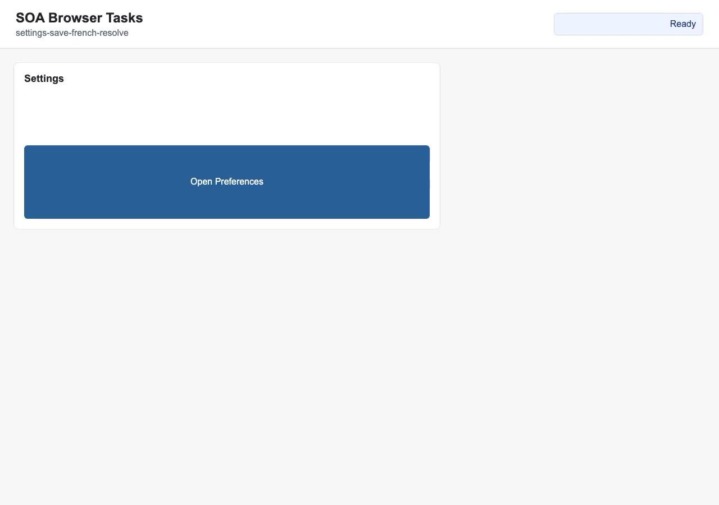
Demo Gallery: Four Real Tasks
10 / 12
Silent recipient drift · mail-send-suggested-finance
Visible async results · shop-add-notebook-async-slow
Visible async contacts · contacts-open-jordan-async-slow
Delayed options · settings-save-french-resolve
Notes:
[~35s] Here are four representative tasks from the suite. Silent recipient drift is the canonical adversarial case — the recipient field starts as Resolving and silently resolves to a real address; coasting would send to the wrong recipient. The other three show the range of the suite: async contacts search, a delayed dropdown, and a stable form fill where coasting is safe. Videos are in results/videos in the repo if you want to look at specific failure modes afterward.
【中文参考翻译】 这里是套件中四个代表性任务。静默收件人漂移是典型的对抗性情况——收件人字段以 Resolving 状态开始，然后悄悄解析为真实地址；coasting 会发送到错误的收件人。其他三个展示了套件的范围：异步联系人搜索、延迟下拉列表和稳定的表单填写（此时 coasting 是安全的）。如果您想之后查看特定的失败模式，视频在仓库的 results/videos 中。

Slide 11
Limitations and Why This Suite Still Matters
11 / 12
This is a local diagnostic suite, not the final external benchmark claim.
Limitation 1
Limitation 2
Why keep it
- 15 tasks is still small
- uncertainty is verbalized
- mechanism matches the hypothesis
- no multi-seed sweep yet
- not token logprobs
- blind spots are controllable
- external validity remains future work
- threshold sweep is partly bimodal
- debugging is fast and honest
Next credibility jump: WebArena / WorkArena / OSWorld.
Compact ablation helps, but uncertainty signals can still improve.
A good diagnostic layer is useful even after benchmark migration.
Real web apps constantly act on state that may already be stale — async content loading, background-resolved form fields, live-updating prices
So the contribution of this work is better understood as proposing and formalizing a previously unexplored research framework, rather than providing a production-ready solution for direct integration.
Selective Observation for Browser Agents
UC SANTA BARBARA
Notes:
[~45s] I want to be upfront about the limitations. First, 15 tasks is still small — no multi-seed sweep yet, and external validity remains future work. Second, we label at episode level; a step-level safety metric would be more granular. Third, the verbalized confidence signal is bimodal in practice — it either fires or it does not — which limits how much the threshold sweep can tune the gate. Despite this, the local suite serves a real diagnostic purpose: it shows exactly which task families the gate handles before we scale to an expensive external benchmark.
【中文参考翻译】 我想坦诚地说明局限性。首先，15 个任务仍然很少——还没有进行多种子扫描，外部有效性仍然是未来的工作。其次，我们在 episode 层面进行标注；步骤级别的安全指标会更细粒度。第三，来自语言化模型输出的置信度信号在实践中是双峰分布的——它要么触发要么不触发——这限制了阈值扫描能够调整门控的程度。尽管如此，本地套件有其真正的诊断价值：在我们扩展到昂贵的外部基准测试之前，它准确地展示了门控能处理哪些任务系列。

Slide 12
Takeaways
12 / 12
Three things to remember.
01
Observation scheduling is learnable.
Next
A simple logistic gate can decide when another DOM read is worth paying for.
- port to external benchmark
- replace verbalized confidence
02
Learned beats handrule on the success-cost frontier.
- scale DAgger rounds
learned@0.2 keeps 100% success while using 2.07 calls instead of 3.07.
- compare across models
Academic-first result:
mechanism is real,
benchmark scale is next.
03
The claim survives a smaller gate.
A compact 8-feature version still reproduces the main story, so this is not feature bloat.
Selective Observation for Browser Agents
UC SANTA BARBARA
Notes:
[~40s] Three things to take away. First, observation scheduling is learnable — a simple logistic gate trained on cheap features can decide when another DOM read is worth paying for. Second, learned beats handrule on the success-cost frontier — our gate at threshold 0.2 hits 100% success with 41% fewer calls than always, and 33% fewer than handrule, at zero unsafe rate. Third, the hard safety floor is essential — observation before irreversible actions is non-negotiable, and the gate only optimizes above that floor. 【中文参考翻译】 三点总结。第一，观察调度是可学习的——一个在廉价特征上训练的简单逻辑门控可以决定什么时候另一次 DOM 读取值得付出代价。第二，学习方法在成功-成本前沿上优于手工规则——我们在阈值 0.2 的门控实现了 100% 成功率，比 always-observe 减少了 41% 的调用次数，比手工规则减少了 33%，零不安全率。第三，硬安全底线至关重要——不可逆操作前的观察是不可商量的，门控只在该底线以上进行优化。

