Slide 1
Multi-View Semantic 3D Gaussian Splatting for
Component-Aware Bridge Reconstruction from UAV Imagery
Rendering a bridge's appearance and its structural parts from any camera pose, in one pass
Quoc-Bao Ta Trung Ha Nguyen Thai Ha Dang
IC-SHM 2026 — Project 2: Multi-view Semantic 3D Reconstruction of Bridge Structures
[Team identifier]
September 2026
Notes:
Title slide. Replace [Team identifier] with the registered team ID before recording. Source: paper/DRAFT.md title block.

Slide 2
The story in one page
1
The task
Given 400 posed UAV images of a suspension bridge, render both an RGB image and a 5-class semantic map from an arbitrary camera pose.
2
What existed before
3D Gaussian Splatting renders photorealistic RGB but carries no semantics; 2D segmentation gives labels but not a renderable 3D scene.
3
Our backbone
Semantic 3D Gaussian Splatting: give each Gaussian 5 extra semantic logits and render RGB + semantics in one fused rasterization pass.
4
Our additions
Multi-view plurality-vote semantic warm-start; SegFormer pseudo-labels for the 100 unlabeled images; three real bugs found and fixed.
5
The experiment
PSNR 22.43 dB, SSIM 0.854, LPIPS 0.321, structural mIoU 92.08% on 30 held-out test views.
6
What we learned
High cable IoU reflects a coarse annotation convention, not precise cable geometry recovery — and after fixing other bugs, resolution matters less than it first appeared to.
1 / 30
Notes:
One-page summary of the whole talk, in the same spirit as a plain-language abstract. Source: paper/DRAFT.md Abstract and Section 1 (Introduction).

Slide 3
Part 1: The task
1
Part 1 — The task
2
Part 2 — Related work
3
Part 3 — The backbone
4
Part 4 — Our adaptations
5
Part 5 — Experiments and results
6
Part 6 — Discussion and conclusion
2 / 30
Notes:
We start with what the contest actually asks us to build.

Slide 4
What exactly are we asked to build?
Input
5 semantic classes
Blind evaluation
400 posed UAV images
background
Visual fidelity
300 carry manual polygon labels; 100 do not
PSNR, SSIM, LPIPS
deck
Camera calibration + poses
Semantic accuracy
SfM estimates, documented as “reference only”
stay_cable
mIoU over the 4 structural classes
Accuracy Score
tower
Required output
= 0.5 × Visual Fidelity + 0.5 × Semantic mIoU
RGB image
foundation
matching a held-out photograph
Semantic map
Think about it: The competition brief calls the physical component “main cable” (p. 9); the dataset's own class ID is stay_cable. We keep the dataset ID for scoring and name the physical part correctly in prose.
Key idea: Our numbers are all measured on a local 30-view holdout carved from the released data — not the organizers' blind test set.
5 classes, see center column
...from any query pose
poses never captured during the flight
Source: paper/DRAFT.md Section 1 (Introduction), Section 3.1; competition brief p. 9.
3 / 30
Notes:
The contest gives us 400 posed images and asks for a model that renders both RGB and a semantic map from any camera pose, scored on a blind held-out set we never see.

Slide 5
Why is this hard? Three reasons
1
Coarse cable annotation
Physical cable strands span only a few pixels, but the stay_cable polygon encloses the whole cable-and-hanger region — including sky and river between the strands. High overlap with this label does not mean precise strand geometry.
2
A quarter of the images are unlabeled
100 of 400 images carry no manual annotation. Using their viewpoints for semantic supervision requires pseudo-labeling.
3
Camera poses are estimates, not ground truth
Poses come from Structure-from-Motion and are documented as “reference only”, so residual geometric inconsistency can affect rendering quality.
Think about it: None of these three problems is solved by a bigger model — each needs its own targeted fix, covered in Part 4.
Source: paper/DRAFT.md Section 1 (Introduction).
4 / 30
Notes:
Three specific properties of this dataset make the task non-trivial, independent of model capacity.

Slide 6
How is the answer scored?
Accuracy Score = 0.5 × Visual Fidelity (PSNR / SSIM / LPIPS) + 0.5 × Semantic mIoU
PSNR / SSIM
pixel and structural similarity between rendered and real RGB
LPIPS
a learned perceptual distance (AlexNet backbone), lower is better
Structural mIoU
mean IoU over the 4 structural classes; we also report the 5-class mIoU (including background) for completeness
Think about it: The brief specifies the 0.5/0.5 weighting but does not define how PSNR/SSIM/LPIPS combine into one “Visual Fidelity” number. We document our own combination explicitly as illustrative, not an organizer-defined formula.
Source: paper/DRAFT.md Section 4.3 (Metrics), Illustrative combined score.
5 / 30
Notes:
We are careful to separate the organizer's actual scoring rule from our own documented choice for how to combine PSNR/SSIM/LPIPS internally.

Slide 7
Part 2: What existed before
1
Part 1 — The task
2
Part 2 — Related work
3
Part 3 — The backbone
4
Part 4 — Our adaptations
5
Part 5 — Experiments and results
6
Part 6 — Discussion and conclusion
6 / 30

Slide 8
From implicit fields to explicit, labelable primitives
1
NeRF
Implicit, coordinate-based network; renders via ray-marching. High quality, slow, and no natural place to attach a discrete label.
2
3D Gaussian Splatting (Kerbl et al.)
Explicit anisotropic Gaussians, tile-based rasterization. Real-time, and every pixel traces to an addressable set of primitives — the property we build on.
3
Semantic-NeRF / Feature-3DGS / LangSplat / Gaussian Grouping
Attach extra attributes (semantic logits, distilled 2D features, language embeddings, SAM-derived identity codes) to a renderable representation — but for different supervision and different downstream tasks than ours.
Key idea: Our task needs class IDs for a fixed set of bridge components — so we optimize five class logits directly against real and pseudo-labeled masks, rather than distilling an open-vocabulary feature field.
Source: paper/DRAFT.md Section 2 (Related Work).
7 / 30
Notes:
We situate our method between plain 3DGS and the family of attribute-augmented Gaussian methods.

Slide 9
Where our design sits
Method | Renders RGB | Native semantics | Single fused pass | Fixed class set
NeRF [6] | yes | no | — | —
3D Gaussian Splatting [7] | yes | no | — | —
Semantic-NeRF [8] | yes | yes | no (ray integration) | yes
Feature-3DGS [9] / LangSplat [12] | yes | distilled features | yes | no (open-vocab)
Ours | yes | yes | yes | yes
Task A (2D pseudo-labeling) uses SegFormer
a lightweight hierarchical-Transformer encoder (MiT-B0) with an all-MLP decoder — compact enough to fine-tune on a single GPU
Source: paper/DRAFT.md Section 2 (Related Work); reference numbers match the paper's own list.
8 / 30
Notes:
This table is our own summary, not copied from any single cited paper.

Slide 10
Part 3: The backbone
1
Part 1 — The task
2
Part 2 — Related work
3
Part 3 — The backbone
4
Part 4 — Our adaptations
5
Part 5 — Experiments and results
6
Part 6 — Discussion and conclusion
9 / 30

Slide 11
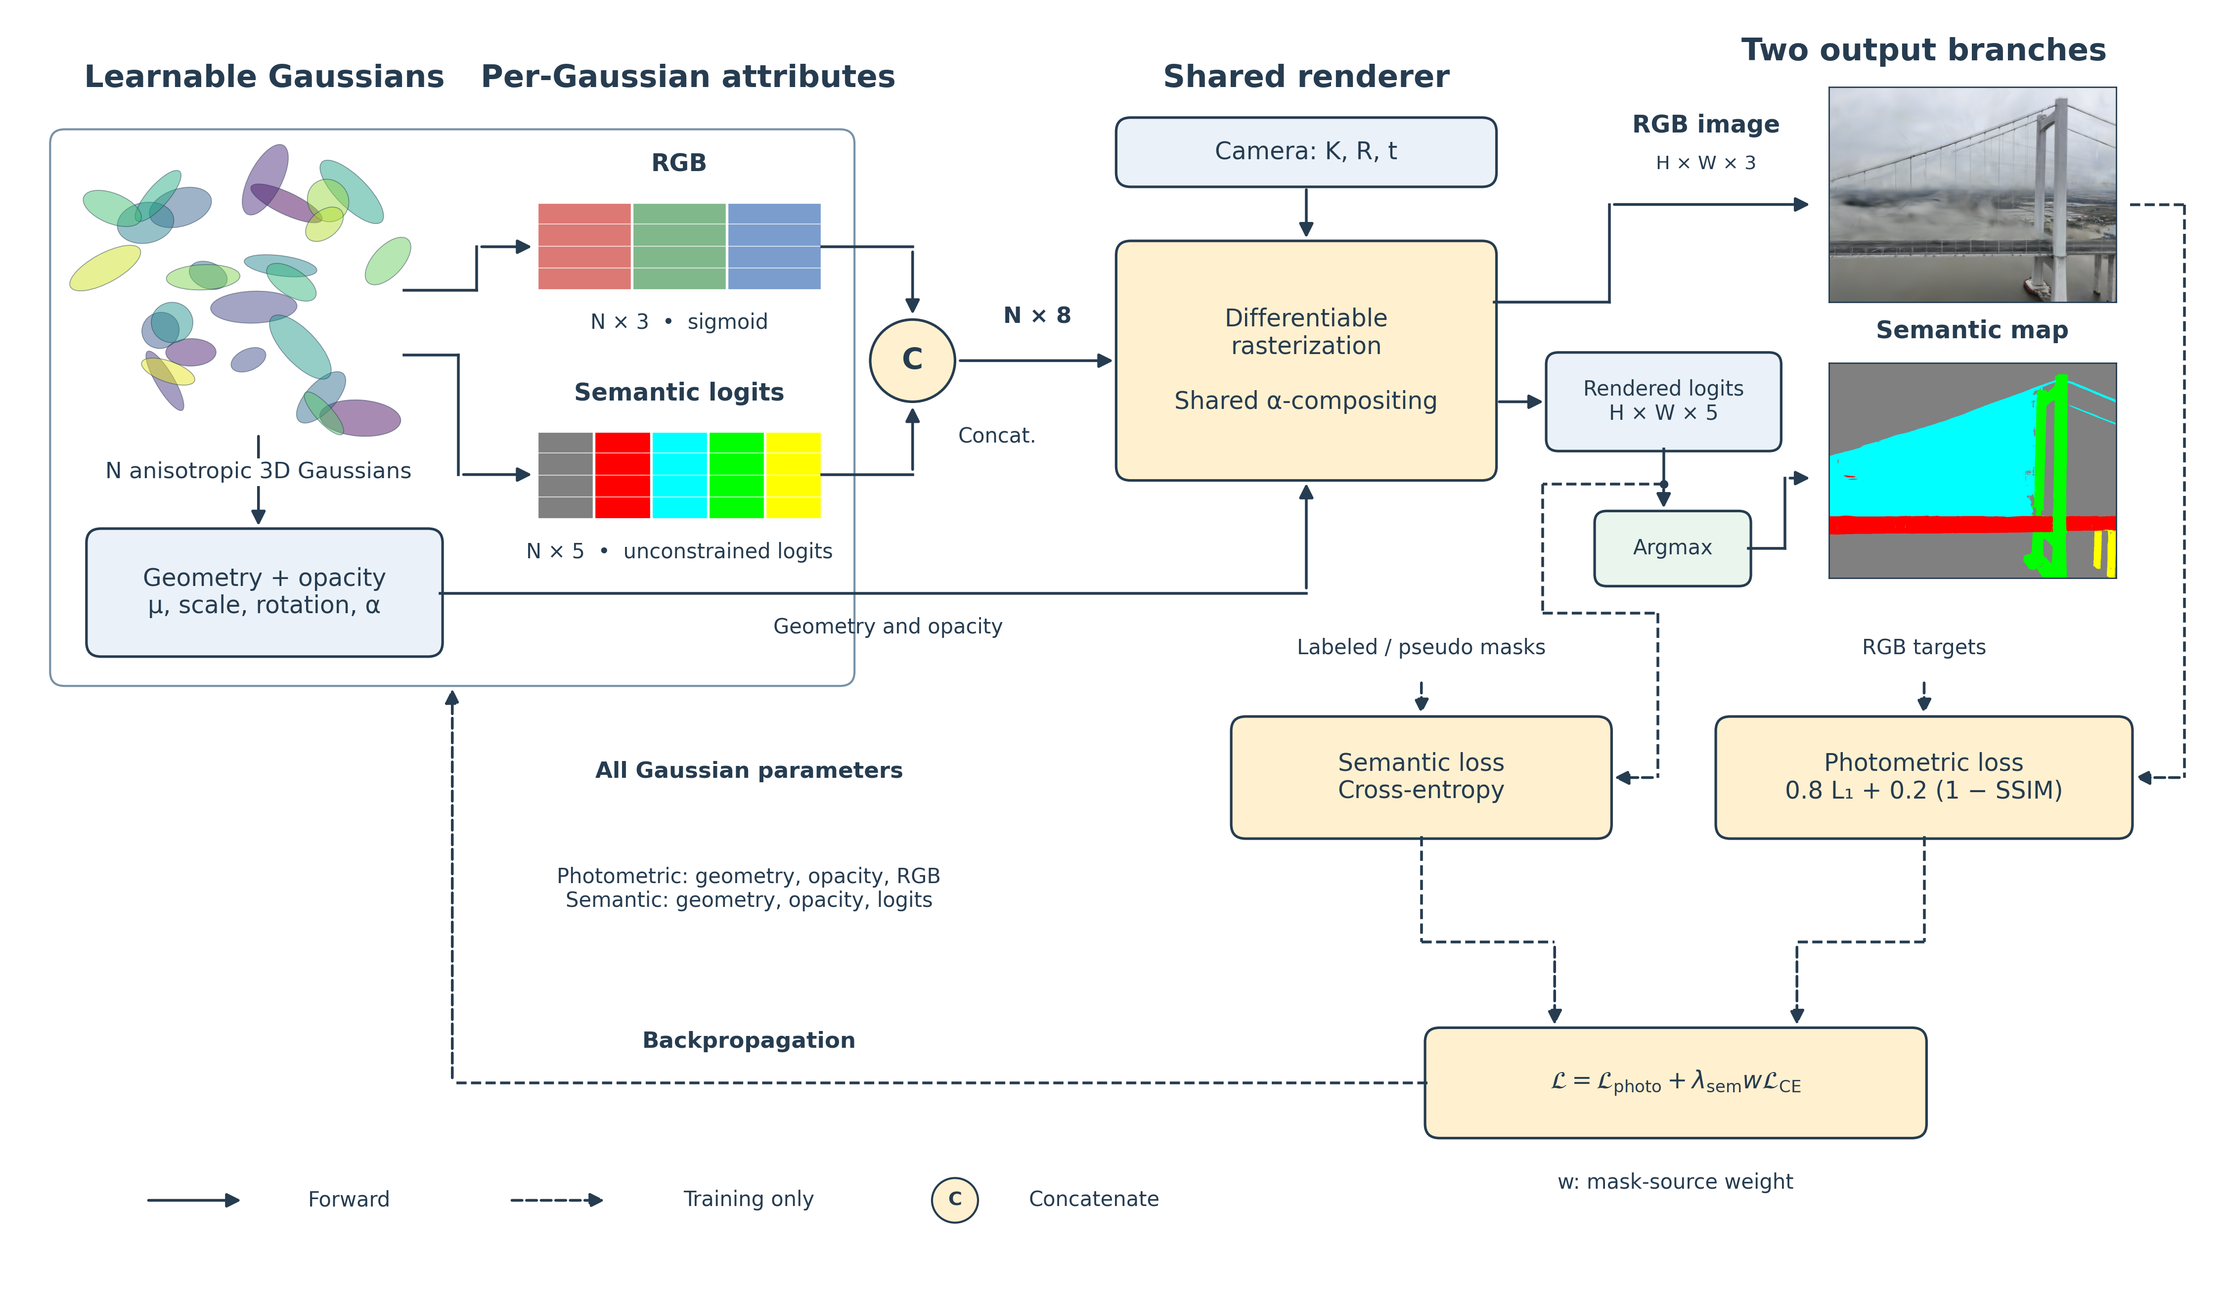
What is a 3D Gaussian, intuitively?
A soft, blurry ellipsoid in 3D space
not a point, not a triangle — a smooth splat of color with a position, size, orientation, and opacity
A scene = thousands of overlapping splats
rendering a view means projecting every splat onto the image plane and blending them by depth
“Alpha-compositing” = blending front-to-back
each pixel's color is a weighted sum of every splat that covers it, nearest splats contributing most
Key idea: Because every rendered pixel traces back to an explicit, addressable set of Gaussians, it is natural to give each Gaussian one more attribute beyond color.
Source: paper/DRAFT.md Section 3.4 (Task B: Semantic 3D Gaussian Splatting), Representation.
10 / 30
Notes:
A plain-language framing of 3D Gaussian Splatting before we add semantics to it.

Slide 12
Adding a semantic channel: one tensor, one rasterization pass
Each Gaussian already carries
position, scale, rotation, opacity, and RGB color (3 numbers, constrained to [0,1] by a sigmoid)
We add 5 more numbers per Gaussian
unconstrained semantic logits, one per class (background, deck, stay_cable, tower, foundation)
Concatenate: 3 + 5 = 8 channels
rasterized together in a single gsplat pass, sharing the exact same projection, depth order, and blending weights as color
Split the output back apart
channels 0–2 → RGB image; channels 3–7 → semantic logits → argmax → class map
Key idea: Because RGB and semantics share the same compositing weights, the two outputs are pixel-aligned by construction — no separate alignment step, no extra rasterization cost.
Source: paper/DRAFT.md Section 3.4, Fused rendering.
11 / 30
Notes:
This is the core architectural idea: one shared rasterization pass, two outputs split from the same 8-channel tensor.

Slide 13
The full picture: representation, rendering, and losses
Source: paper/DRAFT.md Figure 4 (Section 3.4).
12 / 30
Notes:
This diagram is reused verbatim from the paper. Walk through: geometry+opacity, RGB (sigmoid), semantic logits (unconstrained) concatenate, one rasterization pass, argmax for the class map, and the two losses that update everything.

Slide 14
Part 4: Our adaptations
1
Part 1 — The task
2
Part 2 — Related work
3
Part 3 — The backbone
4
Part 4 — Our adaptations
5
Part 5 — Experiments and results
6
Part 6 — Discussion and conclusion
13 / 30

Slide 15
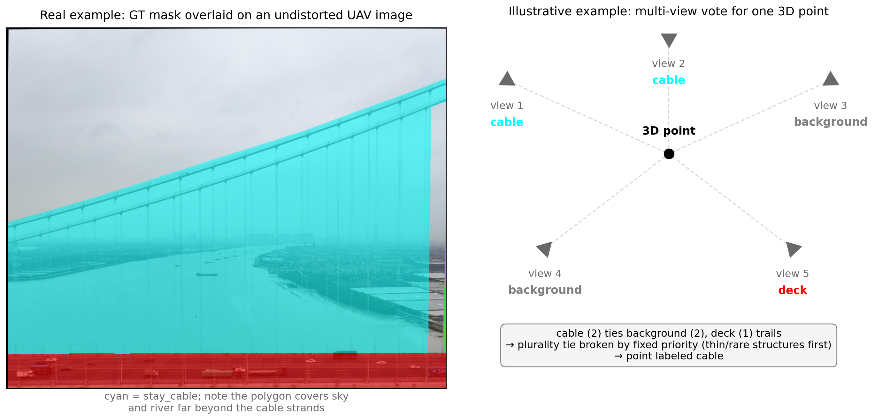
Starting from a good guess, not from noise
Triangulate a sparse point cloud
86,319 tracks from the 370 training-pool images (test images excluded, see Part 5) → 84,086 triangulated → 82,518 after outlier filtering
Position + color initialize each Gaussian
not random — real triangulated position, real averaged pixel color from every observing view
Semantic logits initialize by multi-view plurality vote
every labeled view observing a point votes for the class at its feature-track pixel; the winning class gets logit +2, others -2 (a confident but not saturated prior)
Source: paper/DRAFT.md Section 3.2, Section 3.4 (Initialization); Figure 3.
14 / 30
Notes:
Both geometry and semantics start from a real, data-derived guess, which the training loss then refines.

Slide 16
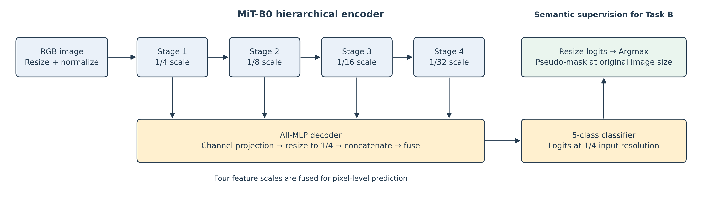
Task A: turning 100 unlabeled images into training signal
Fine-tune SegFormer (MiT-B0)
on 240 labeled images, 80 epochs
Select checkpoint by validation mIoU
on a separate 30-image internal validation split — never the 30-image test split
Best validation mIoU: 81.67%
at epoch 69
Predict pseudo-masks for 100 images
270 labeled + 100 pseudo-labeled = 370 views supervise Task B
Think about it: Checkpoint selection never touches the 30-image test split — an earlier version of our pipeline leaked this and we fixed it (next slides).
Source: paper/DRAFT.md Section 3.3 (Task A), Figure 2.
15 / 30
Notes:
SegFormer's job is only to extend semantic supervision to the unlabeled images; it never contributes to the final Gaussian model directly.

Slide 17
Adaptation 1: align masks to the space we actually render in
Problem:
Ground-truth and pseudo masks are rasterized/predicted on the original, lens-distorted photos. But Gaussian Splatting assumes an ideal pinhole camera, so training and rendering happen in an undistorted image space.
Consequence:
A mask compared pixel-for-pixel against an undistorted render is silently misaligned by several pixels near the frame edges — worst exactly where thin classes like the cable live.
Fix:
Undistort every ground-truth and pseudo mask with the same per-pixel remap used for images, with nearest-neighbor interpolation so discrete class IDs never blur.
Key idea: A geometric consistency bug, not a modeling choice — fixed once, at the data layer, so every downstream number is computed on correctly aligned data.
Source: paper/DRAFT.md Section 3.2 (Camera Geometry and Sparse Point Initialization).
16 / 30
Notes:
This was the first of several concrete pipeline bugs we found and fixed during development, each verified against real re-measured numbers.

Slide 18
Adaptation 2: initialize Gaussian color from real pixels
Problem:
An earlier version of our pipeline initialized each Gaussian's RGB from a fixed 5-color class-legend swatch (the same palette used for figures) — not the point's actual observed appearance.
Hypothesis:
Starting the photometric loss from a class-swatch color — not real appearance — makes optimization spend part of its fixed 40,000-step budget just correcting the starting point, converging to a worse final fit.
Fix:
Sample each point's real RGB from every observing image, averaged over views.
Metric | Before (class-swatch color) | After (real pixel color)
PSNR | 21.83 dB | 22.13 dB
Structural mIoU | 88.97% | 91.04%
Key idea: Test of the hypothesis: every single metric improved after the fix.
Source: paper/DRAFTING_NOTES.md, external review fix #4; src/colmap_io/reconstructor.py sample_point_colors.
17 / 30
Notes:
A real bug with a real before/after measurement — not a hyperparameter tweak. Numbers come from re-running the full pipeline both ways.

Slide 19
Adaptation 3: keep the test split out of the sparse cloud too
Problem:
Our training loss and semantic vote always excluded the 30 test images — but sparse triangulation and Gaussian color sampling used observations from all 400 images, test images included.
Fix:
Exclude the 30 test images' 2D observations from every feature track before triangulation; their poses still load (needed to render them at evaluation time), but they cannot influence any point's position or color.
Metric | Before (test leaked in) | After (test fully excluded)
PSNR | 22.13 dB | 22.43 dB
Structural mIoU | 91.04% | 92.08%
Key idea: Again, every metric improved — consistent with the dense flight's >99% frame-to-frame overlap making a training-adjacent frame almost as informative as the excluded test frame itself.
Source: paper/DRAFTING_NOTES.md, external review fix #5; src/colmap_io/reconstructor.py exclude_image_names.
18 / 30
Notes:
This is the most subtle of the three fixes — the leak was only in the one-time geometric/photometric initialization, not the training loop.

Slide 20
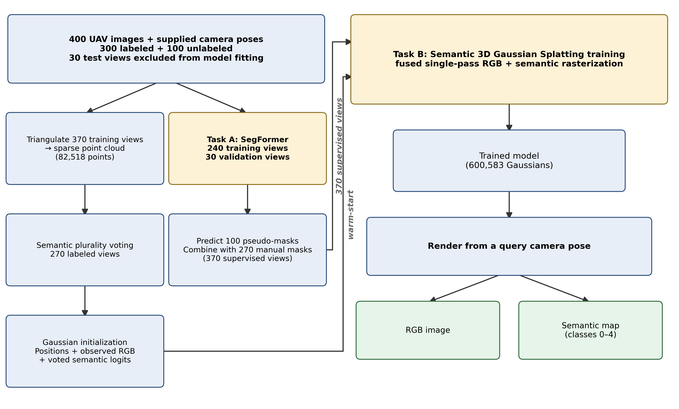
The whole pipeline, end to end
Source: paper/DRAFT.md Figure 1 (Section 3).
19 / 30
Notes:
This is the actual pipeline diagram from the paper, with the real current counts: 82,518 sparse points, 370 supervised views, 600,583 final Gaussians.

Slide 21
Part 5: Experiments and results
1
Part 1 — The task
2
Part 2 — Related work
3
Part 3 — The backbone
4
Part 4 — Our adaptations
5
Part 5 — Experiments and results
6
Part 6 — Discussion and conclusion
20 / 30

Slide 22
Experimental setup
Data
400 UAV images, 1320×989, shared SIMPLE_RADIAL calibration (f≈925.7 px, k₁≈0.009); 300 labeled, 100 unlabeled
Split
240 / 30 / 30 labeled (train / Task A validation / test), strided by flight order; +100 unlabeled via pseudo-labels
Metrics
PSNR, SSIM, LPIPS (visual fidelity); per-class and structural mIoU (semantic accuracy), pooled over all test pixels
Compute
Single NVIDIA RTX 3080 (10 GB); 40,000 iterations, seed 42, ≈46 min full resolution
Fair comparison
Both resolution-ablation runs share the same split, initialization, loss weights, and density-control schedule — only resolution differs
Source: paper/DRAFT.md Section 3.6 (Evaluation Protocol), Section 4.1–4.2.
21 / 30
Notes:
The setup slide before results, matching the paper's own experimental protocol section.

Slide 23
Main result: 30-view local test split
Metric | Value
PSNR | 22.43 dB
SSIM | 0.854
LPIPS | 0.321
Structural mIoU (4 classes) | 92.08%
mIoU incl. background (5 classes) | 93.5%
Illustrative Accuracy Score | 0.823
Class | IoU
deck | 95.72%
tower | 92.37%
stay_cable | 91.76%
foundation | 88.49%
background | 99.20%
Think about it: For reference: Task A's own 2D validation mIoU is 81.67% (30-image internal validation, not the test split above) — a different task, split, and role.
Source: paper/DRAFT.md Tables 1–3 (Section 5.1).
22 / 30
Notes:
We keep Task A's own mIoU clearly separate from Task B's, since both are called mIoU but measure different things.

Slide 24
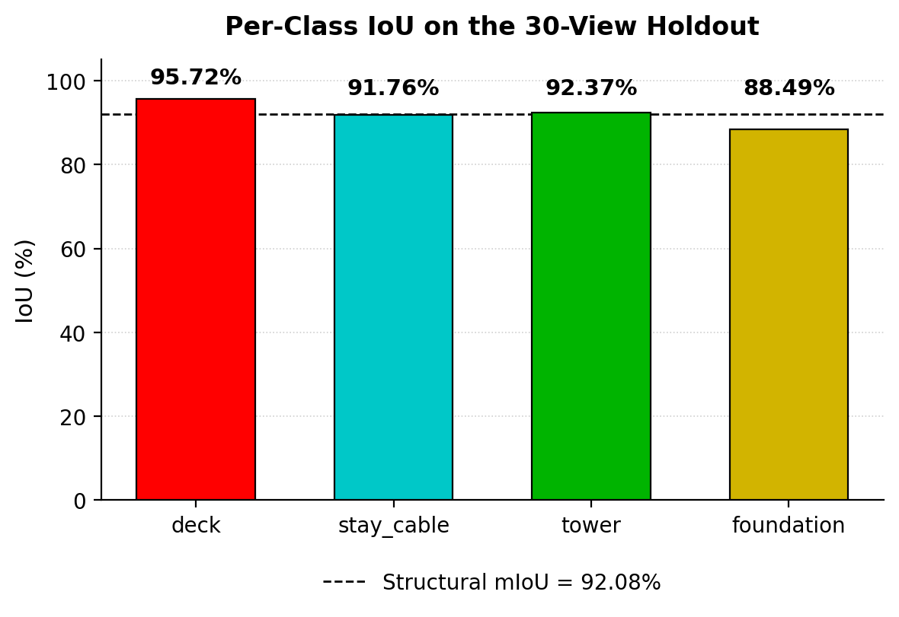
Per-class IoU: why is the thinnest class not the worst?
Cable strands are physically the thinnest component
yet stay_cable IoU (91.76%) is within a point of tower and clearly ahead of foundation
The scored class is a coarse polygon, not the strands
cable covers 7.12% of test pixels — more than deck's 4.99% — because the annotation encloses sky and river between strands
High cable IoU measures annotation agreement
not precise recovery of individual cable geometry
Foundation's lower IoU is not simply fewer observations
it receives more average observations per point than deck (6.57 vs. 3.12), so observation count alone does not explain the ranking
Think about it: We report these as descriptive statistics, not a confirmed causal explanation — isolating the true cause would need a dedicated error analysis we have not run.
Source: paper/DRAFT.md Section 5.2 (Discussion — Per-Class Behavior).
23 / 30
Notes:
This slide deliberately keeps the paper's own hedged, non-causal framing rather than overstating what the descriptive statistics show.

Slide 25
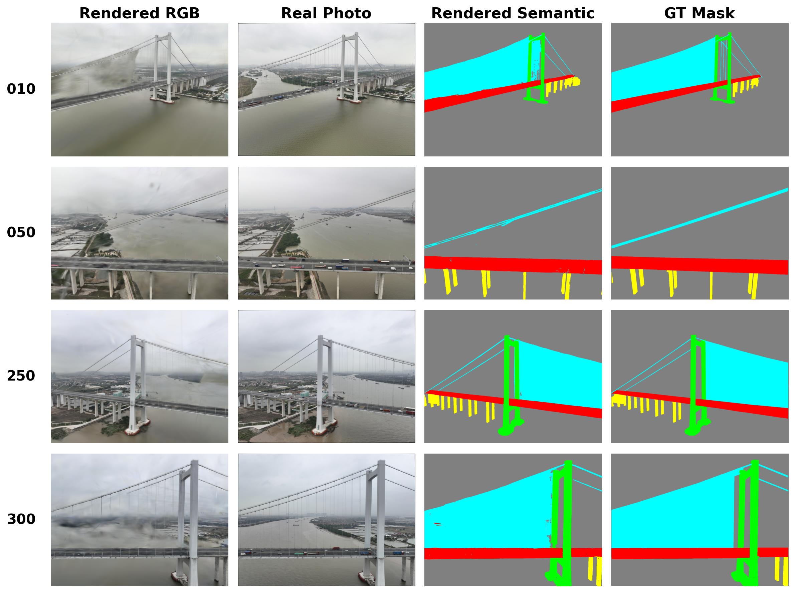
Qualitative check: four held-out views
Source: paper/DRAFT.md Figure 6 (Section 5.3): views 010, 050, 250, 300.
24 / 30
Notes:
View 250 is the cleanest RGB reconstruction by every metric; 010 and 300 show comparable RGB degradation. Notably, the semantic map stays close to ground truth in all four views even where RGB is visibly degraded.

Slide 26
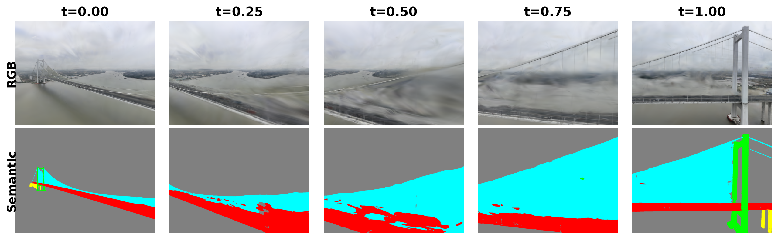
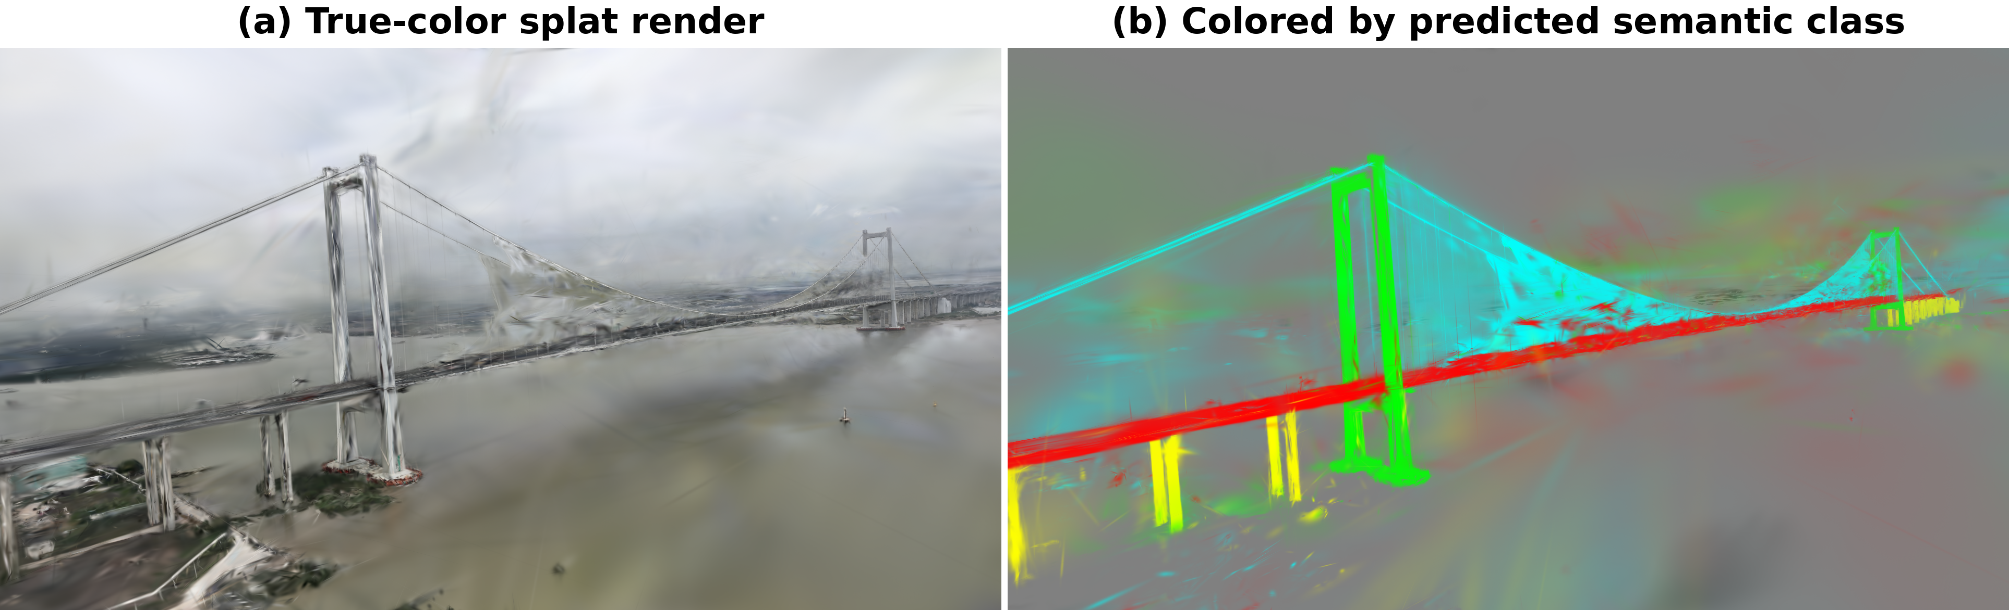
Beyond the flight line: interpolated poses and the full 3D structure
5 poses interpolated between two real test views (images 280, 300). Endpoints and intermediate frames all show some artifacts; broad component regions stay identifiable but boundaries fragment.
Interactive-viewer screenshots of the same model: (a) learned RGB, (b) each Gaussian recolored by its own argmax class before rendering. Panel (b) is a different visualization from the evaluated metric, which argmaxes after compositing.
Think about it: Rendering a pose is not the same as being accurate at that pose — we show these views to be transparent about where the system still struggles.
Source: paper/DRAFT.md Figures 7–8 (Section 5.3).
25 / 30
Notes:
We are explicit that Figure 8 panel (b) is not the same computation as the evaluated semantic output — it recolors before compositing, the metric argmaxes after.

Slide 27
Ablation: does training resolution matter?
Training resolution | PSNR | SSIM | LPIPS | Structural mIoU
Half (660×494) | 22.03 | 0.838 | 0.330 | 89.71%
Full (1320×989) | 22.43 | 0.854 | 0.321 | 92.08%
Full resolution wins on every metric
+0.40 dB PSNR, +0.016 SSIM, −0.009 LPIPS, +2.37 points structural mIoU
Cost: ≈46 minutes vs. ≈18 minutes on the same GPU
a modest absolute difference for the same 40,000-step budget
Think about it: These results support full resolution for this dataset and budget; we have not quantified variation across random seeds, other scenes, or other training budgets.
Source: paper/DRAFT.md Table 4, Section 5.5 (Ablation: Training Resolution).
26 / 30
Notes:
Full resolution is the better default within what we actually tested — we do not overstate generalization beyond this paired experiment.

Slide 28
Part 6: Discussion and conclusion
1
Part 1 — The task
2
Part 2 — Related work
3
Part 3 — The backbone
4
Part 4 — Our adaptations
5
Part 5 — Experiments and results
6
Part 6 — Discussion and conclusion
27 / 30

Slide 29
Honest limitations
1
The split tests interpolation, not extrapolation
the strided test split places a training frame next to almost every held-out frame along a dense flight path
2
Cable IoU reflects an annotation convention
not verified precision at the level of individual strands
3
Accuracy at distant, off-trajectory viewpoints is unverified
we can render an arbitrary pose, but rendering a pose is not the same as being accurate there
4
Not evaluated for the actual SHM end task
no damage detection, deformation measurement, or structural response estimation has been tested
5
Single run per configuration
no multi-seed variance estimate for the headline numbers or the resolution ablation
Source: paper/DRAFT.md Section 3.6, Section 5.3, Section 6 (Conclusion).
28 / 30
Notes:
A dedicated limitations slide, matching the paper's own explicit hedging rather than a generic closing disclaimer.

Slide 30
Conclusion
1
A semantic 3D Gaussian Splatting system that renders aligned RGB and 5-class semantic maps from any query pose in one fused rasterization pass.
2
Sparse geometry, observed colors, and multi-view plurality votes warm-start the representation instead of starting from noise.
3
SegFormer pseudo-labels extend semantic supervision from 270 to 370 views at no extra annotation cost.
4
On a local 30-view test split: PSNR 22.43 dB, SSIM 0.854, LPIPS 0.321, 92.08% structural mIoU.
5
Three real pipeline bugs were found and fixed during development — mask alignment, color initialization, and test-split leakage into triangulation — each verified by a measured before/after improvement.
6
Results establish agreement with the released annotations near the flight trajectory, not survey-grade geometric accuracy or unrestricted novel-view fidelity.
Source: paper/DRAFT.md Section 6 (Conclusion).
29 / 30
Notes:
Closing summary, staying within exactly what the paper itself claims.

Slide 31
References and code
Kerbl, Kopanas, Leimkühler, Drettakis (2023) — 3D Gaussian Splatting for Real-Time Radiance Field Rendering. ACM ToG.
Mildenhall et al. (2020) — NeRF: Representing Scenes as Neural Radiance Fields. ECCV.
Zhi, Laidlow, Leutenegger, Davison (2021) — Semantic-NeRF. ICCV.
Zhou et al. (2024) — Feature 3DGS. CVPR. · Qin et al. (2024) — LangSplat. CVPR.
Xie et al. (2021) — SegFormer. NeurIPS. · Ye et al. (2025) — gsplat. JMLR.
Lin, Abe, Zheng, Li, Chun (2025) — A structure-oriented loss function for bridge point clouds. CACAIE.
Full reference list: paper/DRAFT.md References (19 numbered entries).
Code: github.com/zeki-aitech/ic-shm-2026-project-2
Thank you — questions?
Source: paper/DRAFT.md References section and Section 1 (repository link).
30 / 30
Notes:
Closing slide with the repository link, matching Section 1's stated URL.

