Slide 1
FULL STACK WEB GIS
Zelal SÖNMEZ
2210674062

Slide 2
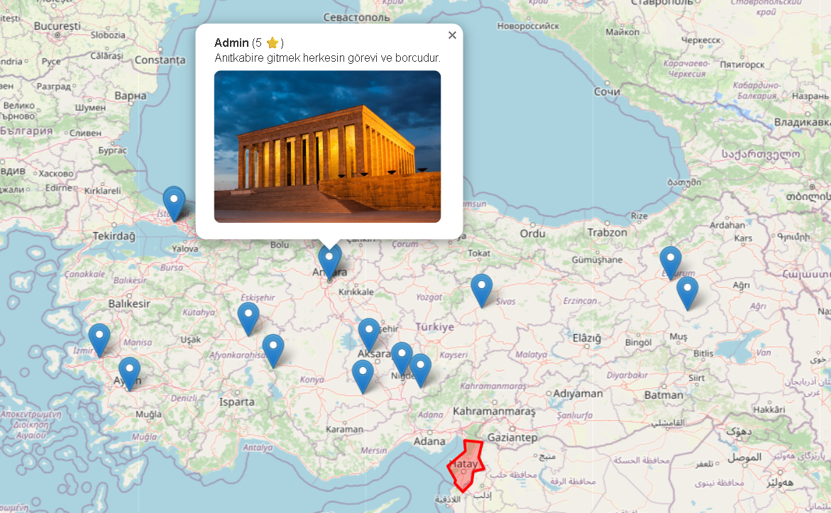
This project is an interactive Digital Travel Guide platform designed for travelers and tourism professionals.
INTRODUCTION

Slide 3
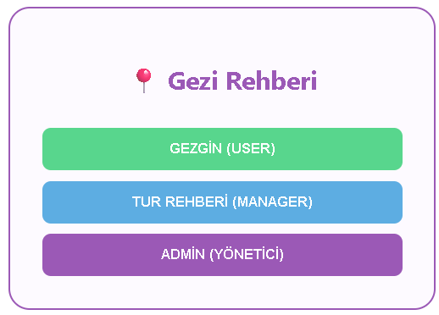
Managing different user types

Slide 4
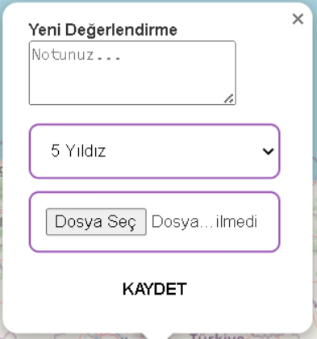



CRUD Operations
Create
Update/Delete
Line/polygon layer

Slide 5
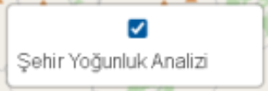
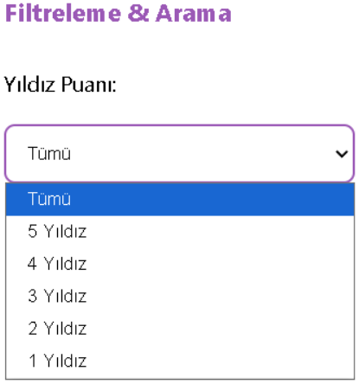

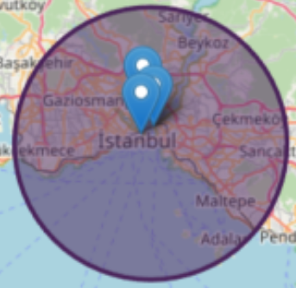
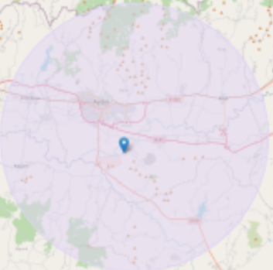
Spatial Density Analysis (Heatmap) layer.
Filter

Slide 6
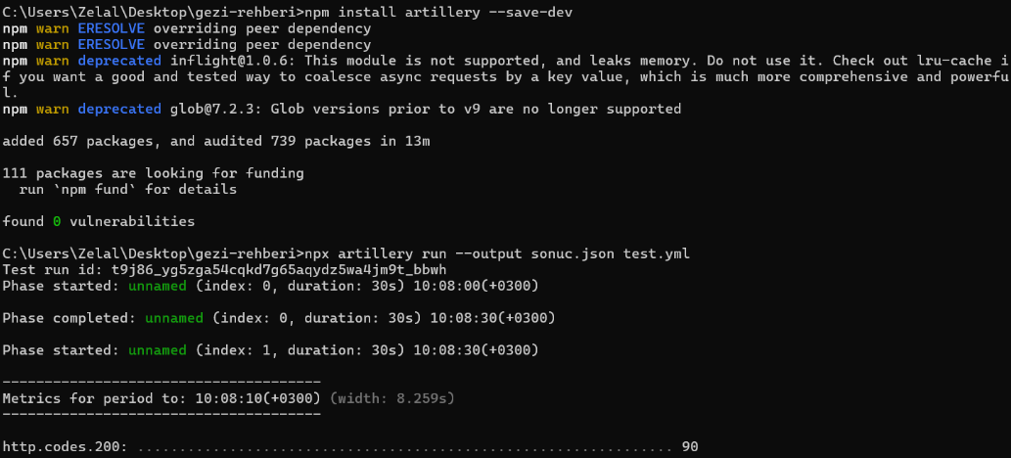
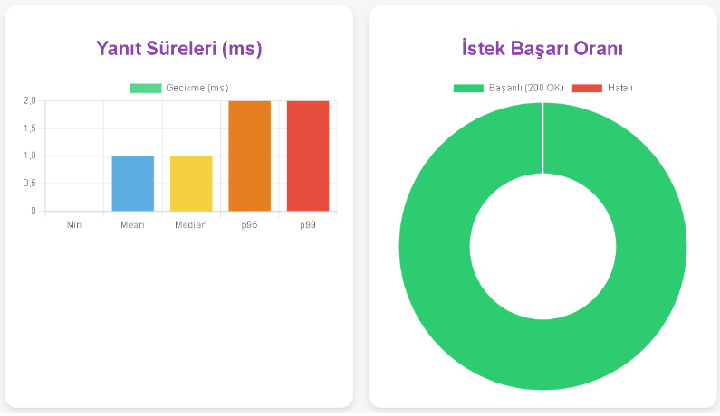
Performance testing-Artillery
I did this by simulating a realistic user traffic scenario (test.yml) using the "npx artillery run" command via the test terminal.
The system successfully processed 1200 simultaneous requests with a 0% error rate and a very low average latency of 1ms.
I achieved this high speed because I stored the data in a NoSQL (JSON) format and retrieved it directly using key-value matching.

Slide 7
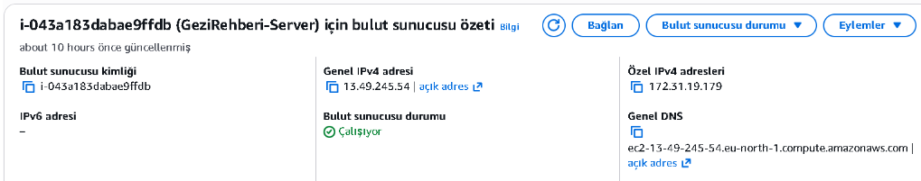
Amazon Web Services (AWS)
Operating system: Ubuntu Server 24.04.
Continuity: PM2 configuration was done so that the application automatically restarts even if the server shuts down.
Port 3000 was opened to the outside world via Security Groups settings on AWS, enabling live testing.
http://13.49.245.54:3000

Slide 8
Thank You

