Slide 1


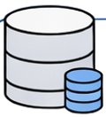
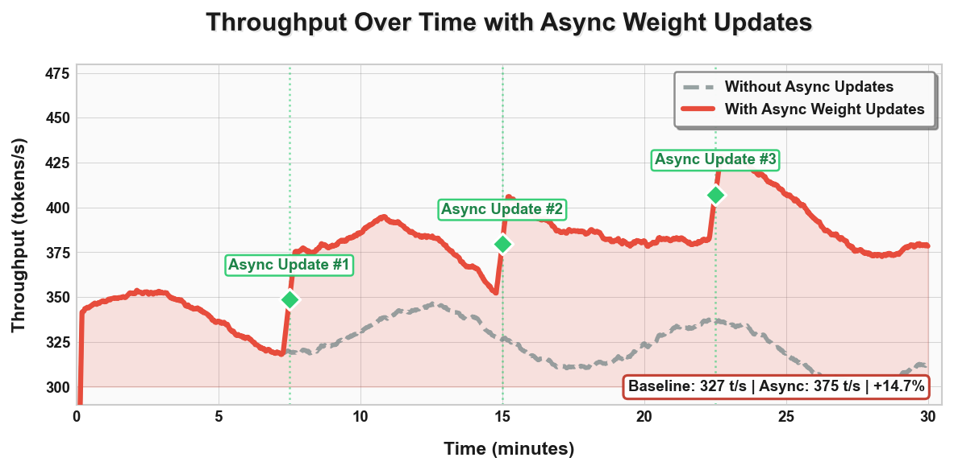
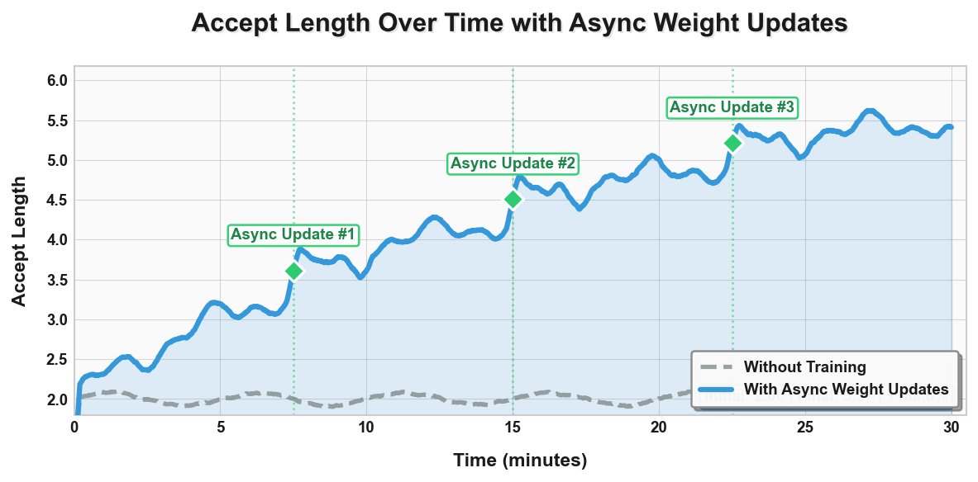
Inference Server
Training Server
Request
Async
Update
New
Speculator
User Input
Verifying…
Drafting…
Draft
Draft
💻
Draft
Target
T-1
Off
Policy
Speculator
Trainer
🕐
🕐
T
TokenN
…
Token3
Token2
Token1
Data
Buffer
✅
✅
✅
Transfer
Data Pipeline
Response
❌
Model Output
Keep Training…

Slide 2
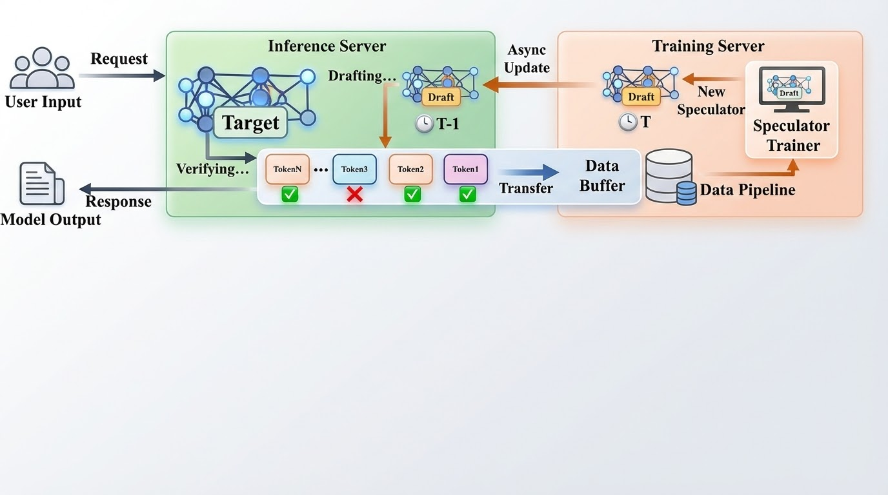

Slide 3
Update Frequency: 3
Batch 1
2
3
4
5
6
dynamic batching
verifying….update weight
/init_weights_send_group_for_remote_instance
/send_weights_to_remote_instance
/get_remote_instance_transfer_engine_info
/update_weights_from_disk
IB
update tensor don’t break cuda graph
Inferece
Aborted
Training
Batch 1
2
3
Update
4
5
Inferece
Batch 1 (12)
2 (8+4)
3
4
5
6
Aborted
Training
Batch 1 (12=4; 6)
2 (12)
3 (12)
4
5
Fully async
how much samples
continuous batching
Inferece
Batch 1
2
3 36 request
4
5
6
Update
Update
Training
Batch 1
2
3
4
6
Checkpoint of Batch1;2

Slide 4
Update Frequency: 3
Inferece
Batch 1
2
3
4
5
6
Barrier
Update
Training
Batch 1
2
3
how to use data; domain shift; coding math; mega-speculator (MoE) (ensembling) routing -> s1,s2,s3,
=> data -> general; vs overfit in distrub
how many inference, how many training 1:1, N:1 ???

