Slide 1
Compiling, Linking & Mix Languages
Ivan Girotto – igirotto@ictp.it
International Centre for Theoretical Physics (ICTP)

Slide 2
Script Language Benefits
Portability
Script code does not need to be recompiled
Platform abstraction is part of script library
Flexibility
Script code can be adapted much easier
Data model makes combining multiple extensions easy
Convenience
Script languages have powerful and convenient facilities for pre- and post-processing of data
Only time critical parts in compiled language

Slide 3
From Scripting to Compiled Codes
maximum control of the low-level implementation
high-performance
compiler are written to deliver best optimization by having full/relevant knowledge of the back-end architecture
the O.S. loads the binary into memory and starts the execution (no other support would be required)
direct interface to most of scientific code available

Slide 4
The Compiler
Creating an executable includes multiple steps
The “compiler” (gcc) is a wrapper for several commands that are executed in succession
The “compiler flags” similarly fall into categories and are handed down to the respective tools
The “wrapper” selects the compiler language from source file name, but links “its” runtime
We will look into a C example first, since this is the language the OS is (mostly) written in

Slide 5
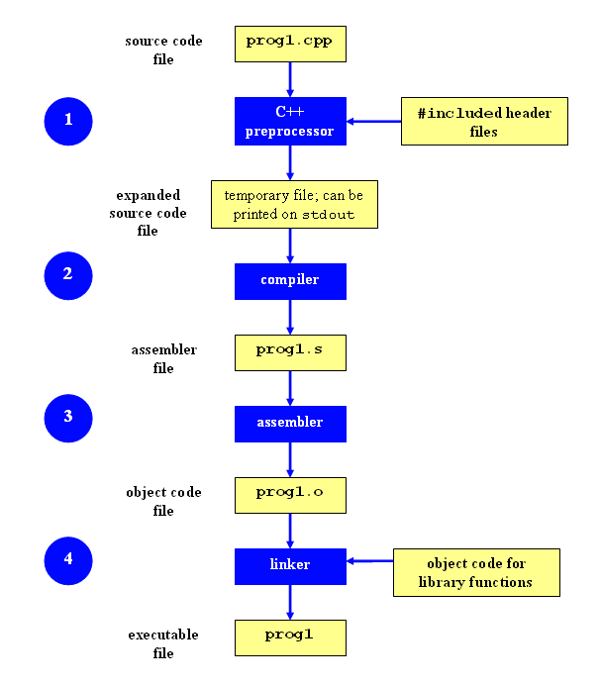
The Compiling Phases
#include <stdio.h>
int main(int argc, char **argv)
{
printf(“hello world\n”);
return 0;
}
Compilation Command examples
Notes:
Show the compiling phases

Slide 6
Pre-Processing
Pre-processing is mandatory in C (and C++)
Pre-processing will handle '#' directives
File inclusion with support for nested inclusion
Conditional compilation and Macro expansion
In this case: /usr/include/stdio.h
and all files are included by it - are inserted and the contained macros expanded
Use -E flag to stop after pre-processing:
gcc -E -o hello.pp.c hello.c
cpp main.c main.i (same)
Notes:
Fare menzione a compilazion condizionale

Slide 7
Compiling
Compiler converts a high-level language into the specific instruction set of the target CPU
Individual steps:
Parse text (lexical + syntactical analysis)
Do language specific transformations
Translate to internal representation units (IRs)
Optimization (reorder, merge, eliminate)
Replace IRs with pieces of assembler language
Using -S the compilation stops after the stage of compilation (does not assemble). The output is in the form of an assembler code file for each non-assembler input file specified.
gcc -S hello.c (produces hello.s)
Notes:
Mention built in function (-g)

Slide 8
Assembling
Assembler (as) translates assembly to binary
from there, Linux tools are needed for accessing the content
Creates so-called object files (in ELF format)
gcc -c hello.c
nm hello.o
Be careful at built-in functions
-fno-builtin can be used to work-around the problem
Notes:
Extensible Linking Format

Slide 9
Linking
Linker (ld) puts binary together with startup code and required libraries
Final step, result is executable
gcc -o hello hello.o
The linker then “builds” the executable by matching undefined references with available entries in the symbol tables of the objects/libraries

Slide 10
Why is a linker interesting to us?!
Understanding linkers will help you to build large programs
Understanding linkers will help you to avoid dangerous programming errors
Understanding linkers will help you how language scoping rules are implemented
Understanding linkers will help you understand how things works
Understanding linkers will enable you to exploit shared libraries

Slide 11
Object Files
Object Files are divided in three categories:
Rolocatable Object Files (*.o)
Executable Object File
Shared Object Files
Compiled object files have multiple sections and a symbol table describing their entries:
“Text”: this is executable code
“Data”: pre-allocated variables storage
“Constants”: read-only data
“Undefined”: symbols that are used but not defined
“Debug”: debugger information (e.g. line numbers)
Sections can be inspected with the “readelf” command

Slide 12
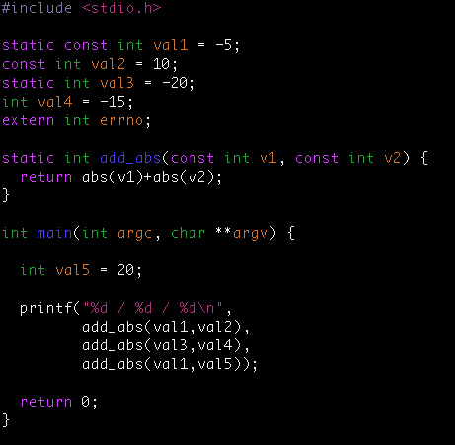
Symbols in Object Files
ig@hp83-inf-21> nm visibility.o
0000000000000000 t add_abs
000000000000002a T main
U printf
0000000000000000 r val1
0000000000000004 R val2
0000000000000000 d val3
0000000000000004 D val4

Slide 13
Static Libraries
Static libraries built with the “ar” command are collections of objects with a global symbol table
When linking to a static library, object code is copied into the resulting executable and all direct addresses recomputed (e.g. for “jumps”)
Symbols are resolved “from left to right”, so circular dependencies require to list libraries multiple times or use a special linker flag
When linking only the name of the symbol is checked, not whether its argument list matches

Slide 14
#building static the library
ig@hp83-inf-21 > ar -rcs libmy.a myfile*.o
#brute force linking
ig@hp83-inf-21 > gcc main.c ./libmy.a
#Using -L (tells the compiler where look for libraries)
ig@hp83-inf-21 > gcc main.c -L./ -lmy
#Same above using gcc notation
igi@hp83-inf-21 > gcc main.c \
> -Wl,--library-path=/scratch/igirotto/linking -Wl,-lmy

Slide 15
Shared Libraries
Shared libraries are more like executables that are missing the main() function
When linking to a shared library, a marker is added to load the library by its “generic” name (soname) and the list of undefined symbols
When resolving a symbol (function) from shared library all addresses have to be recomputed (relocated) on the fly.
The shared linker program is executed first and then loads the executable and its dependencies

Slide 16
#building shared library
ig@hp83-inf-21 > gcc -shared -o mylib.so swap.o
#brute force linking
ig@hp83-inf-21 > gcc main.c ./libmy.so
#Using -L (tells the compiler where look for libraries)
ig@hp83-inf-21 > gcc main.c -L./ -lmy
ig@hp83-inf-21 > ldd a.out
linux-vdso.so.1 => (0x00007fffdbb6b000)
libmy.so => not found
/lib64/ld-linux-x86-64.so.2 (0x00007fa003cd1000)
#Add a directory to the runtime library search pathigi@hp83-inf-21 > gcc main.c \
> -Wl,--rpath=/scratch/igirotto/linking -Wl,-lmy

Slide 17
Using LD_PRELOAD
Using the LD_PRELOAD environment variable, symbols from a shared object can be preloaded into the global object table and will override those in later resolved shared libraries
replace specific functions in a shared library
Example: override log() with a faster version:
double log(double x) {
return my_log(x);
}
$gcc -shared -o fasterlog.so faster.c -lmy_log
$LD_PRELOAD=./fasterlog.so ./myprog-with

Slide 18
Mixed Linking
Fully static linking is a bad idea with GNU libc; it requires matching shared objects for NSS
Dynamic linkage of add-on libraries requires a compatible version to be installed (e.g. MKL)
Static linkage of individual libs via linker flags -Wl,-Bstatic,-lfftw3,-Bdynamic
can be combined with grouping, example:
gcc [...] -Wl,--start-group,-Bstatic -lmkl_gf_lp64 \
-lmkl_sequential -lmkl_core -Wl,--end-group,-Bdynamic

Slide 19
From C to FORTRAN
Basic compilation principles are the same
preprocess, compile, assemble, link
In Fortran, symbols are case insensitive
most compilers translate them to lower case
In Fortran symbol names may be modified to make them different from C symbols (e.g. append one or more underscores)
Fortran entry point is not “main” (no arguments) PROGRAM => MAIN__ (in gfortran)
C-like main() provided as startup (to store args)

Slide 20
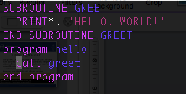
Symbols in Object Files (FORTRAN COMPILED)
ig@hp83-inf-21> nm test.o
000000000000006d t MAIN__
U _gfortran_set_args
U _gfortran_set_options
U _gfortran_st_write
U _gfortran_st_write_done
U _gfortran_transfer_character_write
0000000000000000 T greet_
0000000000000078 T main
0000000000000020 r options.1.1883

Slide 21
Fortran 90+ Modules
module func
integer :: val5, val6
contains
integer function add_abs(v1,v2)
integer, intent(in) :: v1, v2
add_abs = iabs(v1)+iabs(v2)
end function add_abs
end module func
gfortran creates the following symbols:
00000000 T __func_MOD_add_abs
00000000 B __func_MOD_val5
00000004 B __func_MOD_val6

Slide 22
Dynamic Linking via dlopen()
POSIX compliant C libraries allow loading of shared objects are runtime via dlopen()/dlsym()
Calls to dlopen() open a handle to shared object; lookup of this file is subject to same rules as dynamic library searches
Calls to dlsym() look up symbol by its name in shared object pointed to by handle; returns pointer; for functions need to cast/assign to function pointer
Calls to dlclose() unload shared object (if last user) and revoke assignments to code made by dlsym()

Slide 23
Example: static program test-0.c
#include <stdio.h>
void hello()
puts(“Hello, World”);
}
int main(int argc, char **argv)
{
void (*hi)(); /* function pointer variable */
hi = &hello; /* initialize function pointer */
(*hi)(); /* this is the same as: hello(); */
return 0;
}
/* compile with: gcc -o test-0 -Wall -O test-0.c */

Slide 24
Example: main program test-1.c
#include <dlfcn.h>
int main(int argc, char **argv)
{
void *handle; /* handle for dynamic object */
void (*hi)(); /* function pointer for symbol */
handle = dlopen("./hello.so", RTLD_LAZY);
if (handle) {
hi = (void (*)()) dlsym(handle,"hello");
(*hi)();
dlclose(handle);
}
return 0;
}/* compile with: gcc -o test-1 -Wall -O test-1.c -ldl
add -rdynamic if shared object needs symbols in main */

Slide 25
Example: shared object hello.c
#include <stdio.h>
void hello(void)
{
puts("Hello, World!");
}
/* compile: gcc -shared -o hello.so -fPIC -Wall -O hello.c */
With this setup, hello.c can be changed and hello.so recompiled without having to recompile and re-link test-1
Thus access to test-1.c is not needed

Slide 26
Extending Python with ctypes
The ctypes module in python provides an interface to dlopen()/dlsym() and thus allows to call compiled C code from python.
Support for dll files on Windows is also included
Since symbols in compiled objects have no information about calling sequence and return values, this has to be set on the python side
Incorrect use can lead to segmentation faults or corrupted data; often prototypes are needed

Slide 27
Example: calling hello.c from python
#!/usr/bin/env python
from ctypes import *
# import shared object on POSIX compatible OS
dso = CDLL(“./hello.so”)
# call symbol in shared object as function w/o args
dso.hello()
This python script does pretty much the same thing as the test-1 compiled program
Since there are no arguments and no return values, no code needs to know about the other

Slide 28
Arguments & Return Value
By default ctypes will assume arguments and return values are standard size integer
#include<stdio.h>
int sum_of_int(int a, int b) {
int c = a + b;
printf("sum of %d and %d is %d\n",a,b,c);
return c;
}
#!/usr/bin/env python
from ctypes import *
dso = CDLL(“./sum.so”)
isum = dso.sum_of_int(1,2)
print "Integer sum is: ", isum

Slide 29
Prototypes with ctypes
If argument and/or return value are of different type, ctypes needs to be informed about it; works similar to prototypes in C
#!/usr/bin/env python
from ctypes import *
dso = CDLL(“./sum.so”)
dso.sum_of_int.argtypes = [ c_int, c_int ]
dso.sum_of_int.restype = c_int
isum = dso.sum_of_int(1,2)
print ("Integer sum w/ prototypes is: ", isum)
dso.sum_of_double.argtypes = [ c_double, c_double ]
dso.sum_of_double.restype = c_double
dsum = dso.sum_of_double(0.5,2.5)
print ("Double sum w/ prototypes is: ", dsum)

Slide 30
Passing Strings
Strings in python are read-only, thus when a C-function will modify a string we have to use create_string_buffer()
#!/usr/bin/env python
from ctypes import *
dso = CDLL(“./hello.so”)
# hello() in hello.so takes a “char *” argument
dso.hello.argtypes = [ c_char_p ]
dso.hello(b”World”)
# create buffer for mutable string data
buf = create_string_buffer(b”World”)
dso.hello(buf)

Slide 31
Passing Arrays
When passing allocatable objects like arrays, it is usually best to do the allocating in python. ctypes offers constructors for all basic types
#!/usr/bin/env python
from ctypes import *
dso = CDLL(“./sum.so”)
num = 10
dlist = (c_double * num)() # (primitive * length)()
for i in range(num):
dlist[i] = 0.333*(i*0.5)
# note the use of POINTER()
dso.sum_of_doubles.argtypes=[POINTER(c_double),c_int]
dso.sum_of_doubles.restype = c_double
dsum = dso.sum_of_doubles(dlist,num)
print ("Double sum is: ", dsum)

Slide 32
Passing Structs /1
Even complex storage elements like struct can be managed by ctypes. Derive a class from Structure that mimics the corresponding C-type
#!/usr/bin/env python
from ctypes import *
dso = CDLL(“./data.so”)
class parm(Structure):
_fields_ = [ ("type", c_int), ("label", c_char_p),
("epsilon",c_double),("sigma",c_double) ]
# use constructor to initialize struct
p = parm(type=1,label=b"LJ-12-6",epsilon=0.1,sigma=3.4)
# p is passed by value, to pass by reference use byref(p)
dso.pass_by_value(p)
dso.pass_by_reference(byref(p))

Slide 33
Passing Structs /2
Below is the corresponding C code:
#include<stdio.h>
struct parm { int type; char *label;
double epsilon, sigma;
};
void pass_by_value(struct parm p) {
printf("type=%d label=%s epsilon=%g sigma=%g\n",
p.type, p.label, p.epsilon, p.sigma);
}
void pass_by_reference(struct parm *p) {
printf("type=%d label=%s epsilon=%g sigma=%g\n",
p->type, p->label, p->epsilon, p->sigma);
}

Slide 34
Interfacing Fortran with f2py /1
Interfacing Fortran with python is both easier and more complicated than interfacing C
The Fortran ABI can be much more complex and is more compiler specific than the C ABI
The numpy project has a tool “f2py” that automates the process and hides the complications
If you have a Fortran file with some functions or subroutine do: f2py -c code.f90 -m module
Creates python loadable module “module”
Flag '-c' calls compiler; flag '-m' sets module name

Slide 35
Interfacing Fortran with f2py /2
Then in python do: from module import * and call the Fortran functions in python
The f2py tool will parse the Fortran code and generate the necessary C-code for a module
The f2py generated code will automatically insert code to convert data as needed; e.g. lists are converted to arrays
The f2py tool works best with well formed Fortran code; otherwise data maps can help

Slide 36
Example of Fortran code that converts cleanly with f2py:
subroutine hello
print*, "Hello, World!"
end subroutine hello
function sum_of_int(a,b) result(c)
integer, intent(in) :: a, b
integer :: c
c = a + b
print*,"sum of ", a, " and ", b, " is ", c
end function sum_of_int
function sum_of_double(a,b) result(c)
double precision, intent(in) :: a, b
double precision :: c
c = a + b
print*,"sum of ", a, " and ", b, " is ", c
end function sum_of_double

Slide 37
Passing arrays with f2py
Arrays are traditional style arrays with f2py:
function sum_of_doubles(a,n) result(s)
double precision, intent(in) :: a(*)
integer, intent(in) :: n
double precision :: s
integer :: i
s = 0
do i=1,n
s = s + a(i)
end do
end function sum_of_doubles
num = 10
dlist = [sqrt(float(i)) for i in range(1,num)]
dsum = sum_of_doubles(dlist,num)

Slide 38
Passing strings with f2py
Strings are handled in a very similar fashion to traditional style arrays with f2py:
subroutine hello(name)
character(len=*), intent(in) :: name
print* , "Hello, ", name, "!"
end subroutine hello
#!/usr/bin/env python
from hello import *
print ("Calling DSO")
hello('World')
print ("Done")

