Slide 1
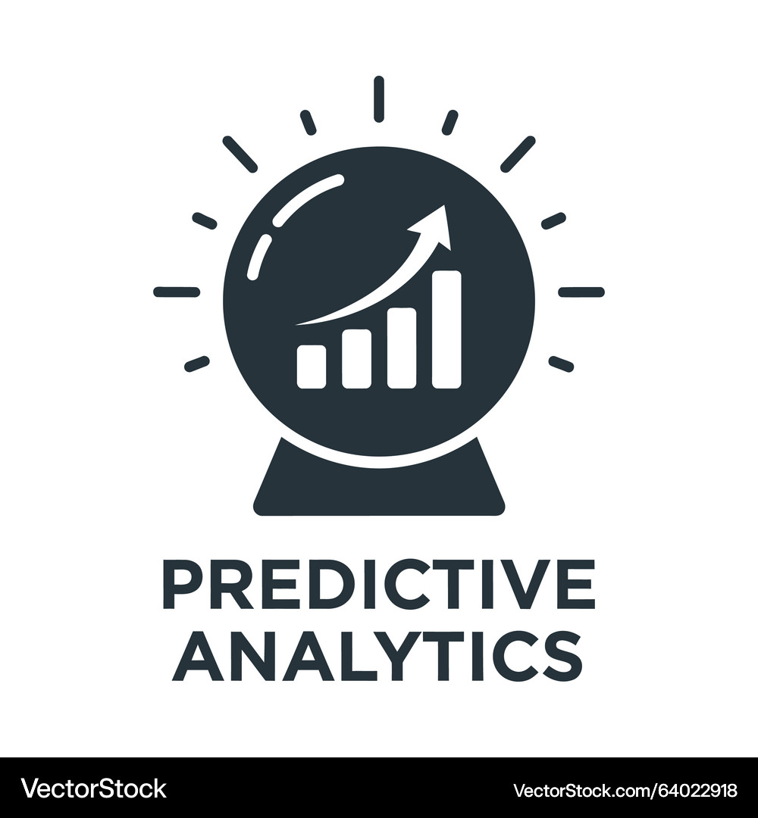
Predictive Analytics Course

Slide 2

About Us
The World's Largest Provider Of Classroom And Online Training Courses
World Class Training Solutions
Subject Matter Experts
Highest Quality Training Material
Accelerated Learning Techniques
Project, Programme, and Change Management, ITIL® Consultancy
Bespoke Tailor Made Training Solutions
PRINCE2®, MSP®, ITIL®, Soft Skills, and More

Slide 3

OBJECTIVES
Understand Predictive Analytics applications in engineering and manufacturing.
Analyse and prepare industrial sensor and time-series data.
Apply Python, Pandas, and NumPy for industrial data analysis.
Build and evaluate predictive models for faults, quality, and maintenance.
Implement end-to-end predictive analytics workflows, deployment, and monitoring.

Slide 4

Course Syllabus
Module 1: Predictive Analytics in Engineering and Manufacturing
Module 2: Industrial Data Engineering Fundamentals
Module 3: Sensor and Time-Series Data Analytics
Module 4: Python for Industrial Predictive Analytics
Module 5: Data Preparation and Feature Engineering

Slide 5
Course Syllabus
Module 6: End-to-End Data Engineering Workflow
Module 7: Predictive Modelling for Engineering Applications
Module 8: Model Evaluation Using Industrial Data
Module 9: End-to-End Predictive Analytics Workflow
Module 10: Deployment and Monitoring in Production Environments

Slide 6

Module 1: Predictive Analytics in Engineering and Manufacturing
Role of Predictive Analytics in Industrial Engineering
Predictive Maintenance, Quality Prediction, and Process Optimisation
Engineering Data Sources: Sensors, PLC, SCADA, and Industrial IoT
Engineering Use Cases Across Manufacturing Operations

Slide 7
Role of Predictive Analytics in Industrial Engineering
Moving from Reactive Decisions to Data-Driven Prediction
Predictive analytics applies historical and current operational data to estimate future conditions, behaviours, or outcomes within engineering environments.
Instead of waiting for equipment failures, quality problems, or process inefficiencies to occur, organisations can analyse patterns that indicate what is likely to happen next.
Industrial engineers use predictive insights to support maintenance planning, production scheduling, resource utilisation, and operational decision-making.
Data generated from machines, production systems, and connected devices provides the foundation for these predictions.
By identifying patterns and relationships within this data, predictive analytics helps engineering teams anticipate operational issues and take appropriate action earlier, improving reliability, productivity, consistency, and overall manufacturing performance.

Slide 8

Role of Predictive Analytics in Industrial Engineering
The Predictive Analytics Lifecycle
Predictive analytics is not simply the application of a machine learning algorithm. It involves a structured sequence that transforms industrial data into actionable predictions. Engineering organisations first identify the operational problem and determine which data sources are relevant. Data is then collected, prepared, analysed, and used to build predictive models. Model outputs are interpreted within the engineering context before actions are taken.
A typical lifecycle includes:
Define the engineering or manufacturing problem.
Collect relevant operational and historical data.
Prepare and validate the available data.
Identify useful patterns and predictive variables.
Build and evaluate predictive models.
Generate predictions for operational decisions.
Monitor outcomes and continuously improve the approach.

Slide 9
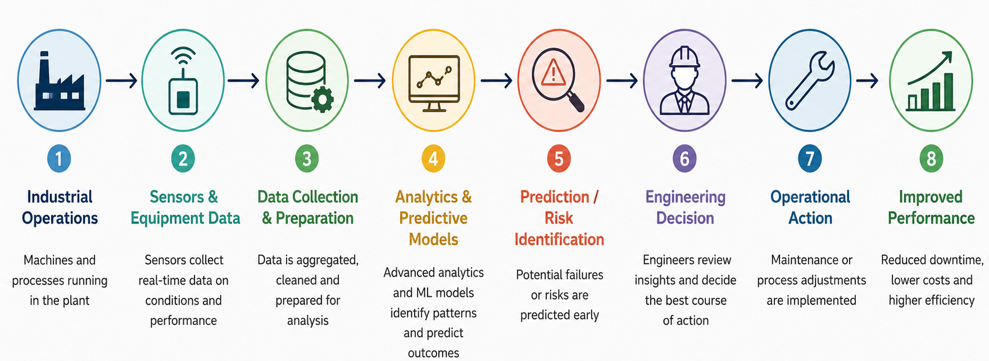
Role of Predictive Analytics in Industrial Engineering
From Industrial Data to Predictive Action
Notes:
This infographic illustrates how predictive analytics converts industrial data into actionable engineering decisions. Data generated by machines and equipment sensors is first collected, cleaned, and prepared for analysis. Predictive models then analyse patterns and operating conditions to identify potential failures, risks, or performance issues before they occur. Engineers use these insights to make informed decisions and take proactive actions such as preventive maintenance or process adjustments. This data-driven approach helps industrial organisations reduce unplanned downtime, lower maintenance costs, improve equipment reliability, and increase overall operational efficiency.

Slide 10
Role of Predictive Analytics in Industrial Engineering
From Descriptive Insight to Predictive Decisions
Industrial analytics can support different levels of decision-making. Descriptive analysis explains what has already happened, such as identifying the number of equipment failures during a production period.
Diagnostic analysis examines why an event occurred by exploring contributing variables and operational conditions. Predictive analytics extends this process by estimating what is likely to happen next.
For example, historical temperature, vibration, pressure, and operating-hour data may indicate an increased probability of equipment failure.
This forward-looking capability enables engineers to intervene before an event affects production. Predictive analytics therefore changes industrial decision-making from retrospective reporting towards proactive planning, helping organisations manage operational risks before they develop into costly failures or quality problems.

Slide 11
Predictive Maintenance, Quality Prediction, and Process Optimisation
Predictive Maintenance for Industrial Equipment
Predictive maintenance uses equipment condition and operational data to identify signs that machinery may require maintenance or could potentially fail.
Traditional reactive maintenance repairs equipment after failure, while scheduled preventive maintenance services equipment at predetermined intervals. Predictive maintenance instead uses actual equipment behaviour to support maintenance decisions.
Variables such as vibration, temperature, pressure, operating hours, load, and power consumption can reveal changes in machine condition. Predictive models analyse these patterns to estimate failure probability or maintenance requirements.
Engineering teams can then prioritise maintenance based on risk and equipment condition, helping reduce unexpected downtime, unnecessary servicing, production disruption, and maintenance costs while improving asset availability and reliability.

Slide 12
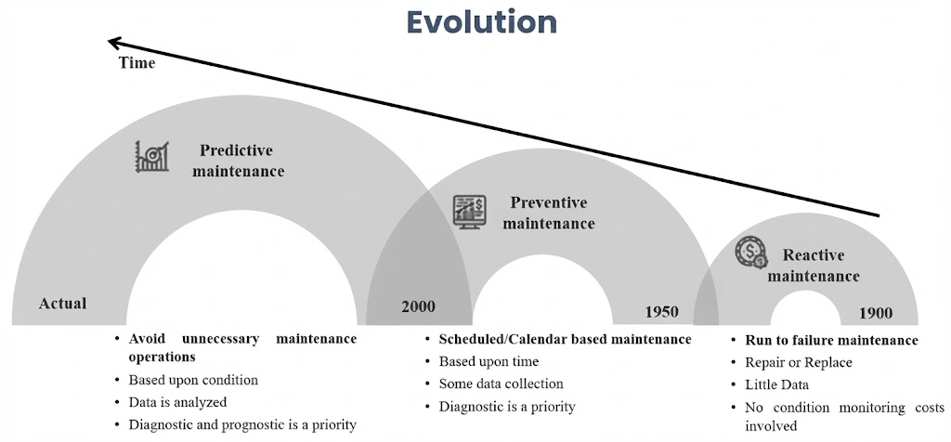
Predictive Maintenance, Quality Prediction, and Process Optimisation
Evolution of Industrial Maintenance
Notes:
This infographic illustrates the evolution of industrial maintenance strategies from reactive to preventive and ultimately predictive maintenance. Reactive maintenance addresses equipment only after failure, while preventive maintenance uses predefined schedules to reduce the likelihood of breakdowns. Predictive maintenance represents a more advanced, data-driven approach in which equipment condition and operational data are continuously analysed to anticipate potential failures. By identifying problems before they cause disruption, organisations can schedule maintenance more effectively, reduce unnecessary interventions, minimise downtime, extend equipment life, and improve overall operational efficiency.

Slide 13
Predictive Maintenance, Quality Prediction, and Process Optimisation
Quality Prediction in Manufacturing
Quality prediction applies historical production and process data to estimate whether manufactured products are likely to meet required quality standards. Instead of relying only on inspection after production, predictive approaches identify process conditions associated with defects or quality deviations. Relevant variables may include machine settings, temperature, pressure, cycle time, material characteristics, production line, and operating conditions.
Predictive quality analytics can help manufacturers:
Estimate the probability of defective output.
Detect abnormal production conditions earlier.
Identify variables associated with quality problems.
Reduce scrap and rework.
Improve process consistency.
Support earlier corrective action.
Strengthen continuous quality improvement.

Slide 14
Predictive Maintenance, Quality Prediction, and Process Optimisation
Process Optimisation Through Predictive Insights
Manufacturing processes involve interacting variables such as equipment speed, cycle time, temperature, resource consumption, workload, and production demand.
Predictive analytics can examine relationships between these variables and operational outcomes to identify conditions associated with better performance.
For example, analytics may reveal operating ranges that reduce cycle time while maintaining product quality or identify production conditions associated with excessive energy consumption. These insights allow engineering teams to adjust processes using evidence rather than assumptions.
Predictive process optimisation can therefore support higher throughput, improved resource utilisation, lower operational costs, reduced waste, and more stable production. The objective is not simply to maximise one metric but to balance productivity, quality, reliability, and efficiency.

Slide 15
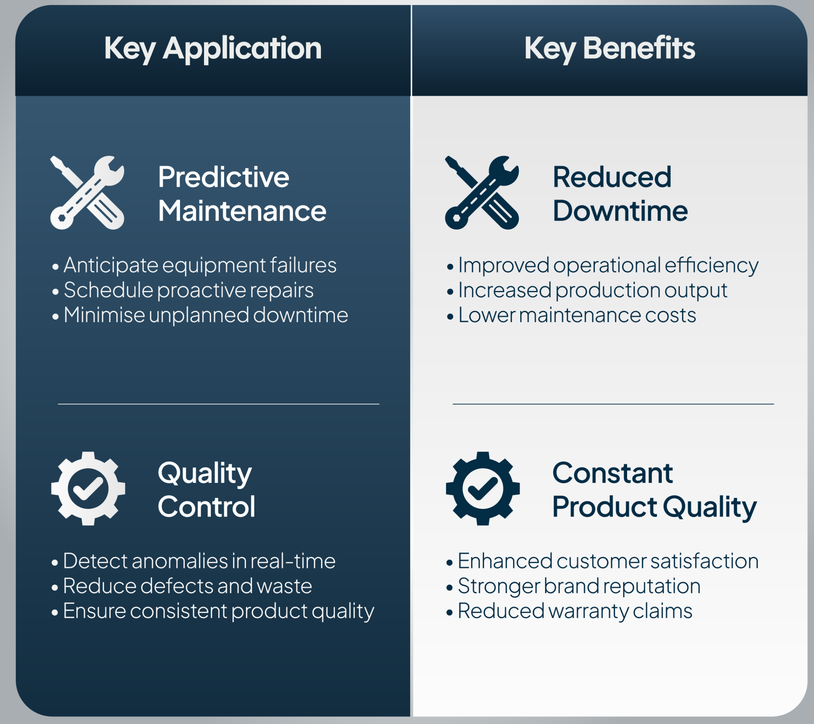
Predictive Maintenance, Quality Prediction, and Process Optimisation
Core Industrial Predictive Analytics Applications
Notes:
This infographic highlights key applications of predictive analytics in industrial engineering. Predictive maintenance uses equipment and operational data to anticipate potential failures, enabling proactive maintenance and reducing unplanned downtime and maintenance costs. Quality prediction and control applies analytics to identify anomalies and potential defects during production, helping organisations maintain consistent product quality, reduce waste, and improve customer satisfaction. Together with process optimisation, these predictive approaches enable manufacturers to move from reactive operations towards proactive, data-driven decision-making, resulting in greater reliability, efficiency, productivity, and overall operational performance.

Slide 16
Engineering Data Sources: Sensors, PLC, SCADA, and Industrial IoT
Industrial Data as the Foundation of Prediction
Predictive analytics depends on relevant and reliable engineering data. Modern manufacturing environments continuously generate information describing machine behaviour, production conditions, process states, and equipment performance.
Sensor measurements can capture variables such as temperature, vibration, pressure, speed, flow, and energy consumption. PLC systems provide control and equipment-state information, while SCADA platforms support supervisory monitoring and collection of operational data across industrial processes.
Industrial IoT environments extend connectivity by allowing distributed equipment and devices to exchange operational information. Combining these sources creates a richer representation of manufacturing operations, enabling predictive models to identify patterns that may not be visible when individual data sources are analysed independently.

Slide 17
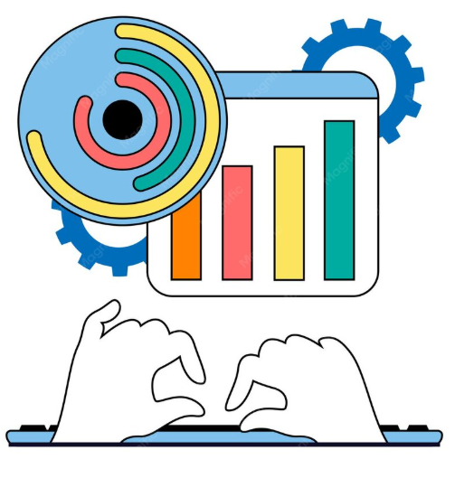
Engineering Data Sources: Sensors, PLC, SCADA, and Industrial IoT
Sensors and PLC Data
Sensors provide direct measurements of physical conditions occurring within industrial equipment and manufacturing processes. Temperature, vibration, pressure, humidity, flow, speed, and electrical measurements can provide valuable indicators of machine condition and process behaviour. Because measurements may be generated frequently, sensor data often forms time-series datasets that allow engineers to analyse how equipment behaviour changes over time.
Programmable Logic Controllers (PLCs) provide another important operational source. PLCs execute control logic and interact with machinery, actuators, and sensors. Their data can represent:
Machine operating states.
Process values and setpoints.
Equipment start/stop conditions.
Alarm and fault states.
Production-cycle information.
Control-system events.

Slide 18
Engineering Data Sources: Sensors, PLC, SCADA, and Industrial IoT
SCADA and Industrial IoT Data
SCADA systems provide supervisory monitoring and control across industrial processes, allowing operational information from multiple machines and control systems to be observed centrally.
Historical SCADA information can provide valuable context for analysing equipment states, alarms, process conditions, and operational trends.
Industrial IoT expands this environment by connecting machines, sensors, gateways, and applications through networked technologies.
This enables industrial data to be collected from distributed assets and made available for analytics. For predictive analytics, combining SCADA history with IIoT-generated sensor information can create a broader picture of asset and process behaviour.
However, the usefulness of these sources depends on data quality, timestamp consistency, appropriate sampling, and reliable integration between systems.
Notes:
Key message:Multiple industrial data sources can be integrated to create the historical and real-time information required for predictive decision-making.

Slide 19
Engineering Use Cases Across Manufacturing Operations
Predictive Analytics Across Manufacturing Operations
Predictive analytics can support decisions across multiple areas of manufacturing rather than being limited to equipment maintenance.
Production teams can use historical operational patterns to anticipate bottlenecks, abnormal cycle times, or changes in throughput. Maintenance teams can identify equipment with increasing failure risk, while quality teams can analyse process conditions associated with defects.
Engineering teams may also evaluate energy consumption, resource utilisation, and equipment performance to identify opportunities for operational improvement. The value of predictive analytics comes from connecting predictions with specific manufacturing decisions.
A prediction is useful only when engineers can translate it into an appropriate response, such as scheduling maintenance, adjusting process parameters, investigating quality risk, or reallocating production resources.

Slide 20
Engineering Use Cases Across Manufacturing Operations
Manufacturing Use Cases and Business Outcomes
Different manufacturing operations generate different predictive opportunities. The appropriate use case depends on available data, operational priorities, and the decisions that engineering teams need to support.
Asset maintenance: Predict potential equipment failures.
Quality management: Estimate defect or quality risk.
Production: Anticipate bottlenecks and performance issues.
Process engineering: Identify conditions associated with improved efficiency.
Energy management: Analyse and predict consumption patterns.
Operations: Detect unusual equipment or process behaviour.
Resource planning: Support better utilisation of manufacturing capacity.
Successful applications connect technical model outputs with measurable operational outcomes such as reduced downtime, lower scrap, improved throughput, higher equipment availability, and more consistent production performance.

Slide 21
Let’s Recall
Monday
1
Monday
1
Which scenario best represents predictive maintenance in an industrial environment?
Repairing a machine immediately after it fails
Servicing every machine at the same fixed interval
Using equipment condition data to estimate failure risk
Recording completed maintenance activities in a database
Monday
1
Friday
5
Notes:
Answer: C
Explanation: Predictive maintenance analyses equipment condition and historical patterns to identify potential failure or maintenance requirements before breakdown occurs.

Slide 22
Let’s Recall
Monday
1
Monday
1
Which combination provides the most appropriate foundation for predictive analytics in a connected manufacturing environment?
Sensors, PLC, SCADA, and Industrial IoT data
Only annual financial reports
Only manually entered maintenance records
Marketing and customer demographic data
Monday
1
Friday
5
Notes:
Answer: A
Explanation: Sensors, PLCs, SCADA systems, and Industrial IoT platforms provide operational and equipment information that can support industrial predictive analytics.

Slide 23
Module 2: Industrial Data Engineering Fundamentals
Industrial Data Architecture and Data Flow
ETL Processes for Industrial Data
Industrial Data Pipelines and Data Integration
Batch, Streaming, and Real-Time Data Processing

Slide 24
Industrial Data Architecture and Data Flow
Understanding Industrial Data Architecture
Industrial data architecture defines how operational data is generated, collected, transported, stored, processed, and made available for analysis.
Manufacturing environments may generate information from sensors, machines, PLCs, SCADA systems, production applications, and Industrial IoT devices.
These sources often operate at different frequencies and produce data in different formats. A well-designed architecture establishes a structured path through which this information can move from operational equipment to storage and analytics platforms.
It also helps maintain consistency, accessibility, reliability, and traceability across the data lifecycle. For predictive analytics, industrial data architecture provides the foundation required to transform raw operational information into trusted datasets that can support engineering analysis and predictive modelling.

Slide 25
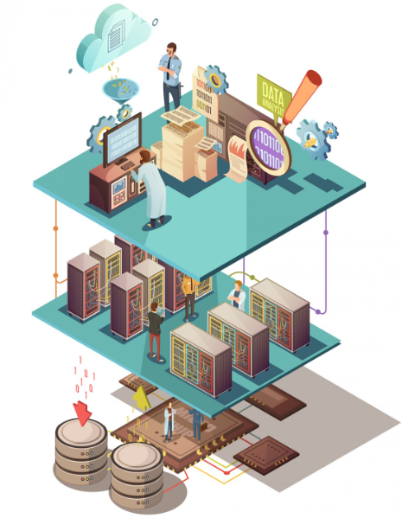
Industrial Data Architecture and Data Flow
Layers of an Industrial Data Architecture
Industrial data architectures can be understood as a series of connected layers, each responsible for a specific stage of data movement and processing. The exact implementation varies between manufacturing organisations, but the underlying responsibilities remain similar.
Data source layer: Sensors, PLCs, machines and production systems generate operational data.
Collection layer: Data is acquired from industrial sources.
Integration layer: Information from different systems is combined and standardised.
Processing layer: Raw data is cleaned, transformed and prepared.
Storage layer: Historical and processed information is retained.
Analytics layer: Data is analysed for patterns and predictions.
Consumption layer: Insights are delivered to engineers, applications or operational systems.

Slide 26
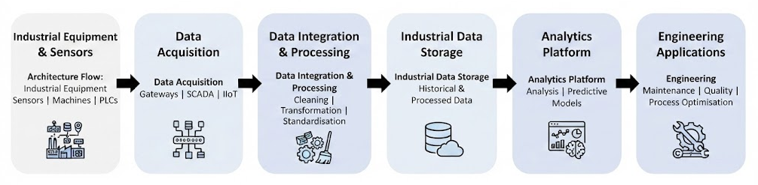
Industrial Data Architecture and Data Flow
Industrial Data Architecture
Notes:
This architecture illustrates the end-to-end flow of industrial data from physical equipment to engineering applications. Sensors, machines and PLCs generate operational data, which is collected through technologies such as SCADA, gateways and Industrial IoT systems. The acquired data is then cleaned, transformed, standardised and integrated before being stored for historical and analytical use. Analytics platforms apply statistical analysis and predictive models to identify patterns, risks and improvement opportunities. These insights are ultimately used by engineering teams for applications such as predictive maintenance, quality improvement and process optimisation, enabling more reliable and data-driven industrial operations.

Slide 27
Industrial Data Architecture and Data Flow
Managing Industrial Data Flow
Industrial data flow describes the movement of information between equipment, control systems, processing components, storage platforms, analytics applications, and users.
Effective data flow requires more than transferring information from one location to another. Engineering teams must consider when data is generated, how frequently it arrives, how it is identified, and where it should be processed.
For example, rapidly changing equipment measurements may need to reach monitoring systems quickly, whereas historical production records may be transferred periodically for analysis. Poorly designed data flows can introduce delays, duplication, inconsistent timestamps, or missing information.
Establishing reliable movement between industrial systems therefore helps ensure that downstream analytics receives accurate, timely, and contextually meaningful information.

Slide 28
ETL Processes for Industrial Data
Understanding ETL in Industrial Environments
ETL stands for Extract, Transform, and Load and provides a structured method for moving data from industrial sources into systems where it can be analysed.
During extraction, information is collected from sources such as sensors, PLC logs, SCADA records, production systems, or equipment files.
Transformation prepares the extracted information by cleaning values, standardising formats, aligning timestamps, handling inconsistencies, and creating useful structures.
The load stage transfers the transformed information into its target storage environment. Industrial ETL processes are particularly important because manufacturing information may originate from multiple systems with different formats and levels of quality.
ETL creates consistent and usable datasets that can support reliable engineering analytics and predictive modelling.

Slide 29
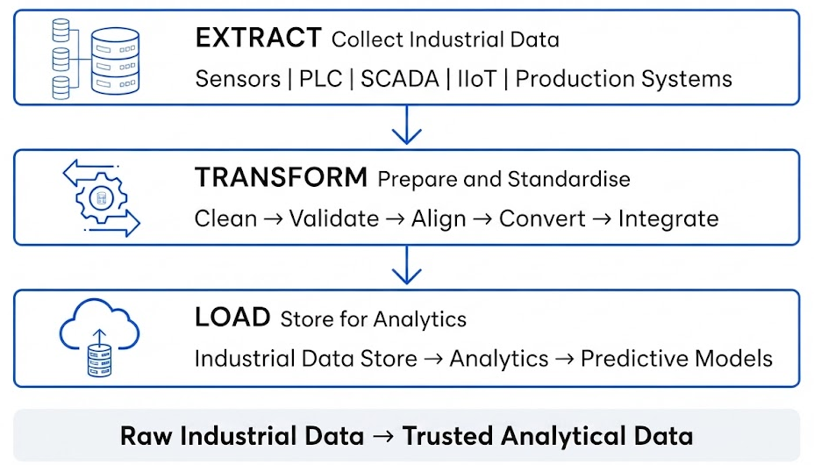
ETL Processes for Industrial Data
Industrial ETL Process
Notes:
This infographic illustrates the ETL (Extract, Transform, Load) process used to prepare industrial data for analytics. During the Extract stage, raw operational data is collected from sources such as sensors, PLCs, SCADA systems, IIoT devices and production systems. In the Transform stage, the collected data is cleaned, validated, aligned, converted and integrated to improve its consistency and reliability. Finally, during the Load stage, the processed data is stored in an industrial data repository where it can support analytics and predictive models. ETL therefore transforms raw industrial data into trusted, analysis-ready information for reliable engineering decisions.

Slide 30
ETL Processes for Industrial Data
Extracting Data from Industrial Sources
Extraction is the first stage of ETL and involves acquiring information from relevant operational systems without compromising its meaning or integrity.
Industrial environments present additional challenges because information can originate from continuously operating equipment, historical databases, machine logs, production applications, or connected devices. Some sources generate measurements every few seconds, while others create records only when specific events occur.
Extraction strategies must therefore consider data frequency, volume, format, connectivity, and operational requirements. Engineers should also preserve important contextual information such as timestamps, machine identifiers, production-line references, and measurement units.
Effective extraction ensures that downstream processing receives sufficient and representative information for reliable analysis while maintaining traceability back to the original industrial source.

Slide 31
ETL Processes for Industrial Data
Transforming and Loading Industrial Data
Transformation converts extracted industrial information into a consistent structure suitable for storage and analysis.
Manufacturing datasets commonly require timestamp alignment, data-type conversion, unit standardisation, duplicate removal, missing-value handling, and validation of measurement ranges.
Data from different machines may also use different naming conventions or sampling frequencies, requiring additional standardisation before integration. After transformation, the prepared information is loaded into a destination where it can be accessed by analytical applications.
The destination may contain historical operational data, processed manufacturing records, or datasets prepared specifically for predictive modelling.
Separating transformation from raw data collection also improves traceability because engineering teams can retain original records while producing validated analytical datasets for downstream use.

Slide 32
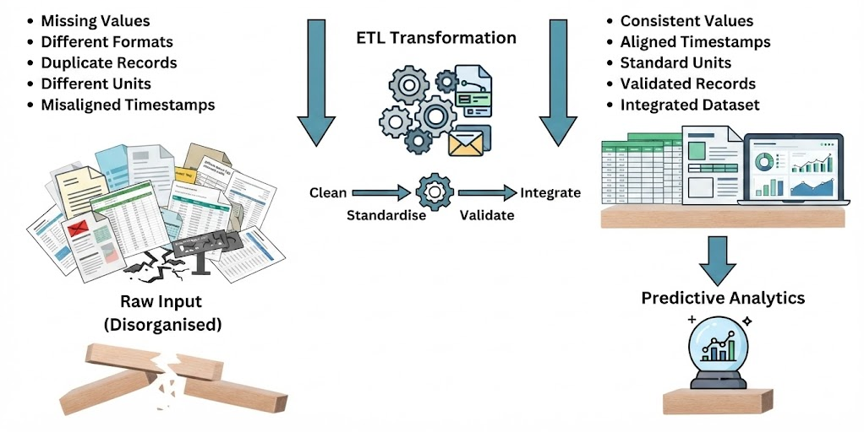
ETL Processes for Industrial Data
From Raw Industrial Data to Analytics-Ready Data
Notes:
This infographic demonstrates how ETL transforms raw and inconsistent industrial data into reliable, analytics-ready information. Industrial datasets may contain missing values, duplicate records, inconsistent formats, different measurement units and misaligned timestamps. During transformation, the data is cleaned, standardised, validated and integrated to create a consistent dataset. The resulting information contains aligned timestamps, standard units and validated records that can be reliably used for analysis. This preparation is particularly important for predictive analytics, because the accuracy and reliability of predictive models depend heavily on the quality and consistency of the input data.

Slide 33
Industrial Data Pipelines and Data Integration
Building Industrial Data Pipelines
An industrial data pipeline is a sequence of connected processes that moves data from operational sources to destinations where it can support reporting, analytics, or predictive models.
Unlike a single manual data transfer, pipelines provide a repeatable mechanism for acquiring, processing, validating, and delivering industrial information.
A pipeline may collect sensor readings, standardise measurement formats, check data quality, combine information from multiple machines, and deliver the resulting dataset to an analytics environment.
Well-designed pipelines reduce repetitive manual processing and help ensure that the same transformation rules are consistently applied.
For predictive analytics, this consistency is essential because models depend on receiving data with expected structures, formats, measurement units, and quality characteristics.

Slide 34
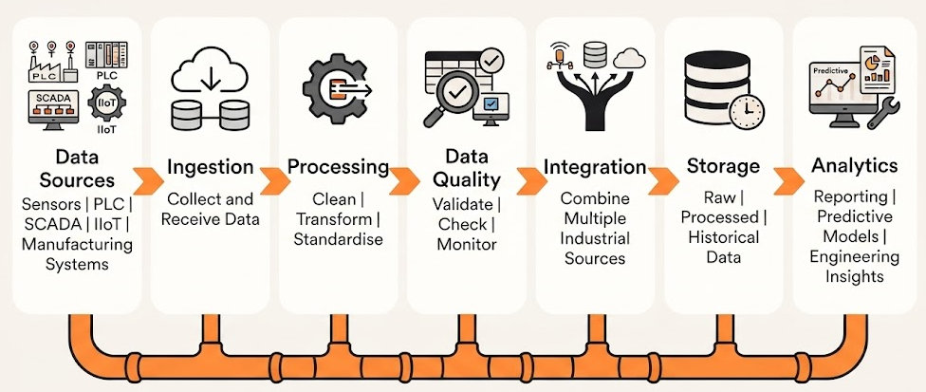
Industrial Data Pipelines and Data Integration
Industrial Data Pipeline Architecture
Notes:
The pipeline creates a repeatable path between operational data generation and analytical consumption. This infographic illustrates the end-to-end industrial data pipeline used to transform operational data into engineering insights. Data generated by sensors, PLCs, SCADA systems, IIoT devices and manufacturing systems is first ingested into the pipeline. It is then cleaned, transformed and standardised before undergoing data-quality checks to ensure accuracy and consistency. The integration stage combines information from multiple industrial sources, creating a unified dataset that can be stored as raw, processed or historical data. Finally, analytics platforms use this integrated information for reporting, predictive modelling and engineering decision-making, enabling organisations to improve operational efficiency and make more reliable data-driven decisions.

Slide 35
Industrial Data Pipelines and Data Integration
Integrating Heterogeneous Industrial Data
Industrial data integration combines information from different operational sources into a consistent analytical view.
This can be challenging because equipment and systems may use different data structures, identifiers, units, timestamps, and sampling frequencies.
For example, vibration data may arrive every second while production-quality records are created once per completed product. To analyse these datasets together, engineers must establish relationships based on elements such as machine identifiers, production batches, time ranges, or process stages.
Effective integration provides richer analytical context because predictive models can consider multiple aspects of manufacturing behaviour simultaneously.
Notes:
Poor integration, however, can associate unrelated observations or create misleading relationships, making accurate identifiers, timestamp alignment, and validation important components of industrial data engineering.

Slide 36
Industrial Data Pipelines and Data Integration
Data Pipeline Reliability and Quality
Reliable industrial analytics depends on pipelines consistently delivering complete and trustworthy information. Pipeline failures may result from unavailable source systems, connectivity problems, unexpected data formats, missing measurements, duplicated records, or changes to upstream systems.
Data engineering processes therefore need controls that detect abnormal conditions before unreliable information reaches downstream analytics.
Validation rules can check whether required fields are present, values fall within expected ranges, timestamps are valid, and records conform to expected structures. Monitoring can also identify interruptions or unusual changes in data volumes.
These controls improve confidence in analytical outputs and help engineering teams distinguish genuine operational changes from problems caused by the underlying data pipeline.

Slide 37
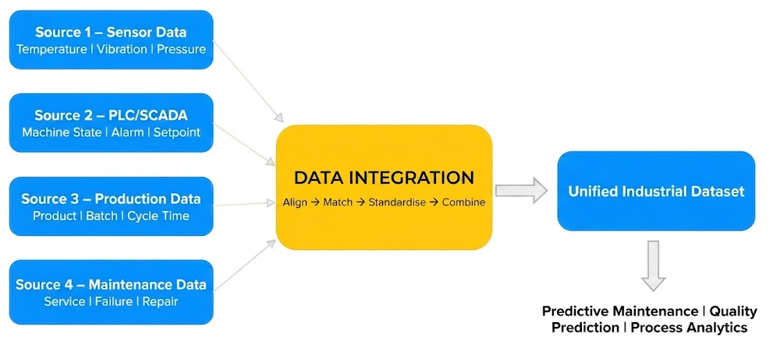
Industrial Data Pipelines and Data Integration
Industrial Data Integration
Notes:
This infographic illustrates how data integration combines information from multiple industrial systems into a unified dataset. Sensor data provides measurements such as temperature, vibration and pressure, while PLC and SCADA systems provide machine states, alarms and setpoints. Production systems contribute information such as batch details and cycle times, and maintenance systems provide service, failure and repair records. During integration, these different datasets are aligned, matched, standardised and combined to create a consistent industrial dataset. This unified information provides a stronger foundation for applications such as predictive maintenance, quality prediction and process analytics, where insights often depend on relationships between multiple operational data sources.

Slide 38
Batch, Streaming, and Real-Time Data Processing
Batch Processing for Industrial Analytics
Batch processing collects and processes groups of records at scheduled intervals rather than processing each event immediately when it is generated.
In manufacturing environments, batch processing can be suitable for historical analysis, daily production summaries, periodic equipment-performance calculations, or model training using large historical datasets.
For example, sensor measurements collected throughout a production shift could be processed together after the shift finishes. Batch processing is generally easier to manage when immediate results are not required and can efficiently handle substantial volumes of historical information.
However, because processing occurs periodically, there is an inherent delay between data generation and analytical output, making batch processing less appropriate for operational situations requiring immediate detection or response.

Slide 39
Batch, Streaming, and Real-Time Data Processing
Streaming and Real-Time Data Processing
Streaming processing handles industrial events continuously as data is generated, allowing information to be processed without waiting for a scheduled batch.
Real-time processing places additional emphasis on producing analytical results with sufficiently low latency to support time-sensitive operational decisions. These approaches are useful when rapidly changing machine conditions must be detected quickly.
For example, continuously analysing vibration or temperature measurements could help identify abnormal equipment behaviour before conditions become critical.
Streaming architectures must manage continuous data arrival, ordering, timestamps, processing capacity, and temporary connectivity problems.
Not every manufacturing use case requires real-time processing; organisations should select processing approaches according to how quickly information must be transformed into an operational decision.

Slide 40
Batch, Streaming, and Real-Time Data Processing
Batch vs Streaming vs Real-Time Processing
Batch | Streaming | Real-Time
Data collected in groups | Continuous data flow | Immediate/low-latency processing
Scheduled processing | Ongoing processing | Time-critical response
Historical analysis | Continuous monitoring | Immediate operational decisions
Periodic reporting | Sensor/event processing | Rapid alerts/actions
Industrial Examples
Batch: Daily production analysis Streaming: Continuous equipment telemetry Real-Time: Critical equipment condition detection

Slide 41
Let’s Recall
Monday
1
Monday
1
Which sequence correctly represents an ETL process for industrial data?
Transform → Extract → Load
Extract → Transform → Load
Load → Analyse → Extract
Extract → Predict → Transform
Monday
1
Friday
5
Notes:
Answer: B
Explanation: ETL first extracts information from source systems, transforms it into an appropriate structure, and then loads it into the target environment.

Slide 42
Let’s Recall
Monday
1
Monday
1
A manufacturing system needs to continuously analyse incoming vibration readings to identify abnormal machine behaviour quickly. Which approach is most appropriate?
Annual batch processing
Manual data entry
Streaming processing
Archived reporting
Monday
1
Friday
5
Notes:
Answer: C
Explanation: Streaming processing supports continuously arriving sensor information and is suitable when operational data needs to be analysed as it arrives.

Slide 43
Module 3: Sensor and Time-Series Data Analytics
Understanding Sensor and Time-Series Data
Time-Series Data Preparation and Cleaning
Handling Missing Values, Noise, and Outliers
Practical Exercise: Exploring Industrial Sensor Datasets Using Python

Slide 44
Understanding Sensor and Time-Series Data
Understanding Industrial Sensor Data
Industrial sensors continuously capture physical conditions associated with machines, equipment, and production processes. Common measurements include temperature, vibration, pressure, speed, flow, humidity, voltage, current, and energy consumption.
These measurements provide engineers with visibility into how equipment behaves during normal and abnormal operating conditions. Unlike conventional business records, sensor datasets can contain large numbers of observations generated at frequent intervals.
Each measurement normally includes a timestamp, sensor or machine identifier, and measured value. Analysing sensor data allows engineers to detect changing operating conditions, recognise abnormal behaviour, and identify patterns that may indicate developing equipment problems.
Consequently, sensor information provides an important foundation for predictive maintenance, process monitoring, and manufacturing analytics.

Slide 45

Understanding Sensor and Time-Series Data
Characteristics of Time-Series Data
Time-series data consists of observations recorded sequentially over time. In manufacturing, a machine may generate temperature, vibration, or pressure measurements every second, minute, or production cycle. The ordering of these observations is important because current equipment behaviour may depend on previous conditions. Unlike ordinary tabular datasets where records may often be analysed independently, time-series analysis considers temporal relationships between observations.
Important characteristics include:
Timestamp: Indicates when each measurement occurred.
Frequency: Defines how often measurements are recorded.
Trend: Represents longer-term movement in values.
Patterns: Repeated behaviour occurring over time.
Variation: Changes around expected operating conditions.
Anomalies: Unusual measurements that differ from normal behaviour.

Slide 46
Understanding Sensor and Time-Series Data
Characteristics of Time-Series Data
Time-series data consists of observations recorded sequentially over time. In manufacturing, a machine may generate temperature, vibration, or pressure measurements every second, minute, or production cycle. The ordering of these observations is important because current equipment behaviour may depend on previous conditions. Unlike ordinary tabular datasets where records may often be analysed independently, time-series analysis considers temporal relationships between observations.
Important characteristics include:
Timestamp: Indicates when each measurement occurred.
Frequency: Defines how often measurements are recorded.
Trend: Represents longer-term movement in values.
Patterns: Repeated behaviour occurring over time.
Variation: Changes around expected operating conditions.
Anomalies: Unusual measurements that differ from normal behaviour.

Slide 47
Understanding Sensor and Time-Series Data
Patterns and Behaviour in Sensor Measurements
Sensor values naturally change as equipment operates under different loads, speeds, environmental conditions, and production requirements.
Engineers therefore need to distinguish normal operational variation from patterns that may indicate a developing problem. A gradual increase in temperature may represent a trend, while recurring changes in machine load may produce repeated patterns.
Sudden spikes in vibration could represent an abnormal event, sensor error, or actual equipment deterioration. Understanding these behaviours is important before predictive modelling begins because algorithms may otherwise learn patterns caused by poor-quality measurements rather than genuine equipment conditions.
Exploratory analysis helps engineers understand typical operating ranges, relationships between measurements, and periods where machine behaviour differs significantly from established patterns.

Slide 48

Time-Series Data Preparation and Cleaning
Preparing Industrial Time-Series Data
Raw time-series data is rarely immediately suitable for analysis. Measurements may arrive from different machines, sensors, or control systems and can contain inconsistent timestamps, duplicated observations, missing records, incorrect data types, or different sampling intervals.
Preparation converts this information into a consistent analytical structure. Engineers typically verify timestamps, arrange observations chronologically, remove duplicates, check measurement units, and confirm that machine and sensor identifiers are correctly represented.
Data types should also be appropriate; timestamps should be recognised as time values rather than ordinary text, while sensor readings should be represented numerically.
Notes:
Careful preparation ensures that subsequent trend analysis, feature engineering, and predictive models operate on reliable and correctly ordered industrial information.

Slide 49
Time-Series Data Preparation and Cleaning
Timestamp Alignment and Sampling Frequency
Industrial sensors may operate at different sampling frequencies. One device might record temperature every minute while another captures vibration every few seconds.
Combining such measurements without appropriate alignment can create inaccurate comparisons or missing observations. Timestamp alignment organises readings around a consistent temporal reference so that measurements from different sources can be meaningfully compared.
Resampling can also convert observations into a common frequency by aggregating or reorganising measurements over defined intervals. The selected frequency should preserve information relevant to the engineering problem.
Excessive aggregation may hide short-duration anomalies, whereas extremely frequent measurements may create unnecessary data volume and noise. Understanding sampling behaviour therefore helps engineers prepare time-series datasets that accurately represent equipment and process conditions.

Slide 50
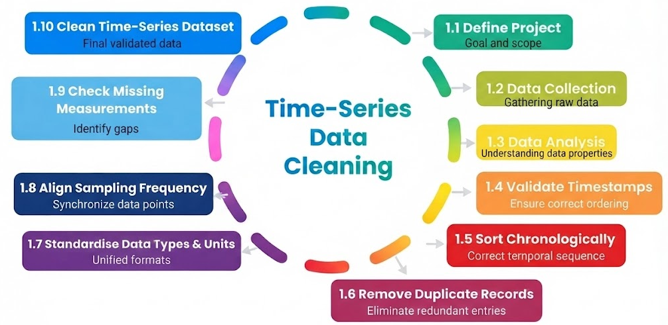
Time-Series Data Preparation and Cleaning
Industrial Time-Series Data Preparation Workflow
Notes:
This infographic illustrates the workflow for preparing industrial time-series data before analysis and predictive modelling. The process begins by defining the project scope and collecting raw operational data. The dataset is then examined and prepared by validating timestamps, arranging observations chronologically, removing duplicate records, and standardising data types and measurement units. Sampling frequencies are aligned to ensure measurements from different sensors can be compared accurately, while missing measurements are identified and addressed. The final result is a clean, consistent and correctly sequenced time-series dataset, providing a reliable foundation for applications such as predictive maintenance, anomaly detection, forecasting and process optimisation.

Slide 51
Time-Series Data Preparation and Cleaning
Preserving Time-Series Integrity During Cleaning
Cleaning time-series information requires particular care because observations have a temporal relationship. Simply deleting problematic records may create gaps in measurement sequences, while incorrectly replacing missing values can introduce artificial patterns.
Engineers should first understand why a quality problem occurred and determine whether it represents a sensor malfunction, communication failure, maintenance event, equipment shutdown, or genuine operating condition.
Cleaning decisions should therefore consider both statistical characteristics and engineering context. Original timestamps should be preserved whenever possible, and transformations should remain traceable so analysts understand how the cleaned dataset was produced.
Maintaining temporal integrity is particularly important for predictive maintenance because changes occurring before equipment faults may provide valuable indicators for future failure prediction.

Slide 52
Handling Missing Values, Noise, and Outliers
Missing Values in Industrial Sensor Data
Missing measurements are common in industrial datasets and can result from sensor failures, network interruptions, equipment shutdowns, communication delays, or data-collection problems.
Before selecting a treatment method, engineers should determine the scale and pattern of missing information. A single missing temperature reading between two valid observations may require different treatment from several hours of missing measurements during equipment downtime.
Possible approaches include removing affected records, filling values using neighbouring observations, or applying interpolation where appropriate.
However, missing data should not automatically be replaced because gaps themselves may contain operational meaning. The chosen approach should consider measurement frequency, duration of the gap, sensor behaviour, and intended analytical use to avoid creating misleading patterns.

Slide 53

Handling Missing Values, Noise, and Outliers
Noise in Industrial Measurements
Sensor noise refers to unwanted fluctuations in measurements that do not represent meaningful changes in the underlying physical process.
Noise can arise from electrical interference, sensor limitations, environmental conditions, calibration issues, or communication problems. Excessive noise can obscure genuine trends and make it difficult to identify changes associated with equipment condition.
Smoothing techniques, such as rolling averages, can help reveal underlying behaviour by reducing short-term fluctuations. However, excessive smoothing may also remove important short-duration events that could indicate developing faults.
Notes:
Engineers therefore need to balance noise reduction with preservation of useful operational information. Understanding the characteristics of the equipment and sensor is essential when determining whether variation represents measurement noise or genuine process behaviour.

Slide 54
Handling Missing Values, Noise, and Outliers
Detecting and Handling Outliers
An outlier is an observation that differs substantially from expected values or surrounding measurements. In industrial sensor data, outliers can result from measurement errors, sensor faults, communication problems, unusual process conditions, or genuine equipment failures.
This makes automatic removal risky because an extreme vibration or temperature reading may be precisely the event predictive analytics needs to identify. Engineers can investigate outliers using statistical thresholds, visualisation, expected operating ranges, and comparisons with neighbouring observations.
Once identified, each outlier should be interpreted within its engineering context. Invalid measurements may be corrected or excluded, while genuine abnormal operating events should normally be retained because they may contain important information about faults, deterioration, or process instability.

Slide 55
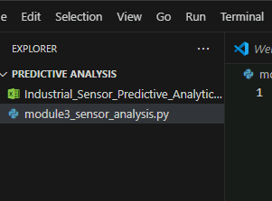
Practical Exercise: Exploring Industrial Sensor Datasets Using Python
Objective: Explore and clean an industrial sensor time-series dataset using Python. Participants will inspect sensor readings, identify data-quality problems, handle missing values and outliers, and visualise sensor behaviour over time.
Tools Required: Python, VS Code, Pandas, NumPy, Matplotlib, and a CSV industrial sensor dataset.
Step 1 – Load and Inspect the Sensor Dataset
Create the project folder: (Predictive_Analytics_Training)
Inside it, keep these two files:
(Predictive_Analytics_Training
Industrial_Sensor_Predictive_Analytics_Dataset.xlsx
module3_sensor_analysis.py)

Slide 56
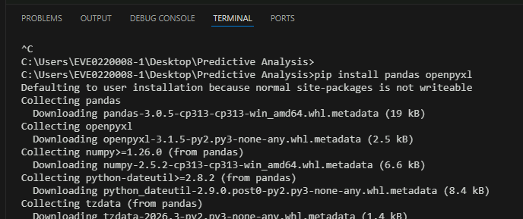
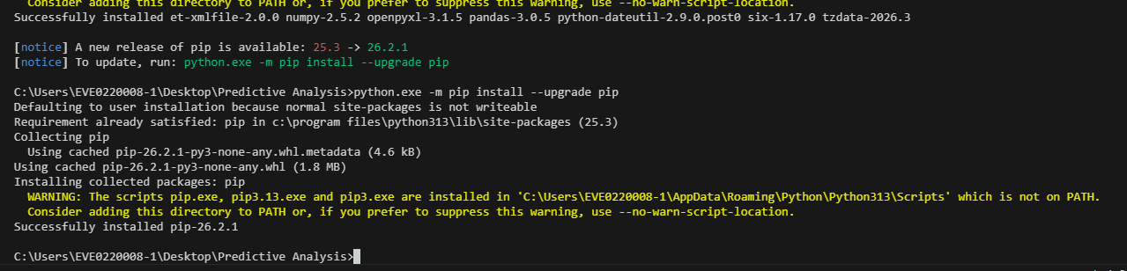
Practical Exercise: Exploring Industrial Sensor Datasets Using Python
Step 2 – Open the folder in VS Code
Create (module3_sensor_analysis.py)
Install the required Python packages.
In VS Code, select : Terminal → New Terminal
Run: pip install pandas openpyxl
Notes:
pip install pandas openpyxl

Slide 57
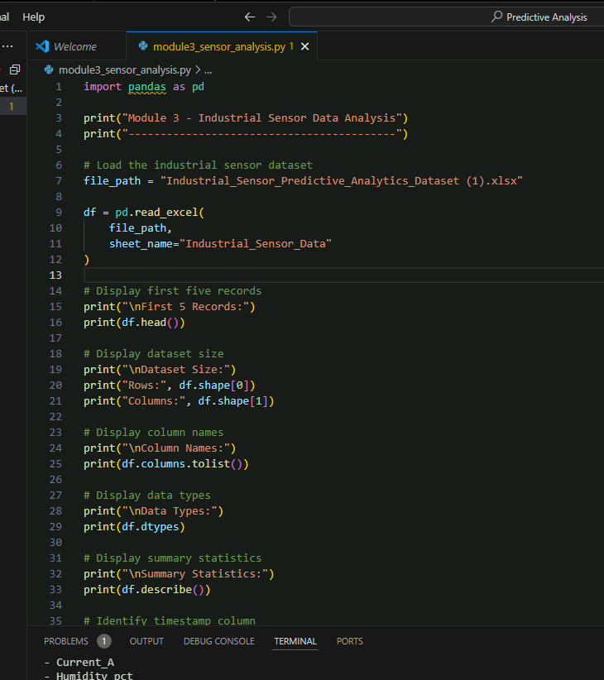
Practical Exercise: Exploring Industrial Sensor Datasets Using Python
Step 3 – Add the Step 1 code
Open: module3_sensor_analysis.py
Paste this complete code:
import pandas as pd
print("Module 3 - Industrial Sensor Data Analysis")
print("------------------------------------------")
# Load the industrial sensor dataset
file_path = "Industrial_Sensor_Predictive_Analytics_Dataset.xlsx"
df = pd.read_excel(
file_path,
sheet_name="Industrial_Sensor_Data"
)
# Display first five records
print("\nFirst 5 Records:")
print(df.head())
# Display dataset size
print("\nDataset Size:")
print("Rows:", df.shape[0])
print("Columns:", df.shape[1])
# Display column names
print("\nColumn Names:")
print(df.columns.tolist()
# Display data types
print("\nData Types:")
print(df.dtypes)
# Display summary statistics
print("\nSummary Statistics:")
print(df.describe())
# Identify timestamp column
print("\nTimestamp Column:")
print("Timestamp")
# Identify sensor measurement columns
sensor_columns = [
"Temperature_C",
"Pressure_bar",
"Vibration_mm_s",
"RPM",
"Current_A",
"Humidity_pct"
]
print("\nSensor Measurement Columns:")
for column in sensor_columns:
print("-", column)
print("\nStep 1 completed successfully.")
Notes:
import pandas as pd
print("Module 3 - Industrial Sensor Data Analysis")
print("------------------------------------------")
# Load the industrial sensor dataset
file_path = "Industrial_Sensor_Predictive_Analytics_Dataset.xlsx"
df = pd.read_excel(
file_path,
sheet_name="Industrial_Sensor_Data"
)
# Display first five records
print("\nFirst 5 Records:")
print(df.head())
# Display dataset size
print("\nDataset Size:")
print("Rows:", df.shape[0])
print("Columns:", df.shape[1])
# Display column names
print("\nColumn Names:")
print(df.columns.tolist())
# Display data types
print("\nData Types:")
print(df.dtypes)
# Display summary statistics
print("\nSummary Statistics:")
print(df.describe())
# Identify timestamp column
print("\nTimestamp Column:")
print("Timestamp")
# Identify sensor measurement columns
sensor_columns = [
"Temperature_C",
"Pressure_bar",
"Vibration_mm_s",
"RPM",
"Current_A",
"Humidity_pct"
]
print("\nSensor Measurement Columns:")
for column in sensor_columns:
print("-", column)
print("\nStep 1 completed successfully.")

Slide 58
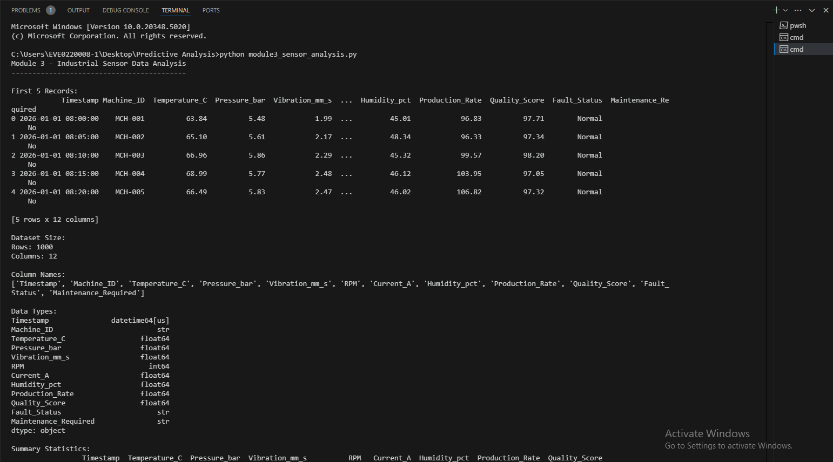
Practical Exercise: Exploring Industrial Sensor Datasets Using Python
Step 4 – Run the Python file
Run: python module3_sensor_analysis.py
Outcome : By completing this lab, participants will be able to load and explore industrial sensor data, prepare timestamp-based records, identify and treat missing values, detect potential outliers, and visualise time-series sensor behaviour using Python. The cleaned dataset can then be reused in later modules for feature engineering and predictive modelling.
Notes:
python module3_sensor_analysis.py

Slide 59
Let’s Recall
Monday
1
Monday
1
Why should engineers be cautious when removing outliers from industrial sensor data?
Outliers always improve data quality
Extreme values may represent genuine equipment faults
Outliers occur only because of missing timestamps
Predictive models cannot process normal values
Monday
1
Friday
5
Notes:
Answer: B
Explanation: An extreme sensor measurement may represent either an error or a genuine abnormal operating condition, making engineering context essential before removal.

Slide 60
Let’s Recall
Monday
1
Monday
1
Why is timestamp alignment important when combining measurements from multiple industrial sensors?
It guarantees that no sensor will fail
It converts all measurements into categorical data
It allows observations from different sources to be compared across consistent time references
It automatically removes every missing value
Monday
1
Friday
5
Notes:
Answer: C
Explanation: Timestamp alignment provides a consistent temporal reference for comparing measurements generated by sensors operating at different times or frequencies.

Slide 61
Module 4: Python for Industrial Predictive Analytics
Python Fundamentals for Predictive Analytics
Data Analysis Using Pandas
Numerical Computing Using NumPy
Practical Exercise: Processing Industrial Manufacturing Datasets

Slide 62
Python Fundamentals for Predictive Analytics
Role of Python in Industrial Predictive Analytics
Python provides a flexible programming environment for transforming industrial data into analytical insights and predictive models.
Engineering datasets often contain large volumes of machine measurements, production records, quality information, and operational variables that require systematic processing. Python allows these tasks to be automated rather than performed manually.
Its extensive analytical ecosystem supports data loading, manipulation, numerical computation, visualisation, statistical analysis, and machine learning within a consistent workflow.
Engineers can use Python to process repeated manufacturing datasets, calculate operational indicators, identify abnormal conditions, and prepare information for predictive modelling.
Its readable syntax and reusable code also make analytical workflows easier to document, repeat, and modify as manufacturing requirements or data sources change.

Slide 63

Python Fundamentals for Predictive Analytics
Core Python Components for Industrial Analysis
Industrial predictive analytics uses several fundamental Python concepts to organise and process manufacturing information. Variables store individual values, while lists and dictionaries can represent collections of measurements or equipment information. Conditional statements allow different actions to be performed according to operating conditions, and loops support repeated processing across machines, measurements, or production records. Functions package reusable analytical logic into manageable components.
Key Python concepts include:
Variables: Store measurements and calculated values.
Data types: Represent numbers, text, and logical states.
Lists: Maintain collections of observations.
Dictionaries: Store related information using key-value relationships.
Conditions: Apply logic based on specified criteria.
Loops: Repeat processing tasks.
Functions: Create reusable analytical operations.

Slide 64
Python Fundamentals for Predictive Analytics
Building Repeatable Analytical Workflows
A major advantage of Python is the ability to convert manual analytical procedures into repeatable workflows.
For example, an engineer may need to load production records, calculate machine-level statistics, identify measurements exceeding defined thresholds, and export the results.
Performing these activities manually can become inefficient and inconsistent when datasets are frequently updated. Python scripts can execute the same processing logic whenever new information becomes available.
Functions can further divide the workflow into reusable operations for loading, processing, validation, and analysis.
Repeatability is particularly valuable in industrial environments because predictive analytics frequently depends on consistent processing across machines, production lines, shifts, or time periods. Well-structured code therefore supports efficiency, traceability, and reproducibility.

Slide 65
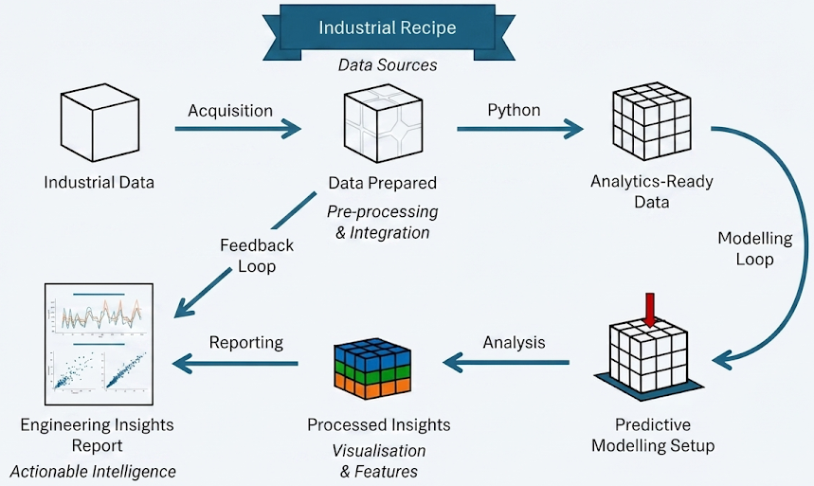
Python Fundamentals for Predictive Analytics
Python-Based Industrial Analytics Workflow
Notes:
This infographic illustrates how Python supports an industrial predictive analytics workflow from raw data to actionable engineering insights. Industrial data is first acquired and prepared through preprocessing and integration. Python can then be used to clean, transform and organise the information into an analytics-ready dataset. The prepared data supports predictive modelling, feature analysis and visualisation to identify patterns and generate useful insights. Results can subsequently be presented through reports and visualisations to support engineering decisions. The feedback loop allows new operational information to continuously improve the analysis, demonstrating Python's role as a flexible foundation for data preparation, predictive modelling, visualisation and industrial decision support.

Slide 66
Data Analysis Using Pandas
Pandas for Manufacturing Data Analysis
Pandas is a Python library designed for working with structured data and is particularly useful for manufacturing datasets organised into rows and columns.
Its primary structure, the DataFrame, allows engineers to represent information such as machine identifiers, timestamps, temperatures, cycle times, production quantities, downtime, and quality results within a single analytical object.
Pandas provides functions for loading CSV or spreadsheet data, inspecting records, selecting columns, filtering observations, sorting values, handling missing information, and calculating summary statistics.
These capabilities make it possible to move efficiently from raw manufacturing records to organised analytical datasets. Pandas also integrates with other Python libraries, allowing processed DataFrames to become inputs for visualisation, numerical analysis, feature engineering, and predictive modelling.

Slide 67

Data Analysis Using Pandas
Filtering, Grouping, and Aggregating Industrial Data
Manufacturing datasets frequently contain observations from multiple machines, products, shifts, or production lines. Pandas enables engineers to separate and summarise these records according to operational requirements. Filtering can isolate machines operating above a temperature threshold or production records associated with a particular shift. Grouping can organise observations according to machine, production line, product type, or other categories. Aggregation can then calculate statistics such as average temperature, maximum vibration, total production, defect count, or mean cycle time.
Typical analytical operations include:
Selecting relevant columns.
Filtering records using conditions.
Sorting measurements.
Grouping data by machine or production line.
Calculating mean, minimum, maximum, and totals.
Counting production or quality events.
Creating derived analytical columns.

Slide 68
Data Analysis Using Pandas
Using Pandas to Examine Data Quality
Before industrial data is used for predictive analytics, engineers need to understand its structure and quality. Pandas provides several capabilities for examining datasets and identifying potential issues.
Analysts can inspect column data types, determine whether values are missing, identify duplicated records, review unique categories, and calculate descriptive statistics for numerical measurements.
These checks can reveal unexpected values or structural inconsistencies before more advanced analysis begins.
For example, an unusually high maximum temperature may indicate an equipment event or incorrect measurement, while missing machine identifiers may prevent records from being associated with the correct asset.
Early data-quality inspection helps ensure that subsequent numerical calculations and predictive models operate on information that has been properly understood and prepared.

Slide 69
Data Analysis Using Pandas
Using Pandas to Examine Data Quality
Before industrial data is used for predictive analytics, engineers need to understand its structure and quality. Pandas provides several capabilities for examining datasets and identifying potential issues.
Analysts can inspect column data types, determine whether values are missing, identify duplicated records, review unique categories, and calculate descriptive statistics for numerical measurements.
These checks can reveal unexpected values or structural inconsistencies before more advanced analysis begins.
For example, an unusually high maximum temperature may indicate an equipment event or incorrect measurement, while missing machine identifiers may prevent records from being associated with the correct asset.
Early data-quality inspection helps ensure that subsequent numerical calculations and predictive models operate on information that has been properly understood and prepared.

Slide 70
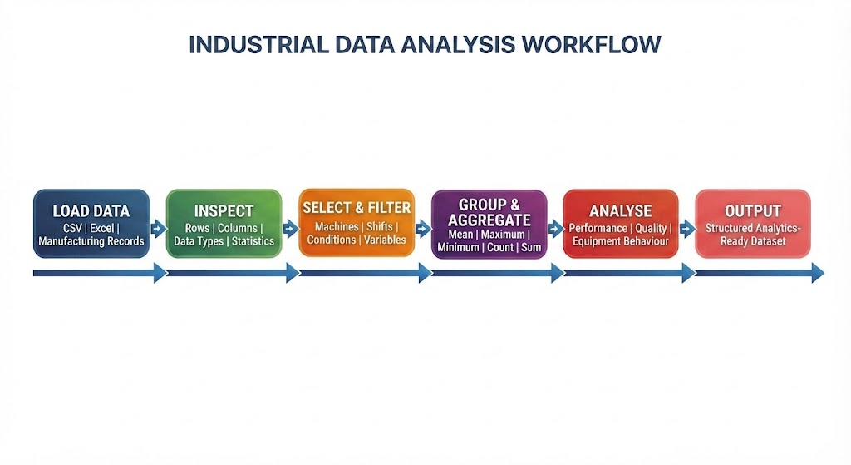
Data Analysis Using Pandas
Pandas Workflow for Industrial Data
Notes:
This infographic illustrates a typical Pandas workflow for preparing and analysing industrial datasets. Data from CSV files, Excel workbooks or manufacturing records is first loaded into a Pandas DataFrame and inspected to understand its rows, columns, data types and basic statistics. Relevant records can then be selected and filtered according to machines, shifts, operating conditions or other variables. Pandas aggregation functions can calculate measures such as mean, maximum, minimum, count and sum. The processed information can then be analysed for equipment performance, quality trends and operational behaviour, producing a structured, analytics-ready dataset for visualisation or predictive modelling.

Slide 71
Numerical Computing Using NumPy
NumPy for Industrial Numerical Computing
NumPy provides efficient numerical computing capabilities for Python and is widely used when analytical workflows involve large collections of numerical values.
Its core structure, the multidimensional array, enables numerical data to be stored and processed efficiently. Industrial analytics often requires calculations across thousands of sensor readings, equipment measurements, production values, or engineered variables.
NumPy supports mathematical and statistical operations across these arrays without requiring engineers to process each observation individually.
Operations such as averages, standard deviations, minimum and maximum values, differences, and mathematical transformations can therefore be applied efficiently.
NumPy also provides a numerical foundation for many other Python data-science and machine-learning libraries, making it an important component of predictive analytics workflows.

Slide 72
Numerical Computing Using NumPy
Applying Numerical Operations to Manufacturing Data
Numerical calculations help engineers transform raw manufacturing measurements into information that better describes equipment and process behaviour.
NumPy can calculate statistical summaries across arrays of sensor or production values and perform element-wise mathematical operations efficiently.
For example, engineers may calculate average machine temperatures, variability in cycle times, differences between successive measurements, or normalised values for further analysis. Arrays can also represent multiple measurements simultaneously, enabling consistent calculations across large datasets.
The value of numerical computing becomes particularly significant when processing high-volume industrial information where manual calculations would be impractical.
By combining NumPy with Pandas, engineers can use Pandas for structured data manipulation while applying efficient numerical operations to selected manufacturing variables.

Slide 73
Module 4 Hands-On Lab
Practical Exercise: Industrial Sensor Data Analysis Using Python, Pandas and NumPy
Objective: Use Python in VS Code to load, inspect, analyse and process an industrial manufacturing sensor dataset. Participants will practise fundamental Python operations, use Pandas for tabular data analysis, use NumPy for numerical calculations, and generate a processed dataset that can later be used for feature engineering in Module 5.
Dataset Used
File: Industrial_Sensor_Predictive_Analytics_Dataset.xlsx
Sheet: Industrial_Sensor_Data
The dataset contains 1,000 records and 12 columns, including temperature, pressure, vibration, RPM, electrical current, production rate, quality score, fault status and maintenance indicators.

Slide 74
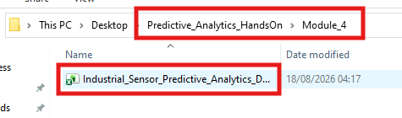
Module 4 Hands-On Lab
Step 1 — Create the Module 4 Project and Load the Dataset
Purpose: Set up the Python project in VS Code and load the industrial sensor dataset into a Pandas DataFrame.
1. Create the project folder
Create a new folder on your system: Predictive_Analytics_HandsOn
Inside it, create another folder: Module_4
Your structure should initially look like:
2. Place the dataset inside the Module 4 folder
Copy Industrial_Sensor_Predictive_Analytics_Dataset.xlsx into Predictive_Analytics_HandsOn/Module_4/

Slide 75
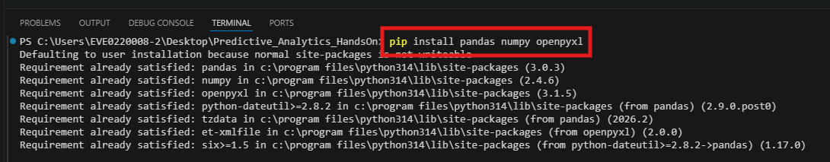
Module 4 Hands-On Lab
3. Open the folder in VS Code
Open VS Code.
Select: File → Open Folder
Select: Predictive_Analytics_HandsOn
4. Open the VS Code terminal
Select: Terminal → New Terminal
Install the required packages if they are not already installed:
pip install pandas numpy openpyxl
Notes:
pip install pandas numpy openpyxl

Slide 76
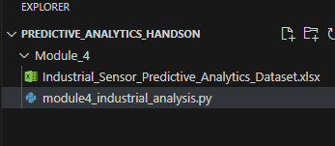
Module 4 Hands-On Lab
5. Create the Python file
Inside Module_4, create:
module4_industrial_analysis.py
Your structure becomes:

Slide 77
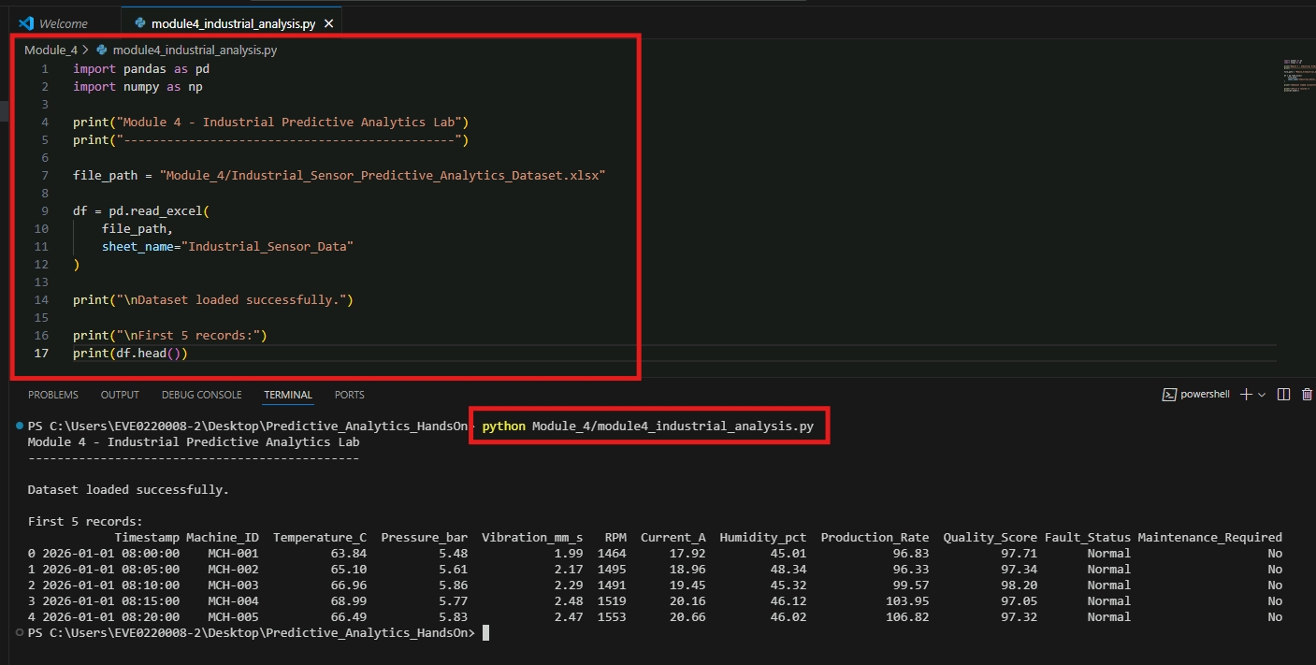
Module 4 Hands-On Lab
6. Add the following code
7. Run the program
From the VS Code terminal: python Module_4/module4_industrial_analysis.py
Notes:
import pandas as pd
import numpy as np
print("Module 4 - Industrial Predictive Analytics Lab")
print("----------------------------------------------")
file_path = "Module_4/Industrial_Sensor_Predictive_Analytics_Dataset.xlsx"
df = pd.read_excel(
file_path,
sheet_name="Industrial_Sensor_Data"
)
print("\nDataset loaded successfully.")
print("\nFirst 5 records:")
print(df.head())

Slide 78
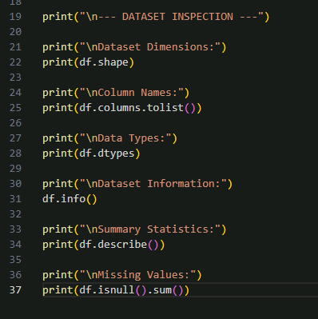
Module 4 Hands-On Lab
Step 2 — Inspect the Industrial Dataset Using Pandas
Purpose: Understand the dataset structure before performing predictive analytics.
Continue in the same file: module4_industrial_analysis.py
Add the following code below Step 1:
Notes:
print("\n--- DATASET INSPECTION ---")
print("\nDataset Dimensions:")
print(df.shape)
print("\nColumn Names:")
print(df.columns.tolist())
print("\nData Types:")
print(df.dtypes)
print("\nDataset Information:")
df.info()
print("\nSummary Statistics:")
print(df.describe())
print("\nMissing Values:")
print(df.isnull().sum())

Slide 79
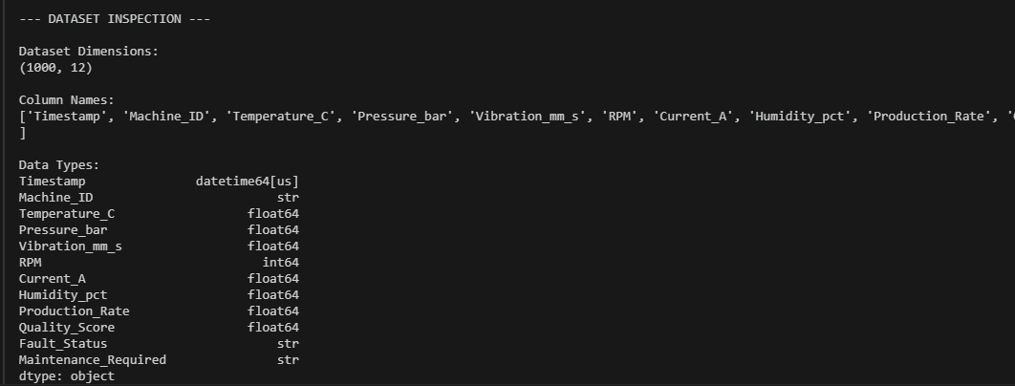
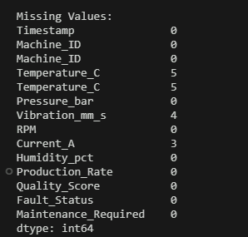
Module 4 Hands-On Lab
Run the file again: python Module_4/module4_industrial_analysis.py
Notes:
python Module_4/module4_industrial_analysis.py

Slide 80
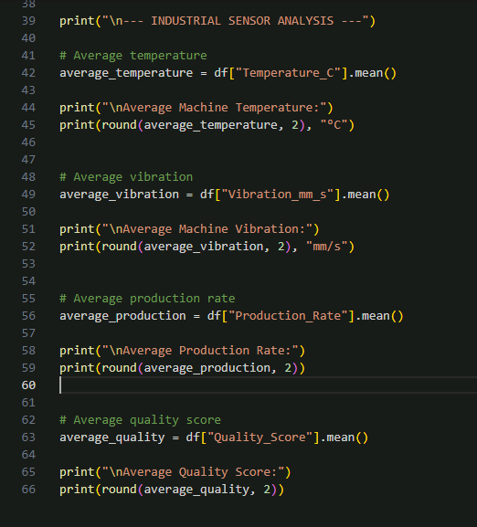
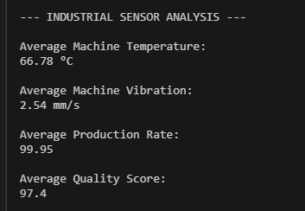
Module 4 Hands-On Lab
Step 3 — Analyse Manufacturing Sensor Data Using Pandas
Purpose: Use filtering, grouping and aggregation to obtain meaningful industrial insights.
Add this code below Step 2:
Output:
Notes:
print("\n--- INDUSTRIAL SENSOR ANALYSIS ---")
# Average temperature
average_temperature = df["Temperature_C"].mean()
print("\nAverage Machine Temperature:")
print(round(average_temperature, 2), "°C")
# Average vibration
average_vibration = df["Vibration_mm_s"].mean()
print("\nAverage Machine Vibration:")
print(round(average_vibration, 2), "mm/s")
# Average production rate
average_production = df["Production_Rate"].mean()
print("\nAverage Production Rate:")
print(round(average_production, 2))
# Average quality score
average_quality = df["Quality_Score"].mean()
print("\nAverage Quality Score:")
print(round(average_quality, 2))

Slide 81
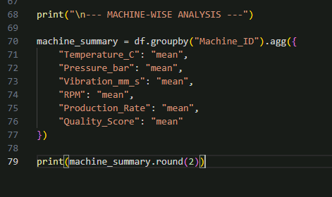
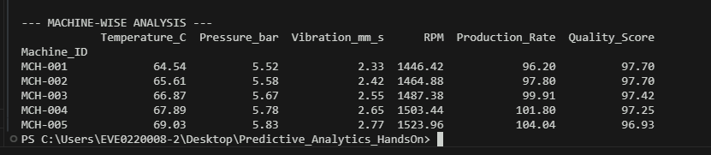
Module 4 Hands-On Lab
Now analyse the machines individually:
What this demonstrates
Participants are using Pandas to convert raw sensor readings into machine-level operational information.
For example, instead of analysing hundreds of individual readings, they can determine the average:
temperature,
pressure,
vibration,
RPM,
production rate,
quality score
for each machine.
Notes:
print("\n--- MACHINE-WISE ANALYSIS ---")
machine_summary = df.groupby("Machine_ID").agg({
"Temperature_C": "mean",
"Pressure_bar": "mean",
"Vibration_mm_s": "mean",
"RPM": "mean",
"Production_Rate": "mean",
"Quality_Score": "mean"
})
print(machine_summary.round(2))

Slide 82
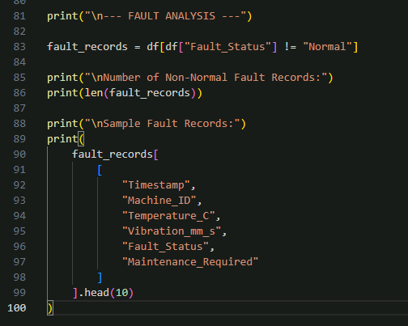
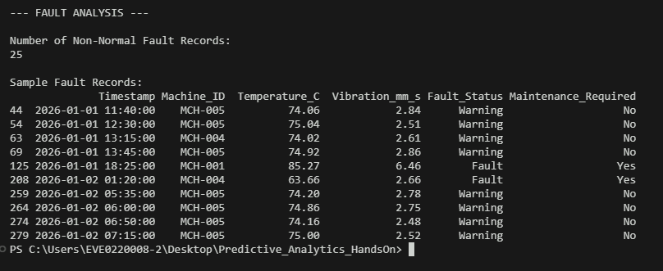
Module 4 Hands-On Lab
Step 4 — Identify Fault and Maintenance Conditions
Purpose: Use Python filtering and conditional analysis to isolate abnormal manufacturing conditions.
Add the following code:
Output:
Notes:
print("\n--- FAULT ANALYSIS ---")
fault_records = df[df["Fault_Status"] != "Normal"]
print("\nNumber of Non-Normal Fault Records:")
print(len(fault_records))
print("\nSample Fault Records:")
print(
fault_records[
[
"Timestamp",
"Machine_ID",
"Temperature_C",
"Vibration_mm_s",
"Fault_Status",
"Maintenance_Required"
]
].head(10)
)

Slide 83
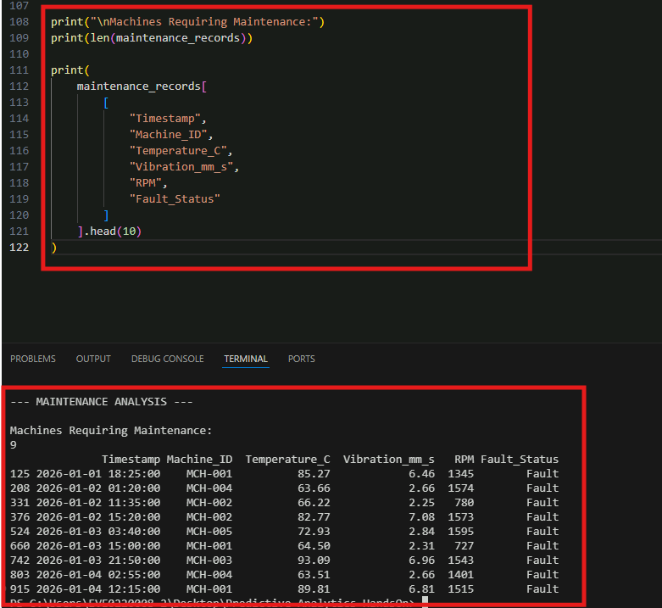
Module 4 Hands-On Lab
Step 4 — Identify Fault and Maintenance Conditions
Now inspect maintenance requirements:
Output:
Notes:
print("\n--- MAINTENANCE ANALYSIS ---")
maintenance_records = df[
df["Maintenance_Required"] == "Yes"
]
print("\nMachines Requiring Maintenance:")
print(len(maintenance_records))
print(
maintenance_records[
[
"Timestamp",
"Machine_ID",
"Temperature_C",
"Vibration_mm_s",
"RPM",
"Fault_Status"
]
].head(10)
)

Slide 84
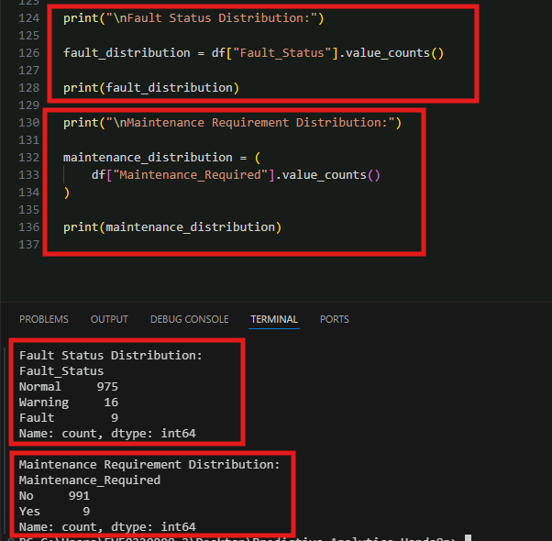
Module 4 Hands-On Lab
Calculate fault distribution. Add:
Calculate maintenance distribution
Learning Point
This demonstrates a typical industrial analytics task:
Raw Sensor Readings → Filter Abnormal Conditions → Identify Potential Maintenance Events
Later, these same fields can become the targets for predictive models.
Notes:
print("\nFault Status Distribution:")
fault_distribution = df["Fault_Status"].value_counts()
print(fault_distribution)
print("\nMaintenance Requirement Distribution:")
maintenance_distribution = (
df["Maintenance_Required"].value_counts()
)
print(maintenance_distribution)

Slide 85
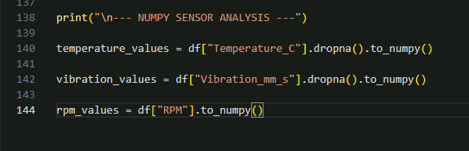
Module 4 Hands-On Lab
Step 5 — Perform Numerical Analysis Using NumPy
Purpose: Use NumPy to perform numerical calculations on sensor measurements and identify potentially abnormal operating behaviour.
Add this below Step 4:
Notes:
print("\n--- NUMPY SENSOR ANALYSIS ---")
temperature_values = df["Temperature_C"].dropna().to_numpy()
vibration_values = df["Vibration_mm_s"].dropna().to_numpy()
rpm_values = df["RPM"].to_numpy()

Slide 86
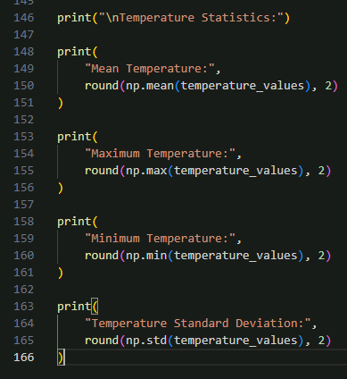
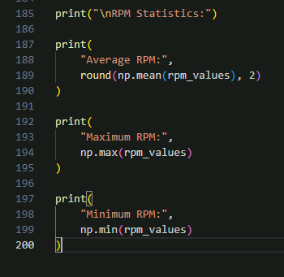
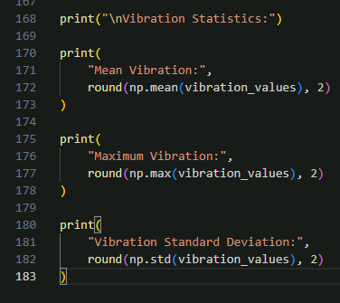
Module 4 Hands-On Lab
Calculate temperature statistics
Analyse vibration
Analyse RPM
Notes:
Calculate temperature statistics
print("\nTemperature Statistics:")
print(
"Mean Temperature:",
round(np.mean(temperature_values), 2)
)
print(
"Maximum Temperature:",
round(np.max(temperature_values), 2)
)
print(
"Minimum Temperature:",
round(np.min(temperature_values), 2)
)
print(
"Temperature Standard Deviation:",
round(np.std(temperature_values), 2)
)
Analyse vibration
print("\nVibration Statistics:")
print(
"Mean Vibration:",
round(np.mean(vibration_values), 2)
)
print(
"Maximum Vibration:",
round(np.max(vibration_values), 2)
)
print(
"Vibration Standard Deviation:",
round(np.std(vibration_values), 2)
)
Analyse RPM
print("\nRPM Statistics:")
print(
"Average RPM:",
round(np.mean(rpm_values), 2)
)
print(
"Maximum RPM:",
np.max(rpm_values)
)
print(
"Minimum RPM:",
np.min(rpm_values)
)

Slide 87
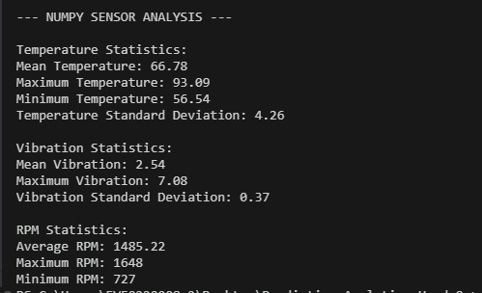
Module 4 Hands-On Lab
Output:

Slide 88
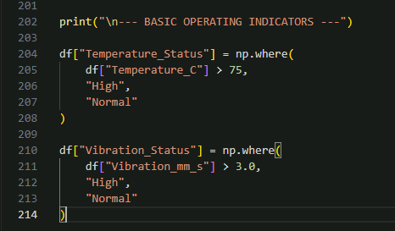
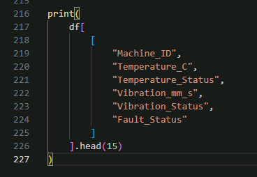
Module 4 Hands-On Lab
Step 6 — Create Basic Industrial Operating Indicators
Purpose: Combine Python conditions with sensor values to categorise operating behaviour.
We will create simple analysis fields. These are only introductory indicators; more advanced feature engineering will happen in Module 5.
Add:
Now display the results:
Notes:
print("\n--- BASIC OPERATING INDICATORS ---")
df["Temperature_Status"] = np.where(
df["Temperature_C"] > 75,
"High",
"Normal"
)
df["Vibration_Status"] = np.where(
df["Vibration_mm_s"] > 3.0,
"High",
"Normal"
)
print(
df[
[
"Machine_ID",
"Temperature_C",
"Temperature_Status",
"Vibration_mm_s",
"Vibration_Status",
"Fault_Status"
]
].head(15)
)

Slide 89
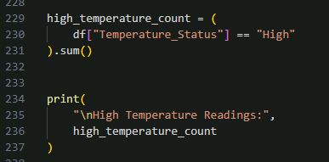
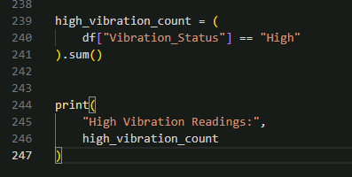
Module 4 Hands-On Lab
Count high-temperature readings
Count high-vibration readings
Concept demonstrated: Participants can now see how sensor values can be converted into operational indicators:
Temperature Reading->Python / NumPy Condition->High or Normal
Notes:
Count high-temperature readings
high_temperature_count = (
df["Temperature_Status"] == "High"
).sum()
print(
"\nHigh Temperature Readings:",
high_temperature_count
)
Count high-vibration readings
high_vibration_count = (
df["Vibration_Status"] == "High"
).sum()
print(
"High Vibration Readings:",
high_vibration_count
)

Slide 90
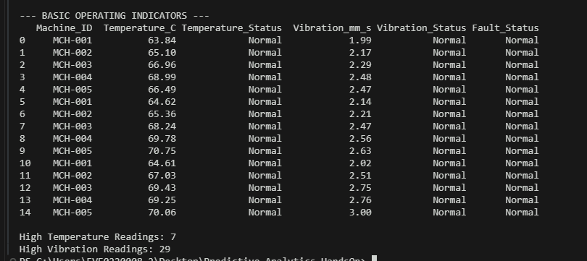
Module 4 Hands-On Lab
Output:

Slide 91
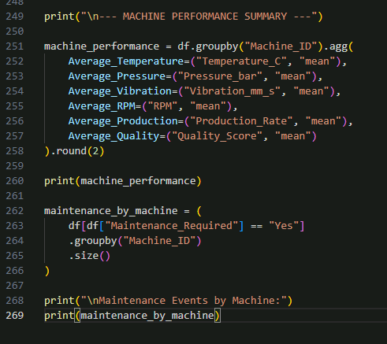
Module 4 Hands-On Lab
Step 7 — Produce a Machine-Level Summary
Purpose: Create a compact analytical summary for each industrial machine.
Add:
Now calculate maintenance events per machine:
This helps participants answer engineering questions such as:
Which machine operates at the highest average temperature?
Which machine has higher vibration?
Which machine shows more maintenance events?
Does higher vibration appear alongside lower quality or fault events?
These are useful questions before building machine-learning models.
Notes:
print("\n--- MACHINE PERFORMANCE SUMMARY ---")
machine_performance = df.groupby("Machine_ID").agg(
Average_Temperature=("Temperature_C", "mean"),
Average_Pressure=("Pressure_bar", "mean"),
Average_Vibration=("Vibration_mm_s", "mean"),
Average_RPM=("RPM", "mean"),
Average_Production=("Production_Rate", "mean"),
Average_Quality=("Quality_Score", "mean")
).round(2)
print(machine_performance)
maintenance_by_machine = (
df[df["Maintenance_Required"] == "Yes"]
.groupby("Machine_ID")
.size()
)
print("\nMaintenance Events by Machine:")
print(maintenance_by_machine)

Slide 92
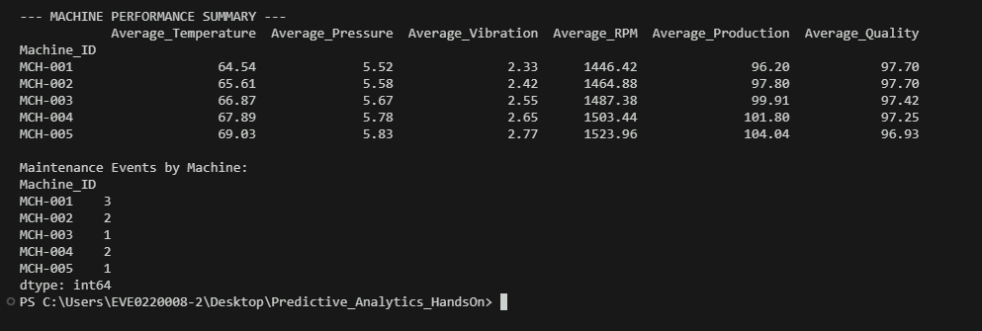
Module 4 Hands-On Lab
Output:

Slide 93
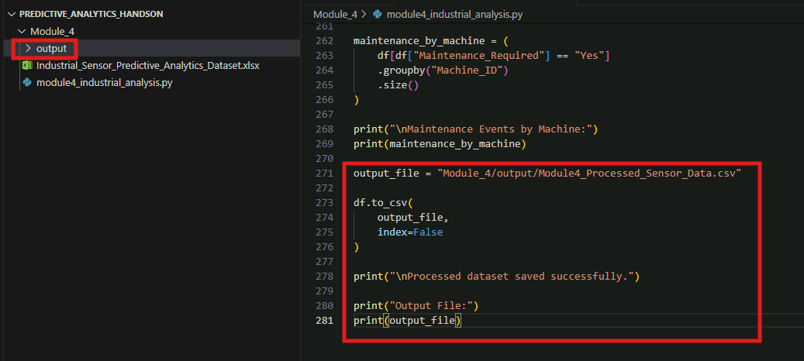
Module 4 Hands-On Lab
Step 8 — Export the Processed Module 4 Dataset
Purpose: Save the processed dataset so it can be used as the starting point for Module 5.
First create an output folder inside Module_4: output
Add this code at the bottom of the Python file:
The structure becomes:
Predictive_Analytics_HandsOn
│
└── Module_4
├── Industrial_Sensor_Predictive_Analytics_Dataset.xlsx
├── module4_industrial_analysis.py
│
└── output

Slide 94
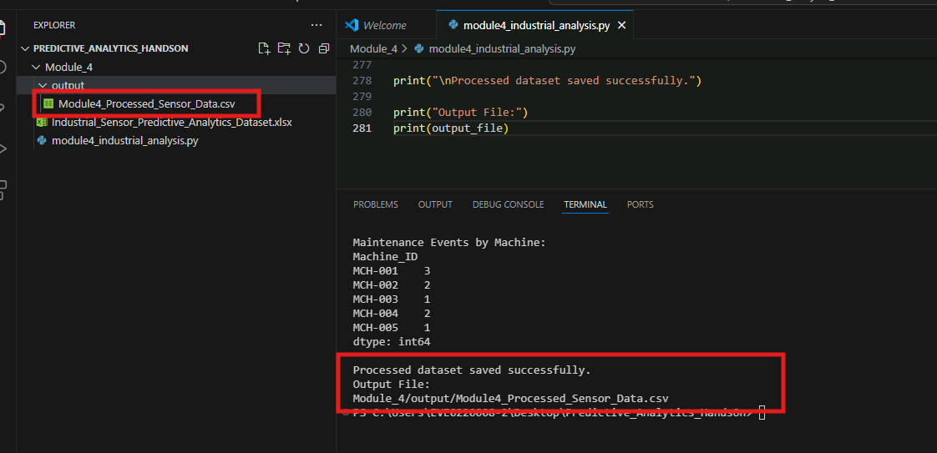
Module 4 Hands-On Lab
Run the complete script: python Module_4/module4_industrial_analysis.py
After execution, you should have:
Notes:
python Module_4/module4_industrial_analysis.py

Slide 95
Let’s Recall
Monday
1
Monday
1
A manufacturing engineer needs to calculate average temperature and maximum vibration for each machine in a large production dataset. Which approach is most appropriate?
Manually calculate every measurement individually
Use Pandas grouping and aggregation operations
Convert all numerical values into text
Remove the machine identifiers before analysis
Monday
1
Friday
5
Notes:
Answer: B
Explanation: Pandas grouping and aggregation can organise records by machine and efficiently calculate statistics such as mean, maximum, minimum, and totals.

Slide 96
Let’s Recall
Monday
1
Monday
1
What is the primary advantage of NumPy when analysing large collections of industrial numerical measurements?
It automatically predicts every equipment failure
It replaces industrial sensors and PLCs
It provides efficient array-based numerical computation
It eliminates the need to prepare manufacturing data
Monday
1
Friday
5
Notes:
Answer: C
Explanation: NumPy provides efficient array structures and numerical operations for processing large collections of industrial measurements.

Slide 97
Module 5: Data Preparation and Feature Engineering
Data Cleaning for Industrial Machine Learning
Feature Engineering for Manufacturing Data
Rolling Windows, Lag Features, and Aggregated Features
Practical Exercise: Feature Engineering Using Industrial Sensor Data

Slide 98
Data Cleaning for Industrial Machine Learning
Preparing Reliable Data for Machine Learning
Industrial machine learning depends heavily on the quality of the data used to train predictive models. Manufacturing datasets may contain missing measurements, duplicate records, incorrect data types, inconsistent units, abnormal values, or information collected from different operating conditions.
If these issues remain unresolved, machine learning algorithms may learn misleading relationships and produce unreliable predictions. Data cleaning establishes a consistent and trustworthy analytical foundation before model development begins.
Engineers should examine the completeness, validity, consistency, and relevance of each variable while considering the operational context behind unusual observations.
Cleaning is therefore not simply about deleting imperfect records; it involves distinguishing genuine equipment behaviour from data-quality problems and preparing information that accurately represents manufacturing processes.

Slide 99
Data Cleaning for Industrial Machine Learning
Common Data Quality Issues in Manufacturing
Manufacturing datasets combine information from machines, sensors, production systems, and operational records, creating several potential quality challenges. Missing measurements may result from equipment downtime or communication failures, while duplicate records can distort calculated statistics. Incorrect units or inconsistent naming conventions can make measurements from different equipment difficult to compare.
Important quality checks include:
Identify missing or incomplete values.
Detect duplicated observations.
Verify numerical and categorical data types.
Standardise measurement units.
Validate machine and production identifiers.
Check measurements against realistic operating ranges.
Review inconsistent category labels.
Investigate extreme or unusual observations.
Confirm timestamps and chronological order.

Slide 100
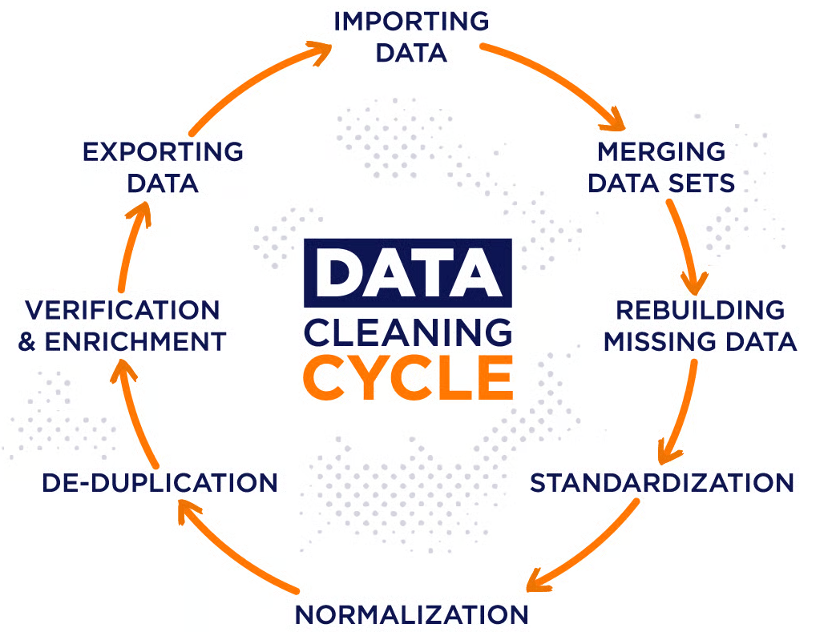
Data Cleaning for Industrial Machine Learning
Industrial Data Cleaning Workflow
Notes:
This infographic illustrates the data-cleaning cycle used to prepare raw industrial information for reliable analysis and machine learning. Data collected from different sources is first imported and merged into a common dataset. Missing information is identified and addressed, while standardisation and normalisation help create consistent formats, units and numerical scales. Duplicate records are removed to prevent repeated observations from influencing the analysis. The cleaned data is then verified and, where necessary, enriched with additional information before being exported for further analysis. These activities improve data quality, consistency and reliability, providing a stronger foundation for accurate industrial machine-learning models.

Slide 101
Data Cleaning for Industrial Machine Learning
Cleaning Data Without Losing Engineering Meaning
Industrial data cleaning requires engineering context because unusual observations are not necessarily errors. A sudden rise in vibration, temperature, or pressure may represent an actual machine condition that is highly valuable for predictive maintenance.
Removing such records simply because they are statistically unusual could eliminate important failure indicators. Similarly, periods containing missing measurements may correspond to planned shutdowns, maintenance events, or communication failures.
Engineers should therefore investigate why unusual data exists before applying transformations. Cleaning decisions should preserve relevant operational information while correcting genuine quality problems.
Maintaining traceability of changes is also important so that analysts can understand which records were modified or removed and why. This helps ensure that prepared datasets remain meaningful representations of real manufacturing behaviour.

Slide 102
Feature Engineering for Manufacturing Data
Understanding Feature Engineering
Features are the input variables that machine learning models use to identify patterns and generate predictions. Raw industrial measurements may not always describe equipment behaviour in the most useful form.
Feature engineering transforms existing data or combines multiple variables to create new information that better represents the underlying manufacturing process.
For example, raw temperature readings can be supplemented with temperature change, average temperature over a recent period, or deviation from a normal operating range. Effective features incorporate both statistical information and engineering knowledge.
In manufacturing applications, feature engineering can help models recognise equipment deterioration, abnormal process behaviour, or quality-related conditions that may be difficult to identify from individual raw measurements alone.

Slide 103

Feature Engineering for Manufacturing Data
Creating Meaningful Manufacturing Features
Feature engineering should be guided by the operational problem being solved rather than creating large numbers of variables without purpose. For predictive maintenance, features may describe machine usage, recent sensor behaviour, operating load, or changes in equipment condition. Quality prediction may require process parameters, cycle characteristics, environmental measurements, or production information.
Examples include:
Temperature change between observations.
Vibration variability over a defined period.
Machine operating hours.
Average production cycle time.
Defect rate by production batch.
Energy consumed per unit produced.
Difference between actual and target pressure.
Equipment utilisation indicators.
Count of recent alarm events.

Slide 104
Feature Engineering for Manufacturing Data
Engineering Knowledge in Feature Creation
Domain knowledge plays an important role in industrial feature engineering because statistical relationships alone may not explain how equipment or processes behave.
Engineers understand operating limits, failure mechanisms, process dependencies, and interactions between variables.
This knowledge can guide the creation of features that represent meaningful physical conditions. For example, the relationship between machine load and temperature may provide more useful information than either measurement considered independently.
Similarly, the rate at which vibration increases could indicate deterioration more effectively than a single vibration reading. Combining engineering knowledge with analytical techniques helps create features that are interpretable and relevant to real manufacturing conditions.
Notes:
This can improve model usefulness while helping engineering teams understand why particular variables contribute to predictions.

Slide 105
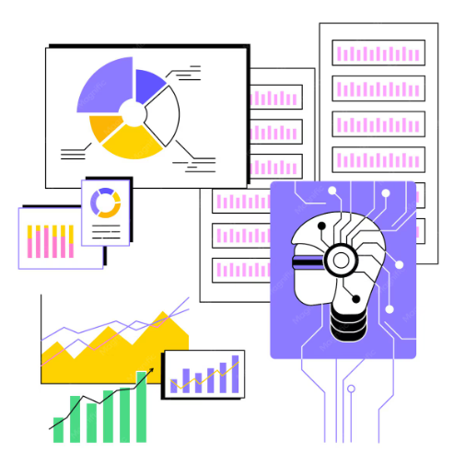
Rolling Windows, Lag Features, and Aggregated Features
Rolling Windows for Recent Equipment Behaviour
A rolling window calculates statistics across a continuously moving group of recent observations. This is particularly valuable for industrial time-series data because equipment condition is often better represented by recent behaviour than by an isolated measurement.
For example, rather than using only the current vibration reading, engineers could calculate the average vibration across the previous ten measurements. Rolling windows can calculate averages, minimums, maximums, standard deviations, and other statistics.
These features help smooth short-term fluctuations and reveal recent trends or changes in equipment behaviour. The appropriate window size depends on sensor frequency and the engineering process being analysed. A window that is too large may hide short-duration changes, while one that is too small may remain sensitive to noise.

Slide 106
Rolling Windows, Lag Features, and Aggregated Features
Lag Features and Historical Context
Lag features represent previous observations of a variable and allow predictive models to incorporate information about what happened before the current measurement.
For example, if a machine's current temperature is 85°C, a one-period lag feature might contain its previous temperature reading.
Multiple lag values can describe how measurements have evolved over several observations. This historical context is valuable because industrial conditions often develop progressively rather than appearing instantly.
Increasing vibration across several consecutive measurements, for example, may indicate equipment deterioration more effectively than one isolated value.
Lag features therefore allow machine learning models to consider temporal relationships within industrial data. Careful chronological ordering is essential when creating them to ensure previous observations are correctly associated with current records.

Slide 107
Rolling Windows, Lag Features, and Aggregated Features
Aggregated Features for Manufacturing Analysis
Aggregated features summarise multiple observations into higher-level measurements that describe equipment, production, or process behaviour. Instead of analysing every individual record independently, engineers can calculate statistics across meaningful groups such as machines, production shifts, batches, or time periods.
Examples include average machine temperature per shift, maximum vibration during a production cycle, total downtime per day, or defect rate for a batch. Aggregation can reduce data complexity while capturing important operational characteristics.
However, the selected grouping and aggregation method must align with the predictive objective. Excessive aggregation may remove important short-term behaviour, whereas insufficient aggregation may retain unnecessary variability.
Effective aggregated features therefore balance information reduction with preservation of relevant manufacturing patterns.

Slide 108

Module 5 Hands-On Lab
Hands-On Title: Cleaning and Engineering Features from Industrial Sensor Data
Objective: Prepare the industrial sensor dataset for machine learning by cleaning missing values and creating useful manufacturing features such as rolling averages, lag values and machine-level aggregated features.
Input Dataset
Use the output generated from Module 4:
Module_4/output/Module4_Processed_Sensor_Data.csv
Output Dataset
Module_5/output/Module5_Feature_Engineered_Data.csv

Slide 109

Module 5 Hands-On Lab
Step 1 — Create the Module 5 Project File
Create the following folder:
Predictive_Analytics_HandsOn
│
├── Module_4
│
└── Module_5
└── module5_feature_engineering.py
Inside Module_5, also create: output
Final structure:
Module_5
│
├── module5_feature_engineering.py
│
└── output
Open: module5_feature_engineering.py

Slide 110


Module 5 Hands-On Lab
Add:
Output:
Notes:
import pandas as pd
import numpy as np
print("Module 5 - Data Preparation and Feature Engineering")
print("--------------------------------------------------")
file_path = "Module_4/output/Module4_Processed_Sensor_Data.csv"
df = pd.read_csv(file_path)
print("\nDataset loaded successfully.")
print(df.head())
print("\nDataset shape:")
print(df.shape)

Slide 111

Module 5 Hands-On Lab
Step 2 — Clean the Industrial Sensor Data
Purpose: Handle missing sensor values and prepare the timestamp field for time-series analysis.
Add below Step 1:
Now fill missing numerical sensor values using the median:
Notes:
print("\n--- DATA CLEANING ---")
# Convert Timestamp into datetime format
df["Timestamp"] = pd.to_datetime(df["Timestamp"])
print("\nMissing values before cleaning:")
print(df.isnull().sum())
Now fill missing numerical sensor values using the median:
sensor_columns = [
"Temperature_C",
"Pressure_bar",
"Vibration_mm_s",
"RPM",
"Current_A",
"Humidity_pct",
"Production_Rate",
"Quality_Score"
]
for column in sensor_columns:
df[column] = df[column].fillna(df[column].median())
print("\nMissing values after cleaning:")
print(df.isnull().sum())

Slide 112

Module 5 Hands-On Lab
Output:
Why Median?
Sensor datasets can contain unusually high or low readings. Median filling is less affected by extreme values than the mean.

Slide 113

Module 5 Hands-On Lab
Step 3 — Create Manufacturing Features
Purpose: Transform raw sensor readings into features that may be more useful for predictive modelling.
First sort the dataset correctly:
Create vibration-to-RPM ratio:
Create production-quality interaction:
Display the new features:
Notes:
Step 3 — Create Manufacturing Features
Purpose
Transform raw sensor readings into features that may be more useful for predictive modelling.
First sort the dataset correctly:
df = df.sort_values(
by=["Machine_ID", "Timestamp"]
).reset_index(drop=True)
Now create a simple temperature-pressure interaction feature:
df["Temp_Pressure_Index"] = (
df["Temperature_C"] * df["Pressure_bar"]
)
Create vibration-to-RPM ratio:
df["Vibration_RPM_Ratio"] = (
df["Vibration_mm_s"] /
df["RPM"].replace(0, np.nan)
)
Create production-quality interaction:
df["Production_Quality_Index"] = (
df["Production_Rate"] *
df["Quality_Score"]
)
Display the new features:
print("\n--- ENGINEERED FEATURES ---")
print(
df[
[
"Machine_ID",
"Temperature_C",
"Pressure_bar",
"Temp_Pressure_Index",
"Vibration_RPM_Ratio",
"Production_Quality_Index"
]
].head()
)

Slide 114

Module 5 Hands-On Lab
Output:

Slide 115

Module 5 Hands-On Lab
Step 4 — Create Rolling Window and Lag Features
Purpose: Capture recent machine behaviour using time-series features.
A. Rolling Average Temperature
Create a rolling average using the previous 3 sensor observations for each machine:
Notes:
df["Temperature_Rolling_Mean_3"] = (
df.groupby("Machine_ID")["Temperature_C"]
.transform(
lambda x: x.rolling(
window=3,
min_periods=1
).mean()
)
)

Slide 116

Module 5 Hands-On Lab
B. Rolling Average Vibration
Notes:
df["Vibration_Rolling_Mean_3"] = (
df.groupby("Machine_ID")["Vibration_mm_s"]
.transform(
lambda x: x.rolling(
window=3,
min_periods=1
).mean()
)
)

Slide 117

Module 5 Hands-On Lab
C. Temperature Lag Feature
Create the previous temperature reading:
D. Vibration Lag Feature
Fill the first lag value for each machine:
Notes:
df["Vibration_Lag_1"] = (
df.groupby("Machine_ID")["Vibration_mm_s"]
.shift(1)
)
df["Temperature_Lag_1"] = (
df["Temperature_Lag_1"]
.fillna(df["Temperature_C"])
)
df["Vibration_Lag_1"] = (
df["Vibration_Lag_1"]
.fillna(df["Vibration_mm_s"])
)

Slide 118

Module 5 Hands-On Lab
Display the features:
Notes:
print("\n--- ROLLING AND LAG FEATURES ---")
print(
df[
[
"Machine_ID",
"Temperature_C",
"Temperature_Rolling_Mean_3",
"Temperature_Lag_1",
"Vibration_mm_s",
"Vibration_Rolling_Mean_3",
"Vibration_Lag_1"
]
].head(10)
)

Slide 119
Module 5 Hands-On Lab
Learning Point
The model can now understand both:
This is particularly important in predictive maintenance because faults often develop gradually rather than from one isolated reading.
Current Sensor Reading
Previous Sensor Behaviour
Previous Sensor Behaviour

Slide 120

Module 5 Hands-On Lab
Step 5 — Create Aggregated Machine Features and Export the Dataset
Purpose: Add information about the overall operating behaviour of each machine.
Create machine-level average temperature:
Create average vibration:
Create average production rate:
Display the final features:
Now save the feature-engineered dataset:
Notes:
Create machine-level average temperature:
df["Machine_Avg_Temperature"] = (
df.groupby("Machine_ID")["Temperature_C"]
.transform("mean")
)
Create average vibration:
df["Machine_Avg_Vibration"] = (
df.groupby("Machine_ID")["Vibration_mm_s"]
.transform("mean")
)
Create average production rate:
df["Machine_Avg_Production"] = (
df.groupby("Machine_ID")["Production_Rate"]
.transform("mean")
)
Display the final features:
print("\n--- MACHINE AGGREGATED FEATURES ---")
print(
df[
[
"Machine_ID",
"Machine_Avg_Temperature",
"Machine_Avg_Vibration",
"Machine_Avg_Production"
]
].head()
)
Now save the feature-engineered dataset:
output_file = (
"Module_5/output/"
"Module5_Feature_Engineered_Data.csv"
)
df.to_csv(
output_file,
index=False
)
print("\nFeature engineering completed successfully.")
print("Output saved to:")
print(output_file)
print("\nFinal dataset shape:")
print(df.shape)

Slide 121

Module 5 Hands-On Lab
Run the complete file:
Notes:
python Module_5/module5_feature_engineering.py

Slide 122
Let’s Recall
Monday
1
Monday
1
An engineer wants a predictive model to consider the vibration reading immediately before the current reading. Which feature is most appropriate?
Aggregated production count
Lag feature
Machine identifier
Random variable
Monday
1
Friday
5
Notes:
Answer: B
Explanation: A lag feature represents a previous observation and allows the model to incorporate historical sensor behaviour.

Slide 123
Let’s Recall
Monday
1
Monday
1
Why are rolling-window features particularly useful for industrial time-series data?
They permanently remove every abnormal measurement
They replace the need for sensor measurements
They summarise recent behaviour and help capture changing equipment conditions
They convert all numerical data into categorical data
Monday
1
Friday
5
Notes:
Answer: C
Explanation: Rolling-window statistics capture recent patterns, variability, and trends that can provide stronger indicators of changing equipment condition than isolated readings.

Slide 124
Module 6: End-to-End Data Engineering Workflow
Building Industrial ETL Pipelines
Data Validation and Quality Assurance
Automating Industrial Data Processing Workflows
Practical Exercise: Creating an End-to-End Industrial Data Pipeline

Slide 125
Building Industrial ETL Pipelines
From Industrial Data Sources to Analytics-Ready Data
An industrial ETL pipeline provides a structured workflow for collecting raw operational data and transforming it into information suitable for analytics and machine learning.
Manufacturing data may originate from sensors, machines, production systems, quality records, or equipment logs and often arrives in different formats and structures.
The pipeline first extracts relevant information from these sources, transforms it by applying cleaning, standardisation, validation, and integration rules, and then loads the processed information into an appropriate destination.
Unlike one-time manual processing, an ETL pipeline creates a repeatable flow that can process new industrial records consistently.
This repeatability is essential when predictive analytics depends on regularly updated manufacturing data and consistent transformation logic.

Slide 126
Building Industrial ETL Pipelines
Designing the Extract Stage
Extraction is responsible for obtaining data from industrial sources while preserving the information required for subsequent processing. Different manufacturing systems may generate sensor measurements, equipment events, production records, maintenance information, or quality results at different frequencies. An effective extraction process identifies which fields are required, where they originate, and how frequently they should be collected.
Key considerations include:
Identify relevant industrial data sources.
Preserve timestamps and machine identifiers.
Maintain original measurement values.
Capture required production and process variables.
Consider differences in source formats.
Track where extracted information originated.
Avoid unnecessary modification during extraction.
Confirm that expected records have been successfully acquired.

Slide 127

Building Industrial ETL Pipelines
End-to-End Industrial ETL Pipeline
Notes:
This infographic illustrates the end-to-end ETL pipeline used to move industrial data from source systems into analytics-ready storage. During the Extract stage, data is collected from operational sources such as sensors, PLCs, SCADA systems, production databases and IIoT platforms. The Transform stage cleans, validates, standardises and restructures the collected information to improve its quality and consistency. During the Load stage, the transformed data is transferred to a target environment such as a cloud platform, data warehouse or industrial data store. This pipeline creates a reliable foundation for reporting, predictive analytics, machine learning and engineering decision-making.

Slide 128
Building Industrial ETL Pipelines
Transforming and Loading Industrial Data
The transformation stage converts extracted manufacturing data into a consistent structure. Typical operations include converting data types, standardising measurement units, handling missing information, removing duplicate records, aligning timestamps, and combining information from related sources.
Transformation rules should be defined consistently so that newly received records are processed in the same way as historical data.
After transformation, validated information is loaded into a destination where downstream analytical processes can access it. Depending on the workflow, processed data may be stored as structured files or within an industrial data platform.
Maintaining separation between raw and transformed information is useful because original records remain available for traceability while analytical systems work with prepared and validated datasets.

Slide 129
Data Validation and Quality Assurance
Why Data Validation Matters in Industrial Pipelines
Data validation verifies that information moving through an industrial pipeline satisfies expected structural and quality requirements.
Without validation, missing measurements, invalid values, duplicated records, incorrect timestamps, or unexpected data types may reach analytical systems and influence predictive results.
Validation should therefore occur before processed information is accepted for downstream use. Rules can verify whether required columns exist, identifiers are populated, numerical measurements remain within expected ranges, and timestamps use appropriate formats.
Validation does not guarantee that every measurement represents perfect equipment behaviour; instead, it identifies records that violate predefined expectations and require investigation.
Effective validation creates an important control point between raw industrial information and the datasets used for engineering analytics and machine learning.

Slide 130

Data Validation and Quality Assurance
Industrial Data Quality Dimensions
Data quality assurance evaluates whether industrial information is sufficiently reliable for its intended analytical purpose. Quality should be assessed across multiple dimensions rather than using a single measure.
Completeness: Are required measurements and fields available?
Validity: Do values follow defined formats and rules?
Consistency: Are units, categories, and structures standardised?
Accuracy: Do measurements reasonably represent actual conditions?
Timeliness: Is information available when required?
Uniqueness: Are unintended duplicate records avoided?
Integrity: Are relationships between machines, timestamps, and records preserved?
Traceability: Can processed information be linked to its source?
Different predictive applications may place different levels of importance on each dimension, depending on operational requirements.

Slide 131
Data Validation and Quality Assurance
Handling Failed Data-Quality Checks
Not every record that fails a quality check should automatically be deleted. In manufacturing environments, unusual data may represent genuine equipment behaviour rather than incorrect information.
A temperature reading beyond the normal operating range, for example, could indicate either a faulty sensor or an overheating machine.
Quality workflows should therefore distinguish between invalid records and valid operational anomalies. Failed records may be flagged for investigation, isolated from normal processing, corrected when reliable information is available, or retained with an appropriate quality indicator.
Recording validation outcomes also improves traceability and allows engineering teams to understand why particular information was accepted or rejected.
This controlled approach helps maintain data quality without unintentionally removing important evidence of abnormal industrial conditions.

Slide 132
Automating Industrial Data Processing Workflows
Moving from Manual Processing to Automation
Manual industrial data preparation can become inefficient when manufacturing information is generated continuously or must be processed repeatedly.
Automation allows predefined extraction, transformation, validation, and loading operations to execute consistently whenever new data becomes available or according to an established schedule.
A Python-based workflow, for example, can load new manufacturing records, apply cleaning rules, calculate required transformations, validate the resulting dataset, and save the processed output without repeating each operation manually.
Automation improves repeatability and reduces the risk of inconsistent processing between datasets. However, automated workflows still require monitoring because changes in source structures, missing files, invalid values, or processing failures can interrupt the pipeline or produce incomplete analytical outputs.

Slide 133
Automating Industrial Data Processing Workflows
Designing Reliable Automated Workflows
A reliable automated data workflow should clearly define the sequence of processing activities and what should happen when a problem occurs.
Each stage should perform a specific responsibility, such as loading input data, validating structure, transforming values, checking output quality, or saving processed results.
Breaking workflows into manageable components makes failures easier to identify and individual stages easier to maintain.
Automated pipelines should also provide useful information about execution status rather than failing silently. Basic logging can record when processing started, which stages completed, how many records were processed, and whether errors occurred.
These controls improve operational visibility and make automated industrial workflows more dependable as datasets and processing requirements evolve.

Slide 134

Automating Industrial Data Processing Workflows
Automated Industrial Data Processing Cycle
Notes:
This infographic illustrates the end-to-end ETL pipeline used to move industrial data from source systems into analytics-ready storage. During the Extract stage, data is collected from operational sources such as sensors, PLCs, SCADA systems, production databases and IIoT platforms. The Transform stage cleans, validates, standardises and restructures the collected information to improve its quality and consistency. During the Load stage, the transformed data is transferred to a target environment such as a cloud platform, data warehouse or industrial data store. This pipeline creates a reliable foundation for reporting, predictive analytics, machine learning and engineering decision-making.

Slide 135
Module 6 Hands-On Lab
Hands-On Title: Automating an Industrial Data Engineering Pipeline with Python
Objective
Build a reusable Python ETL workflow that imports the cleaned and feature-engineered dataset from Module 5, performs final transformations for machine learning, applies a lightweight quality checkpoint, and exports a model-ready dataset for Module 7.
Input Dataset
Use the output from Module 5: Module_5/output/Module5_Feature_Engineered_Data.csv
Output Dataset
We will create: Module_6/output/Module6_Model_Ready_Data.csv

Slide 136

Module 6 Hands-On Lab
Step 1 — Create the Module 6 Folder and Python Script
Inside your existing project Predictive_Analytics_HandsOn create Module_6
Inside Module_6, create module6_etl_pipeline.py and output
Your project should look like this:

Slide 137

Module 6 Hands-On Lab
Open:
module6_etl_pipeline.py
Add the required imports:
Notes:
Open:
module6_etl_pipeline.py
Add the required imports:
import pandas as pd
import numpy as np
from pathlib import Path

Slide 138

Module 6 Hands-On Lab
Step 2 — Build the Extract Function
Purpose: Instead of simply writing: df = pd.read_csv(...) we will convert the loading operation into a reusable ETL function.
Add:
This function:
Input CSV
↓
extract_data()
↓
Pandas DataFrame
Notes:
def extract_data(file_path):
print("\n--- EXTRACT PHASE ---")
df = pd.read_csv(file_path)
print("Dataset extracted successfully.")
print("Rows:", len(df))
print("Columns:", len(df.columns))
return df

Slide 139

Module 6 Hands-On Lab
Now define the input file:
At this point, the pipeline can automatically read the output generated from Module 5.
Notes:
Now define the input file:
INPUT_FILE = (
"Module_5/output/"
"Module5_Feature_Engineered_Data.csv"
)
At this point, the pipeline can automatically read the output generated from Module 5.

Slide 140

Module 6 Hands-On Lab
Step 3 — Build the Transformation Function
Purpose:
Prepare the feature-engineered dataset specifically for machine learning.
We do not need to repeat all Module 5 cleaning. Instead, we will perform final model-oriented transformations.
Add:
Notes:
def transform_data(df):
print("\n--- TRANSFORM PHASE ---")
df = df.copy()
# Convert Timestamp to datetime
df["Timestamp"] = pd.to_datetime(df["Timestamp"])
# Extract useful time-based information
df["Hour"] = df["Timestamp"].dt.hour
df["Day"] = df["Timestamp"].dt.day
df["Month"] = df["Timestamp"].dt.month
print("Time-based features created.")

Slide 141

Module 6 Hands-On Lab
Now encode the categorical maintenance target:
Encode whether a fault exists:
Now remove columns that will not be directly useful for model training:
Finally:
What happened here?
The raw timestamp:
2026-01-01 08:00:00
becomes:
Hour = 8
Day = 1
Month = 1
And:
Maintenance_Required = Yes
becomes:
Maintenance_Target = 1
Notes:
Now encode the categorical maintenance target:
df["Maintenance_Target"] = (
df["Maintenance_Required"]
.map({
"No": 0,
"Yes": 1
})
)
Encode whether a fault exists:
df["Fault_Target"] = np.where(
df["Fault_Status"] == "Normal",
0,
1
)
Now remove columns that will not be directly useful for model training:
columns_to_remove = [
"Timestamp",
"Temperature_Status",
"Vibration_Status"
]
df = df.drop(
columns=columns_to_remove,
errors="ignore"
)
Finally:
print("Categorical target variables encoded.")
print("Unnecessary columns removed.")
return df

Slide 142

Module 6 Hands-On Lab
Step 4 — Add a Lightweight Quality Check
We will just perform a small pipeline quality check before exporting.
Add:
Notes:
def validate_data(df):
print("\n--- QUALITY CHECK ---")
missing_values = df.isnull().sum().sum()
duplicate_rows = df.duplicated().sum()
print("Missing values:", missing_values)
print("Duplicate rows:", duplicate_rows)
if missing_values > 0:
print("Warning: Dataset contains missing values.")
else:
print("Missing-value check passed.")
if duplicate_rows > 0:
print("Warning: Duplicate rows detected.")
else:
print("Duplicate-row check passed.")
print("Basic pipeline validation completed.")
return df

Slide 143

Module 6 Hands-On Lab
Step 5 — Build the Load Function
Purpose: Save the transformed dataset automatically.
Add:
Notes:
def load_data(df, output_file):
print("\n--- LOAD PHASE ---")
output_path = Path(output_file)
output_path.parent.mkdir(
parents=True,
exist_ok=True
)
df.to_csv(
output_path,
index=False
)
print("Model-ready dataset exported successfully.")
print("Output location:")
print(output_path)
print("\nFinal dataset shape:")
print(df.shape)

Slide 144

Module 6 Hands-On Lab
Define the output file:
Now we have all three core ETL components:
EXTRACT
↓
TRANSFORM
↓
LOAD
Notes:
OUTPUT_FILE = (
"Module_6/output/"
"Module6_Model_Ready_Data.csv"
)

Slide 145

Module 6 Hands-On Lab
Step 6 — Automate the Complete Workflow
Purpose
This is the most important part of Module 6.
Instead of manually running each operation, create one function that executes the complete industrial pipeline.
Add:
Notes:
def run_pipeline():
print("=" * 55)
print("MODULE 6 - INDUSTRIAL DATA ENGINEERING PIPELINE")
print("=" * 55)
# Extract
df = extract_data(INPUT_FILE)
# Transform
df = transform_data(df)
# Validate
df = validate_data(df)
# Load
load_data(
df,
OUTPUT_FILE
)
print("\n" + "=" * 55)
print("ETL PIPELINE COMPLETED SUCCESSFULLY")
print("=" * 55)

Slide 146

Module 6 Hands-On Lab
Then add:
This means whenever you run the Python file, the entire workflow will execute automatically.
Notes:
Then add:
if __name__ == "__main__":
run_pipeline()
This means whenever you run the Python file, the entire workflow will execute automatically.

Slide 147

Module 6 Hands-On Lab
Run the Pipeline
Make sure your terminal is currently at:
C:\Users\...\Desktop\Predictive_Analytics_HandsOn>
Then run:
python Module_6/module6_etl_pipeline.py
Notes:
python Module_6/module6_etl_pipeline.py

Slide 148

Module 6 Hands-On Lab
Expected Terminal Output: You should see something similar to:

Slide 149
Let’s Recall
Monday
1
Monday
1
An industrial ETL pipeline receives a temperature value outside the expected operating range. What is the most appropriate initial action?
Automatically delete every unusual value
Flag the value for validation and investigation
Replace it with zero without checking
Stop collecting temperature measurements
Monday
1
Friday
5
Notes:
Answer: B
Explanation: An unusual industrial measurement may indicate either a data-quality problem or genuine abnormal equipment behaviour, so it should first be validated and investigated.

Slide 150
Let’s Recall
Monday
1
Monday
1
What is the primary advantage of automating an industrial data-processing workflow?
It guarantees that industrial equipment will never fail
It eliminates the need for data-quality checks
It enables repeatable and consistent processing of new industrial data
It removes the requirement for predictive models
Monday
1
Friday
5
Notes:
Answer: C
Explanation: Automation allows predefined extraction, transformation, validation, and loading operations to be applied consistently whenever industrial data is processed.

Slide 151
Module 7: Predictive Modelling for Engineering Applications
Regression Models for Industrial Prediction
Classification Models for Fault Detection and Quality Prediction
Model Training, Validation, and Performance Optimisation
Practical Exercise: Building Predictive Models Using Industrial Datasets

Slide 152
Regression Models for Industrial Prediction
Understanding Regression in Industrial Analytics
Regression models are used when an engineering problem requires prediction of a continuous numerical value. Manufacturing organisations may use regression to estimate energy consumption, production cycle time, equipment temperature, process output, or remaining operating time before maintenance.
The model learns relationships between historical input variables and a known numerical target. Inputs could include temperature, vibration, pressure, operating hours, machine load, or engineered features created from sensor measurements.
Once trained, the model applies learned relationships to new industrial observations to generate numerical predictions. Effective regression modelling requires relevant input features, representative historical data, and a clearly defined prediction target that directly supports an engineering or operational decision.

Slide 153

Regression Models for Industrial Prediction
Applying Regression to Engineering Problems
Regression can support several manufacturing decisions where estimating a quantity provides operational value. The selected target should represent a measurable outcome, while input features should contain information that helps explain changes in that outcome.
Common applications include:
Predicting equipment temperature or pressure.
Estimating future energy consumption.
Forecasting production cycle duration.
Estimating remaining operating hours.
Predicting process-performance indicators.
Estimating manufacturing throughput.
Forecasting resource consumption.
A regression model does not simply produce a number; engineers must determine whether the expected prediction error is acceptable for the intended application.
Notes:
Model outputs should therefore be interpreted alongside engineering knowledge and operational requirements.

Slide 154
Classification Models for Fault Detection and Quality Prediction
Classification for Industrial Prediction
Classification models predict discrete categories rather than continuous numerical values. Industrial applications commonly require determining whether equipment is operating normally or experiencing a fault, whether a manufactured product is acceptable or defective, or which fault category is most likely.
Classification models learn from historical observations where the correct class is already known. Input features may include sensor measurements, equipment conditions, production parameters, and engineered variables.
Once trained, the model can classify new observations according to patterns learned from previous examples.
Classification therefore converts complex combinations of industrial measurements into operationally meaningful categories that can help engineering teams prioritise maintenance, inspection, quality intervention, or further investigation.

Slide 155
Classification Models for Fault Detection and Quality Prediction
Fault Detection and Quality Prediction
Fault detection and quality prediction are two important industrial classification applications. A fault-detection model might classify equipment as Normal or Fault, while more advanced models may distinguish between several fault types. Quality models may classify manufactured products as Acceptable or Defective based on process conditions.
Important considerations include:
Historical observations require appropriate class labels.
Input features should represent relevant operating conditions.
Rare faults may be underrepresented in training data.
Predictions should support defined operational actions.
Incorrect classifications can have different business consequences.
Changing manufacturing conditions can affect model performance.
Models should therefore be assessed according to the engineering consequences of their predictions, not only overall accuracy.

Slide 156
Classification Models for Fault Detection and Quality Prediction
Regression vs Classification
Regression | Classification
Predicts numerical values | Predicts categories
Remaining hours | Normal / Fault
Energy consumption | Acceptable / Defective
Cycle time | Fault Type A / B / C
Equipment temperature | Risk category
Decision Guide
Is the required output numerical? → Regression
Is the required output a category/class? → Classification

Slide 157
Model Training, Validation, and Performance Optimisation
Training Predictive Models
Model training allows an algorithm to learn relationships between industrial input features and known historical outcomes.
A prepared dataset is commonly separated into training and evaluation portions. Training data is used to fit the model, while unseen data provides evidence of how effectively learned relationships generalise beyond the examples used during training.
The training dataset should represent the operating conditions the model is expected to encounter, including relevant machine states, production conditions, and fault scenarios.
If important situations are absent or poorly represented, the model may struggle when they occur later. Successful model training therefore depends on appropriate features, sufficient representative data, correct targets, and a modelling approach suited to the engineering problem.

Slide 158
Model Training, Validation, and Performance Optimisation
Validation and Model Generalisation
Validation determines whether a trained model can perform effectively on observations it has not previously seen. Strong training performance alone is insufficient because the model may have learned patterns that are specific to its training dataset.
Comparing training and validation results helps engineers identify potential modelling problems. Overfitting occurs when training performance is strong but performance on unseen data deteriorates.
Underfitting occurs when the model fails to capture important relationships and performs poorly even on training observations. Industrial validation should also consider whether different machines, operating conditions, or production periods are adequately represented.
The objective is to develop a model that performs consistently across realistic manufacturing conditions rather than simply memorising historical examples.

Slide 159

Model Training, Validation, and Performance Optimisation
Model Training and Validation Workflow
Notes:
This infographic illustrates the model training and validation workflow used to develop reliable predictive models. The available dataset is divided into training and validation data. The training set is used to build supervised models using different parameter configurations, while the validation set measures how well each configuration performs on unseen data. Validation errors are compared to identify the best-performing parameters, which are then used to develop the optimal model. Finally, a separate test dataset is used to evaluate the selected model's ability to generalise to new observations. This process helps reduce overfitting and supports reliable model selection before deployment.

Slide 160
Model Training, Validation, and Performance Optimisation
Performance Optimisation and Model Improvement
Performance optimisation aims to improve predictive results while maintaining reliable generalisation. Engineers can compare modelling approaches, refine input features, improve data quality, adjust model parameters, and investigate prediction errors.
Increasing model complexity does not automatically produce a better industrial solution. A highly complex model may be difficult to interpret or may overfit historical data.
Optimisation should therefore balance predictive performance with stability, computational requirements, and engineering usefulness. Model improvement is typically iterative: train a model, validate its performance, identify weaknesses, adjust the modelling approach, and evaluate again.
The final model should provide sufficiently accurate and consistent predictions to support the maintenance, quality, or production decision for which it was developed.

Slide 161
Module 7 Hands-On Lab
Hands-On Title: Building Regression and Fault-Detection Models Using Industrial Sensor Data
Objective
Use the model-ready dataset created in Module 6 to build two industrial machine-learning models:
Regression model → predict Quality_Score
Classification model → predict whether a machine is operating normally or experiencing a fault/warning using Fault_Target
Participants will split data into training and testing sets, train models, perform basic optimisation, evaluate initial performance, and save the trained models for Module 8.
Input Dataset: Module_6/output/Module6_Model_Ready_Data.csv
Notes:
Module 7 Outputs
Module_7/output/
├── regression_model.pkl
├── classification_model.pkl
├── Regression_Test_Predictions.csv
└── Classification_Test_Predictions.csv

Slide 162

Module 7 Hands-On Lab
Step 1 — Create the Module 7 Project
Inside Predictive_Analytics_HandsOn create Module_7
Then create:
Module_7
│
├── module7_predictive_models.py
└── output
Your overall project will now look like:

Slide 163

Module 7 Hands-On Lab
Install Scikit-learn
From the main project directory, run:
pip install scikit-learn joblib
Open:
Module_7/module7_predictive_models.py
Add:
Notes:
import pandas as pd
import numpy as np
import joblib
from pathlib import Path
from sklearn.model_selection import train_test_split
from sklearn.ensemble import (
RandomForestRegressor,
RandomForestClassifier
)
from sklearn.metrics import (
mean_absolute_error,
mean_squared_error,
r2_score,
accuracy_score,
precision_score,
recall_score,
f1_score
)

Slide 164

Module 7 Hands-On Lab
Now load the Module 6 dataset:
Notes:
INPUT_FILE = (
"Module_6/output/"
"Module6_Model_Ready_Data.csv"
)
OUTPUT_DIR = Path("Module_7/output")
OUTPUT_DIR.mkdir(
parents=True,
exist_ok=True
)
df = pd.read_csv(INPUT_FILE)
print("Module 7 - Predictive Modelling")
print("--------------------------------")
print("\nDataset loaded successfully.")
print("\nDataset shape:")
print(df.shape)
print("\nAvailable columns:")
print(df.columns.tolist())

Slide 165

Module 7 Hands-On Lab
Run:
python Module_7/module7_predictive_models.py
Notes:
Run:
python Module_7/module7_predictive_models.py

Slide 166
Module 7 Hands-On Lab
Step 2 — Build the Regression Dataset
Purpose
We will predict:
Quality_Score
This is a regression problem because Quality_Score is a continuous numerical value.
The workflow is:
Industrial Sensor Features
Random Forest Regressor
Predicted Quality Score

Slide 167

Module 7 Hands-On Lab
Select Regression Features
Add:
Important
We are intentionally not using:
Production_Quality_Index
for this model.
Why?
Because Module 5 created it using:
Production_Rate × Quality_Score
Since Quality_Score is now our prediction target, using Production_Quality_Index would reveal part of the answer to the model.
That is called target leakage.
Notes:
print("\n--- REGRESSION MODEL ---")
regression_features = [
"Temperature_C",
"Pressure_bar",
"Vibration_mm_s",
"RPM",
"Current_A",
"Humidity_pct",
"Production_Rate",
"Temp_Pressure_Index",
"Vibration_RPM_Ratio",
"Temperature_Rolling_Mean_3",
"Vibration_Rolling_Mean_3",
"Temperature_Lag_1",
"Vibration_Lag_1",
"Machine_Avg_Temperature",
"Machine_Avg_Vibration",
"Machine_Avg_Production",
"Hour",
"Day",
"Month"
]
X_reg = df[regression_features]
y_reg = df["Quality_Score"]
print("\nRegression Features:")
print(regression_features)
print("\nRegression Target:")
print("Quality_Score")

Slide 168

Module 7 Hands-On Lab
Step 3 — Train and Test the Regression Model
Split the dataset:
With 1,000 rows, you should get approximately:
Training = 800
Testing = 200
Notes:
X_reg_train, X_reg_test, y_reg_train, y_reg_test = (
train_test_split(
X_reg,
y_reg,
test_size=0.20,
random_state=42
)
)
print("\nRegression Training Records:")
print(len(X_reg_train))
print("Regression Testing Records:")
print(len(X_reg_test))

Slide 169

Module 7 Hands-On Lab
Now build a Random Forest regression model:
Train it
Generate predictions
Notes:
Now build a Random Forest regression model:
regression_model = RandomForestRegressor(
n_estimators=200,
max_depth=10,
min_samples_split=4,
random_state=42
)
Train it:
regression_model.fit(
X_reg_train,
y_reg_train
)
Generate predictions:
reg_predictions = regression_model.predict(
X_reg_test
)

Slide 170


Module 7 Hands-On Lab
Calculate Initial Regression Metrics:
At this stage, participants have completed: Training → Validation on unseen test data → Prediction
Notes:
reg_mae = mean_absolute_error(
y_reg_test,
reg_predictions
)
reg_rmse = np.sqrt(
mean_squared_error(
y_reg_test,
reg_predictions
)
)
reg_r2 = r2_score(
y_reg_test,
reg_predictions
)
print("\nRegression Model Performance")
print(
"MAE:",
round(reg_mae, 4)
)
print(
"RMSE:",
round(reg_rmse, 4)
)
print(
"R2 Score:",
round(reg_r2, 4)
)

Slide 171

Module 7 Hands-On Lab
Step 4 — Build the Fault Classification Model
Purpose: Now we will predict: Fault_Target
Module 6 converted:
Normal → 0
Warning/Fault → 1
Therefore:
0 = Normal operation
1 = Abnormal/Fault condition
Your dataset is highly imbalanced because most observations represent normal machine operation. Therefore, we will use:
This tells the model to give greater importance to the minority fault class.
Notes:
class_weight="balanced"

Slide 172


Module 7 Hands-On Lab
Add
Select features
Check the target distribution
For your original industrial dataset, most observations are normal, while only a small minority are warnings or faults. That makes this a useful example of a realistic imbalanced industrial fault-detection problem.
Notes:
Add:
print("\n--- CLASSIFICATION MODEL ---")
Select features:
classification_features = [
"Temperature_C",
"Pressure_bar",
"Vibration_mm_s",
"RPM",
"Current_A",
"Humidity_pct",
"Production_Rate",
"Quality_Score",
"Temp_Pressure_Index",
"Vibration_RPM_Ratio",
"Production_Quality_Index",
"Temperature_Rolling_Mean_3",
"Vibration_Rolling_Mean_3",
"Temperature_Lag_1",
"Vibration_Lag_1",
"Machine_Avg_Temperature",
"Machine_Avg_Vibration",
"Machine_Avg_Production",
"Hour",
"Day",
"Month"
]
X_cls = df[classification_features]
y_cls = df["Fault_Target"]
Check the target distribution:
print("\nFault Target Distribution:")
print(
y_cls.value_counts()
)
print("\nFault Target Percentage:")
print(
y_cls.value_counts(
normalize=True
).mul(100).round(2)
)
For your original industrial dataset, most observations are normal, while only a small minority are warnings or faults. That makes this a useful example of a realistic imbalanced industrial fault-detection problem.

Slide 173

Module 7 Hands-On Lab
Step 5 — Train and Optimise the Classification Model
Split the classification data:
Why stratify=y_cls?
It attempts to maintain the same fault-to-normal ratio in both the training and testing datasets.
Notes:
xxxxxxX_cls_train, X_cls_test, y_cls_train, y_cls_test = (
train_test_split(
X_cls,
y_cls,
test_size=0.20,
random_state=42,
stratify=y_cls
)
)

Slide 174

Module 7 Hands-On Lab
Now create the classifier:
Train:
Predict:
Notes:
Now create the classifier:
classification_model = RandomForestClassifier(
n_estimators=300,
max_depth=10,
min_samples_split=4,
class_weight="balanced",
random_state=42
)
Train:
classification_model.fit(
X_cls_train,
y_cls_train
)
Predict:
cls_predictions = classification_model.predict(
X_cls_test
)

Slide 175


Module 7 Hands-On Lab
Calculate initial classification metrics:
Why are we not focusing only on Accuracy?
Imagine:
975 Normal Records
25 Abnormal Records
A model could predict almost everything as Normal and still achieve very high accuracy.
For predictive maintenance, Recall and F1-score can therefore be more informative.
Recall asks: Of the machines that were actually abnormal, how many did our model detect?
Notes:
cls_accuracy = accuracy_score(
y_cls_test,
cls_predictions
)
cls_precision = precision_score(
y_cls_test,
cls_predictions,
zero_division=0
)
cls_recall = recall_score(
y_cls_test,
cls_predictions,
zero_division=0
)
cls_f1 = f1_score(
y_cls_test,
cls_predictions,
zero_division=0
)
print("\nClassification Model Performance")
print(
"Accuracy:",
round(cls_accuracy, 4)
)
print(
"Precision:",
round(cls_precision, 4)
)
print(
"Recall:",
round(cls_recall, 4)
)
print(
"F1 Score:",
round(cls_f1, 4)
)

Slide 176

Module 7 Hands-On Lab
Step 6 — Save Predictions and Trained Models
Purpose
Instead of rebuilding the models in Module 8, save both the models and their test predictions.
Save Regression Predictions
Save Classification Predictions
Now save the trained models:
Print completion information:
Notes:
Step 6 — Save Predictions and Trained Models
Purpose
Instead of rebuilding the models in Module 8, save both the models and their test predictions.
Save Regression Predictions
regression_results = pd.DataFrame({
"Actual_Quality_Score":
y_reg_test.values,
"Predicted_Quality_Score":
reg_predictions
})
regression_results.to_csv(
OUTPUT_DIR /
"Regression_Test_Predictions.csv",
index=False
)
Save Classification Predictions
classification_results = pd.DataFrame({
"Actual_Fault":
y_cls_test.values,
"Predicted_Fault":
cls_predictions
})
classification_results.to_csv(
OUTPUT_DIR /
"Classification_Test_Predictions.csv",
index=False
)
Now save the trained models:
joblib.dump(
regression_model,
OUTPUT_DIR /
"regression_model.pkl"
)
joblib.dump(
classification_model,
OUTPUT_DIR /
"classification_model.pkl"
)
Print completion information:
print("\n--- MODEL EXPORT ---")
print(
"Regression model saved successfully."
)
print(
"Classification model saved successfully."
)
print(
"Test predictions exported successfully."
)
print("\nModule 7 completed successfully.")

Slide 177


Module 7 Hands-On Lab
Output:

Slide 178

Module 7 Hands-On Lab
Expected Workflow
Module 7 Outcome
By the end of this lab, participants will have:
built a Random Forest regression model for industrial quality prediction;
built a Random Forest classification model for fault detection;
separated training and testing datasets;
handled an imbalanced industrial fault target using class_weight="balanced";
calculated initial regression and classification metrics;
avoided target leakage during regression modelling;
saved trained models using joblib;
exported actual versus predicted results for further model evaluation.

Slide 179
Let’s Recall
Monday
1
Monday
1
An engineering team wants to predict the remaining operating hours before equipment requires maintenance. Which modelling approach is most appropriate?
Classification
Regression
Clustering
Data aggregation
Monday
1
Friday
5
Notes:
Answer: B)

Slide 180
Let’s Recall
Monday
1
Monday
1
A predictive model performs extremely well on training data but poorly on unseen validation data. What does this most likely indicate?
Underfitting
Data integration
Overfitting
Data aggregation
Monday
1
Friday
5
Notes:
Answer: C

Slide 181
Module 8: Model Evaluation Using Industrial Data
Selecting Performance Metrics for Engineering Models
Evaluating Regression and Classification Models
Error Analysis and Model Improvement
Practical Exercise: Evaluating Models with Manufacturing Data

Slide 182
Selecting Performance Metrics for Engineering Models
Why Model Evaluation Matters
Building a predictive model is only the beginning of an industrial analytics workflow. Engineers must determine whether its predictions are sufficiently reliable for the operational decision it is intended to support.
Model evaluation compares predicted outcomes with known actual outcomes using appropriate performance metrics.
The choice of metric depends on whether the model performs regression or classification and on the consequences of different prediction errors.
For example, failing to identify an equipment fault may be substantially more costly than incorrectly flagging healthy equipment for inspection. Evaluation should therefore combine statistical performance with engineering context.
A model should ultimately be judged by whether its prediction quality is appropriate for the maintenance, quality, or production decision it supports.

Slide 183
Selecting Performance Metrics for Engineering Models
Matching Metrics to Engineering Objectives
No single metric is suitable for every predictive model. The appropriate measure depends on the target, model type, data distribution, and operational consequences of errors. Regression models require metrics that quantify differences between predicted and actual numerical values, whereas classification models require measures that assess correct and incorrect class assignments.
Important considerations include:
Determine whether the problem is regression or classification.
Understand which prediction errors have the greatest operational impact.
Consider whether fault or defect classes are uncommon.
Avoid relying on a single metric without context.
Evaluate performance using unseen data.
Compare metrics against engineering requirements.
Consider the cost of false alarms and missed events.
Metric selection should reflect the actual manufacturing decision.

Slide 184

Selecting Performance Metrics for Engineering Models
Selecting the Right Evaluation Metric
Notes:
This infographic illustrates how model evaluation metrics should be selected according to the type of engineering prediction problem. Regression models commonly use MAE, RMSE and R² to measure prediction error and explained variation, while classification models use metrics such as accuracy, precision, recall and F1-score. Precision becomes important when false alarms are costly, whereas recall is particularly valuable when failing to identify an actual fault could have serious operational consequences. Unsupervised models require different evaluation approaches depending on the clustering or pattern-discovery objective. Selecting appropriate metrics ensures that model performance reflects both statistical accuracy and the practical engineering consequences of prediction errors.

Slide 185
Evaluating Regression and Classification Models
Evaluating Industrial Regression Models
Regression evaluation measures how closely predicted numerical values correspond to actual values.
Mean Absolute Error (MAE) expresses the average magnitude of prediction errors and is relatively easy to interpret in the target variable's units.
Root Mean Squared Error (RMSE) gives greater weight to larger errors, making it useful when substantial prediction mistakes are particularly undesirable.
R² describes how much variation in the target is explained by the model relative to a simple baseline. These metrics provide different perspectives and are often considered together.
For industrial applications, engineers should also examine whether errors remain acceptable across different machines, loads, shifts, or operating conditions rather than relying exclusively on an overall score.

Slide 186
Evaluating Regression and Classification Models
Evaluating Industrial Classification Models
Classification evaluation requires understanding how frequently the model predicts each class correctly and what types of mistakes occur.
Accuracy measures the proportion of all predictions that are correct, but it can be misleading when fault or defect cases are rare.
Precision indicates how often predicted positive cases are actually positive, while recall measures how many actual positive cases the model successfully detects.
F1-score provides a balance between precision and recall. In industrial fault detection, recall can be particularly important when missing an actual failure has serious consequences.
In other situations, excessive false alarms may make precision more important. Metric interpretation should therefore reflect operational priorities rather than assuming that the highest overall accuracy represents the best model.

Slide 187
Evaluating Regression and Classification Models
Understanding Classification Outcomes
 | Actual Fault | Actual Normal
Predicted Fault | True Positive | False Positive
Predicted Normal | False Negative | True Negative
Engineering Interpretation
True Positive Fault correctly detected
False Positive Healthy machine incorrectly flagged
False Negative Actual fault missed ⚠️
True Negative Healthy machine correctly identified

Slide 188
Evaluating Regression and Classification Models
Evaluating Models Beyond a Single Score
A single evaluation score can hide important differences in model behaviour. A fault-detection model might achieve high overall accuracy simply because most observations represent normal operation, while still failing to identify many actual faults.
Similarly, a regression model may have acceptable average error but produce large mistakes during high-load operating conditions. Engineers should therefore review multiple metrics and investigate performance across relevant operating scenarios.
Evaluation can be segmented by machine, production line, shift, load range, product type, or fault category where appropriate. This provides a more realistic understanding of model reliability. Industrial model evaluation should answer not only “How accurate is the model?” but also “Where does it work well, and where does it fail?”

Slide 189
Error Analysis and Model Improvement
Error Analysis and Continuous Model Improvement
Error analysis investigates individual prediction failures to understand why a model performs poorly under particular conditions.
Engineers can compare incorrect predictions with sensor measurements, operating conditions, machine states, and engineered features to identify recurring patterns.
Errors concentrated on a particular machine or operating range may indicate insufficient training examples, changing equipment behaviour, weak features, or data-quality problems.
Improvement may involve refining features, collecting additional representative data, adjusting model parameters, comparing alternative algorithms, or revisiting data preparation.
Model improvement should be iterative rather than based on random changes: evaluate → identify error patterns → investigate causes → improve → evaluate again.
Notes:
This approach helps ensure that optimisation addresses meaningful engineering weaknesses rather than merely increasing an overall performance score.

Slide 190
Module 8 Hands-On Lab
Hands-On Title: Evaluating Regression and Fault-Detection Models Using Manufacturing Data
Objective: Evaluate the regression and classification models created in Module 7 using appropriate engineering metrics, identify prediction errors, analyse where the models perform poorly, and perform a small model-improvement exercise.
Input Files
Use the outputs created in Module 7:
Module_7/output/
├── regression_model.pkl
├── classification_model.pkl
├── Regression_Test_Predictions.csv
└── Classification_Test_Predictions.csv
We will mainly use the two prediction CSV files.

Slide 191

Module 8 Hands-On Lab
Step 1 — Create the Module 8 Project
Inside your existing project, create:
Module_8
Inside it, create:
Module_8
│
├── module8_model_evaluation.py
└── output
Your project will look like:

Slide 192

Module 8 Hands-On Lab
Open:
module8_model_evaluation.py
Add:
Notes:
import pandas as pd
import numpy as np
from sklearn.metrics import (
mean_absolute_error,
mean_squared_error,
r2_score,
accuracy_score,
precision_score,
recall_score,
f1_score,
confusion_matrix,
classification_report
)
print("=" * 60)
print("MODULE 8 - MODEL EVALUATION USING INDUSTRIAL DATA")
print("=" * 60)

Slide 193

Module 8 Hands-On Lab
Step 2 — Evaluate the Regression Model
Purpose
Measure how accurately the regression model predicts manufacturing quality.
Load the regression predictions:
Notes:
regression_file = (
"Module_7/output/"
"Regression_Test_Predictions.csv"
)
reg_df = pd.read_csv(regression_file)
print("\nRegression predictions loaded.")
print(reg_df.head())

Slide 194


Module 8 Hands-On Lab
Now calculate the main regression metrics:
Display them:
Notes:
actual_quality = (
reg_df["Actual_Quality_Score"]
)
predicted_quality = (
reg_df["Predicted_Quality_Score"]
)
mae = mean_absolute_error(
actual_quality,
predicted_quality
)
rmse = np.sqrt(
mean_squared_error(
actual_quality,
predicted_quality
)
)
r2 = r2_score(
actual_quality,
predicted_quality
)
print("\n--- REGRESSION PERFORMANCE ---")
print(
"Mean Absolute Error:",
round(mae, 4)
)
print(
"Root Mean Squared Error:",
round(rmse, 4)
)
print(
"R2 Score:",
round(r2, 4)
)

Slide 195
Module 8 Hands-On Lab
How participants interpret these
MAE
Average size of the prediction error.
RMSE
Similar to MAE, but gives more weight to large errors.
R²
Shows how much variation in Quality_Score is explained by the model.
In an engineering application, MAE and RMSE are useful because they express error in the same general scale as the predicted variable.

Slide 196


Module 8 Hands-On Lab
Step 3 — Perform Regression Error Analysis
Purpose
Do not stop at one metric. Identify where the model produces its largest prediction errors.
Create an error column:
Create signed residual error:
Notes:
reg_df["Absolute_Error"] = abs(
reg_df["Actual_Quality_Score"] -
reg_df["Predicted_Quality_Score"]
)
reg_df["Prediction_Error"] = (
reg_df["Actual_Quality_Score"] -
reg_df["Predicted_Quality_Score"]
)

Slide 197

Module 8 Hands-On Lab
Display the largest errors:
Engineering Interpretation
This lets participants answer:
Which manufacturing records were predicted poorly?
Is the model usually overpredicting or underpredicting quality?
Are there a few unusually large prediction errors?
This is much more useful than simply saying:
R² = 0.82
because engineering teams need to understand where the model fails.
Notes:
largest_errors = (
reg_df
.sort_values(
by="Absolute_Error",
ascending=False
)
.head(10)
)
print("\n--- LARGEST REGRESSION ERRORS ---")
print(largest_errors)
print(
"\nAverage Absolute Error:",
round(
reg_df["Absolute_Error"].mean(),
4
)
)

Slide 198

Module 8 Hands-On Lab
Step 4 — Evaluate the Classification Model
Purpose
Evaluate how effectively the classification model detects abnormal machine operation.
Load:
Notes:
classification_file = (
"Module_7/output/"
"Classification_Test_Predictions.csv"
)
cls_df = pd.read_csv(
classification_file
)
print("\nClassification predictions loaded.")
print(cls_df.head())

Slide 199

Module 8 Hands-On Lab
Assign targets:
Now calculate:
Notes:
actual_fault = (
cls_df["Actual_Fault"]
)
predicted_fault = (
cls_df["Predicted_Fault"]
)

Slide 200

Module 8 Hands-On Lab
Display:
Most Important Point for Industrial Fault Detection
Do not judge this model using accuracy alone.
For predictive maintenance, Recall can be especially important.
A false negative means:
Actual Fault = 1
Predicted = 0
In real engineering operations, this means:
The machine had an abnormal condition, but the model failed to detect it.
That can be more costly than producing an occasional false alarm.
Notes:
print("\n--- CLASSIFICATION PERFORMANCE ---")
print(
"Accuracy:",
round(accuracy, 4)
)
print(
"Precision:",
round(precision, 4)
)
print(
"Recall:",
round(recall, 4)
)
print(
"F1 Score:",
round(f1, 4)
)

Slide 201

Module 8 Hands-On Lab
Step 5 — Generate the Confusion Matrix and Analyse Errors
Create the confusion matrix:
The output follows:
[[TN FP]
[FN TP]]
Where:
TN = Correct Normal Predictions
FP = False Alarms
FN = Missed Faults
TP = Correctly Detected Faults
Notes:
cm = confusion_matrix(
actual_fault,
predicted_fault
)
print("\n--- CONFUSION MATRIX ---")
print(cm)

Slide 202

Module 8 Hands-On Lab
Extract the values:
Also display the complete report:
Notes:
Extract the values:
tn, fp, fn, tp = cm.ravel()
print("\nTrue Negatives:", tn)
print("False Positives:", fp)
print("False Negatives:", fn)
print("True Positives:", tp)
Also display the complete report:
print("\n--- CLASSIFICATION REPORT ---")
print(
classification_report(
actual_fault,
predicted_fault,
zero_division=0
)
)

Slide 203

Module 8 Hands-On Lab
Step 6 — Perform Simple Model Improvement Analysis
Purpose
Demonstrate model improvement without turning Module 8 into another full model-building module.
We can compare model predictions against simple acceptance criteria.
For regression: REGRESSION_MAE_LIMIT = 2.0
For classification: FAULT_RECALL_TARGET = 0.80
Add:
Notes:
REGRESSION_MAE_LIMIT = 2.0
FAULT_RECALL_TARGET = 0.80
print("\n--- MODEL IMPROVEMENT CHECK ---")
if mae <= REGRESSION_MAE_LIMIT:
print(
"Regression model meets the "
"selected MAE requirement."
)
else:
print(
"Regression model requires improvement."
)
if recall >= FAULT_RECALL_TARGET:
print(
"Fault detection model meets "
"the selected recall target."
)
else:
print(
"Fault detection recall requires improvement."
)

Slide 204

Module 8 Hands-On Lab
Now print possible improvement actions:
This directly covers:
Error Analysis and Model Improvement
without unnecessarily retraining multiple models.
Notes:
print("\nPotential Model Improvement Actions:")
print(
"1. Collect more fault examples."
)
print(
"2. Tune Random Forest hyperparameters."
)
print(
"3. Review engineered sensor features."
)
print(
"4. Adjust the classification threshold."
)
print(
"5. Investigate high-error production records."
)

Slide 205
Module 8 Hands-On Lab
Now print possible improvement actions:
This directly covers:
Error Analysis and Model Improvement
without unnecessarily retraining multiple models.
Notes:
print("\nPotential Model Improvement Actions:")
print(
"1. Collect more fault examples."
)
print(
"2. Tune Random Forest hyperparameters."
)
print(
"3. Review engineered sensor features."
)
print(
"4. Adjust the classification threshold."
)
print(
"5. Investigate high-error production records."
)

Slide 206


Module 8 Hands-On Lab
Step 7 — Export the Evaluation Results
Create a small summary table:
Export:
Also export the regression error analysis:
Print completion:
Notes:
evaluation_summary = pd.DataFrame({
"Model": [
"Quality Regression",
"Fault Classification"
],
"Primary_Metric": [
"MAE",
"Recall"
],
"Primary_Score": [
round(mae, 4),
round(recall, 4)
],
"Secondary_Metric": [
"RMSE",
"F1 Score"
],
"Secondary_Score": [
round(rmse, 4),
round(f1, 4)
]
})
evaluation_summary.to_csv(
"Module_8/output/"
"Module8_Model_Evaluation_Summary.csv",
index=False
)
reg_df.to_csv(
"Module_8/output/"
"Regression_Error_Analysis.csv",
index=False
)
print("\nEvaluation files exported successfully.")
print("\nModule 8 completed successfully.")

Slide 207

Module 8 Hands-On Lab
Run the Hands-On
From your project root:
python Module_8/module8_model_evaluation.py
Notes:
python Module_8/module8_model_evaluation.py

Slide 208

Module 8 Hands-On Lab
Lab Outcome
By the end of Module 8, participants will be able to select appropriate metrics for engineering models, evaluate regression using MAE, RMSE and R², evaluate fault classification using Accuracy, Precision, Recall and F1, analyse a confusion matrix, identify the largest regression errors, distinguish missed faults from false alarms, and recommend practical model-improvement actions.

Slide 209
Let’s Recall
Monday
1
Monday
1
A fault-detection model identifies 98% of observations correctly, but frequently misses actual machine failures. Which metric should engineers examine most closely?
R²
Recall
MAE
RMSE
Monday
1
Friday
5
Notes:
Answer: B
Solution: Recall measures the proportion of actual positive cases that the model successfully identifies. When missing genuine machine failures is a major operational concern, recall for the failure class becomes particularly important.

Slide 210
Let’s Recall
Monday
1
Monday
1
An industrial regression model occasionally produces very large prediction errors, and engineers want a metric that penalises these large errors more strongly. Which metric is most appropriate?
Accuracy
Precision
RMSE
Recall
Monday
1
Friday
5
Notes:
AnswerC
Solution: RMSE squares prediction errors before averaging them, meaning larger errors receive greater weight. It is useful when substantial prediction errors have greater engineering consequences.

Slide 211
Module 9: End-to-End Predictive Analytics Workflow
Complete Predictive Analytics Workflow from Data Collection to Prediction
Integrating Data Engineering, Feature Engineering, and Machine Learning
Industrial Case Study: Predictive Maintenance Using Sensor and Time-Series Data
Practical Exercise: End-to-End Predictive Analytics Project Using Industrial Data

Slide 212
Complete Predictive Analytics Workflow from Data Collection to Prediction
Connecting the Complete Analytics Lifecycle
An end-to-end predictive analytics workflow connects industrial data collection, preparation, feature engineering, modelling, evaluation, and prediction into one coordinated process.
Manufacturing data may begin as raw sensor measurements, machine logs, production records, or quality information.
Before this data can support prediction, it must be validated, cleaned, transformed, and organised into suitable analytical features.
Machine learning models can then learn relationships between these features and historical outcomes. Evaluation determines whether predictions are sufficiently reliable for engineering use.
The workflow ultimately converts operational data into actionable predictions that can support maintenance, quality, and process decisions.
Notes:
Understanding the complete lifecycle also helps engineers recognise that model performance depends on every preceding stage rather than on the modelling algorithm alone.

Slide 213
Complete Predictive Analytics Workflow from Data Collection to Prediction
Moving from Raw Industrial Data to Prediction
Predictive analytics begins with defining an engineering problem and identifying the data required to address it. Raw measurements must then pass through a sequence of processing stages before useful predictions can be generated. Each stage contributes to the reliability of the final result.
A typical workflow includes:
Define the engineering prediction objective.
Collect relevant machine and sensor data.
Validate and clean incoming records.
Prepare time-series information.
Create meaningful predictive features.
Select an appropriate modelling approach.
Train the model using historical data.
Evaluate performance on unseen data.
Generate predictions for new observations.
Interpret results in an engineering context.

Slide 214

Complete Predictive Analytics Workflow from Data Collection to Prediction
End-to-End Industrial Predictive Analytics Lifecycle
Notes:
This infographic illustrates the complete lifecycle of industrial predictive analytics, beginning with the definition of an engineering problem and ending with operational action. Relevant data is collected from sensors, machines, production and quality systems before being cleaned, validated and integrated. Feature engineering then transforms the prepared data into meaningful variables that can support predictive modelling. Regression or classification models are developed and evaluated using appropriate validation techniques and performance metrics. The resulting predictions identify potential faults, risks or performance issues. Engineers can then convert these insights into practical actions such as predictive maintenance, quality improvement and process optimisation, creating a continuous data-driven approach to industrial decision-making.

Slide 215
Integrating Data Engineering, Feature Engineering, and Machine Learning
Integrating the Three Core Analytical Layers
Industrial predictive analytics brings together three closely connected capabilities. Data engineering establishes reliable pipelines for collecting, cleaning, validating, and organising manufacturing information.
Feature engineering transforms that prepared information into variables that describe equipment and process behaviour more effectively.
Machine learning uses those features to learn relationships and generate predictions. These activities should not be treated as isolated tasks.
Poorly prepared data can create unreliable features, while weak features can limit even sophisticated machine learning models. Similarly, model evaluation may reveal problems that require engineers to revisit earlier preparation or feature-engineering decisions.
Effective predictive analytics therefore operates as an integrated and iterative system in which data quality, feature relevance, and modelling performance influence one another.

Slide 216

Integrating Data Engineering, Feature Engineering, and Machine Learning
Integration of Data Engineering, Features and Machine Learning
Notes:
This infographic illustrates how data engineering, feature engineering and machine learning work together to support industrial decision-making. Data engineering first collects, cleans, transforms and validates raw operational data to create a reliable analytical foundation. Feature engineering then derives meaningful variables, such as lag features, rolling statistics, aggregations and operational indicators. These features are used to train regression or classification models and generate predictions. Model performance is evaluated using appropriate metrics such as MAE and RMSE for regression or Precision, Recall and F1-score for classification. Finally, validated predictions are interpreted and converted into practical industrial actions, connecting analytical results directly with engineering decisions.

Slide 217
Industrial Case Study – Predictive Maintenance Using Sensor and Time-Series Data
Case Study Scenario – Predicting Equipment Failure
Consider a manufacturing facility operating critical production machines equipped with temperature, vibration, and pressure sensors. Maintenance has traditionally been performed according to fixed schedules or after equipment problems become visible. However, unexpected machine failures continue to cause production interruptions and costly emergency maintenance. The engineering team therefore wants to use historical sensor and maintenance information to identify equipment behaviour associated with developing faults. The objective is to create a predictive maintenance workflow capable of estimating whether current machine conditions indicate an increased risk of failure. Historical timestamped sensor readings, operating conditions, and known maintenance or fault events provide the analytical foundation for developing and evaluating the predictive solution.

Slide 218
Industrial Case Study – Predictive Maintenance Using Sensor and Time-Series Data
Case Study – Preparing Data and Engineering Features
The predictive maintenance workflow begins by collecting historical sensor measurements and checking their quality. Missing readings, duplicated observations, timestamp inconsistencies, and unusual measurements are investigated before modelling. Because individual sensor readings may not fully represent developing equipment deterioration, additional features are created from the time-series data. Rolling averages can summarise recent temperature or vibration behaviour, lag features can provide historical context, and variability measures can indicate increasing instability. Machine operating hours or recent alarm counts may provide additional information where available. These features convert raw sensor measurements into variables that better describe equipment condition. The prepared feature dataset can then be associated with known fault outcomes and used to train a predictive model.

Slide 219
Industrial Case Study – Predictive Maintenance Using Sensor and Time-Series Data
Case Study – Model Evaluation and Engineering Action
After the predictive maintenance model is trained, it must be evaluated using industrial data that was not used directly during training. The engineering team examines whether the model successfully detects fault conditions and how frequently it generates false alarms. Recall may be particularly important when the operational priority is avoiding missed equipment failures, while precision helps determine whether maintenance teams are receiving excessive unnecessary alerts. Prediction errors should also be investigated by machine type and operating condition. Once performance is considered acceptable, predictions can support maintenance prioritisation rather than automatically determining maintenance actions. Engineers can combine predicted risk with equipment criticality, inspection findings, and operational knowledge to make more informed maintenance decisions.

Slide 220
Module 9 Hands-On Lab
Hands-On Title: End-to-End Predictive Maintenance Using Industrial Sensor Data
Objective: Combine the outputs from earlier modules into one complete predictive analytics workflow that loads model-ready industrial data, applies the trained fault-detection model, generates maintenance predictions, and exports a final predictive-maintenance report.
This should be a short integration lab, not another long modelling exercise.
Inputs Used
From Module 6: Module_6/output/Module6_Model_Ready_Data.csv
From Module 7: Module_7/output/classification_model.pkl
Final Output: Module_9/output/Module9_Predictive_Maintenance_Report.csv

Slide 221

Module 9 Hands-On Lab
Step 1 — Create the Module 9 Project
Create: Module_9
Inside it:
Module_9
│
├── module9_end_to_end_workflow.py
└── output
Open: module9_end_to_end_workflow.py
Add:
Notes:
import pandas as pd
import joblib
from pathlib import Path
print("=" * 60)
print("MODULE 9 - END-TO-END PREDICTIVE ANALYTICS")
print("=" * 60)

Slide 222

Module 9 Hands-On Lab
Define the file locations:
Notes:
DATA_FILE = (
"Module_6/output/"
"Module6_Model_Ready_Data.csv"
)
MODEL_FILE = (
"Module_7/output/"
"classification_model.pkl"
)
OUTPUT_FILE = (
"Module_9/output/"
"Module9_Predictive_Maintenance_Report.csv"
)

Slide 223

Module 9 Hands-On Lab
Step 2 — Load the Industrial Data and Trained Model
Purpose: Simulate the point where processed manufacturing data enters the prediction stage.
Add:
This represents the integrated workflow:
Industrial Sensor Data
↓
Data Preparation
↓
Feature Engineering
↓
ETL Pipeline
↓
Model Prediction
The first four stages were already completed in Modules 4-7.
Notes:
print("\n--- LOAD DATA AND MODEL ---")
df = pd.read_csv(DATA_FILE)
fault_model = joblib.load(
MODEL_FILE
)
print("Industrial dataset loaded successfully.")
print("Trained fault-detection model loaded successfully.")
print("\nDataset shape:")
print(df.shape)

Slide 224

Module 9 Hands-On Lab
Step 3 — Prepare the Prediction Features
Use exactly the same features used to train the Module 7 classification model.
Add:
Notes:
classification_features = [
"Temperature_C",
"Pressure_bar",
"Vibration_mm_s",
"RPM",
"Current_A",
"Humidity_pct",
"Production_Rate",
"Quality_Score",
"Temp_Pressure_Index",
"Vibration_RPM_Ratio",
"Production_Quality_Index",
"Temperature_Rolling_Mean_3",
"Vibration_Rolling_Mean_3",
"Temperature_Lag_1",
"Vibration_Lag_1",
"Machine_Avg_Temperature",
"Machine_Avg_Vibration",
"Machine_Avg_Production",
"Hour",
"Day",
"Month"
]
X = df[classification_features]
print("\nPrediction features prepared.")
print("Number of records:", len(X))

Slide 225

Module 9 Hands-On Lab
Step 4 — Generate Fault and Maintenance Predictions
Purpose: Use the trained model to identify industrial records that may require attention.
Generate predicted fault classes:
Notes:
Generate predicted fault classes:
print("\n--- GENERATING PREDICTIONS ---")
df["Predicted_Fault"] = (
fault_model.predict(X)
)
Now obtain fault probability:
df["Fault_Probability"] = (
fault_model.predict_proba(X)[:, 1]
)
Create an easy-to-understand status:
df["Predicted_Status"] = df[
"Predicted_Fault"
].map({
0: "Normal",
1: "Potential Fault"
})
Create a maintenance recommendation:
df["Maintenance_Action"] = df[
"Predicted_Fault"
].map({
0: "Continue Monitoring",
1: "Inspect Machine"
})

Slide 226

Module 9 Hands-On Lab
Display a sample:
Notes:
print(
df[
[
"Machine_ID",
"Temperature_C",
"Vibration_mm_s",
"Predicted_Status",
"Fault_Probability",
"Maintenance_Action"
]
].head(10)
)

Slide 227

Module 9 Hands-On Lab
Step 5 — Identify High-Risk Machines and Export the Report
Purpose: Convert model predictions into something an engineering or maintenance team could actually use.
Create a risk level:
Notes:
def assign_risk(probability):
if probability >= 0.70:
return "High"
elif probability >= 0.40:
return "Medium"
else:
return "Low"

Slide 228

Module 9 Hands-On Lab
Step 5 — Identify High-Risk Machines and Export the Report
Notes:
Apply it:
df["Risk_Level"] = (
df["Fault_Probability"]
.apply(assign_risk)
)
Now create the predictive-maintenance report:
report_columns = [
"Machine_ID",
"Temperature_C",
"Pressure_bar",
"Vibration_mm_s",
"RPM",
"Quality_Score",
"Predicted_Status",
"Fault_Probability",
"Risk_Level",
"Maintenance_Action"
]
maintenance_report = df[
report_columns
].copy()
Sort higher-risk predictions first:
maintenance_report = (
maintenance_report
.sort_values(
by="Fault_Probability",
ascending=False
)
)
Create the output directory and save:
output_path = Path(
OUTPUT_FILE
)
output_path.parent.mkdir(
parents=True,
exist_ok=True
)
maintenance_report.to_csv(
output_path,
index=False
)
Display the highest-risk records:
print("\n--- TOP PREDICTIVE MAINTENANCE ALERTS ---")
print(
maintenance_report.head(10)
)
Finish with:
print("\nPredictive maintenance report created successfully.")
print("\nOutput:")
print(OUTPUT_FILE)
print("\nModule 9 completed successfully.")

Slide 229

Module 9 Hands-On Lab
Run the Lab
From the main project directory: python Module_9/module9_end_to_end_workflow.py
Notes:
python Module_9/module9_end_to_end_workflow.py

Slide 230
Let’s Recall
Monday
1
Monday
1
Which sequence best represents an end-to-end industrial predictive analytics workflow?
Model Training → Data Collection → Cleaning → Prediction
Data Collection → Preparation → Feature Engineering → Modelling → Evaluation → Prediction
Prediction → Feature Engineering → Data Collection → Evaluation
Evaluation → Data Collection → Modelling → Cleaning
Monday
1
Friday
5
Notes:
Answer: B
Solution: Industrial data must first be collected and prepared before meaningful features and predictive models can be developed. The model is then evaluated before predictions are used for engineering decisions.

Slide 231
Let’s Recall
Monday
1
Monday
1
In a predictive maintenance application where missing an actual equipment failure is particularly costly, which classification metric may require greater attention?
MAE
R²
Recall
RMSE
Monday
1
Friday
5
Notes:
Answer: C
Solution: Recall measures how many actual positive cases, such as equipment faults, are successfully detected. Higher recall reduces the proportion of genuine faults that the model fails to identify.

Slide 232
Module 10: Deployment and Monitoring in Production Environments
Deploying Predictive Analytics Models in Industrial Production
Batch and Real-Time Model Inference
Model Monitoring, Drift Detection, and Retraining
Practical Exercise: Production Deployment and Monitoring Considerations

Slide 233
Deploying Predictive Analytics Models in Industrial Production
Moving Predictive Models into Production
A predictive model creates operational value only when its predictions can be incorporated into real engineering and manufacturing workflows.
Deployment moves a validated model from the development environment into a production setting where it can receive new data and generate predictions consistently.
In an industrial environment, deployment may connect the model with sensor data, production databases, manufacturing applications, or maintenance systems.
The production workflow must preserve the same data preparation and feature-engineering logic used during model development.
Engineers must also consider model availability, prediction frequency, computational requirements, reliability, and integration with existing processes. Deployment should therefore be treated as an engineering workflow rather than simply transferring a trained model file to another system.

Slide 234

Deploying Predictive Analytics Models in Industrial Production
Production Deployment Requirements
Before deployment, teams should verify that the complete prediction pipeline can operate reliably with production data. The deployed solution needs more than the trained model because incoming information must be processed consistently before inference occurs.
Important deployment considerations include:
Validate incoming production data.
Apply the same transformations used during training.
Recreate required engineered features.
Load the approved model version.
Generate predictions consistently.
Record prediction outputs and timestamps.
Define actions for processing failures.
Control model and pipeline versions.
Integrate predictions with engineering workflows.
Notes:
A difference between training and production processing can significantly affect prediction quality, even when the underlying model itself has not changed.

Slide 235

Deploying Predictive Analytics Models in Industrial Production
Industrial Model Deployment Architecture
Notes:
This architecture illustrates how a predictive analytics model operates after deployment in an industrial production environment. Data generated by sensors, machines and production systems flows through a data pipeline where it is validated, cleaned and transformed. Feature engineering converts this information into model-ready variables such as lag values, rolling statistics and aggregated features. The deployed predictive model processes these features to estimate outcomes such as equipment failure risk, quality risk or process conditions. These predictions are then translated into practical engineering actions, including maintenance, inspection or process adjustments. This enables organisations to move from reactive operations towards continuous, data-driven and proactive industrial decision-making.

Slide 236
Batch and Real-Time Model Inference
Understanding Model Inference
Inference is the process of applying a trained predictive model to new data to generate predictions. Unlike training, which learns relationships from historical examples, inference uses those already learned relationships to evaluate current or newly collected observations.
Industrial inference can occur according to different schedules depending on how quickly predictions are required. A maintenance model may analyse machine information once every shift or day, whereas a monitoring application may require predictions soon after new sensor measurements become available.
The inference design should therefore reflect the operational decision being supported. Prediction frequency, data availability, processing latency, computational resources, and the urgency of engineering actions all influence whether batch or real-time inference is the more appropriate approach.

Slide 237
Batch and Real-Time Model Inference
Batch vs Real-Time Inference
Batch inference processes groups of observations together at scheduled intervals. It is appropriate when predictions do not need to be generated immediately, such as daily equipment-risk scoring or scheduled production analysis. Real-time inference generates predictions as new information becomes available and is more appropriate when rapid operational responses are required.
Key differences include:
Batch: Processes multiple records together.
Real-time: Processes observations as they arrive.
Batch: Suitable for scheduled predictions.
Real-time: Suitable for time-sensitive decisions.
Batch: Generally simpler to operate and monitor.
Real-time: Requires greater attention to latency and availability.
Both: Require consistent preprocessing and feature logic.
Notes:
The choice should reflect engineering requirements rather than simply selecting the fastest architecture.

Slide 238

Batch and Real-Time Model Inference
Batch vs Real-Time Industrial Inference
Notes:
This infographic compares batch and real-time model inference in industrial analytics. In real-time inference, incoming sensor or machine data is processed as it becomes available, allowing predictive models to generate immediate results. This approach is suitable for applications such as fault detection, safety monitoring, anomaly alerts and rapid process control. In batch inference, operational data is first accumulated in a database and then processed periodically, such as hourly, daily or by production shift. Batch processing is appropriate for maintenance planning, quality analysis, production reporting and long-term performance assessment. The appropriate approach depends on how quickly an industrial decision must be made.

Slide 239
Model Monitoring, Drift Detection, and Retraining
Why Production Models Require Monitoring
A model that performs well during development may not maintain the same performance indefinitely. Manufacturing environments change as machines age, materials vary, production settings are adjusted, maintenance activities occur, or new operating conditions appear.
Monitoring provides visibility into whether the deployed solution continues to receive expected data and produce useful predictions.
Teams can monitor incoming feature distributions, missing values, prediction patterns, processing failures, and model performance when actual outcomes later become available.
Monitoring should also cover the surrounding pipeline because a change in data structure or feature calculation can affect predictions even when the model itself remains unchanged.
Continuous observation therefore helps engineering teams identify emerging reliability problems before they significantly affect operational decisions.

Slide 240

Model Monitoring, Drift Detection, and Retraining
Understanding Data Drift and Model Drift
Data drift occurs when the statistical characteristics of production inputs change compared with the data used during model development. For example, machine vibration values may gradually shift as equipment ages or production loads change.
Model performance degradation occurs when the relationships learned historically no longer produce sufficiently accurate predictions under current conditions.
Drift does not automatically mean a model must immediately be replaced, but it provides a signal for investigation. Engineers should determine whether changes originate from genuine operational evolution, sensor replacement, calibration differences, altered processes, or data-quality problems.
Monitoring these changes helps teams identify when the assumptions underlying the original model may no longer adequately represent the current manufacturing environment.

Slide 241
Model Monitoring, Drift Detection, and Retraining
Retraining and Model Lifecycle Management
Retraining updates a predictive model using more recent or representative industrial data when evidence indicates that the existing model no longer performs adequately.
Retraining should be controlled rather than triggered simply because new data exists. Teams should first confirm that data quality is acceptable and determine whether observed performance changes justify an update.
The candidate model should then be trained and evaluated against appropriate validation data before replacing the existing production version.
Model versions, training datasets, features, evaluation results, and deployment dates should be traceable. Maintaining the previous approved model also supports rollback if a new version behaves unexpectedly.
This controlled lifecycle helps ensure that production predictive analytics evolves alongside changing industrial conditions without introducing unnecessary operational risk.

Slide 242
Module 10 Hands-On
Objective
Deploy the trained fault-detection model as a simple Python prediction service, perform both batch and single-record inference, simulate incoming production data, detect basic model/data drift, and define when retraining should be triggered.
The flow would be:
Saved Model → Prediction Service → Batch/Real-Time Inference → Monitoring → Drift Check → Retraining Decision

Slide 243

Module 10 Hands-On
Step 1 — Load the Production Model
Use the model created earlier:
Module_7/output/classification_model.pkl
Create:
Module_10
├── module10_production_monitoring.py
└── output
Load the model:
This represents the deployment stage.
Notes:
Load the model:
import joblib
import pandas as pd
MODEL_FILE = (
"Module_7/output/"
"classification_model.pkl"
)
model = joblib.load(MODEL_FILE)
print("Production model loaded successfully.")
This represents the deployment stage.

Slide 244

Module 10 Hands-On
Step 2 — Perform Batch Inference
Use the Module 6 model-ready dataset as simulated incoming production data:
Select the same features used in training:
Notes:
DATA_FILE = (
"Module_6/output/"
"Module6_Model_Ready_Data.csv"
)
df = pd.read_csv(DATA_FILE)
features = [
"Temperature_C",
"Pressure_bar",
"Vibration_mm_s",
"RPM",
"Current_A",
"Humidity_pct",
"Production_Rate",
"Quality_Score",
"Temp_Pressure_Index",
"Vibration_RPM_Ratio",
"Production_Quality_Index",
"Temperature_Rolling_Mean_3",
"Vibration_Rolling_Mean_3",
"Temperature_Lag_1",
"Vibration_Lag_1",
"Machine_Avg_Temperature",
"Machine_Avg_Vibration",
"Machine_Avg_Production",
"Hour",
"Day",
"Month"
]
X = df[features]

Slide 245

Module 10 Hands-On
Generate batch predictions:
Save:
This covers batch inference.
Notes:
Generate batch predictions:
df["Predicted_Fault"] = model.predict(X)
df["Fault_Probability"] = (
model.predict_proba(X)[:, 1]
)
Save:
df.to_csv(
"Module_10/output/"
"Batch_Predictions.csv",
index=False
)
This covers batch inference.

Slide 246

Module 10 Hands-On
Step 3 — Simulate Real-Time Inference
Instead of building a full web API, use one incoming machine reading as a real-time simulation.
Take one row:
Predict:
Display:
Interpret:
Notes:
Step 3 — Simulate Real-Time Inference
Instead of building a full web API, use one incoming machine reading as a real-time simulation.
Take one row:
new_machine_reading = X.iloc[[0]]
Predict:
prediction = model.predict(
new_machine_reading
)[0]
probability = model.predict_proba(
new_machine_reading
)[0][1]
Display:
print("\n--- REAL-TIME INFERENCE ---")
print("Predicted Fault:", prediction)
print(
"Fault Probability:",
round(probability, 4)
)
Interpret:
if prediction == 1:
print("Action: Inspect machine.")
else:
print("Action: Continue monitoring.")

Slide 247

Module 10 Hands-On
Step 4 — Simulate Production Drift
This is where Module 10 becomes more interesting.
Create simulated production data where temperature and vibration have shifted:
Compare baseline and production averages:
Calculate percentage change:
Display:
Notes:
Step 4 — Simulate Production Drift
This is where Module 10 becomes more interesting.
Create simulated production data where temperature and vibration have shifted:
production_data = X.copy()
production_data["Temperature_C"] = (
production_data["Temperature_C"] + 8
)
production_data["Vibration_mm_s"] = (
production_data["Vibration_mm_s"] * 1.25
)
Compare baseline and production averages:
baseline_temp = X["Temperature_C"].mean()
production_temp = (
production_data["Temperature_C"].mean()
)
baseline_vibration = (
X["Vibration_mm_s"].mean()
)
production_vibration = (
production_data["Vibration_mm_s"].mean()
)
Calculate percentage change:
temperature_drift = (
abs(
production_temp - baseline_temp
)
/ baseline_temp
) * 100
vibration_drift = (
abs(
production_vibration -
baseline_vibration
)
/ baseline_vibration
) * 100
Display:
print("\n--- DRIFT MONITORING ---")
print(
"Temperature Drift:",
round(temperature_drift, 2),
"%"
)
print(
"Vibration Drift:",
round(vibration_drift, 2),
"%"
)

Slide 248


Module 10 Hands-On
Step 5 — Trigger a Retraining Decision
Set a simple threshold:DRIFT_THRESHOLD = 10
Then display;
You can also save a monitoring report:
Notes:
Step 5 — Trigger a Retraining Decision
Set a simple threshold:
DRIFT_THRESHOLD = 10
Then:
if (
temperature_drift > DRIFT_THRESHOLD
or
vibration_drift > DRIFT_THRESHOLD
):
retraining_required = "Yes"
else:
retraining_required = "No"
Display:
print(
"\nRetraining Required:",
retraining_required
)
You can also save a monitoring report:
monitoring_report = pd.DataFrame({
"Metric": [
"Temperature Drift %",
"Vibration Drift %",
"Retraining Required"
],
"Value": [
round(temperature_drift, 2),
round(vibration_drift, 2),
retraining_required
]
})
monitoring_report.to_csv(
"Module_10/output/"
"Model_Monitoring_Report.csv",
index=False
)

Slide 249

Module 10 Hands-On
Final Outputs

Slide 250
Let’s Recall
Monday
1
Monday
1
A manufacturing organisation calculates equipment failure risk once every night for maintenance planning the following day. Which inference approach is most appropriate?
Real-time inference
Batch inference
Model retraining
Feature removal
Monday
1
Friday
5
Notes:
Answer: B
Solution: Batch inference is appropriate because predictions are generated periodically for a collection of equipment records and immediate responses are not required.

Slide 251
Let’s Recall
Monday
1
Monday
1
A deployed predictive model begins receiving sensor measurements whose statistical distribution differs significantly from its historical training data. What does this most directly indicate?
Underfitting
Data drift
Batch inference
Feature aggregation
Monday
1
Friday
5
Notes:
Answer: B
Solution: Data drift occurs when the characteristics or distribution of production input data change relative to the data on which the model was originally developed.

Slide 252









The World’s Largest Global Training Provider
theknowledgeacademy.com
info@theknowledgeacademy.com
/The.Knowledge.Academy.Ltd
/TKA_Training
/the-knowledge-academy
Congratulations
/TheKnowledgeAcademy

