Slide 1

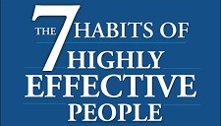
group 1:
OUALIBOUCH Meriem
BENNIS Uthmane Supervised by: Yassir Yousfi
BATTAHI Yassin
NOURELABIDINE Fatimaezzahra 2020-2021
CHARIFI ALAOUI Taha

Slide 2
Introduction
About the author
About the book
Habits
First habit: Be proactive
Conclusion
Summary

Slide 3
The 7 habits of highly effective people is a guide to the procces of Personal leadership
Introduction

Slide 4
Stephen Richards Covey was born October 24, 1932 in Salt Lake City and died July 16, 2012 in Idaho Falls, is an author,professor , internationally respected leadership authority ,businessman and US speaker.
Books by stephen covey: First things first, The leader in me and Living the 7 habits.
About the author

Slide 5

About the book
These book Destined to be the personal leadership
of the decade, it impressed a lot of big names
in society like :the author bennis, jake garn
the first senator in space.
The idea of the book start with a simple question,
is it worth it?, is what i want worth losing the knowledge of what is importate to me and what i realy need.

Slide 6
Habits
Habits
Knowledge
desire
skils

Slide 7
dependence
independence
interdependence

Slide 8
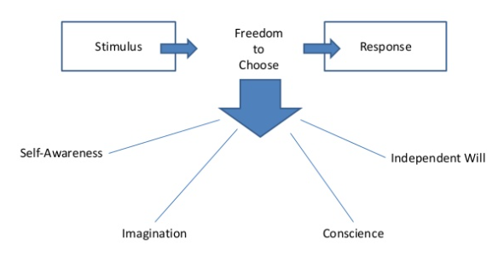
First habit: Be proactive
We can define proactivity by these model:

Slide 9
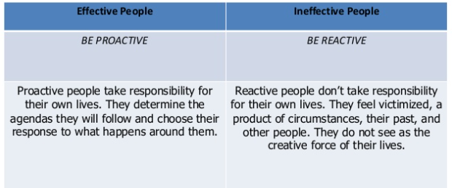

Slide 10
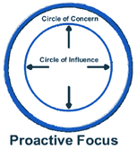
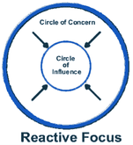
circle of concern

Slide 11
Conclusion

