Slide 1
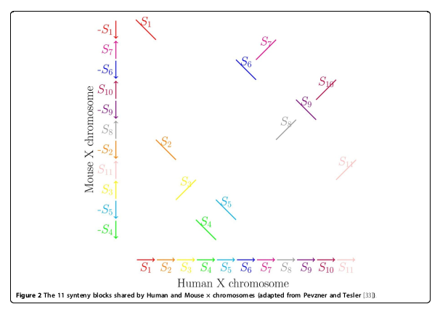
Can a Breakpoint Graph be inferred from HiC?
Synteny blocks

Slide 2
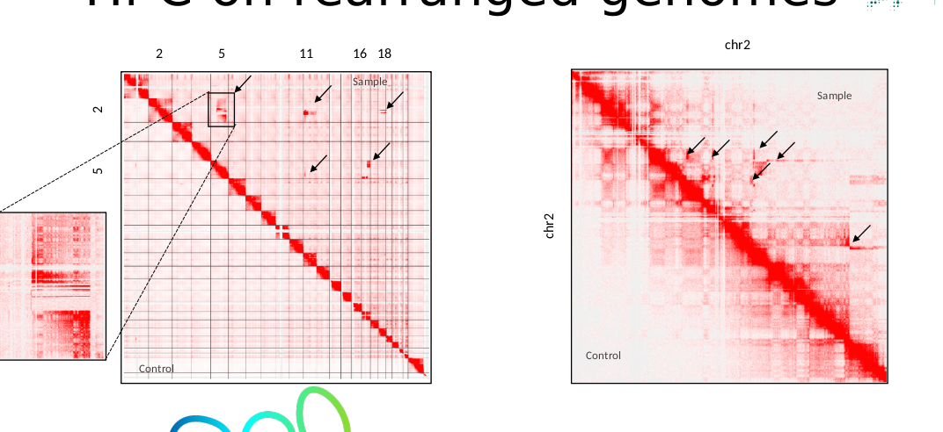
Bottom half: ref against re, which is the correct signal
Top half: signals far from the main diagonal,
Which indicate wrong mapping

Slide 3
The problem
Reference genome and the patient have the same contigs. But in HiC maps, the x, and y axes show the same ordering (I.e human human) but the patterns
reveal the real order of the contigs.
Think of mapping a mouse genome into the human genome’s order.

Slide 4
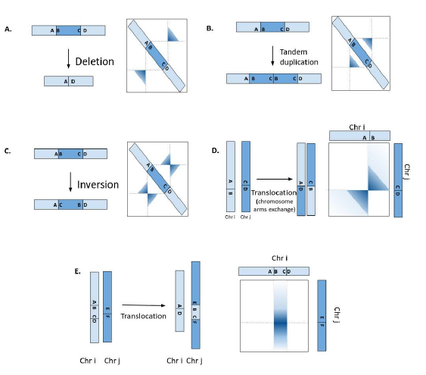
Identifying signals
In principle if the hiC is not too noisy these translocations/inversions etc. can be identified.

Slide 5
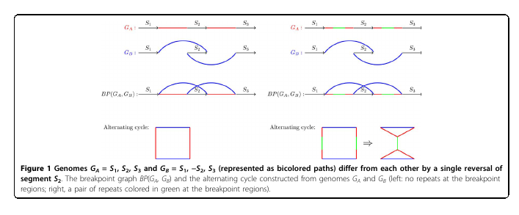
How does it relates to graphs
The ‘original’ break point graph, on synteny blocks

Slide 6
Classical breakpoint analysis
Genome1: {s1, s2, …, sn}
Genome2: {S_k, s_i, …} (some permutation of Genome1)
Find the shortest way to transform G1 to G2 by
Translocations, inversions etc. (permutation)

Slide 7
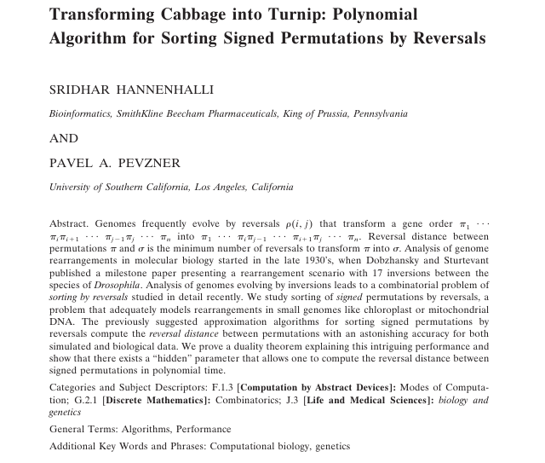

Slide 8
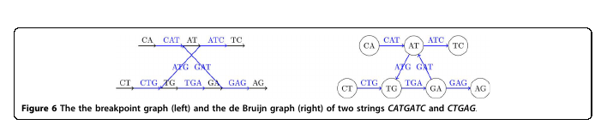
Can be generalized to a graph on k-1 mers which is equivalent to a deBrujn graph

Slide 9
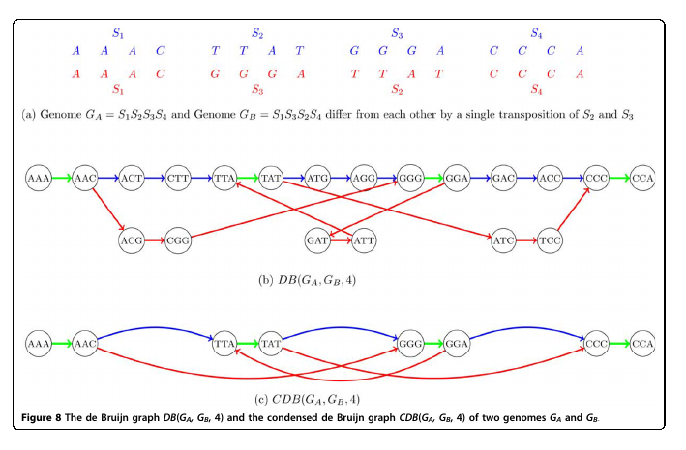
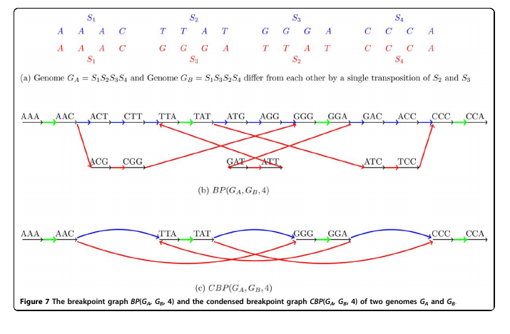
And both the BPG and dBG can be condenced

Slide 10
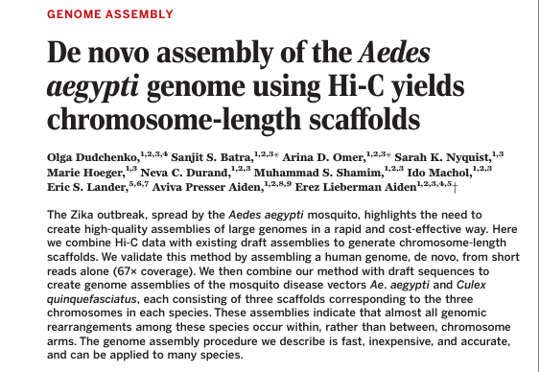
What other people have done

Slide 11
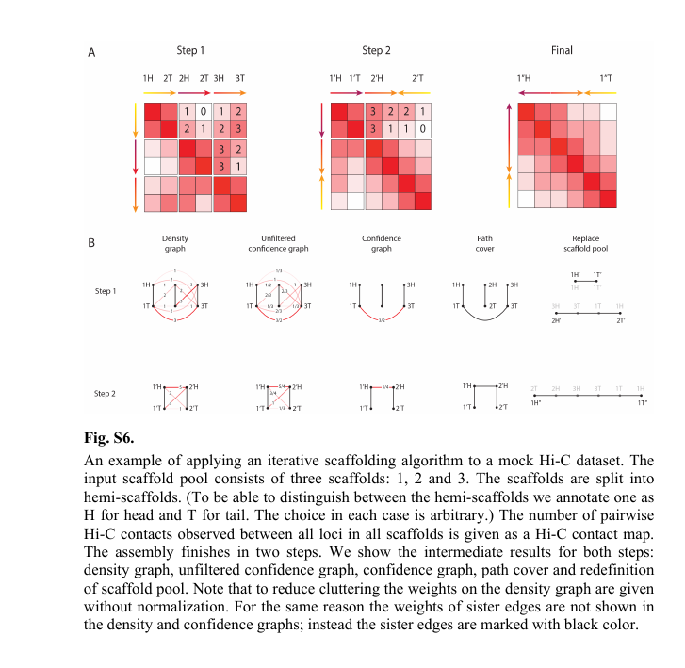
Dudchenco et. al are doing de novo assembly. And actually their method involves something they call confidence graph.
Dudchenco et. al are doing de novo assembly. And actually their method involves something they call confidence graph.

Slide 12
Maybe we should look into that.
And then there is this group

Slide 13
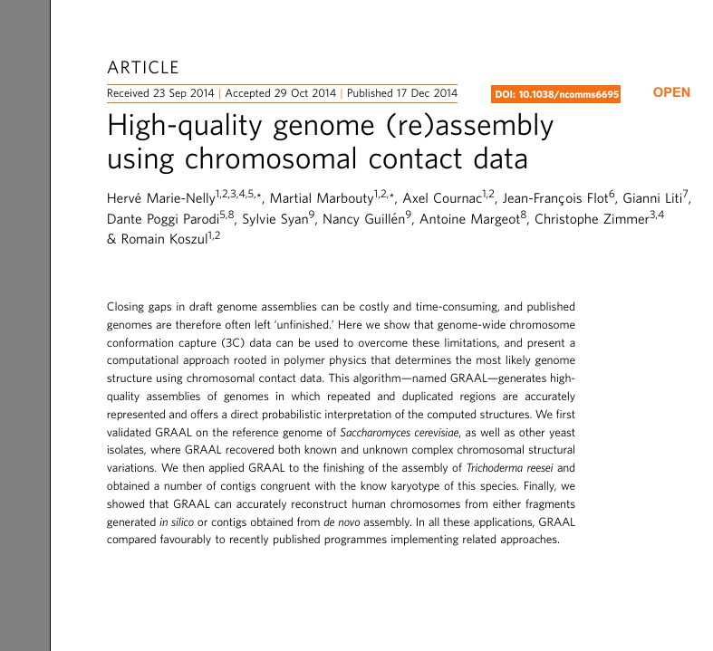
GRAAL works on contigs whose order is unkown.

Slide 14
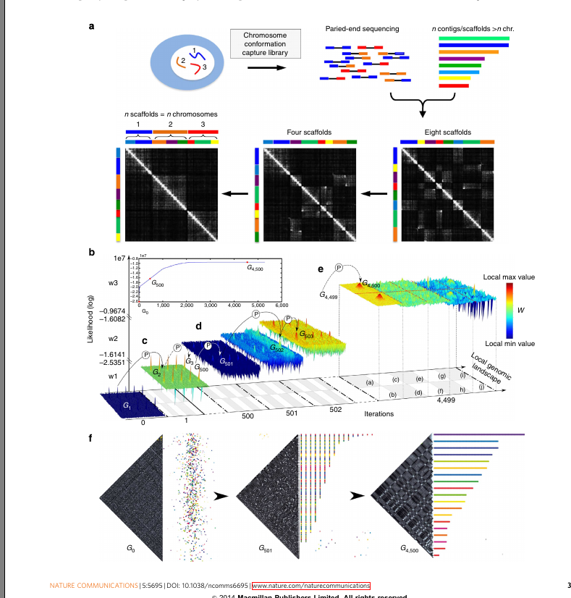

Slide 15
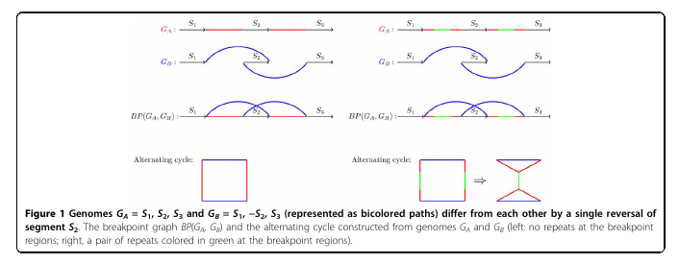
Back to bp graphs

Slide 16
The classical application is comparing two genomes, where one is a rearrangement of the other.
Find out how many break points it take to transform one
Genmoe into the other.
Whereas dBG are used for genome assembly problems

