Slide 1
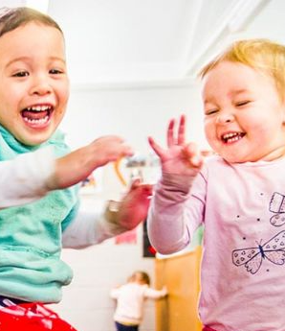


The child day-care center service
I8C hackathon group

Slide 2
Index
Introduction.
Use cases.
Technologies used.
Conception.
Demo.

Slide 3
Introduction
Our workshop aims to provide a solution to parents who wish to stay informed about critical daily events that their children experience during their childcare time in the nursery.

Slide 4
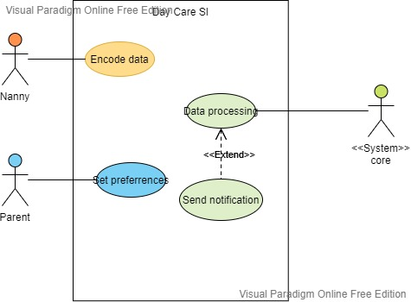
Use cases
Main actor: Nanny, Parent.
The nanny manually logs the information about the child's activities.
The parent desires to be notified of any relevant information.
Daily reporting.

Slide 5
Technologies stack
Kafka,
Confluent cloud
kSqlDB
Spring-boot
Angular
Firebase

Slide 6
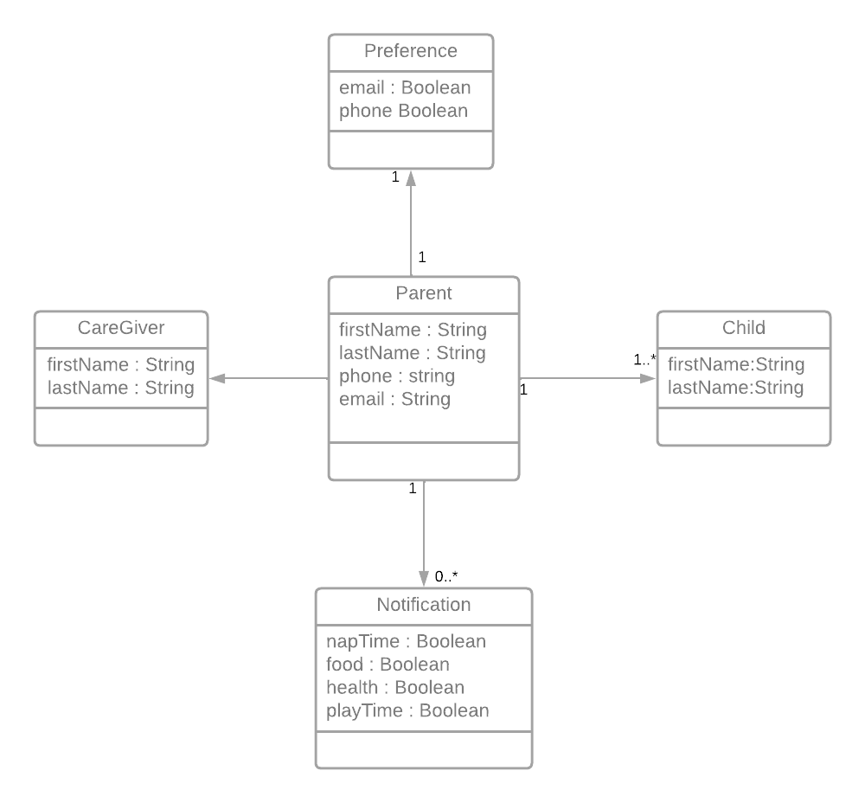
Conception
Data schema.

Slide 7
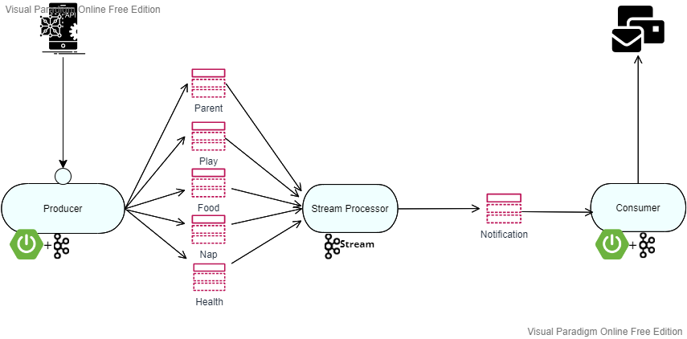
Conception
Event-driven architecture.
“Real-time” events as they happen at the producer.
Immediate action at the consumer.

Slide 8
Demo

Slide 9
Thank’s for your attention

