Slide 1
Understanding Earthquakes and Volcanic Eruptions through kMeans and Time-Series
Zelig Dhi Lee
DAT3, General Assembly
27 May 2017

Slide 2
Overview of Presentation and What was Done
Why this topic?
Dataset at a glance
Data Exploration
Application of kMeans
Time Series Analysis
Challenges

Slide 3
Why this topic?
To explore the effect on statistical analysis / machine learning on natural phenomena
Volcanoes / Earthquakes can be easily quantified as datapoints where the strength can be measured (eg. Ritcher Scale)
To explore the feasibility of creating predictive models for natural phenomena

Slide 4
Source of Data
Smithsonian Institution National Museum of Natural History Global Volcanism Program
- http://volcano.si.edu/
Earthquakes
Volcano List
Volcano Eruptions
SO₂ Emissions

Slide 5
Structure of Dataset
Earthquakes
Volcano List
Volcano Eruptions
SO₂ Emissions
Date
Magnitude
Latitude
Longitude
Depth
Place (eg. Vanuatu, Kuril Islands)
Volcano Number
Volcano Name
Country / Region
Explosivity Index Max
Latitude
Longitude
Elevation
Date (Both Start and End)
Volcano Number
Volcano Name
Explosivity Index Max
Latitude
Longitude
Volcano Number
Volcano Name
Country
Date
SO₂ Mass
Assumed SO₂ Altitude

Slide 6
Some cool facts about Earthquakes
75,849 observations since 1960
Major Earthquakes tend to have multiple “shocks”
2011 Great East Japan Earthquake – 281
2004 Indian Ocean Tsunami – 144
2010 Chile Earthquake - 129
Average earthquake
5.39 Magnitude (75% percentile – 5.60)
70km Depth
Note – Dataset only records quakes of Magnitude 5.0 and above!

Slide 7
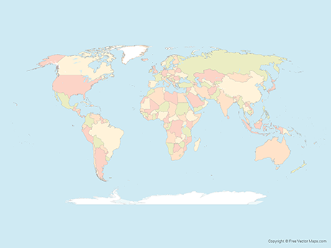

Which area have the most quakes since 1960?
Kuril Islands (Russia) 2,103
Papua New Guinea 1,443
Vanuatu 2,149
Fiji 1,901
Tonga 1,977

Slide 8
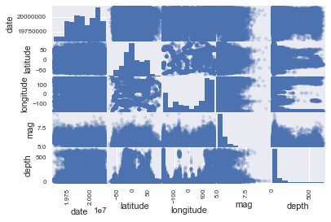

Slide 9
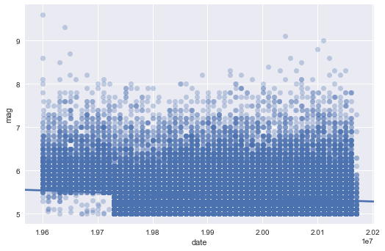

Slide 10
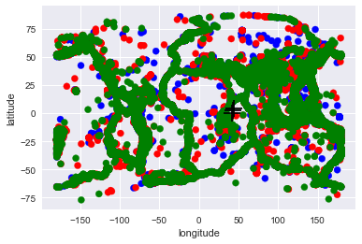
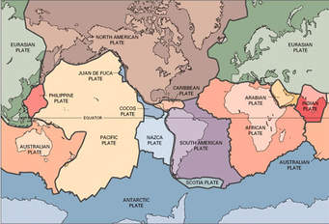
kMeans with 3 Earthquake clusters
Source: geology.com

Slide 11
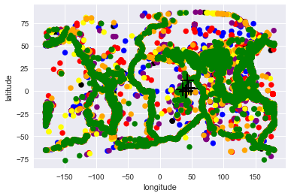
kMeans with 7 Earthquake clusters
Source: geology.com

Slide 12
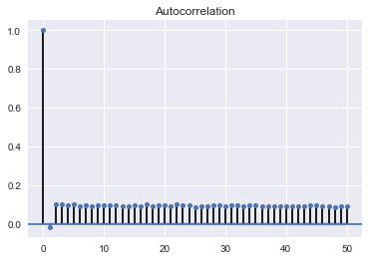
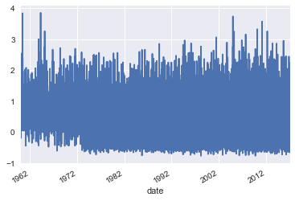
Time Series analysis for Earthquakes, 1960-2017, ARMA (1,0)

Slide 13
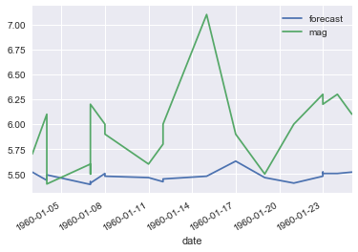
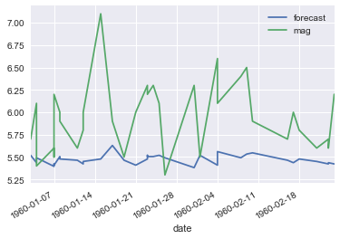
Looks pretty “off”, our forecast

Slide 14
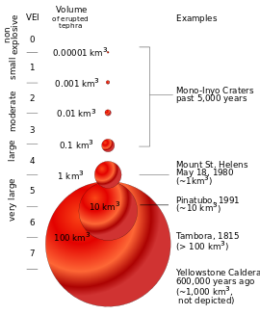
Some cool facts about Volcanoes
325 volcanoes recorded with eruptions since 1960
1,985 eruptions recorded till date – avg. 29 eruptions a year!
2002, 2004-2006, 2008 had most eruptions (44 to 49)
Average eruption (VEI)
1.63 (small!)
2.00 – 75th percentile
Source: Wikipedia

Slide 15
Which volcanoes have erupted most often since 1960?
Klyuchevskoy (Russia) 40
Etna (Italy) 44
Bezymianny (Russia) 46
Piton de la Fournaise (Reunion) 37
Ruapehu (New Zealand) 35

Slide 16
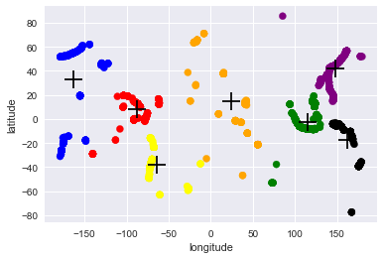
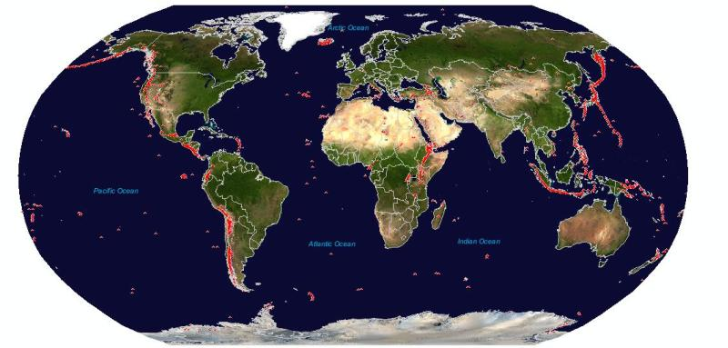
kMeans with 7 Volcano clusters
Source: http://volcano.oregonstate.edu/oldroot/volcanoes/

Slide 17
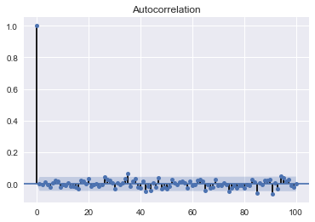
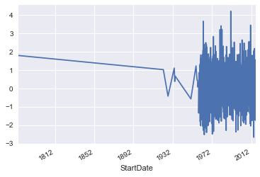
Time Series analysis for Volcanoes, 1960-2017, ARIMA (2,0,2)

Slide 18
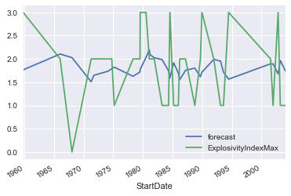
Forecasting severity of eruptions

Slide 19
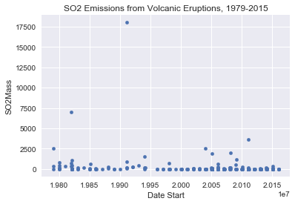
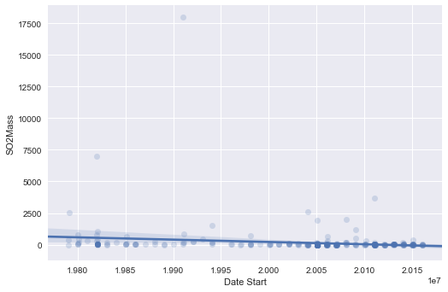
Understanding SO₂ emissions
Observations – 395, Mean - 146

Slide 20
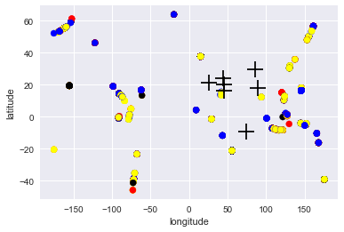
kMeans for SO₂ emissions with 7 Volcano clusters
Source: http://volcano.oregonstate.edu/oldroot/volcanoes/

Slide 21
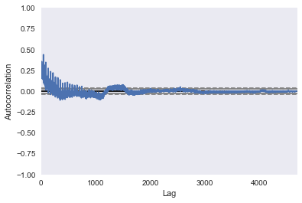
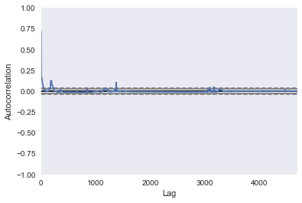
Explosivity Index Max vs SO₂ emissions

Slide 22
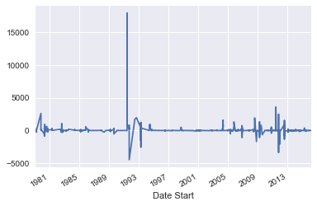
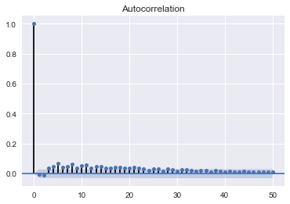
Time Series analysis for SO₂ emissions, 1960-2017, ARIMA (2,0,2)

Slide 23
Challenges / Issues to Think About
Can the models be further refined to come out with better forecast models?
Can models accurately predict the “big” earthquakes / volcanoes that we always hear in the news?
Dividing by geographic regions may be useful but will it be less statistically significant? (Ie. Reduced sample size for each region)
Perhaps, we can’t put a trend to seismic movements vis-à-vis other natural phenomena (eg. climate)

