Slide 1
Campus Sontheim
H⊣N
HEILBRONN UNIVERSITY
OF APPLIED SCIENCES
IMAGE PROCESSING 2
Kniffel Vision AI
Automated Dice Recognition with OpenCV
Zeliha Ilgın Güven • Sybren Veninga

Slide 2
Campus Sontheim
H⊣N
HEILBRONN UNIVERSITY
OF APPLIED SCIENCES
AGENDA
1. What is Kniffel?
9. User Interface
2. Project Goal
10. Background Threading
3. System Architecture
11. Key Technical Decisions
4. CV Pipeline 1: Contours
12. Development Workflow
5. Pip Detection
13. Results
6. CV Pipeline 2: Watershed
14. Technologies Used
7. Game State Machine
15. Conclusion
8. Scoring Engine
Lecture topic Image Processing 2 | Zeliha Ilgın Güven & Sybren Veninga | Summer Semester 26
| 2

Slide 3
Campus Sontheim
H⊣N
HEILBRONN UNIVERSITY
OF APPLIED SCIENCES
WHAT IS KNIFFEL?
Dice game for 2–5 players
5 dice, up to 3 rolls per turn
Hold dice between rolls to chase categories
13 scoring categories per player — each used once
Categories: Ones–Sixes, Three/Four of a Kind, Full House, Small/Large Straight, Kniffel (all 5 equal), Chance
+35 bonus if upper section totals ≥ 63
Highest total score wins after 13 rounds each
Also known as…
Yahtzee®
Our project automates the tedious part:
counting pips and calculating scores.
Point a webcam at physical dice
→ instant digital scorecard
Lecture topic Image Processing 2 | Zeliha Ilgın Güven & Sybren Veninga | Summer Semester 26
| 3

Slide 4
Campus Sontheim
H⊣N
HEILBRONN UNIVERSITY
OF APPLIED SCIENCES
PROJECT GOAL
THE PROBLEM
OUR SOLUTION
Players manually count pips after every roll
Must mentally match 13 scoring categories
Slow and error-prone under pressure
Point a webcam at physical dice on the table
OpenCV detects each die value in real time
Digital scorecard shows categories + points instantly
Two players — all math handled automatically
CONSTRAINT: Pure classical computer vision — no machine learning, no pretrained models
Lecture topic Image Processing 2 | Zeliha Ilgın Güven & Sybren Veninga | Summer Semester 26
| 4

Slide 5
Campus Sontheim
H⊣N
HEILBRONN UNIVERSITY
OF APPLIED SCIENCES
SYSTEM ARCHITECTURE
WEBCAM
Physical hardware input
↓
CAPTURE LAYER
camera.py · Background Thread
↓
DETECTION LAYER
detector.py · Contours + Watershed
↓
GAME ENGINE
engine/ · Turn State Machine
↓
UI RENDERER
ui/renderer.py · pygame 60 FPS
Each layer independently testable — CV, game engine, and UI have no circular dependencies
Lecture topic Image Processing 2 | Zeliha Ilgın Güven & Sybren Veninga | Summer Semester 26
| 5

Slide 6
Campus Sontheim
H⊣N
HEILBRONN UNIVERSITY
OF APPLIED SCIENCES
CV PIPELINE 1: CONTOURS
DEFAULT PIPELINE — OPTIMISED FOR DARK PIPS; MAY STRUGGLE UNDER STRONG SHADOWS
STEP | OPERATION
1 | Convert to grayscale → Gaussian blur (7×7)
2 | Adaptive threshold (Gaussian, inverted) → binary mask
3 | Morphological close (5×5, 2×) → fills gaps inside dice
4 | Find and fill external contours > 200 px²
5 | Estimate single-die area from median of square-ish blobs
6 | Divide each blob area by median → number of dice in blob
7 | Multiple dice merged? → K-means splits blob into die centers
8 | Crop each die ROI → SimpleBlobDetector counts pips
KEY INSIGHT
Using the median area instead of a fixed threshold makes the die-size estimate robust to stray noise contours.
K-means handles any touching geometry without needing to know the exact overlap shape.
Lecture topic Image Processing 2 | Zeliha Ilgın Güven & Sybren Veninga | Summer Semester 26
| 6

Slide 7
Campus Sontheim
H⊣N
HEILBRONN UNIVERSITY
OF APPLIED SCIENCES
PIP DETECTION
SHARED STEP — BOTH PIPELINES FEED DIE ROIs INTO THE SAME PIP-COUNTING STEP
Crop die ROI from original BGR frame
Disabling circularity and convexity filters avoids false rejections when pips are slightly non-circular due to print quality or viewing angle.
↓
Grayscale → Gaussian blur (5×5)
↓
Adaptive threshold (Gaussian, 11×11 block, C=4)
↓
cv2.SimpleBlobDetector
filterByArea = True (30 – 50 000 px²)
filterByInertia = True (ratio ≥ 0.60)
filterByCircularity = False ← disabled
filterByConvexity = False ← disabled
↓
blob count = face value (1–6)
Lecture topic Image Processing 2 | Zeliha Ilgın Güven & Sybren Veninga | Summer Semester 26
| 7

Slide 8
Campus Sontheim
H⊣N
HEILBRONN UNIVERSITY
OF APPLIED SCIENCES
CV PIPELINE 2: WATERSHED
SECONDARY PIPELINE — REQUIRES HIGH CONTRAST BETWEEN DICE AND BACKGROUND
STEP | OPERATION
1 | Convert to HSV → threshold near-white pixels (S≤60, V≥150)
2 | Morphological close to fill holes inside dice
3 | Distance transform → threshold at 40% of max → sure foreground
4 | Dilate mask → sure background → unknown = bg − fg
5 | cv2.watershed with connected-component markers
6 | Extract contours from watershed output
7 | K-means split + SimpleBlobDetector pip count (same as Pipeline 1)
KEY INSIGHT
Watershed treats each die center as a basin peak in the distance-transform landscape. Water rising from each peak stays within its basin, naturally separating touching objects — no explicit contour gap needed.
WHEN TO USE WHICH PIPELINE
Contours → colored dice, controlled contrast, any surface
Watershed → white/cream dice, multiple touching dice
Switch at runtime with the D key
Lecture topic Image Processing 2 | Zeliha Ilgın Güven & Sybren Veninga | Summer Semester 26
| 8

Slide 9
Campus Sontheim
H⊣N
HEILBRONN UNIVERSITY
OF APPLIED SCIENCES
GAME STATE MACHINE
ROLL
Hold logic in DiceSet.update_from_cv:
start of each turn / no dice captured
When the user holds a die, its last bounding-box center is remembered. On the next capture, the detection closest to that center is claimed and excluded.
capture() / roll_random()
↓
HOLD
1st or 2nd roll done / can hold dice or score early
score() →
3rd capture
↓
SCORE
advance_turn /
next player
→
must pick a category
can_capture() → True in ROLL and HOLD phases
can_score() → True in HOLD and SCORE phases (after ≥ 1 roll)
After 13 rounds × 2 players → Phase.GAME_OVER
Lecture topic Image Processing 2 | Zeliha Ilgın Güven & Sybren Veninga | Summer Semester 26
| 9

Slide 10
Campus Sontheim
H⊣N
HEILBRONN UNIVERSITY
OF APPLIED SCIENCES
SCORING ENGINE
All 13 categories are pure functions in engine/scoring.py
CATEGORY | IMPLEMENTATION
Ones – Sixes | counts[n] × n
Three of a Kind | sum(dice) if any count ≥ 3
Four of a Kind | sum(dice) if any count ≥ 4
Full House | 25 if sorted counts == [2, 3]
Small Straight | 30 if any 4-sequence is a subset
Large Straight | 40 if exact 5-sequence set matches
Kniffel | 50 if any count == 5
Chance | sum(dice) always
Upper Bonus | +35 if upper subtotal ≥ 63
Scorecard.potential_scores(dice) calculates what each unfilled category would score with the current dice — shown in grey on the scorecard after every roll.
Lecture topic Image Processing 2 | Zeliha Ilgın Güven & Sybren Veninga | Summer Semester 26
| 10

Slide 11
Campus Sontheim
H⊣N
HEILBRONN UNIVERSITY
OF APPLIED SCIENCES
USER INTERFACE
Header: 'Kniffel Vision AI' | Round / Roll chips | Players
• Casino felt green left panel
immediate Yahtzee association
SCORECARD
— Upper section (Ones–Sixes) —
Bonus progress bar
— Lower section (combinations) —
Potential scores (grey)
Running totals
• Warm cream paper right panel
OpenCV Live Stream Panel
— annotated camera feed —
Bounding boxes + labels
HUD badges: mode, count
analog scorecard feel
• Gold action buttons
high contrast, draws attention
• Green HUD overlays on camera feed
tech/AI aesthetic
DICE TRAY (wooden frame) — 5 rendered dice, LOCK buttons
• Pulsing LIVE indicator
shows camera is active
• Potential scores in grey
ROLL DICE | NEW GAME — Hint text —
guide the player without dictating
Lecture topic Image Processing 2 | Zeliha Ilgın Güven & Sybren Veninga | Summer Semester 26
| 11

Slide 12
Campus Sontheim
H⊣N
HEILBRONN UNIVERSITY
OF APPLIED SCIENCES
BACKGROUND THREADING
class CameraFeed:
def start(self):
self._thread = threading.Thread(
target=self._loop, daemon=True
)
self._thread.start()
def _loop(self):
while self._running:
ret, frame = self._cap.read()
detections = detect_dice_from_frame(
frame, mode=self._mode
)
annotated = self._draw_overlay(
frame.copy(), detections
)
with self._lock:
self._annotated = annotated
self._detections = detections
KEY DESIGN POINTS
• Detection runs as fast as the camera hardware allows
• The UI reads only the latest annotated frame on each pygame tick
• A threading.Lock prevents torn reads/writes
• The UI stays at a smooth 60 FPS even if detection is slower
Lecture topic Image Processing 2 | Zeliha Ilgın Güven & Sybren Veninga | Summer Semester 26
| 12

Slide 13
Campus Sontheim
H⊣N
HEILBRONN UNIVERSITY
OF APPLIED SCIENCES
KEY TECHNICAL DECISIONS
DECISION | WHY
Background capture thread | Decouples CV processing speed from UI frame rate
Two swappable pipelines | No single algorithm works optimally for all dice/lighting
K-means to split merged blobs | Works for any touching geometry — angle-independent
Median area for die sizing | One large noise blob cannot skew the estimate
SimpleBlobDetector over Hough | Faster on small crops; tunable without complex cascades
filterByCircularity = False | Slightly non-circular pips (print, angle) are still valid
Left-to-right bbox ordering | Consistent positional identity for held-die tracking
CVAdapter singleton | Clean seam — different CV module pluggable without touching game code
Fallback random roll | Game remains playable during CV demo setup or camera failure
Lecture topic Image Processing 2 | Zeliha Ilgın Güven & Sybren Veninga | Summer Semester 26
| 13

Slide 14
Campus Sontheim
H⊣N
HEILBRONN UNIVERSITY
OF APPLIED SCIENCES
DEVELOPMENT WORKFLOW
BinContours.py
cv_interface/detector.py
standalone research script
interactive mode: camera / image / video
→
Standalone scripts let CV work be tested and tuned independently of the game
cv_interface/mock.py injects fake detections so UI can be developed without a camera
Each layer tested in isolation before integration
both pipelines, unified output format
tested independently via CLI:
python -m cv_interface.detector image.jpg --debug
BinWatershed.py
standalone research script
HSV + watershed approach
→
↓
engine/ (no camera dep)
tested with mock.py
fake detections injected via cv_interface/mock.py
↓
ui/renderer.py — integrated in main.py
Lecture topic Image Processing 2 | Zeliha Ilgın Güven & Sybren Veninga | Summer Semester 26
| 14

Slide 15
Campus Sontheim
H⊣N
HEILBRONN UNIVERSITY
OF APPLIED SCIENCES
RESULTS
WHAT WORKS WELL
KNOWN LIMITATIONS
✓ Consistent detection of 5 separated dice under normal indoor lighting
⚠ Pip accuracy drops under motion blur or very low contrast
✓ K-means reliably splits 2–3 touching dice
✓ All 13 scoring categories implemented correctly with potential-score preview
⚠ Watershed pipeline heavily dependent on background tuning → use Contours
✓ UI clearly communicates game phase and available actions at all times
⚠ Not reliable held dice tracking across multiple rerolls
Lecture topic Image Processing 2 | Zeliha Ilgın Güven & Sybren Veninga | Summer Semester 26
| 15

Slide 16
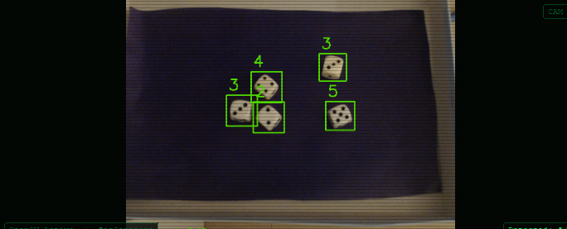
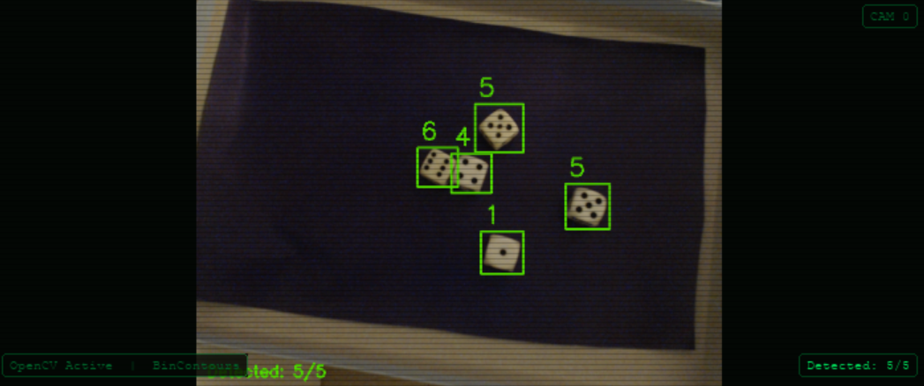
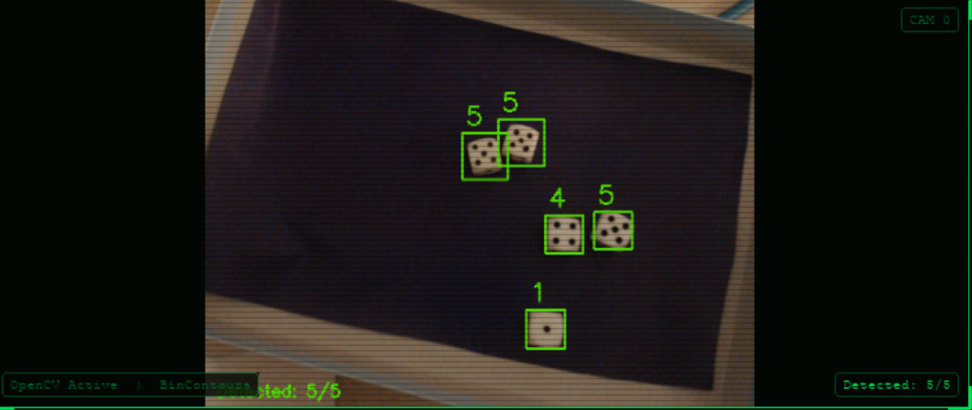
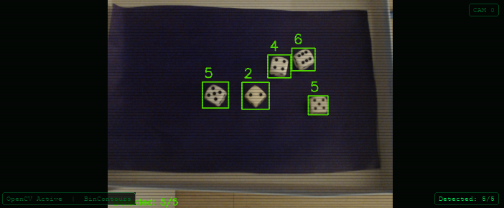
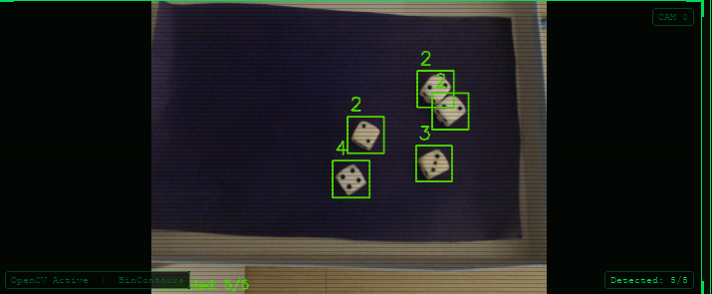
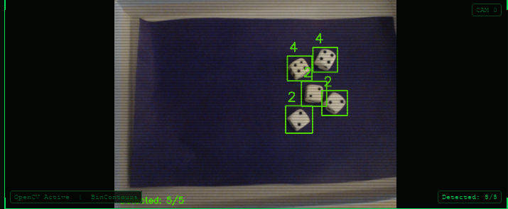
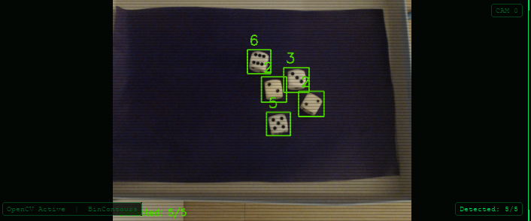
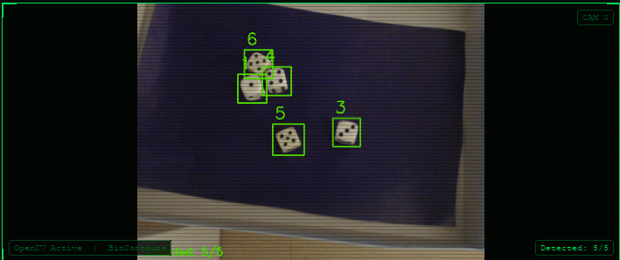
RESULTS
Campus Sontheim
H⊣N
HEILBRONN UNIVERSITY
OF APPLIED SCIENCES
WHAT WORKS WELL
✓ Consistent detection of 5 separated dice under normal indoor lighting
✓ K-means reliably splits 2–3 touching dice
Lecture topic Image Processing 2 | Zeliha Ilgın Güven & Sybren Veninga | Summer Semester 26
| 15b

Slide 17
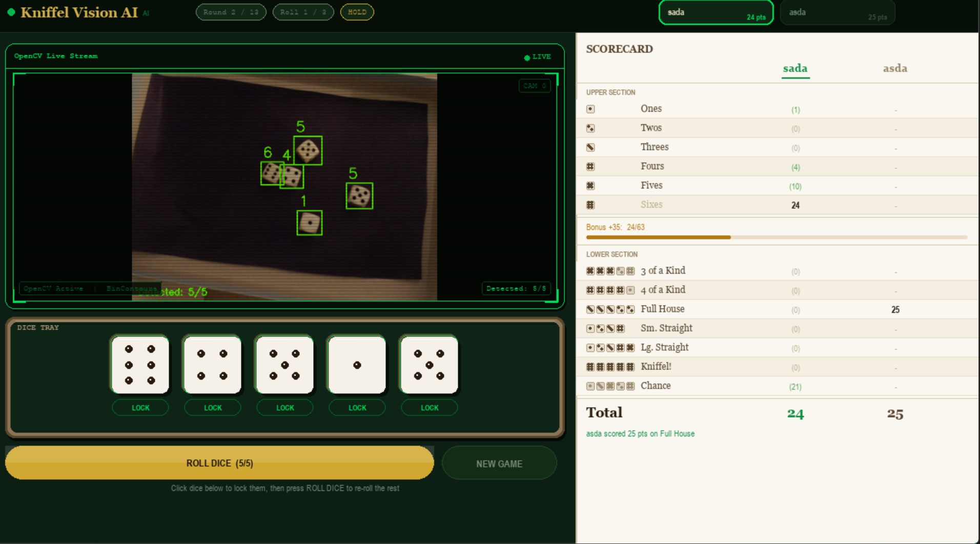
Campus Sontheim
H⊣N
HEILBRONN UNIVERSITY
OF APPLIED SCIENCES
RESULTS
WHAT WORKS WELL
✓ All 13 scoring categories implemented correctly with potential-score preview
✓ UI clearly communicates game phase and available actions at all times
Lecture topic Image Processing 2 | Zeliha Ilgın Güven & Sybren Veninga | Summer Semester 26
| 15

Slide 18
Campus Sontheim
H⊣N
HEILBRONN UNIVERSITY
OF APPLIED SCIENCES
TECHNOLOGIES USED
No deep-learning frameworks used — all detection is classical CV.
TOOL / LIBRARY | ROLE
Python 3.13 | Primary language
OpenCV 4.x | All image processing (threshold, morphology, watershed, blob detection)
pygame 2.x | Game loop, event handling, 2D rendering
NumPy | Array operations, K-means input preparation
threading (stdlib) | Background camera capture thread
VS Code / Cursor | Development environment
Pure classical computer vision: adaptive thresholding → morphological operations → watershed → blob detection
Lecture topic Image Processing 2 | Zeliha Ilgın Güven & Sybren Veninga | Summer Semester 26
| 16

Slide 19
Campus Sontheim
H⊣N
HEILBRONN UNIVERSITY
OF APPLIED SCIENCES
CONCLUSION
• Built a fully functional 2-player Kniffel game driven by real-time computer vision
POTENTIAL FUTURE WORK
• Two CV pipelines cover different dice types and lighting conditions
→ CNN / YOLO-based detection for higher robustness
• Classical CV (thresholding + morphology + watershed + blob detection) proved sufficient under controlled conditions
→ Per-pip overlay drawn directly on the camera feed
• Modular architecture: CV, game engine, and UI layers are independent and independently testable
→ Network multiplayer support
→ Score suggestion AI (highlight the optimal category)
• Demonstrates that image processing course techniques can be combined into a working interactive application
Thank you — Questions?
Lecture topic Image Processing 2 | Zeliha Ilgın Güven & Sybren Veninga | Summer Semester 26
| 17

