Slide 1

Profit Risk Analysis of Public EV Charging Stations
Monte Carlo Simulation · Queueing Model · Risk Analysis
BA3093 Simulation and Risk Analysis
Group G | Jiang Haoran · Zhu Zelin · Lu Xinyu · Gong Yihang
Graduate Course Project Defense

Slide 2
01
Agenda
BA3093 Simulation and Risk Analysis
Defense roadmap for the EV charging station risk analysis
01
Problem Context
Research questions and business risk logic
Defense emphasis
• show exact data pipeline
• highlight profit tail risk
• connect queueing outputs to profit
• end with actionable thresholds
02
Data & Parameters
UrbanEV files, cleaning, station-level inputs
03
Model Design
M/G/c queueing + Monte Carlo risk simulation
04
Results & Risk Metrics
Profit distribution, VaR, CVaR, loss probability
05
Sensitivity Analysis
Demand, capacity, dwell-time penalty stress tests
06
Recommendations
Pricing, expansion trigger, procurement hedging
EV Charging Station Queueing · Monte Carlo Simulation · Risk Analysis
Group G Defense Deck

Slide 3
02
Problem Context
BA3093 Simulation and Risk Analysis
Profitability must be read as a distribution, not an average.
Business problem
Research questions
• Scale does not guarantee station-level profit.
• Average budgets hide left-tail cash-flow risk.
• Operators need P(loss), VaR/CVaR, and congestion impact.
• RQ1: What does the daily profit distribution look like?
• RQ2: How does dwell time turn congestion into financial risk?
Why simulation
Main thesis
• Monte Carlo handles simultaneous stochastic inputs.
• M/G/c queueing captures multi-charger waiting and dwell time.
The station is profitable on average, but financially fragile because downside days are frequent.
EV Charging Station Queueing · Monte Carlo Simulation · Risk Analysis
Group G Defense Deck

Slide 4
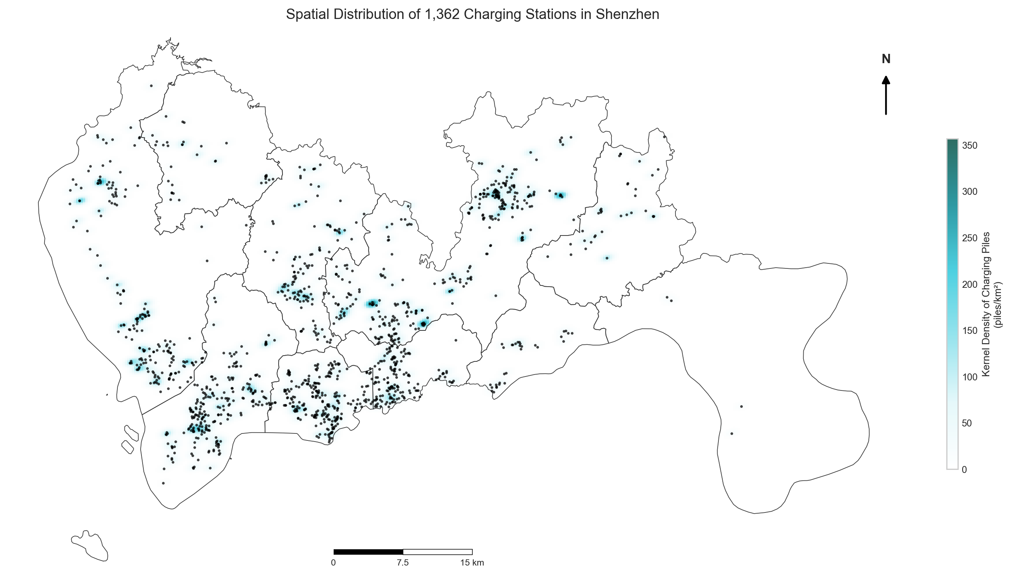
03
UrbanEV Evidence Base
BA3093 Simulation and Risk Analysis
Station geography and operating records define the empirical inputs.
UrbanEV files used
inf.csv — station metadata
occupancy.csv — concurrent sessions
duration.csv — service duration
volume-11kW.csv — energy volume
e_price.csv / s_price.csv — price inputs
Pre-processing logic
• Align common TAZ columns.
• Trim extreme duration and kWh observations.
• Remove implausible prices outside 0.1–5.0 RMB/kWh.
Spatial evidence: 275 TAZs and 1,362 public charging stations.
EV Charging Station Queueing · Monte Carlo Simulation · Risk Analysis
Group G Defense Deck

Slide 5
04
Baseline Parameters
BA3093 Simulation and Risk Analysis
Cleaned TAZ-hour aggregates become station-level assumptions.
13
3.0682
1.3815
0.365
chargers per station
arrival rate λ / hour
service rate μ / hour
service-time CV
Model inputs
Important assumption
• Fixed operating cost: 300 RMB/day.
• Wholesale benchmark: 0.55 RMB/kWh.
• Peak/off-peak split exposes hidden pressure.
Because service-time CV is below 1, a plain M/M/c model would overstate waiting time. The deck uses an M/G/c correction.
EV Charging Station Queueing · Monte Carlo Simulation · Risk Analysis
Group G Defense Deck

Slide 6
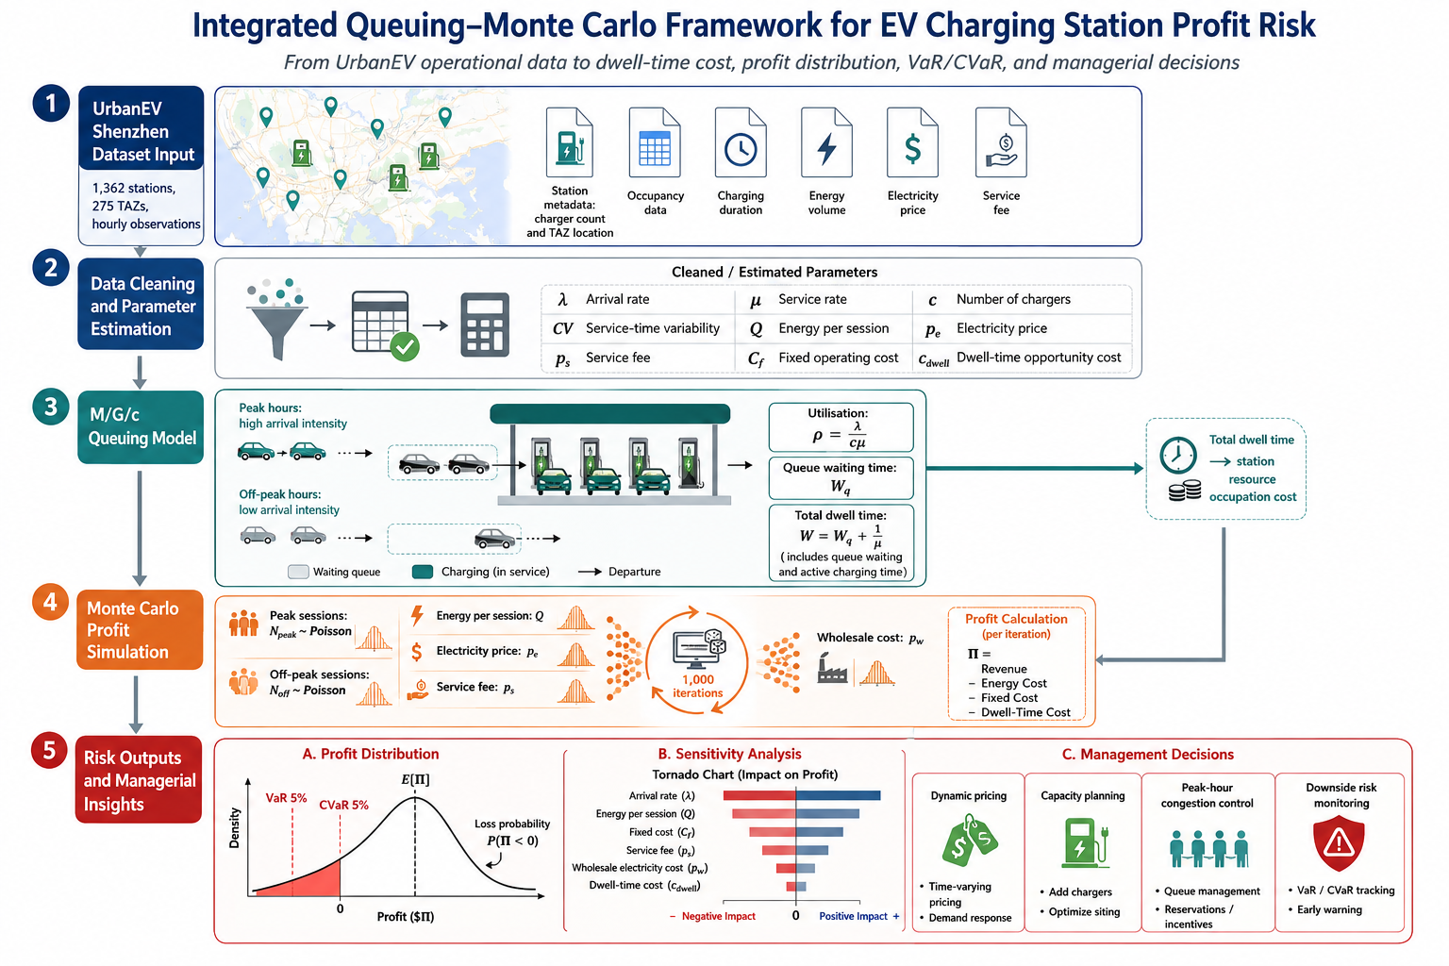
05
Integrated Simulation Design
BA3093 Simulation and Risk Analysis
Queueing outputs enter the profit model as a dwell-time cost.
Queueing layer
λ, μ, c, CV → Wq, W
Monte Carlo layer
1,000 days → profit distribution
Decision layer
VaR, CVaR, P(loss) → pricing/capacity
Analytical bridge: M/G/c provides total dwell time W; Monte Carlo subtracts dwell-time opportunity cost from each simulated day.
EV Charging Station Queueing · Monte Carlo Simulation · Risk Analysis
Group G Defense Deck

Slide 7
06
Peak Pressure Is Hidden by Averages
BA3093 Simulation and Risk Analysis
Peak-hour utilisation is materially higher than the all-day average.
0.5125
2.14%
0.083
43.5
36.8
peak utilisation ρ
peak P(wait)
M/G/c Wq min
total dwell min
sessions / segment
Operational interpretation
Profit interpretation
• All-day utilisation is only 0.1709, so an average view looks safe.
• Peak utilisation is three times higher and concentrates waiting risk.
• Customer queue delay is short at baseline.
• Operator cost is driven by total station occupation time, including active charging.
EV Charging Station Queueing · Monte Carlo Simulation · Risk Analysis
Group G Defense Deck

Slide 8
07
Stochastic Profit Engine
BA3093 Simulation and Risk Analysis
1,000 simulated operating days generate the profit-risk distribution.
Random inputs
Profit equation
Reported risk metrics
• Peak sessions: Poisson(λpeak × 4)
• Off-peak sessions: Poisson(λoff × 20)
• kWh/session: clipped empirical normal
• Prices and wholesale cost: bounded shocks
• E[Π]
• σ[Π]
• P(Π < 0)
• VaR5%
• CVaR5%
• median / 95th percentile
Profit = Revenue − Energy Cost − Fixed Cost − Dwell-Time Penalty
1,000 iterations
fixed seed = 42
EV Charging Station Queueing · Monte Carlo Simulation · Risk Analysis
Group G Defense Deck

Slide 9
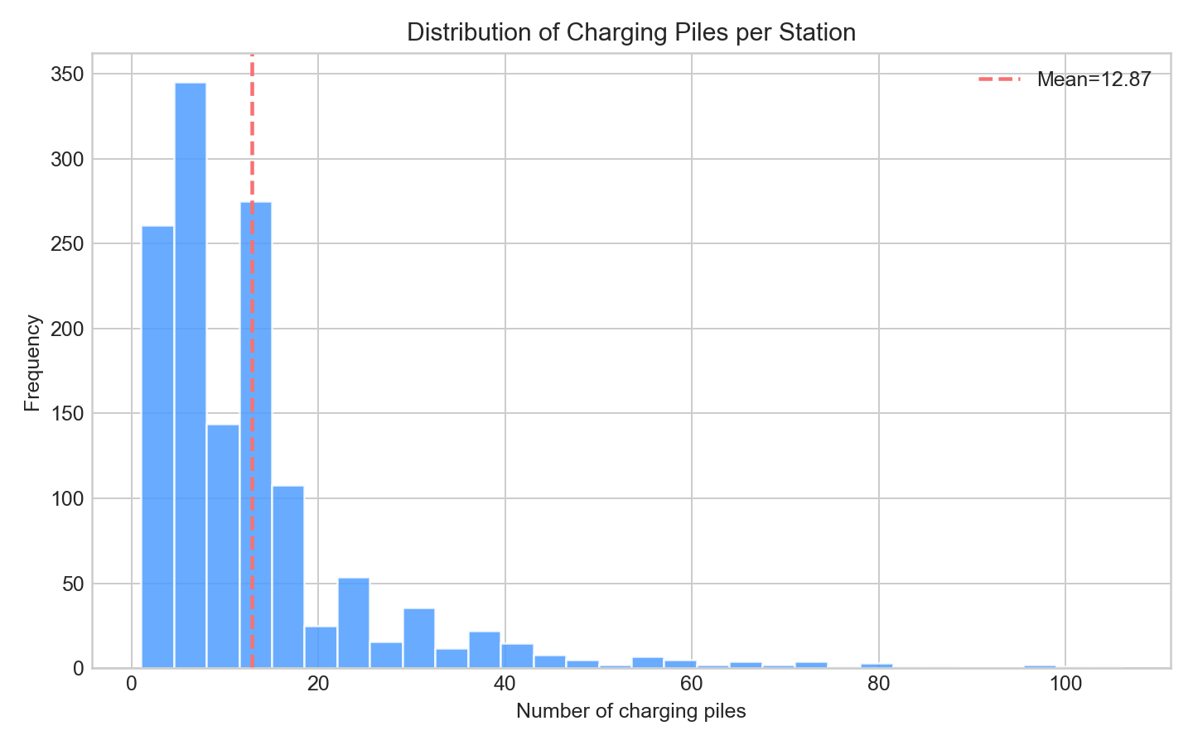
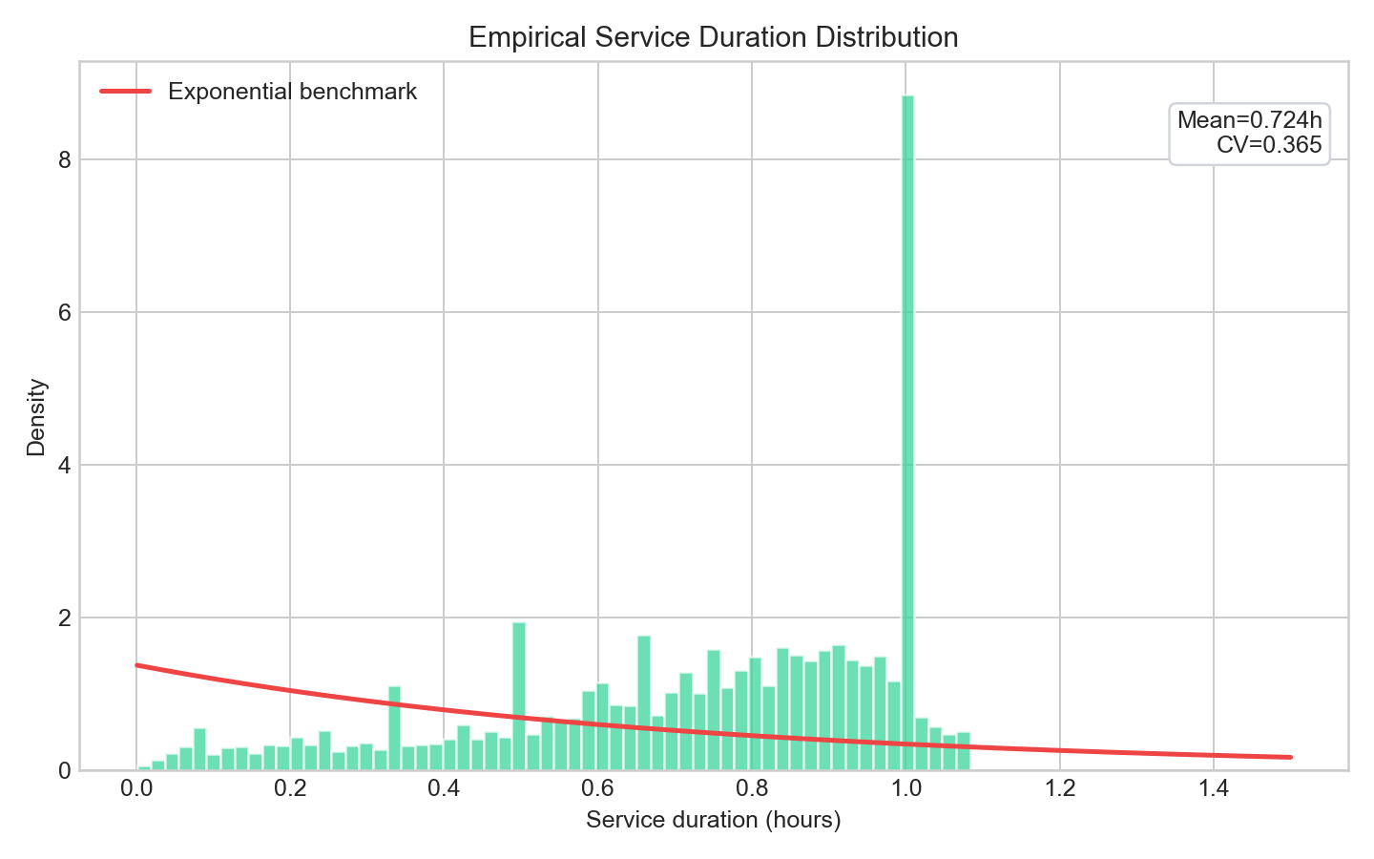
08
Capacity and Service-Time Evidence
BA3093 Simulation and Risk Analysis
The representative station has 13 chargers and non-exponential service time.
Charger count is right-skewed; c = 13 is a representative station average.
Service time is less variable than exponential, supporting the M/G/c correction.
EV Charging Station Queueing · Monte Carlo Simulation · Risk Analysis
Group G Defense Deck

Slide 10
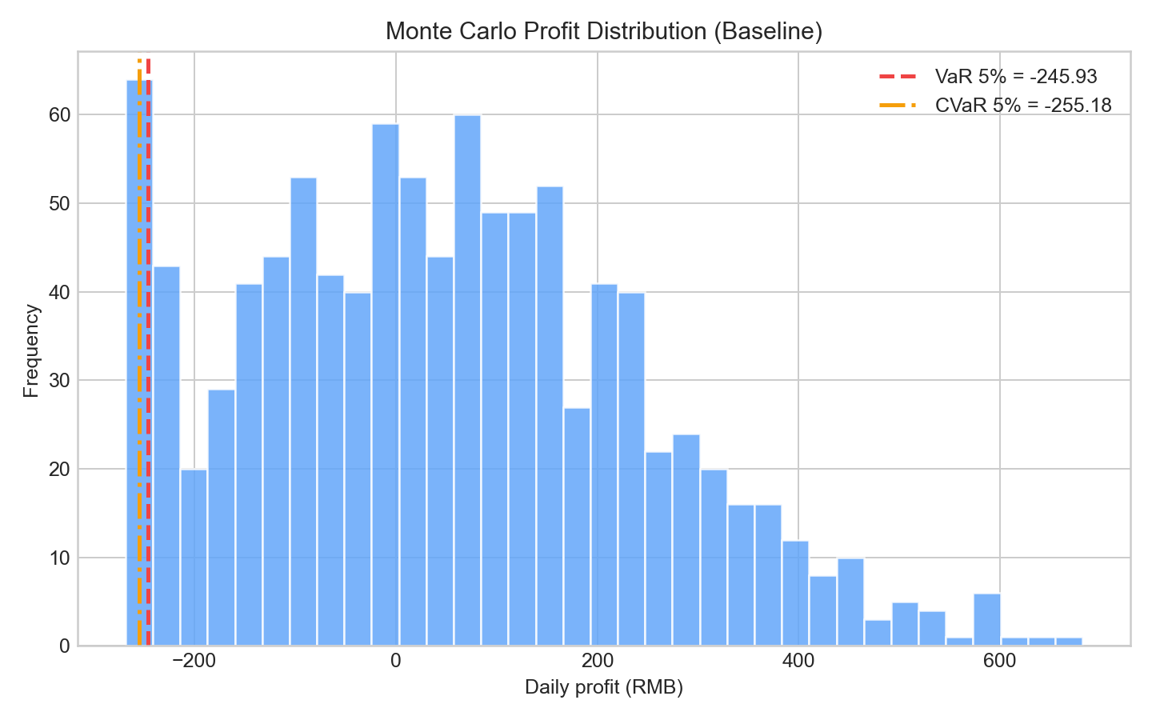
09
Positive Mean, Heavy Downside
BA3093 Simulation and Risk Analysis
Expected profit is positive, but loss-making days remain frequent.
86.42
198.75
VaR5% = -210.35
CVaR5% = -221.81
E[Π] RMB/day
σ[Π] RMB/day
37.1%
-210.35
P(Π<0)
VaR5% RMB
-221.81
436.22
CVaR5% RMB
95th pct. RMB
Expected profit is positive, but downside days are frequent.
EV Charging Station Queueing · Monte Carlo Simulation · Risk Analysis
Group G Defense Deck

Slide 11
10
Tail Risk Drives the Decision
BA3093 Simulation and Risk Analysis
Average profit understates cash-flow exposure.
What the histogram means
Decision implication
• Mean profit: 86.42 RMB/day.
• Median: 68.84 RMB/day.
• Worst 5% days lose about 210–222 RMB.
• Fixed cost makes weak-demand days fragile.
Manage the station as a cash-flow risk problem, not only a revenue growth problem.
Left-tail controls
• Calibrate cash reserve to VaR/CVaR, not mean profit.
• Use peak pricing and procurement hedging to protect downside days.
• Watch utilisation before congestion becomes visible.
EV Charging Station Queueing · Monte Carlo Simulation · Risk Analysis
Group G Defense Deck

Slide 12
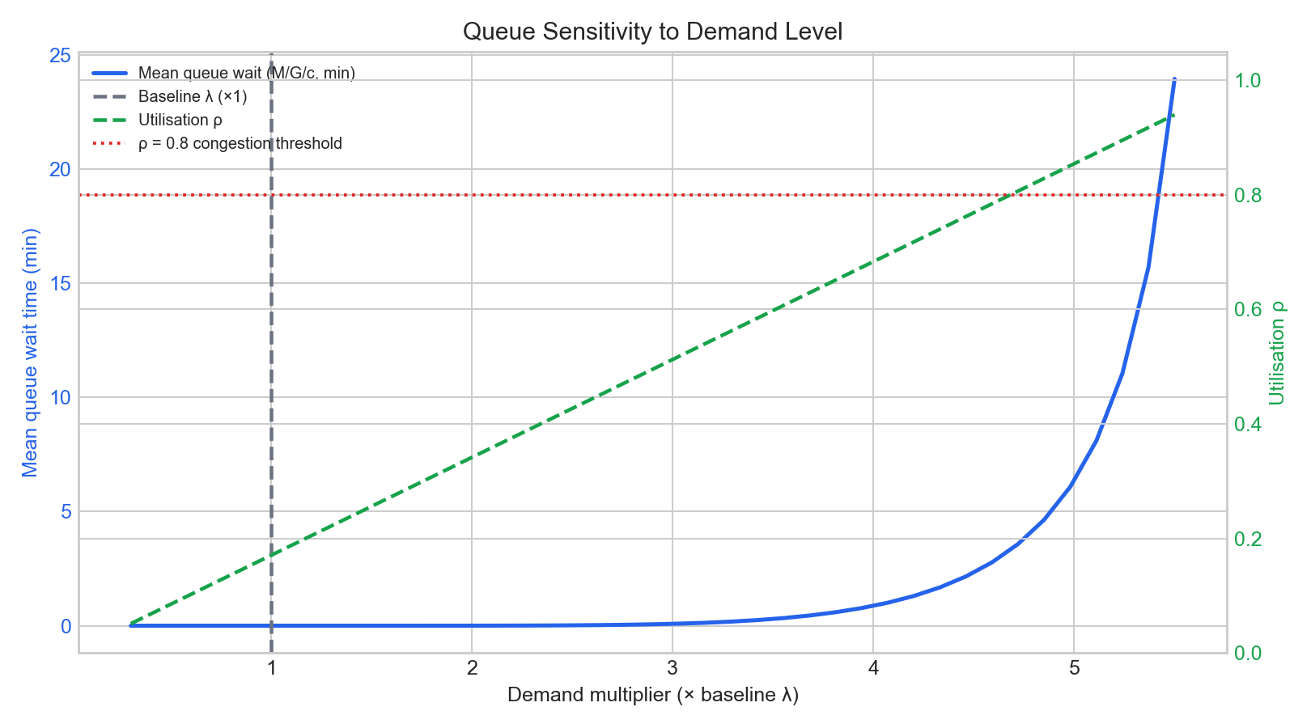
11
Congestion Has a Nonlinear Threshold
BA3093 Simulation and Risk Analysis
Demand growth turns dwell time into an accelerating penalty.
Key reading
• At baseline, waiting is limited.
• As demand rises, utilisation approaches nonlinear congestion.
• ρ = 0.8 is a practical warning line.
Managerial signal
The queueing curve turns dwell time into a capacity trigger.
EV Charging Station Queueing · Monte Carlo Simulation · Risk Analysis
Group G Defense Deck

Slide 13
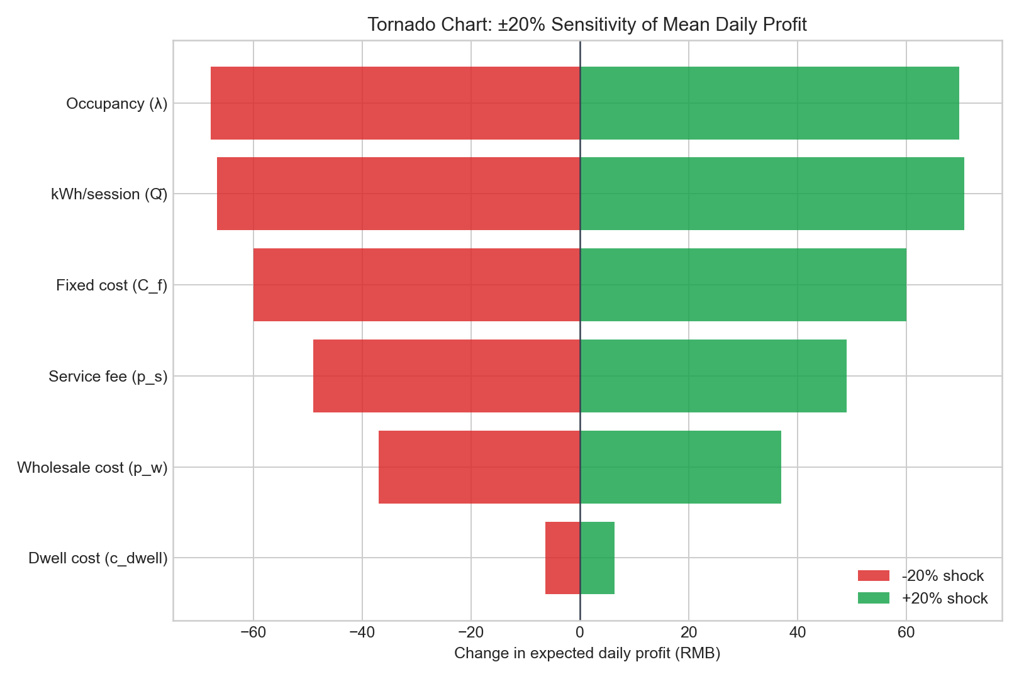
12
Demand Is the Largest Profit Lever
BA3093 Simulation and Risk Analysis
Sensitivity results separate controllable levers from external risks.
Largest driver
Arrival rate λ
Management classification
• Controllable: service fee, capacity, dwell mitigation.
• Partly controllable: demand shaping.
• External: electricity price risk.
EV Charging Station Queueing · Monte Carlo Simulation · Risk Analysis
Group G Defense Deck

Slide 14
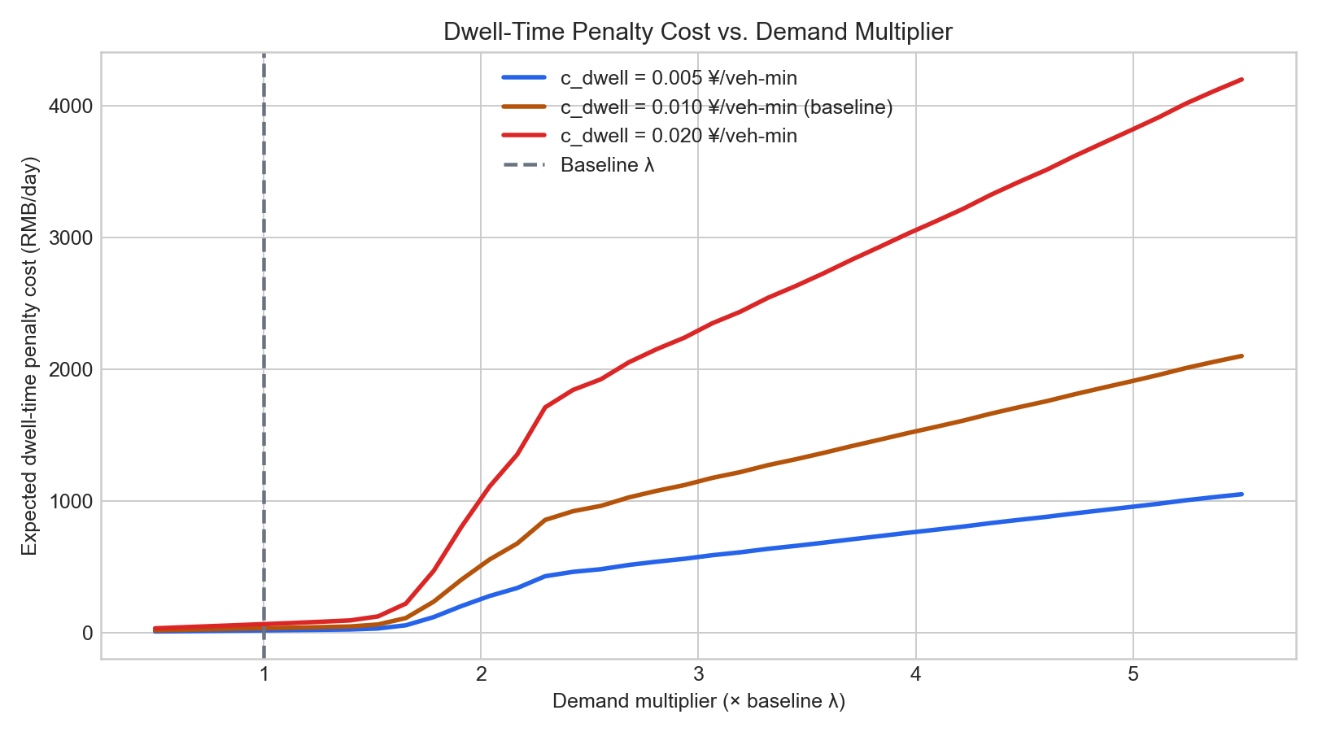
13
Capacity Review Before the Cliff
BA3093 Simulation and Risk Analysis
Dwell-time penalty rises sharply near the congestion region.
Capacity trigger
ρ > 0.5
30-day peak utilisation
Why before 0.8?
• Installation lead time is not immediate.
• Waiting until visible congestion makes expansion late.
EV Charging Station Queueing · Monte Carlo Simulation · Risk Analysis
Group G Defense Deck

Slide 15
14
Managerial Playbook
BA3093 Simulation and Risk Analysis
Translate simulation results into pricing, expansion, and procurement actions.
Recommendation 01
Dynamic peak-hour pricing
When peak ρ > 0.5, introduce a 15%–25% peak service-fee premium.
Recommendation 02
Data-triggered expansion
Start procurement/site planning when 30-day peak utilisation stays above 0.5.
Recommendation 03
Procurement hedge
Lock or cap 50%–60% of expected monthly electricity demand.
Answer to RQ1
Answer to RQ2
Average profit is positive, but the risk profile is fragile: P(loss) = 37.1%, VaR5% = -210.35 RMB, CVaR5% = -221.81 RMB.
Peak pressure and total dwell time convert operational congestion into financial risk.
Final takeaway: connect queueing-based dwell-time cost to financial downside risk.
EV Charging Station Queueing · Monte Carlo Simulation · Risk Analysis
Group G Defense Deck

