Slide 1

Design patterns in light of Java 8 & Lambdas
Vitalii Zelinskyi

Slide 2
Agenda
What is GOF patterns?
Common OOP patterns in functional style
Some patterns in functional languages

Slide 3
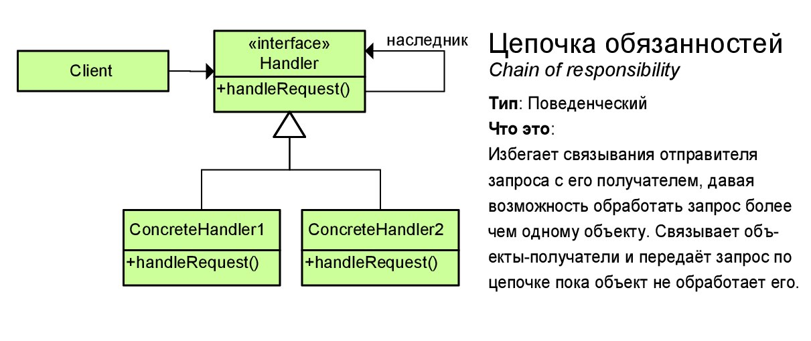

Chain of responsibility
Java 8 style:
A lambda that may or may not delegate to another lambda, which may or may not delegate to another lambda, ad infinitum.

Slide 4
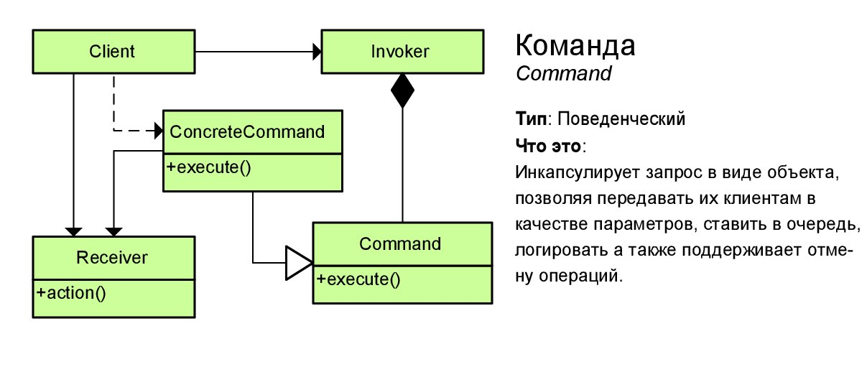
Command
Java 8 style:
Otherwise known as: a lambda!

Slide 5
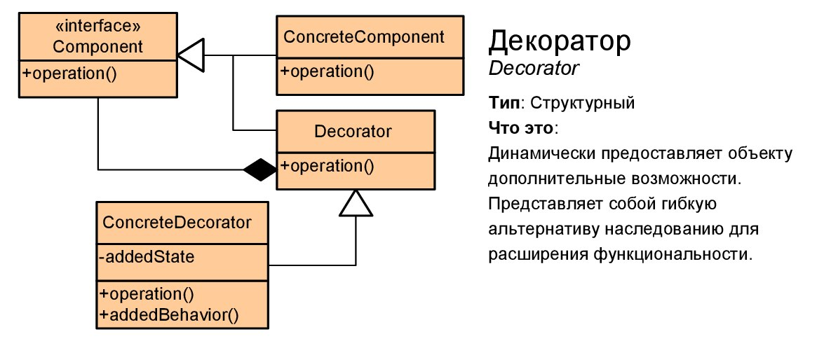
Decorator
Java 8 style:
A lambda that calls another lambda with the same signature but changes the arguments on the way in, or the result on the way out, or performs some extra action.

Slide 6
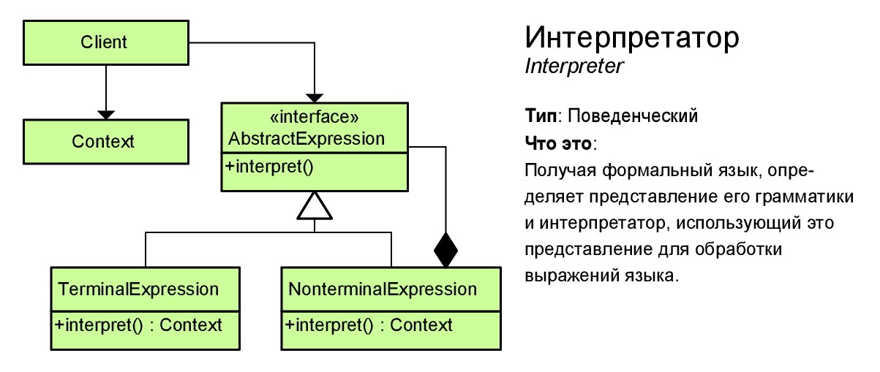
Interpreter
Java 8 style:
Use map of lambdas

Slide 7
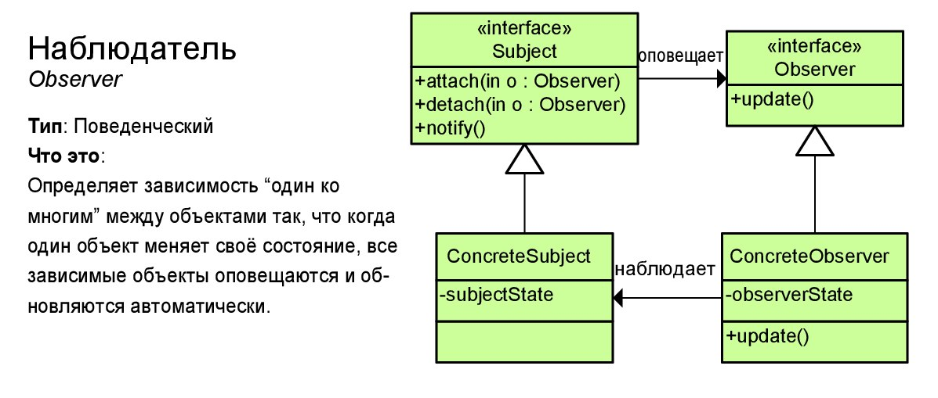
Observer
Java 8 style:
Give some other object a lambda to call when something happens in the future.

Slide 8
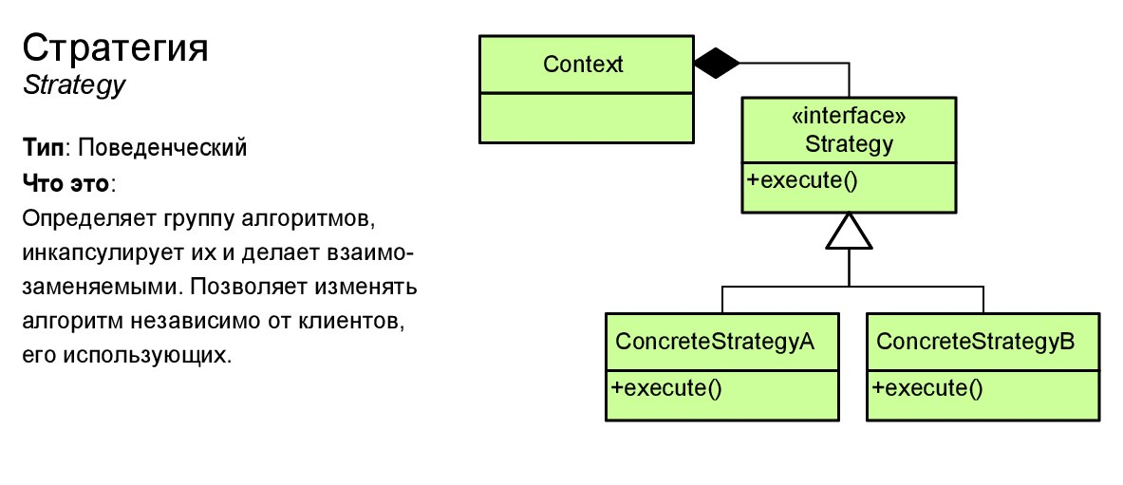
Strategy
Java 8 style:
Choose from a family of lambdas with identical signatures at runtime.

Slide 9
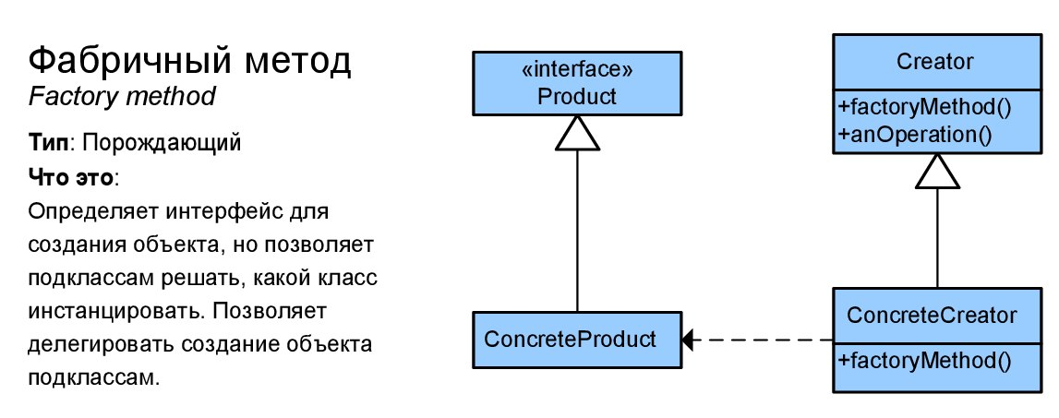
Factory method
Java 8 style:
A lambda that conforms to some interface and returns a new object

Slide 10
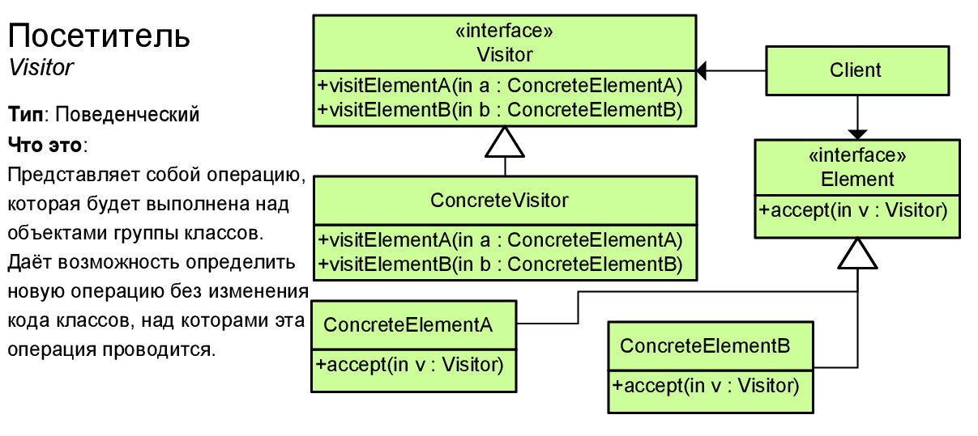
Visitor
Java 8 style:
Use map of lambdas for Visitors

Slide 11
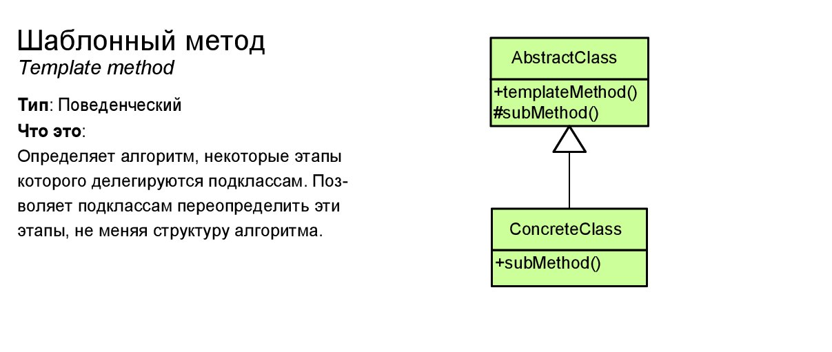
Template method
Java 8 style:
Replace the abstract method polymorphism with composition, passing lambdas into the constructor.

Slide 12
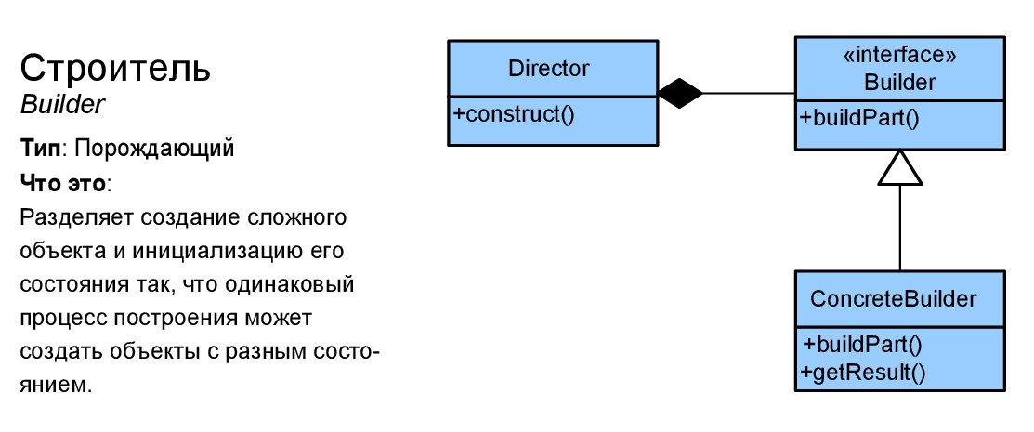
Builder
Java 8 style:
Delegate building into function

Slide 13
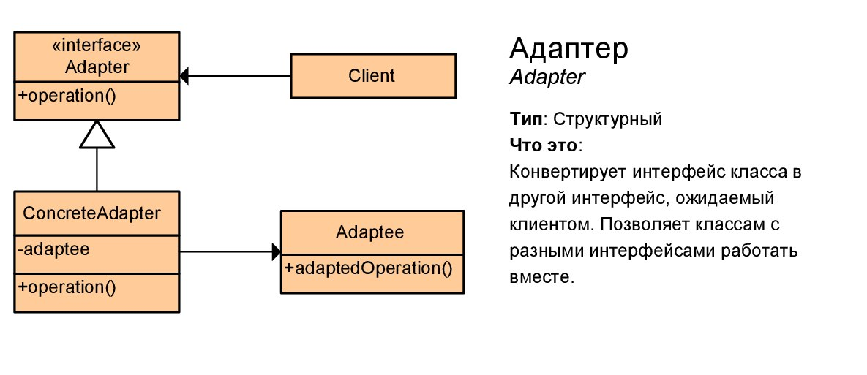
Adapter
Java 8 style:
A lambda that calls a function with a different signature on some other object.

Slide 14
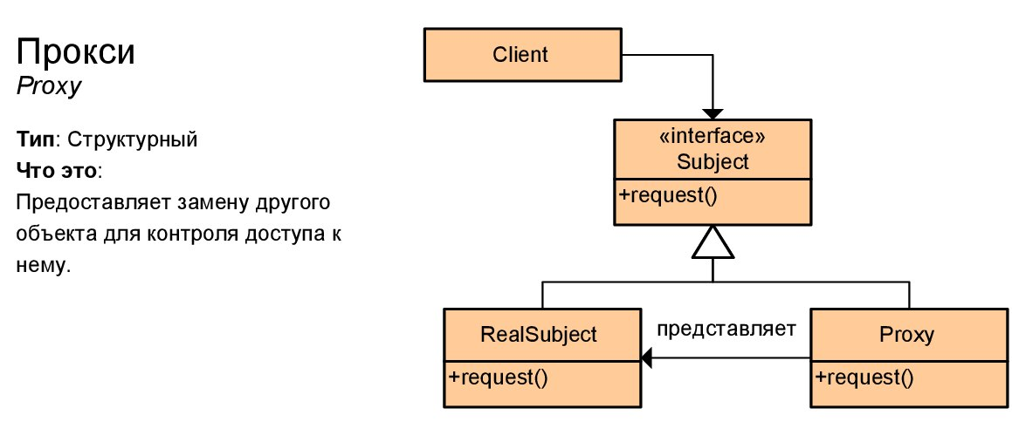

Proxy
Java 8 style:
Don’t create proxy manually, use framework capabilities (AOP)

Slide 15
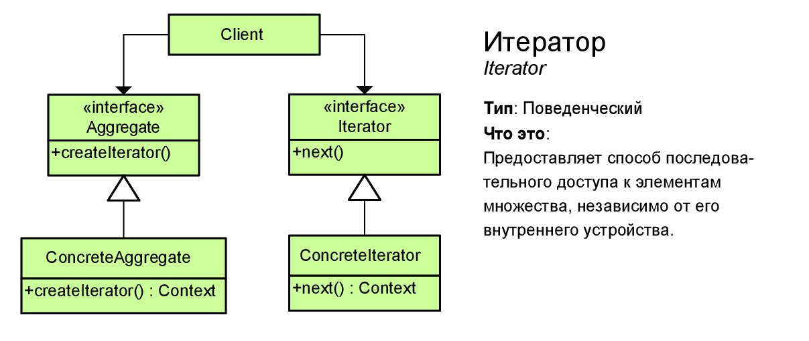
Iterator
Java 8 style:
Use Stream Api

Slide 16
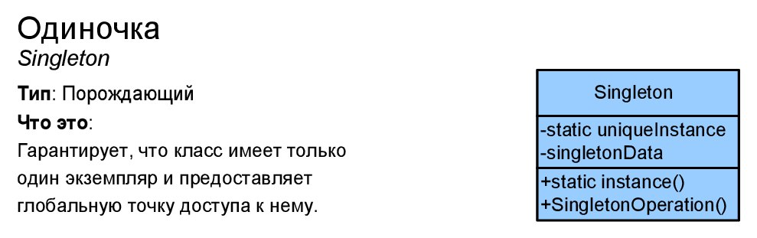
Singleton
Java 8 style:
Use container Api (Spring, JEE, etc). Refactor existing singletons

Slide 17
Resource management
Java 7 ARM
Around method pattern
try is not mandatory, easy to forget
AutoClosable interface – doesn’t insist on executing close method
private constructor – can’t get resource and never close it.

Slide 18
Optional Api
Wrong usage
Correct usage
Optionals
Optional<Integer> result; if(some.isPresent()) { result = Optional.of(some.get() + 1); } else { result = Optional.empty(); }
Optional<Integer> some = Optional.of(100);
Optional<Integer> result = some.map(i -> i + 1);
Do job
Unpack
Pack
Do job
Values

Slide 19
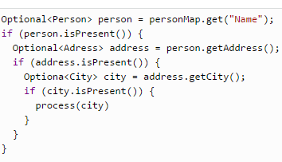
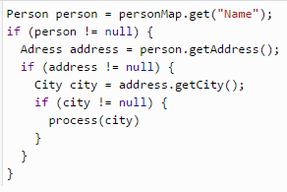
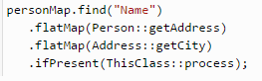
Pyramid of doom

Slide 20
Hollywood principle*: continuations
Caller will decide what to do
*Don’t call us, we will call you
Function<Money, String> party = money -> { if (money.isEnough()) { throw new IllegalStateException("No money!!"); } return "Nice party!!"; };
Function<Money, String> party = money -> { if (money.isEnough()) { problem.accept("No money!!!"); } return "Nice party!!"; };

Slide 21
Links
https://www.youtube.com/watch?v=hjmQWZTH2oQ
https://www.youtube.com/watch?v=e4MT_OguDKg
http://radar.oreilly.com/2014/12/using-the-command-pattern-with-lambda-expressions.html
http://shop.oreilly.com/product/0636920030713.do
http://www.grahamlea.com/2014/07/lambda-design-patterns-java-8/
https://vimeo.com/113588389

Slide 22
Questions

