Slide 1
Design patterns in light of Java 8 & Lambdas
Vitalii Zelinskyi

Slide 2
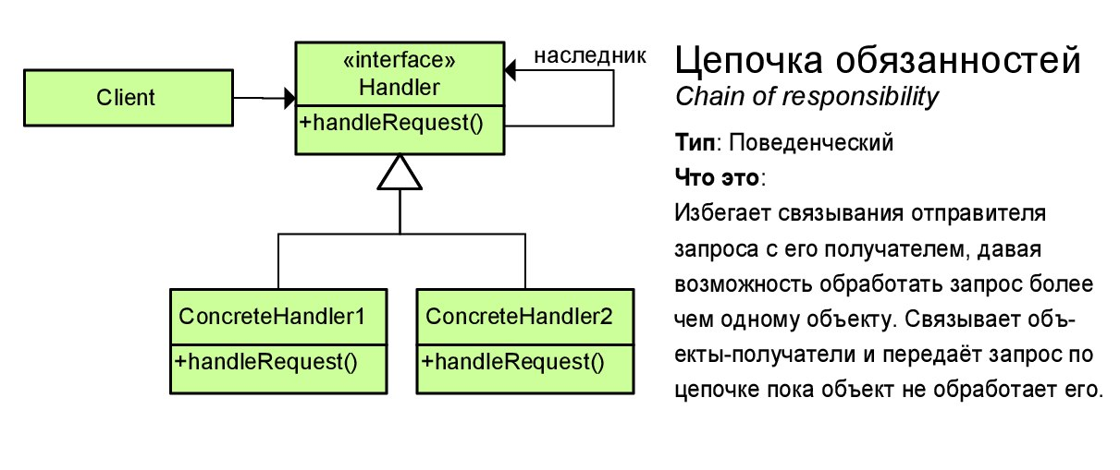

Chain of responsibility
Java 8 style:
A lambda that may or may not delegate to another lambda, which may or may not delegate to another lambda, ad infinitum.

Slide 3
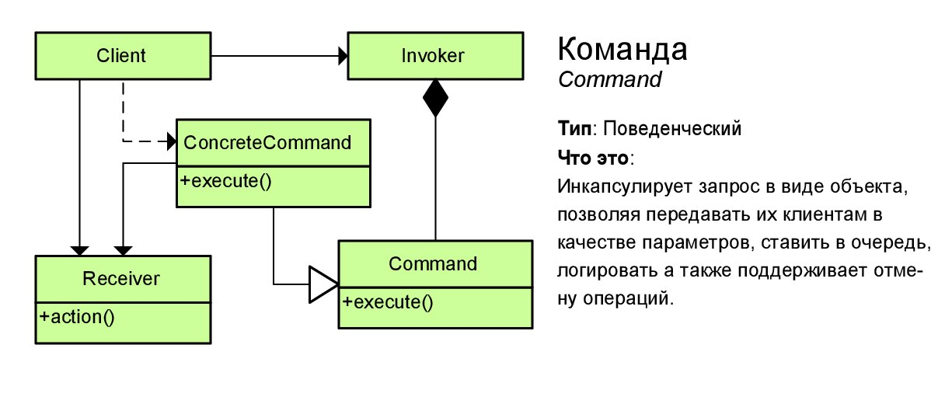
Command
Java 8 style:
Otherwise known as: a lambda!

Slide 4
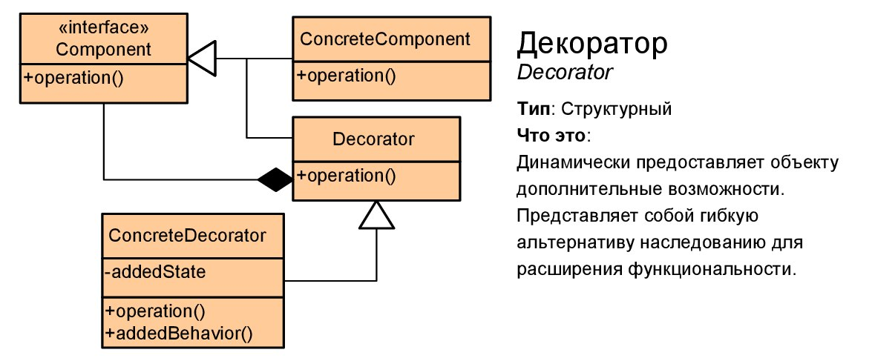
Decorator
Java 8 style:
A lambda that calls another lambda with the same signature but changes the arguments on the way in, or the result on the way out, or performs some extra action.

Slide 5
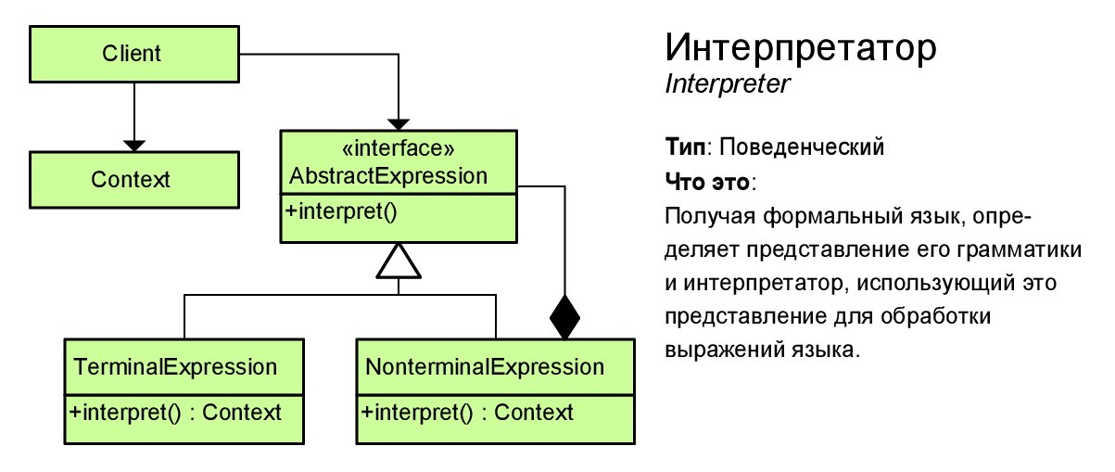
Interpreter
Java 8 style:
Use map of lambdas

Slide 6
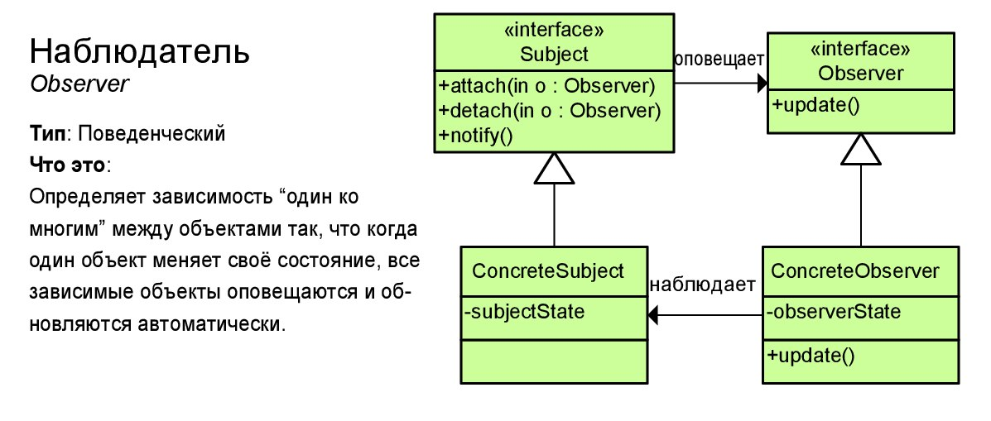
Observer
Java 8 style:
Give some other object a lambda to call when something happens in the future.

Slide 7
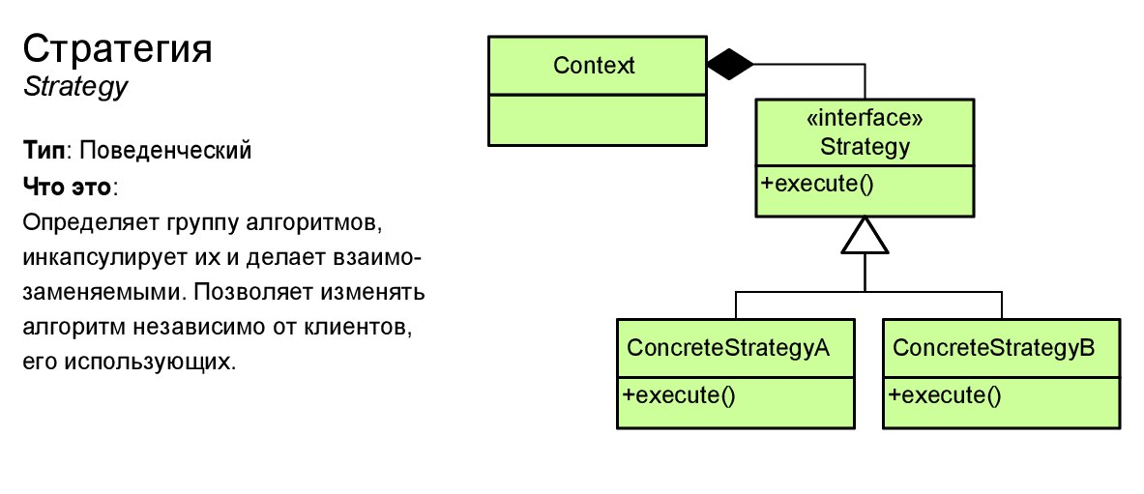
Strategy
Java 8 style:
Choose from a family of lambdas with identical signatures at runtime.

Slide 8
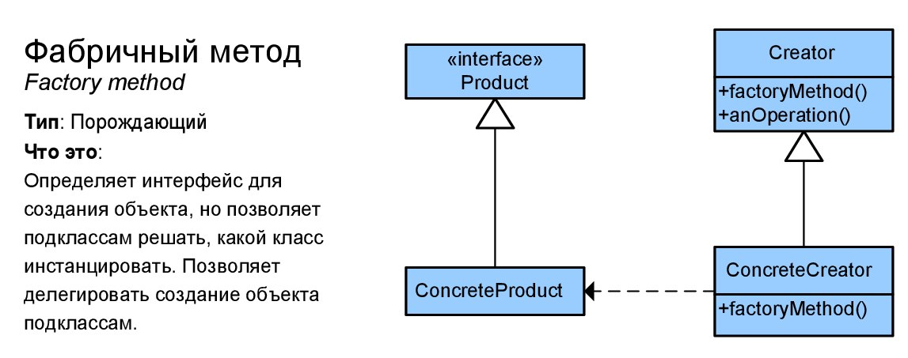
Factory method
Java 8 style:
A lambda that conforms to some interface and returns a new object

Slide 9
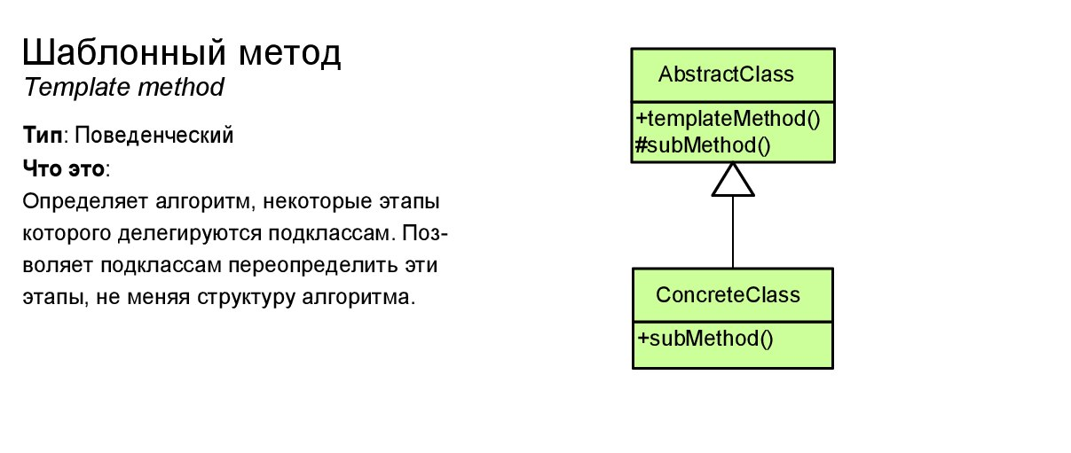
Template method
Java 8 style:
Replace the abstract method polymorphism with composition, passing lambdas into the constructor.

Slide 10
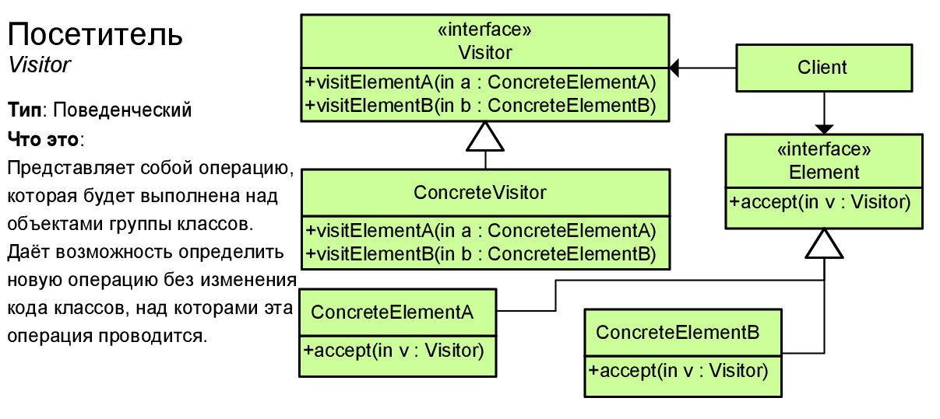
Visitor
Java 8 style:
Use map of lambdas for Visitors

Slide 11
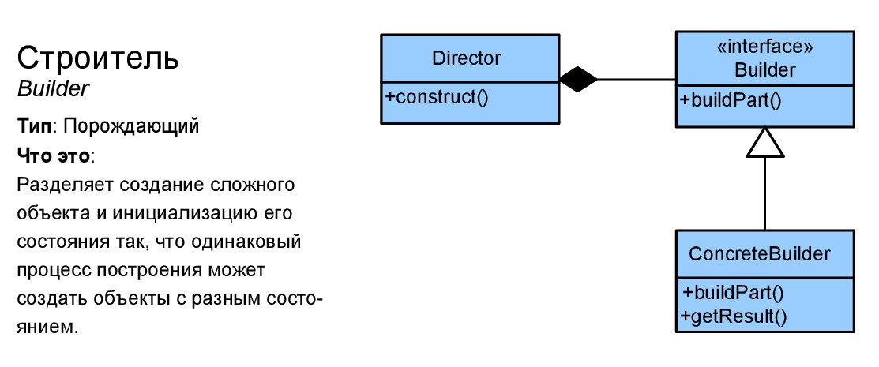
Builder
Java 8 style:
Delegate building into function

Slide 12
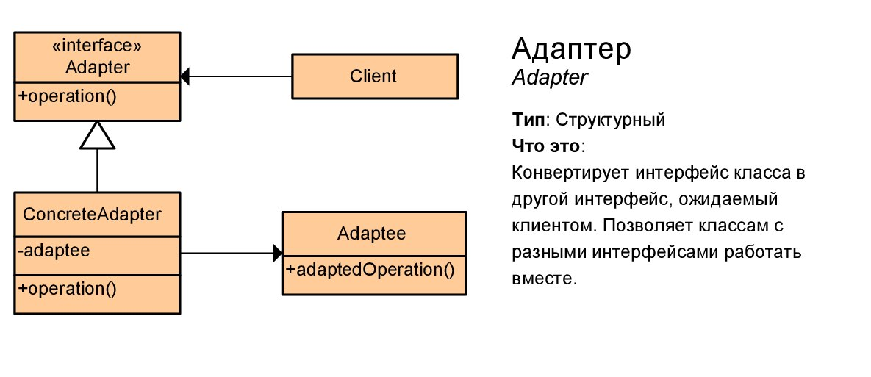
Adapter
Java 8 style:
A lambda that calls a function with a different signature on some other object.

Slide 13
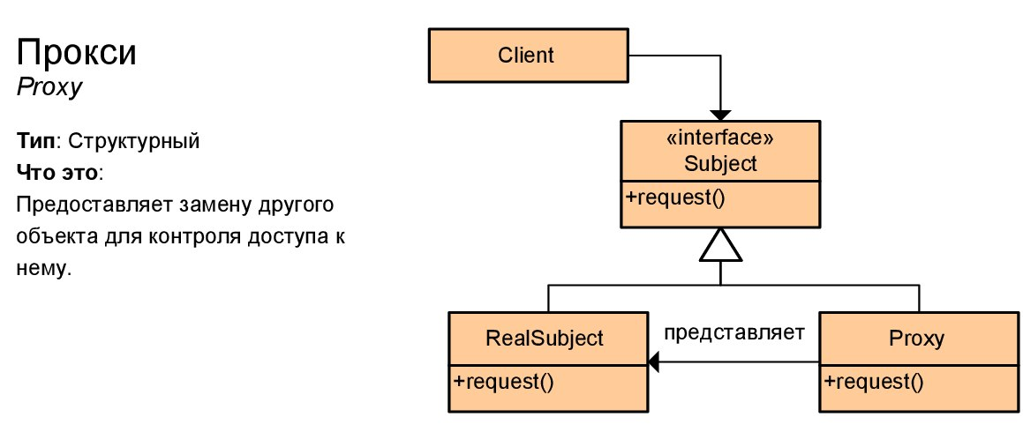

Proxy
Java 8 style:
Don’t create proxy manually, use framework capabilities (AOP)

Slide 14
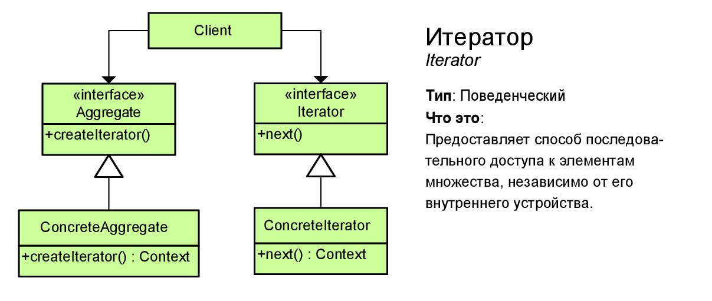
Iterator
Java 8 style:
Use Stream Api

Slide 15
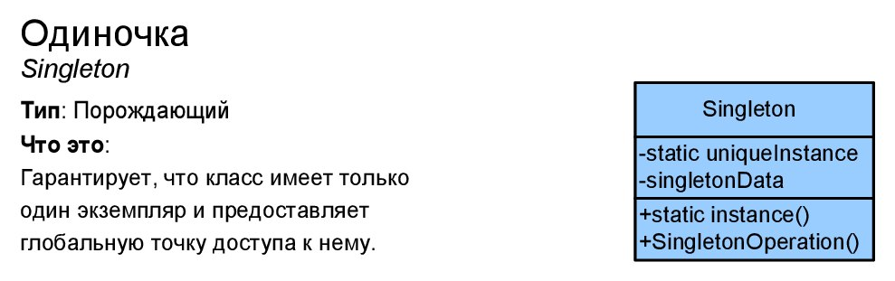
Singleton
Java 8 style:
Use container Api (Spring, JEE, etc). Refactor existing singletons

Slide 16
Resource management
Java 7 ARM
Around method pattern
try is not mandatory, easy to forget
AutoClosable interface – doesn’t insist on executing close method
private constructor – can’t get resource and never close it.

Slide 17
Links
https://www.youtube.com/watch?v=hjmQWZTH2oQ
https://www.youtube.com/watch?v=e4MT_OguDKg
http://radar.oreilly.com/2014/12/using-the-command-pattern-with-lambda-expressions.html
http://shop.oreilly.com/product/0636920030713.do
http://www.grahamlea.com/2014/07/lambda-design-patterns-java-8/

Slide 18
Questions

