Slide 1
Full Stack Development at QUBEE
Zellur Rahman
141014040
Supervised By
Md. Anowarul Abedin
Senior Lecturer
Department of CSE
University of Liberal Arts Bangladesh(ULAB)

Slide 2
Content
Introduction
About QUBEE.
Technologies of QUBEE.
Interview.
Work Schedule
Web development work.
Work on Progress.
Future Task.

Slide 3
Introduction
How I work ->Full time(9Am-5Pm).
How we communicate(skype).
QUBEE IT Team.

Slide 4

About QUBEE
Augere Wireless Broadband Bangladesh Limited is engaged in the business of providing high speed broadband wireless access and related services in Bangladesh under the name and style of QUBEE.

Slide 5
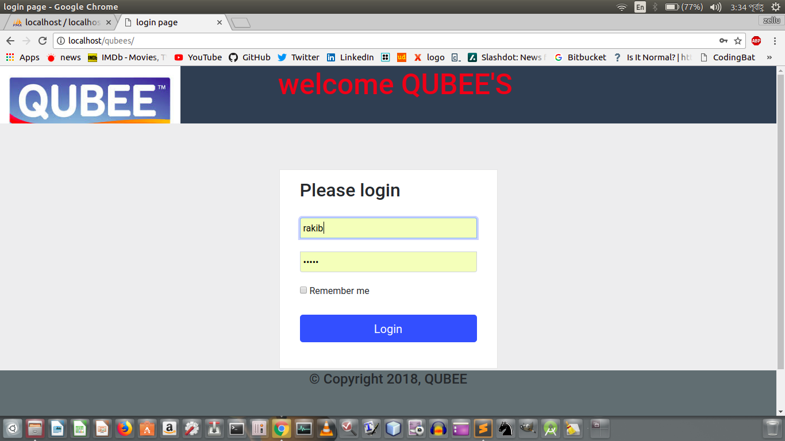
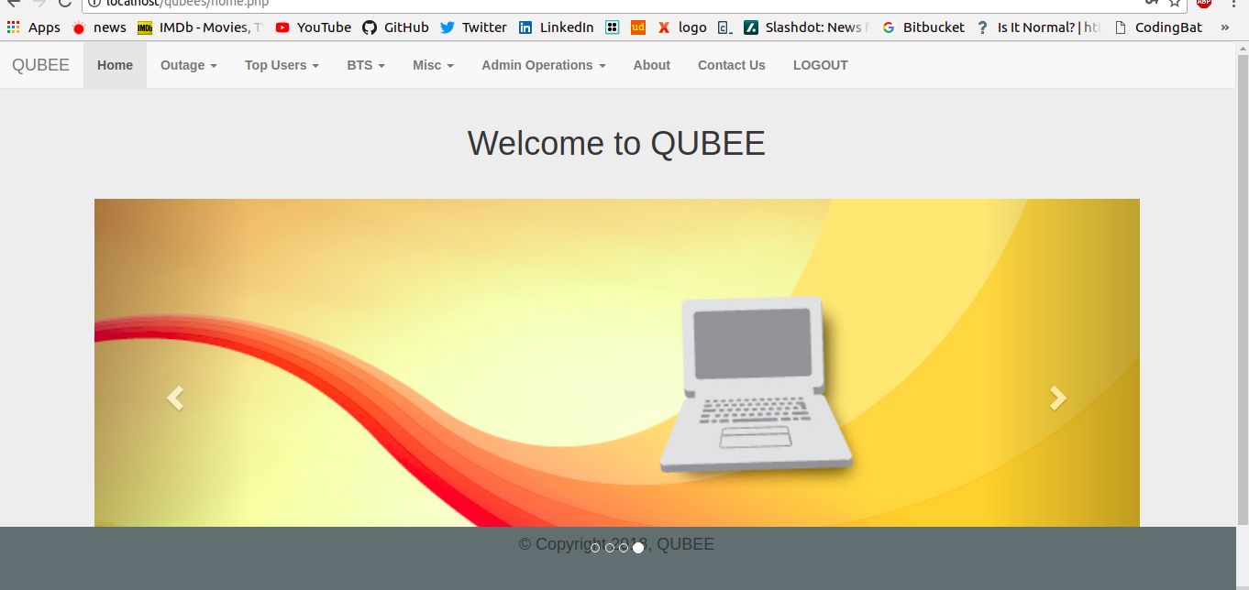
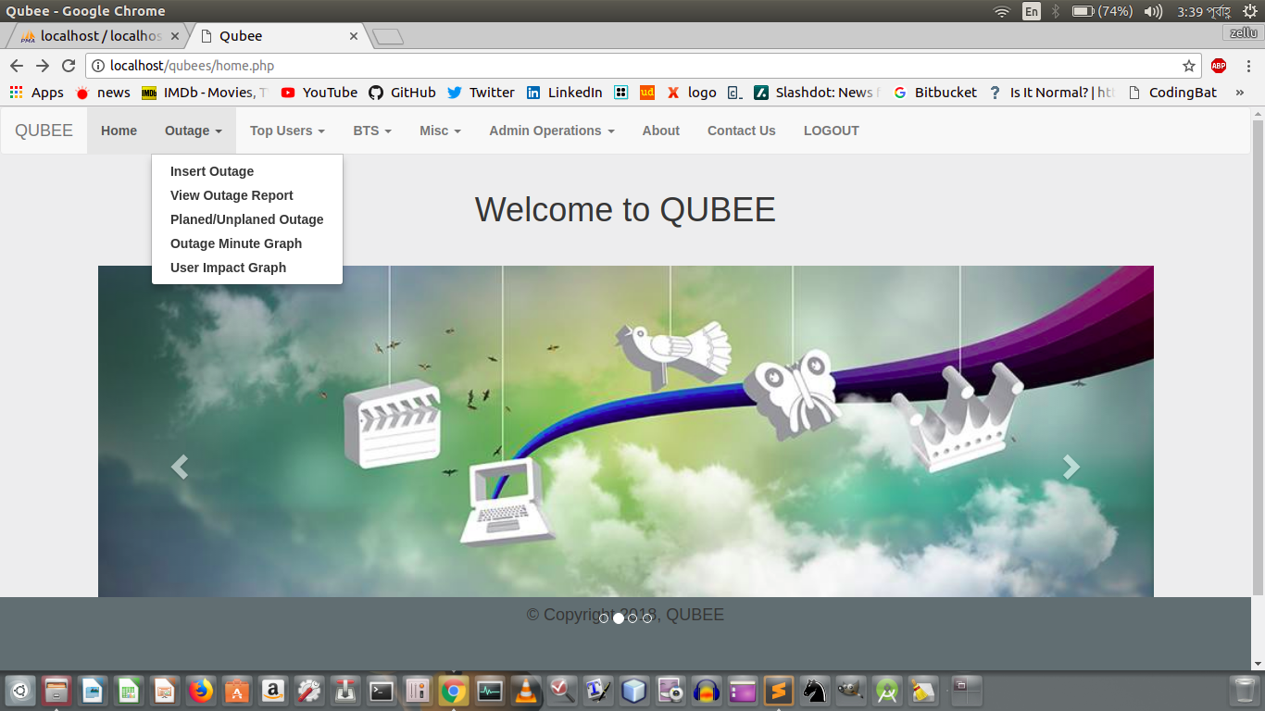
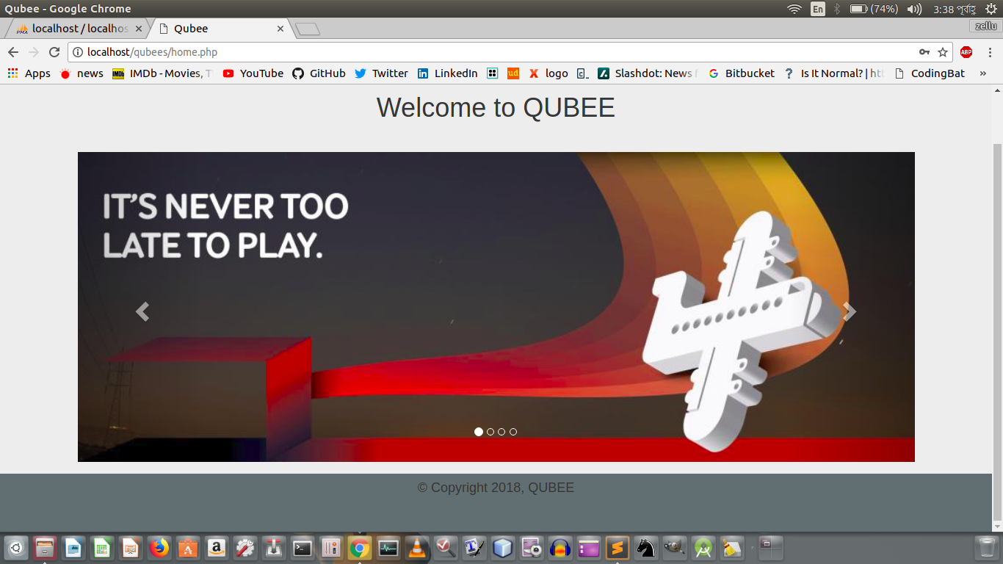
QUBEE WEB:

Slide 6
Technologies of QUBEE
PHP
Bootstrap 3 (for Responsiveness website)
HTML, CSS, JAVASCRIPT
Jquery.
Saas(tool)

Slide 7
Interview Task.
Landing page User Login and Registration
Using PHP
Using Session.
Securing Site.

Slide 8
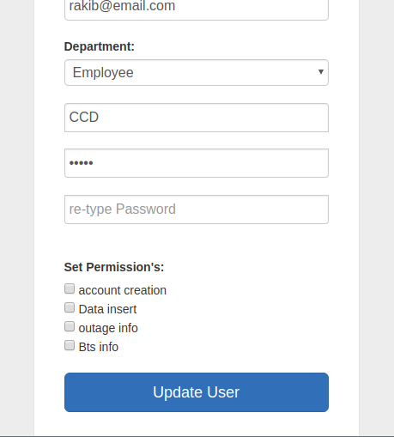
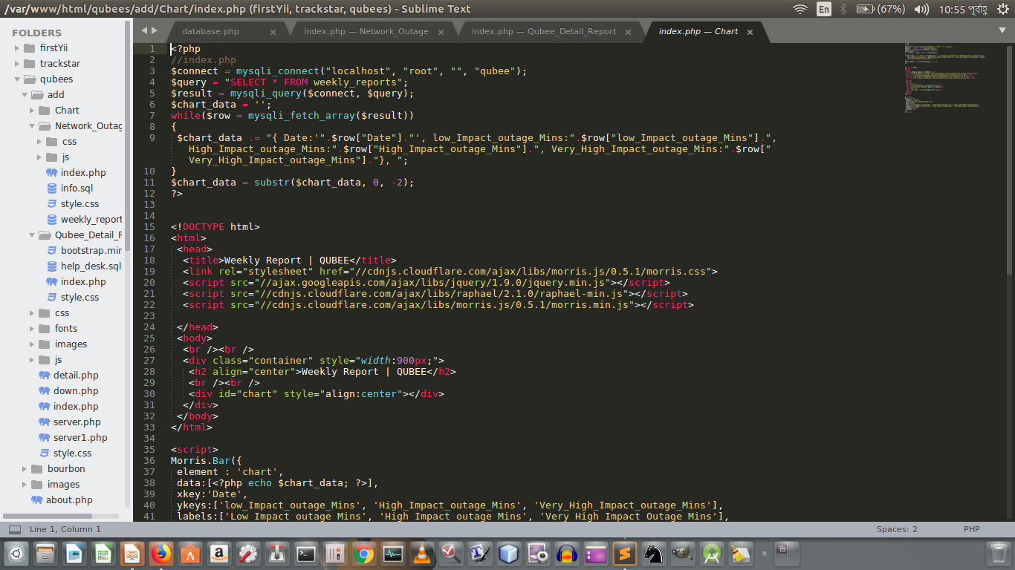
Development Tools

Slide 9
Work On:
Front-end Work (Html ,Css ,javascript, jquery)
Backend (PHP)
Yii(MVC Php)→currently working.

Slide 10
Developing QUBEE Web
Creating Template for end user.

Slide 11
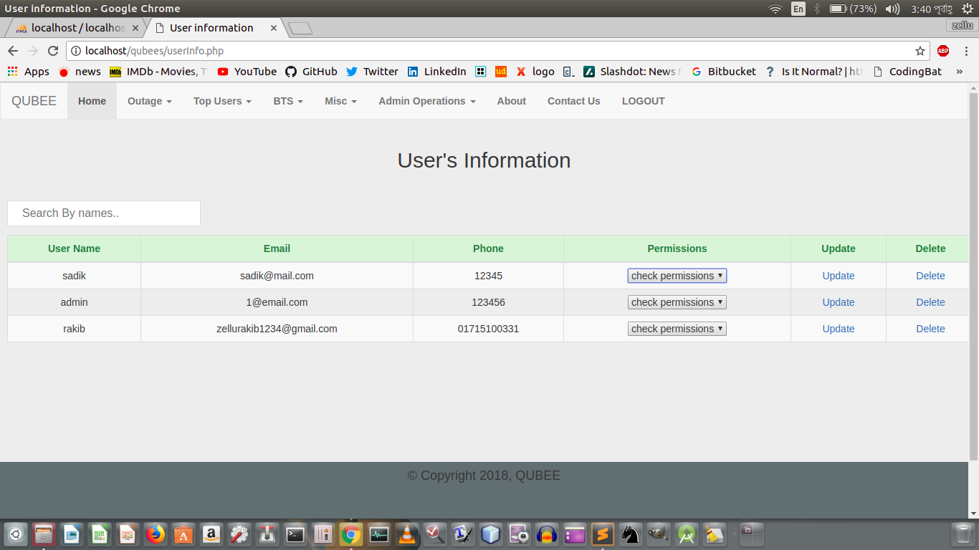
Developing QUBEE WEB
Create the role based authentication,

Slide 12
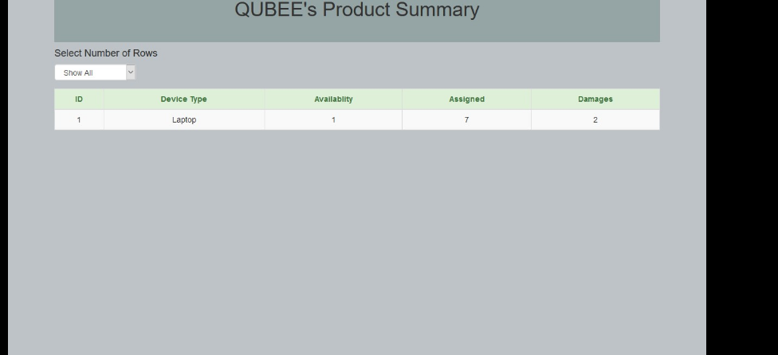
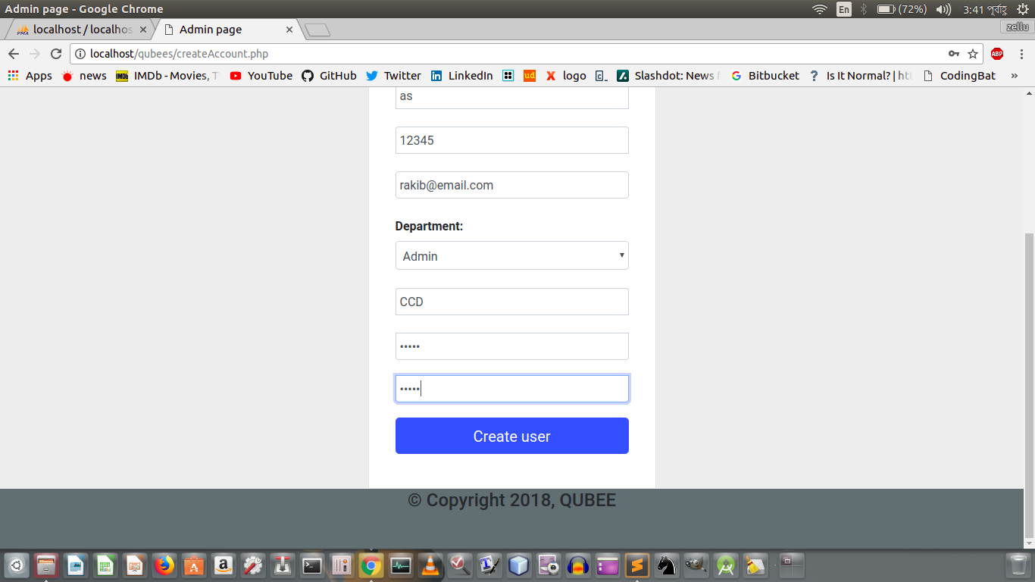
Developing QUBEE WEB

Slide 13
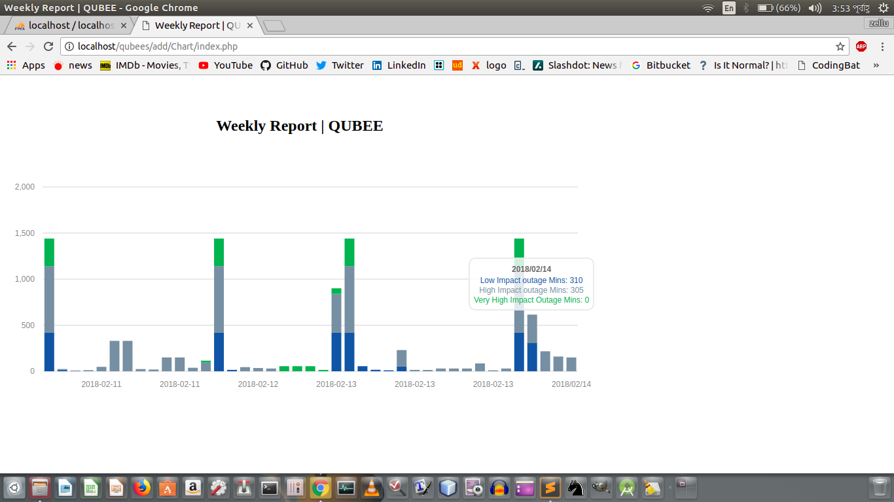
Developing QUBEE WEB:

Slide 14
Developing QUBEE WEB:

Slide 15
Requirement For this web:
I have to make the template for this site.
I have create the Role Based Authentication System.
Generating Graph from report.
When a user try to register the register form should be validate that time.

Slide 16

Future Task.
Work in Yii(php Framework)
Work in Spring (Java Framerwork)

Slide 17
To be continue for final defence….
Thank You.

