Slide 1
Executive Inflection Intelligence
Predictive functional inflection modeling for executive operators
Goal: ramp to $100k+ income fast via high-ARPU founding cohort
Built by operators; delivered as weekly intelligence, not a job board

Slide 2
Why Now
Executives don’t need more job posts—they need earlier signals
Most ‘best-fit’ roles appear after inflection begins (too late)
We surface companies before roles are posted (30/60/90 days)

Slide 3
Who It’s For (v1)
CS/CX leaders, RevOps leaders, GTM operators targeting Seed–Series A
Builder/journeyman preference: 0→1, high agency roles
High-signal search beats high-volume applying

Slide 4
What We Deliver
Weekly Inflection Radar (Top 25–50) + ‘Why now’ narrative
30/60/90-day role-likelihood scores + reason codes
Watchlist + change alerts
Outreach angles + context pack

Slide 5
How It Works (Signals)
Funding recency + stage
Headcount velocity (overall + sales ramp)
Leadership gaps (no CS/RevOps leader)
Enterprise cues (pricing/security pages)
Customer proof velocity (logos/case studies)

Slide 6
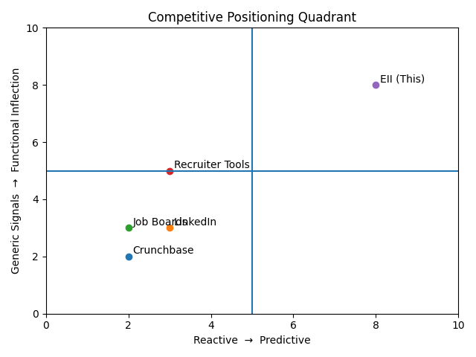
Competitive Positioning

Slide 7
Why This Is Unique
Lens-driven: encodes operator philosophy + disqualifiers
Predictive: focuses on what the company will need next
Reason-coded: explains ‘why now’ for trust
Outcome loop: calibrates based on observed hires/postings
Operator credibility enables premium pricing + fast outbound

Slide 8
Business Model
Founding Cohort: $99–$149/mo (target $125), locked 12 months
Standard plan later: $149–$199/mo (alerts + outreach pack)
Optional concierge add-on: $300–$600/mo (limited)
Key margin lever: dedup/caching to reduce enrichment cost

Slide 9
30/60/90/120 Day Plan
0–30
Pre-sell
25–40 members
First report
31–60
Retention
75–100 members
Weekly cadence
61–90
Automation
125–150 members
Outcome loop
91–120
2nd lens
150–200 members
Scale engine

Slide 10
KPIs (Early)
Acquisition: reply %, calls booked, close rate
Activation: report opens, watchlist engagement
Value: intros, interviews, conversations started
Retention: month-1 churn, month-2 retention

Slide 11
Risks and Mitigations
Churn: make wins visible + tighten report quality
Data fragility: rely on public/first-party sources; cache/dedup
No audience: outbound + referrals + weekly public memos
Overbuild: keep v1 manual; automate after retention

Slide 12
Path to Exit (Optional)
Design for acquirability: clean data model, outcome dataset, multi-lens expansion
Target 3–6x ARR with strong retention + growth
Likely buyers: recruiting platforms, exec search, career intelligence tools

