Slide 1
Solving the problem of antibody grouping based on cross-inhibition index using hierarchical clustering methods
Oleksandr Zelinskyiª, Vitaliy Horlatchª, Yuri Lebedin^{b} , Yaryna Paslavskaª
Ivan Franko National University of Lviv, 1 Universytetska St., Lviv, 79000, Ukraine
Xema OY, Myllymäenkatu 21, Lappeenranta, 53550, Finland

Slide 2
Antibodies binding model
A
A
SARS-CoV-2

Slide 3
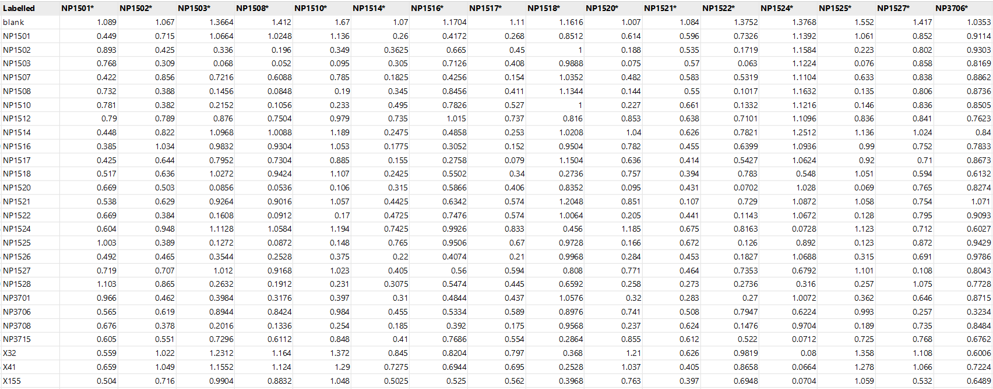
Row data

Slide 4

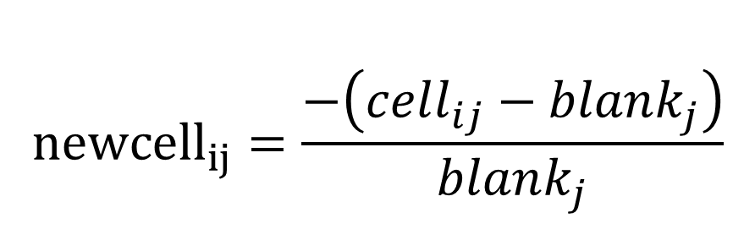
Data preparation
$${newcell}_{ij}=\frac{−\left(cell_{ij}−blank_{j}\right)}{blank_{j}}$$
$${0<newcell}_{ij}<1$$

Slide 5
Main goal
Divide the antibody cross-inhibition matrix into groups based on the similarity of the previously created binding index to facilitate the identification of optimal pairs and approximate localization of the binding site

Slide 6
Expected result
1A | 1B | 1B/2 | 2 | 2B/3 | 3A | 3B | 4A | 4B | 4C | 5
NP1501 | X190 | NP1512 | NP1502 | NP1528 | X202 | X32 | NP3706 | X211 | X215 | X220
NP1514 | NP1526 | NP1521 | NP1503 |  | X218 | X41 |  |  |  | X275
NP1516 | X200 |  | NP1508 |  | NP1518 | X155
NP1517 | X201 |  | NP1510 |  | NP1527 | X212
NP1507 |  |  | NP1520 |  |  | X213
 |  |  | NP1522 |  |  | X217
 |  |  | NP1525 |  |  | X223
 |  |  | X221 |  |  | X224
 |  |  | X271 |  |  | X233
 |  |  | NP3701 |  |  | NP1524
 |  |  | NP3708 |  |  | NP3715

Slide 7
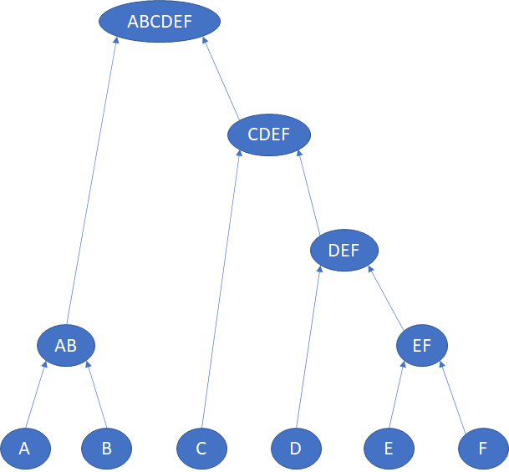
Hierarchical clustering

Slide 8
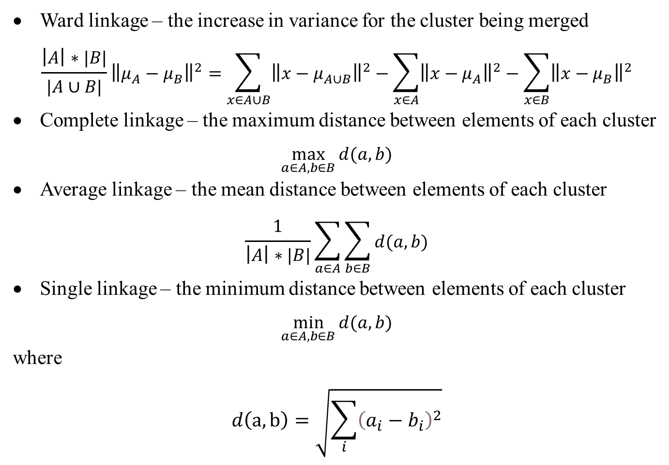
Linkage methods
Ward linkage – the increase in variance for the cluster being merged
$$\frac{\left|A\right|∗|B|}{|A∪B|}{\left\|μ_{A}−μ_{B}\right\|}^{2}=\sum_{x∈A∪B}{{\left\|x−μ_{A∪B}\right\|}^{2}}−\sum_{x∈A}{{\left\|x−μ_{A}\right\|}^{2}}−\sum_{x∈B}{{\left\|x−μ_{B}\right\|}^{2}}$$
Complete linkage – the maximum distance between elements of each cluster
$$\max_{a∈A,b∈B}{d(a,b)}$$
Average linkage – the mean distance between elements of each cluster
$$\frac{1}{\left|A\right|∗|B|}\sum_{a∈A}{\sum_{b∈B}{d(a,b)}}$$
Single linkage – the minimum distance between elements of each cluster
$$\min_{a∈A,b∈B}{d(a,b)}$$
where
$$d\left(a,b\right)=\sqrt{\sum_{i}{{\left(a_{i}−b_{i}\right)}^{2}}}$$

Slide 9
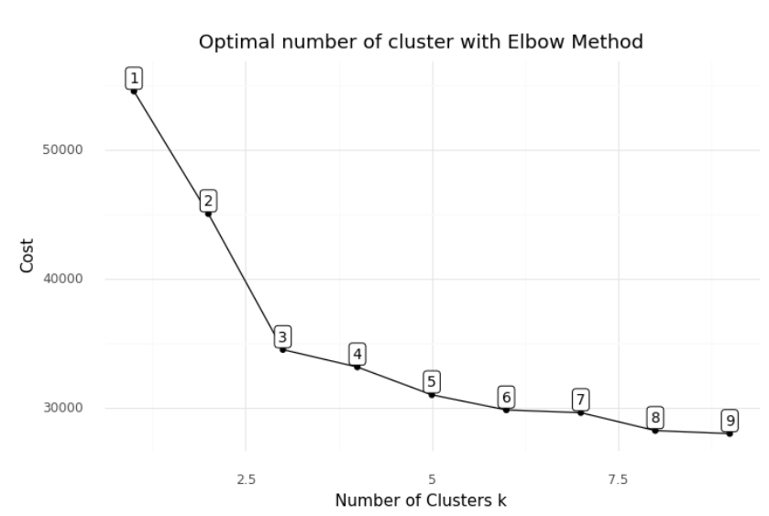
Elbow method

Slide 10
Ward linkage result
1 | 2 | 3 | 4 | 5 | 6 | 7
X41 | NP1521 | X200 | X202 | NP1528 | NP1527 | NP1517
X32 | X275 | X190 | NP1518 |  | X211 | NP1514
X233 | X215 | X221 | X218 |  | NP3706 | NP1516
X224 | NP1512 | X201 |  |  |  | NP1507
X223 | X220 | X271 |  |  |  | NP1501
X217 |  | NP3708
X213 |  | NP3701
X212 |  | NP1526
X155 |  | NP1525
NP3715 |  | NP1522
NP1524 |  | NP1520
 |  | NP1502
 |  | NP1503
 |  | NP1510
 |  | NP1508

Slide 11
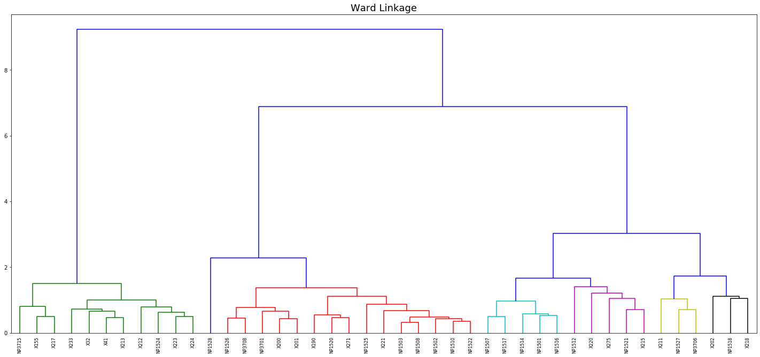
Ward linkage result

Slide 12
Complete linkage result
1 | 2 | 3 | 4 | 5 | 6 | 7 | 8 | 9
X275 | X221 | X211 | NP1507 | X202 | X213 | NP1521 | NP1528 | X217
NP1512 | X201 | NP1527 | NP1501 | NP1518 | X32 | X215 |  | X155
 | X200 | NP3706 | NP1516 | X218 | X41 | X220 |  | NP3715
 | X190 |  | NP1517 |  | X233
 | X271 |  | NP1514 |  | X224
 | NP3701 |  |  |  | NP1524
 | NP1526 |  |  |  | X212
 | NP1525 |  |  |  | X223
 | NP1522
 | NP3708
 | NP1502
 | NP1503
 | NP1520
 | NP1508
 | NP1510

Slide 13
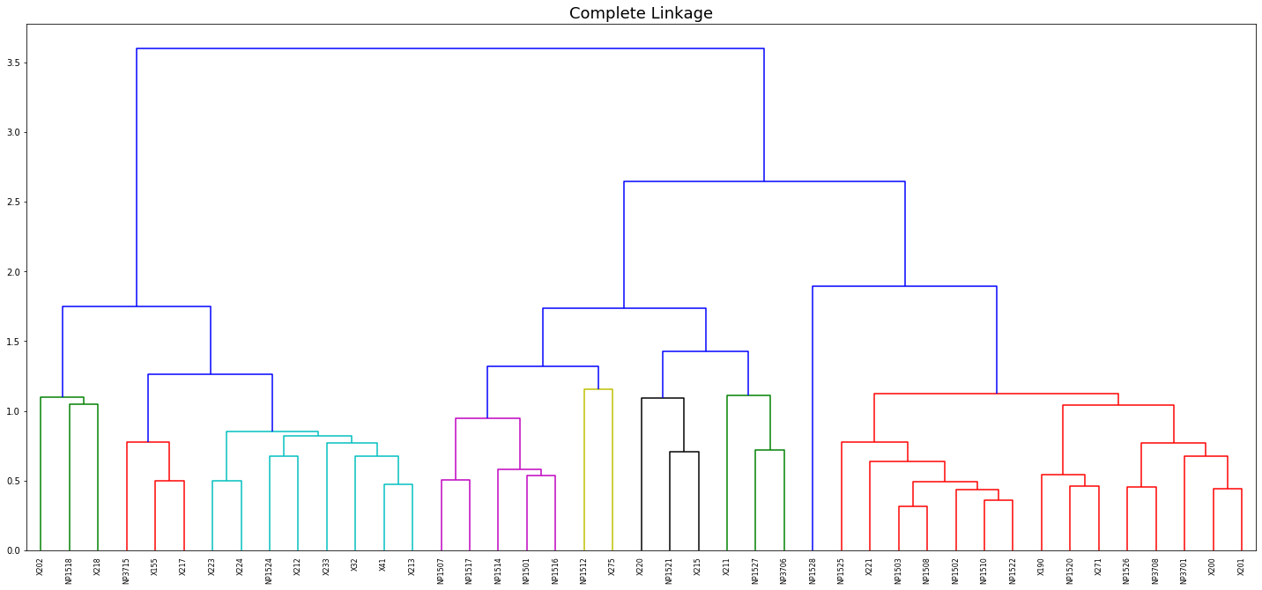
Complete linkage result

Slide 14
Average linkage result
1 | 2 | 3 | 4 | 5 | 6 | 7 | 8 | 9 | 10 | 11
X275 | NP3715 | X211 | X220 | NP1501 | NP1502 | NP1512 | NP1528 | X202 | NP1518 | X218
NP1521 | NP1524 | NP3706 |  | NP1517 | NP1503
X215 | X32 | NP1527 |  | NP1507 | X221
 | X41 |  |  | NP1514 | NP1508
 | X155 |  |  | NP1516 | NP1510
 | X212 |  |  |  | NP3701
 | X213 |  |  |  | X200
 | X217 |  |  |  | X190
 | X223 |  |  |  | NP1520
 | X224 |  |  |  | NP1522
 | X233 |  |  |  | NP1525
 |  |  |  |  | X271
 |  |  |  |  | NP1526
 |  |  |  |  | X201
 |  |  |  |  | NP3708

Slide 15
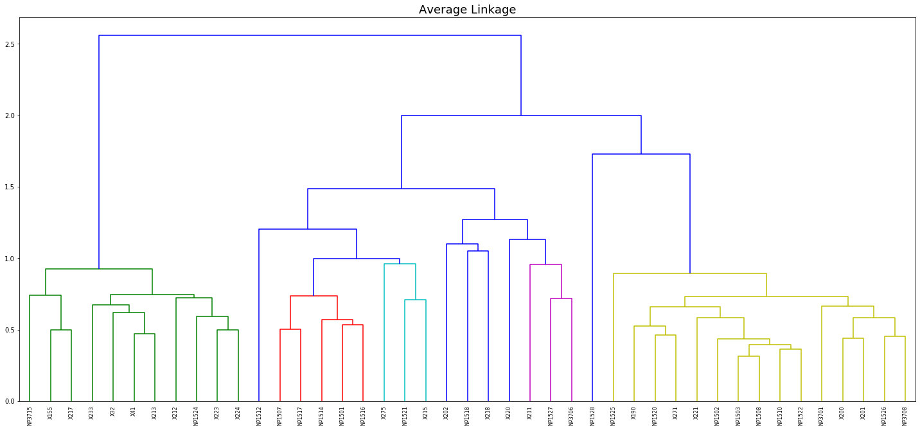
Average linkage result

Slide 16
Single linkage result
1 | 2 | 3 | 4 | 5 | 6 | 7 | 8 | 9 | 10 | 11 | 12 | 13
NP1527 | X213 | NP1517 | X201 | NP1521 | X220 | X218 | NP1518 | NP1528 | X202 | X275 | NP1512 | X211
NP3706 | X32 | NP1514 | X200 | X215
 | X41 | NP1507 | X221
 | X155 | NP1516 | X190
 | NP1524 | NP1501 | NP3708
 | X212 |  | NP3701
 | NP3715 |  | NP1502
 | X217 |  | NP1526
 | X223 |  | NP1525
 | X224 |  | NP1522
 | X233 |  | NP1503
 |  |  | NP1508
 |  |  | NP1520
 |  |  | X271

Slide 17
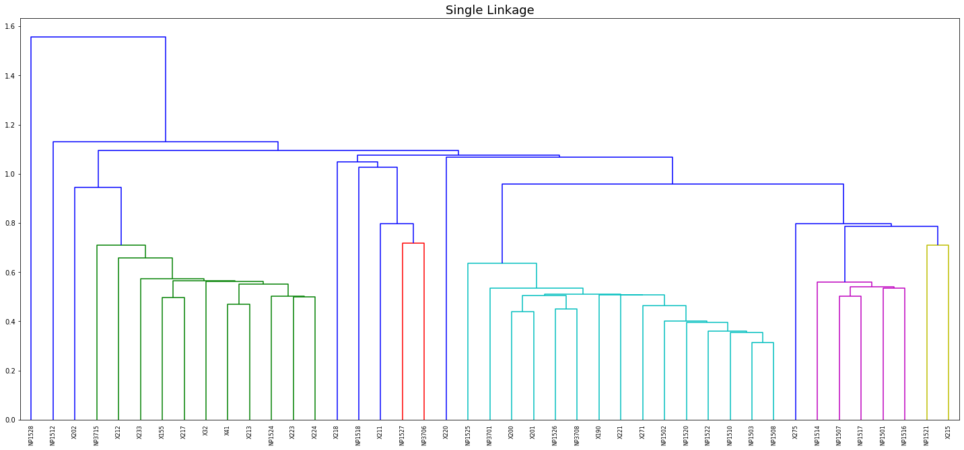
Single linkage result

Slide 18
Thank you
for your
attention!

