Slide 1
Welcome to the wonders
You will see that this one can give you another view of the world. Just think about scenes around you and compare them with these ones.

Slide 2
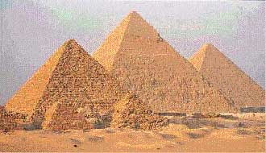
The Pyramids of Egypt
Built at Giza during the 4th Dynasty (circa 2680-c.2544 BC) are the oldest of the seven wonders and the only ones remaining intact today. The great pyramids of Egypt still stand. They were built between 2650 and 2500 BC.
Except for parts of the Mausoleum and of the temple of Artemis, they are the only one of the seven ancient wonders still standing. Of the seven wonders of the ancient world, only the pyramids of Egypt have survived in a form that resembles their original condition.
The largest of the three, known as the Great Pyramid of Khufu, was made of approximately 2.3 million blocks of stone each weighing an average of 2.5 tons.Located in Giza on the west bank of the Nile River, near Cairo, the pyramids remain one of the engineering marvels of all time.

Slide 3
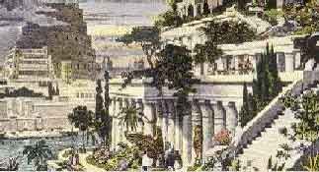
The Hanging Gardens of Babylon
The walls of Babylon were often included with the Hanging Gardens among the wonders of Babylon. Built by Nebuchadnezzar, they were faced with glazed tile and pierced by openings fitted with magnificent brass gates. {According to tradition, the homesickness of a favorite wife prompted Nebuchadnezzar, king of Babylon, to build the famous Hanging Gardens. Nothing remains of these luxuriant terraces.
Great terraces of masonry were built one on top of the other. On these were planted gardens of tropical flowers and trees and avenues of palms. They were irrigated by water pumped from the Euphrates River. Nebuchadnezzar and his queen could sit in the shade and lookdown upon the beauties of the city.
Perhaps built by King Nebuchadnezzar II about 600 BC, were a mountain like series of planted terraces. The Hanging Gardens of Babylon have long since disappeared. They were said to have been built by King Nebuchadnezzarin the 6th century BC to please and console his favorite wife, Amytis.

Slide 4
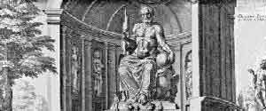
Statue of Zeus
The 12-m (40-ft) (mid-5th century BC) by the Greek sculptor Phidias was the central feature of the Temple of Zeus at Olympia, Greece.
The statue of Olympian Zeus was erected at Olympia, in the Peloponnesus of Greece, bythe great sculptor Phidias in the 5th century BC. It was a towering structure of ivory and gold, 40 feet high, majestic and beautiful. After about 10 centuries of existence the statue was destroyed.
Our only idea of it is gained from coins of Elis, which are thought to bear copies of the original. The ivory and gold statue of the Olympian Zeus was perhaps the greatest masterpiece of the sculptor Phidias.It stood in a shrine on the Olympian plain until the early Middle Ages.

Slide 5
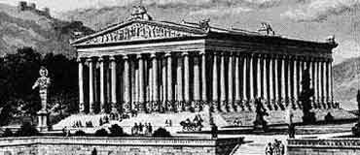
The Temple of Artemis
The early settlers found the Asian inhabitants worshiping a many-breasted nature goddess whom they identified with their Artemis (called Diana by the Romans). They raised a shrine to her, which was rebuilt and enlarged from time to time.
The fourth temple was the one regarded as the wonder of the world. Dedicated about 430 BC, it is said to have been built by contributions from all the great cities of Asia and to have taken 120years to complete.
This great temple was set on fire in 356 BC on the night Alexander the Great was born, according to tradition. The crime was committed by one Herostratusmerely that his name might be remembered in after ages. Very little of the temple of Artemis (Diana) at Ephesus remains today. The drawing shows the huge temple as it probably looked in the 4th century BC.
At Ephesus in Greece (356 BC), which combined great size with elaborate ornamentation, was destroyed by the Goths in AD 262. Greek colonists at Ephesus, in Asia Minor, built the famous temple of Artemis.

Slide 6
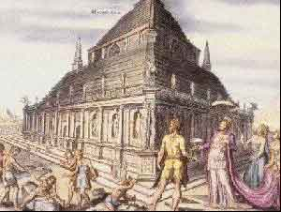
The Mausoleum of Halicarnassus
At the apex stood a four-horse chariot in which were statues of the king and queen.So famous was this structure that the word mausoleum came to be applied to any monumental tomb. Some relics of the original Mausoleum are presser ved in the British Museum. Only crumbling fragments remain of the Mausoleum at Halicarnassus on the coast of Asia Minor. It was raised to the memory of King Mausolus of Caria by his devoted Queen, Artemisia.
(circa 353 BC) was a monumental marble tomb,decorated by the leading sculptor of the age, for King Mausolus of Caria in Asia Minor; only fragments remain. The Mausoleum at Halicarnassus, also in Asia Minor,derived its name from King Mausolus of Caria.
After his death in the middle of the 4th century BC, his queen, Artemisia, employed Greek architects to constructa superb monument over his remains. It was a great rectangular pile of masonry, surmounted by an Ionic colonnade s up porting a roof like pyramid.

Slide 7
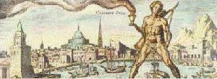
The Colossus of Rhodes
It was a 30-m (100-ft) bronze statue of the Greek sun god Helios, erected about 280 BC to guard the entrance to the harbor at Rhodes; it was destroyed about 55 years later. The Colossus of Rhodes was a great bronze statue, erected in about 280 BC by the citizens of Rhodes, capital of the Greek island of the same name. It represented their sun-god Helios and was said to be 105 feet high. According to legend, it straddled the harbor entrance, but it is more likely that it stood to one side.
The statue was overthrown by an earthquake in 224 BC butits huge fragments long were regarded with wonder. Nearly a thousand years later,in AD 656, a Muslim dealer bought the fragments as old metal and carried them away to be melted down. The old engraving of the Colossus of Rhodes is purely imaginary and is based on the legend that the statue stood astride the harbor entrance.

Slide 8
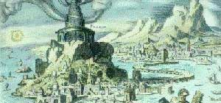
The Pharos of Alexandria
(circa 280 BC), located on an island in the harbor of Alexandria, Egypt, was a famous ancient lighthouse standing more than 134 m (440ft) tall; it was destroyed in the 14th century. The Pharos of Alexandria,in Egypt, was the fore runner of modern lighthouses. The name belonged originally to an island lying off the coast. When Alexander the Great laid out the city he connected the island of Pharos with the mainland by means of a mole, or cause way.
On the eastern point of the island his successors, Ptolemy I and Ptolemy II, erected a great light house made of white marble. It was this structure, said to have been 400 feet high, that came to be known as the Pharos of Alexandria. For more than 1,000years the light house known as Pharos of Alexandria guided Mediterranean ships to harbor. Built for Ptolemy II of Egypt in about 280 BC, the light house was severely damaged by an earthquake in AD 955 and disappeared completely by 1500.

