Slide 1
Operator Satisfiability under Commutation-Group Constraints
QuCSPs Workshop
6th July 2026
Jianwen Chen (University College London)

Slide 2
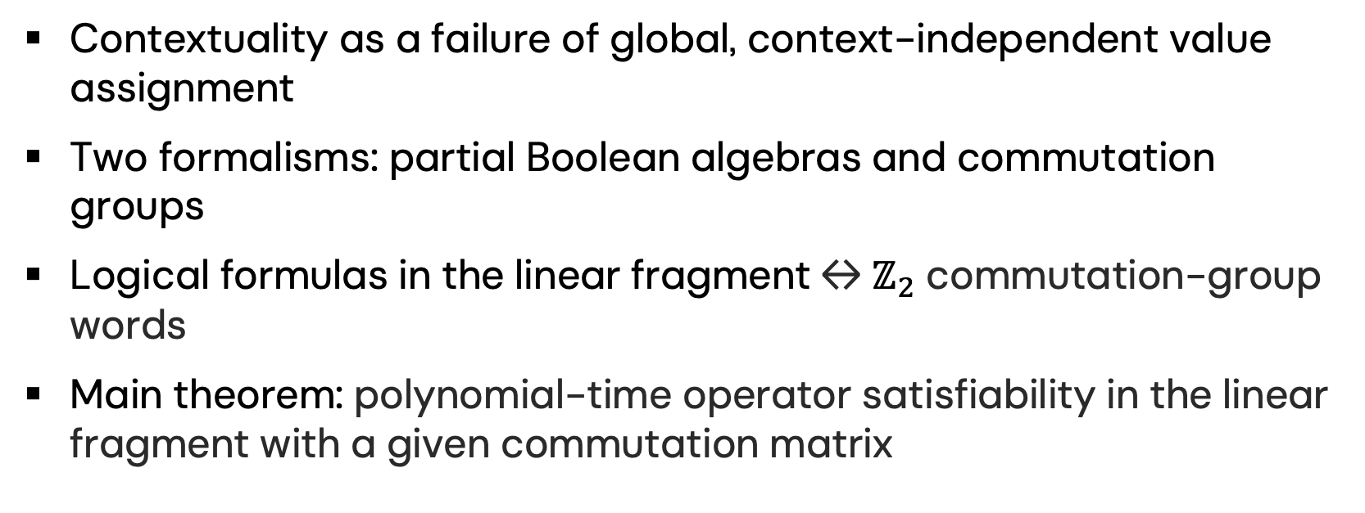
Outline
Contextuality as a failure of global, context-independent value assignment
Two formalisms: partial Boolean algebras and commutation groups
Logical formulas in the linear fragment ↔ $ℤ_{2}$ commutation-group words
Main theorem: polynomial-time operator satisfiability in the linear fragment with a given commutation matrix

Slide 3
Main Implications
Satisfiability gap: a formula may be classically unsatisfiable, but still satisfiable by quantum operators.
Polynomial-time result gives an efficient way to detect this gap in the linear fragment, once the commutation matrix is fixed.
Hardness of operator satisfiability:
Identifies a tractable island inside a very hard problem, where commutation data is enough to determine whether the required operator assignment exists.

Slide 4
Contextuality: the obstruction
Question: can every observable have a pre-existing value, independent of which compatible observables are measured with it?
Noncontextuality demands a single valuation v(A), compatible with all functional relations inside every context. Contextuality is the impossibility of such a valuation.
Context A
{A, B, C}
Observable A
same operator
Context B
{A, D, E}

Slide 5
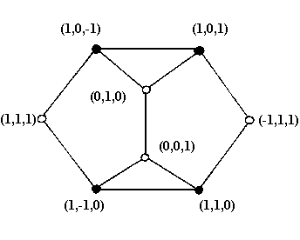
Kochen-Specker Arguments
Projectors represent propositions about measurement outcomes.
A context is a commuting family of projectors, typically forming a basis.
A classical valuation assigns 0/1 to projectors and preserves Boolean operations within each context.
KS configurations force contradictory constraints on these local Boolean choices.
8-point KS-Clifton graph with inconsistent colouring

Slide 6
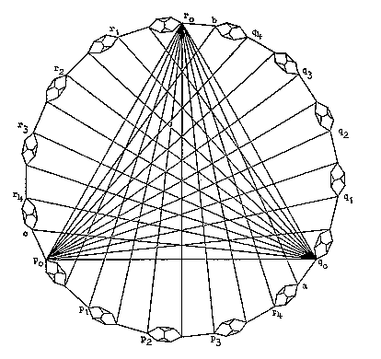
Kochen-Specker Arguments
We assume that an arbitrary point keeps its value 1 or 0 as we move from one orthogonal triple to the next.
Although the graph is constructible, it is not consistently colourable.

Slide 7
Peres-Mermin Square
Six commuting contexts: three rows and three columns.
Quantum mechanically, the row products are +I, but one column product is −I.
Z ⊗ I
I ⊗ Z
Z ⊗ Z
→ +I
I ⊗ X
X ⊗ I
X ⊗ X
→ +I
Z ⊗ X
X ⊗ Z
Y ⊗ Y
→ +I
↓ +I
↓ +I
↓ −I
Classically, multiplying all six constraints counts each observable twice, so the total product must be +1. The square demands −1.

Slide 8
Why Contextuality?
Computational resource:
(Google Quantum AI, 2025): Quantum contextuality enables certain tasks to be performed with success probabilities beyond classical limits.
(Khu et al., 2025): Contextuality is an intrinsic feature of important classes of fault-tolerant QEC codes and protocols.
Foundational question:
A contextual formalism may offer a more coherent conceptual foundation for quantum theory.

Slide 9
Requirements for Mathematical Formalisms
Begin from measurement contexts as the basic objects.
Avoid assuming globally defined classical values.
Capture how compatible measurements combine locally.
Explain contextuality as a structural feature arising from the formalism.
Build toward an operational reformulation of quantum theory.

Slide 10
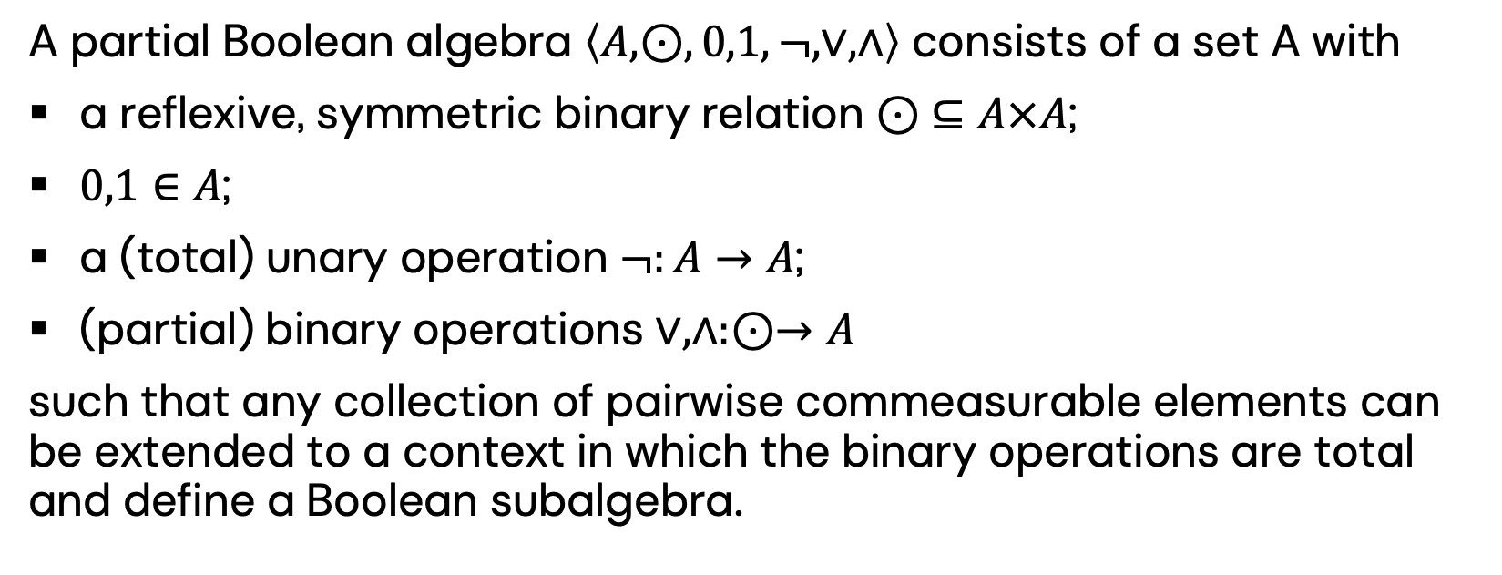
Partial Boolean Algebra
A partial Boolean algebra $\left\langle A,⊙,0,1,¬,∨,∧\right\rangle$ consists of a set A with
a reflexive, symmetric binary relation $⊙ ⊆A×A$;
$0,1∈A$;
a (total) unary operation $¬:A→A$;
(partial) binary operations $∨,∧:⊙→A$
such that any collection of pairwise commeasurable elements can be extended to a context in which the binary operations are total and define a Boolean subalgebra.

Slide 11
Partial Boolean Algebra
Boolean connectives are defined only on compatible projectors.
A formula is a logical paradox when every classical valuation fails, but an operator model exists to satisfy it, or conversely.
((a ↔ b) ↔ (c ↔ d)) ↔ ((a ↔ c) ↔ (b ↔ d))
a := X ⊗ I, b := I ⊗ X
c := I ⊗ Z, d := Z ⊗ I

Slide 12
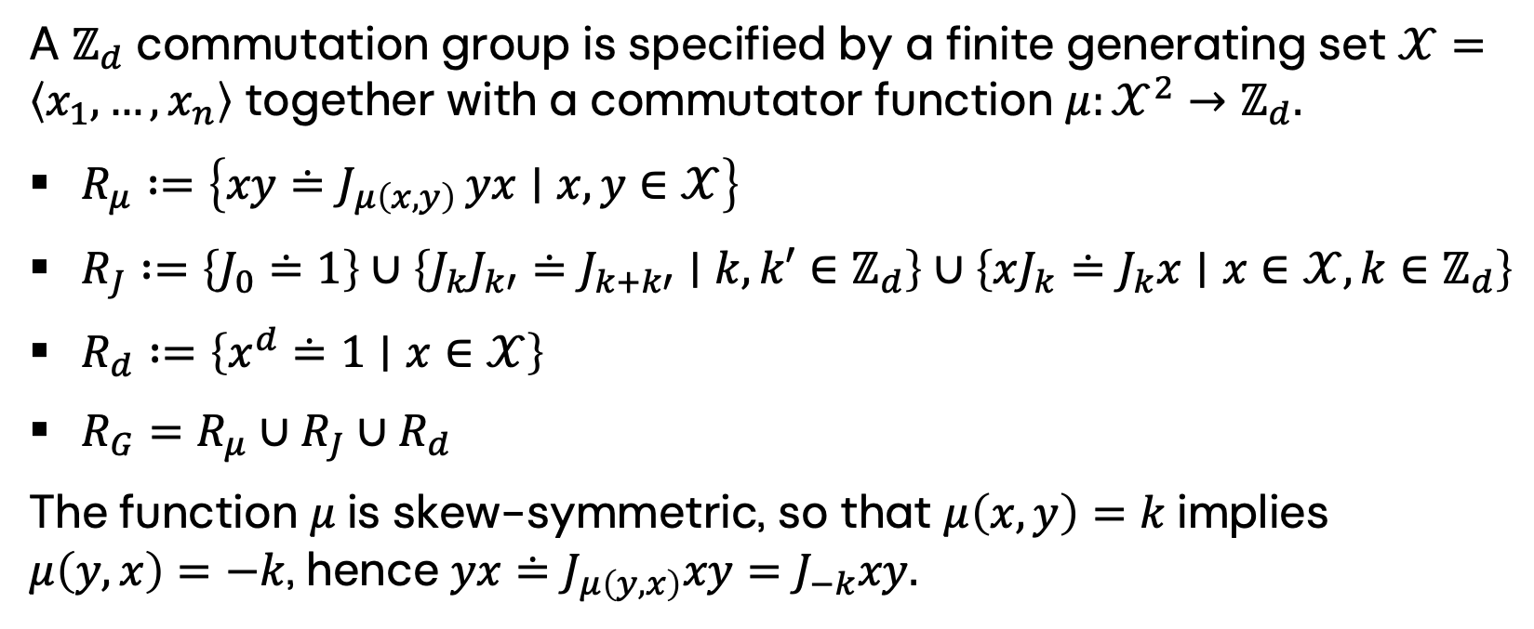
Commutation Groups
A $ℤ_{d}$ commutation group is specified by a finite generating set $𝒳=\left\langle x_{1},…,x_{n}\right\rangle$ together with a commutator function $μ:𝒳^{2}→ℤ_{d}.$
$R_{μ} :=\left\{xy≐J_{μ\left(x,y\right)} yx∣x,y∈𝒳\right\}$
$R_{J} :=\left\{J_{0}≐1\right\}∪\left\{J_{k}J_{k′}≐J_{k+k′}∣k,k′∈ℤ_{d}\right\}∪\left\{xJ_{k}≐J_{k}x∣x∈𝒳,k∈ℤ_{d}\right\}$
$R_{d} :=\left\{x^{d}≐1∣x∈𝒳\right\}$
$R_{G}=R_{μ}∪R_{J}∪R_{d}$
The function $μ$is skew-symmetric, so that $μ\left(x,y\right)=k$implies $μ\left(y,x\right)=−k$, hence $yx≐J_{μ\left(y,x\right)}xy=J_{−k}xy.$

Slide 13
Commutation Groups
Word w in generators
Each gᵢ occurs evenly
But w = J_{k}, k ≠ 0
Peres-Mermin square: (((ab)(cd))((ac)(bd)))
Classical valuation: gᵢ ↦ ±1. Even occurrence forces w ↦ +1, while w = J_{k} forces w ↦ −1.

Slide 14
Partial Commutative Algebra
Partial Boolean algebra struggle to describe cases where contextuality appears only after combining systems that are non-contextual on their own.
Commutation groups capture only those contextuality arguments that come directly from the way observables commute or fail to commute.
Partial commutative algebra provides a broader algebraic framework that includes both partial Boolean algebras and commutation groups as special cases.

Slide 15
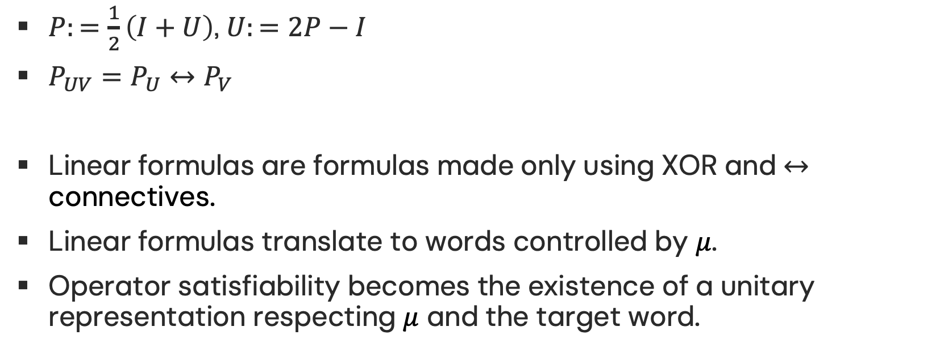
Correspondence in the Linear Fragment
$P:=\frac{1}{2}\left(I+U\right)$, $U:=2P−I$
$P_{UV}=P_{U}↔P_{V}$
Linear formulas are formulas made only using XOR and $↔$ connectives.
Linear formulas translate to words controlled by $μ$.
Operator satisfiability becomes the existence of a unitary representation respecting $μ$ and the target word.

Slide 16
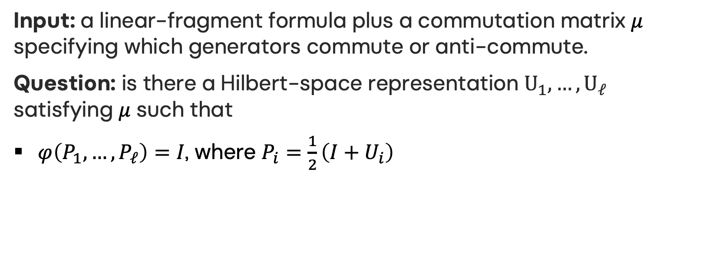
Main Result: Operator Satisfiability
Input: a linear-fragment formula plus a commutation matrix $μ$ specifying which generators commute or anti-commute.
Question: is there a Hilbert-space representation $U_{1},…,U_{ℓ}$ satisfying $μ$ such that
$φ\left(P_{1},…,P_{ℓ}\right)=I$, where $P_{i}=\frac{1}{2}\left(I+U_{i}\right)$
Decision problem: SAT_linear(φ, μ) = ?

Slide 17
Main Result: Operator Satisfiability
Schaefer's dichotomy theorem: whereas general Boolean satisfiability is NP-complete, Boolean satisfiability in the linear fragment can be decided in polynomial time.
(Paddock and Slofstra, 2025): General operator satisfiability over arbitrary finite-dimensional Hilbert spaces is RE-complete.
(Dawar and Shah, 2026): For any fixed finite Hilbert-space dimension, satisfiability of partial Boolean algebras by projectors is complete for the existential theory of the reals (ETR-complete).

Slide 18


Main Result: Operator Satisfiability
Theorem: Given the commutation matrix $μ$, operator satisfiability for the linear fragment is decidable in polynomial time.
Proceed via the associated word $w$ in the $ℤ_{2}$-commutation group. $φ≡1$ if and only if $w≡I$.
When satisfiable, $μ$ also guides construction of a finite-dimensional Pauli representation.
When unsatisfiable, the certificate is a parity/commutation obstruction

Slide 19
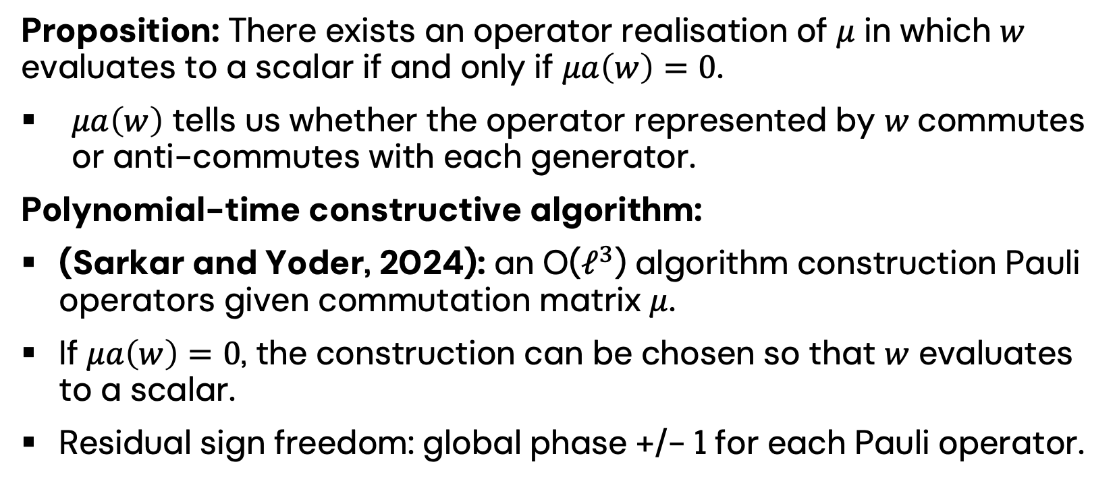
Main Result: Operator Satisfiability
Proposition: There exists an operator realisation of $μ$ in which $w$ evaluates to a scalar if and only if $μa\left(w\right)=0$.
$μa\left(w\right)$ tells us whether the operator represented by 𝑤 commutes or anti-commutes with each generator.
Polynomial-time constructive algorithm:
(Sarkar and Yoder, 2024): an O($ℓ^{3}$) algorithm construction Pauli operators given commutation matrix $μ$.
If $μa\left(w\right)=0$, the construction can be chosen so that $w$ evaluates to a scalar.
Residual sign freedom: global phase +/- 1 for each Pauli operator.

Slide 20
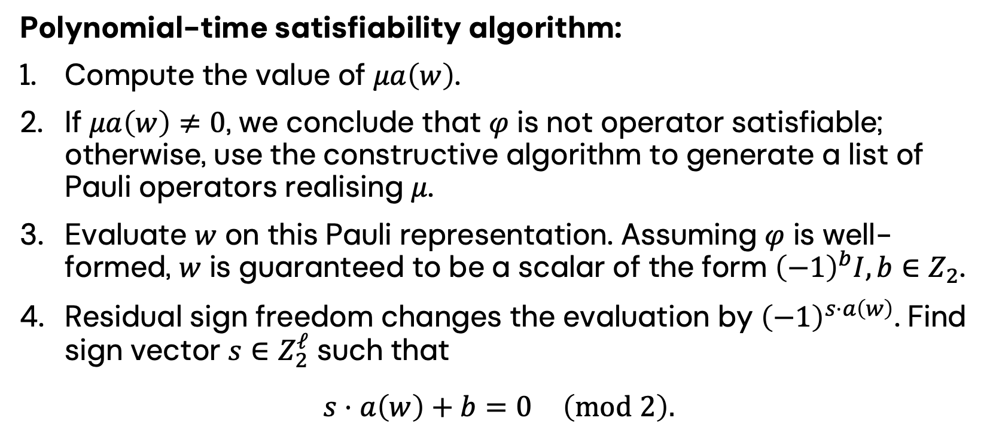
Main Result: Operator Satisfiability
Polynomial-time satisfiability algorithm:
Compute the value of $μa\left(w\right)$.
If $μa\left(w\right)≠0$, we conclude that $φ$ is not operator satisfiable; otherwise, use the constructive algorithm to generate a list of Pauli operators realising $μ$.
Evaluate $w$ on this Pauli representation. Assuming $φ$ is well-formed, $w$ is guaranteed to be a scalar of the form ${\left(−1\right)}^{b}I,b∈Z_{2}$.
Residual sign freedom changes the evaluation by ${\left(−1\right)}^{s⋅a\left(w\right)}$. Find sign vector $s∈Z_{2}^{ℓ}$ such that
$$s⋅a\left(w\right)+b=0 \left(mod 2\right).$$

Slide 21
Future Work
Can we find a similarly polynomial-time satisfiability algorithm for d-valued operator assignment in the linear fragment?
What happens when we move beyond the linear fragment? Is there a hierarchy of time-complexity marked from the linear fragment, to degrees of polynomial constraints, and so on?

