Slide 1
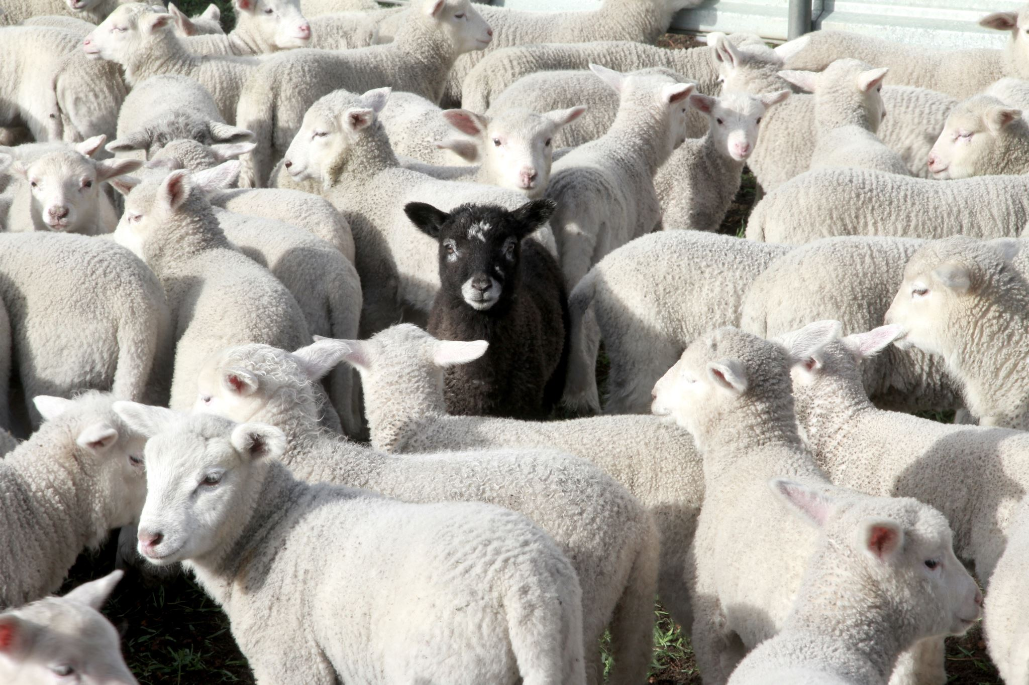
Predictive Analysis of Live Sheep Marketing Dataset to Develop Optimization Strategies
DSC630-T301 Predictive Analytics (2247-1)
Term Project Final Presentation
Week 10
Author: Zemelak Goraga
Date: 8/9/2024
Instructor: Prof. Andrew Hua

Slide 2
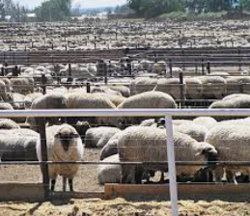
Introduction
Sheep trade is vital for agriculture, providing meat, milk, and wool.
The market's complexity and fluctuating conditions challenge accurate predictions.
This project uses predictive analytics to analyze historical data and forecast future trends in the sheep market.

Slide 3
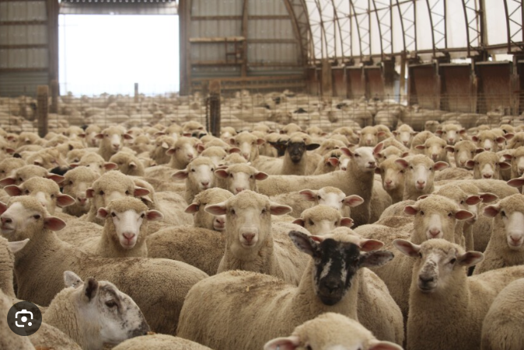
Statement of the Problem
Sheep markets face price fluctuations, varying demand, and changing trade policies.
My goal is to develop predictive models to forecast export quantity and value trends, helping stakeholders make informed decisions.

Slide 4
Research Questions
Trend Analysis: What are the historical trends in the global export quantities and values of live sheep from 1998 to 2013?
Country Comparison: Which countries were the top exporters of live sheep from 1998 to 2013?
Correlation Analysis: What is the correlation between export quantities and values of live sheep globally?
Predictive Modeling: Which predictive models provide the most accurate forecasts for future export quantities and values of live sheep, and what are the key predictors influencing these exports?
Optimization and Sustainability Strategies: What strategies can be recommended to enhance trade agreements, stabilize prices during economic volatility, and improve productivity and export capacity through sustainable farming practices and efficient agricultural techniques?

Slide 5
About the Dataset
I used the FAOSTAT dataset (1961-2013), covering over 200 countries.
It includes data on export quantities and values of live sheep, providing a comprehensive view of global trade trends.

Slide 6
Methodology
My methodology involved data importation, cleaning, feature engineering, and exploratory data analysis.
I tested models like Linear Regression, Random Forest, K-Nearest Neighbors, and Support Vector Regression, using visualization to interpret results.

Slide 7
Assumptions
The historical data is representative of future trends.
The models selected are appropriate for the data characteristics.
There is sufficient computational power to handle the dataset and perform analyses.

Slide 8
Ethical Concerns
Ethical considerations are paramount in this project. Ensuring data privacy and compliance with privacy regulations is crucial.
Efforts were made to identify and mitigate biases in the dataset to avoid perpetuating unfair outcomes.
Transparency in model development and interpretation was maintained to ensure accountability and trustworthiness.
Ethical use of data was emphasized, particularly given the potential impact on trade policies and market strategies.
These measures ensure that the analysis is conducted responsibly and that the insights generated are fair and equitable.

Slide 9
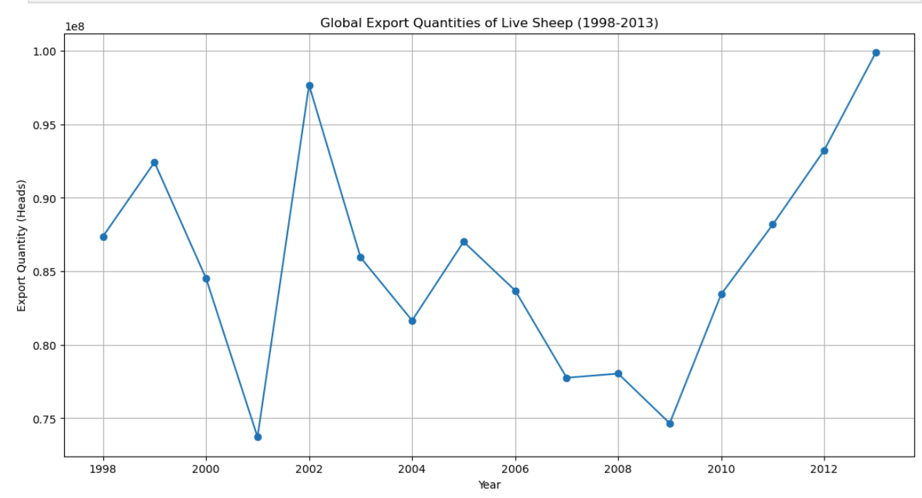
Trend Analysis: Live Sheep Export Quantity (heads)
Export quantities increased from 73.7 million heads in 2001 to 99.9 million in 2013.
Export values showed volatility, peaking at $10.17 million in 2013.
These trends reflect market demand and economic conditions.

Slide 10
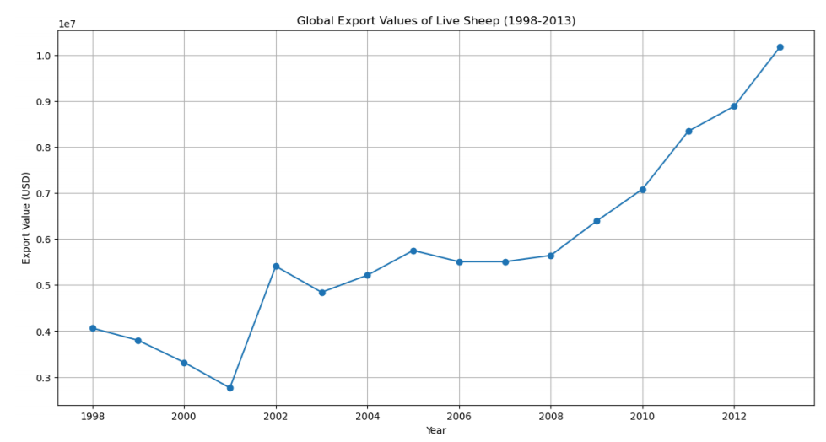
Trend Analysis: Export Value (US$)
Export values exhibited a more volatile trend compared to quantities, reflecting global economic events.
The export value grew from $4.06 million in 1998 to a peak of $10.17 million in 2013.
Significant fluctuations were observed during this period, with a notable increase from $5.40 million in 2002 to $10.17 million in 2013.

Slide 11
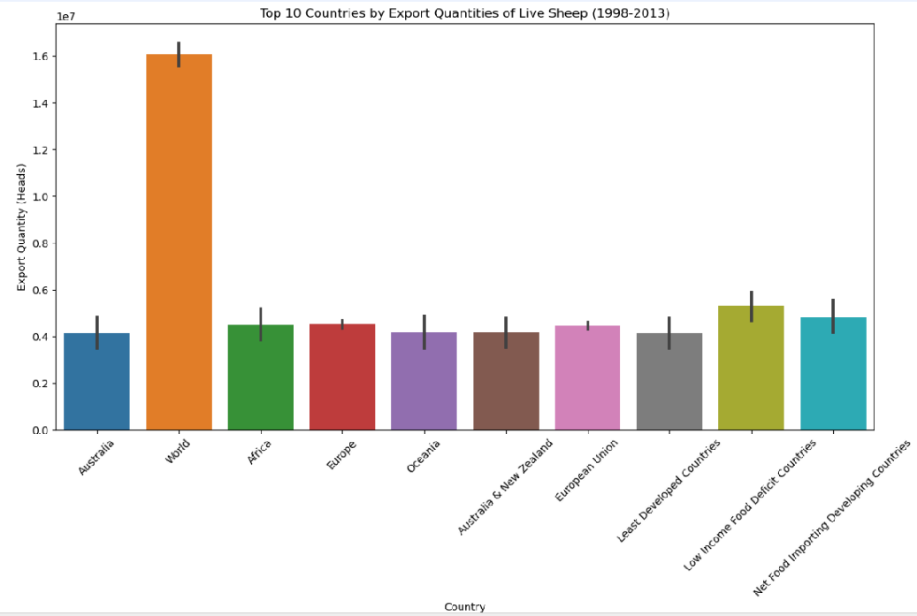
Country Comparison
Australia led sheep exports, averaging 66.1 million heads from 1998-2013.
Other major exporters included Africa, Oceania, and the European Union, highlighting the market's global nature.

Slide 12
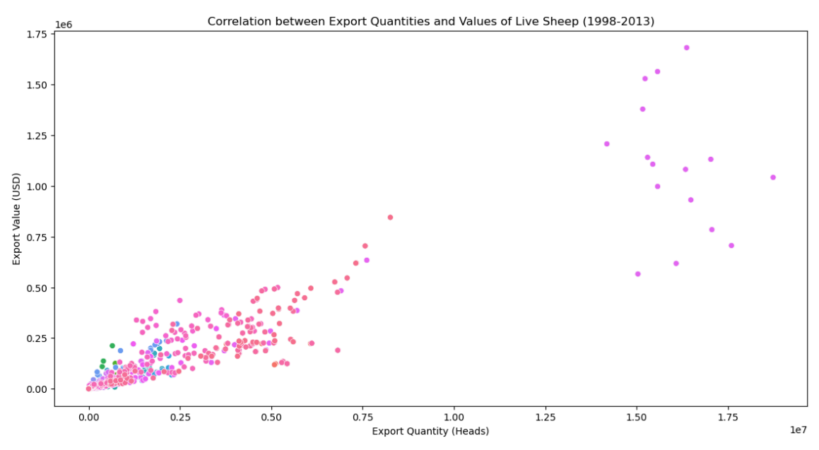
Correlation Analysis
A strong correlation (r=0.93) between export quantities and values was observed, especially during stable economic periods.
This indicates that higher export volumes generally lead to higher revenues.

Slide 13
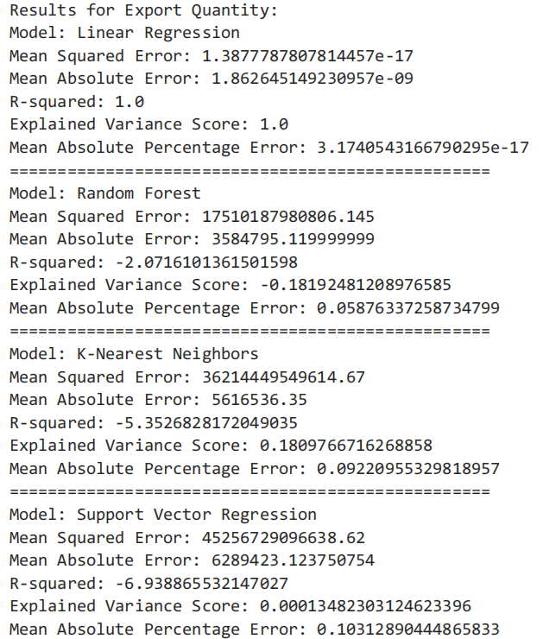
Predictive Modeling
I tested various models; Random Forest performed best for export values.
Linear Regression showed near-perfect fit, possibly indicating overfitting.
KNN and SVR models underperformed, highlighting the need for careful model selection.

Slide 14
Discussion
Key insights include rising export quantities, volatile values, and strong correlations.
Emerging markets like China and Brazil showed growth, suggesting new opportunities for sheep trade expansion.

Slide 15
Conclusions
The predictive analysis of the global sheep export market from 1998 to 2013 has revealed important trends and insights.
The significant growth in export quantities highlights the increasing global demand for sheep products, while the volatility in export values underscores the sensitivity of the market to external factors.
The analysis also demonstrated the importance of choosing the right predictive models, with the Random Forest model showing strong predictive power for export values.
These findings emphasize the need for tailored market strategies to enhance performance and stability in the sheep export sector.
By leveraging predictive analytics, stakeholders can make more informed decisions, optimizing trade outcomes and improving market efficiency.

Slide 16
Recommendations
To optimize the sheep export market, I recommend several strategic actions:
First, enhancing trade agreements with high-GDP countries, especially emerging markets like China and Brazil, can help boost export quantities and values.
Second, implementing policies to stabilize prices during periods of economic volatility, such as government support during crises and strategic stockpiling, can mitigate risks and ensure market stability.
Third, investing in modern agricultural infrastructure and sustainable farming practices is crucial. This includes adopting efficient technologies and practices that can increase productivity and meet growing demand.
Additionally, continuous validation and refinement of predictive models are necessary to ensure accurate forecasts and support data-driven decision-making.

Slide 17
Way Forward
Looking ahead, the sheep export sector can benefit from a multifaceted approach to sustain growth and stability.
Leveraging advanced data analytics and machine learning models should be prioritized to continually refine predictive capabilities and adapt to changing market conditions.
Regularly updating models with the latest data ensures more accurate forecasts and better decision-making. Fostering international collaborations and enhancing trade relations with high-demand markets will create new opportunities for exporters. This includes participating in global trade forums and negotiating favorable trade agreements.
Moreover, adopting sustainable and innovative farming practices will enhance productivity and address growing consumer demand for ethically produced goods.
Lastly, developing comprehensive risk management strategies to mitigate the impact of economic fluctuations and market volatility is essential. This can include diversifying export markets, strategic stockpiling, and robust support mechanisms for farmers during downturns. By implementing these strategies, the sheep export sector can achieve long-term resilience and success.

Slide 18
Reference
FAOSTAT Data. (n.d.). FAOSTAT Data. Food and Agriculture Organization of the United Nations (FAO). Retrieved from http://www.fao.org/faostat/en/#data
Hindawi. (2021). Broadening the Research Pathways in Smart Agriculture: Predictive Analysis Using Semiautomatic Information Modeling. Hindawi. Retrieved from https://www.hindawi.com/journals/complexity/2021/5391823/
Kaggle. (n.d.). FAOSTAT: Food and Agriculture Data. Kaggle. Retrieved from https://www.kaggle.com/datasets/faoorg/faostat-food-and-agriculture-data

Slide 19
Thank You for your attention!
I'm open to any questions. Feel free to ask about specific aspects or share your thoughts on the market.
" You can reach me via my email: Zemelak.s.goraga@gmail.com."

