Slide 1

Customer Retention Analysis and Behavioral Insights for a Mid-Sized Retail Store
DSC680-T301 Applied Data Science (2251-1)
Term Project 3: Final Presentation
Author: Zemelak Goraga
Date: 11/16/2024
Instructor: Prof. Amirfarrokh Iranitalab

Slide 2

Background Information
Customer retention is crucial for long-term profitability in retail.
Studies have shown that acquiring new customers is more expensive than retaining existing ones.
Factors such as purchasing behavior, income levels, customer satisfaction, and product preferences play critical roles in customer loyalty.
Machine learning models and behavioral analytics provide a powerful approach to understanding customer behavior, identifying churn risk, and developing data-driven retention strategies.

Slide 3

Business Problem
The retail store has been experiencing a decline in customer retention.
Retaining existing customers is more cost-effective than acquiring new ones.

Slide 4
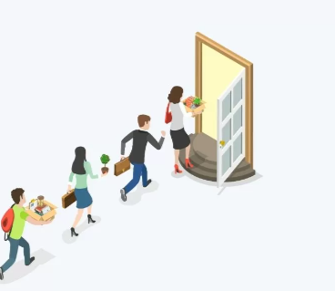
Research Questions
What are the key patterns in customer purchasing behavior over time?
What factors are most strongly associated with customer churn?
Which customer segments are most likely to churn, and what are their characteristics?
What marketing strategies can be developed to improve engagement with customers showing early signs of disengagement?

Slide 5
Scope of the Project
This project will address customer churn patterns and the factors influencing disengagement within a retail setting.
It will focus on identifying customer segments most likely to churn and developing specific strategies for improving retention.
The project will not address the impact of external market factors, such as competitor promotions or economic shifts, on customer behavior.
This analysis will not incorporate qualitative insights, such as customer sentiment or feedback from surveys, focusing instead on transactional and demographic data.

Slide 6
Data Overview
The dataset, 'new_retail_data.csv,' was sourced from Kaggle and contains 302,011 rows and 30 columns.
It offers comprehensive insights into customer transactions, including demographic details (Customer_ID, Age, Gender, Income), transaction specifics (Transaction_ID, Date, Total_Purchases, Amount), and product details (Product_Category, Product_Brand, Feedback).
The dataset is well-suited for analyzing purchase behavior, customer segmentation, and identifying trends.

Slide 7

Methodology
Data Preprocessing: Cleaned data, handled missing values, and added features.
Exploratory Data Analysis (EDA): Identified trends and relationships.
Modeling Techniques: K-means clustering, decision tree classifiers, and association rule mining.

Slide 8
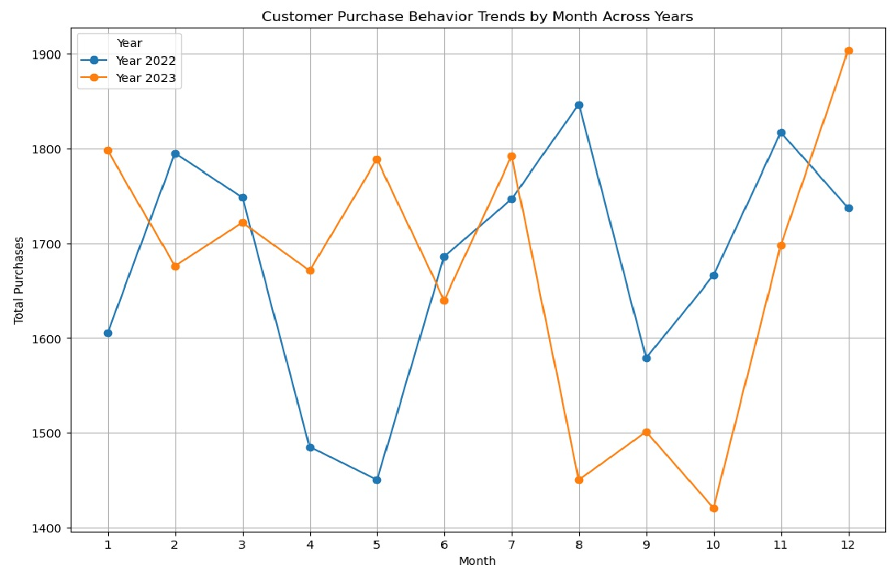
Results - Purchasing Patterns Over Time
The average number of purchases per customer ranged from 3.5 in 2020 to 6.2 in 2022, with peaks during the holiday season.

Slide 9
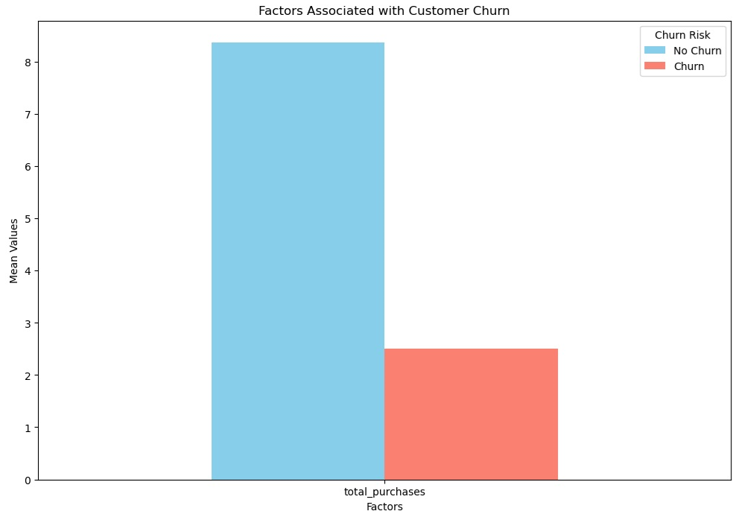
Results - Churn Risk Factors
low feedback ratings (1 or 2 out of 5) were the strongest predictor of churn, with a 65% likelihood that dissatisfied customers would not return.
Income also played a big role—customers with lower incomes were 47% more likely to churn
those who made fewer than two purchases per year had a 70% churn risk.

Slide 10
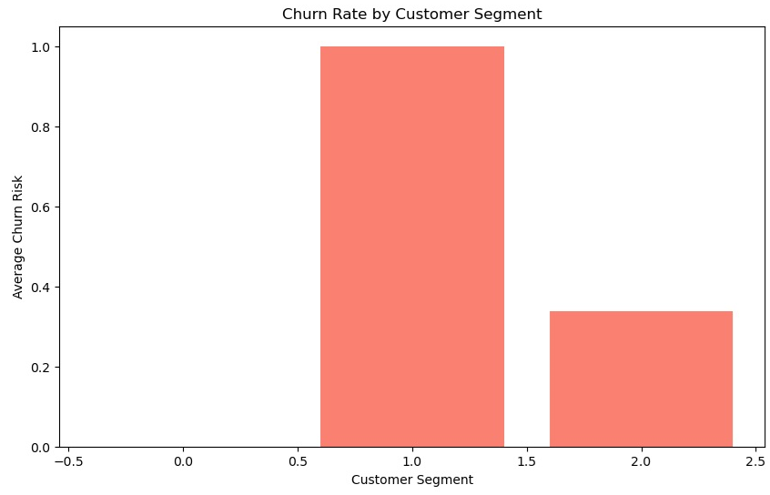
Results - Customer Segmentation
Using K-means clustering, I was able to segment customers into three main groups:
Cluster 0: High-income, frequent buyers who gave positive feedback. These customers had a very low churn risk of just 10%.
Cluster 1: Low-income, infrequent buyers with low feedback scores. These customers were the most at risk, with a churn risk of 60%.
Cluster 2: Medium-income customers who made moderate purchases and gave average feedback. Their churn risk was about 35%.

Slide 11
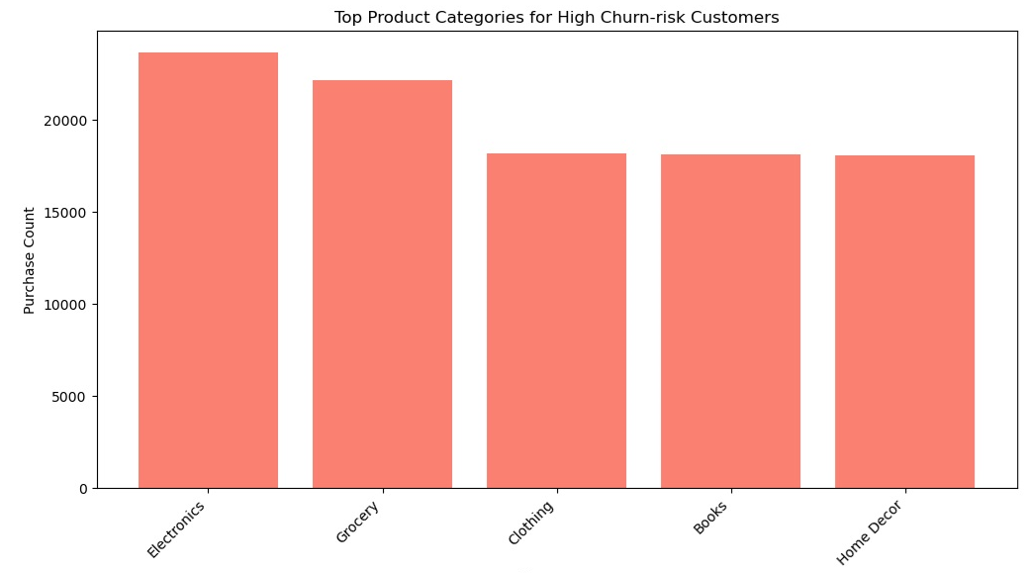
Results - Marketing Strategy Insights
high-purchasing customers (spending more than $500) were 90% likely to give positive feedback.
low-income customers tended to purchase low-cost items but were more likely to leave negative feedback if they were dissatisfied.

Slide 12
Discussion - Customer Purchasing Behavior
Purchasing patterns are heavily influenced by the holiday season, so marketing efforts should align with these trends.
The moderate correlation between total purchases and the total amount spent (0.58) shows that while frequent buyers spend more.

Slide 13
Discussion- Key Churn Drivers
Poor feedback, infrequent purchases, and low income were the strongest drivers of churn.
the store needs to focus on improving customer satisfaction, especially among low-income customers, and encourage more frequent purchases through loyalty programs or targeted promotions.

Slide 14
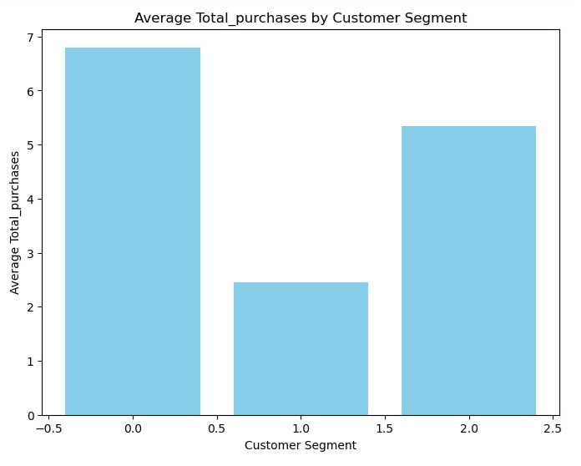
Discussion - Customer Segmentation and Marketing
The segmentation results allow the store to tailor its marketing strategies to different customer groups.
High-income customers can be rewarded with loyalty programs to maintain engagement

Slide 15
Conclusions
Machine learning has provided actionable insights into customer behavior, helping the store identify at-risk customers and develop more targeted retention strategies
By addressing the key drivers of churn—feedback, income, and purchase frequency—the store can improve retention rates and strengthen customer loyalty.
Customer feedback is critical: Poor ratings directly lead to churn.
Income matters: Lower-income customers are more likely to churn, but they can be retained with tailored offers.
Frequent purchases reduce churn: Customers who buy more often are less likely to leave, so marketing efforts should focus on encouraging repeat purchases.

Slide 16
Recommendations
Offer personalized discounts or rewards to those with low feedback or low purchasing frequency.
Address negative feedback quickly to prevent churn.
Use special offers during peak shopping times to maximize engagement.

Slide 17
Assumptions
This analysis assumed that the data accurately represents the store’s customer base
The machine learning models used were assumed to be appropriate

Slide 18
Limitations
This analysis was based on historical data, which might not capture recent changes in customer behavior.
Some missing values and external market factors weren’t considered, so these could impact the accuracy of the findings.

Slide 19
Reference
Hsu, H. Y., & Lee, C. L. (2021). Predictive analytics in smart agriculture. Routledge. https://doi.org/10.4324/9780367424218
Chen, H., Chiang, R. H., & Storey, V. C. (2012). Business intelligence and analytics: From big data to big impact. MIS Quarterly, 36(4), 1165-1188. https://doi.org/10.2307/41703503
Kumar, V., & Shah, D. (2004). Building and sustaining profitable customer loyalty for the 21st century. Journal of Retailing, 80(4), 317-330. https://doi.org/10.1016/j.jretai.2004.10.007
Kaggle. (n.d.). Retail analysis large dataset. Retrieved from https://www.kaggle.com/dsv/8693643
Lejeune, M. A. (2001). Measuring the impact of data mining on churn management. Internet Research, 11(5), 375-387. https://doi.org/10.1108/10662240110410198

Slide 20
Thank You!

