Slide 1
Airplane Crash Data Analysis - Unveiling the Truth Behind Aviation Safety
DSC640-T301 Data Presentation & Visualization (2247-1)
Term Project Final Presentation
Week 9 & 10
Author: Zemelak Goraga
Date: 8/9/2024
Instructor: Prof. Catherine Williams

Slide 2
Introduction
Brief overview of the project: aviation safety is a global concern. Understanding crash causes helps improve safety protocols.
Objectives: To analyze historical airplane crash data, counteract negative media narratives, and enhance aviation safety.

Slide 3
Statement of the Problem
Public Concern: Recent media coverage has raised public concern about aviation safety.
Need for Data-Driven Analysis: a comprehensive, data-driven analysis to provide factual insights and address these concerns.

Slide 4
About the Dataset
Source: Kaggle
Coverage: "The dataset includes 5268 crash observations, covering various variables such as Date, Time, Location, Operator, Route, Aircraft Type, Number Aboard, Fatalities, and Ground Casualties.
It represents the year 1908 to 2009.

Slide 5
Methodology
Data Cleaning and Preprocessing
Exploratory Data Analysis (EDA)
Visualization and Communication
Tools: Python, Plotly, Dash, Seaborn

Slide 6
Assumptions
Dataset accuracy, trends reflecting broader patterns, and the impact of technological and regulatory changes over time.

Slide 7
Ethical Concerns
Privacy and data integrity considered crucial. The analyses were performed to provide accurate insights without sensationalizing or downplaying the impact of crashes.

Slide 8
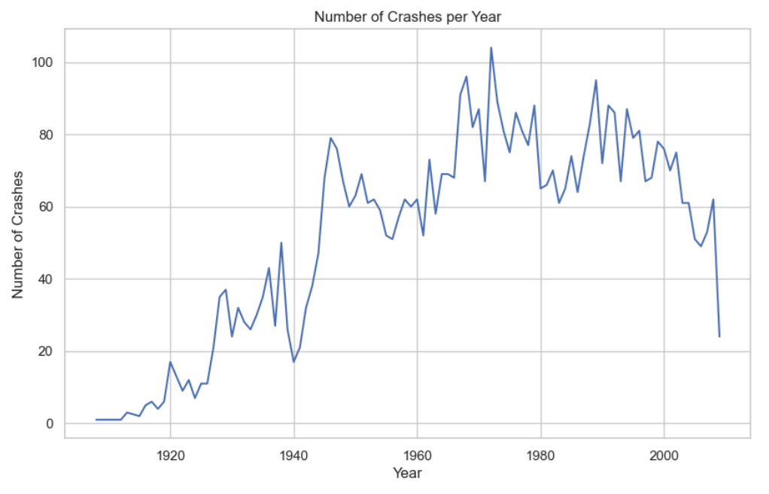
Visualizations Overview
The data indicates a gradual increase in the number of crashes over the years to some point, and then a significant decline over the years, indicating improvements in safety measures and technology.
This positive trend reflects the industry's commitment to safety."

Slide 9
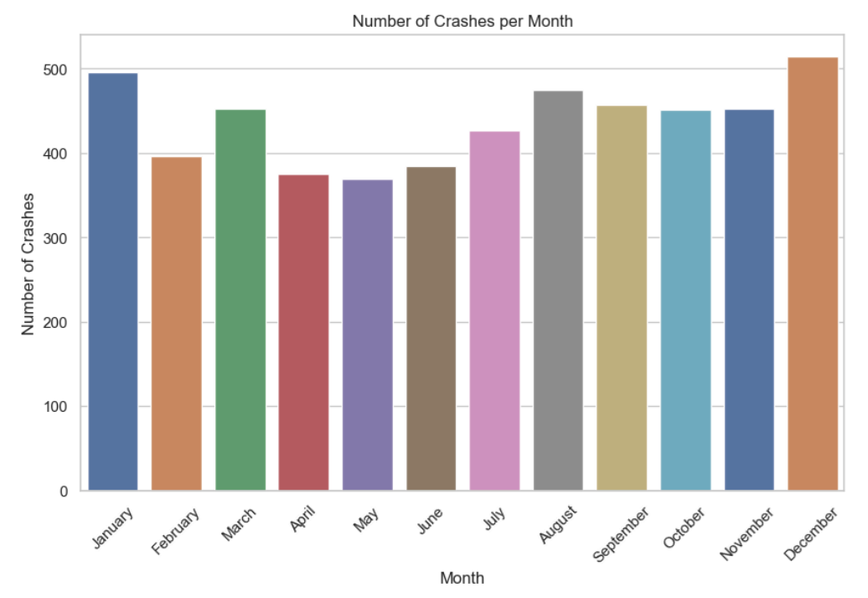
Number of Crashes per Month
Seasonal Distribution: December recorded the highest number of crashes (517), followed by January (496) and August (476).
These findings could be related to seasonal travel patterns and weather conditions.

Slide 10
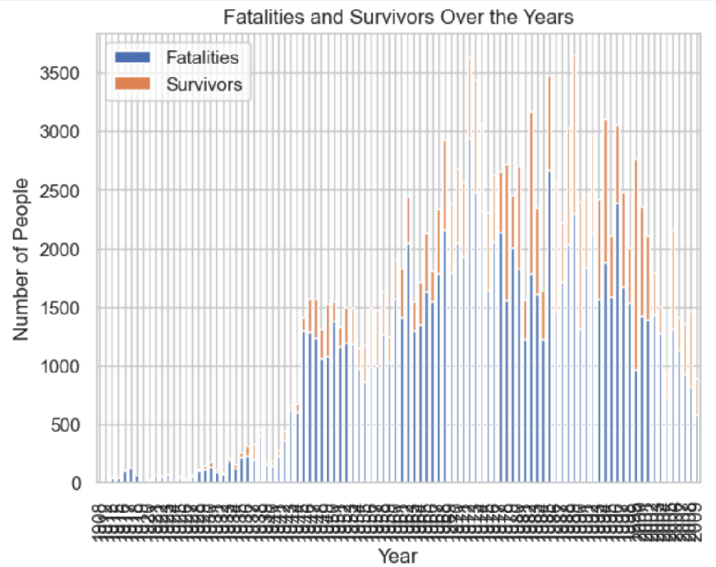
Fatalities and Survivors Over the Years
The chart compares the number of fatalities and survivors from 1908 to 2009, showing significant variations year-to-year.
There has been a decrease in fatalities and an increase in survivors over the years, due to improved safety measures and emergency protocols.

Slide 11
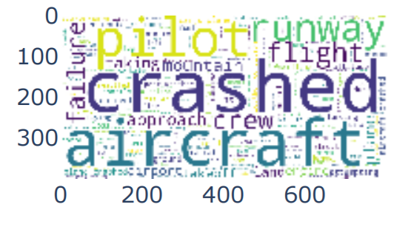
Common Words in Crash
Words like "crashed," "aircraft," "pilot," and "runway" are most frequent, highlighting key aspects and recurring themes in aviation incidents.
Addressing these through technology and training is vital for safety.

Slide 12
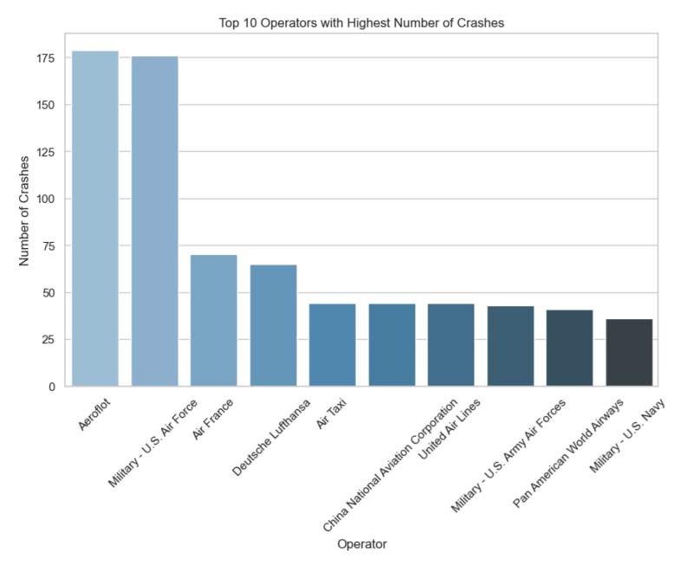
Top 10 Operators with Highest Number of Crashes
High-volume and military operators have higher crash numbers. Emphasizing safety practices and compliance can reduce these incidents.

Slide 13
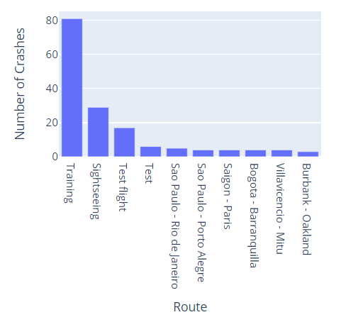
Top 10 Routes with Highest Number of Crashes
Training flights (81 crashes) and sightseeing flights (29 crashes) are the most accident-prone.

Slide 14
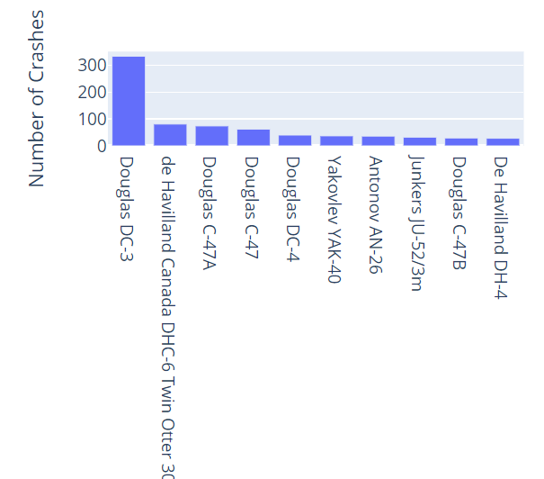
Top 10 Aircraft Types with Highest Number of Crashes
The Douglas DC-3 had the highest number of crashes (334), followed by the de Havilland Canada DHC-6 Twin Otter 300 (81).

Slide 15
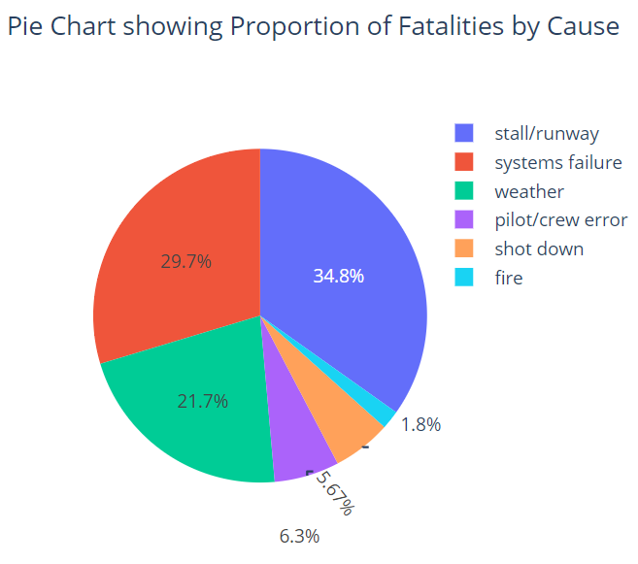
Proportion of Fatalities by Cause
Stall/runway" accidents (774 fatalities) and "systems failure" (659 fatalities) were the most common causes.

Slide 16
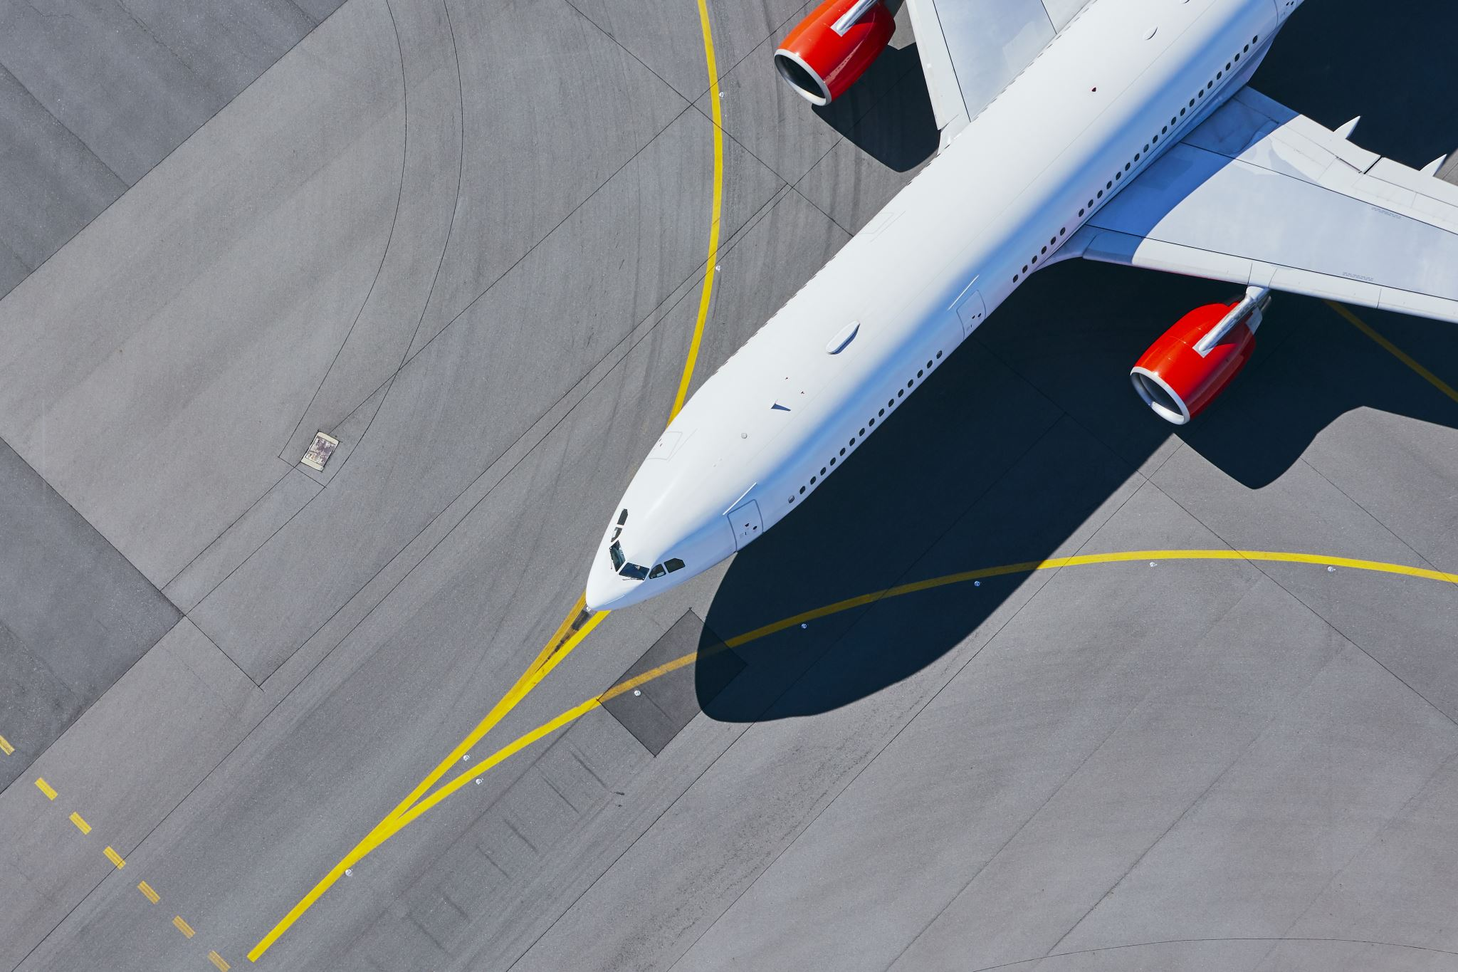
Conclusions
Increasing trend in crashes over the years.
Specific aircraft models and certain routes were more prone to accidents.
runway issues, systems failures, and adverse weather conditions were leading causes of fatalities.
Crashes occur globally, necessitating widespread safety measures.

Slide 17
The Way Forward
Implement stricter safety protocols and regular maintenance checks.
Enhance pilot training programs.
Increase safety measures during peak travel seasons.
Invest in advanced aviation technologies.

Slide 18

"Thank you for your attention!

