Slide 1
Enterprise AI Orchestrator
for UiPath
UiPath AgentHack - Track 3: UiPath Test Cloud

Slide 2
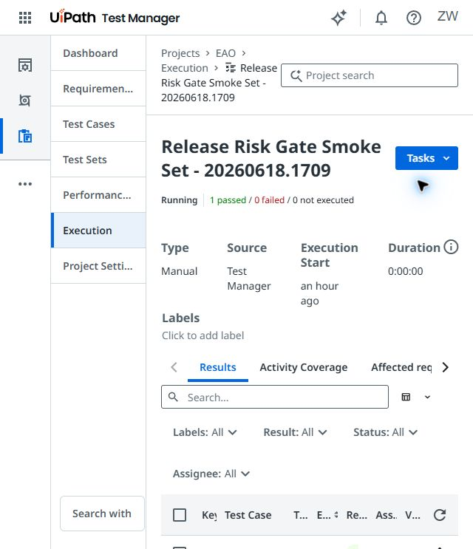
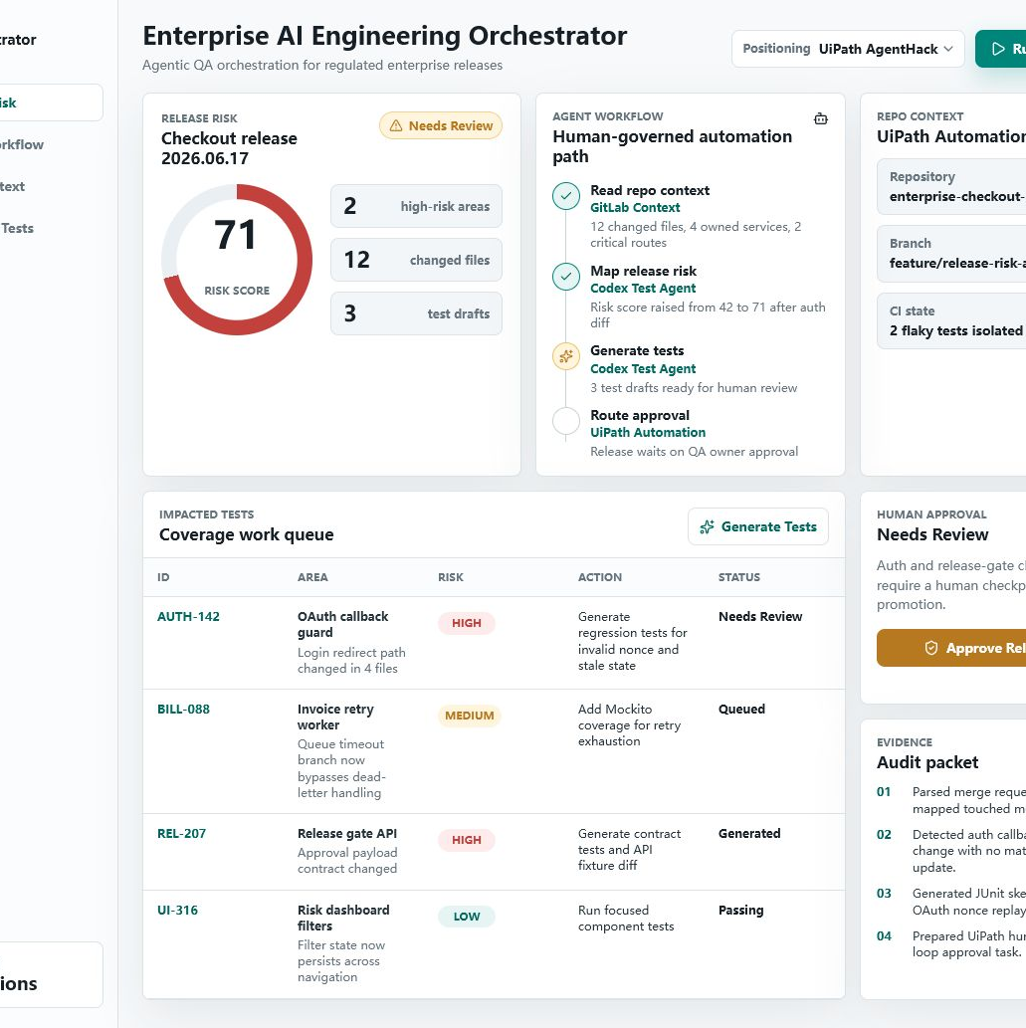
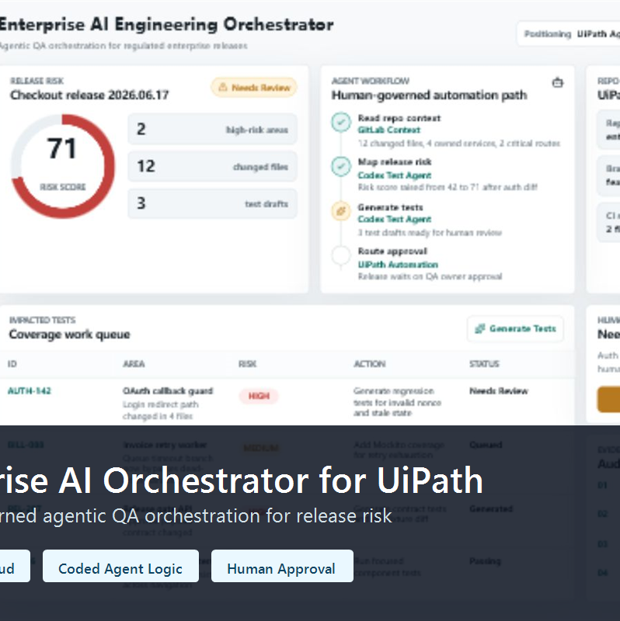
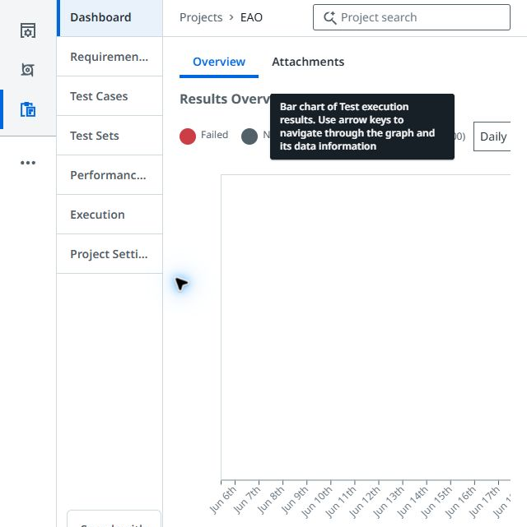
Team and judging evidence
Enterprise AI Orchestrator for UiPath
Zack Wang
Public demo
UiPath proof
Judging packet
Solo builder
Full-stack / enterprise automation
React + TypeScript workflow UI
UiPath AgentHack mode included
Test Manager project
Release-risk validation Passed
README, setup steps, deck,
proof index, source release

Slide 3
Problem statement and proposed solution
Problem
Solution
Enterprise release decisions depend on scattered PR context, CI status, test ownership, risk notes, and manual approvals.
Regulated teams need visible evidence and a human checkpoint before promotion.
UiPath-governed workflow converts release context into risk score, targeted QA actions, Test Manager evidence, and human approval.
Public MVP uses safe simulated release state plus real hackathon Test Manager proof.

Slide 4
Benefits and technologies used
Details
Benefits, impact and outcomes
End-user | Release / QA owners
User department | Enterprise engineering
Industries | Finance, insurance, regulated SaaS
UiPath products used | Test Cloud / Test Manager; Automation Cloud path
Other integrations | React, TypeScript, Vite, GitHub Pages
Turns scattered release signals into one evidence packet.
Produces targeted test recommendations before approval.
Keeps high-risk release decisions human-owned.
Public proof links include demo, repo, video, and Test Manager Passed evidence.

Slide 5
Solution architecture
1. React UI selects UiPath AgentHack mode and release context.
2. Coded-agent logic normalizes changed files, CI signals, and critical routes.
3. Release-risk scoring produces risk level, evidence, and targeted test recommendations.
4. UiPath Test Cloud / Test Manager is the validation surface for approved checks.
5. Human approval gate blocks automatic release promotion until evidence is reviewed.
6. Public proof hub links repo, demo, screenshots, video, and stable release package.

Slide 6
Setup instructions and judging links
Run locally:
1. git clone https://github.com/zemeng2015/enterprise-ai-engineering-orchestrator.git
2. cd enterprise-ai-engineering-orchestrator
3. npm install
4. npm run dev -- --port 5178
5. Open http://127.0.0.1:5178/ and select UiPath AgentHack mode.
Public judging links:
Demo: zemeng2015.github.io/enterprise-ai-engineering-orchestrator
Video: youtu.be/8AKMY8VoN7c
Proof index: live demo /submission-proof-index.json

Slide 7
Governed agentic QA:
faster release review with explicit human accountability.

