Slide 1


MOVIE
RECOMMENDER
AGILE DATA PROJECT
SPRINT 1

Slide 2


AS A USER I WANT TO BE ABLE TO GET CERTAIN NUMBER OF PERSONALISED RECCOMANDATIONS
PREPOCESSING
MODELLING
WEBSITE
ml-latest-small.csv
Spotlight
Streamlit

Slide 3

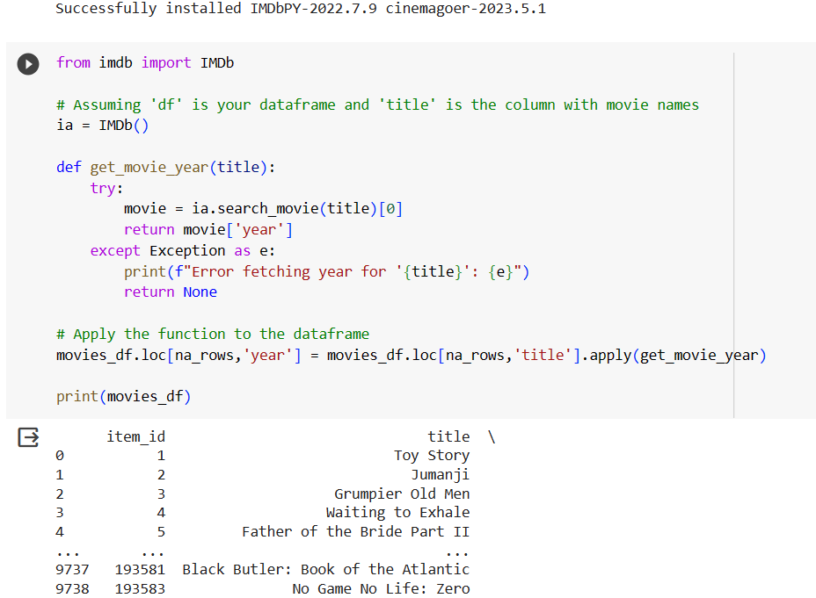
PREPOCESSING DATA
DATA: ml-latest-small
integer values
year and title seperation
inputting missing years

Slide 4
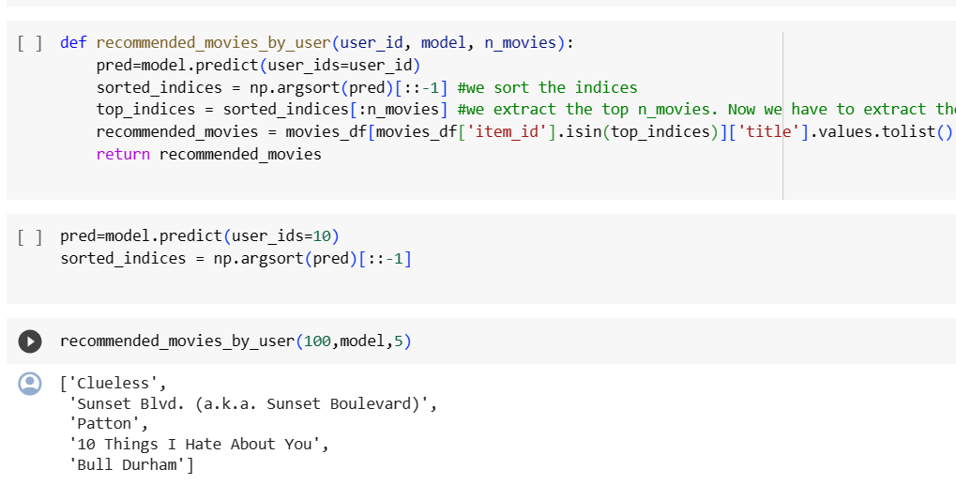
MODELLING
using SPOTLIGHT
based on ID of user reccomand demanded amount of movies

Slide 5
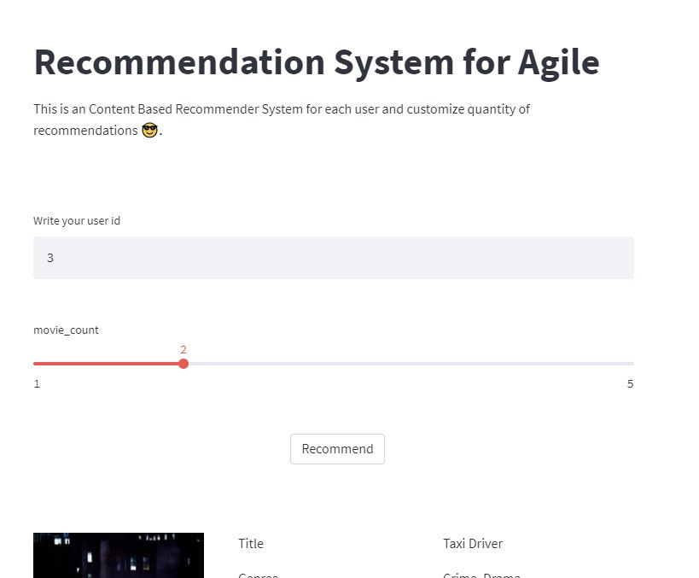
WEBSI TE
identifying user
based on ID
customize the quantity of recommendations

Slide 6
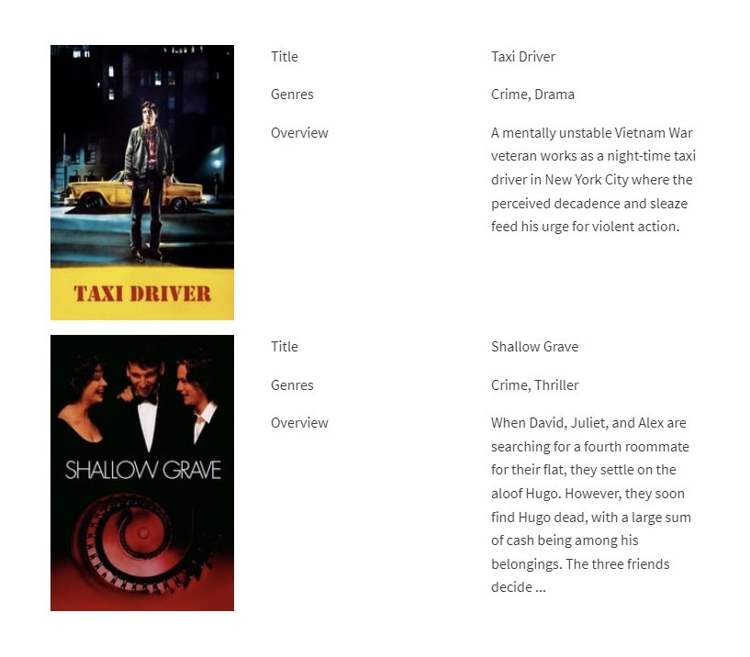
RESULT OF
RECCOMENDATION
based on user’s previous movie rating
3 features

Slide 7

FOR NEXT SPRINT
PREPOCESSING
MODELLING
WEBSITE
add filter by year and genre
filter option by year/genre
prepocess the data from new user
recommendation to new user
differentiate user or non-user
show five titles movies and assign a number from 1-5

Slide 8

THANKS FOR WATCHING
PERE
EDDIE
OUR TEAM
DANIEL
DUŠANA
IGNACIO
GABRIELA
BRANDON

