Slide 1
Melanoma Skin Cancer Detection
Madhu Babu Sikha
Zeming Zhang
Ajith Kumar Ethirajulu
Deepak Raj Mohan Raj

Slide 2
NEED FOR Melanoma Detection
Melanoma is the least common skin cancer, but responsible for 75% of skin cancer deaths.
Estimated new cases in 2022: 99,780
Estimated deaths in 2022: 7,650
Detection in early stages helps in effective treatment and can save lives.

Slide 3
The objective of this project is to predict whether a patient has Melanoma, given a lesion image.
A binary classification problem to classify a given image as Benign (non-cancerous) or Malignant (cancerous).
OBJECTIVE

Slide 4
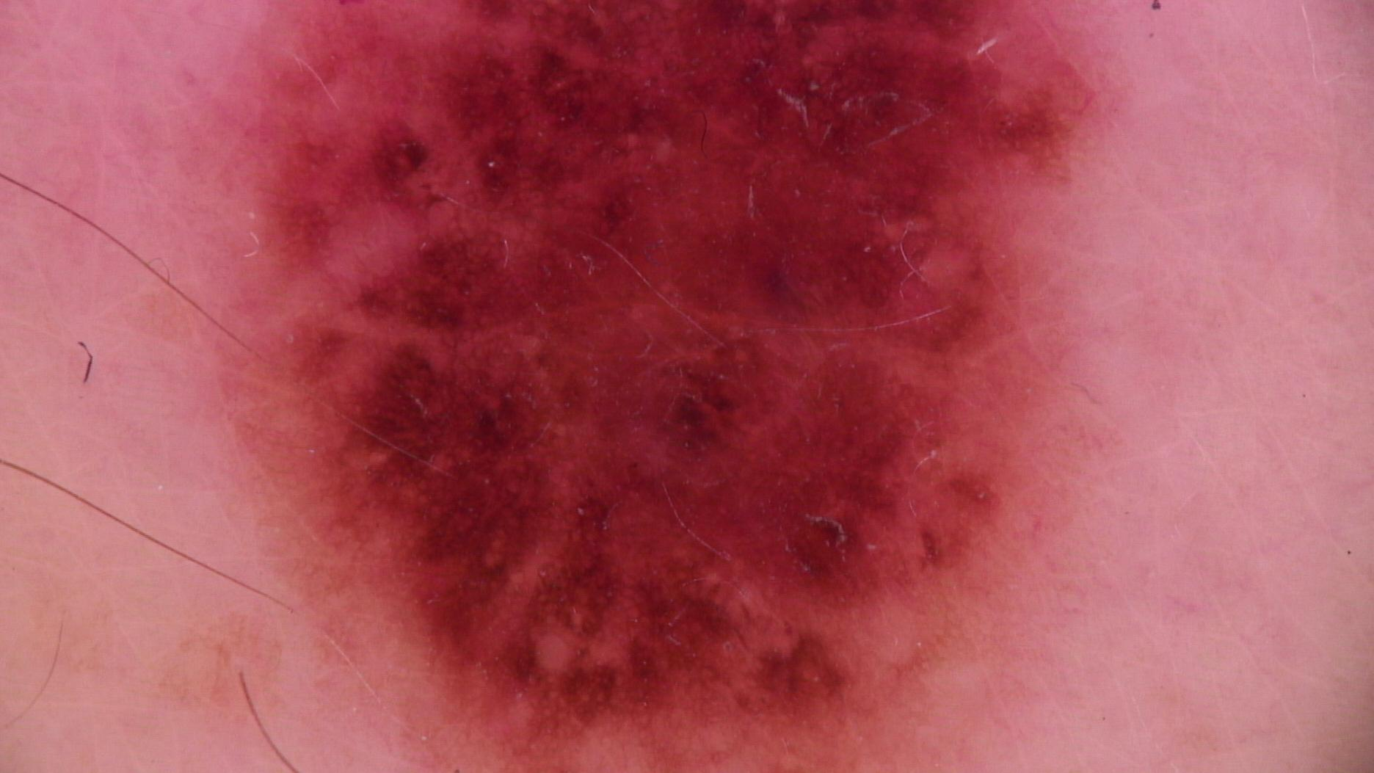
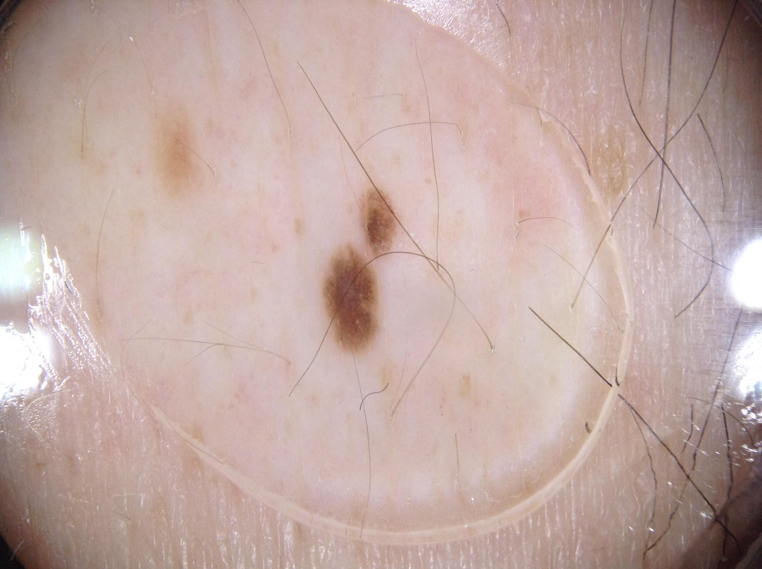
DATASET
Referred from the official dataset of the SIIM-ISIC Melanoma Classification Challenge.
Total training images: 33126
Features:
image_name - unique identifier, points to filename of related image
patient_id - unique patient identifier
sex - the sex of the patient
age_approx - approximate patient age at time of imaging
anatom_site_general_challenge - location of imaged site
diagnosis - detailed diagnosis information
benign_malignant - indicator of malignancy of imaged lesion
target - binarized version of the target variable

Slide 5
MODEL
Model design flow
01
02
03
04
DATA LOADING
CLEANING & EDA
ACCURACY
Skin lesions images as training data
Removing columns that are not required for our model,
Compiling and training
Hyper parameter fine tuning

Slide 6
Challenges of the Dataset
Highly Imbalanced Dataset
32524 Benign images occupies 98.23% and Malignant-584 images are of 1.763%
Since the percentage of malignant images are very less, we were unable to proceed with the conventional methods.
For this project, we have considered the images as the input and the target column as the output to be predicted.
Hence, the integrity of the other columns were not validated
The image and the target column have no missing data or NA values.

Slide 7
OUR SOLUTIONS FOR DATA IMBALANCE
STRATIFIED SAMPLING
IMAGE AUGMENTATION

Slide 8
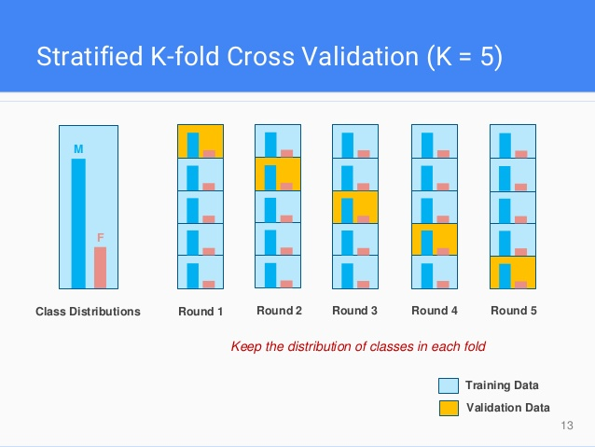
STRATIFIED SAMPLING
In regular train-test split, the split will usually by completely random, which is not good for imbalance datasets
Stratified sampling splits the data such that the ratio between the target classes is the same as it is in the full dataset.
Using stratified k-fold has shown improvement in accuracy.

Slide 9
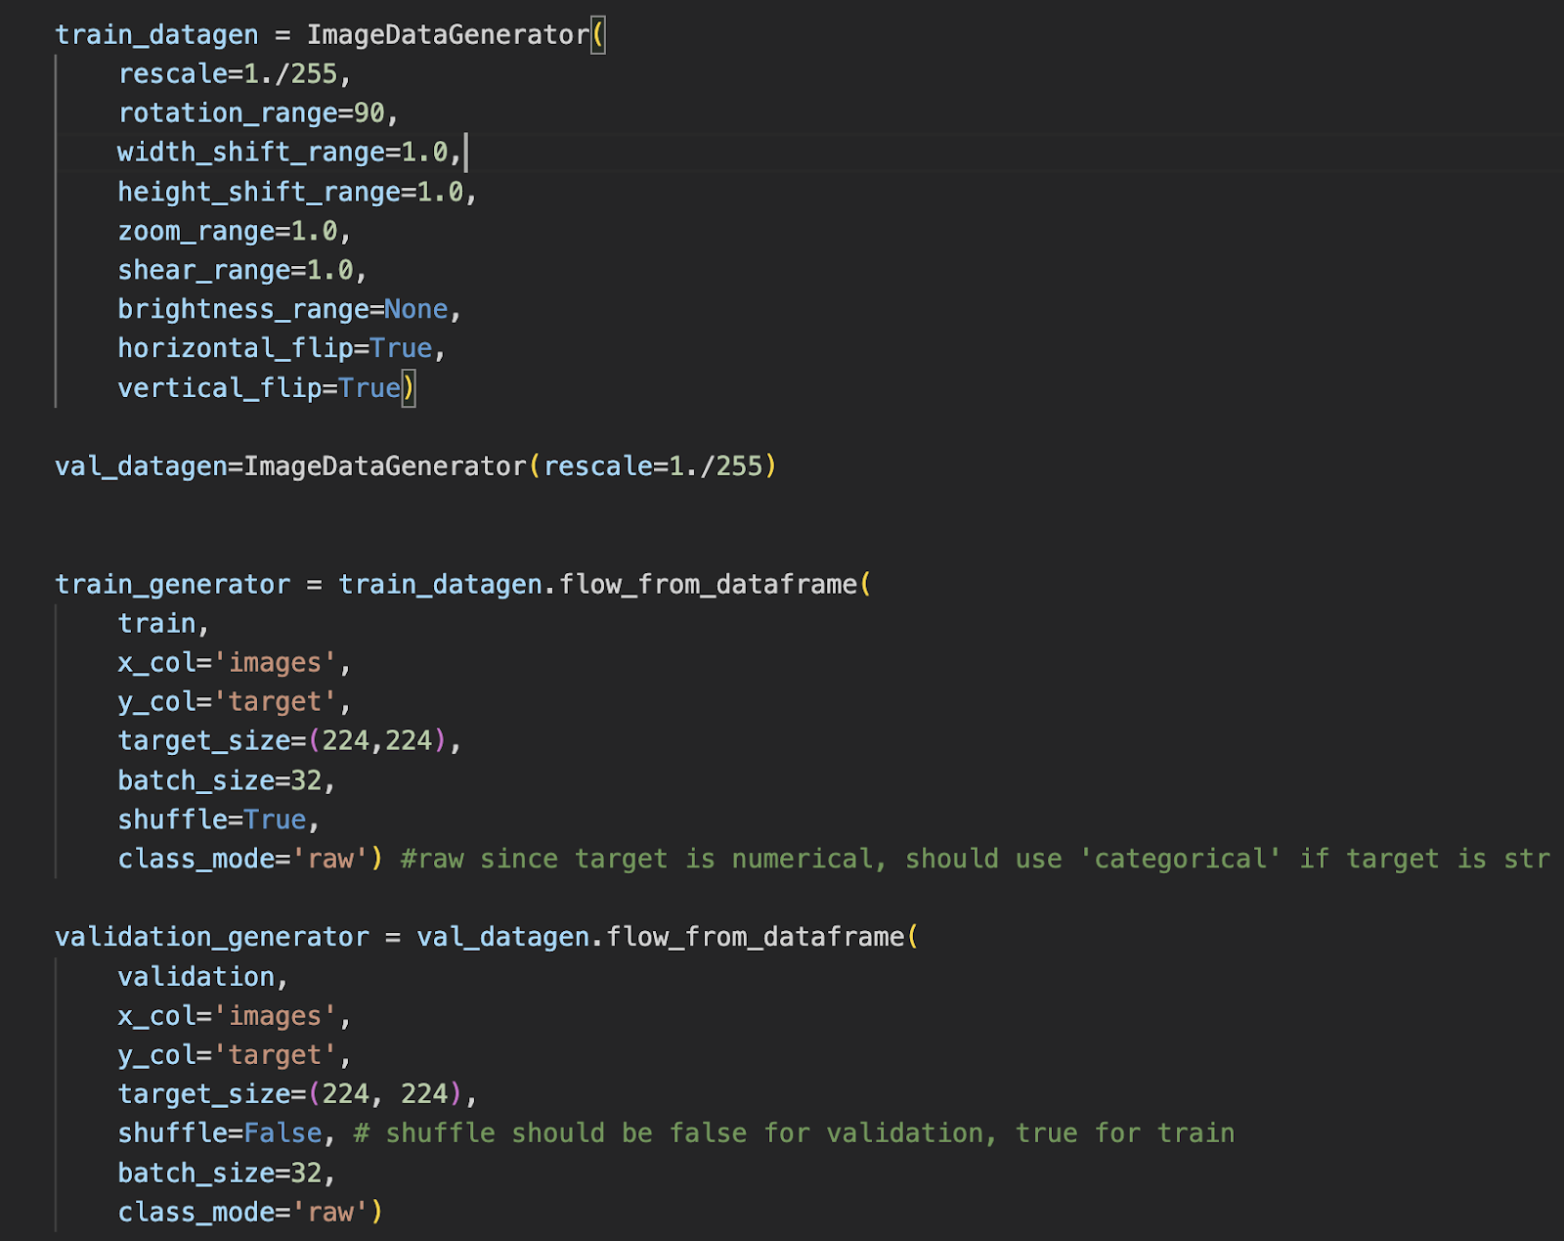
IMAGE AUGMENTATION
Image augmentation is the artificial way of creating new images from existing images by applying geometrical transformations(horizontal, vertical) and also applying noise like gaussian blur, brightness and scaling.

Slide 10
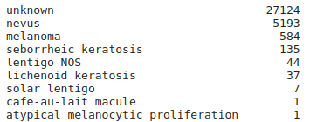
DATA CLEANING
In diagnosis feature, there are different types of skin diseases, along with Melanoma.
One of the values in ‘diagnosis’
feature is unknown and all the
images corresponding to the ‘unknown’ belongs to benign.
Hence we have deleted all images corresponding to unknown category, along with last three diagnosis types as they are less in count and are of unknown category.
Now, Total Images in training set: 5993

Slide 11
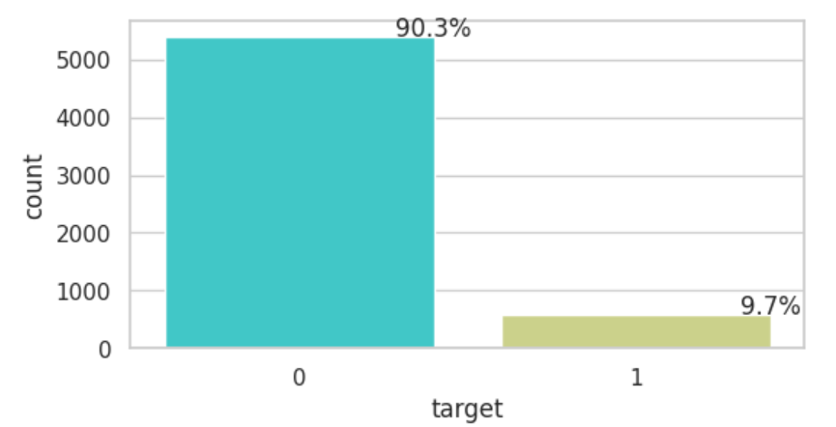
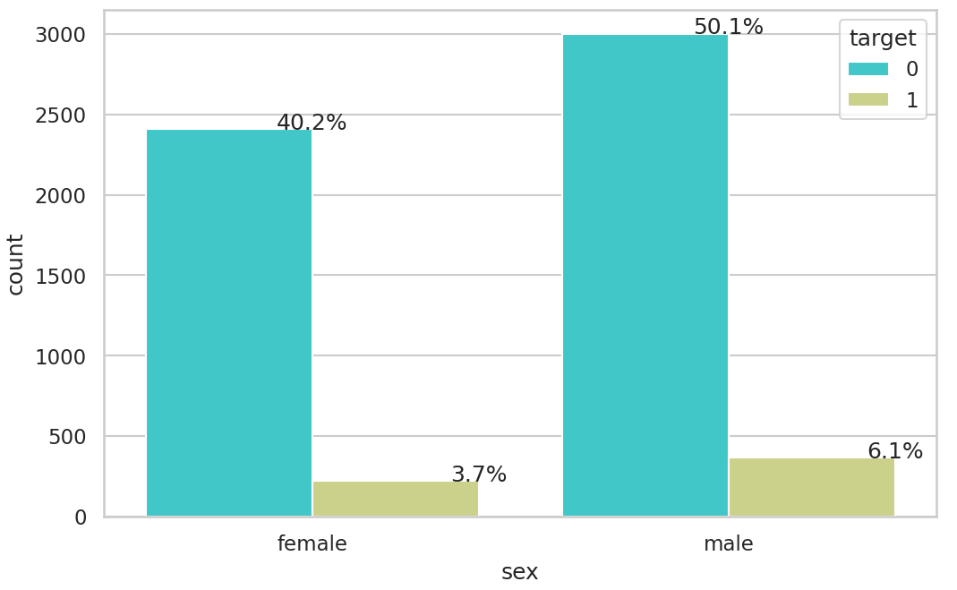
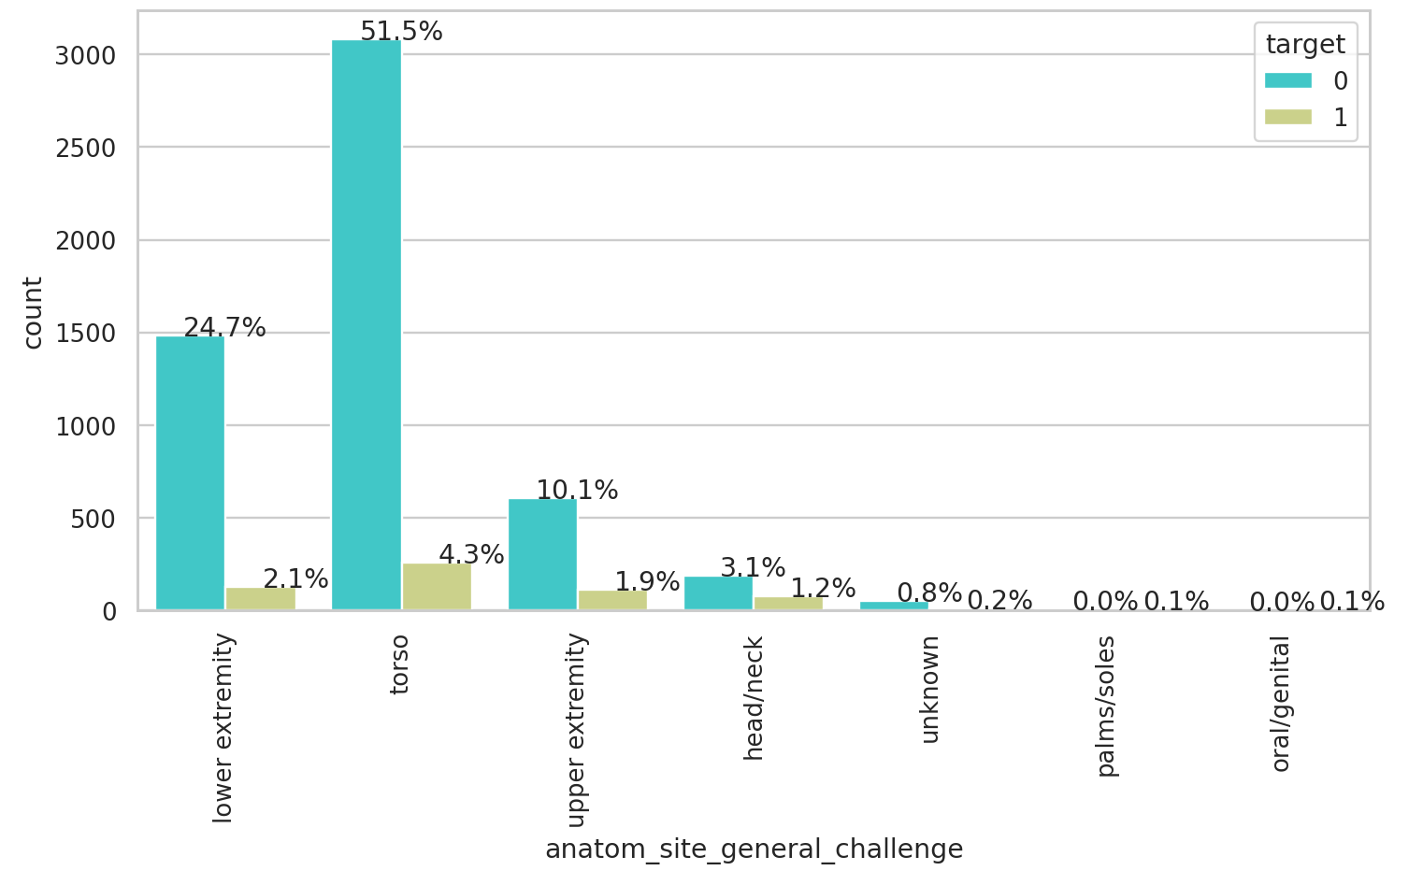
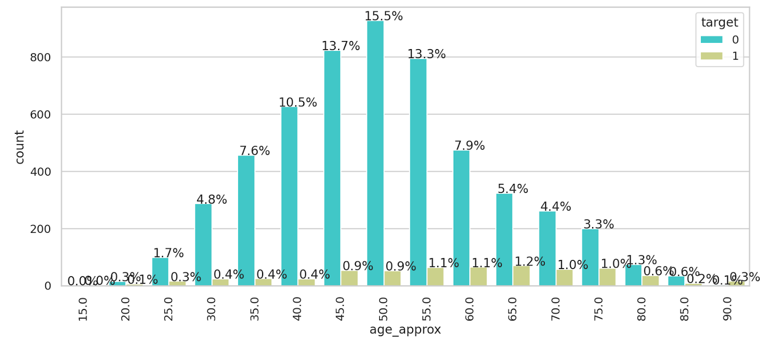
Exploratory Data Analysis
Target count Distribution
Target Distribution by Gender
Target Distribution by Image location
Target Distribution by Age

Slide 12
Modeling: SVC
Modeling: SVC
01
01
Building the model using support vector classification
Building the model using support vector classification

Slide 13
SVC MODEL RUNS
SVC MODEL RUNS
Output with good predictions accuracy but lesion image was not predicted as expected
Output with good predictions accuracy but lesion image was not predicted as expected
Takes longer time to render but the predicts the lesion image with good accuracy
100 images
1000 images
500 images
5994 images
More execution time but same result as 100 images
No output. As the model uses all CPU power and is impossible to render the model

Slide 14
DISADVANTAGE OF USING SVC
DISADVANTAGE OF USING SVC
SVC is not suitable for large datasets
The original SVM implementation is known to have a concrete theoretical foundation, but it is not suitable for classifying in large datasets for one straightforward reason — the complexity of the algorithm’s training is highly dependent on the size of the dataset.
In other words, training time grows with the dataset to a point where it becomes infeasible to train and use due to compute constraints.missing data or NA values.
The original SVM implementation is known to have a concrete theoretical foundation, but it is not suitable for classifying in large datasets for one straightforward reason — the complexity of the algorithm’s training is highly dependent on the size of the dataset.
In other words, training time grows with the dataset to a point where it becomes infeasible to train and use due to compute constraints.missing data or NA values.
SVC perform poorly in imbalanced datasets
SVC perform poorly in imbalanced datasets
The reason arises from the issue of an imbalanced support vector ratio, i.e. the ratio between the positive and negative support vectors becoming imbalanced and as a result, datapoints at the decision boundaries of the hyperplanes have a higher chance of being classified as negative.
The reason arises from the issue of an imbalanced support vector ratio, i.e. the ratio between the positive and negative support vectors becoming imbalanced and as a result, datapoints at the decision boundaries of the hyperplanes have a higher chance of being classified as negative.

Slide 15
Modeling: CNN
Modeling: CNN
02
02
Building the model using convolution neural network
Building the model using convolution neural network

Slide 16
MODEL COMPILING
MODEL COMPILING
OPTIMIZATION FUNCTION
Binary cross entropy used widely for binary classification
It compares the predicted probabilities with the target variable and penalizes the misclassifications heavily.
Performance Metrics
AUC-ROC, Accuracy
ADAM is the best stochastic gradient optimization algorithm that is used in deep learning applications.
Learning rate for ADAM: 0.001 (default value).
AUC-ROC, Accuracy
ADAM is the best stochastic gradient optimization algorithm that is used in deep learning applications.
Learning rate for ADAM: 0.001 (default value).
ROC curve plots TPR (True Positive Rate) against FPR (False Positive Rate). Ideally, in any binary classification problem, we need TPR to be 1 and FPR to be 0, hence AUC (Area Under the Curve) to be 1.
AUC-ROC metric is well suited for highly imbalanced datasets.
LOSS FUNCTION
binary_cross_entropy
binary_cross_entropy

Slide 17
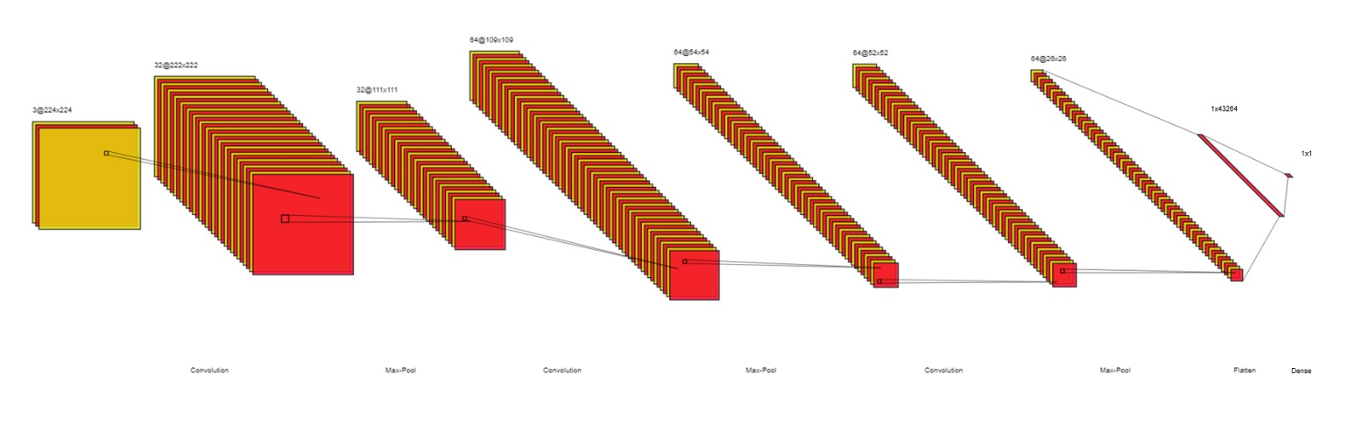
CNN - BASE MODEL
CNN - BASE MODEL
A simple CNN with 5 layers.
Activation Function: ReLU for hidden layers and Sigmoid for the last layer.
The accuracy while using this model was 92%
A simple CNN with 5 layers.
Activation Function: ReLU for hidden layers and Sigmoid for the last layer.
The accuracy while using this model was 92%

Slide 18
Modeling:
Modeling:
03
03
Building the model using Transfer Learning and EfficientNetB4
Building the model using Transfer Learning and EfficientNetB4

Slide 19
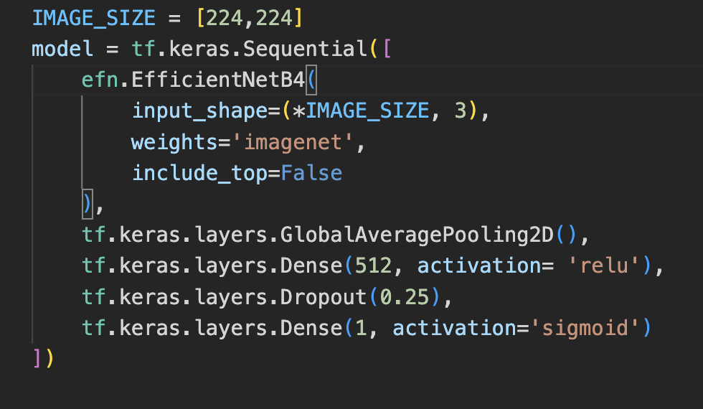
Modeling: Transfer Learning
Modeling: EfficientNetB4
Modeling: EfficientNetB4
Transfer learning makes use of the pre-trained model weights for handling a new problem.
We used Transfer Learning because of lack of resources and dataset is not large
We used ImageNet (a widely used database, especially for image classification) weights with top_layer=false
Transfer learning makes use of the pre-trained model weights for handling a new problem.
We used Transfer Learning because of lack of resources and dataset is not large
We used ImageNet (a widely used database, especially for image classification) weights with top_layer=false
EfficientNet model by Google is the best CNN in literature for image classification
EfficientNet model by Google is the best CNN in literature for image classification

Slide 20
HOW TO DEAL WITH OVERFITTING?
HOW TO DEAL WITH OVERFITTING?
1. dropout regularization: During model training, this approach randomly removes a number of neurons from a neural network. The performance of the model is unaffected by the lost neurons because their contribution is temporally erased.
2. Image Augmentation: Image augmentation artificially creates training images through different ways of processing or combination of multiple processing, such as random rotation, shifts, shear and flips, etc.,
1. dropout regularization: During model training, this approach randomly removes a number of neurons from a neural network. The performance of the model is unaffected by the lost neurons because their contribution is temporally erased.
2. Image Augmentation: Image augmentation artificially creates training images through different ways of processing or combination of multiple processing, such as random rotation, shifts, shear and flips, etc.,

Slide 21
TRAINING VALIDATION AND RESULTS
TRAINING VALIDATION AND RESULTS
 | Training | Validation
Loss (Binary cross entropy) | 0.1471 | 0.1619
Accuracy | 0.9420 | 0.9349
AUC | 0.9545 | 0.9419
 | Training | Validation
Loss (Binary cross entropy) | 0.1471 | 0.1619
Accuracy | 0.9420 | 0.9349
AUC | 0.9545 | 0.9419

Slide 22
CONCLUSION
CONCLUSION
In this project, we detected Melanoma using image classification and CNNs with an accuracy & AUC-ROC of around 95%.
Stratified sampling and data augmentation is used to deal with imbalance in the datasets
We could increase the performance by almost 2% with the help of these techniques
In this project, we detected Melanoma using image classification and CNNs with an accuracy & AUC-ROC of around 95%.
Stratified sampling and data augmentation is used to deal with imbalance in the datasets
We could increase the performance by almost 2% with the help of these techniques

Slide 23
Further considerations: Future work
Further considerations: Future work
We believe that the performance can further be improved by,
We believe that the performance can further be improved by,
Image preprocessing for removing various image artifacts.
Other input features like Sex, Age and location of the disease is not considered for classification. We can train CNN with these features besides image data.
Implementation using advanced CNN models like EfficientNetB7 on TPUs
Image preprocessing for removing various image artifacts.
Other input features like Sex, Age and location of the disease is not considered for classification. We can train CNN with these features besides image data.
Implementation using advanced CNN models like EfficientNetB7 on TPUs

Slide 24
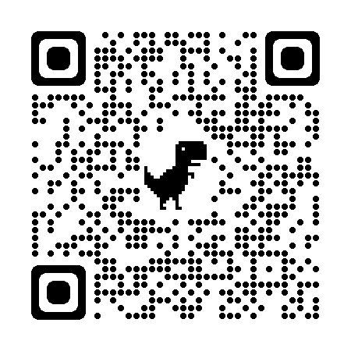
Further considerations: Prevent Melanoma?
Further considerations: Prevent Melanoma?
Wearing Hats, goggles, long sleeve shirts (protective cloths), using sunscreen lotion and regular doctor/self checkups.
Wearing Hats, goggles, long sleeve shirts (protective cloths), using sunscreen lotion and regular doctor/self checkups.

Slide 25
REFERENCES
REFERENCES
https://seer.cancer.gov/statfacts/html/melan.html
https://www.wcrf.org/cancer-trends/skin-cancer-statistics/
https://arxiv.org/abs/1412.6980
https://challenge2020.isic-archive.com/
https://arxiv.org/abs/1905.11946
https://seer.cancer.gov/statfacts/html/melan.html
https://www.wcrf.org/cancer-trends/skin-cancer-statistics/
https://arxiv.org/abs/1412.6980
https://challenge2020.isic-archive.com/
https://arxiv.org/abs/1905.11946

