Slide 1
FLOW
Antoni Mleczko
Jacek Gosztyła
24.05.2019

Slide 2

Rozwój
Licencja: https://github.com/elixir-lang/elixir#license
Repozytorium:
https://github.com/plataformatec/flow

Slide 3






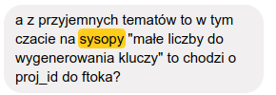

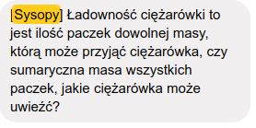


Problem, idea

Slide 4
Flow
File.stream!("path/to/some/file")
|> Flow.from_enumerable()
|> Flow.flat_map(&String.split(&1, " "))
|> Flow.reduce(fn -> %{} end, fn word, acc ->
Map.update(acc, word, 1, & &1 + 1)
end)
|> Enum.to_list()

Slide 5
Brut
File.stream!("path/to/some/file")
|> Enum.flat_map(&String.split(&1, " "))
|> Enum.reduce(%{}, fn word, acc ->
Map.update(acc, word, 1, & &1 + 1)
end)
|> Enum.to_list()

Slide 6
Lazy
File.stream!("path/to/some/file")
|> Flow.from_enumerable()
|> Flow.flat_map(&String.split(&1, " "))
|> Flow.partition()
|> Flow.reduce(fn -> %{} end, fn word, acc ->
Map.update(acc, word, 1, & &1 + 1)
end)
|> Enum.to_list()

Slide 7
Partitioning
File.stream!("path/to/some/file")
|> Flow.from_enumerable()
|> Flow.flat_map(&String.split(&1, " "))
|> Flow.partition()
|> Flow.reduce(fn -> %{} end, fn word, acc ->
Map.update(acc, word, 1, & &1 + 1)
end)
|> Enum.to_list()

Slide 8
Elixir-mess

