Slide 1
Scientist

Slide 2
Types of Scientist

Slide 3
What does a Scientist do?

Slide 4
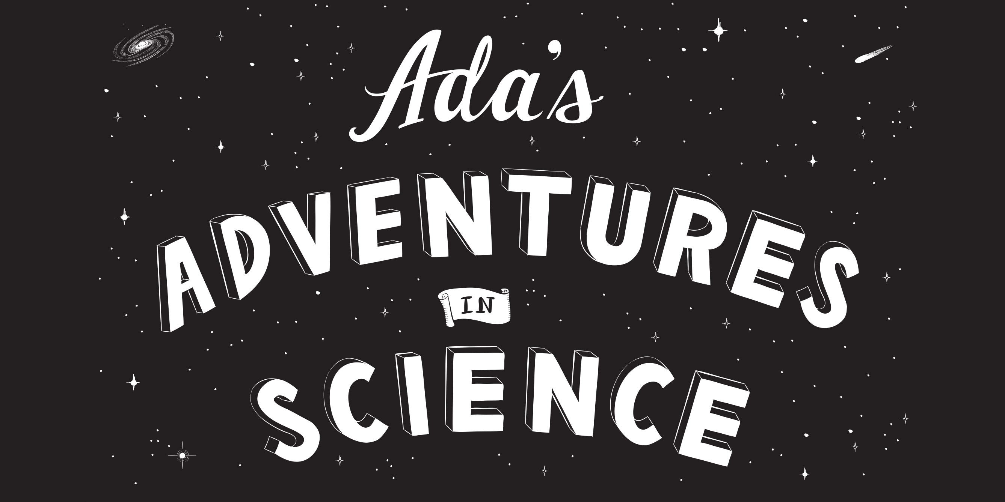

Slide 5
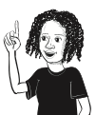

Hi, I’m Ada!
I like finding
things out

Slide 6
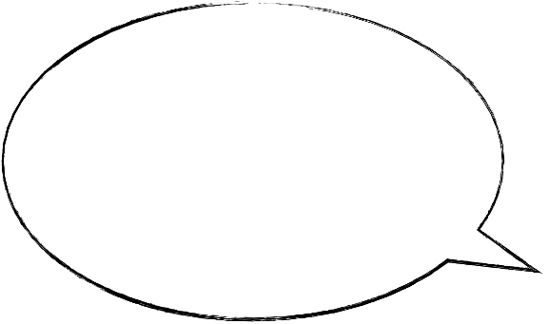
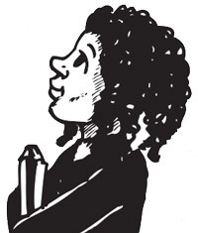
Asking questions is
the best way to
find things out,
because…

Slide 7
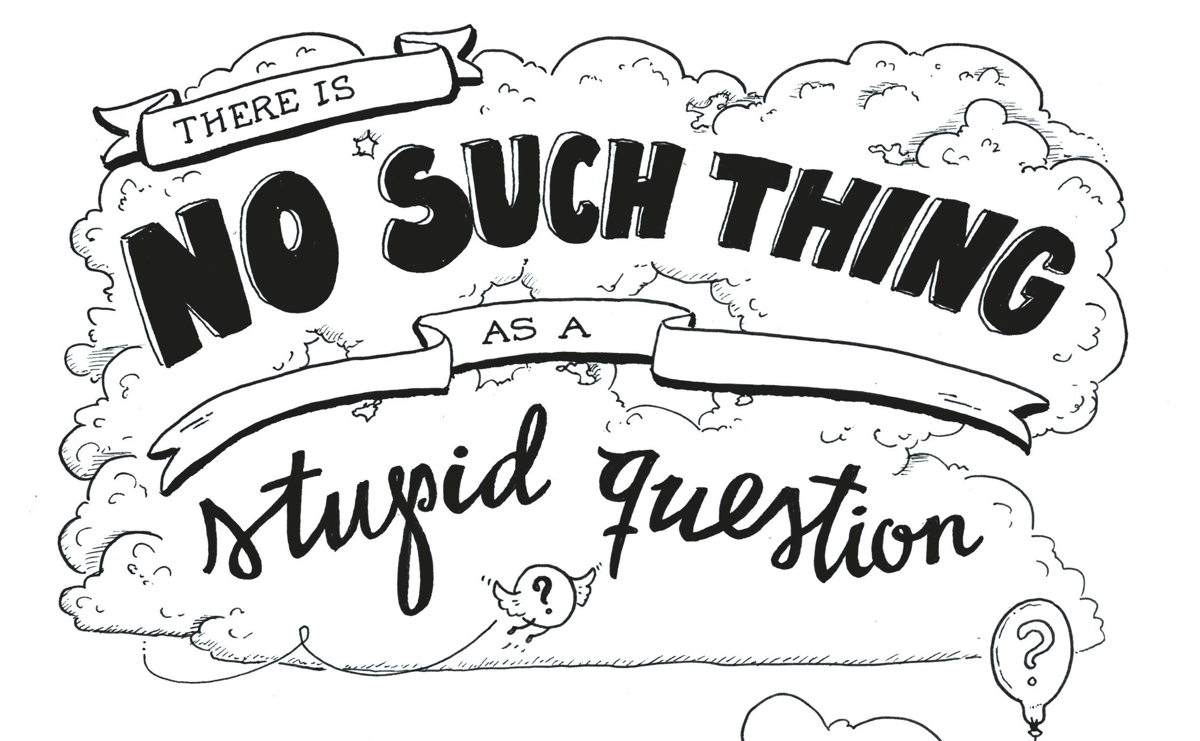

Slide 8
Characters
Ada
Theo
Serol (a robot)
Telescopes
UN person

Slide 9
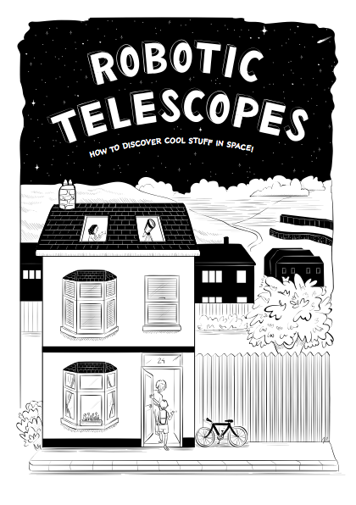

Slide 10
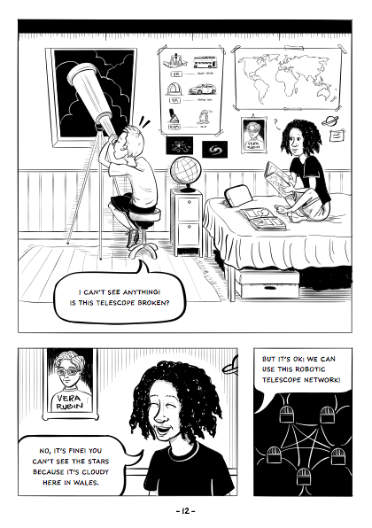

Slide 12
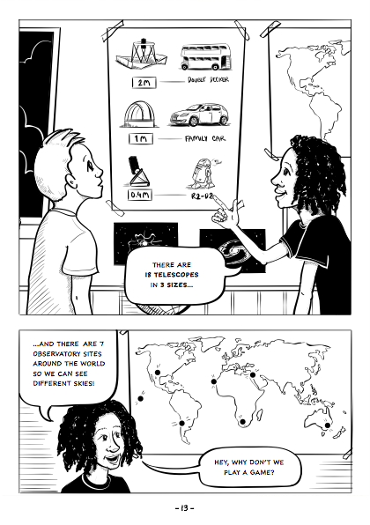

Slide 14
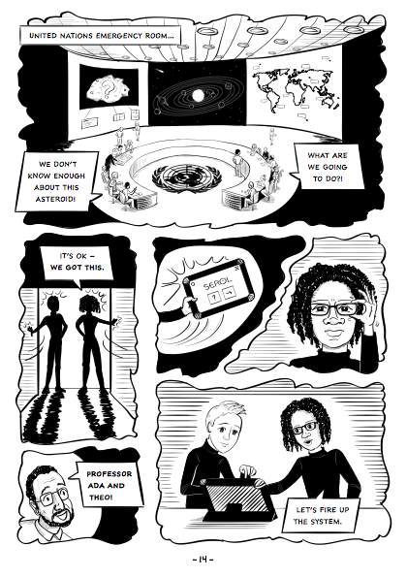

Slide 16
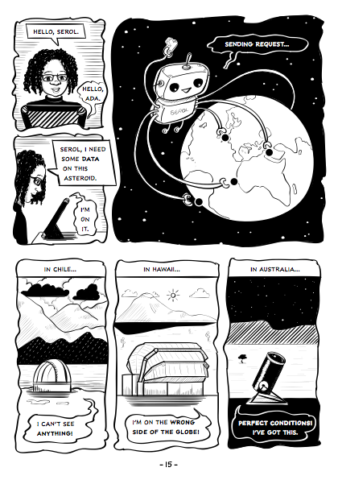

Slide 20
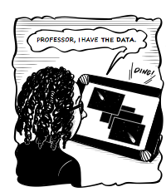

Slide 21
What happens next…?

Slide 22

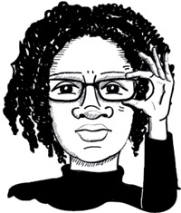
How did
your story
end?
http://www.adacomic.uk

